Slide 1
Towards verifying algorithms for model-based engineering with TLA+
TLA+ Community Event, 22/04/2023
Olivier Constant
Thales Research & Technology France

Slide 2
1. Context

Slide 3
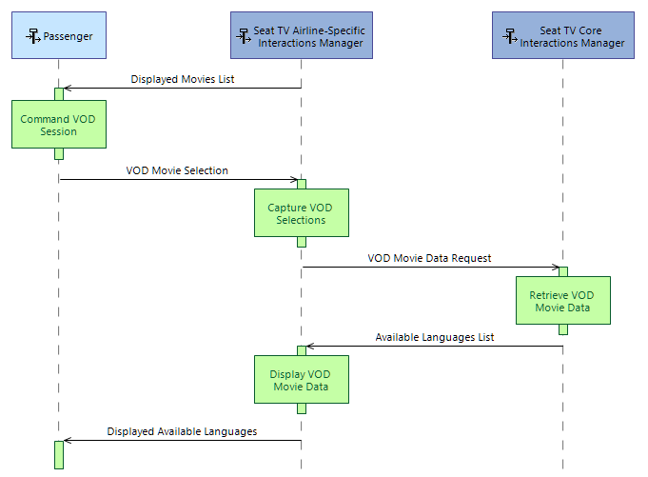
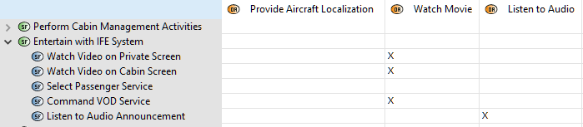
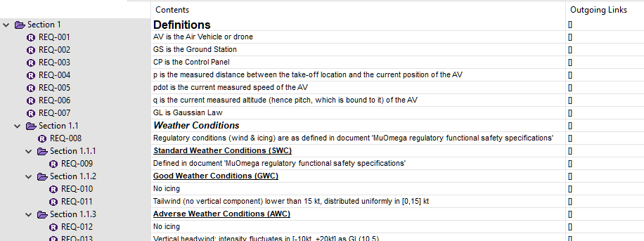
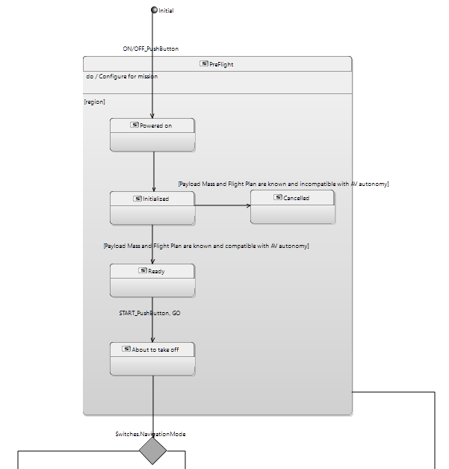

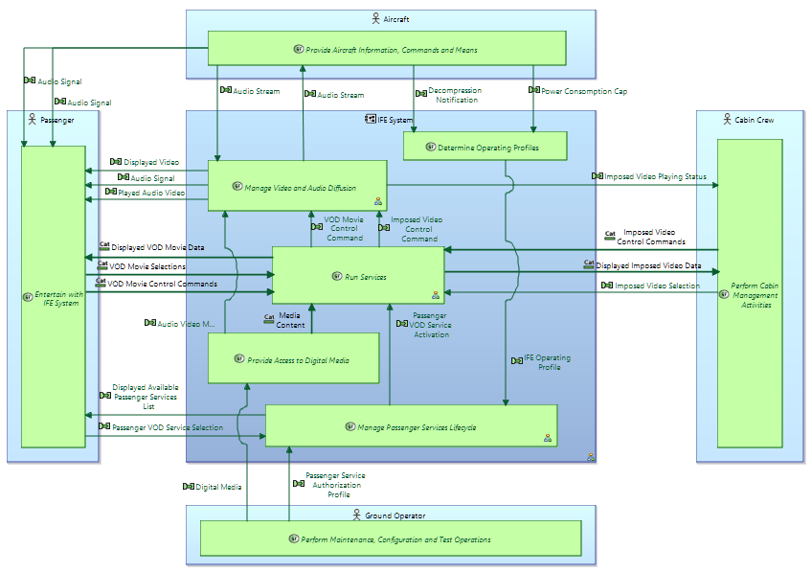
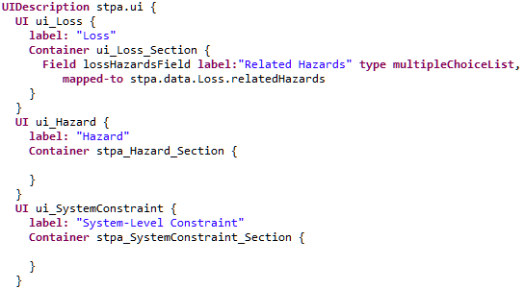
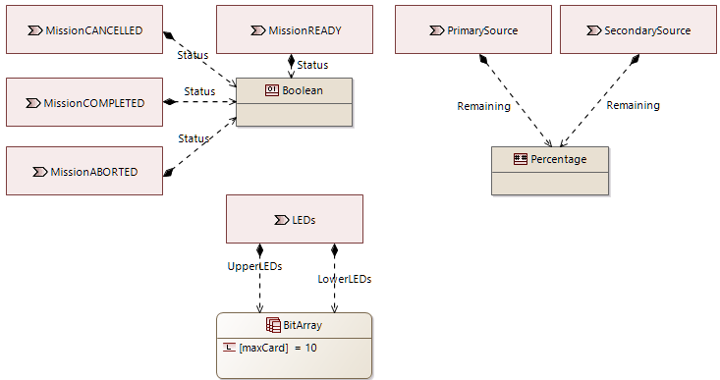
‘Model-*’ in engineering
Model-Based …
Systems Engineering (MBSE)
Software Engineering
Development
Testing
Model-Driven …
Engineering
Architecture
Etc.
type: CPU
name: ‘CPU1’
frequency: 3.2
arch: x64
Stakeholders
: represents subset of
deployment
allocation
describes
allocation
(Engineering)
part
Model

Slide 4
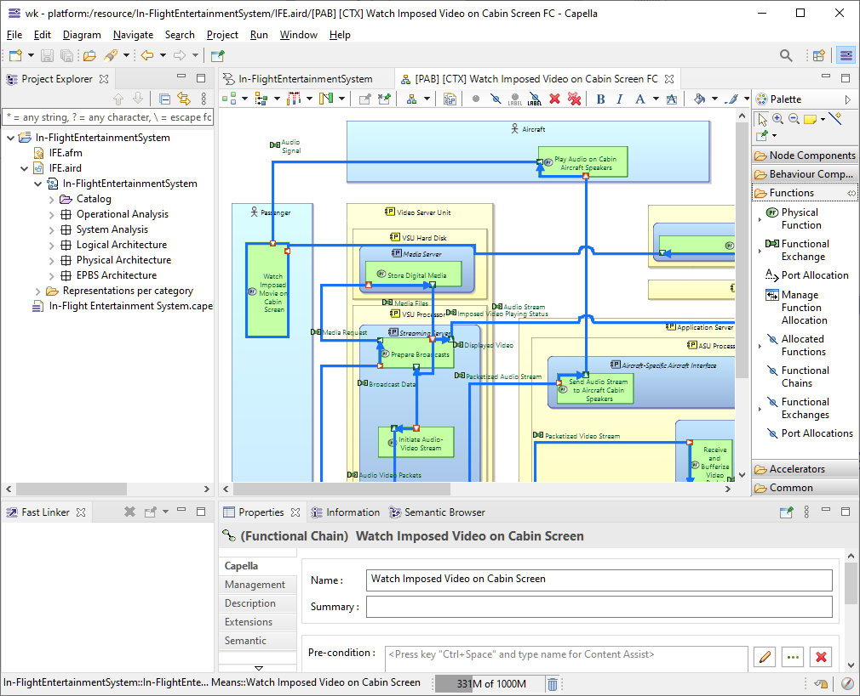
Example: Capella, an MBSE tool and a method
The trigger for the present work
Developed at Thales, originally for internal usage
Released in open source in 2014
Used in many industrial domains (*)
(*) https://blog.obeosoft.com/capella-community-survey-2020-the-results

Slide 5
MBSE at large scale (ideally*)
System model
Product-line engineering
: must be consistent with each other
Need analysis
Patterns
Safety perspective
: contributes contents to
Libraries
Logical architecture
Cybersecurity perspective
Software model
Physical architecture
Perspective X
Specialty model W
Specialty model W
Specialty model W
Analysis Model
Analysis Model
Analysis model Z
Subsystem Model
Subsystem Model
Subsystem model Y
Version Control
(*) https://eclipse.org/kitalpha/

Slide 6
MBSE at large scale
System model
Product-line engineering
: must be consistent with each other
Need analysis
Patterns
Safety perspective
: contributes contents to
Libraries
require
Logical architecture
Cybersecurity perspective
Software model
Physical architecture
Perspective X
Algorithms for model synchronization and merging
Specialty model W
Specialty model W
Specialty model W
Analysis Model
Analysis Model
Analysis model Z
Subsystem Model
Subsystem Model
Subsystem model Y
Version Control

Slide 7
Merge
allocation
1) Match
allocation
deployment
2) Diff
allocation
part
Model A
3) Merge
part
Model B
+
part
part
‘contributes contents to’?
Algorithms for model synchronization and merging

Slide 8
Synchronization
allocation
allocation
deployment
Match-Diff-Merge
allocation
part
Model A’
part
Model B
part
part
Transform
Algorithms for model synchronization and merging
‘consistent with each other’?
W
Y
Z
Model A
W
X

Slide 9

Expectations
variation points
Expected properties
Well-formedness preservation
Confluence of merge process
Diff accuracy preservation
Etc.
guarantees?
Algorithms for model synchronization and merging
Generic and customizable software framework
plead for
Agnostic to what models describe
relies
on
de facto standard
(open source, Java-based)
But must still rely on a technical definition of models…

Slide 10
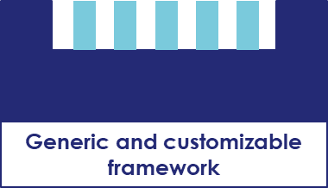


A bit of history
2010: Framework for model merging
2011: Basic GUI
2012: Released in open source
2012-now: Widespread usage in Capella and some other products
2013-2017: Reuse and synchronization mechanisms
2018-now: Application beyond original scope, new needs
2021-now: Trying to do something about it
“It looks OK and all tests pass but formal methods would help.”
“OK, now we really need formal methods.”

Slide 11
2. Zooming on a piece of the challenge

Slide 12
Models in EMF
typed by
Metamodel
(schema)
Ecore: the meta-metamodel
part
Metaclass
type
Reference
Component
CPU
deployment
name : string
frequency : float
arch : CPUArch
references
allocation
typed by
‘References’
‘Metaclasses’
name: ‘CPU1’
frequency: 3.2
arch: x64
Function
(example)
typed by
allocation
deployment
allocation
part
Model
Notes:
UML-like representation
Ecore defines the possible characteristics of metamodels

Slide 13
Sync/merge perspective on EMF models
conforms to
Metamodel
Ecore: the meta-metamodel
(i.e., assumed well-formed)
part
Metaclass
type
Reference
CPU
Known
(properties)
(properties)
Component
deployment
name : string
frequency : float
arch : CPUArch
references
allocation
‘Well-formedness preservation’?
Unknown but fixed
Unknown and evolving
Function
allocation
deployment
must keep conforming to
(i.e., must remain well-formed)
allocation
part
Model

Slide 14
Well-formedness constraints
Well-formedness constraints
Automatically enforced by EMF
By construction
By model APIs
EMF implementation
Metaclass: Java class
Reference: Java methods
Node creation: Java class
instantiation
EMF implementation
Side effects of atomic API operations

Slide 15
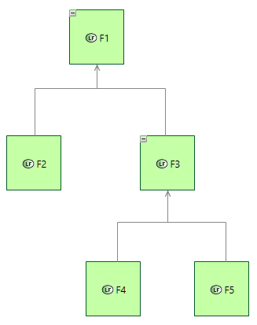
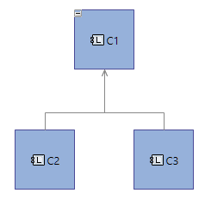
Side effects: Capella-like illustration
Functions
Components
allocated [*]
allocation [1]

Slide 16
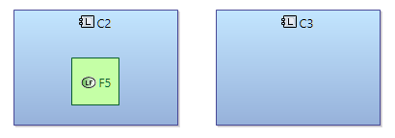



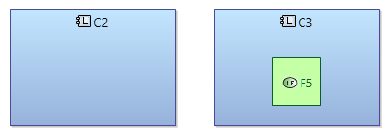
Side effects: Capella-like illustration (1)
(allocated)
allocated
allocation
+
allocated
+
allocation

Slide 17
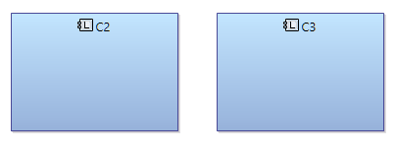
Side effects: Capella-like illustration (2)
(allocated)

Slide 18
Well-formedness constraints
‘Well-formedness preservation’?
Formally specify
Take into account
Well-formedness constraints
Automatically enforced by EMF
To be explicitly enforced
By construction
By model APIs
EMF implementation
Metaclass: Java class
Reference: Java methods
Node creation: Java class
instantiation
EMF implementation
Side effects of atomic API operations
E.g.
Mandatory outgoing edges
Forbidden cycles
Etc.

Slide 19
3. Handling this piece of the challenge with TLA+

Slide 20
Expected TLA+ usage
Expected properties of algorithm
Example: well-formedness preservation [for all models, for all metamodels]
What the (sync/merge) algorithm does in terms of API calls on models
verify
Specification of algorithm X
What are model APIs and how they affect models through side effects
Specification of model APIs
How EMF ‘works’
What are models for a given metamodel
Specification of models
Specification of metamodels
What are metamodels and their possible characteristics

Slide 21
Done so far
Expected known, general properties of EMF
validate
verify
Specification of model APIs
How EMF ‘works’
Specification of models
Specification of metamodels

Slide 22
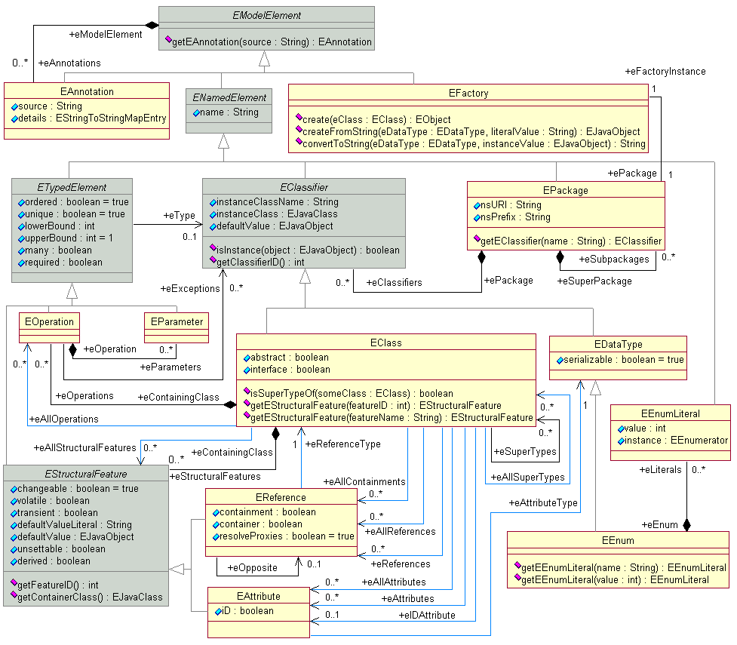
Specification of metamodels
+ Constraints
Official definition of Ecore
Source: https://download.eclipse.org/modeling/emf/emf/javadoc/2.11/org/eclipse/emf/ecore/doc-files/EcoreRelations.gif

Slide 23
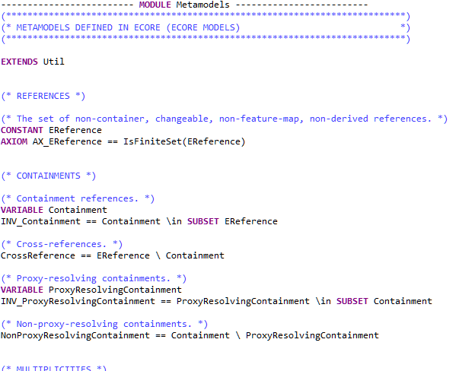
Specification of metamodels
+ Constraints
Abstracting away by focussing on the problem…
~100 lines of TLA+

Slide 24
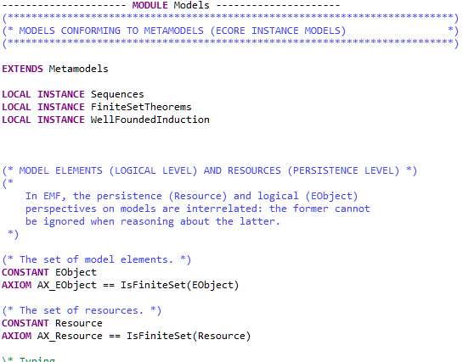
Specification of models
(Overview)
Reference
+ Constraints
reference
values
Models: logical layer
Element
settings
Setting
roots
~300 lines of TLA+
Resource
Models: persistence layer

Slide 25
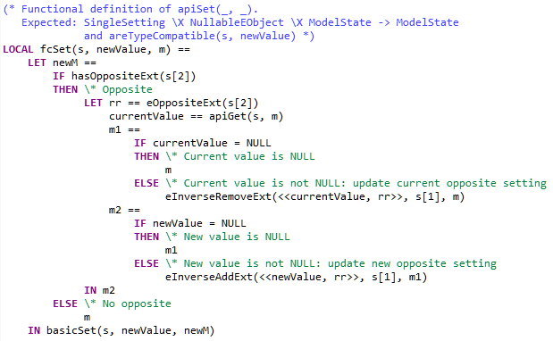

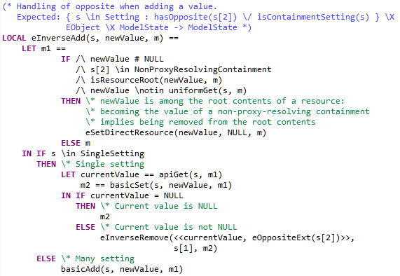
Specification of model APIs
Example: setting of a reference that has certain characteristics
Java
TLA+
public void setCrSingleOppSingle(B newCrSingleOppSingle) {
if (newCrSingleOppSingle != crSingleOppSingle) {
NotificationChain msgs = null;
if (crSingleOppSingle != null)
msgs = ((InternalEObject)crSingleOppSingle).eInverseRemove(this, CodegenTestPackage.B__BCR_SINGLE_OPP_SINGLE, B.class, msgs);
if (newCrSingleOppSingle != null)
msgs = ((InternalEObject)newCrSingleOppSingle).eInverseAdd(this, CodegenTestPackage.B__BCR_SINGLE_OPP_SINGLE, B.class, msgs);
msgs = basicSetCrSingleOppSingle(newCrSingleOppSingle, msgs);
if (msgs != null) msgs.dispatch();
}
else if (eNotificationRequired())
eNotify(new ENotificationImpl(this, Notification.SET, CodegenTestPackage.A__CR_SINGLE_OPP_SINGLE, newCrSingleOppSingle, newCrSingleOppSingle));
}
Method calls
‘Visual’ traceability
public NotificationChain basicSetCrSingleOppSingle(B newCrSingleOppSingle, NotificationChain msgs) {
B oldCrSingleOppSingle = crSingleOppSingle;
crSingleOppSingle = newCrSingleOppSingle;
if (eNotificationRequired()) {
ENotificationImpl notification = new ENotificationImpl(
this, Notification.SET, CodegenTestPackage.A__CR_SINGLE_OPP_SINGLE, oldCrSingleOppSingle, newCrSingleOppSingle);
if (msgs == null) msgs = notification; else msgs.add(notification);
}
return msgs;
}
public NotificationChain eInverseAdd(InternalEObject otherEnd, int featureID, NotificationChain msgs) {
switch (featureID) {
case CodegenTestPackage.B__BCR_SINGLE_OPP_SINGLE:
if (bCrSingleOppSingle != null)
msgs = ((InternalEObject)bCrSingleOppSingle).eInverseRemove(this, CodegenTestPackage.A__CR_SINGLE_OPP_SINGLE, A.class, msgs);
return basicSetBCrSingleOppSingle((A)otherEnd, msgs);
case CodegenTestPackage.B__BCR_SINGLE_OPP_MANY:
if (bCrSingleOppMany != null)
msgs = ((InternalEObject)bCrSingleOppMany).eInverseRemove(this, CodegenTestPackage.A__CR_MANY_OPP_SINGLE, A.class, msgs);
return basicSetBCrSingleOppMany((A)otherEnd, msgs);
case CodegenTestPackage.B__BCR_MANY_OPP_SINGLE:
return ((InternalEList<InternalEObject>)(InternalEList<?>)getBCrManyOppSingle()).basicAdd(otherEnd, msgs);
case CodegenTestPackage.B__BCR_MANY_OPP_MANY:
return ((InternalEList<InternalEObject>)(InternalEList<?>)getBCrManyOppMany()).basicAdd(otherEnd, msgs);
}
return super.eInverseAdd(otherEnd, featureID, msgs);
}
Etc.
~500 lines of TLA+ overall

Slide 26
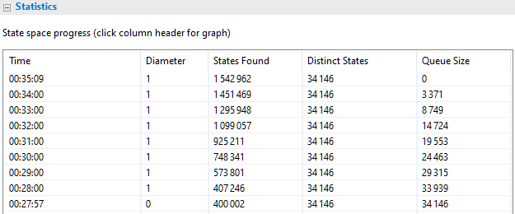
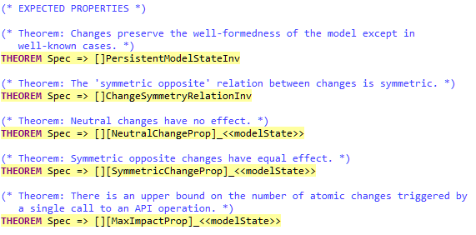
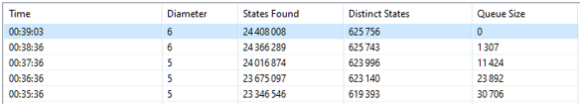

Checking expected properties with TLC
For every possible metamodel …
For every possible conforming model …
For every possible sequence of API calls on that model …
Check that
Well-formedness is broken if and only if we are in a known ‘harmful’ scenario
Expected properties of API operations hold
Symmetries, ‘neutral’ changes, etc.
+ Constraints
Otherwise, state space gets unreasonable even in small cases
➔ Switch to TLAPS with some confidence

Slide 27
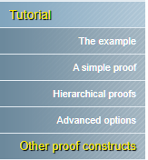

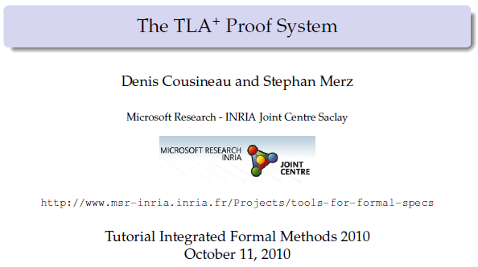
First steps with TLAPS: An engineer’s experience
“This helps.”
“I (believe I) entirely
understand this page.”
Cumulated effort spent
“This helps.”
“Isn’t it addictive?”
Outcome (so far)
We never got stuck because
The math and proof approach are familiar
Suitable documentation is available (although not necessarily at a single location)
The UI is appropriate
“Ouch.”
“It works well!”
“I have no experience with a theorem prover.”
Work progress
First case of recursion
A ternary recursive operator…
… not based on Nat
… not based on the subset partial order
Very simple things to begin with
First significant theorems

Slide 28
Conclusion

Slide 29
Conclusion
Complexity here is essentially ‘functional’ (e.g., unrelated to concurrency)
TLA+, TLC and TLAPS have all been helpful
Should I consider Apalache?
Interesting stage reached but still a lot of work to do
Sync/merge algorithms to be specified, verified and improved…
… for more trust AND more functionality
Off-stage, glad to discuss and get some wisdom on many topics, including
Specifying for model checking vs. for formal proof vs. for both
Elaborating verification strategies
Managing proof development

Slide 30

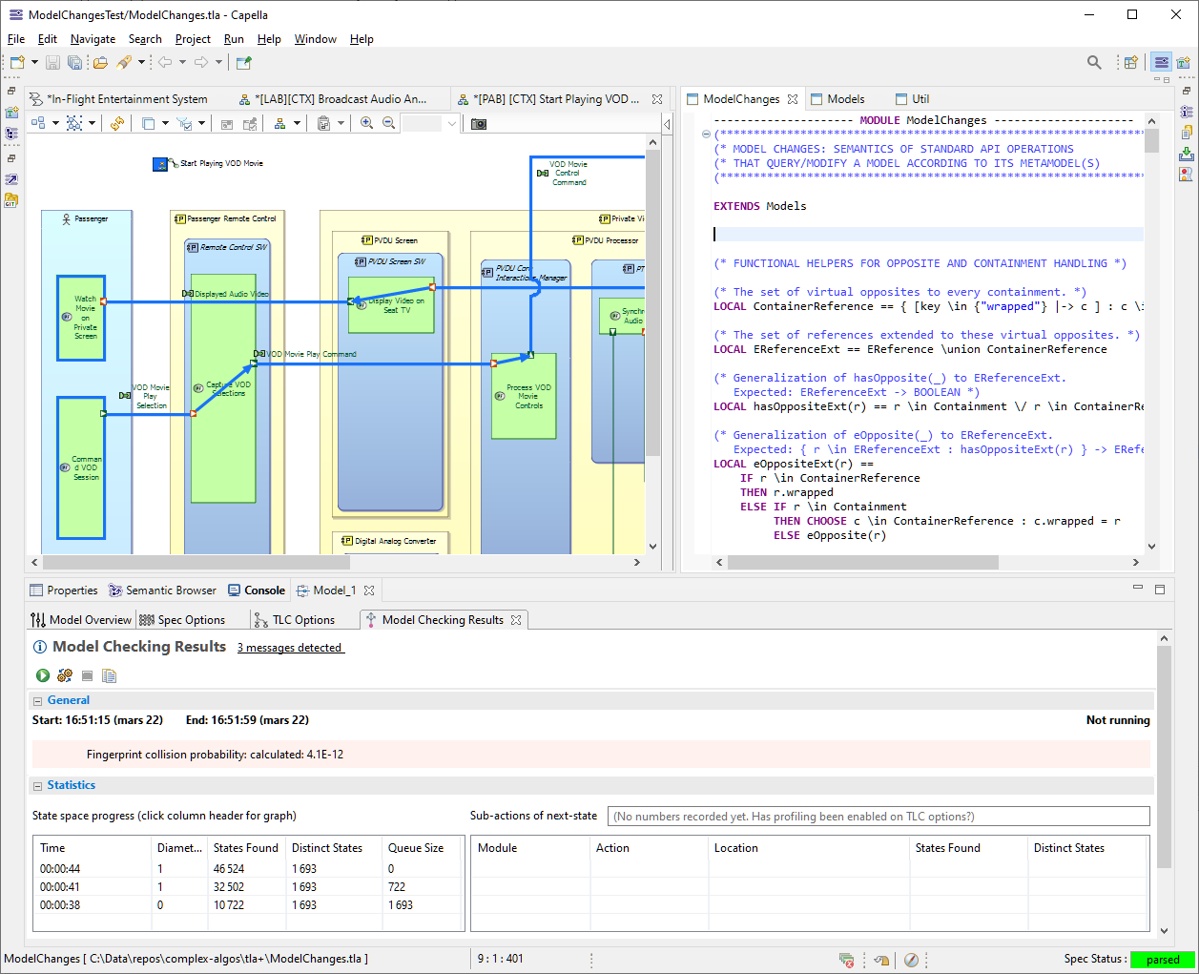
Thanks! Questions?
Thanks to:
Nikolaï Kosmatov
Delphine Longuet

