Slide 1
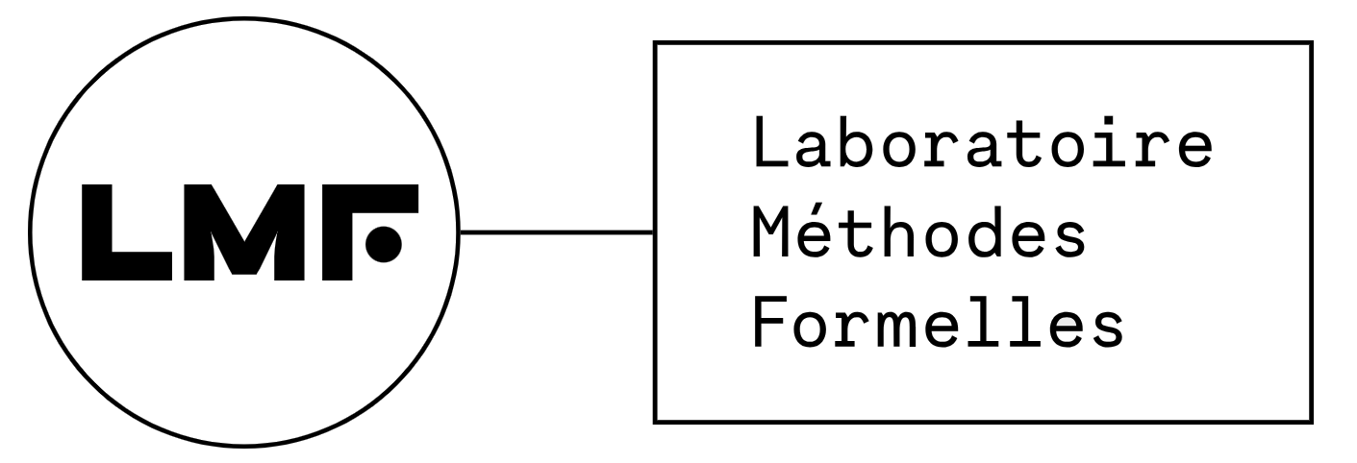

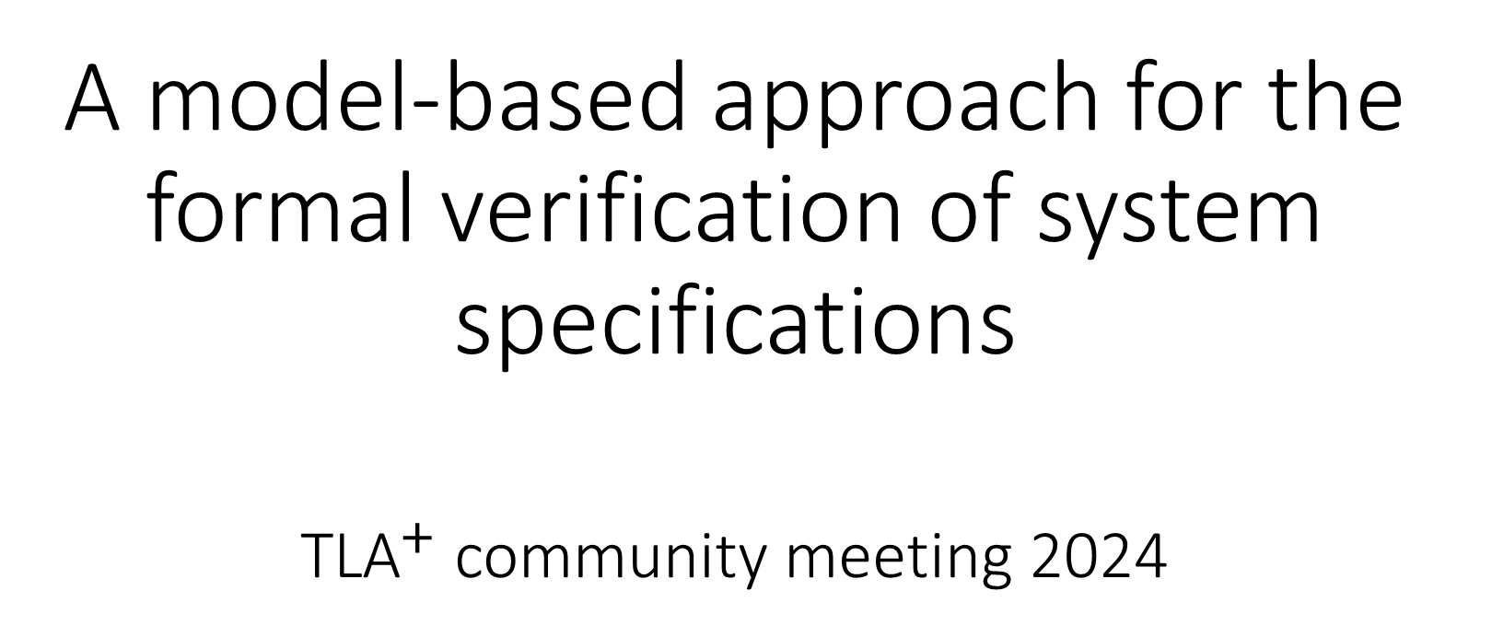
A model-based approach for the formal verification of system specifications ${\text{TLA}}^{+}$ community meeting 2024
Andrei Samokish
Laboratoire Méthodes Formelles (University Paris-Saclay, France)
Knowledge Inside

Slide 2
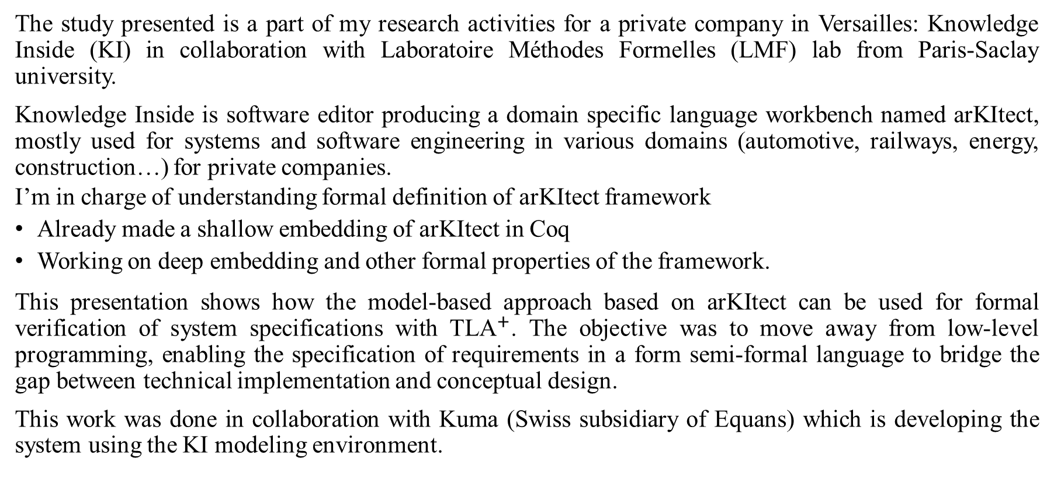
arKItect
The study presented is a part of my research activities for a private company in Versailles: Knowledge Inside (KI) in collaboration with Laboratoire Méthodes Formelles (LMF) lab from Paris-Saclay university.
Knowledge Inside is software editor producing a domain specific language workbench named arKItect, mostly used for systems and software engineering in various domains (automotive, railways, energy, construction…) for private companies.
I’m in charge of understanding formal definition of arKItect framework
Already made a shallow embedding of arKItect in Coq
Working on deep embedding and other formal properties of the framework.
This presentation shows how the model-based approach based on arKItect can be used for formal verification of system specifications with ${\text{TLA}}^{+}$. The objective was to move away from low-level programming, enabling the specification of requirements in a form semi-formal language to bridge the gap between technical implementation and conceptual design.
This work was done in collaboration with Kuma (Swiss subsidiary of Equans) which is developing the system using the KI modeling environment.

Slide 3
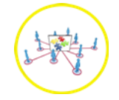
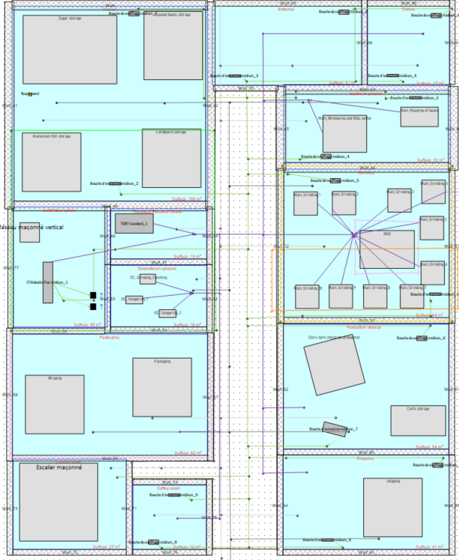
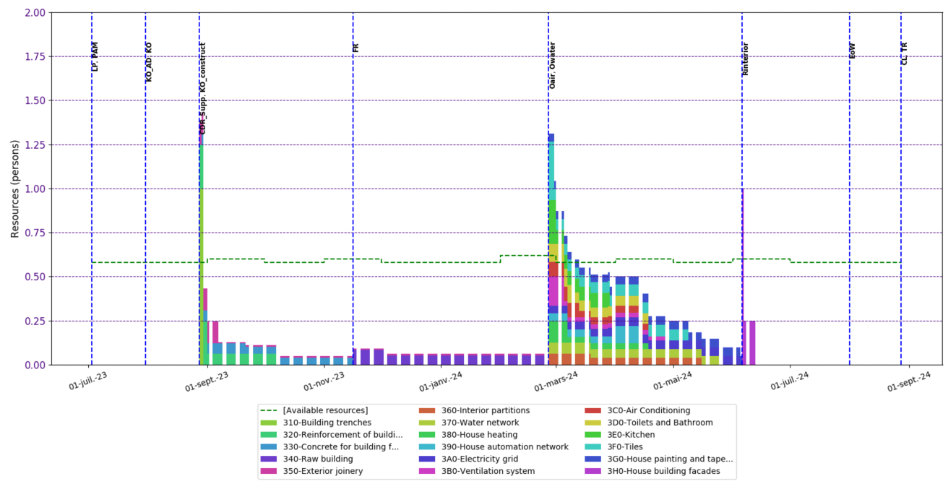
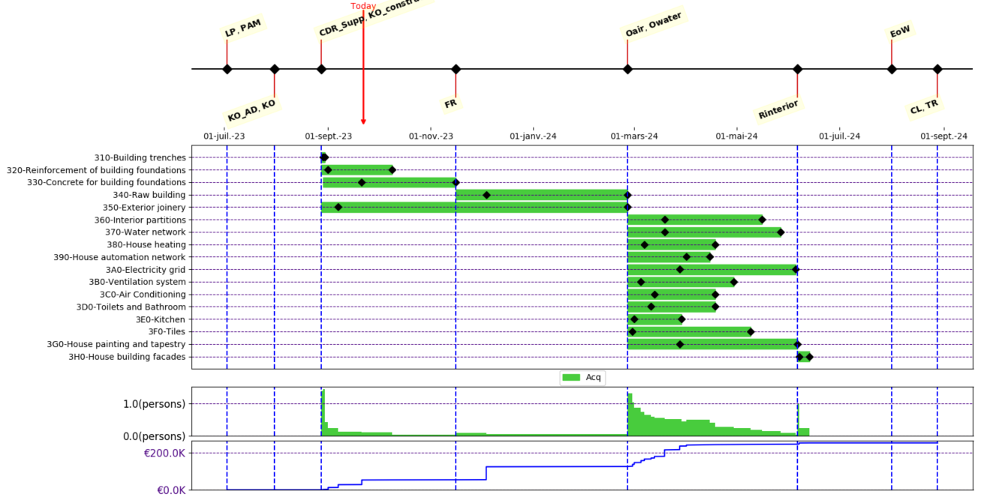
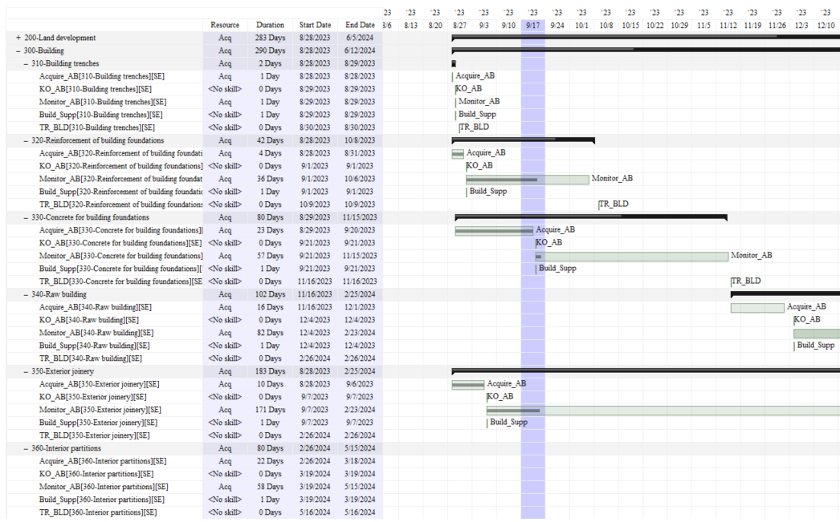
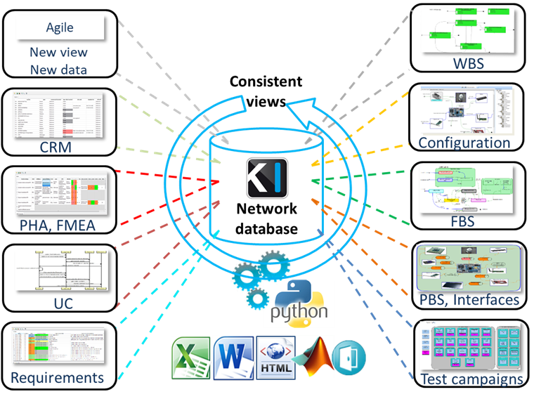
arKItect is a graphical DSL workbench system for custom applications in engineering/architecting
Theory: Typed DAGs data base / recursive types
Smart
Adaptable to a wide variety of applications: systems & software engineering, project planning, process modeling
Adaptable to a wide variety of domains: automotive, railways, space, energy, finance…
Low code
Easy and fast set up of new or modified data model
Collaborative
Full python API
Viewpoints are generative (automated generation of obects and display from DAG database)
Any change in a viewpoint is centralized in database and propagated to other viewpoints automatically.
Specific viewpoints can be build based on functional chains
Without risk
Millions of hours of use in industrial context since 2006
Application stabilized (except scripts and 2D views) since 2017
Completely open - you remain in control of your own information
2D view
PM Synthesis
GANTT
Workload

Slide 4
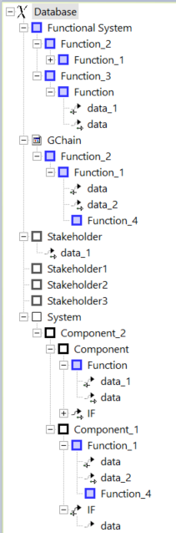
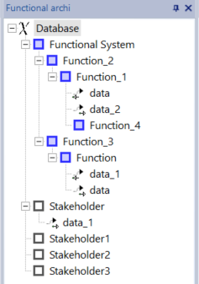
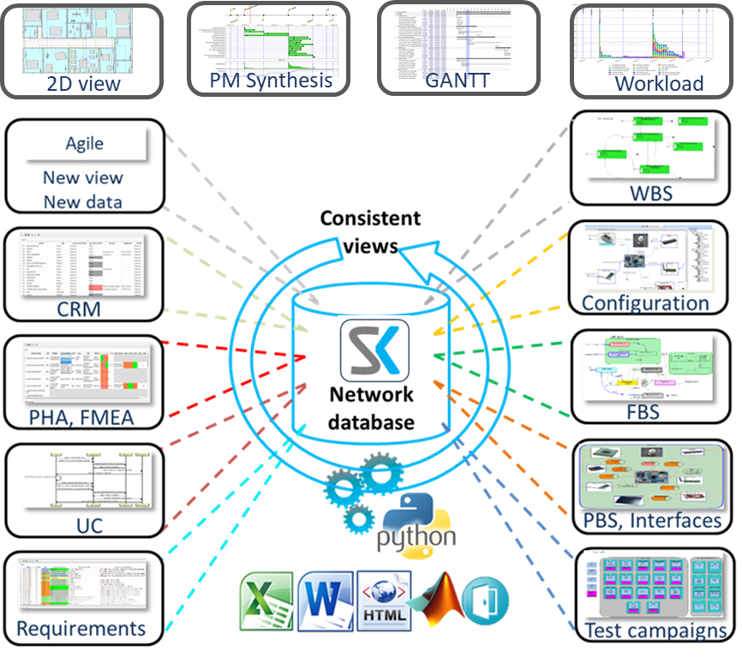
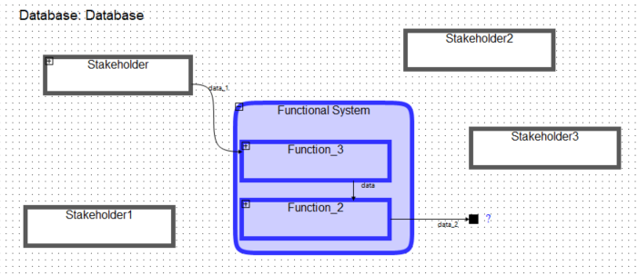
Principles of the viewpoints and Typed DAG structure
Network
database
Functional viewpoint
Objects do have attributes as well
We can use part of metamodel tree representation as an abstract syntax for a formal language
Then we can interpret it or tag it with TLA terms

Slide 5
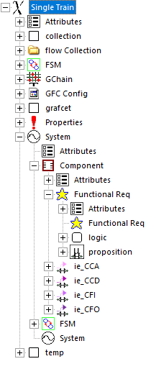
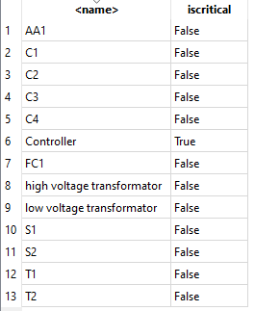
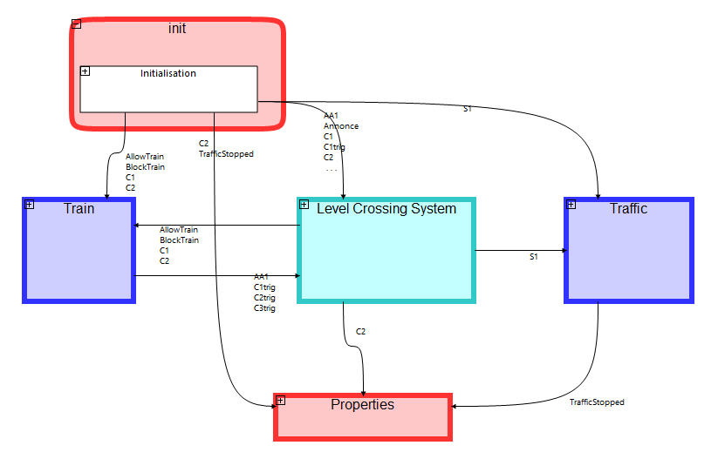
arKItect project
Metamodel
Data
Representation

Slide 6
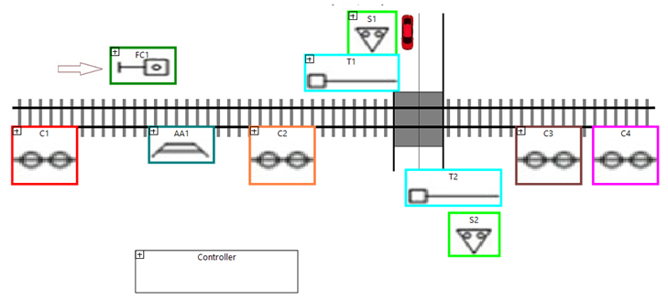
Example: Level Crossing model
Specification: When there is a train in the range of level crossing, turn red light on for cars and close the barrier
{When} {Announcement =True} {Then} {S1 = True; T1 = True}
Invariant: If there is a train on line crossing (train passed C2 sensor), traffic should already be stopped
{C2 = True => TrafficStopped = True}

Slide 7
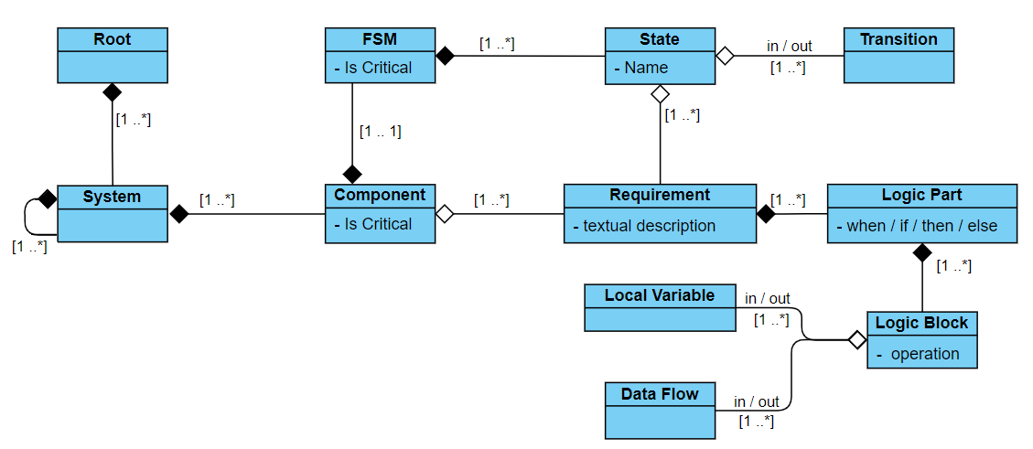
Domain Specific Modelling Language

Slide 8
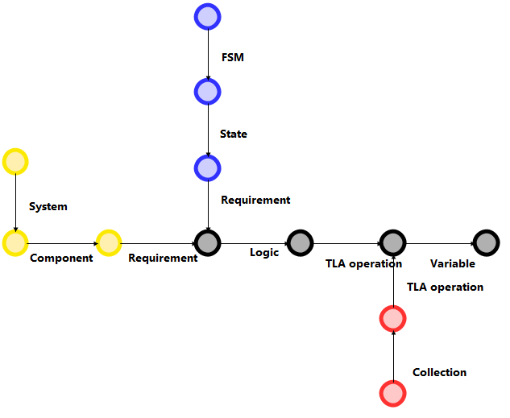
Domain Specific Modeling Language (Behavior, System, Collection) in form of FSM
Behavior metamodel
System metamodel
Collection metamodel

Slide 9
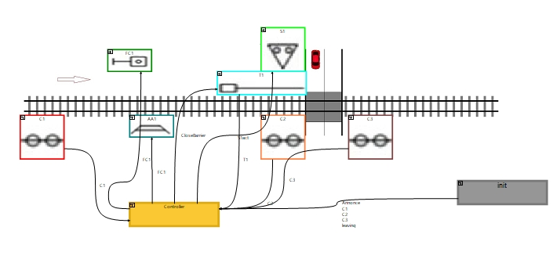
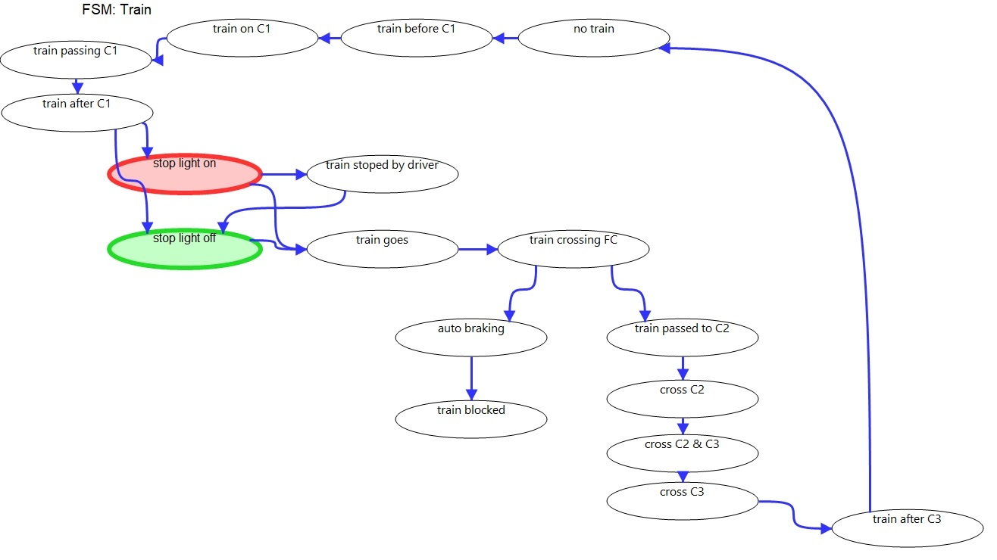
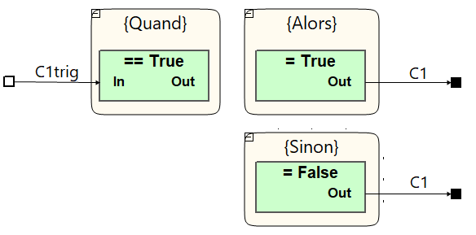
Level Crossing example
System model
Model
Behavior model
Requirement

Slide 10

Requirement language. AST -> Model (Sensor C1)
Semi-formal language inspired by FRET (Formal Requirements Elicitation Tool, NASA Ames Research Center)
{When} sensor is triggered {C1trig = True}
{Then} output signal is True {C1 = True}
{Else} output signal is False {C1 = False}
Instantiated block from the Collection
Name: TLA op_1365
Alias: = False
TLA+ formula template: {out}' = False

Slide 11
Scenario: Train FSM

Slide 12
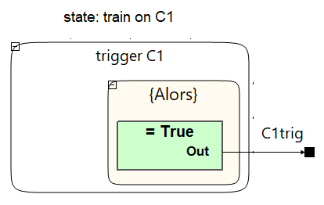
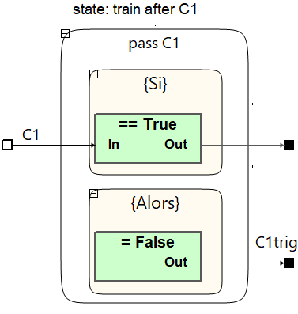
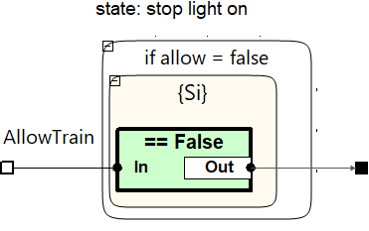
States logic (Requirements)

Slide 13
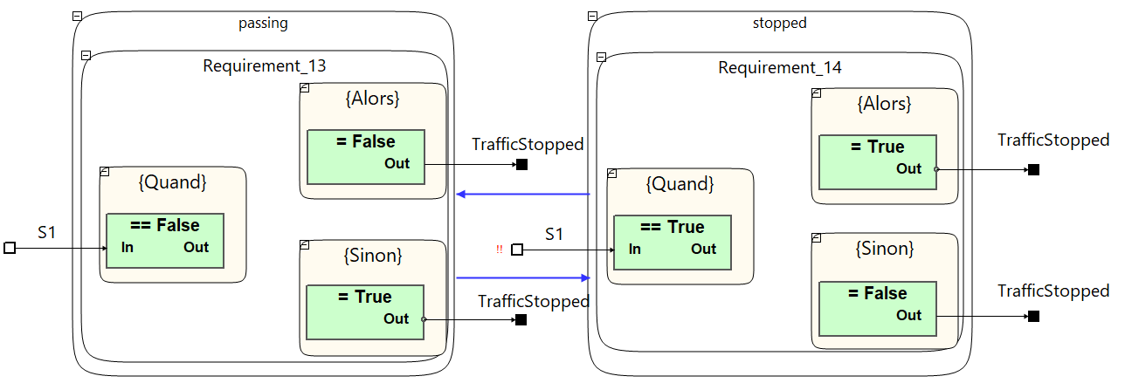
Traffic FSM

Slide 14
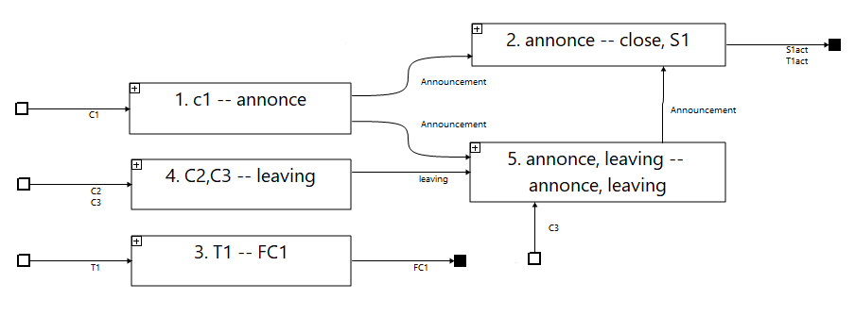
Controller schema

Slide 15
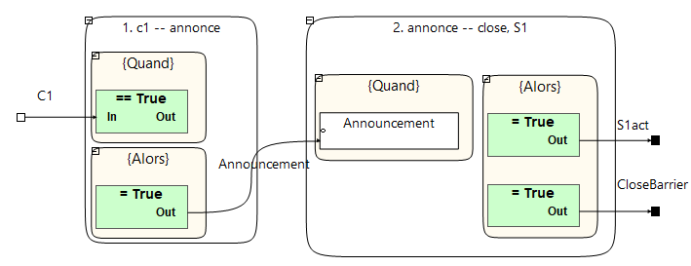
Controller, step 1, 2
Controller, step 1:
{When} train appears in the range of C1 sensor {C1=True}
{Then} remember, that train appears in the range of level crossing {Announcement = True}
Controller, step 2:
{When} there is a train in the range of level crossing {Announcement =True}
{Then} turn red light on for cars and close the barrier {S1act = True; T1act = True}

Slide 16
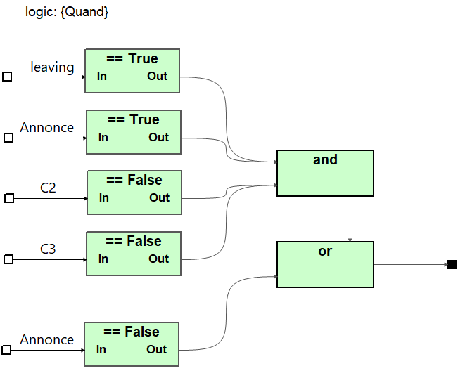
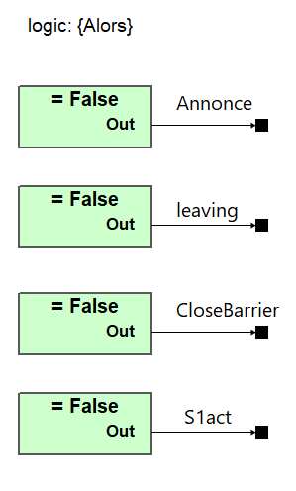
Controller: 5. announce, leaving
{Quand} {((leaving == True) and (Annonce == True) and
(C2 == False) and (C3 == False)) or (Annonce == False)}
{Alors} {Annonce = False; Leaving = False; CloseBarrier = False; S1act = False}

Slide 17
Model in the loop

Slide 18
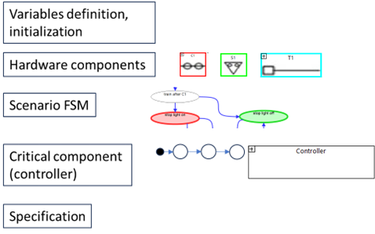
TLA+ script structure for automatic generation

Slide 19
Assumptions
Real-world components act much slower than a controller. We must assume that all controller actions are performed while environment variables are unchanged (like time evolutions are not taken into account).
SoI acts in the context of the scenario, with a restricted set of actions being possible to execute.
As far as we are not introducing controller automata manually, the controller should be able to proceed with all train-triggered actions before the train can act with the following scenario state.
Formal descriptions of all components come from requirement specifications, not from the implementation model
Time is not included in the model. We assume that all physical components react instantly, and time evolutions are not taken into account
All hardware components should react instantly – the environment does not change during the computation of the reaction (this principle allows us to execute all hardware component logics together at each model checker step)

Slide 20
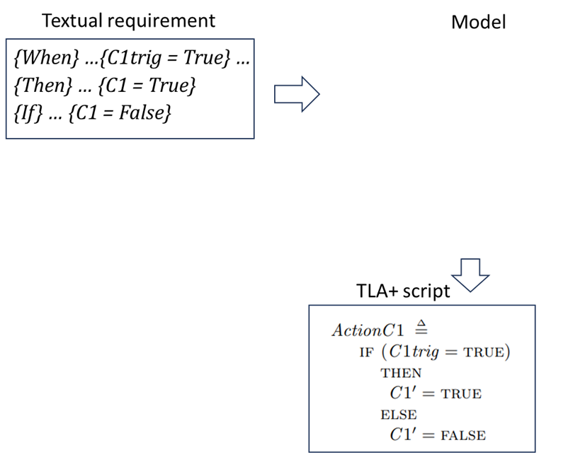

Requirement automatic ${\text{TLA}}^{+}$ translation

Slide 21

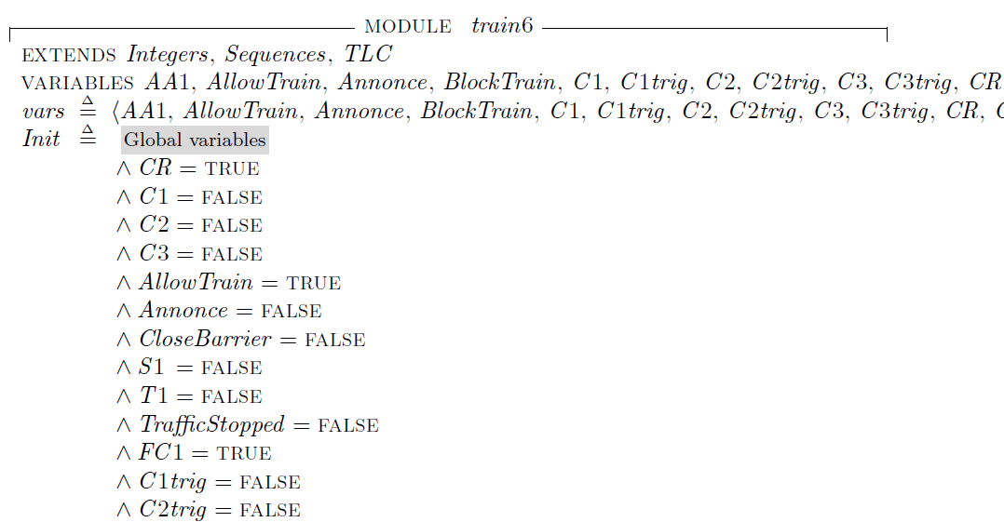

${\text{TLA}}^{+}$ code, initialization

Slide 22
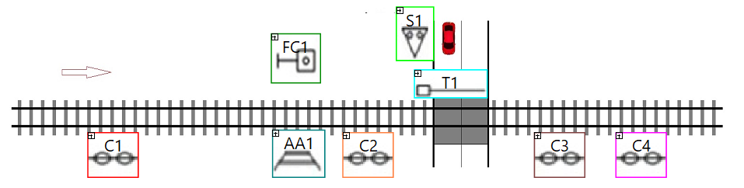
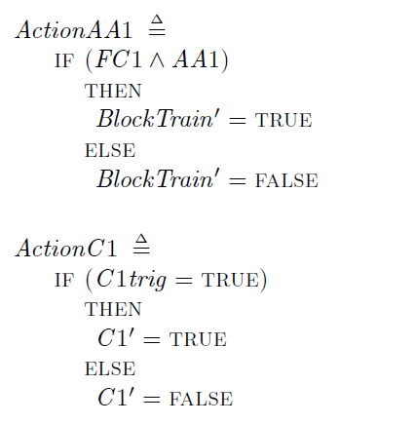
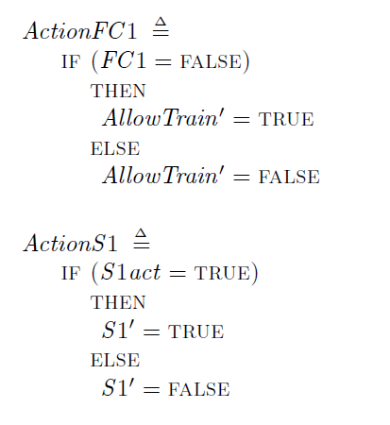

${\text{TLA}}^{+}$ code, components

Slide 23
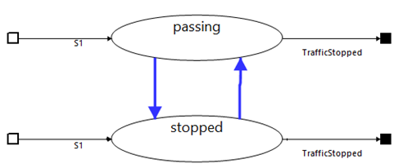
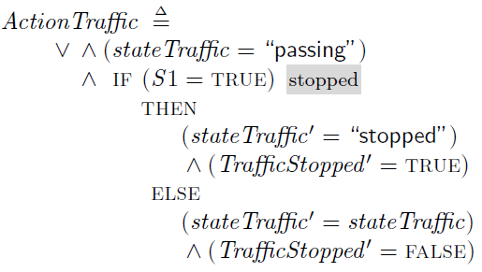
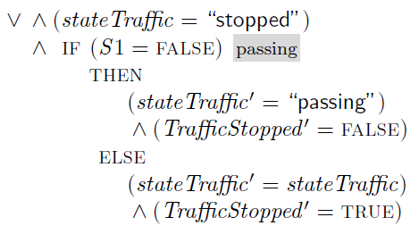

${\text{TLA}}^{+}$ code, traffic FSM

Slide 24
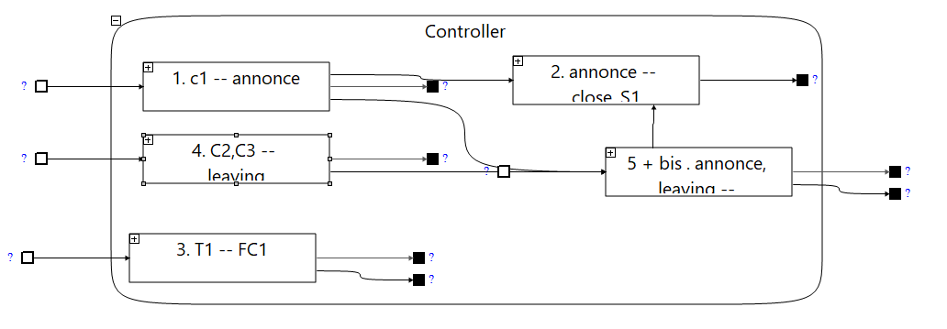
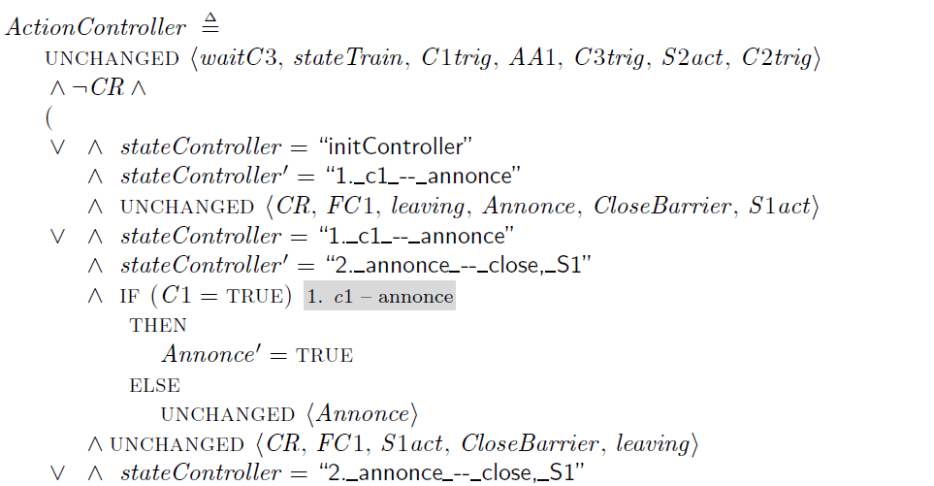
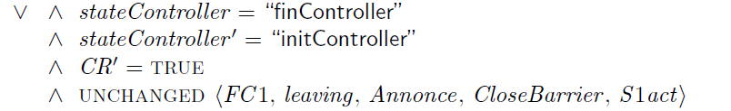

${\text{TLA}}^{+}$ code, controller
…

Slide 25
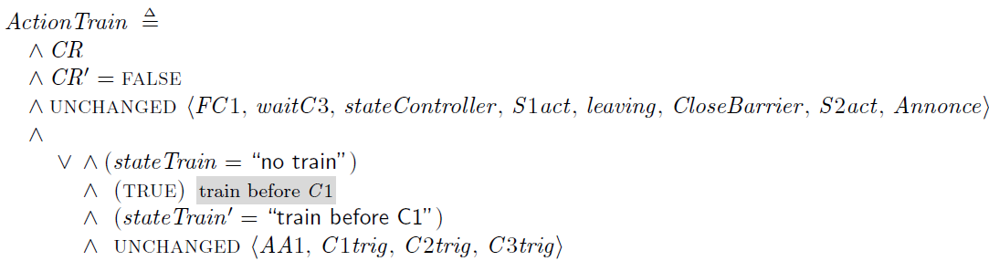

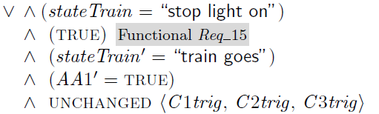


${\text{TLA}}^{+}$ code, train FSM
…

Slide 26
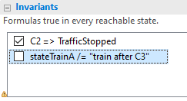

${\text{TLA}}^{+}$ Behavior, invariant

Slide 27
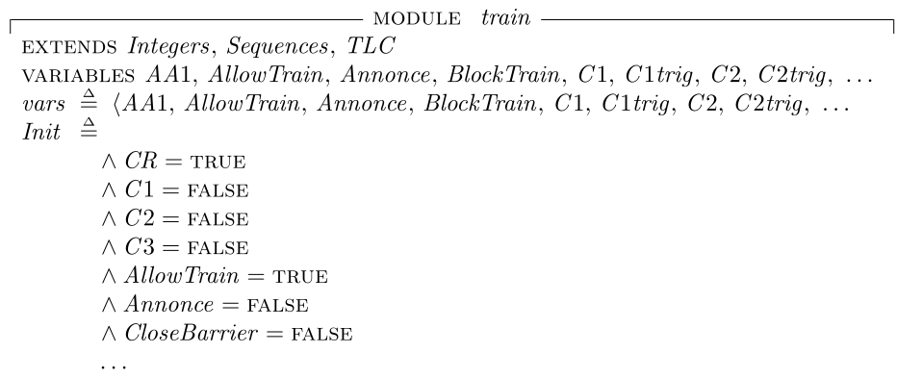
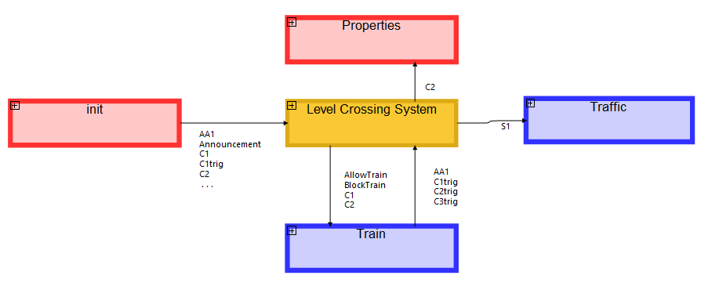
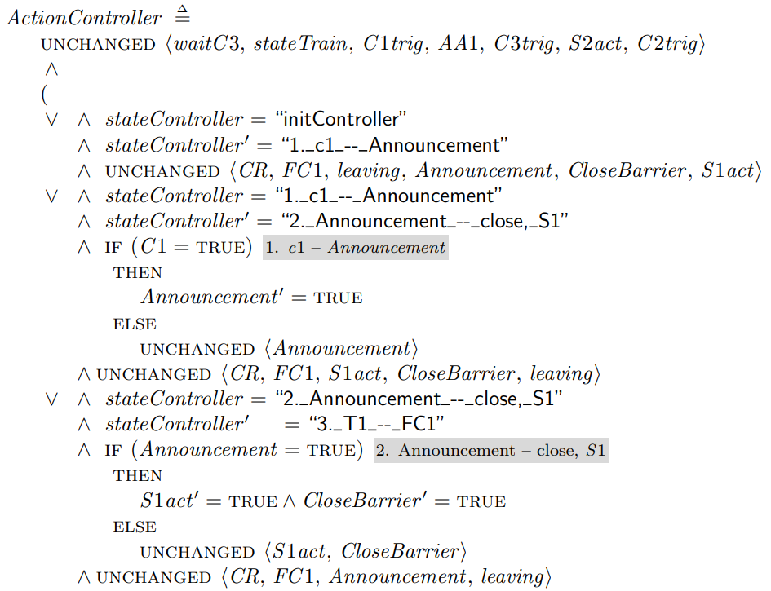
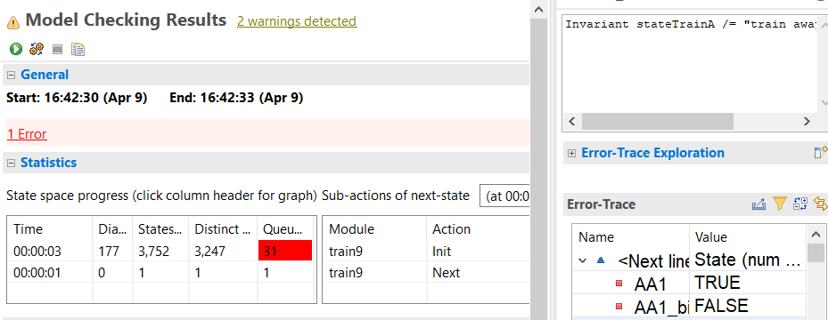
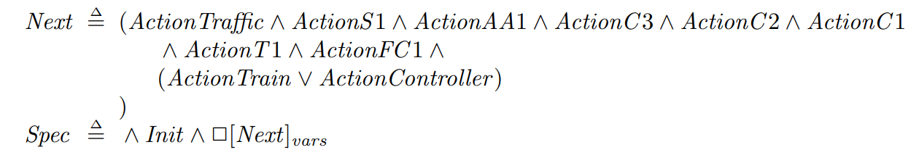




Automated Specification validation process with Model Checking
Automated generation of ${\text{TLA}}^{+}$
TLC Model Checker
No invariant broken
Actions trace in case of problem

Slide 28
Advantages of the model
Versioning
Configuration management
Flow traceability
Collaborative work
Integration
Low-code approach
Model management
Requirement traceability
Variant management
Facilitates the learning curve

