Slide 1
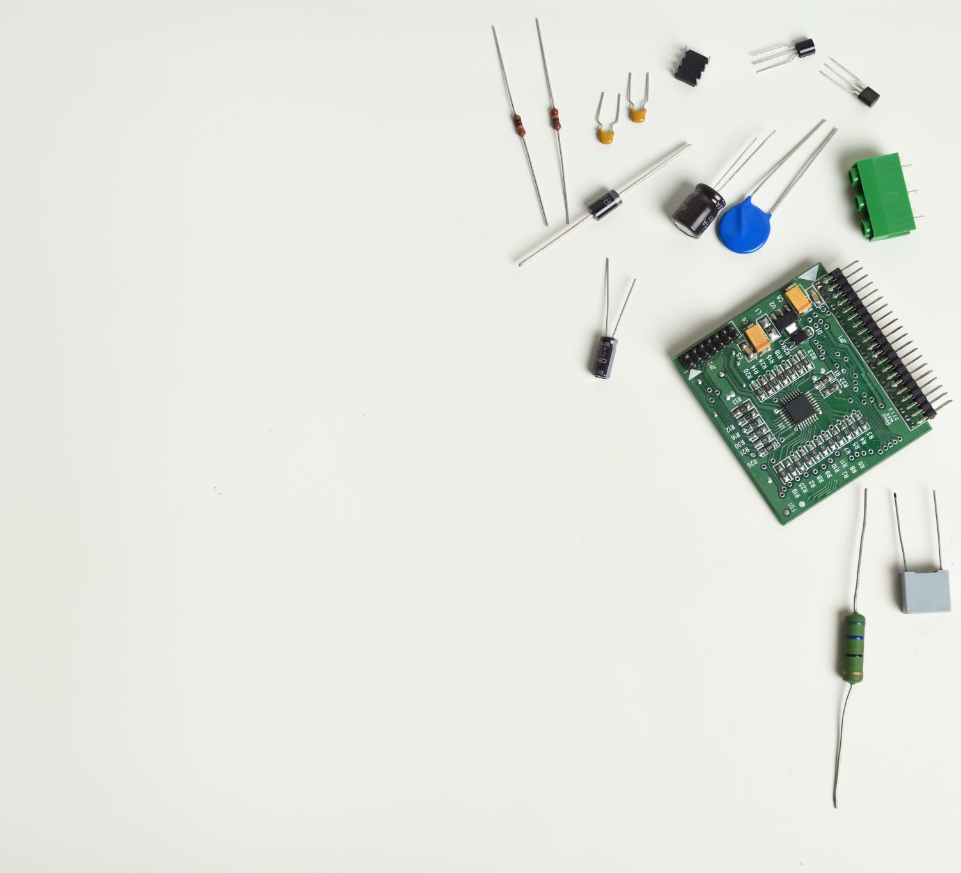
Building Hyperscale IOT Services With TLA+
Notes:
Hi, I am Vaibhav from Azure IoT
Today I want to talk about how we use TLA+ to build cloud solutions that operate at IoT scale.

Slide 2
Things
IoT Hub
Insights
Actions
Insights
Actions
Notes:
Let’s first understand what is IoT and what Azure IoT offers.
Billions of devices connect to cloud today.
These devices could be Smart bulb, Smart Plugs, Modern cars, Security Cameras, Oil Rigs.
After connecting to cloud they send massive amount of data.
The data is enriched, transformed and then it handed over to the storage layer.
From there the data is processed by AI models, Rule Engines and other services.
The processing of data results in action that goes back the device through the same channel.

Slide 3
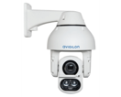
ioT Example : Intruder Detection
AI: Identify Objects
Action: Warn Intruder
Send Command Back
Data Source: Camera
Enrichment : Add Location
Rule: Detect Intruder
Notes:
Let me show a real example to explain how it works.
Let’s say a security camera sends and image.
Enrichment add the camera location details to the data.
AI model identifies objects in the image.
A rule engine finds a foreign object as intruder and decides to warn the intruder.
The command to run the warning goes back to the device through the same channel.

Slide 4
Exponential growth
IoT is Growing
Billions to devices connect to cloud and IoT is still growing exponentially.
Gradually, we start hitting rare race conditions and failure sequences that were unlikely.
TLA+ to detect and eliminated them during design.
Rare is Relative
Cellular IoT connections are expected to reach 3.5B in 2023. [Forbes]
Can’t test for every permutation of failure and race conditions.
Notes:
As I said earlier, Billions of devices connect to the cloud sending large volume of amount of data.
Projections show exponential growth in future.

Slide 5
Model Checking A Design
In The Product Lifecycle
Collect and Prioritize Requirements
Define Abstract Solution
TLA+ Model Check
Work Estimate
Implement, Test, Deploy Cycles
Notes:
Every project starts with understand of requirements,
once we have clear set of requirements,
we do an abstract design where we identify components we need to build, components we need to modify and interaction between them.
At this point we do the TLA+ modeling and update the design as needed to have a verified model.
Then we do the estimates and if the project is funded it goes through the regular implement, test deploy cycle.

Slide 6
Model Checking A Design
Cost, Skill and Process
Project Overhead
Less than 5% of overall project time
Prevent expensive postproduction issues
Skill Set
One engineer proficient in TLA+ in a team of five. Others including managers review it.
We model what we change, not the whole system

Slide 7
Model Checking A Design
Scope of Model
TLA+ covers
The algorithm and cross component interactions.
Traditional Tests Cover
Implementation of each component.
Async interactions, states and state transitions.
Mostly synchronous operations modeled as actions.

Slide 8
Example projects
Cross Region Failover
Azure IoT hub allows cross region failovers.
IoT telemetry message routing system enriches and transforms data..
Device Cache
Azure in-memory device store is backed by Azure storage as the durable store.
Message Routing
The design is model checked to ensure RPO, RTO guarantees.
New routing features are model checked.
Every aspect of the design is model checked.

Slide 9
Example Project
* Some details are excluded to maintain confidentiality
Device State Notifications
Notes:
This was all theory
Let’s look at a real example now.
Let’s see what was the problem.
What did we model, what did we verify.
Let’s look at the full evolution of the design.

Slide 10
Device State Notifications
Core problem
Allow customers (on a cellphone app or a backend service) to receive notifications when device status changes.
Millions of devices can connect or disconnect at any time.
Thousands of servers can failover at the same time.
Duplicates are allowed, ordering is not guaranteed.
Scale
Notification system as well and the backend database wouldn’t operate at this scale.
Devices (like security cameras) can connect and disconnect from the Azure IoT cloud.
Notes:
When a security camera connects to the cloud it is online.
When it disconnects it is offline.
We wanted the customers to know about these events.
As notifications can arrive out of order, we also wanted to put a sequence number in notifications.
So that the customer can know the real order of events.
If the camera connected and disconnected and it is currently offline, an out of order delivery will make customer think it is online.
--------------------
This is a fairly simple problem to solve.
We can use a two phase approach, where we first update the database with device state change and then we send the notification and update the
Database again saying the notification has gone out.
--------------------
Scale makes it a complex problem.
Millions of devices can connect and disconnect at the same time, and thousands of servers can fail at once.
We can not overwhelm the backend database to the notification system during these events.
We can also not reduce availability of device connect by putting a database or notification in the critical path.
This makes it a much harder problem to solve.
-------------------

Slide 11
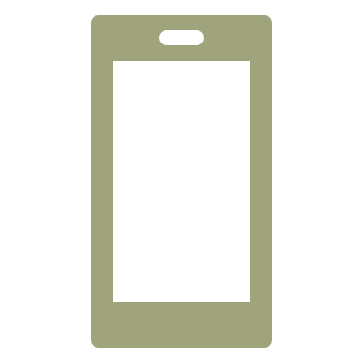
Rudimentary Approach
Device
Client
Topic
Connect 1
Connect 1
Disconnect 2
Disconnect 2
Standby
Primary
Primary (New)
Failed
Database
Connected 1
Disconnected 0
Disconnected 2
Notes:
Let's look at the Rudimentary approach we started with.
Any time the device state changes, the service first notifies the client and then at some point after sending the notification, updates the db.
If the service fails, the standby takes over.
And resumes the operation from there.

Slide 12
Rudimentary Approach – Resend
Device
Client
Topic
Connect 1
Disconnect 2
Primary (New)
Primary
Standby
Disconnect 2
Failed
Database
Connected 1
Disconnected 0
Disconnected 2
Notes:
Let’s look at a failure scenario.
If the service fails before sending the notification,
Things work fine and the new primary looks at the db and the device state.
It sends the notification if needed.

Slide 13
Rudimentary Approach – Resend
Device
Client
Topic
Connect 1
Disconnect 2
Disconnect 2
Disconnect 2
Primary (New)
Primary
Standby
Disconnect 2
Failed
Database
Connected 1
Disconnected 0
Disconnected 2
Notes:
Let’s look at a failure scenario.
If the service fails before sending the notification,
Things work fine and the new primary looks at the db and the device state.
It sends the notification if needed.

Slide 14
Rudimentary Approach – Failure
Device
Client
Topic
Disconnect 1
Disconnect 1
Connect 2
Connect 2
Standby
Primary
Primary (New)
Failed
Database
Connected 0
Disconnected 1
Connected 0
Notes:
Now let’s look at a race condition that can happen.

Slide 15
Device State Notifications
Device
Connected/Disconnected
Notified/Pending
States
Last notification
Components
Service/In-memory
Database/Persistence
Client
Notifications received

Slide 16
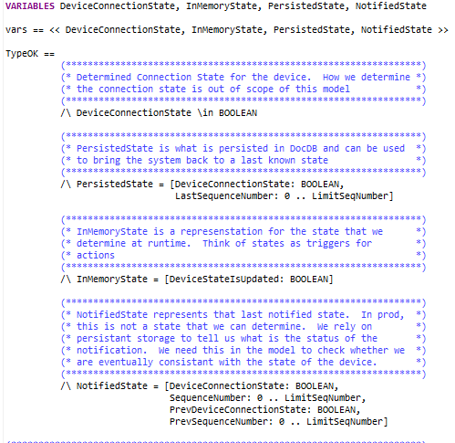
TLA+
Device
Connected/Disconnected
Notified/Pending
States
Last notification
Components
Service/In-memory
Database/Persistence
Client/Notified-State
Notifications received
Notes:
The TLA model has four transitions shown in the right
Any time device can connect, disconnect, the notification can go out, db can get updated or the partition can move.
On the left side I have the data structures representing each state.

Slide 17
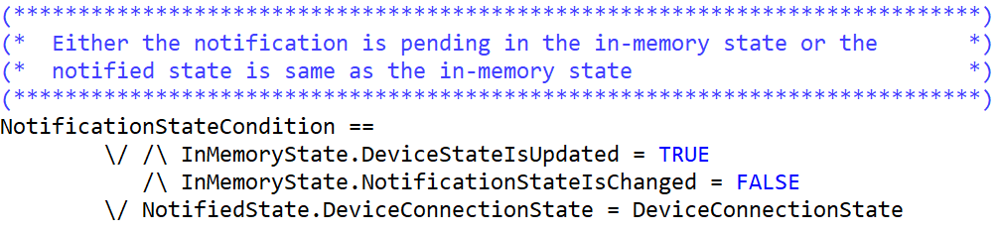
Invariant
Notes:
When we run the model with the invariant saying the client must get notified about the eventual state of the device we see failure.

Slide 18
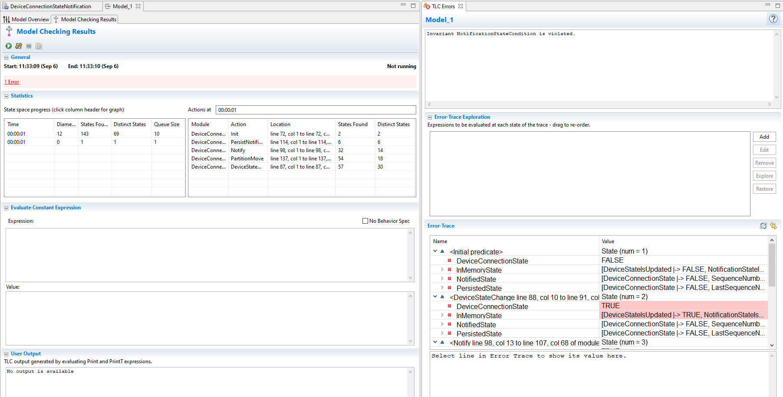
Notes:
When we run the model with the invariant saying the client must get notified about the eventual state of the device we see failure.

Slide 19
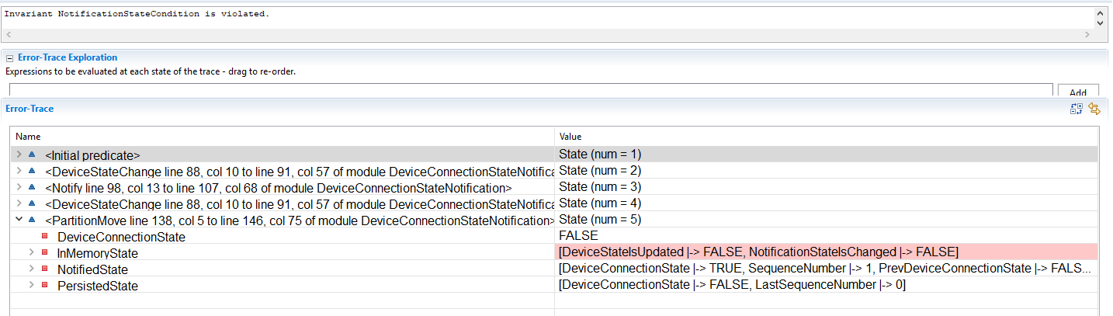
Invariant Failure

Slide 20
FIX
Generate Sequence Numbers
A background process sends the notification and tracks the sequence number processed
Failover
On failover the new service resumes from where the last one left off
Checkpoint
Service assigns a sequence number and stores the event in the DB
We use algorithm for in-memory sequence numbers generation.

Slide 21
Sophisticate Solution – Simple
Device
Client
Topic
Connect 1
Connect 1
Disconnect 2
Disconnect 2
Standby
Primary
Primary (New)
Failed
Database
Connected 1
1
Disconnected 0
Disconnected 2
2
Notes:
Let's look at the fix we applied for this issue.
We have high water mark and a hi-lo sequence generator per service instance.
We assign the next sequence to the next device event and keep track of sequence until which the notification has gone out.
When device connects the service updates the db, then sends the notification and at some point add the check pointer saying what notifications have gone out.

Slide 22
Sophisticate Solution - Failover
Device
Client
Topic
Connect 1
Disconnect 2
Disconnect 2
Standby
Primary
Primary (New)
Failed
Database
Disconnect 2
Connected 1
1
Disconnected 0
2
Notes:
In the case the if the service fails in between the new primary takes over from the last notified sequence number.

Slide 23
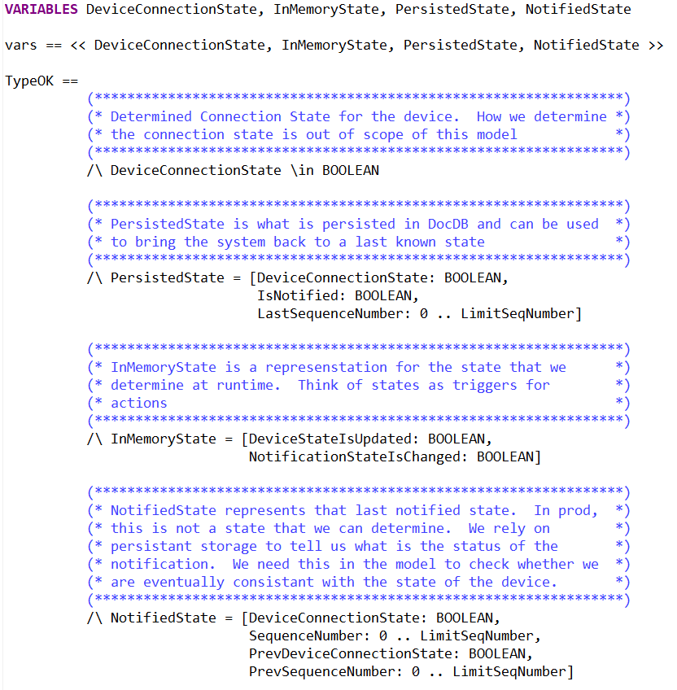
TLA+
Device
Connected/Disconnected
Notified/Pending
States
Last notification
Components
Service/In-memory
Database/Persistence
Client/Notified-State
Notifications received
Notes:
The model is similar with some minor change.
The invariant passes this time.
This about the cost of updating a TLA+ model vs debugging and then fixing such issue in production.

Slide 24
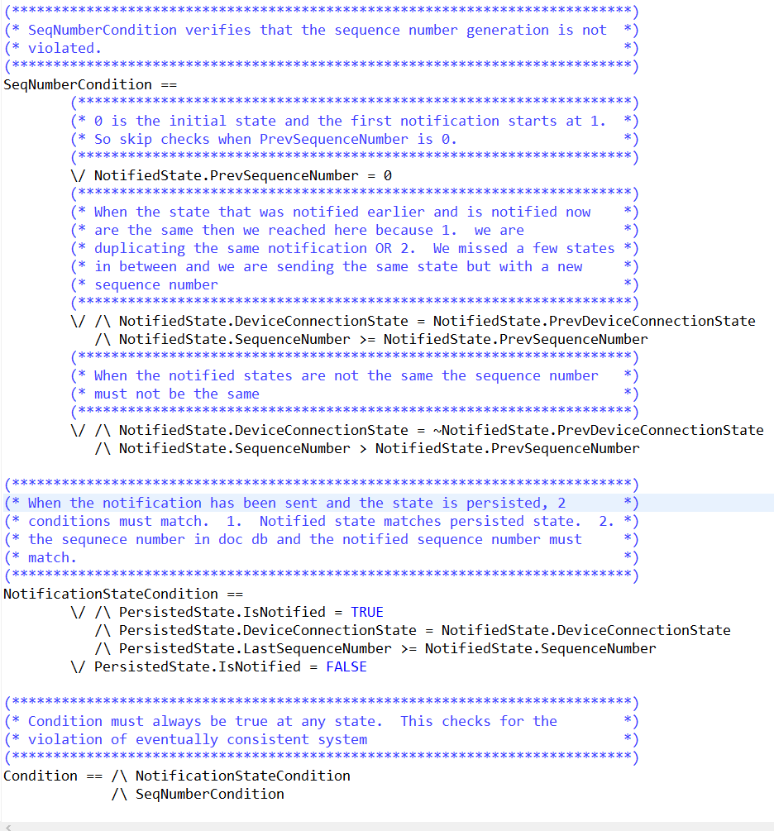
Invariant

Slide 25
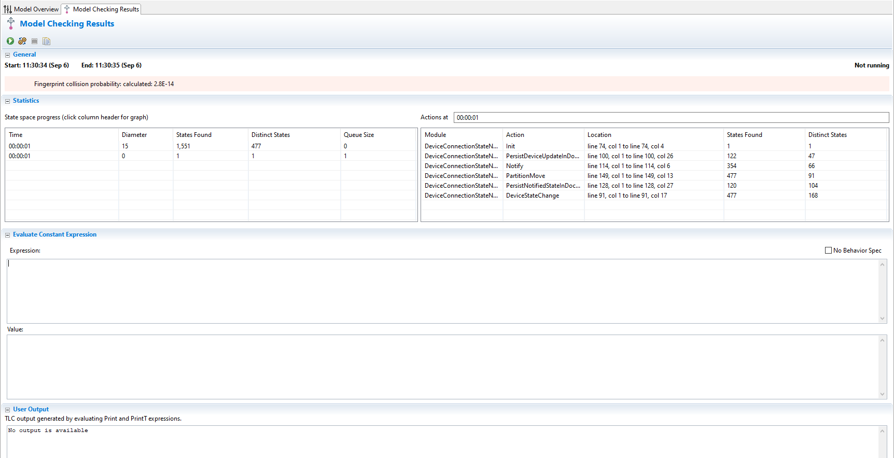
Notes:
When we run the model with the invariant saying the client must get notified about the eventual state of the device we see failure.

Slide 26
Takeaways
We invested less than a week on the TLA+ model.
Cost and Savings
Correctness and Optimizations
No design changes were needed at the development and testing stages.
We can process millions of concurrent device connects and disconnects correctly.
Optimizations reduced operational cost by an order of magnitude.
Database writes and Sending notifications are not in the critical path.
in-memory sequence numbers instead of hitting database.

Slide 27
Conclusion
Operating at Scale
Reduces post-production issues in count and complexity.
Eliminates design reworks that previously took 20-40% of project time.
Agility and Clarity
Code reviews use the TLA+ specifications as reference and primarily focus on code quality.
Allows aggressive optimizations that are necessary at IOT scale.
It’s easier to read, review and iterate over 50 lines of TLA+ than 10 pages of design doc.
Makes cross-component integrations simpler as everyone codes against same specification.

Slide 28
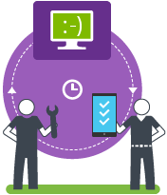
Questions ?

Slide 29
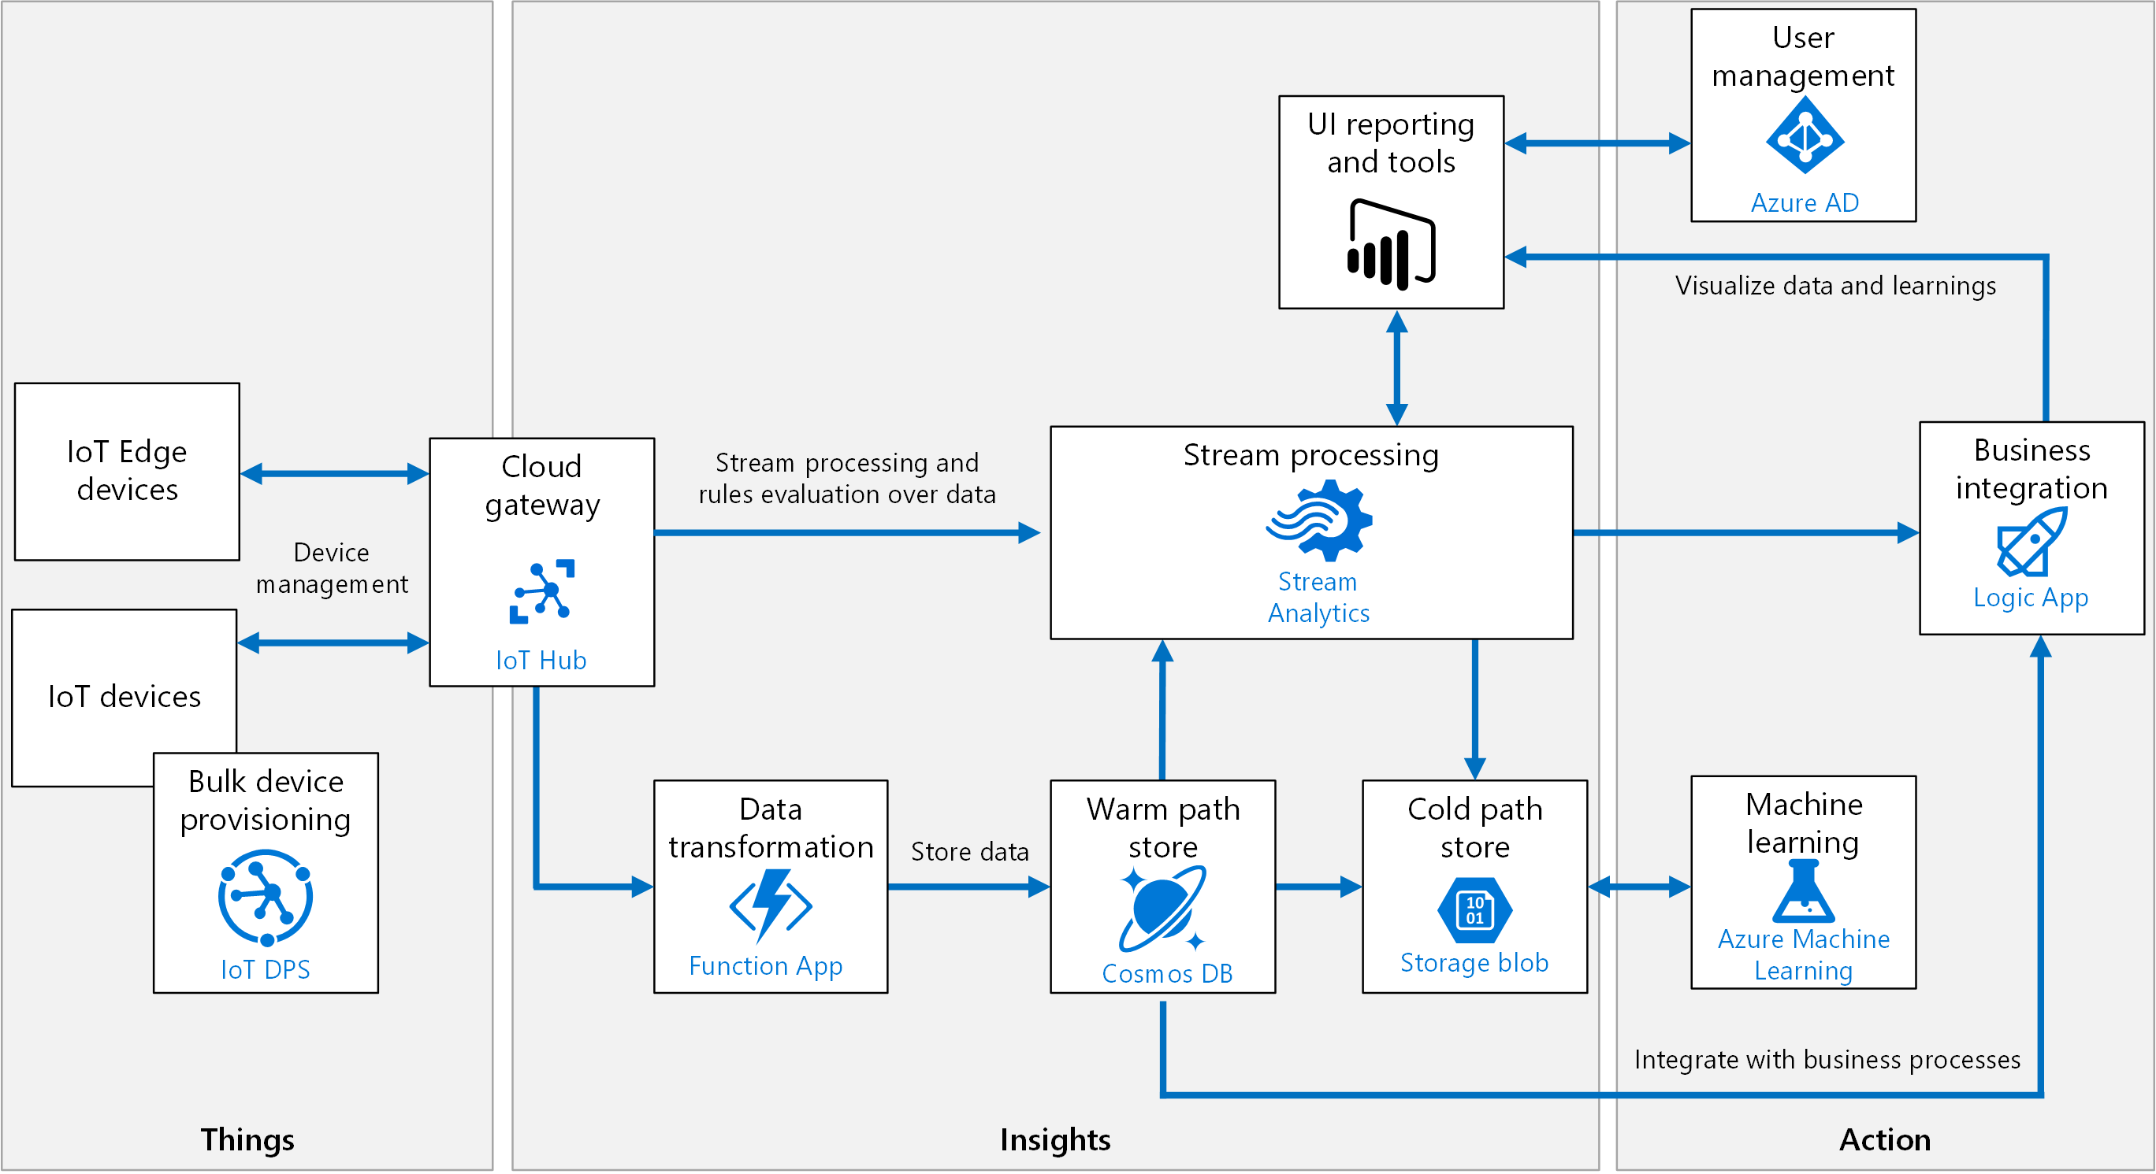
Azure Iot
Devices
(Things)
Enrichment and Transformation and Storage
Actions
Connecting Devices To cloud
Notes:
Let’s first understand what is IoT and what Azure IoT offers.
Billions of devices connect to cloud today.
These devices could be Smart bulb, Smart Plugs, Modern cars, Security Cameras, Oil Rigs.
After connecting to cloud they send massive amount of data.
The data is enriched, transformed and then it handed over to the storage layer.
From there the data is processed by AI models, Rule Engines and other services.
The processing of data results in action that goes back the device through the same channel.

