Slide 1
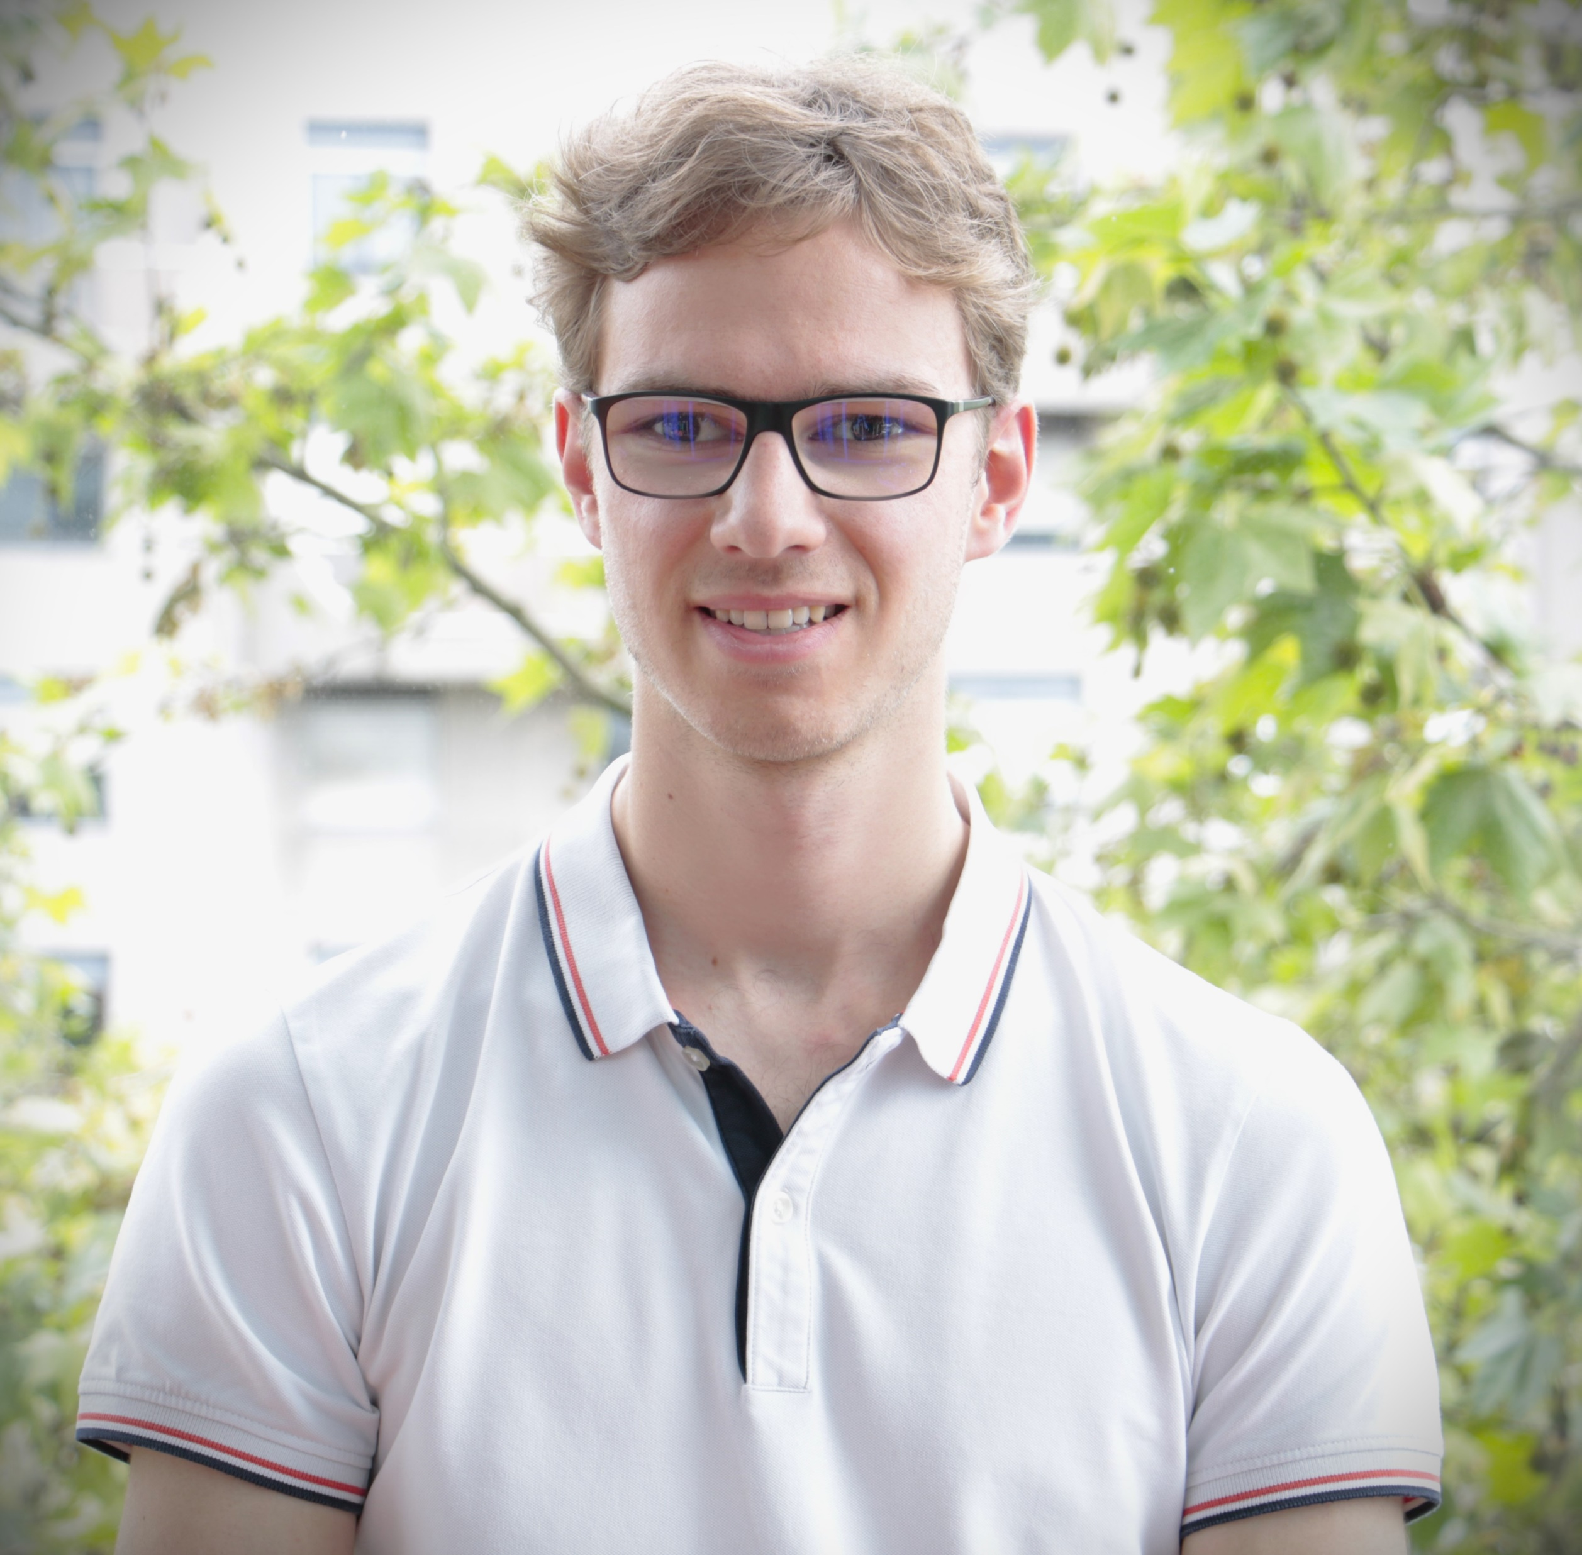
A Compositional Strategy for Verifying Fault-Tolerant Dynamic Task Graph Scheduling in Modern Cloud Environments
2026 TLA⁺ Workshop
April 12, 2026
Quentin Delamea^{1,2}
PhD Student, qdelamea@aneo.fr
Supervisors: Janna Burman¹, Jérôme Gurhem², Stéphane Vialle^{1,3}
Collaborators: Wilfried Kirschenmann², Florian Lemaitre², Stephan Merz⁴
¹LISN laboratory, Paris-Saclay University, Gif-sur-Yvette, France
²Aneo, Boulogne-Billancourt, France
³CentraleSupelec, Gif-sur-Yvette, France
⁴University of Lorraine, CNRS, Inria, LORIA, Nancy, Franc

Slide 2


I Am Severely Visually Impaired
Your guidance is appreciated! Please help me stay on track with the slides. Thank you!

Slide 3
Reliable Dynamic Distributed Scheduling Demands Rigorous Mathematical Foundations
01
Table of Contents
Modular Modeling First Specifies Core Scheduling Aspects Independently Before Composing The Full System
02
Decomposing Specifications Benefits Team Reviews Alongside Model Checking And Formal Proof
03

Slide 4

ArmoniK Abstracts Distributed Infrastructure to Streamline Parallel Workloads
High-Performance Computing (HPC) is highly complex; specialized developers are scarce¹.
@task
def gemm(A, B, C)
return sp.linalg.blas.dgemm(-1.0, A, B, 1.0, c=C, trans_b=1)
def cholesky_tiled(tiles, n):
for k in range(n):
tiles[k, k] = potrf.invoke(tiles[k, k])
for i in range(k + 1, n):
tiles[i, k] = trsm.invoke(tiles[k, k], tiles[i, k])
for i in range(k + 1, n):
tiles[i, i] = syrk.invoke(tiles[i, k], tiles[i, i])
for j in range(k + 1, i):
tiles[i, j] = gemm.invoke(tiles[i, k],
tiles[j, k], tiles[i, j])
return tiles
The Solution: A turnkey cloud platform that provides high-level abstractions.
Allows developers to focus purely on domain algorithms, abstracting away the infrastructure.
¹https://hyperionresearch.com/wp-content/uploads/2025/11/Hyperion-Research-SC25-Breakfast-Briefing-November-2025-1.pdf

Slide 5

ArmoniK Represents Workloads as Bipartite DAGs of Tasks and Data Objects
Tiles[1,1]
ArmoniK's API intercepts @task calls to autonomously build a bipartite DAG of tasks and objects
potrf
Tiles[1,1]
Tiles[2,1]
Exposes massive, native parallelism automatically without manual thread management.
trsm
Tiles[2,2]
Tiles[2,1]
Dynamic Execution: Tasks can seamlessly spawn new tasks or sub-DAGs at runtime.
syrk
Tiles[2,2]
Scheduler natively manages data transfers, routing, elasticity, and fault-tolerance.
potrf
Tiles[1,1]

Slide 6
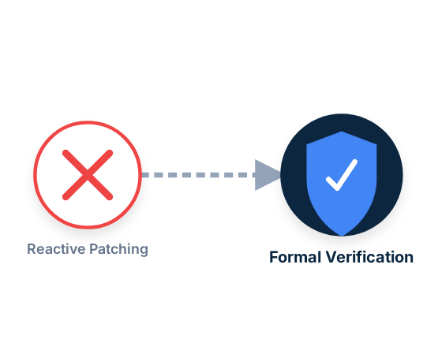
ArmoniK Requires the Adoption of a Rigorous Approach to Distinguish Flawed Logic and Superfluous Mechanisms
The Problem: At massive scale, rare failure sequences leave tasks in transient states, causing unpredictable, hard-to-reproduce errors.
The Limitation: Reactive patching ("firefighting") lacks fundamental guarantees and may break the system.
The Solution: Adopting Formal Methods to meticulously specify, model-check, and mathematically prove scheduling correctness.

Slide 7



TLA⁺ Meets Requirements for Concurrency, Complex Data Structures, Liveness, and Formal Proof Support
Concurrency
Expressivity
The language must be capable of handling distributed systems natively.
Must describe high-level data structures (like bipartite DAGs) alongside low-level system components (message queues, networks).
TLA⁺
Liveness
Proof Support
Scheduling is inherently linked to liveness—the guarantee that execution eventually progresses.
We required a powerful tool to formally prove the reliability of our protocol and component interactions.

Slide 8
Reliable Dynamic Distributed Scheduling Demands Rigorous Mathematical Foundations
01
Table of Contents
Modular Modeling First Specifies Core Scheduling Aspects Independently Before Composing The Full System
02
Decomposing Specifications Benefits Team Reviews Alongside Model Checking And Formal Proof
03

Slide 9
Modular Modeling Specifies Core Aspects Independently Through Successive Refinements Before Composing the Full System
Specifying Distributed Scheduling: Precisely specify scheduling rules and the evolution of the DAG under user and system actions over time,
Task Lifecycle
DAG Lifecycle
Three Core Scheduling Aspects: Tasks, Objects, and Sessions
Object Lifecycle
Strategy: Instead of writing a monolithic specification, we decompose the specification by model each aspect independently using refinement before composing them.
Session Lifecycle
Specifications on Github: https://github.com/aneoconsulting/ArmoniK.Spec/

Slide 10
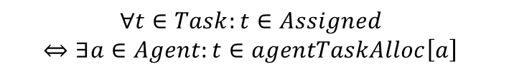
The Task Lifecycle is Modeled Through Iterative Refinements From Abstract To Concrete
Task Processing 1
Unknown
Registered
Staged
Assigned
Processed
Finalized
Safety
Liveness
$$∀t∈Task:t∈Assigned$$
$$⇔∃a∈Agent:t∈agentTaskAlloc\left[a\right]$$
$$∀t∈Task:t∈Processed⇝Finalized$$

Slide 11
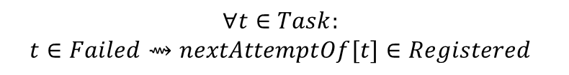
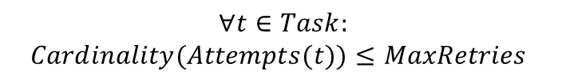
The Task Lifecycle is Modeled Through Iterative Refinements From Abstract To Concrete
Task Processing 1
Task Processing 2
Failed
Retried
Unknown
Registered
Staged
Assigned
Succeeded
Completed
Discarded
Aborted
Safety
Liveness
$∀t∈Task:$
$$Cardinality(Attempts(t))≤MaxRetries$$
$$∀t∈Task:$$
$$t∈Failed⇝nextAttemptOf[t]∈Registered$$

Slide 12
The Task Lifecycle is Modeled Through Iterative Refinements From Abstract To Concrete
Task Processing 1
Task Processing 2
Failed
Retried
Task Processing 3
Unknown
Registered
Staged
Assigned
Succeeded
Completed
Paused
Stopped
Discarded
Aborted

Slide 13
The Task Lifecycle is Modeled Through Iterative Refinements From Abstract To Concrete
Task Processing 1
Task Processing 2
Task Processing 3
Task Processing 4
Extends Task Processing 3 with task deletion considerations.

Slide 14
Data Objects Are Modeled Through a Similar Iterative Refinement Process
Object Processing 1
Unknown
Registered
Finalized
Completed
Object Processing 2
Unknown
Registered
Aborted
Completed
Object Processing 3
Unknown
Registered
Deleted
Aborted

Slide 15
A Single Specification Captures the Lifecycle of Sessions
Session Processing 1
Unknown
Opened
Paused
Closed
Purged
Deleted
Aborted

Slide 16

Lifecycle Compositions Iteratively Refine the Specification of Scheduling for Workloads Composed of Tasks and Objects Grouped within Sessions
Composition adds couplings rules
ObjectProcessing 1
TaskProcessing 1
Tasks can transition to Staged if all its input objects are Finalized
GraphProcessing 1
Objects can transition to Finalized if at least one of its parent tasks is Processed.
ObjectProcessing 2
TaskProcessing 2
Compositions define DAG-related properties
GraphProcessing 2
Tasks-Objects dependencies always form a bipartite DAG which sources and sinks are objects.
TaskProcessing 3
If a task is Aborted then eventually all its dominated tasks and objects will be Aborted.
GraphProcessing 3
SessionProcessing 1
ObjectProcessing 3
TaskProcessing 4
GraphProcessing 4

Slide 17
Reliable Dynamic Distributed Scheduling Demands Rigorous Mathematical Foundations
01
Table of Contents
Modular Modeling First Specifies Core Scheduling Aspects Independently Before Composing The Full System
02
Decomposing Specifications Benefits Team Reviews Alongside Model Checking And Formal Proof
03

Slide 18
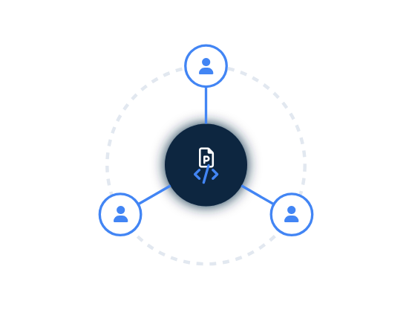

Modular Modeling Enables Domain Experts to Review Specifications Without Formal Methods Expertise
A specification is only valuable if it is mathematically correct AND faithful to the real-world system.
ArmoniK development team had no prior FM experience.
Breaking the system into focused sub-aspects builds cross-functional team expertise gradually.

Slide 19

Modular Modeling Enables Targeted Optimizations and Early Property Verification for TLC
Challenges
State space explosion
Formula evaluation complexity
Symmetry reduction: exploits system symmetries to reduce space
Formula Re-writing (e.g., using recursive instead of existential formulations).Mitigation 2:
Operator Overloading with Java
Mitigations
Incompatible with verifying liveness properties
Encourages computer-oriented code over mathematical-oriented code
Introduces unverified black-boxed code
Drawback
Mitigations can make proofs more difficult and should be used sparingly. Modular modeling allows delaying their use and applying them only where necessary.

Slide 20


Modular Modeling Enhances Tractability of Formal Proofs by Decomposing Them into Elementary Sub-Steps
System decomposition allows completely independent proofs before composition.
Fully proved
Partially proved
ObjectProcessing 1
TaskProcessing 1
Eliminating monolithic entanglement makes many sub-theorems trivial.
GraphProcessing 1
ObjectProcessing 2
TaskProcessing 2
Workflow: Minimal model-checking Formal proof via TLAPS.
GraphProcessing 2
Proved results in high-level simple specifications can be reused in subsequent logic refinements.
TaskProcessing 3
GraphProcessing 3
SessionProcessing 1
ObjectProcessing 3
TaskProcessing 4
GraphProcessing 4

Slide 21
Reliable Dynamic Distributed Scheduling Demands Rigorous Mathematical Foundations
01
Conclusion & Future Works
Modular Modeling First Specifies Core Scheduling Aspects Independently Before Composing The Full System
02
Decomposing Specifications Benefits Team Reviews Alongside Model Checking And Formal Proof
03

Slide 22



Conclusion & Future Works
Toward the Full Specificatio
Current specification describes consistent interactions with the central database.
Extend system modeling to remaining components and their interactions
Compose models into a unified, full-system specification
Reliable Dynamic Distributed Scheduling Demands Rigorous Mathematical Foundations
Modular Modeling First Specifies Core Scheduling Aspects Independently Before Composing The Full System
Message Queue
Object Storage
Central Storage
Decomposing Specifications Benefits Team Reviews Alongside Model Checking And Formal Proof
Failure
Failure
Scheduling Agent
Scheduling Agent
Scheduling Agent
Scheduling Agent

