Slide 1

Using TLA⁺ for fun and profit in
the development of Elasticsearch
Yannick Welsch ywelsch
TLA⁺ Conference, St. Louis, Sept. 12 2019

Slide 2

Elasticsearch in 60 seconds
distributed search and analytics engine
initially released by Shay Banon in 2010
based on Apache Lucene
typical use cases
log analytics
full-text search
operational and security intelligence
business analytics
metrics, ...

Slide 3
Elasticsearch's data replication and clustering
High-level architecture
my-index
Node 1
Node 2
Node 3
Node 4
Cluster state
P0
P1
R2
P2
R1
R0

Slide 4
Towards a more resilient system
A multi-year journey
users with larger clusters and more demanding use cases
stronger resiliency, fault-tolerance & scaling requirements
first focus was on the data replication layer
losing acknowledged writes, out-of-sync shard copies, slow recoveries, not flexible enough to build new features such as cross-cluster replication
sequence numbers project: rework data replication layer to uniquely identify each write operation in the system
started off with an informal specification
explored ways to use formal methods

Slide 5
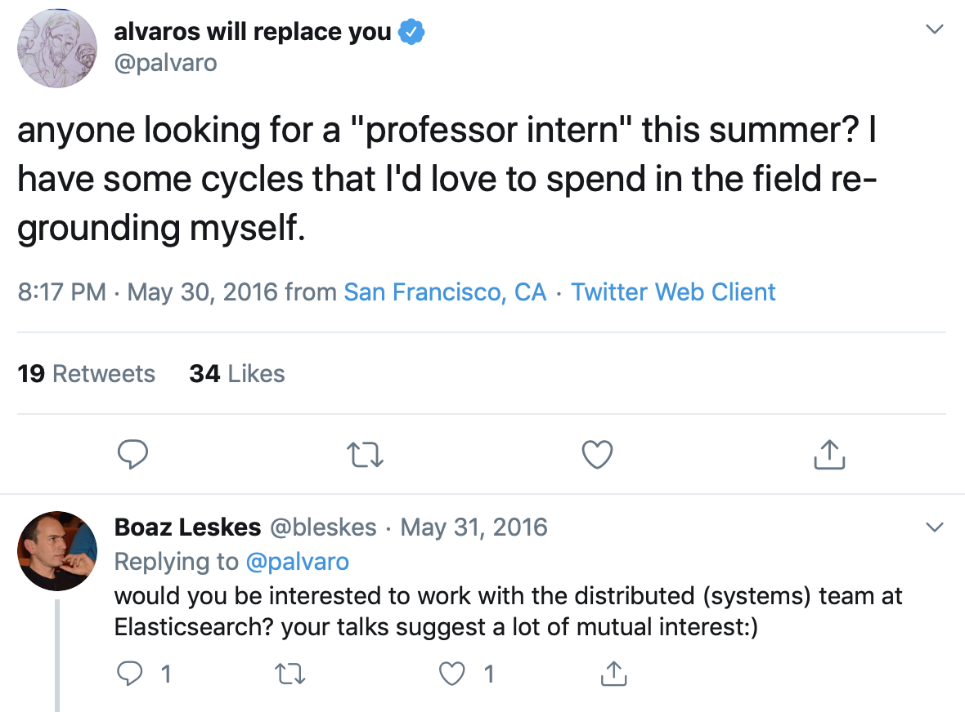

Slide 6
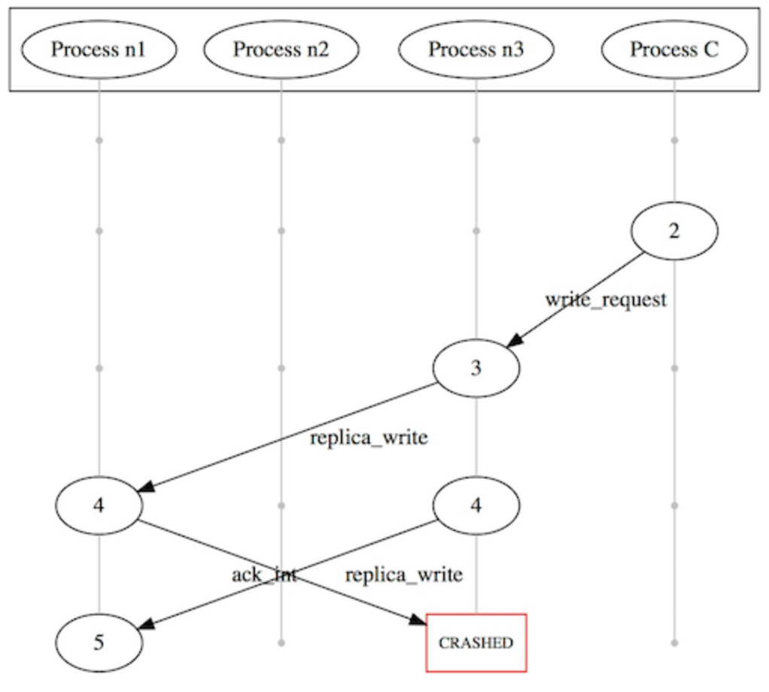
Data replication model
A first formal specification for Elasticsearch
Dedalus spec created by Kamala Ramasubramanian
PhD student in Peter Alvaro's research group at UCSC
specification validated using MOLLY (based on LdFI)
no issues found with new model, but validated bugs of old replication model
as follow-up, I investigated other techniques and tools (in particular TLA+)
TLA⁺ model of the new data replication algorithm that is powering Elasticsearch since version 6, released in November 2017
860 lines of commented TLA+ code, checking safety properties

Slide 7
Studying bugs with TLA+

Slide 8
Investigating concurrency and algorithmic bugs
From implementation to formal model and back
validated two concurrency bugs using PlusCal spec
explored and validated solutions using spec
discovered an additional unknown bug in the implementation, which we only later observed in the wild
in a different component, testing uncovered a bug which only surfaced after running for months on CI
modeled with TLA+, TLC checker finds bug within seconds
bug fixes first prototyped using spec and validated with model checker

Slide 9
Formal design first
A specification for the cluster coordination subsystem

Slide 10
What is cluster coordination?
A redesigned cluster coordination subsystem for Elasticsearch 7.0
elects master and publishes cluster state updates
must be resilient to node failures, unreliable networks, ...
quorum of available nodes sufficient to make progress
Elasticsearch 6.x (Zen Discovery)
quorum size user-defined through minimum_master_nodes setting
algorithmic issues
Elasticsearch 7.0
quorums managed by system itself
new algorithm validated with TLA+

Slide 11
Cluster coordination TLA⁺ spec
TLA⁺ spec (370 LOC) covers safety bits of the algorithm
single rewritable register, dynamic reconfiguration, bootstrapping
manually mapped to Java implementation (570 LOC)
code looking very similar
all interactions with relevant state of the system threaded through this Java class
liveness layer built on top of safety layer (not covered with spec)
powering Elasticsearch since version 7.0, released in April 2019
https://www.elastic.co/blog/a-new-era-for-cluster-coordination-in-elasticsearch

Slide 12
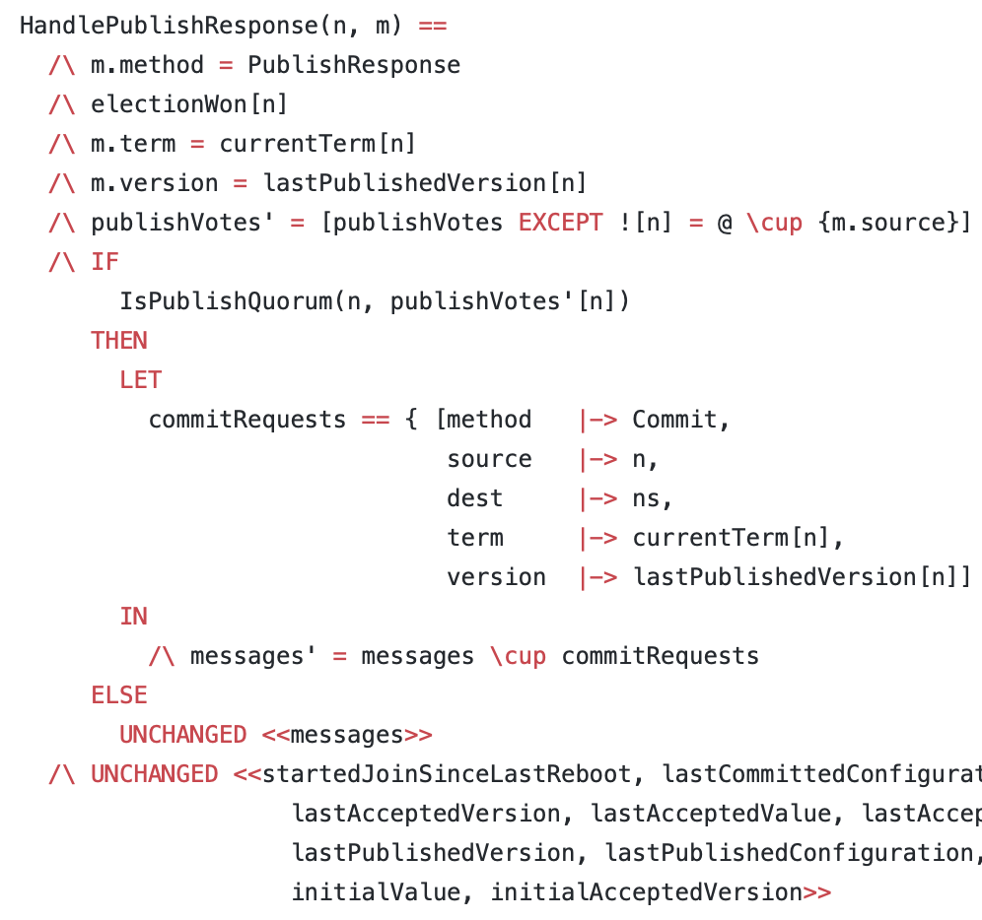
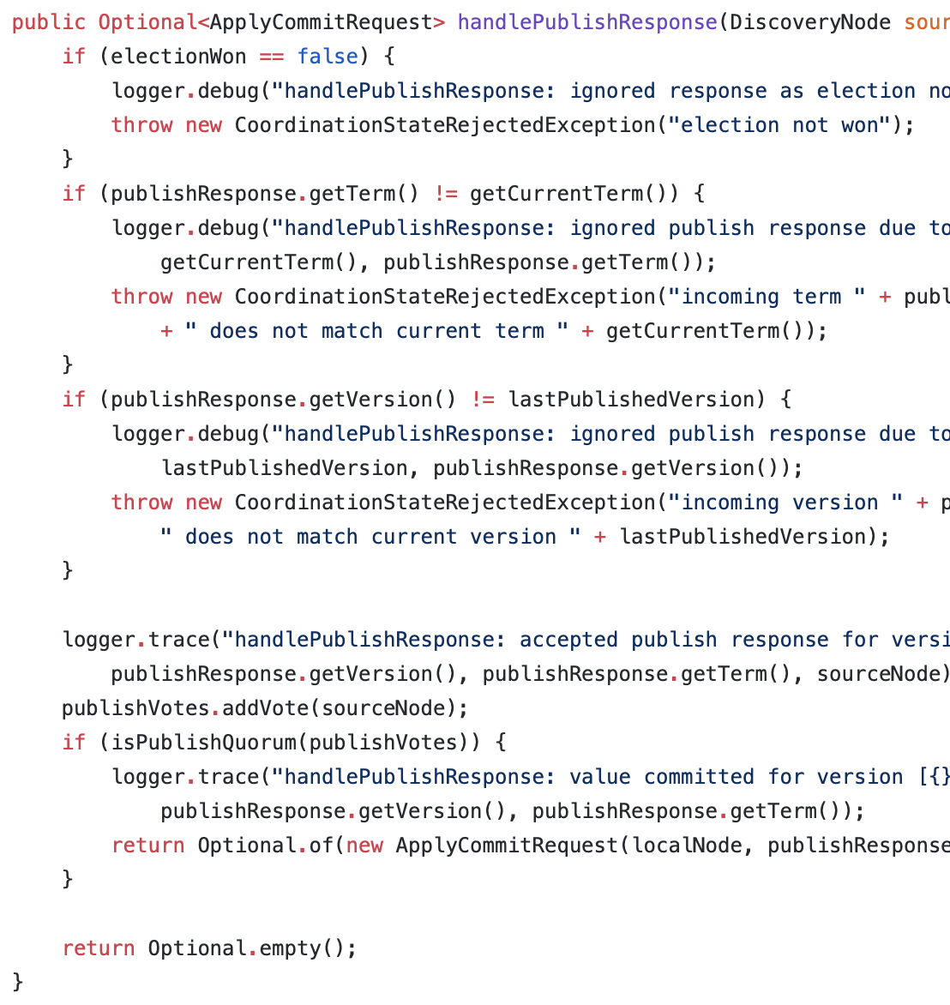
TLA⁺ (370 LOC)
Java (570 LOC)

Slide 13
Lessons learned

Slide 14
Lessons learned
resiliency improvements in Elasticsearch thanks to TLA⁺
versatile use (refine informal spec, map code to spec, formal spec first)
state space explosion
symmetry sets
state constraints
TLA⁺ toolbox very convenient to use
TLC model checker great at finding bugs
next step: expand use of TLA⁺ beyond distributed / concurrent issues

Slide 15

TLA⁺ specs available at
https://github.com/elastic/elasticsearch-formal-models

