Slide 1

University for Applied Science, Constance
Faculty Computer Studies/ Buisiness Information Technics
Prof. Dr. Grütz: Operational System Research
Literature: The lecture closely follows the book:
"Meyer, M. /Hansen, K.: Planungsverfahren des Operations Research, pp 1-78
Further information on literature can be found in this book!
The following material completes the literature indicated!
A detailed script has been produced for those parts
where the lecture differs from the book: units 1 & 2

Slide 2
Summary of Contents
1.Structuring a mathematical model of Linear Programming:
Formulating a model
1.1 Introductory example of planning a production program
1.2 Decision variable (structure variable)
1.3 Restriction
1.4 Non-negativity restriction
1.5 Objective function
1.6 Formulation of Linear Programming
1.6.1 Restrictions and formulation of the problem
1.6.2 Complete formulation of LP
1.6.3 Standard form of Linear Programming

Slide 3
2. Solution of a model of Linear Programming
2.1 Graphical solution
2.2 The Simplex principle
2.3 Solution through enumeration
2.4 The Simplex method
2.4.1 Calculating the permitted basic solutions (Pivot row criterion)
2.4.2 Calculating the optimal basic solutions (optimality test, selecting of Pivot column)
2.4.3 The steps of the Simplex method

Slide 4
3. Non-standard cases
3.1 Overview
3.1.1 Non-standard cases with variables
3.1.2 Non-standard cases with restrictions
3.1.3 Non-standard cases with the objective function
3.2 Goal Programming
3.3 M-method
3.4 Non-linear programming (separable programming)

Slide 5
4. Duality
4.1 A price problem
4.2 The duality theorem
4.3 Motivation for duality
5. Sensitivity analysis
5.1 Difficulties of interpreting dual variables
5.2 Variation of a coefficient of the objective function
5.3 Variation of a coefficient of the b-vector

Slide 6
6. Parametric programming
7. Transport models, transshipmer models, transfer problems
8. Decision tree method (decision tree after Dakin)
9. Software
10. Applications
11. Case study personnel planning
12. Generalised Networks
13. Exercises

Slide 7
Applications of Operations Research
theory practise
- applications of mathematical methods - application of common sense for problems
for operational settings of a problem in general systems
    search for optimal solutions - search for good and practicable solutions
-OR is needed - OR needs to gain acceptance
employing OR on an operative level employing OR on all levels
- operations research - operational research
applied mathematics management science
econometry systems research

Slide 8
  Formulating a model
1.1 Introductory example of planning a production program
The components of a formulation of Linear Programming shall be explained with a simple example of planning a production program:
A factory manufactures the products 1 and 2 on two universal machines. The capacity of the machines is measured in hours: the first machine's capacity must be 12 hours, the second machine's must be 9 hours per day.
Manufacturing product 1 takes three hours per piece on machine 1, and one hour on machine 2, whereas working on product 2 takes two hours on machine 1, and three hours on machine 2.
The profit contribution for product 1 is 1€, but product 2 achieves a profit contribution of 2 €. Ascertain the production program!

Slide 9
1.2 Decision variable
(economic) environment -------- interpretation -------- mathematical model
. .
. .
planning of a production program linear equation system
"How many pieces of product 1 and 2 need to be manufactured per day?"
x1 is the amount of P1, and x2 the amount of P2

Slide 10
Numerical example: …
3x₁ + 2x₂ = 12
1x₁ + 3x₂ = 9
generally: …
A₁₁x₁ + A₁₂x₂ = 12
A₂₁x₁ + A₂₂x₂ = 9

Slide 11
For the solution of linear equation systems:
The Gauss elimination method (Pivot method) employs elementary row transformations. By this we mean:
the interchange of two rows, the addition of a row that is multiplied by any real number, to another row.
b. the multiplication of a row with a real number other than zero.
To revise the Gauss method, we explain it briefly with an example:

Slide 12
1st restriction :
3 x1 + 2 x2 = 12 ; :3
1 x1 + 2/3 x2 = 4;
2nd restriction : x1 + 3 x2 = 9; minus modified first restriction yields:
0 x1 + 7/3 x2 = 5; result after the first Gauss iteration:
1 x1 + 2/3 x2 = 4;
0 x1 + 7/3 x2 = 5; result after the second Gauss iteration:
1 x1 + 0 x2 = 18/7;
0 x1 + 1 x2 = 15/7;
Pivot element

Slide 13
1.3 Subordinate clauses
7
6
5
4
3
2
1
subordinate clause I
straight line I
B
subordinate clause II
straight line II
C
A
D
1 2 3 4 5 6 7 8

Slide 14
1st restriction 2nd restriction
3x₁ + 2x₂ = 12 1x₁ + 3x₂ = 9
x₂ = -3/2x₁ + 6 x₂ = -1/2x₁ + 3
generally: x₂ = mx₁ + b
m = gradient
b = intersection with axis

Slide 15
Relaxation of the existing setting of the task
A factory manufactures the products 1 and 2 on two universal machines. The capacity of the machines is measured in hours: the first machine's maximum capacity is 12 hours, the second machine's maximum capacity is 9 hours per day.
Manufacturing product 1 takes three hours per piece on machine 1, and one hour on machine 2, whereas working on product 2 takes two hours on machine 1, and three hours on machine 2.
The profit contribution for product 1 is 1 euro, but product 2 achieves a profit contribution of 2 euro. Ascertain the production program

Slide 16
1.4 Non-negativity conditions
7
6
5
4
3
2
1
subordinate clause I straight line I
B
C
subordinate clause II
straight line II
A
D
1 2 3 4 5 6 7 8

Slide 17
7
6
5
4
3
2
1
subordinate clause I straight line I
B
C
subordinate clause II
straight line II
A
D
1 2 3 4 5 6 7 8

Slide 18
convex polyhedron M (solution simplex)
5
4
3
2
1
set of acceptable solutions:
(i) 3x₁ + 2x₂ <= 12
(ii) 1x₁ + 3x₂ <= 9
(iii) x_{1,} x₂ > = 0
B
C
M
D
A
1 2 3 4 5 6

Slide 19
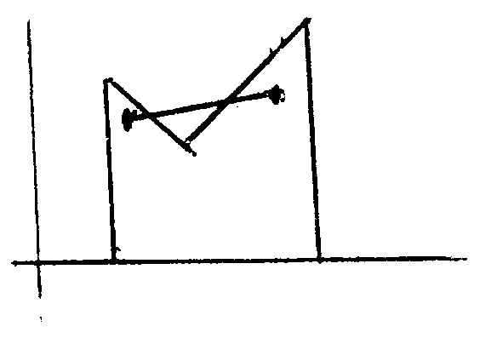

Slide 20
1.5 Objective function
x₂
Objective function : Z = 1x₁ + 2x₂ ---> max!
4
3
2
1,5
1
equation of the straight line of the objective function :
Z = 1x₁ + 2x₂
x₂ = - 1/2 x₁ + Z/2
B
C
Z=6 6/7
M
Z=6
D
A
4
x₁
Z=3
Z=4
Z=0
optimum : x₁ = 18/7; x₂ = 15/7; Z = 48/7;

Slide 21
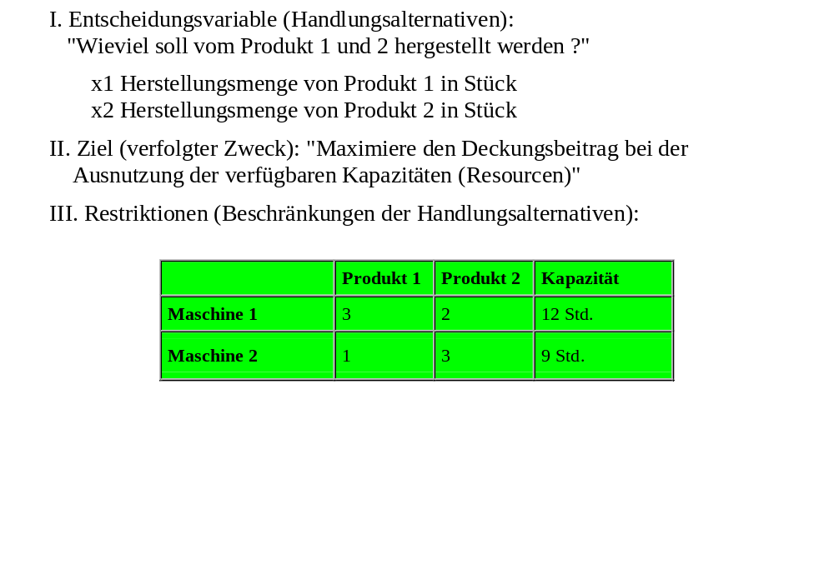
1.6.1 Restriction and formulation of the problem
IV. Nichtnegativitätsbedingungen

Slide 22
1.6 A formulation of linear programming
1.6.1 Restriction and formulation of the problem
I. decision variable (options of proceeding):
"How much do we want to produce of product 1 and 2"?
x1 amount of production of product 1 in pieces
x2 amount of production of product 2 in pieces
II. objective (pursued purpose):
"maximise the profit contribution by using the available capacities (resources)".
III. restrictions (of the options to proceed):
 | product 1 | product 2 | product 3
machine 1 | 3 | 2 | 12 h
machine 2 | 1 | 2 | 9h
IV. Non-negativity conditions

Slide 23
1.6.2 Complete formulation of LP
Z = 1x₁ + 2x₂ ----> max! objective function
3x₁ + 2x₂ <= 12
1x₁ + 3x₂ <= 9 subordinate clauses
x₁; x₂ >= 0 non-negativity conditions

Slide 24
1.6.3 Standard form of linear programming
Z = Sum c_{j}x_{j} ---> Max! (j = 1, n)
Sum a_{ij}x_{j} <= b_{i} (i = 1, 2, ..., m)
x_{ij} <= 0 (j = 1, 2, ..., n)
with a_{ij}, c_{j}, b_{i} constants

Slide 25
2. Solution of the model of linear programming
2.1 Graphical solution
x₂
objective function : Z = 1x₁ + 2x₂ ---> max!
4
3
2
1,5
1
equation of the straight line of the objective function : Z = 1x₁ + 2x₂
x₂ = - 1/2 x₁ + Z/2
B
C
Z=6 6/7
M
Z=6
D
A
4
x₁
Z=3
Z=4
Z=0
optimum: x₁ = 18/7; x₂ = 15/7; Z = 48/7;

Slide 26
Graphical solution: optimum
x2
3
2
1
B
C
Z = 6 6/7
D
A
1 2 3 4 x1

Slide 27
2.2 2 The Simplex principle
Looking for the optimal solution point, it is sufficient to analyse the corners of the convex polyhedron that encloses the solution space M

Slide 28
2.3 Solution through enumeration algorithm:
algorithm :
1st step: calculate all corners of the polyhedron that encloses the solution area M (in the example A, B, C, D)
2nd step: insert the calculated corners into the objective function. The corners with the highest value of the objective function are the solution.

Slide 29
Restrictions:
3x1 + 2x2 <= 12
xl + 3x2 <= 9
introducing slack variables x3 and x4:
3x1 + 2x2 + x3 = 12
x1 + 3x2 + x4 = 9
the variables x1 and x2 are called structure variables ,
the variables x3 and x4 are called slack variables.
economic interpretation of the slack variables:
unused capacities
x3 indicates the zero capacity of machine 1 and
x4 indicates the zero capacity of machine 2.

Slide 30
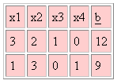
Example:
with x1 = 2.5 and x2 = 2 → slack variables

Slide 31
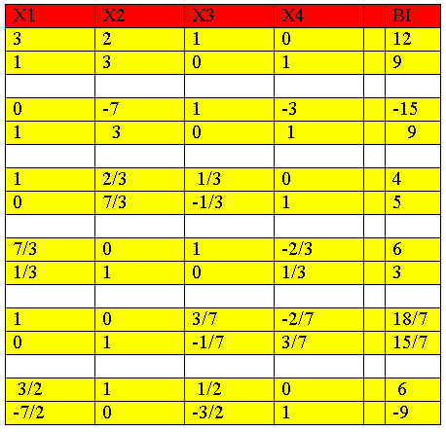
Basic solutions (corners of the convex polyhedron):

Slide 32
acceptable basic solutions :
A: x3 = 12, x4 = 9, x1 = x2 = 0, Z = 0
D: x1 = 4, x4 = 5, x2 = x3 = 0 Z = 4
B: x2 = 3, x3 = 6, x1 = x4 = 0, Z = 6
C: x1=18/7, x2=15/7, x3=x4=0, Z=48/7=6 6/7

Slide 33
A basic solution consists of
the basic variables (in diesem Fall x3 = 12; x4 = 9) and
the non-basic variables (x1 = 0, x2 = 0).
with four variables and two equations, there are six pair combinations altogether. The basic variables of the six basic solutions are as follows:
x1 , x2
x1 , x3
x1 , x4
x2 , x3
x2 , x4
x3 , x4

Slide 34
With the Gauss algorithm, we can ascertain all 6 basic solutions
x1 = 18/7, x2 = 15/7 corner C
x1 = 9, x3 = -15 # zu xj>= 0
x1 = 4, x4 = 5 corner D
x2 = 3 , x3 = 6 corner B
x2 = 6, x4 = -9 # zu xi>= 0
x3 = 12, x4 = 9 corner A
Because of the non-negativity condition, there are 2 unacceptable basic solutions.
6 basic solutions of the equation system
4 acceptable basic solutions
2 unacceptable solutions
4 corners of the solution space M: A, B, C, D.

Slide 35
2.4 The Simplex method
2.4.1 1 Calculating the acceptable basic
solutions (Pivot row criterion)
Avoiding unacceptable basic solutions through ascertainenment of shortage capacity!
selection criterion for Pivot row :
Min{b_{i}/a_{is}}; a_{is}>0
i∈{row indices }
S = Pivot column index

Slide 36
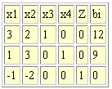
2.4.2 Calculating the optimal basic solution (Pivot column criterion)
3 x1 + 2 x2 + x3 = 12
1 x1 + 3 x2 + x4 = 9
1x1 + 2 x2 = objective function
3 x1 + 2 x2 + x3 = 12
1 x1 + 3 x2 + x4 = 9
1 x1 + 2 x2 - objective function = 0/-1
3x1 + 2x2 + x3 = 12
1x1 + 3x2 + x4 = 9
-1x1 - 2x2 + objective function = 0

Slide 37
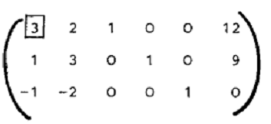
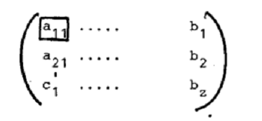
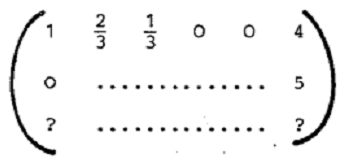
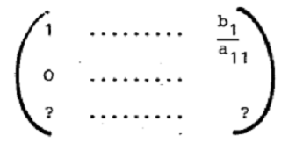
generally
Carrying out the Gauss operations:
- 1st row divided by 3 - 1st row divided by a11
- multilpy modified 1st row by a21 = 1 - multiply modified 1st row by a21
and subtract from 2nd row and subtract from 2nd row

Slide 38
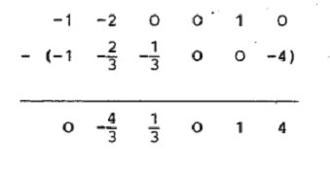
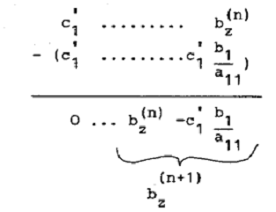
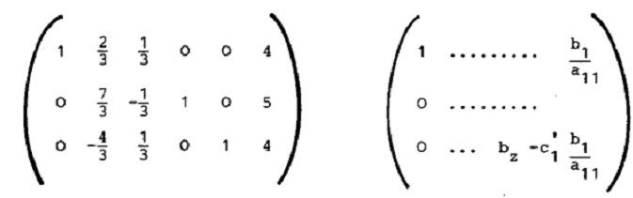
row of objective function (3rd row)
- multiply modified 1st row by c1 = -1 - multiply modified 1st row by c1
and subtract from 3rd row and subtract from 3rd row
3rd row:
resulting matrices:

Slide 39
it applies for row transformations:
b_{z}^{(n+1)} = b_{z}^{(n)} - b_{r}/a_{rs}^{(n)} *c_{s}´^{(n)}
n iteration index
r Pivot row
s Pivot column
b_{z}^{(n+1)} will increase, if c_{s}´< 0

Slide 40
Optimality test:
The value of the objective function can only be increased if a coefficient of the objective function … exists in the matrix depiction.
If cj(n) >= 0 applies (for all j) we have found the optimal solution

Slide 41
Selection criteria for the Pivot column
Min{c_{j}^{(n)}}
j∈{(column indices }
(steepest ascent unit!)

Slide 42
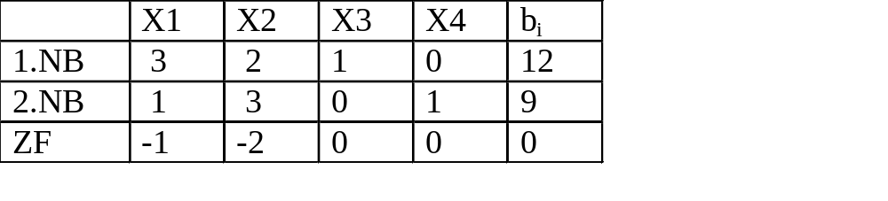
2.4.3 The steps of the Simplex method
The Simplex method is an iterative method (several steps with the same operations)
writing convention: Simplex tableau
pivot row Min{12/2, 9/3} = 3
pivot column
initial tableau

Slide 43
1st step: LP transformation in initial tableau
2nd step: find out whether negative coefficients of objective function exist
YES: carry on with 3rd step
NO: stop, optimal solution found
3rd step: select Pivot column j, min j {column indices}
4th step: select pivot row i, min I {row indices}
5th step: carry out row transformations according to Gauss algorithm; carry on with 2nd step

Slide 44
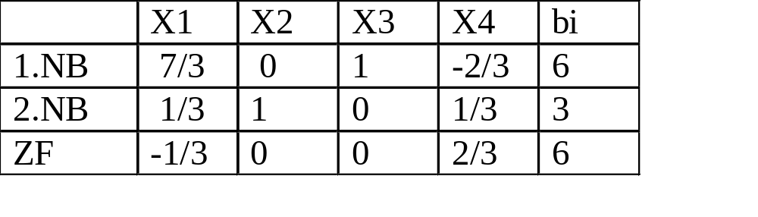
Simplex tableau after 1st iteration
Pivot row
Min{18/7,9}=18/7
Pivot column

Slide 45
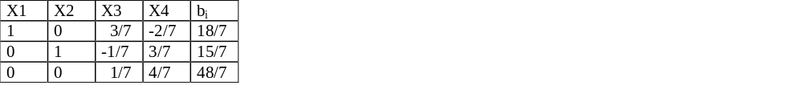
Simplex tableau after 2nd iteration
solution : x1 = 18/7
x2 = 15/7
Z = 48/7
optimal tableau
cj'(n) is equivalent to (z_{j}^{k} - c_{j}) in Meyer/Hansen!

Slide 46
Work scheme "LP"
1) definition of variables (mind dimension!)
2) Definition of subordinate clauses
- type of subordinate clause?
- formulation of (in)equation (plausible?)
- mind non-negativity condition!
3) Definition of objective function
- type of objective function (min/max?, economical)
- formulation of objective function
4) Type of solution
- graphical solution?
- mathematical solution?

Slide 47
5) Initial solution (Simplex tableau)
6) solution method (Simplex algorithm)
7) Optimal solution (optimal tableau)
8) Interpretation of results (plausibility?)

Slide 48
exercise 11 (part 1):
Create the initial tableau for the following LP model, then determine the Pivot element (explanation!)
Z = 3x1 + 5x2 + x3 ---> Max
x1 + 2x2 - 2x3 <= 6
3x1 + 6x2 + 4x3 <= 16
x1 >= 0, x2 >= 0, x3 >= 0
 | X1 | X2 | X3 | 4
1st SC
2nd SC
F

Slide 49
Exercise 12
The following formulation of linear programming has 6 basic solutions. What are they?
Z = 3x1 + 2x2 ---> MAX
3x1 + 2x2 <= 12
x1 + 3x2 <= 9
x1, x2>0

Slide 50
Exercise 13
A farming business specialises in owning cows and young cattle. In the cowsheds of the farm, no more than 70 cows or 300 young cattle can be kept.
To feed one cow, 0.25 ha pasture land are necessary, and 0.10 ha for one young cattle.
The farm has access to 50 ha pasture land altogether.
Owing one cow yields a profit of 400 euro per year, and owning one young cattle yields 50 euro per year.
Formulate an LP formulation to answer the question of how many cows and young cattle the farm needs to own in order to gain maximum profit!

Slide 51
3. Non-standard cases
3.1 Overview
3.1.1 Non-standard cases for variables
3.1.2 Non-standard cases for restrictions
3.1.3 Non-standard cases for objective function

Slide 52
3.1.1 Non-standard cases for variables
sign unrestricted
cure: goal programming
negative integer
cure: decision tree method (see 8.)
0 -1 variables
cure: same as integer, but with additional use of xj <= restrictions

Slide 53
3.1.2 Non-standard cases with restrictions
"=" relation
cure: M-method (see 3.3)
">=" relation
cure: transform into "=" relation with excess variables, then employ M method
only ">=" relations
use of the dual (see 4.)

Slide 54
3.1.3 Non-standard cases with objective function
minimisation instead of maximisation
cure: multiplication by -1
fixed contingents occur
cure: ignore for the time being, after optimisation complete objective function with fixed contingent
non-linear variable in objective function
cure: step by step linearisation as appproxiation (see 3.4)

Slide 55
3.2 Goal programming
If a variable is sign unrestricted, we split it into a positive and a negative part: … with … = 0
the latter will be "automatically" maintained with the Simplex method due to the linearly independent basic vectors.
The positive and negative parts are also called deficit and excess variable.
If we want to minimise the sum of excess and deficit variables, we have the original formulation of "Goal programming": …
x₃⁻ + x₃⁺ + x₄⁻ + x₄⁺ ---> min
3x₁ + 2x₂ + x₃⁻ - x₃⁺ = 12;
1x₁ + 3x₂ + x₄⁻ - x₄⁺ = 9;
x₁, x₂, x₃⁻, x₃⁺, x₄⁻, x₄⁺ >= 0

Slide 56
3.3 M-method
example:
1x₁ + 2x₂ ---> max !
3x₁ + 2x₂ = 12;
1x₁ + 3x₂ ≤ 9; x₁, x₂, ≥ 0
M-method:
1x₁ + 2x₂ - Mx₃ ---> max !
3x₁ + 2x₂ + x₃ = 12;
1x₁ + 3x₂ + x₄ = 9;

Slide 57

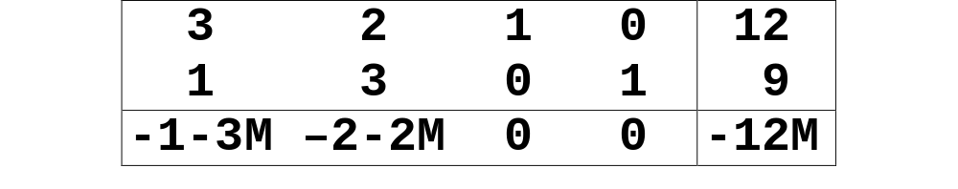
pre-tableau:
initial tableau:
(now with the two essential basic vectors)

Slide 58
3.4 Non-linear programming
method 1 :
For the step by step linearisation of the non-linear objective function, we will - to enable us an approximation - first define aid places. Depending on the number of intervals, we replace the non-linear variable with the sum of the corresponding interval variable. In the objective function, we introduce the gradients for the individual interval variables by differentiating the original function.

Slide 59
f(x2)
3
2
1
1 2 3 4 x2
x21 x22 x23

Slide 60
Example:
  l x_{l} + x₂² ---> min !
  3 x₁ + 2x₂ = 12;
  l x_{l} + 3x₂ ≤ 9; x₁, x₂ ≥ 0
aid places at 1, 2, and 3
splitting up of variable x1 into x21, x22, and x23
f(x₂) = x₂²; f' (x₂) = 2x₂;
The gradient in 0.5 is : f'(O,5) = l;
The gradient in 1.5 is : f'(l,5) = 3;
The gradient in 2.5 is : f'(2,5) = 5;

Slide 61
The approximate LP formulation is then:
  lx_{l} + 1x₂₁ + 3x₂₂ + 5x₂₃ ---> min !
  3x₁ + 2x₂₁ + 2x₂₂ + 2x₂₃ = 12
  lx_{l} + 3x₂₁ + 3x₂₂ + 3x₂₃ ≤ 9
  x₂₁, x₂₂, x₂₃ ≤ 1
  x_{l}, x₂₁, x₂₂, x₂₃ ≥ 0
Also possible would be:
  lx_{l} + 1x₂₁ + 3x₂₂ + 5x₂₃ ---> min !
  3x₁ + 2x₂ = 12
  lx_{l} + 3x₂ ≤ 9
  x₂ = x₂₁ + x₂₂ + x₂₃
  x₂₁, x₂₂, x₂₃ ≤ 1
  x_{l}, x₂₁, x₂₂, x₂₃ ≥ 0

Slide 62
Important note:
This approximation only applies for progressive graphs of a curve and minimisation, or digressive graphs of a curve and maximisation, respectively, in order to ensure that the interval variables will be occupied from the origin.
In all other cases, we attempt approximation using the Goal programming formulation that has been outlined in chapter 3.3: method 2!

Slide 63
Method 2, example :
  lx_{l} + x₂² ---> max !
  3x₁ + 2x₂ = 12
  lx_{l} + 3x₂ ≤ 9; x₁, x₂ ≥ 0
aid places as above: 1, 2, and 3
Including excess variable and deficit variable :
  x₂ + x₃⁻ - x₃⁺ = 1;
  x₂ + x₄⁻ - x₄⁺ = 2;
The new objective function then reads:
  1x₁ + x₂ + 2x₃⁺ + 2x₄⁺ ---> max !
  x₁, x₂, x₃⁻, x₃⁺, x₄⁻, x₄⁺ ≥ 0
Note: x2 applies for all intervals!

Slide 64
f(x2)
3
2
1
gradient 5
gradient 3
gradient 1
1 2 3 4 x2

Slide 65
4. . Duality
4.1 A price problem
The introductory example with the producing firm will not be modelled for the case of outsourcing:
A company rents, based on "machine hours", two production systems, which shall be used to manufacture two products. The rent shall be calculated in such a way that the total manufacturing costs for product 1 are at least 1 profit unit (PU), and for product 2 at least 2 profit units per rent unit (RU) - otherwise the outsourcing party would do it themselves.
The machine capacities to be used are 3h/RU and 1h/RU for P1, and 2h/RU and 3h/RU for P2.
For the production itself, machine M1 is used 12h, M2 9h. Ascertain the rent calculation for 1h of M1 and M2, respectively!

Slide 66
The model :
12 u1 + 9 u2 ---->min!
3 u1 + 1 u2 >= 1;
2 u1 + 3 u2 >= 2; u1 >=0, u2 >=0;

Slide 67
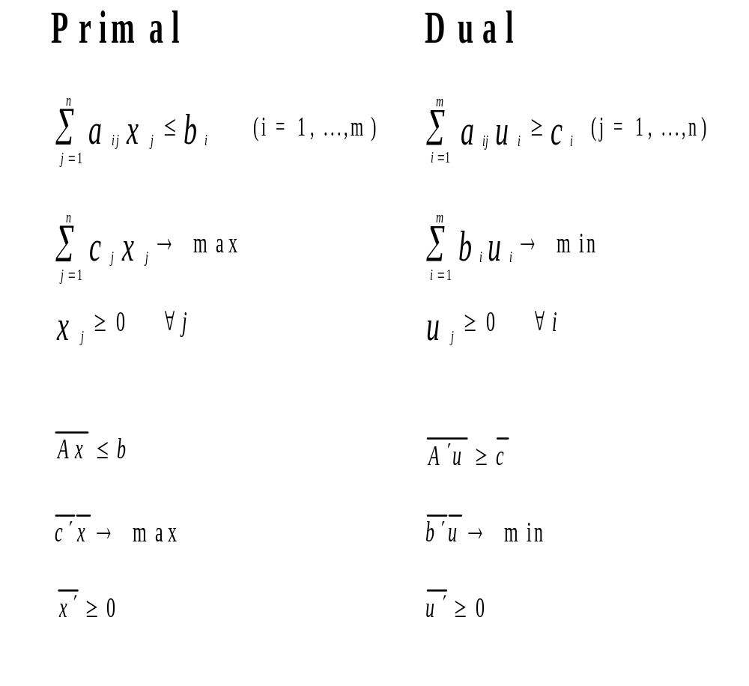
4.2 The duality theorem

Slide 68
4.2 Duality theorem (cont.)
If Primal has optimal solution … ←→ Dual has optimal solution
Conclusion:
FPrimal → oo → Dual does not have an acceptable solution
FPrimal → oo ← Dual does not have an acceptable solution
↓ or
no acceptable solution

Slide 69
Duality theorem (cont.)
optimal tableau
Primal
structure variable … slack variable …
slack variable … structure variable …
Dual
↑
"reduced costs"
It applies: … and … (theorem of the complementary slack)
BVPrimal is allocated to NBVDual, and vice versa!

Slide 70
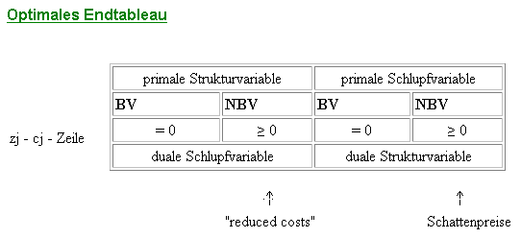
4.2 Duality theorem (cont.)
optimal final tableau
primal structure variable | primal slack variable
BV NBV = 0 >= 0 | BV NBV = 0 >= 0
dual slack variable | dual structure variable
zj - cj - row
↑ ↑
"reduced costs" shadow prices

Slide 71
4.3 Motivation for duality
- Information about the existence of alternative solutions with the same value of the objective function
- reduction of the number of auxiliary variables in the case of ≥, and therefore a more efficient solution of the LP model via the dual
- Information about the "shortage" of restrictions, indication of marginal utility with different values of b-vector.

Slide 72
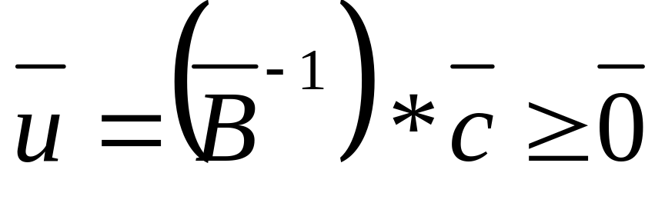
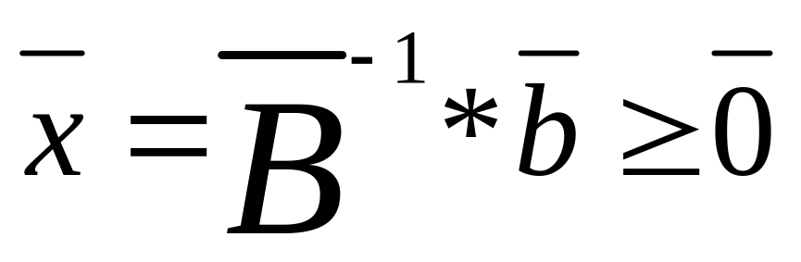
5. Sensitivity analysis
5.1 Difficulties of interpreting dual variables
5.2 Variation of a coefficient of the objective function
Precondition: for the optimum,
all basic variables are identical to structure variables
5.3 Variation of a coefficient of the b-vector

Slide 73

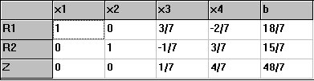
Zu 5.2 Variation of a coefficient of the objective function
Initial tableau:
Optimal solution of the Simplex tableau:
Proof for the optimum:
the values of the F-row ≥ 0

Slide 74
The values of the F-row need to be ≥ 0 for the optimum!!
c1
2
U1 = 3/7(c1)- 1/7(2) >= 0
U2 = -2/7(c1) +3/7(2) >= 0
c1 >= 2/3 und c1 <= 3 !

Slide 75
The values of the F-row need to be ≥ 0 for the optimum!!
1
c2
U1 = 3/7(1)- 1/7(c2) >= 0
U2 = -2/7(1) +3/7(c2) >= 0
c2 <= 3 und c2 >= 2/3 !

Slide 76
5.3 Variation of a coefficient of the b-vector (cont.)
3/7 -2/7 b1
>=0
-1/7 3/7 9
It follows:
b1 >= 6, b1 <= 27

Slide 77
3/7 -2/7 12
>=0
-1/7 3/7 b2
It follows:
b2 >= 4, b2 <= 18

Slide 78
6. Parametric programming
Example
The company Klein & W manufacture two types of mountain bikes (type 1 and 2). The profit contribution of bike type 1 is equivalent to 1 profit unit, that of bike type 2 is 2 profit units.
The wage costs, which are included here, per profit unit for type 1 are five times higher than for type 2.
A pay rise of y % reduces the profit contribution of type 2 by y/100, and that of type 1 by 5y/100.
Manager Klein wants to his production program to remain unchanged, and therefore needs to know how much the due pay rise can be, and what consequences that implies.

Slide 79
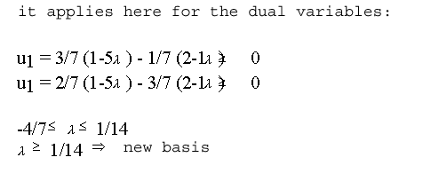
Data constellation depending on one parameter:
Example : c₁* = 5
c₂* = 1

Slide 80
Initial tableau
Optimal solution of Simplex tableau
proof for the optimum:
the values of the objective function row are ≥ 0

Slide 81
the values of the objective function row are ≥ 0
DB
1-5 λ
2-1 λ
U1 = 3/7(1-5 λ) - 1/7(2-1 λ) >= 0
U1 = 2/7(1-5 λ) - 3/7(2-1 λ) >= 0
it follows:
λ<= 1/14 und λ>=-4/7

Slide 82

What will happen, if the pay rise is within the ascertained limit?
Test with 7%:
Z: (1- 7%*5GE)x1 + (2 - 7%*1GE)x2 => Z: 0,65x1 + 1,93x2
Initial tableau

Slide 83

Solution:
The basis has not changed with an increase in wage costs of 7%.

Slide 84

Mr. Klein now also wants to know what will happen if the upper limit maximal pay rise 1/14 = 7,14% is exceeded ?
Test with an increase in wage costs of 8% per quantity unit
Z: (1- 8%*5GE)x1 + (2 - 8%*1GE)x2
=> Z: 0,6x1 + 1,92x2
Initial tableau

Slide 85

Here, the optimal solution (basic solution) has x3 (which so far has been the slack variable for the first restriction) as basic variable. x1 has become the non-basic variable1
Solution :

Slide 86
As Mr. Klein clearly notices, the basic solution has changed. Although acceptability is still guaranteed, the manager is not satisfied with the result.
With this solution, it is advisable to reconsider the production. One option would be to produce product 1 in another country, where it might be cheaper.

Slide 87
Produkt X2
7
6
5
4
3
2
1
subordinate clause I straight line I
B
- 4/7 ≤ λ ≤ 1/14
C
subordinate clause II straight line II
D
A
Product X1
1 2 3 4 5 6 7 8

Slide 88
Produkt X2
7
6
5
4
3
2
1
subordinate clause I straight line I
B
- 4/7 ≤ λ ≤ 1/14
C
subordinate clause II straight line II
D
A
Produkt X1
1 2 3 4 5 6 7 8
-oo ≤ λ ≤ -4/7

Slide 89
Produkt X2
7
6
5
4
3
2
1
subordinate clause I straight line I
B
- 4/7 ≤ λ ≤ 1/14
C
subordinate clause II straight line II
1/14 ≤ λ ≤ 2
D
A
Produkt X1
1 2 3 4 5 6 7 8
-oo ≤ λ ≤ -4/7

Slide 90
Produkt X2
7
6
5
4
3
2
1
subordinate clause I straight line I
B
- 4/7 ≤ λ ≤ 1/14
C
subordinate clause II straight line II
1/14 ≤ λ ≤ 2
D
A
Produkt X1
λ ≥ 2
1 2 3 4 5 6 7 8
-oo ≤ λ ≤ -4/7

Slide 91
7. Transport models, allocation models,
and transfer problems
7.1 The transport problem
7.2 The transfer problem
7.3 The allocation problem

Slide 92
7.1 The transport problem
b1 = 40
b2 = 60
1
2
4
5
2
7
3
8
1
2
3
d1 = 20
d2 = 30
d3 = 50

Slide 93
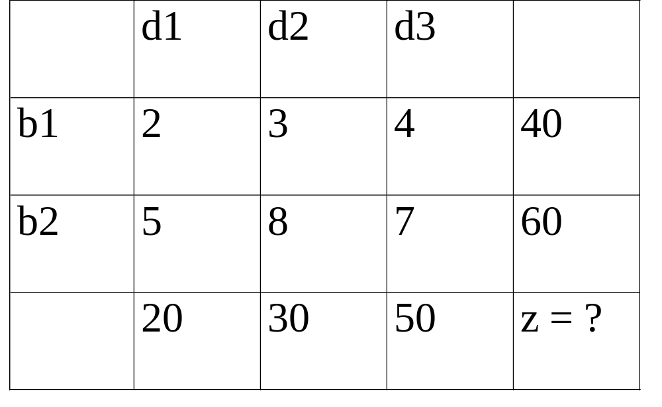
7.1 The transport problem
Variables with double indices permit a two-dimensional depiction of the problem (transport cost tableau) :

Slide 94
7.1 The transport problem
step 1: the initial tableau after NW corner method
(BV ≠ 0)

Slide 95
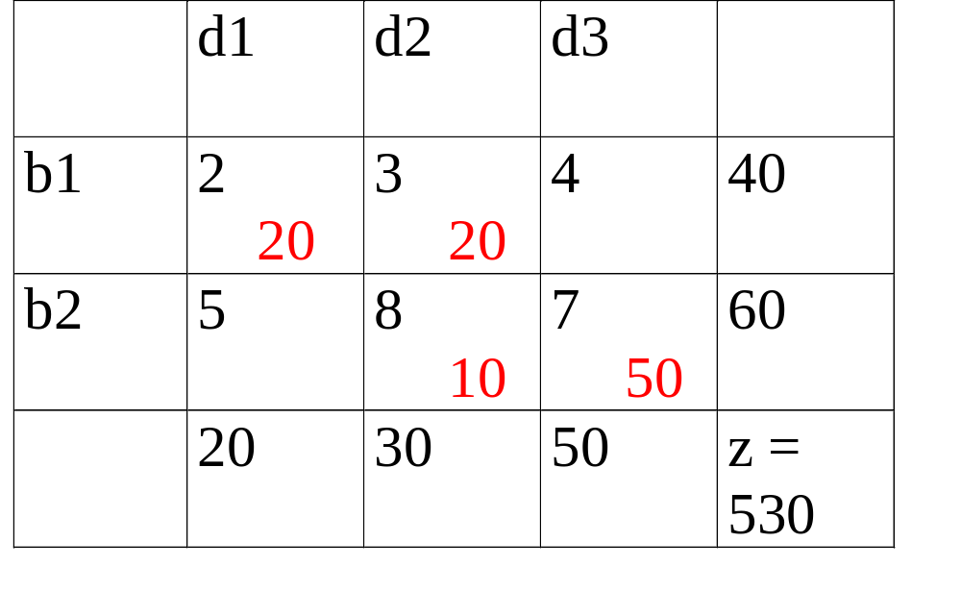
The initial tableau after NW corner method has been carried out:
Transport tableau:

Slide 96
The transport algorithm
step 1: initial solution with NW corner method (BV ≠ 0)
step 2: 'stepping stone method':
calculate the costs of redistribution kij for positions that are not occupied (NBV)

Slide 97
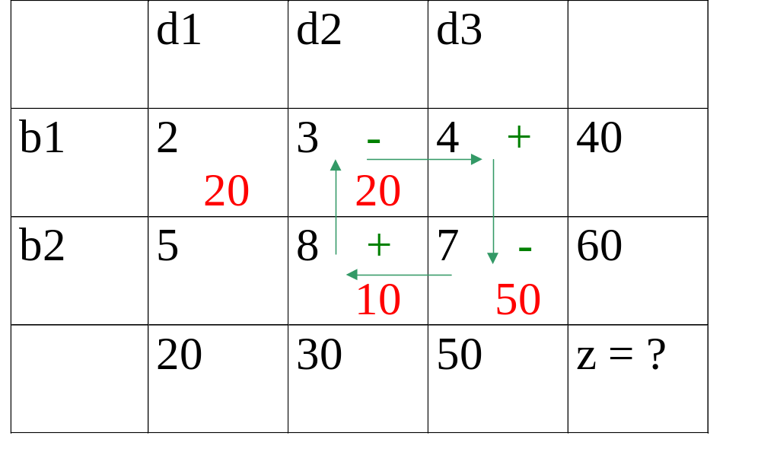
redistribution costs kij
Transport tableau

Slide 98
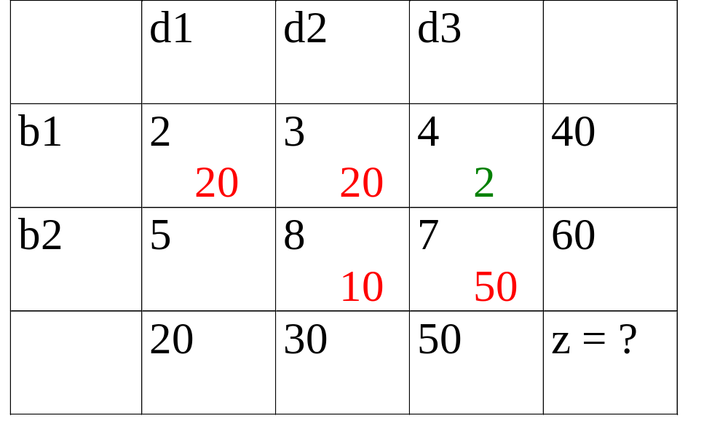
redistribution costs kij
Transport tableau

Slide 99
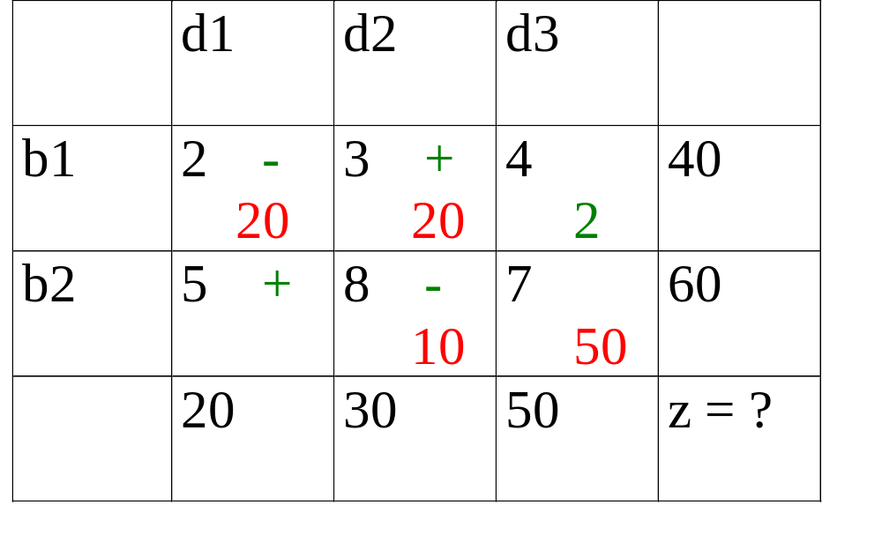
redistribution costs kij
Transport tableau

Slide 100
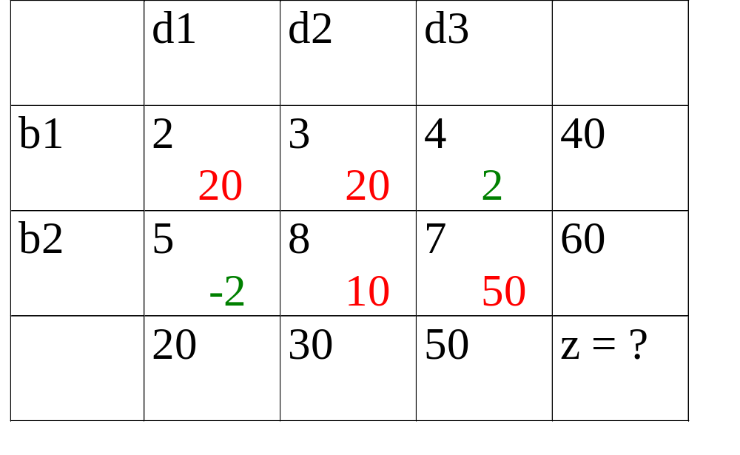
redistribution costs kij
Transport tableau

Slide 101
The transport problem :
step 1: initial solution with NW corner method
(BV ≠ 0)
step 2: stepping stone method calculate redistribution costs for positions that are not occupied
step 3:+k_{ij} ≥ 0 ⇒ optimal solution. Stop!
+k_{ij} < 0 ⇒ step 4
step 4: In the position found, program as many units as the lowest amount whose cost factor with neg. sign has been included into +k_{ij} go to step 2, if Σ a_{i} ≠ Σ b_{j} ⇒ → fictive i' or j', respectively j`

Slide 102
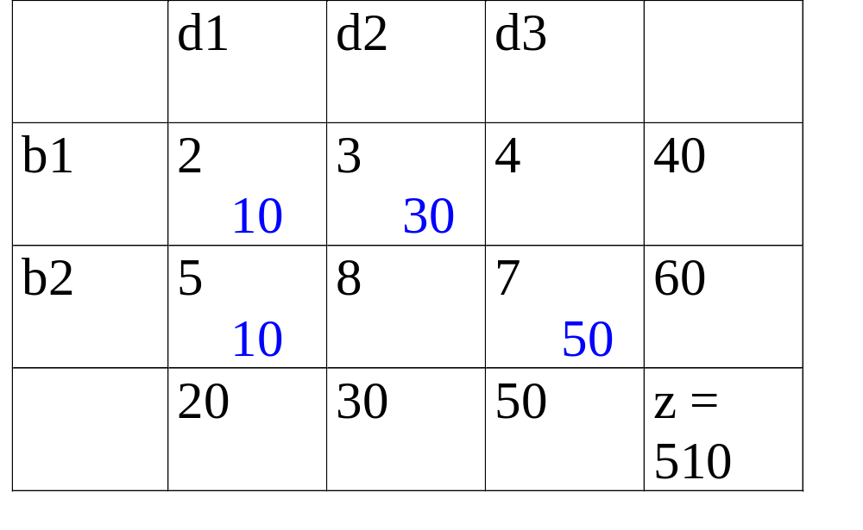
redistribution costs kij
Transport tableau

Slide 103
redistribution costs kij
Transport tableau

Slide 104
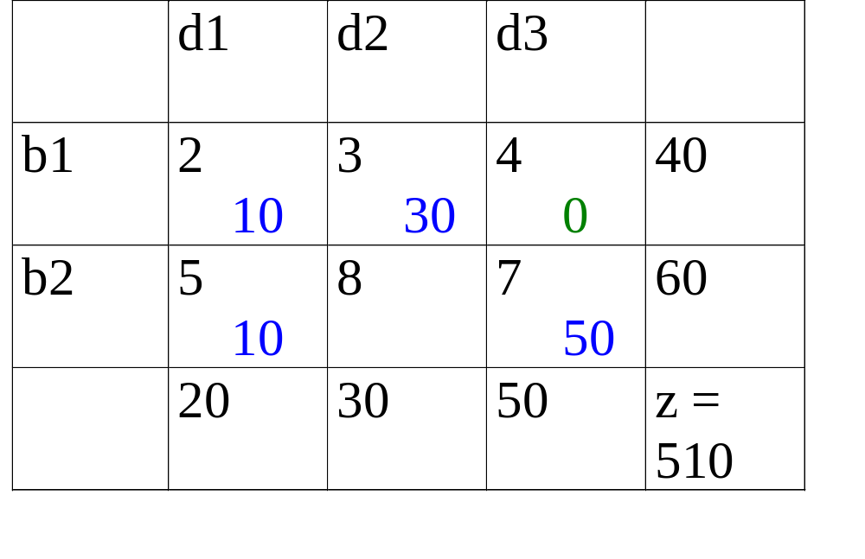
redistribution costs kij
Transport tableau

Slide 105
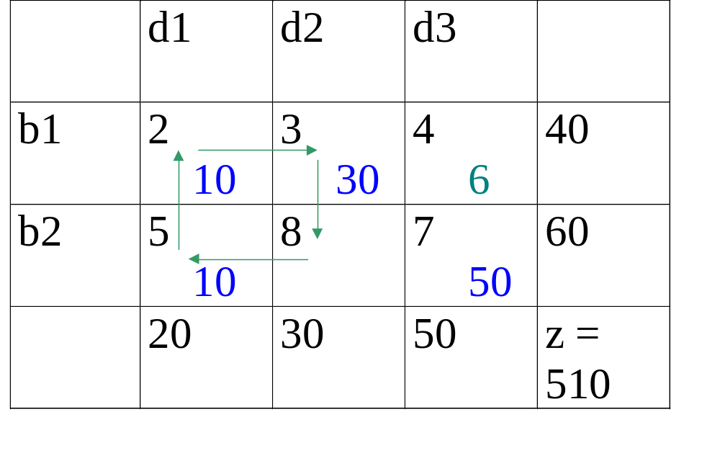
redistribution costs kij
Transport tableau

Slide 106
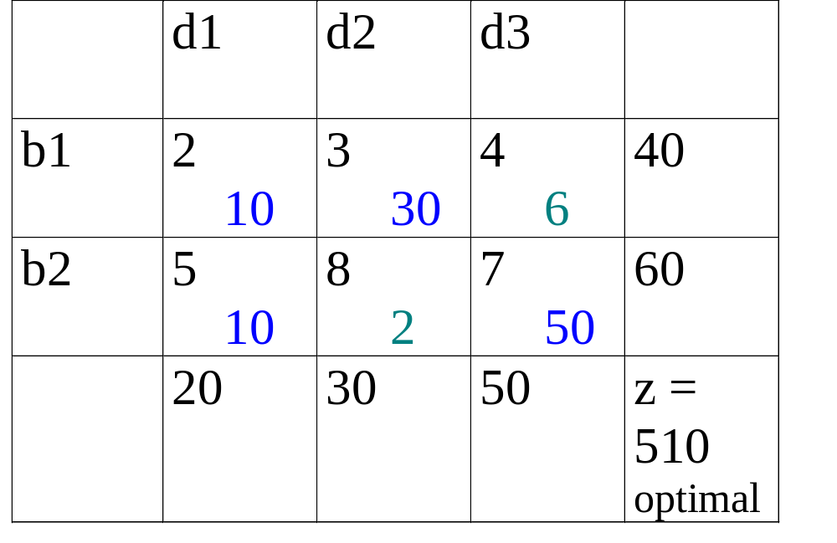
redistribution costs kij
Transport tableau

Slide 107
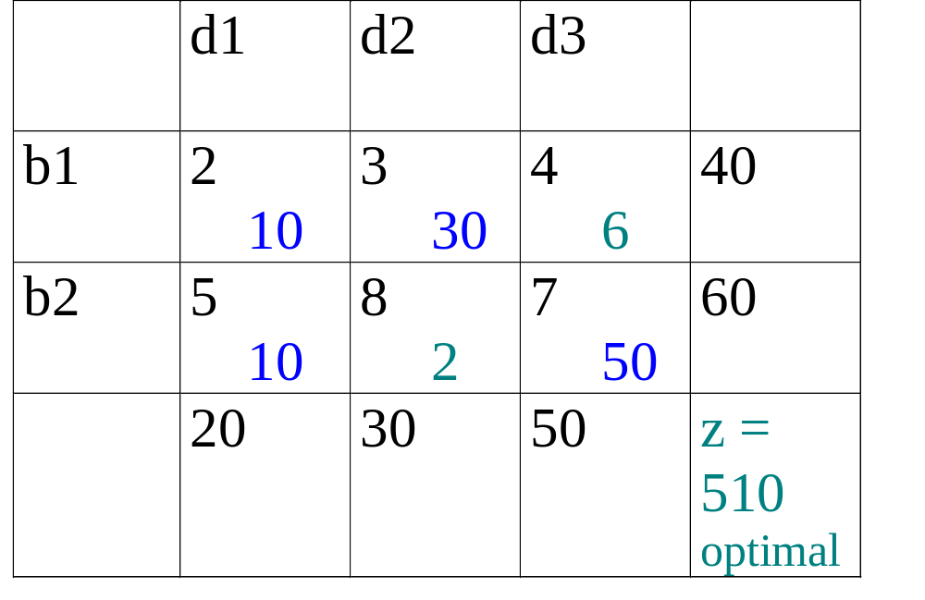
redistribution costs kij
Transport tableau

Slide 108
The optimal solution
b1 = 40
b2 = 60
1
2
4
5
2
7
3
8
30
10
50
10
1
2
3
d1 = 20
d2 = 30
d3 = 50

Slide 109
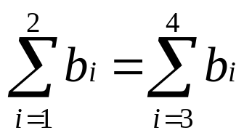
7.2 The transfer problem
b₃
t_{i} = quantities that are
transferred at place I
Transfer costs: c_{i,i}
precond.
3
1
4
b₄
b₁
2
b₂

Slide 110
Edges into knots i edges out of knots i x21+x31+x41=t1; knot 1 x12+x13+x14=b1+t1; x12+x32+x42=t2; knot 2 x21+x23+x24=b2+t2; x13+x23+x43=b3+t3; knot 3 x31+x32+x34=t3; x14+x24+x34=b4+t4; knot 4 x41+x42+x43=t4;
ZF: Sum cij * xij + Sum cii * ti ----->min! xij >=0 for all i,j i,j i,j
(with i=j!) (with i=j!)
-t1+x21+x31+x41=0; knot 1 -t1+x12+x13+x14=b1; x12-t2 x32+x42=0; knot 2 x21- t2 +x23+x24=b2; x13+x23-t3+x43=b3; knot 3 x31+x32-t3+x34=0; x14+x24+x34-t4 =b4; knot 4 x41+x42+x43-t4=0;

Slide 111
Because of the special structure, the formulation can be turned into the form of a transport model (a quicker solution may be possible by employing transport problem algorithms!)!
In order to get positive signs, the complement is done to a high figure
T (> max bi!): xii=T-ti;----> -ti= xii-T; x11+x21+x31+x41=T; knot 1 x11+x12+x13+x14=T+b1; x12+x22+x32+x42=T; knot 2 x21+x22+x23+x24=T+b2; x13+x23+x33+x43=T+b3; knot 3 x31+x32+x33+x34=T; x14+x24+x34+x44=T+b4; knot 4 x41+x42+x43+x44=T;
ZF: Sum cij * xij + Sum T - Sum cii * xii----->min! xij, ti >=0 for all i,j i,j i,j i,j
(with i=j!) (with i=j!) (with i=j!)

Slide 112
x11+x21+x31+x41=T; knot 1 x11+x12+x13+x14=T+b1; x12+x22+x32+x42=T; knot 2 x21+x22+x23+x24=T+b2; x13+x23+x33+x43=T+b3; knot 3 x31+x32+x33+x34=T; x14+x24+x34+x44=T+b4; knot 4 x41+x42+x43+x44=T;
ZF: Sum cij * xij + Sum T - Sum cii * xii----->min! xij, ti >=0 für alle i,j i,j i,j i,j
(with i=j!) (with i=j!) (with i=j!)

Slide 113
x11+x21+x31+x41=T; knot 1 x11+x12+x13+x14=T+b1; x12+x22+x32+x42=T; knot 2 x21+x22+x23+x24=T+b2; x13+x23+x33+x43=T+b3; knot 3 x31+x32+x33+x34=T; x14+x24+x34+x44=T+b4; knot 4 x41+x42+x43+x44=T;
ZF: Sum cij * xij ----->min! xij>=0 for all i,j i,j
(for i=j-->cij= - cii!)

Slide 114
Example:
Transport model with transfer knots
exam: winter term 89/90, task 4
setting of the task:
Ascertain the correspo0nding LP model to the transport network depicted below. Places 1 and 5 are origins with delivery amounts a₁ = 7 and a₅ = 3.
The destinations 2, 6 and 8 have the demands/needs b₂ = 4, b₆ = 4 and b₈ = 2. The transfer costs cij result in 2 in all points cii.

Slide 115
b8=2
b2=4
2
8
4
1
7
6
a1=7
5
3
b6=4
a5=3

Slide 116
Example (cont.)
Restrictions:
out of knots I: into knots I:
x12+x13+x14 =7;
x23+x25+x26 =x22; x12 =4+x22;
x34+x35+x36 =x33; x13+x23 =x33;
x47 =x44; x14+x34 =x44;
x56+x57+x58 =3+x55; x25+x35 =x55;
x67 =x66; x26+x36+x56 =4+x66;
x78 =x77; x47+x57+x67 =x77;
x58+x78 =2;
ZF: Sum cij * xij ----> min!

Slide 117
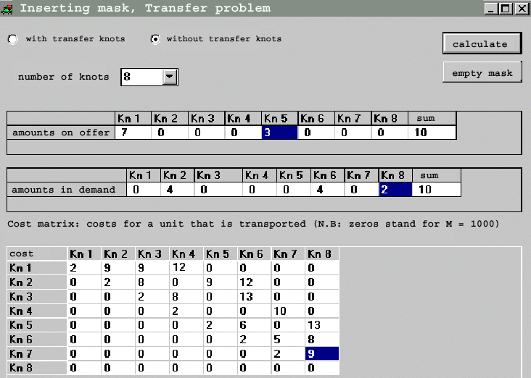
Example (cont.)

Slide 118
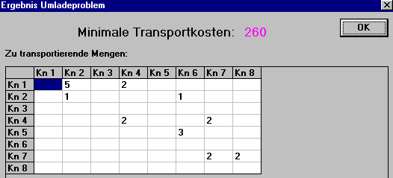
Beispiel (Fortsetzung)
result transfer problem
minimal transport costs:
4
1+3=4
2
Origin 1 delivers 5 goods to demand place 2; here, one is transferred and delivered to
demand place 6. Demand of place 2 has been met. The still required 3 goods for
demand place 6 come directly from origin 5.
2 goods are forwarded from origin 1 via transfer place
7. Now demand of place 8 has also been met.

Slide 119
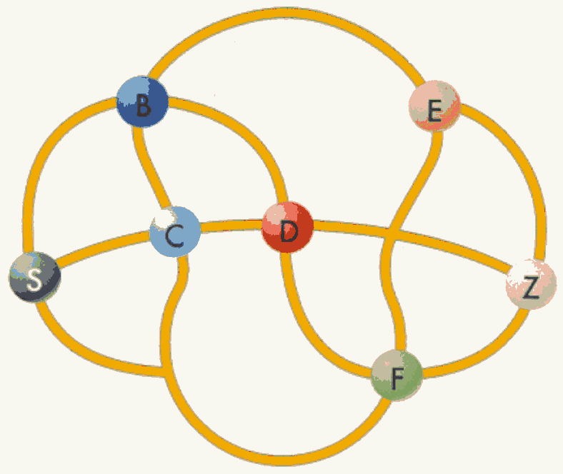
Digression
Which route is the shortest if all places shall be visited?
Soon there may be an efficient solution for the Travelling Salesman problem.
Exkurs:

Slide 120
The group of NP problems also includes, for instance, the known Travelling Salesman problem:
A travelling salesman wants to consecutively travel to a certain number of places, which are at various distances from each other, without having to visit the same place twice. In which order does he have to visit the places in order to minimise his travelling distance?
The fact that for such problems, an efficient algorithm never existed (and many believed such an algorithm could not exist at all) inspired many programmers and researchers to develop new techniques. Often, clever approximation methods were used, i.e. they did without finding the best way through the places, and only looked for a very good way. Even the quantum computers that are currently being developed will have their capacity tested with this task.
Should it be the case that there is a direct approach to the solution of these problems, future research could take on a completely different direction. However, a long time may pass before we can reach this stage. Two months after the algorithm was published, there has neither been confirmation nor refutation from an independent party (from c't 22/2000).

Slide 121
7.3 The allocation problem
K1
K2
K3
K4
1
weighted graph
1
2
2
2
1
2
Kh 1
Kh 2
Kh 3
b_{i} 2 1 1

Slide 122
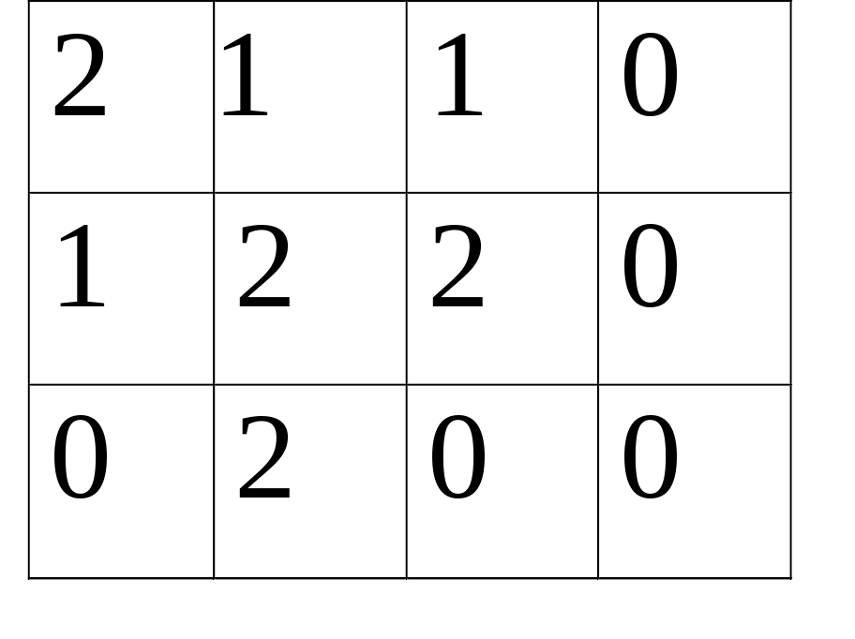
K1 K2 K3 K4
Kh1
Kh 2
Kh 3
c_{ij} - Matrix

Slide 123
given: c_{ij}, b_{i}
transport model:
ZF Σ c_{ij} x_{ij} --> max
i,j
J
Σ x_{ij} ≤ b_{i} capacity rows
j=1
I
Σ x_{ij} = 1 individual rows
i=1

Slide 124
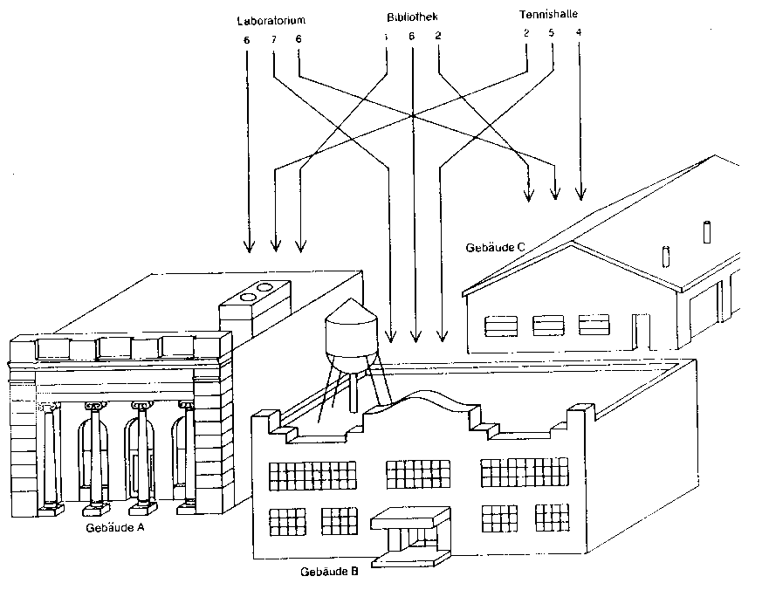
Laboratory
Library
Indoor tennis court
Building C
Building A
Building B

Slide 125
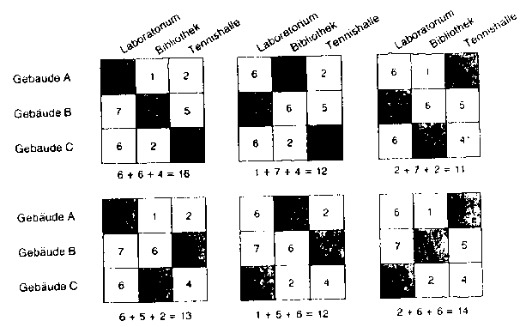
Laboratory
Library
Indoor tennis court
Laboratory
Library
Indoor tennis court
Laboratory
Library
Indoor tennis court
Building A
Building B
Building C
Building A
Building B
Building C

Slide 126
8. Decision tree method
(decision tree after Dakin)
x₁ = 18/7
x₂ = 15/7
Z = 6 6/7
Inclusion of boundary restrictions
x₁ ≤ 2
x₁ ≥ 3
x₁ = 2
x₂ = 2,3
Z = 6,6
x₁ = 3
x₂ = 3/2
Z = 6
x₂ ≤ 2
x₂ ≥ 3
x₁ = 2
x₂ = 2
Z = 6
x₁ = 0
x₂ = 3
Z = 6

Slide 127
9. Software
OR-software at the FH Constance
methods bank
solver
example of commercial software:
LP 5000 LP 5000
see VisualOR
Further examples at http://www.fh-augsburg.de/informatik/projekte/emiel/or_verf.html

Slide 128
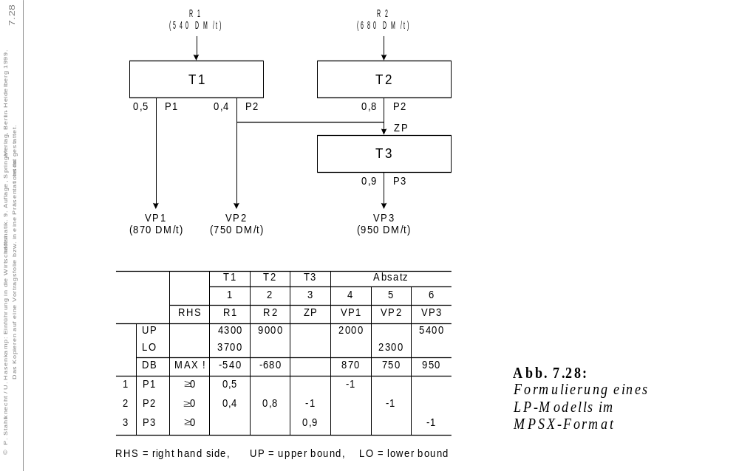
sales
Formulation of an LP
model in MPSX format

Slide 129
M.W. page
http://www.netcologne.de/~nc-weidenma/readme.htm
Hans Mittelmann
http://plato.la.asu.edu/guide.html
collection of LP problems ftp://ftp.netlib.org/lp/data/index.html
http://www.caam.rice.edu/~bixby/miplib/miplib.html
other information to LP
http://www-fp.mcs.anl.gov/otc/Guide/SoftwareGuide/
FAQ for LP problems
http://www-unix.mcs.anl.gov/otc/Guide/faq/linear-programming-faq.html

Slide 130
My experiences with LP (from M.W., in an email to the FH Constance).
I am amazed that I have been included in the curriculum of the FH. For a hobby programmer (I have a degree in chemistry), this is certainly high praise.
The LP solver came about as an experiment in order to understand linear optimisation. I had to deal with LP (production planning) in my job, and just wanted to know how this all works. I started with the tableau, a s presumably every beginner does, and only tried to avoid inevitable calculation errors with bigger models (3-5 variables). I quickly came up against the limitations of the computer I then used (286). Calculation time goes along with about the third power of the matrix size.
Furthermore, we quickly encountered numerical problems. The matrices are usually sparsely occupied
in LP, though they quickly fill up, and from there on, bigger problems (more than 40x40) quickly proved to be the end numerically (division by zero or very small Pivot element).

Slide 131
A colleague of mine, who taught LP (he was a mathematician), gave me some advice as to how other programmers got round the numerical problem, and gave me some literary references. Then I began to play with the revised Simplex method. That helps with calculation time (a column only needs to be calculated once you know that it has a negative DJ), but not with the stability of the matrices. That was only helped when he told me about the Markowitz algorithm.
It is based on the fact that you can arrange a sparse matrix in such a way that almost its elements ≠ 0 lie beneath the diagonal, and only a small corner sticks pout at the top. Resorting the problem in this way (interchange of rows and columns) also keeps the inverse matrix sparse, or does not fill it up so quickly, respectively. The biggest leap in speed was achieved when we used as many pointers as possible for the resorting. That way, you only need to turn over/transform the pointers, but not the entire matrix.
.

Slide 132
Finally, I reached about 10% of the power of the only commercial optimiser I knew of (XPRESS-MP from Dash; I have used the solver in my job).
Then another colleague told me about mixed integer problems (MIP). This is when I really started to be creative. I have become fairly good with this sort of problem, sometimes a lot better than the commercial solvers. With a solver, its power is mainly based on it learning how to approach each problem.
Half the battle with MIP is to select the right variables for Branch and Bound, and then essentially to branch out in the right direction ...

Slide 133
10. Applications: The offcut problem
10.1 The one-dimensional offcut problem
10.2 The two-dimensional offcut problem
see exercise 6, part 1

Slide 134
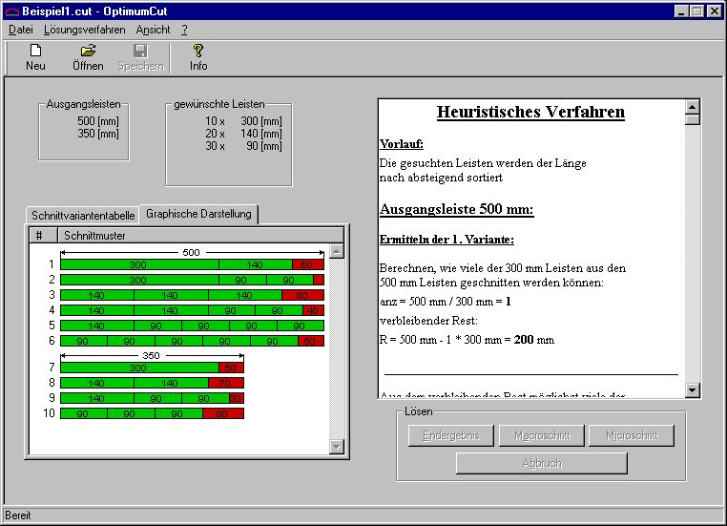
Example 11
File solution method view
new open save info
originalstrips
wanted strips
Heuristic method:
Process:
the strips needed are sorted, in declining
order, according to their lengths.
Original length: 50 mm
Ascertainment of 1st variant:
calculate how many of the 300 mm
strips can be cut out of the 500-mm strip
table of cut variants
graphical depiction
pattern
Remainder
http://www.fh-augsburg.de/informatik/projekte/emiel/or_verf.html

Slide 135
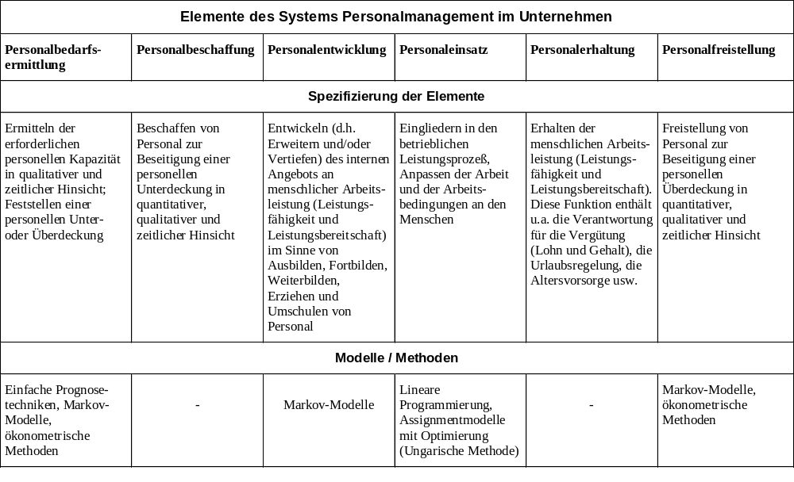
11. Case study personnel planning

Slide 136
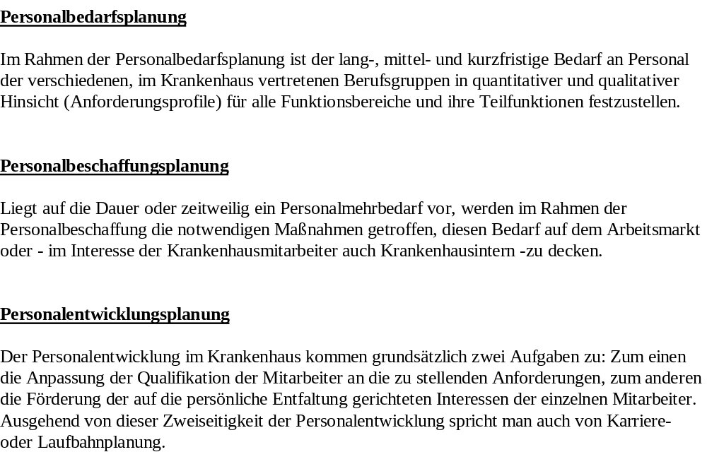

Slide 137
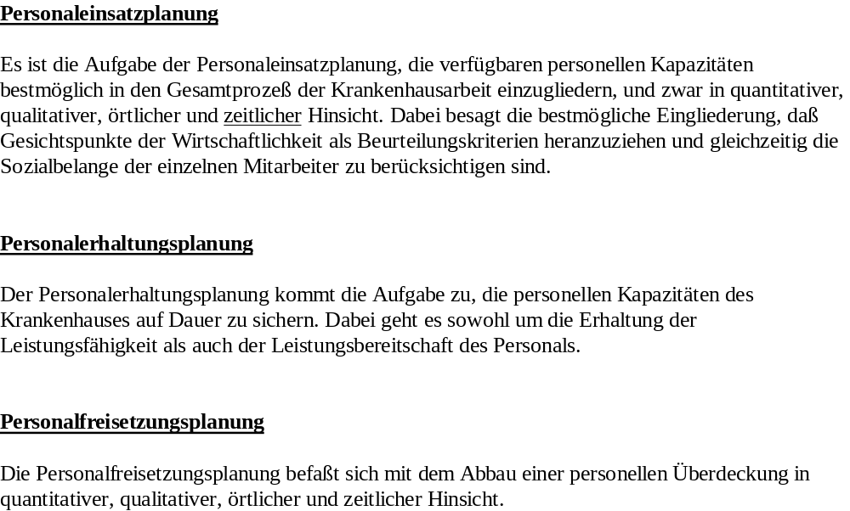

Slide 138
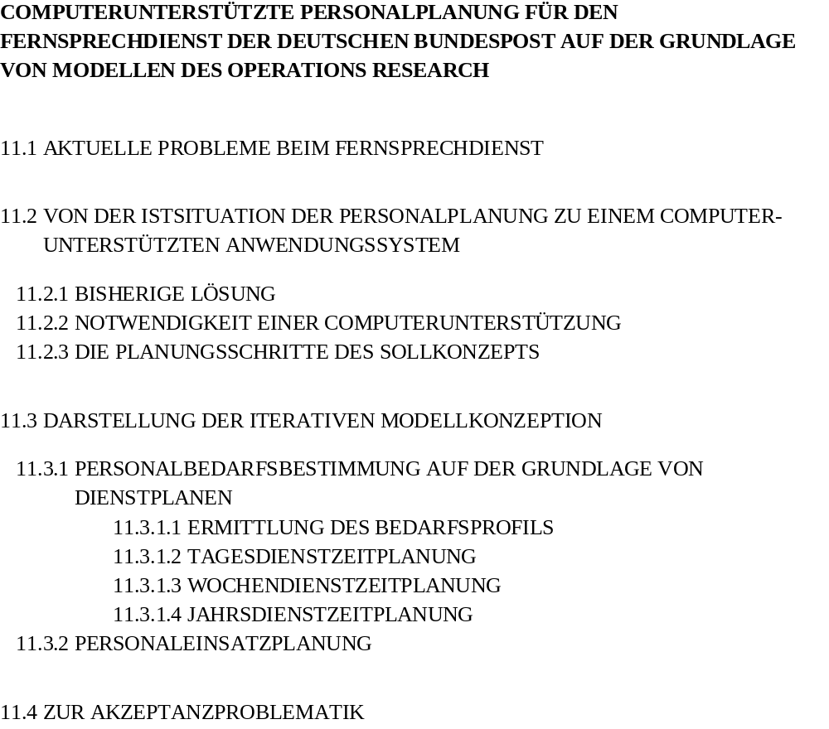

Slide 139
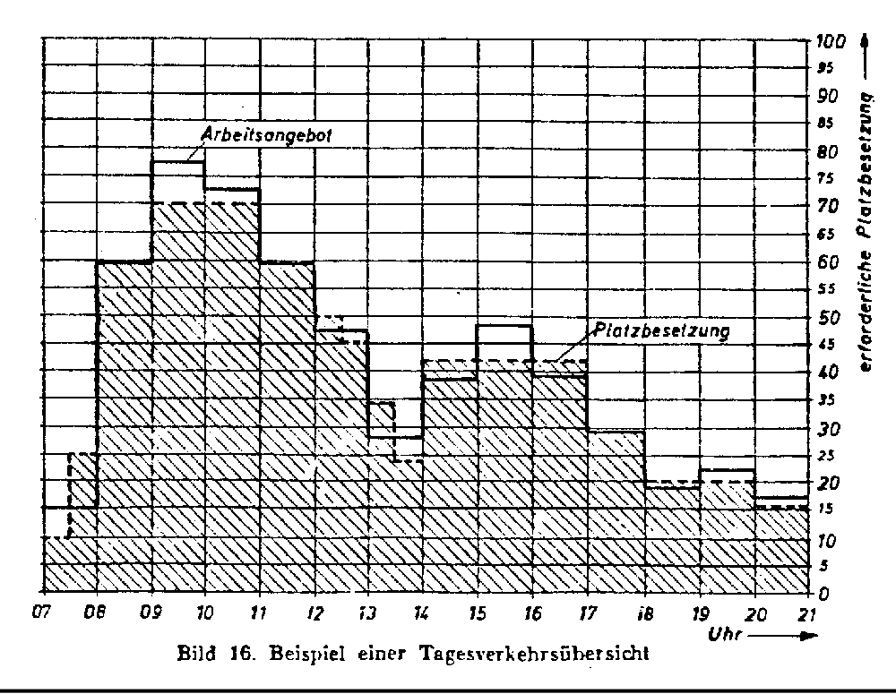
available jobs
positions filled
time
Example of a daily traffic/planning survey
positions filled

Slide 140
sporadic capture of amount of traffic
|
record daily traffic survey
|
planning of duty rota
|
ascertainment of staff requirements
|
|
planning of staff employment
long
short

Slide 141
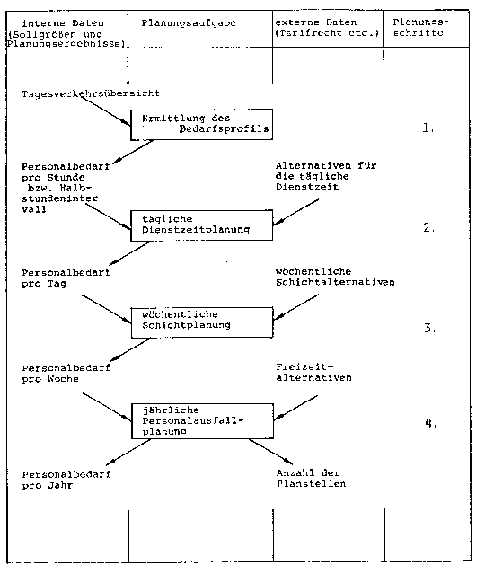
The planning steps of the target concept (look script kap 11)

Slide 142
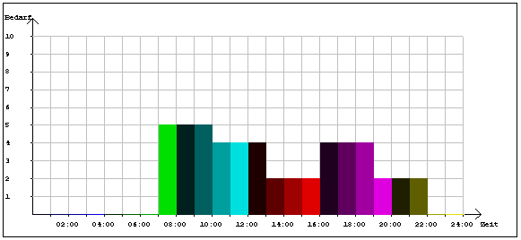
11.3.1.2 Planning of day time working hours
demand
time

Slide 143

Ein Modell des Operations Research:
Planung mit der Linearen Programmierung
ZF x_{j} --> Min !
NB A_{ij}x_{j} ≥ B_{i}
i ∈ (Zeitintervalle)
j ∈ (Schichtalternativen₎
B_{i} Personalbedarf pro Zeitintervall i
x_{j} Anzahl vom Schichttyp j
A_{ij} = 0, wenn Zeitintervall i bei Schichttyp j nicht
als Arbeitszeit vorgesehen ist
A_{ij} = 1, wenn Zeitintervall i bei Schichttyp j
als Arbeitszeit vorgesehen ist
NNB x_{j} ≥ 0, ganzzahlig

Slide 144
Beispiel I: 2 Schichtalternativen 7⁰⁰-19⁰⁰
10⁰⁰-22⁰⁰ (Pausen vernachlässigt)
ZF x₁+x₂ --> Min !
NB 1x₁ ≥ 5 ( 7⁰⁰-10⁰⁰)
1x₁+1x₂ ≥ 4 (10⁰⁰-13⁰⁰)
1x₁+1x₂ ≥ 2 (13⁰⁰-16⁰⁰)
1x₁+1x₂ ≥ 4 (16⁰⁰-19⁰⁰)
1x₂ ≥ 2 (19⁰⁰-22⁰⁰)
NNB x₁,x₂ ≥ 0, ganzzahlig
Lösung: (hier natürlich ganzzahlig)
x₁ = 5, x₂ = 2
Schichtanzahl: 7
Dienstbedarf: 51 Stunden
Geplante Arbeitszeit: 84 Stunden

Slide 145
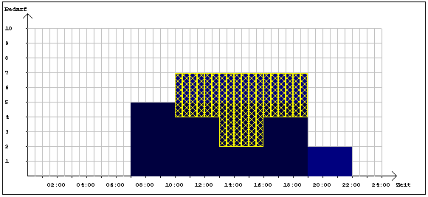
demand
time

Slide 146

Schichtalternativen von Beispiel II

Slide 147
ZF 1,3 1,2 1,1 1 1 1 1 1 1 1 1 1 1 1 1
column 1 2 3 4 5 6 7 8 9 10. . . . 5 . . . . 20. . . . 5 . . . . 30. . . . 5 . . . . 40. .
time row
5.00- 5.30 1 1 1 1 >=1;
5.30- 6.00 2 1 1 1 >=1;
6.00- 6.30 3 1 >=2;
6.30- 7.00 4 1 1 >=2;
7.00- 7.30 5 1 1 1 >=5;
7.30- 8.00 6 1 1 1 >=5;
8.00- 8.30 7 1 1 1 1 >=5;
8.30- 9.00 8 1 1 1 1 >=5;
9.00- 9.30 9 1 1 1 1 1 >=5;
9.30-10.00 10 1 1 1 1 1 >=5;
10.00-10.30 11 1 1 1 1 1 1 >=4;
10.30-11.00 12 1 1 1 1 1 1 >=4;
11.00-11.30 13 1 1 1 1 1 1 1 >=4;
11.30-12.00 14 1 1 1 1 1 1 1 >=4;
12.00-12.30 15 1 1 1 1 1 1 1 1 >=4;
12.30-13.00 16 1 1 1 1 1 1 1 1 1 >=4;
13.00-13.30 17 1 1 1 1 1 1 1 1 1 >=2;
13.30-14.00 18 1 1 1 1 1 1 1 1 >=2;
14.00-14.30 19 1 1 1 1 1 1 1 1 >=2;
14.30-15.00 20 1 1 1 1 1 1 1 1 >=2;
15.00-15.30 21 1 1 1 1 1 1 1 1 >=2;
15.30-16.00 22 1 1 1 1 1 1 1 1 >=2;
16.00-16.30 23 1 1 1 1 1 1 1 >=4;
16.30-17.00 24 1 1 1 1 1 1 1 >=4;
17.00-17.30 25 1 1 1 1 1 1 >=4;
17.30-18.00 26 1 1 1 1 1 1 >=4;
18.00-18.30 27 1 1 1 1 1 >=4;
18.30-19-00 28 1 1 1 1 1 >=4;
19.00-19.30 29 1 1 1 1 >=2;
19.30-20.00 30 1 1 1 >=2;
20.00-20.30 31 1 1 1 >=2;
20.30-21.00 32 1 1 1 >=2;
21.00-21.30 33 1 1 1 >=2;
21.30-22.00 34 1 1 1 >=2;

Slide 148
ZF 1,3 1,2 1,1 1 1 1 1 1 1 1 1 1 1 1 1
column 1 2 3 4 5 6 7 8 9 10. . . . 5 . . . . 20. . . . 5 . . . . 30. . . . 5 . . . . 40. .
time row
5.00- 5.30 1 1 1 1 >=1;
5.30- 6.00 2 1 1 1 >=1;
6.00- 6.30 3 1 >=2;
6.30- 7.00 4 1 1 >=2;
7.00- 7.30 5 1 1 1 >=5;
7.30- 8.00 6 1 1 1 -1 >=5;
8.00- 8.30 7 1 1 1 1 -1 >=5;
8.30- 9.00 8 1 1 1 1 -1 >=5;
9.00- 9.30 9 1 1 1 1 1 -1 >=5;
9.30-10.00 10 1 1 1 1 1 -1 >=5;
10.00-10.30 11 1 1 1 1 1 1 -1 >=4;
10.30-11.00 12 1 1 1 1 1 1 -1 >=4;
11.00-11.30 13 1 1 1 1 1 1 1 -1 >=4;
11.30-12.00 14 1 1 1 1 1 1 1 -1 >=4;
12.00-12.30 15 1 1 1 1 1 1 1 1 -1 >=4;
12.30-13.00 16 1 1 1 1 1 1 1 1 1 -1 >=4;
13.00-13.30 17 1 1 1 1 1 1 1 1 1 -1 >=2;
13.30-14.00 18 1 1 1 1 1 1 1 1 -1 >=2;
14.00-14.30 19 1 1 1 1 1 1 1 1 -1 >=2;
14.30-15.00 20 1 1 1 1 1 1 1 1 -1 >=2;
15.00-15.30 21 1 1 1 1 1 1 1 1 -1 >=2;
15.30-16.00 22 1 1 1 1 1 1 1 1 -1 >=2;
16.00-16.30 23 1 1 1 1 1 1 1 -1 >=4;
16.30-17.00 24 1 1 1 1 1 1 1 -1 >=4;
17.00-17.30 25 1 1 1 1 1 1 -1 >=4;
17.30-18.00 26 1 1 1 1 1 1 -1 >=4;
18.00-18.30 27 1 1 1 1 1 -1 >=4;
18.30-19-00 28 1 1 1 1 1 -1 >=4;
19.00-19.30 29 1 1 1 1 >=2;
19.30-20.00 30 1 1 1 >=2;
20.00-20.30 31 1 1 1 >=2;
20.30-21.00 32 1 1 1 >=2;
21.00-21.30 33 1 1 1 >=2;
21.30-22.00 34 1 1 1 >=2;

Slide 149
ZF 1,3 1,2 1,1 1 1 1 1 1 1 1 1 1 1 1 1
column 1 2 3 4 5 6 7 8 9 10. . . . 5 . . . . 20. . . . 5 . . . . 30. . . . 5 . . . . 40. .
time row
5.00- 5.30 1 1 1 1 >=1;
5.30- 6.00 2 1 1 1 >=1;
6.00- 6.30 3 1 >=2;
6.30- 7.00 4 1 1 >=2;
7.00- 7.30 5 1 1 1 >=5;
7.30- 8.00 6 1 1 1 -1 >=5;
8.00- 8.30 7 1 1 1 1 -1 >=5;
8.30- 9.00 8 1 1 1 1 -1 >=5;
9.00- 9.30 9 1 1 1 1 1 -1 >=5;
9.30-10.00 10 1 1 1 1 1 -1 >=5;
10.00-10.30 11 1 1 1 1 1 1 -1 >=4;
10.30-11.00 12 1 1 1 1 1 1 -1 >=4;
11.00-11.30 13 1 1 1 1 1 1 1 -1 >=4;
11.30-12.00 14 1 1 1 1 1 1 1 -1 >=4;
12.00-12.30 15 1 1 1 1 1 1 1 1 -1 >=4;
12.30-13.00 16 1 1 1 1 1 1 1 1 1 -1 >=4;
13.00-13.30 17 1 1 1 1 1 1 1 1 1 -1 >=2;
13.30-14.00 18 1 1 1 1 1 1 1 1 -1 >=2;
14.00-14.30 19 1 1 1 1 1 1 1 1 -1 >=2;
14.30-15.00 20 1 1 1 1 1 1 1 1 -1 >=2;
15.00-15.30 21 1 1 1 1 1 1 1 1 -1 >=2;
15.30-16.00 22 1 1 1 1 1 1 1 1 -1 >=2;
16.00-16.30 23 1 1 1 1 1 1 1 -1 >=4;
16.30-17.00 24 1 1 1 1 1 1 1 -1 >=4;
17.00-17.30 25 1 1 1 1 1 1 -1 >=4;
17.30-18.00 26 1 1 1 1 1 1 -1 >=4;
18.00-18.30 27 1 1 1 1 1 -1 >=4;
18.30-19-00 28 1 1 1 1 1 -1 >=4;
19.00-19.30 29 1 1 1 1 >=2;
19.30-20.00 30 1 1 1 >=2;
20.00-20.30 31 1 1 1 >=2;
20.30-21.00 32 1 1 1 >=2;
21.00-21.30 33 1 1 1 >=2;
21.30-22.00 34 1 1 1 >=2;

Slide 150
ZF 1,3 1,2 1,1 1 1 1 1 1 1 1 1 1 1 1 1
column 1 2 3 4 5 6 7 8 9 10. . . . 5 . . . . 20. . . . 5 . . . . 30. . . . 5 . . . . 40. .
timw row
5.00- 5.30 1 1 1 1 >=1;
5.30- 6.00 2 1 1 1 >=1;
6.00- 6.30 3 1 >=2;
6.30- 7.00 4 1 1 >=2;
7.00- 7.30 5 1 1 1 >=5;
7.30- 8.00 6 1 1 1 -1 >=5;
8.00- 8.30 7 1 1 1 1 -1 >=5;
8.30- 9.00 8 1 1 1 1 -1 >=5;
9.00- 9.30 9 1 1 1 1 1 -1 >=5;
9.30-10.00 10 1 1 1 1 1 -1 >=5;
10.00-10.30 11 1 1 1 1 1 1 -1 >=4;
10.30-11.00 12 1 1 1 1 1 1 -1 >=4;
11.00-11.30 13 1 1 1 1 1 1 1 -1 >=4;
11.30-12.00 14 1 1 1 1 1 1 1 -1 >=4;
12.00-12.30 15 1 1 1 1 1 1 1 1 -1 >=4;
12.30-13.00 16 1 1 1 1 1 1 1 1 1 -1 >=4;
13.00-13.30 17 1 1 1 1 1 1 1 1 1 -1 >=2;
13.30-14.00 18 1 1 1 1 1 1 1 1 -1 >=2;
14.00-14.30 19 1 1 1 1 1 1 1 1 -1 >=2;
14.30-15.00 20 1 1 1 1 1 1 1 1 -1 >=2;
15.00-15.30 21 1 1 1 1 1 1 1 1 -1 >=2;
15.30-16.00 22 1 1 1 1 1 1 1 1 -1 >=2;
16.00-16.30 23 1 1 1 1 1 1 1 -1 >=4;
16.30-17.00 24 1 1 1 1 1 1 1 -1 >=4;
17.00-17.30 25 1 1 1 1 1 1 -1 >=4;
17.30-18.00 26 1 1 1 1 1 1 -1 >=4;
18.00-18.30 27 1 1 1 1 1 -1 >=4;
18.30-19-00 28 1 1 1 1 1 -1 >=4;
19.00-19.30 29 1 1 1 1 >=2;
19.30-20.00 30 1 1 1 >=2;
20.00-20.30 31 1 1 1 >=2;
20.30-21.00 32 1 1 1 >=2;
21.00-21.30 33 1 1 1 >=2;
21.30-22.00 34 1 1 1 >=2;
7.30- 8.00 35 1 1 1 -1 >=0;
8.00- 8.30 36 1 1 1 -1-1 >=0;
8.30- 9.00 37 1 1 1 -1-1-1 >=0;
9.00- 9.30 38 1 1 1 -1-1-1-1 >=0;
9.30-10.00 39 1 1 1 -1-1-1-1-1 >=0;
10.00-10.30 40 von 1 1 1 -1-1-1-1-1-1 >=0;
10.30-11.00 41 1 1 1 1 1 1 -1-1-1-1-1-1-1 >=0;
11.00-11.30 44 1 1 1 1 1 1 -1-1-1-1-1-1-1-1 >=0;

Slide 151
ZF 1,3 1,2 1,1 1 1 1 1 1 1 1 1 1 1 1 1
column 1 2 3 4 5 6 7 8 9 10. . . . 5 . . . . 20. . . . 5 . . . . 30. . . . 5 . . . . 40. .
time row
5.00- 5.30 1 1 1 1 >=1;
5.30- 6.00 2 1 1 1 >=1;
6.00- 6.30 3 1 >=2;
6.30- 7.00 4 1 1 >=2;
7.00- 7.30 5 1 1 1 >=5;
7.30- 8.00 6 1 1 1 -1 >=5;
8.00- 8.30 7 1 1 1 1 -1 >=5;
8.30- 9.00 8 1 1 1 1 -1 >=5;
9.00- 9.30 9 1 1 1 1 1 -1 >=5;
9.30-10.00 10 1 1 1 1 1 -1 >=5;
10.00-10.30 11 1 1 1 1 1 1 -1 >=4;
10.30-11.00 12 1 1 1 1 1 1 -1 >=4;
11.00-11.30 13 1 1 1 1 1 1 1 -1 >=4;
11.30-12.00 14 1 1 1 1 1 1 1 -1 >=4;
12.00-12.30 15 1 1 1 1 1 1 1 1 -1 >=4;
12.30-13.00 16 1 1 1 1 1 1 1 1 1 -1 >=4;
13.00-13.30 17 1 1 1 1 1 1 1 1 1 -1 >=2;
13.30-14.00 18 1 1 1 1 1 1 1 1 -1 >=2;
14.00-14.30 19 1 1 1 1 1 1 1 1 -1 >=2;
14.30-15.00 20 1 1 1 1 1 1 1 1 -1 >=2;
15.00-15.30 21 1 1 1 1 1 1 1 1 -1 >=2;
15.30-16.00 22 1 1 1 1 1 1 1 1 -1 >=2;
16.00-16.30 23 1 1 1 1 1 1 1 -1 >=4;
16.30-17.00 24 1 1 1 1 1 1 1 -1 >=4;
17.00-17.30 25 1 1 1 1 1 1 -1 >=4;
17.30-18.00 26 1 1 1 1 1 1 -1 >=4;
18.00-18.30 27 1 1 1 1 1 -1 >=4;
18.30-19-00 28 1 1 1 1 1 -1 >=4;
19.00-19.30 29 1 1 1 1 >=2;
19.30-20.00 30 1 1 1 >=2;
20.00-20.30 31 1 1 1 >=2;
20.30-21.00 32 1 1 1 >=2;
21.00-21.30 33 1 1 1 >=2;
21.30-22.00 34 1 1 1 >=2;
7.30- 8.00 35 1 1 1 -1 >=0;
8.00- 8.30 36 1 1 1 -1-1 >=0;
8.30- 9.00 37 1 1 1 -1-1-1 >=0;
9.00- 9.30 38 1 1 1 -1-1-1-1 >=0;
9.30-10.00 39 1 1 1 -1-1-1-1-1 >=0;
10.00-10.30 40 1 1 1 -1-1-1-1-1-1 >=0;
10.30-11.00 41 von 1 1 1 1 1 1 -1-1-1-1-1-1-1 >=0;
11.00-11.30 44 1 1 1 1 1 1 -1-1-1-1-1-1-1-1 >=0;

Slide 152
ZF 1,3 1,2 1,1 1 1 1 1 1 1 1 1 1 1 1 1
column 1 2 3 4 5 6 7 8 9 10. . . . 5 . . . . 20 . . . . 5 . . . . 30 . . . . 5 . . . .
time row
7.30- 35 1 1 1 -1 >=0;
8.00- 36 1 1 1 -1 -1 >=0;
8.30- 37 1 1 1 -1 -1 -1 >=0;
9.00- 38 1 1 1 -1 -1 -1 -1 >=0;
9.30- 39 1 1 1 -1 -1 -1 -1 -1 >=0;
10.00- 40 1 1 1 -1 -1 -1 -1 -1 -1 >=0;
10.30- 41 1 1 1 1 1 1 -1 -1 -1 -1 -1 -1 -1 >=0;
11.00- 42 1 1 1 1 1 1 -1 -1 -1 -1 -1 -1 -1 -1 >=0;
11.30- 43 1 1 1 1 1 1 -1 -1 -1 -1 -1 -1 -1 -1 -1 >=0;
12.00- 44 1 1 1 1 1 1 -1 -1 -1 -1 -1 -1 -1 -1 -1 -1 >=0;
12.30- 45 1 1 1 1 1 1 -1 -1 -1 -1 -1 -1 -1 -1 -1 -1 -1 >=0;
13.00- 46 1 1 1 1 1 1 -1 -1 -1 -1 -1 -1 -1 -1 -1 -1 -1 -1 >=0;
13.30- 47 von 1 1 1 1 1 1 1 1 1 -1 -1 -1 -1 -1 -1 -1 -1 -1 -1 -1 -1 -1 >=0;
14.00- 48 1 1 1 1 1 1 1 1 1 -1 -1 -1 -1 -1 -1 -1 -1 -1 -1 -1 -1 -1 -1 >=0;
14.30- 49 1 1 1 1 1 1 1 1 1 -1 -1 -1 -1 -1 -1 -1 -1 -1 -1 -1 -1 -1 -1 -1 >=0;
15.00- 50 1 1 1 1 1 1 1 1 1 -1 -1 -1 -1 -1 -1 -1 -1 -1 -1 -1 -1 -1 -1 -1 -1 >=0;
15.30- 51 1 1 1 1 1 1 1 1 1 -1 -1 -1 -1 -1 -1 -1 -1 -1 -1 -1 -1 -1 -1 -1 -1 -1 >=0;
16.00- 52 1 1 1 1 1 1 1 1 1 1 1 1 -1 -1 -1 -1 -1 -1 -1 -1 -1 -1 -1 -1 -1 -1 -1 -1 -1 -1 >=0;
16.30- 53 1 1 1 1 1 1 1 1 1 1 1 1 -1 -1 -1 -1 -1 -1 -1 -1 -1 -1 -1 -1 -1 -1 -1 -1 -1 -1 -1 >=0;
17.00- 54 1 1 1 1 1 1 1 1 1 1 1 1 -1 -1 -1 -1 -1 -1 -1 -1 -1 -1 -1 -1 -1 -1 -1 -1 -1 -1 -1 -1 >=0;
17.30- 55 1 1 1 1 1 1 1 1 1 1 1 1 -1 -1 -1 -1 -1 -1 -1 -1 -1 -1 -1 -1 -1 -1 -1 -1 -1 -1 -1 -1 -1 >=0;
18.00- 56 1 1 1 1 1 1 1 1 1 1 1 1 -1 -1 -1 -1 -1 -1 -1 -1 -1 -1 -1 -1 -1 -1 -1 -1 -1 -1 -1 -1 -1 -1 >=0;
18.30- 57 1 1 1 1 1 1 1 1 1 1 1 1 -1 -1 -1 -1 -1 -1 -1 -1 -1 -1 -1 -1 -1 -1 -1 -1 -1 -1 -1 -1 -1 -1 -1 >=0;
19.00 58 1 1 1 1 1 1 1 1 1 1 1 1 -1 -1 -1 -1 -1 -1 -1 -1 -1 -1 -1 -1 -1 -1 -1 -1 -1 -1 -1 -1 -1 -1 -1 -1 =0;
8.00 59 1 1 1 1 1 1 1 1 1 1 1 1 -1 -1 -1 -1 -1 -1 -1 -1 -1 -1 -1 -1 -1 -1 -1 -1 -1 -1 -1 -1 -1 -1 -1 -1 >=0;
8.30 60 1 1 1 1 1 1 1 1 1 1 1 1 -1 -1 -1 -1 -1 -1 -1 -1 -1 -1 -1 -1 -1 -1 -1 -1 -1 -1 -1 -1 -1 -1 -1 >=0;
9.00 61 1 1 1 1 1 1 1 1 1 1 1 1 -1 -1 -1 -1 -1 -1 -1 -1 -1 -1 -1 -1 -1 -1 -1 -1 -1 -1 -1 -1 -1 -1 >=0;
9.30 62 1 1 1 1 1 1 1 1 1 1 1 1 -1 -1 -1 -1 -1 -1 -1 -1 -1 -1 -1 -1 -1 -1 -1 -1 -1 -1 -1 -1 -1 >=0;
10.00 63 1 1 1 1 1 1 1 1 1 1 1 1 -1 -1 -1 -1 -1 -1 -1 -1 -1 -1 -1 -1 -1 -1 -1 -1 -1 -1 -1 -1 >=0;
10.30 64 1 1 1 1 1 1 1 1 1 1 1 1 -1 -1 -1 -1 -1 -1 -1 -1 -1 -1 -1 -1 -1 -1 -1 -1 -1 -1 -1 >=0;
11.00 65 1 1 1 1 1 1 1 1 1 1 1 1 -1 -1 -1 -1 -1 -1 -1 -1 -1 -1 -1 -1 -1 -1 -1 -1 -1 -1 >=0;
11.30 66 1 1 1 1 1 1 1 1 1 1 1 1 -1 -1 -1 -1 -1 -1 -1 -1 -1 -1 -1 -1 -1 -1 -1 -1 -1 >=0;
12.00 67 1 1 1 1 1 1 1 1 1 1 1 1 -1 -1 -1 -1 -1 -1 -1 -1 -1 -1 -1 -1 -1 -1 -1 -1 >=0;
12.30 68 1 1 1 1 1 1 1 1 1 -1 -1 -1 -1 -1 -1 -1 -1 -1 -1 -1 -1 -1 -1 -1 >=0;
13.00 69 1 1 1 1 1 1 1 1 1 -1 -1 -1 -1 -1 -1 -1 -1 -1 -1 -1 -1 -1 -1 >=0;
13.30 70 1 1 1 1 1 1 1 1 1 -1 -1 -1 -1 -1 -1 -1 -1 -1 -1 -1 -1 -1 >=0;
14.00 71 1 1 1 1 1 1 1 1 1 -1 -1 -1 -1 -1 -1 -1 -1 -1 -1 -1 -1 >=0;
14.30 72 1 1 1 1 1 1 -1 -1 -1 -1 -1 -1 -1 -1 -1 -1 -1 >=0;
15.00 73 bis 1 1 1 1 1 1 -1 -1 -1 -1 -1 -1 -1 -1 -1 -1 >=0;
15.30 74 1 1 1 1 1 1 -1 -1 -1 -1 -1 -1 -1 -1 -1 >=0;
16.00 75 1 1 1 1 1 1 -1 -1 -1 -1 -1 -1 -1 -1 >=0;
16.30 76 1 1 1 1 1 1 -1 -1 -1 -1 -1 -1 -1 >=0;
17.00 77 1 1 1 1 1 1 -1 -1 -1 -1 -1 -1 >=0;
17.30 78 1 1 1 -1 -1 -1 -1 -1 >=0;
18.00 79 1 1 1 -1 -1 -1 -1 >=0;
18.30 80 1 1 1 -1 -1 -1 >=0;
19.00 81 1 1 1 -1 -1 >=0;
19.30 82 1 1 1 -1 >=0;

Slide 153
ZF 1,3 1,2 1,1 1 1 1 1 1 1 1 1 1 1 1 1
column 1 2 3 4 5 6 7 8 9101112131415 161718192021222324252627282930313233343536 3738394041
time row
7.30- 35 1 1 1 -1 >=0;
8.00- 36 1 1 1 -1 -1 >=0;
8.30- 37 1 1 1 -1 -1 -1 >=0;
9.00- 38 1 1 1 -1 -1 -1 -1 >=0
9.30- 39 1 1 1 -1 -1 -1 -1 -1 >=0;
10.00- 40 1 1 1 -1 -1 -1 -1 -1 -1 >=0;
10.30- 41 1 1 1 1 1 1 -1 -1 -1 -1 -1 -1 -1 >=0;
11.00- 42 1 1 1 1 1 1 -1 -1 -1 -1 -1 -1 -1 -1 >=0;
11.30- 43 1 1 1 1 1 1 -1 -1 -1 -1 -1 -1 -1 -1 -1 >=0;
12.00- 44 1 1 1 1 1 1 -1 -1 -1 -1 -1 -1 -1 -1 -1 -1 >=0;
12.30- 45 1 1 1 1 1 1 -1 -1 -1 -1 -1 -1 -1 -1 -1 -1 -1 >=0;
13.00- 46 1 1 1 1 1 1 -1 -1 -1 -1 -1 -1 -1 -1 -1 -1 -1 -1 >=0;
13.30- 47 von 1 1 1 1 1 1 1 1 1 -1 -1 -1 -1 -1 -1 -1 -1 -1 -1 -1 -1 -1 >=0;
14.00- 48 1 1 1 1 1 1 1 1 1 -1 -1 -1 -1 -1 -1 -1 -1 -1 -1 -1 -1 -1 -1 >=0;
14.30- 49 1 1 1 1 1 1 1 1 1 -1 -1 -1 -1 -1 -1 -1 -1 -1 -1 -1 -1 -1 -1 -1 >=0;
15.00- 50 1 1 1 1 1 1 1 1 1 -1 -1 -1 -1 -1 -1 -1 -1 -1 -1 -1 -1 -1 -1 -1 -1 >=0;
15.30- 51 1 1 1 1 1 1 1 1 1 -1 -1 -1 -1 -1 -1 -1 -1 -1 -1 -1 -1 -1 -1 -1 -1 -1 >=0;
16.00- 52 1 1 1 1 1 1 1 1 1 1 1 1 -1 -1 -1 -1 -1 -1 -1 -1 -1 -1 -1 -1 -1 -1 -1 -1 -1 -1 >=0;
16.30- 53 1 1 1 1 1 1 1 1 1 1 1 1 -1 -1 -1 -1 -1 -1 -1 -1 -1 -1 -1 -1 -1 -1 -1 -1 -1 -1 -1 >=0;
17.00- 54 1 1 1 1 1 1 1 1 1 1 1 1 -1 -1 -1 -1 -1 -1 -1 -1 -1 -1 -1 -1 -1 -1 -1 -1 -1 -1 -1 -1 >=0;
17.30- 55 1 1 1 1 1 1 1 1 1 1 1 1 -1 -1 -1 -1 -1 -1 -1 -1 -1 -1 -1 -1 -1 -1 -1 -1 -1 -1 -1 -1 -1 >=0;
18.00- 56 1 1 1 1 1 1 1 1 1 1 1 1 -1 -1 -1 -1 -1 -1 -1 -1 -1 -1 -1 -1 -1 -1 -1 -1 -1 -1 -1 -1 -1 -1 >=0;
18.30- 57 1 1 1 1 1 1 1 1 1 1 1 1 -1 -1 -1 -1 -1 -1 -1 -1 -1 -1 -1 -1 -1 -1 -1 -1 -1 -1 -1 -1 -1 -1 -1 >=0;
19.00 58 1 1 1 1 1 1 1 1 1 1 1 1 -1 -1 -1 -1 -1 -1 -1 -1 -1 -1 -1 -1 -1 -1 -1 -1 -1 -1 -1 -1 -1 -1 -1 -1 =0;
8.00 59 1 1 1 1 1 1 1 1 1 1 1 1 -1 -1 -1 -1 -1 -1 -1 -1 -1 -1 -1 -1 -1 -1 -1 -1 -1 -1 -1 -1 -1 -1 -1 -1 >=0;
8.30 60 1 1 1 1 1 1 1 1 1 1 1 1 -1 -1 -1 -1 -1 -1 -1 -1 -1 -1 -1 -1 -1 -1 -1 -1 -1 -1 -1 -1 -1 -1 -1 >=0
9.00 61 1 1 1 1 1 1 1 1 1 1 1 1 -1 -1 -1 -1 -1 -1 -1 -1 -1 -1 -1 -1 -1 -1 -1 -1 -1 -1 -1 -1 -1 -1 >=0;
9.30 62 1 1 1 1 1 1 1 1 1 1 1 1 -1 -1 -1 -1 -1 -1 -1 -1 -1 -1 -1 -1 -1 -1 -1 -1 -1 -1 -1 -1 -1 >=0;
10.00 63 1 1 1 1 1 1 1 1 1 1 1 1 -1 -1 -1 -1 -1 -1 -1 -1 -1 -1 -1 -1 -1 -1 -1 -1 -1 -1 -1 -1 >=0;
10.30 64 1 1 1 1 1 1 1 1 1 1 1 1 -1 -1 -1 -1 -1 -1 -1 -1 -1 -1 -1 -1 -1 -1 -1 -1 -1 -1 -1 >=0;
11.00 65 1 1 1 1 1 1 1 1 1 1 1 1 -1 -1 -1 -1 -1 -1 -1 -1 -1 -1 -1 -1 -1 -1 -1 -1 -1 -1 >=0;
11.30 66 1 1 1 1 1 1 1 1 1 1 1 1 -1 -1 -1 -1 -1 -1 -1 -1 -1 -1 -1 -1 -1 -1 -1 -1 -1 >=0;
12.00 67 1 1 1 1 1 1 1 1 1 1 1 1 -1 -1 -1 -1 -1 -1 -1 -1 -1 -1 -1 -1 -1 -1 -1 -1 >=0;
12.30 68 1 1 1 1 1 1 1 1 1 -1 -1 -1 -1 -1 -1 -1 -1 -1 -1 -1 -1 -1 -1 -1 >=0;
13.00 69 1 1 1 1 1 1 1 1 1 -1 -1 -1 -1 -1 -1 -1 -1 -1 -1 -1 -1 -1 -1 >=0;
13.30 70 1 1 1 1 1 1 1 1 1 -1 -1 -1 -1 -1 -1 -1 -1 -1 -1 -1 -1 -1 >=0;
14.00 71 1 1 1 1 1 1 1 1 1 -1 -1 -1 -1 -1 -1 -1 -1 -1 -1 -1 -1 >=0;
14.30 72 1 1 1 1 1 1 -1 -1 -1 -1 -1 -1 -1 -1 -1 -1 -1 >=0;
15.00 73 biis 1 1 1 1 1 1 -1 -1 -1 -1 -1 -1 -1 -1 -1 -1 >=0;
15.30 74 1 1 1 1 1 1 -1 -1 -1 -1 -1 -1 -1 -1 -1 >=0;

Slide 154
Schichtalternativen von Beispiel II

Slide 155

Optimale Lösung des Beispiels

Slide 156

number of jobs needed
time
time
graphical solution of the example

Slide 157
Optionen des Modells
        - Favorisierung von Schichtalternativen (z.B. unterschiedliche
        Nachtschichtdauern)
        - Freie Pausenplanung durch Angabe eines Pausenbereichs
        - Berücksichtigung präferierter Pausenzeiten
        - Beschränkung der Personalanzahl einer Schichtalternative
        - Berechnung des Arbeitskräftebedarfs für unterschiedliche
        Wochenarbeitszeiten (z .B. Teilzeitkräfte)
        - Wahlweise Möglichkeit zur teilweisen Unterdeckung des Profils
        (,,Abfeilen der Spitzen des Profils")
        - Wahlweise Möglichkeit der Annäherung an das Profil mit
        geringster Summe von Abweichungen
        - Unterstützung bei der Suche einer ganzzahligen Lösung
        - Bestimmung alternativer optimaler Lösungen.

Slide 158


Slide 159


Slide 160
11.3.1.3 Planning of weekend working hours
Demand profile :Mon Tue Wed Thu Fri Sat Sun
10 10 9 9 10 6 5
  1x₁ ≥ 10
  1x₁ + 1x₂ ≥ 10
  1x₁ + 1x₂ ≥ 9
  1x₁ + 1x₂ ≥ 9
  1x₁ + 1x₂ ≥ 10
  1x₂ ≥ 6
  ... ≥ 5

Slide 161

Implementation of LP model

Slide 162
12. Generalised Networks
Problems of Linear Programming
simulation optimising heuristic
algorithms methods
Simplex method
(dual, revised, quotient, etc.)
Generalised networks pure Networks
(stepping stone method of potentials, etc.)
allocation problems
(Hungary method)

Slide 163

activity/abbreviation precursor duration
Activities of a project 'opera

Slide 164


Slide 165
Time calculation
7 (6)
4
150 ,- DM
5 (4)
3
100,- DM
4
5
duration: ? days
4 (2)
[450,- DM]
1
200,- DM
2
2
3 (1)
50,- DM

Slide 166
Time calculation
7 (6)
4
150 ,- DM
5 (4)
3
100,- DM
4
5
duration: 13 days
4 (2)
[450,- DM]
1
200,- DM
2
2
3 (1)
50,- DM

Slide 167
Cost calculation 1
general costs : 250,- DM
7 (6)
4
Maximum:
duration: 13 days
costs : ? DM
150 ,- DM
5 (4)
3
100,- DM
5
4 (2)
1
200,- DM
2
2
3 (1)
50,- DM

Slide 168
Cost calculation 1
general costs : 250,- DM
7 (6)
4
Maximum:
duration: 13 days
costs : 3.250,- DM
150 ,- DM
5 (4)
3
100,- DM
5
Optimum:
duration: ? days
Costs : ? DM
4 (2)
1
200,- DM
2
2
3 (1)
50,- DM

Slide 169
Cost calculation 1
general costs: 250,- DM
7 (6)
4
Maximum:
duration: 13 Tage
costs: 3.250,- DM
150 ,- DM
5 (4)
3
100,- DM
5
optimum:
duration: 11 Tage
Costs: 2.750,- DM
4 (2)
1
200,- DM
2
2
3 (1)
50,- DM

Slide 170
Cost calculation 2
general costs: 250,- DM
7 (6)
4
Maximum:
duration: ? Tage
costs: ? DM
150 ,- DM
5 (4)
3
100,- DM
4
5
Optimum:
duration: ? Tage
costs: ? DM
4 (2)
[450,- DM]
1
200,- DM
2
2
3 (1)
50,- DM

Slide 171
Cost calculation 2
general costs: 250,- DM
7 (6)
4
Maximum:
duration: 13 Tage
costs: 3.250,- DM
150 ,- DM
5 (4)
3
100,- DM
4
5
Optimum:
duration: 9 Tage
costs: 2.900,- DM
4 (2)
[450,- DM]
1
200,- DM
2
2
3 (1)
50,- DM

Slide 172

A pipe system
supply and demand
knots
edges
multiplicator
costs/flow unit
integer
upper/lower bound of acceptable amount of flow
*
(.. ; ..)
-x₁₂ - x₁₃ ≥ 0
0,8x₁₂ - x₂₄ = 0
0,5x₁₃ - x₃₄ = 0
0,5x₂₄ + 0,8x₃₄ ≥ 5000

Slide 173
Selection criteria or the conflict between
supply and demand
calculation time needed number of solvable model formulations
algorithm
number of variables/restrictions
convergence speed (integer)
memory needed
options
user friendliness
compatibility (computer, input format)
costs

Slide 174

Table: calculation times

Slide 175

Table: calculation times of various network codes

Slide 176


Slide 177


