Slide 1
Strategic planning level : OMP
OMP Optimization (OMP)
Developed by OM Partners since 1986
Package for strategic Supply Chain Planning
  (re)location studies of plants and depots
  determination of the number of machines/tools in which plant
  make or buy decisions
  investment studies
  optimal product mix of co- and by-products
Environment
  aggregation of data (by product group, resource group, location, time zone,…)
  horizon : several years
  granularity : months, years
  Mixed Integer Programming solver

Slide 2
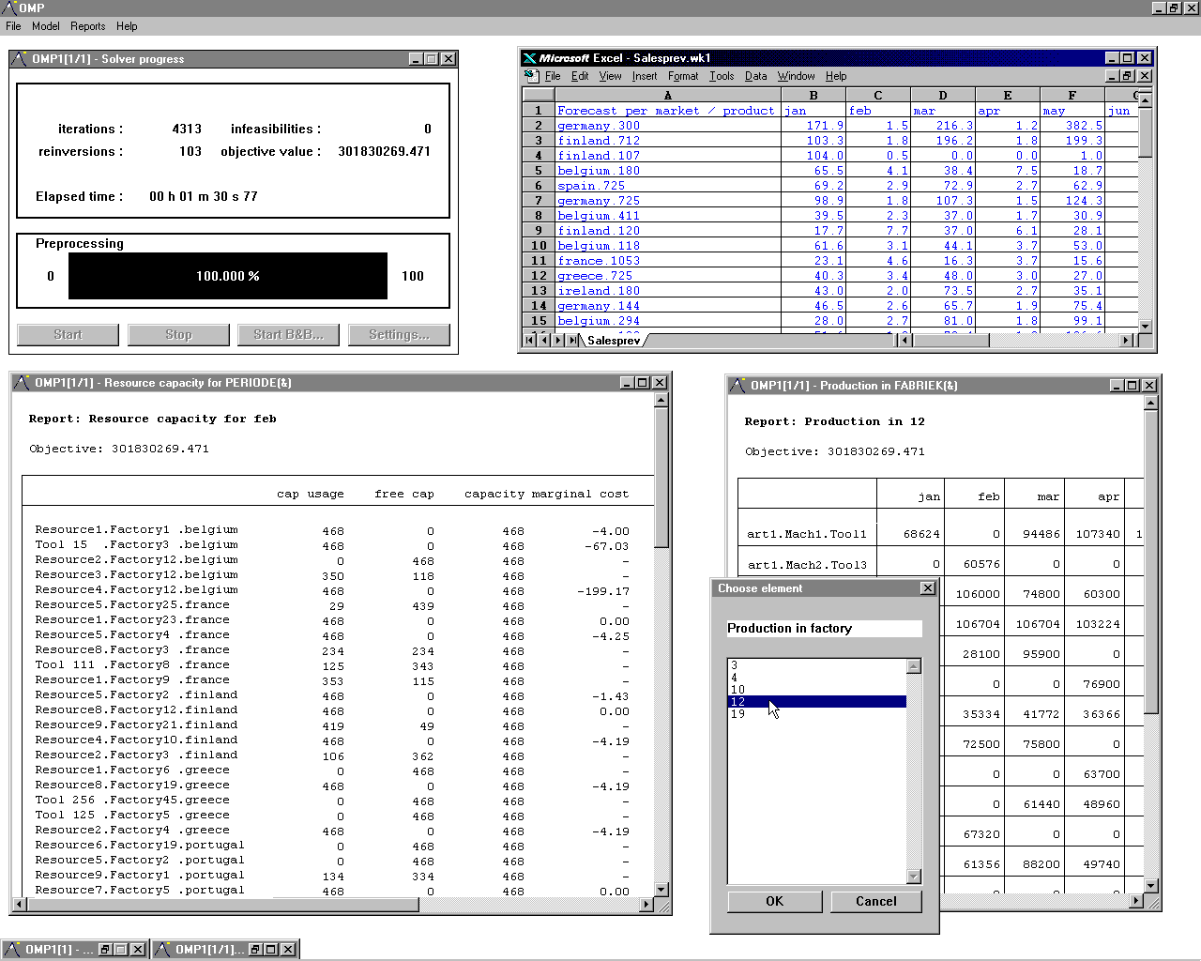
OMP : Graphical User Interface

Slide 3
OMP Optimization - Modules
Graphical user interface
Model generator
Solver (LP , MIP)
Report generator
Simulator

Slide 4
OMP - User interface
Full graphical interface in windowing
Integrated editor
Built-in model generator for readability and structured modelling
Import and export of spreadsheet files
Development environment to create graphical optimization applications

Slide 5
OMP - Linear programming
Revised Simplex method
  primal pivoting
  dual pivoting
Segmentation
Automatic scaling
Automatic determination of starting basis
Partial pricing
Quadratic programming

Slide 6
OMP - Mixed integer programming
Branch & Bound
Objective bounds, minimal improvement
Interrupt and resume optimization
Several priority and branching strategies
  automatic
  SOS1
  branching direction per variable
Pruning of the search-tree by pre-, post- and node processing
  model simplification and substitution
  coefficient reduction
  sharpening of bounds
  elimination of redundant constraints
  generation of cuts

Slide 7
OMP - Reporting & Simulation
Report generator connected with model generator
Extensive functionality
  basic arithmetic functionalities : column/row totals, subtotals, multiplications, ...
  user-defined layout : frames, headers, separation lines, ...
  free definition of several pieces of information in one report : value, LB, UB, ...
Full infeasibility reporting
Full simulation and what-if analysis
  changing variable values and analysing impact on result
  reoptimizing after changing bounds, objective coefficients and right hand sides

Slide 8
OMP - Available versions
Platforms :
  PC/Windows NT (intel processor)
  RS6000/AIX
  HP9000/UX
Network and stand-alone versions
Multiple languages (E,F,D,N,...)

Slide 9
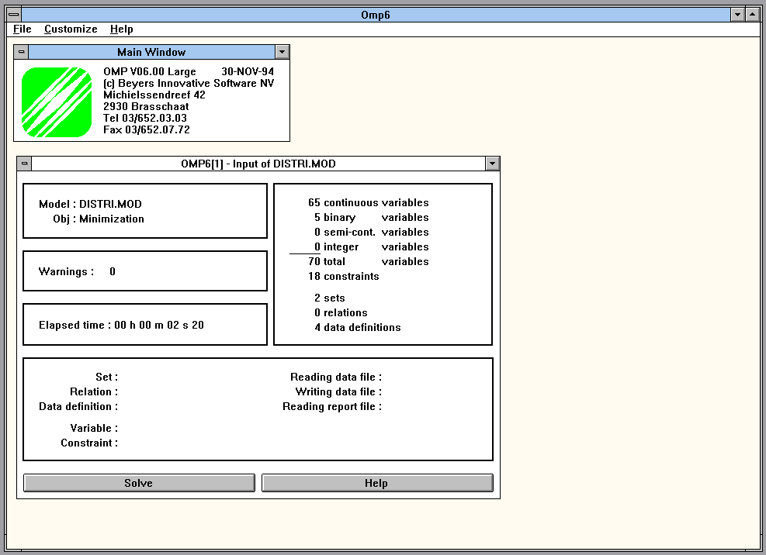
OMP - Input model

Slide 10
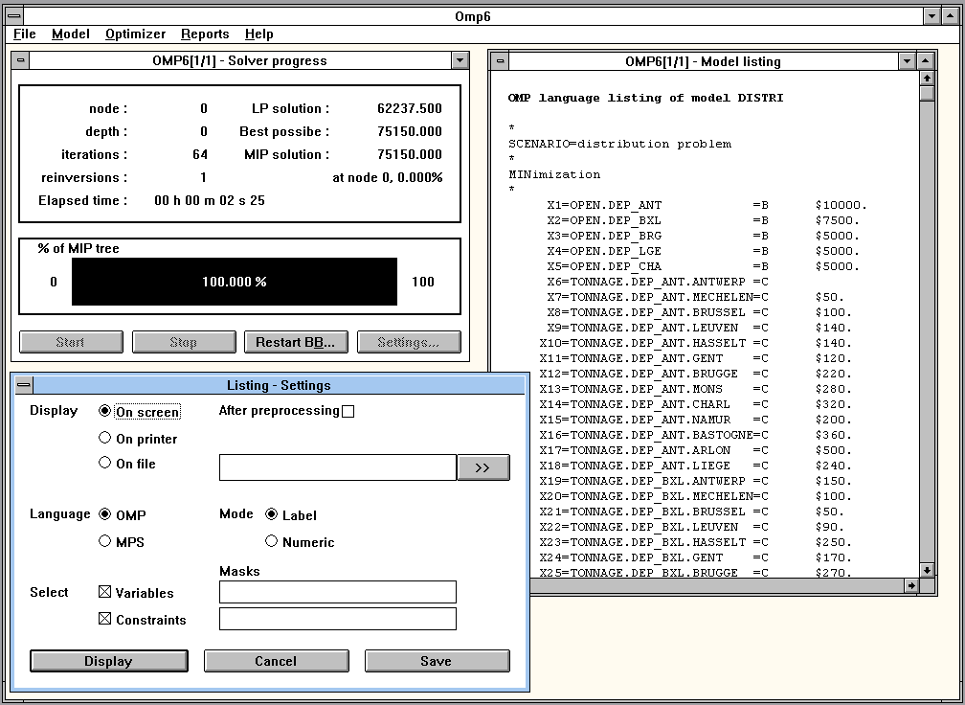
OMP - Model listing

Slide 11
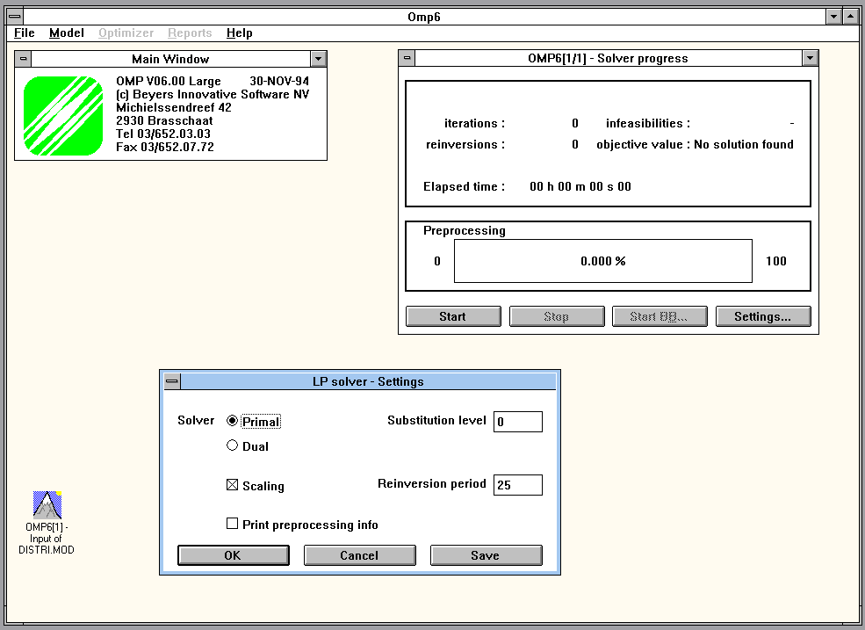
OMP - Solve LP model

Slide 12
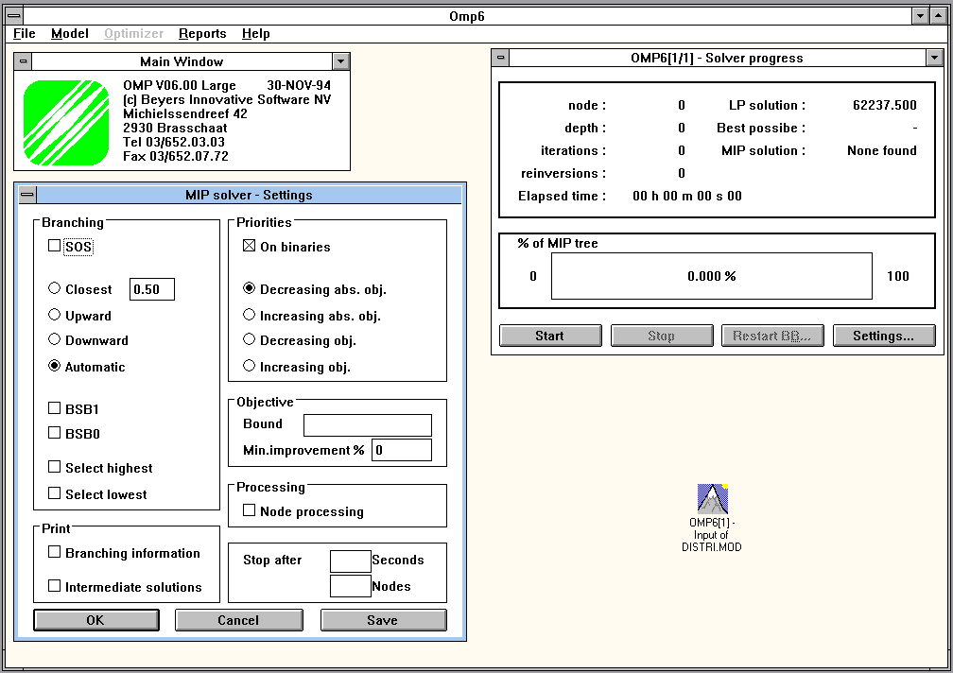
OMP - Solve MIP model

Slide 13
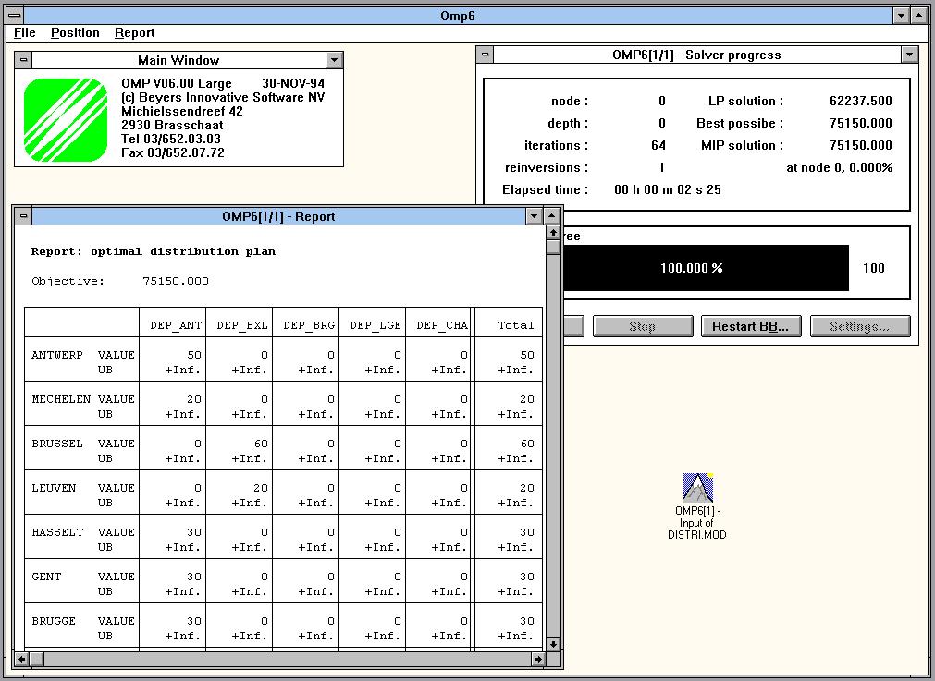
OMP - Reporting & Simulation

