Slide 1

Html Essentials Day 2
Murach's HTML5 and CSS3, C1Name, C1
Slide <number>

Slide 2
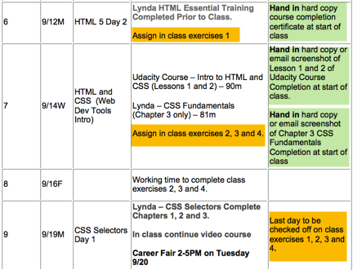
Near Term Plan - Syllabus
Slide <number>

Slide 3
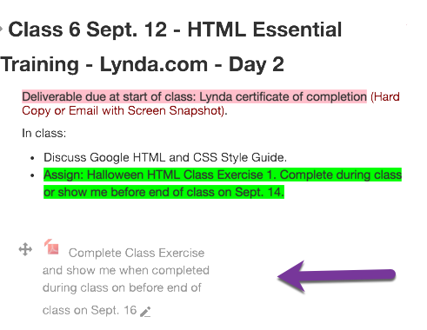
Slide <number>

Slide 4
Big Picture
What should I know at this point?
What is coming up in next 3 weeks?
Murach's HTML5 and CSS3, C1
© 2011, Mike Murach & Associates, Inc.
Slide <number>

Slide 5
Big Picture: What should I know at this point? (1 of 5)
NetBeans
  Create or Open a Web Application Project
  Parts of a NetBeans Project (Web Pages, WEB-INF)
  Create new html files.
  Copy html files into proper location in Project
  Edit html files
  Deploy a project to Tomcat
Tomcat
  Start and Stop from within NetBeans
Chrome Browser
  Supply URL to run html page of local web application
  Supply URL to run html page of GitHub html file
Murach's HTML5 and CSS3, C1Name, C1
© 2011, Mike Murach & Associates, Inc.© 2009, Mike Murach & Associates, Inc.
Slide <number>

Slide 6
Big Picture: What should I know at this point? (2 of 5)
GitHub
  Create a empty repository
  Get the url of a html page in repository
  Modify url to run in a browser (remove blob an change github to rawgit)
  Review commits in a repository
Git (if folder NOT under version control and NOT on GitHub)
  In Git bash, make a directory (mkdir) change directory to the Netbeans project folder that you would like to place under version control using linux commands of cd and pwd.
  Create a repository (git init)
  Add files to staging area (git add –all) 2 dashes before all
  Commit staging area to repository (git commit –m ‘yada, yada’)
  Tell git about github (git remote add origin https://github.com/..../....git)
  Push the commit to GitHub (git push –u origin master)
Murach's HTML5 and CSS3, C1Name, C1
© 2011, Mike Murach & Associates, Inc.© 2009, Mike Murach & Associates, Inc.
Slide <number>

Slide 7
Big Picture: What should I know at this point? (3 of 5)
Git (if folder under version control and already on GitHub)
  Bring up NetBeans and modify html files
  In Git bash, change directory to the folder of the repository/NetBeans Project (cd and pwd).
  In Git bash, add files to staging area (git add –all) (2 dashes)
  In Git bash, commit staging area to repository (git commit –m ‘more yada, yada’)
  I am assuming that your git remembers last setting to github. You can check this with (git remote –v)
  Push the commit to GitHub (git push –u origin master)
Murach's HTML5 and CSS3, C1Name, C1
© 2011, Mike Murach & Associates, Inc.© 2009, Mike Murach & Associates, Inc.
Slide <number>

Slide 8
Big Picture: What should I know at this point? (4 of 5)
GitHub has repository of NetBeans project but repository NOT on my current local machine.
  This could happen if I give you a GitHub repository. Or if you get one from a friend. Or if you have one and are on a different machine.
  In Git bash, navigate to folder where you would like to put GitHub repository. (cd and pwd)
  In Git bash, git clone https://github.com/..../.....git
  Bring up NetBeans on downloaded repository
Murach's HTML5 and CSS3, C1Name, C1
© 2011, Mike Murach & Associates, Inc.© 2009, Mike Murach & Associates, Inc.
Slide <number>

Slide 9
Big Picture: What should I be able to do at this point? (5 of 5)
Create a html file with content using semantic tags, headings, image, links and lists.
Have big picture that html is content, css is styling and javascript is behavior. You should know css after videos due for Wednesday.
Murach's HTML5 and CSS3, C1Name, C1
© 2011, Mike Murach & Associates, Inc.© 2009, Mike Murach & Associates, Inc.
Slide <number>

Slide 10
The Blanks to Fill In This Week and Next
CSS Styling
  Reference to external style sheet
  Knowledge of good sites to go to for looking up css (Mozilla, w3schools, etc)
  Understand layout
    display: flex; (Very, very new in CSS3)
    float (tried and true and shown in all texts)
  Introduced to responsive web design
  Understand selectors and rules (2 classes)
  Understand Web Dev Tools
Web Form Elements (1 whole class)
Murach's HTML5 and CSS3, C1Name, C1
© 2011, Mike Murach & Associates, Inc.© 2009, Mike Murach & Associates, Inc.
Slide <number>

Slide 11
In ~2 Weeks Fill in JavaScript
Spend 2 classes focused on JavaScript.
Spend 1 class focused on JQuery (JavaScript Library)
The purpose of these 3 classes is to give you fundamentals if asked to use these during internship with frameworks such as Angular or BootStrap.
Murach's HTML5 and CSS3, C1Name, C1
© 2011, Mike Murach & Associates, Inc.© 2009, Mike Murach & Associates, Inc.
Slide <number>

Slide 12
Today
Give you a customer specification and a starting GitHub repository of a NetBeans project to clone and start from.
Complete requirements on your local machine.
Three deliverables for Friday/Monday:
  Show me running in Tomcat
  Show me code uploaded to a new repository that you create on GitHub.
  Show me index.html on GitHub validated on validator.w3.org
Murach's HTML5 and CSS3, C1Name, C1
© 2011, Mike Murach & Associates, Inc.© 2009, Mike Murach & Associates, Inc.
Slide <number>

