Slide 1
DWDM-RAM:
Enabling Grid Services with Dynamic Optical Networks
S. Figueira, S. Naiksatam, H. Cohen,
D. Cutrell, P. Daspit, D. Gutierrez,
D. Hoang, T. Lavian, J. Mambretti,
S. Merrill, F. Travostino

Slide 2
DWDM-RAM
DARPA-funded project
  Santa Clara, CA
    Nortel Networks
    Santa Clara University
  Chicago, IL
    iCAIR / Northwestern University
  Australia
    University of Technology, Sydney

Slide 3
DWDM-RAM
Goal
  Make dynamic optical network usable by grid applications
  Provide lightpaths as a service
  Design and implement in prototype a new type of grid service architecture optimized to support data-intensive grid applications through advanced optical network

Slide 4
Why Dynamic Optical Network?
Packet-switching technology
  Great solution for small-burst communication, such as email, telnet, etc.
Data-intensive grid applications
  Involves moving massive amounts of data
  Requires high and sustained bandwidth

Slide 5
Why Dynamic Optical Network?
DWDM
  Basically circuit switching
  Enable QoS at the Physical Layer
  Provide
    High bandwidth
    Sustained bandwidth

Slide 6
Why Dynamic Optical Network?
DWDM based on dynamic wavelength switching
  Enable dedicated optical paths to be allocated dynamically
A
B
A
C
In a few seconds…

Slide 7
Why Dynamic Optical Network?
Any drawbacks?
  The overhead incurred during end-to-end path setup
Not really a problem
  The overhead is amortized by the long time taken to move massive amounts of data

Slide 8
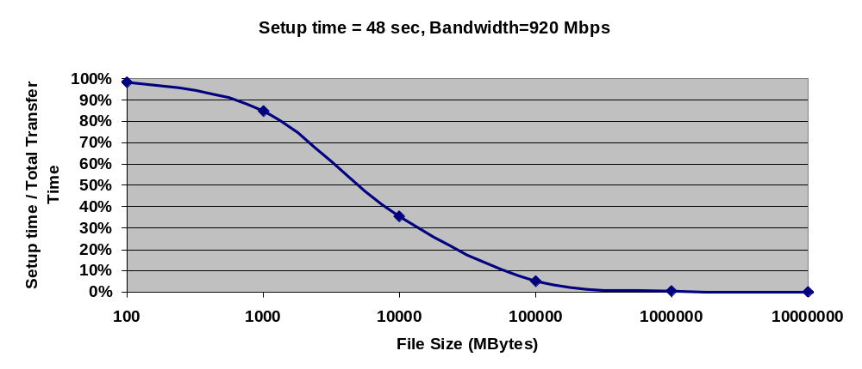
Why Dynamic Optical Network?
When dealing with data-intensive applications, overhead is insignificant!
500GB

Slide 9
Why Grid Services?
Applications need access to the network
  To request and release lightpaths
Grid services
  Can provide an interface to allocate and release lightpaths

Slide 10
DWDM-RAM Architecture
Data-Intensive Applications
DTS API
Application
Middleware
Layer
Data
Transfer Service
Network Resource
Service
NRS Grid Service API
Network Resource
Middleware
Layer
Data
Handler
Service
Basic Network
Resource
Service
Network
Resource
Scheduler
Information Service
λ OGSI-ification API
Dynamic Lambda, Optical Burst, etc., Grid services
Connectivity and
Fabric Layers
Optical path control
Data
Center
λ₁
λ₁
Data
Center
λ_{n}
λ_{n}

Slide 11
DWDM-RAM Architecture
Applications
Application
Data Transfer Scheduling
Collective
Network Resource Scheduling
Resource
Communication Protocols
Connectivity
ODIN
Fabric
OMNInet

Slide 12
DWDM-RAM Architecture
Applications
Application
Data Transfer Scheduling
Collective
Network Resource Scheduling
Resource
Communication Protocols
Connectivity
ODIN
Fabric
OMNInet

Slide 13
DWDM-RAM Architecture
OMNInet - photonic testbed network
  Four-node multi-site optical metro testbed network in Chicago -- the first 10GE service trial!
  All-optical MEMS-based switching and advanced high-speed services
  Partners: SBC, Nortel, iCAIR at Northwestern, EVL, CANARIE, ANL

Slide 14

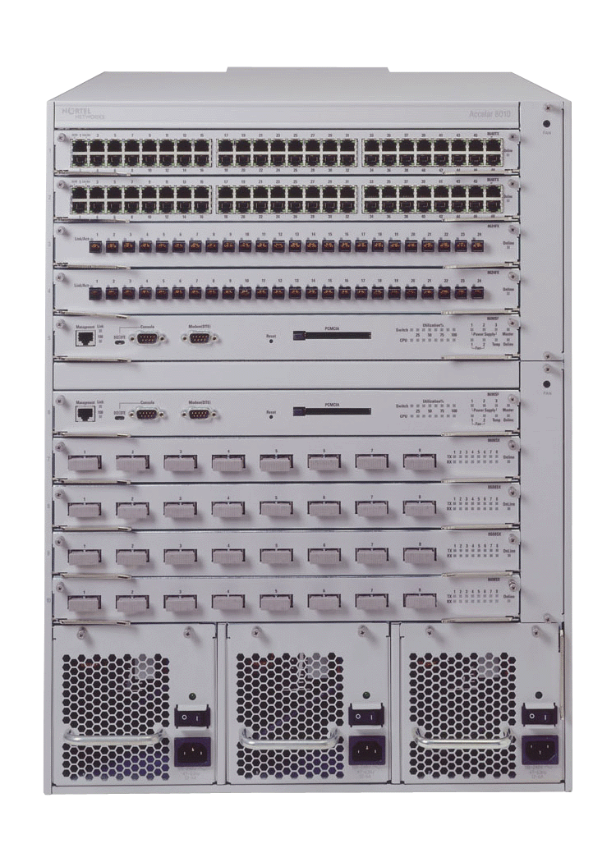
OMNInet Core Nodes
UIC
Northwestern U
8x1GE
4x10GE
4x10GE
8x1GE
Application
Cluster
Optical
Switching
Platform
Optical
Switching
Platform
Passport
8600
Passport
8600
Application
Cluster
OPTera
Metro
5200
StarLight
CA*net3--Chicago
8x1GE
4x10GE
4x10GE
8x1GE
Loop
Application
Cluster
Optical
Switching
Platform
Optical
Switching
Platform
Passport
8600
Passport
8600
Closed loop

Slide 15
DWDM-RAM Architecture
ODIN - Optical Dynamic Intelligent Network
  Software suite that controls the OMNInet through lower-level API calls
  Designed for high-performance, long-term flow with flexible and fine grained control
  Stateless server, which includes an API to provide path provisioning and monitoring to the higher layers

Slide 16
DWDM-RAM Architecture
Applications
Application
Data Transfer Scheduling
Collective
Network Resource Scheduling
Resource
Communication Protocols
Connectivity
ODIN
Fabric
OMNInet

Slide 17
DWDM-RAM Architecture
Communication Protocols
  Currently, using standard off-the-shelf communication protocol suites
  Provide communication between application clients and DWDM-RAM services and between DWDM-RAM components
  Communication consists of mainly SOAP messages in HTTP envelopes transported over TCP/IP connections

Slide 18
DWDM-RAM Architecture
Applications
Application
Data Transfer Scheduling
Collective
Network Resource Scheduling
Resource
Communication Protocols
Connectivity
ODIN
Fabric
OMNInet

Slide 19
DWDM-RAM Architecture
Network Resource Scheduling
  Essentially a resource management service
  Maintains schedules and provisions resources in accordance with the schedule
  Provides an OGSI compliant interface to request the optical network resources

Slide 20
DWDM-RAM Architecture
Applications
Application
Data Transfer Scheduling
Collective
Network Resource Scheduling
Resource
Communication Protocols
Connectivity
ODIN
Fabric
OMNInet

Slide 21
DWDM-RAM Architecture
Data Transfer Scheduling
  Direct extension of the NRS service, provides an OGSI interface
  Shares the same backend scheduling engine and resides on the same host
  Provides a high-level functionality
  Allow applications to schedule data transfers without the need to directly reserve lightpaths
  The service also perform the actual data transfer once the network is allocated

Slide 22
Data Transfer Scheduling
Uses standard ftp
Uses NRS to allocate lambdas
Uses OGSI calls to request network resources
Data Receiver
λ
Data Source
FTP client
FTP server
DTS
NRS
Client App

Slide 23
DWDM-RAM Architecture
Applications
Application
Data Transfer Scheduling
Collective
Network Resource Scheduling
Resource
Communication Protocols
Connectivity
ODIN
Fabric
OMNInet

Slide 24
DWDM-RAM Architecture
Applications
  Target is data-intensive applications since their requirements make them the perfect costumer for DWDM networks

Slide 25
DWDM-RAM Modes
Applications may request a data transfer
Applications
Data Transfer Scheduling
Network Resource Scheduling

Slide 26
DWDM-RAM Modes
Applications may request a network connection
Applications
Network Resource Scheduling

Slide 27
DWDM-RAM Modes
Applications may request a set of resources through any resource allocator, which will handle the network reservation
Applications
Resource Allocator
Network Resource Scheduling

Slide 28
The Network Service
The NRS is the key for providing network as a resource
  It is a service with an application-level interface
  Used for requesting, releasing, and managing the underlying network resources

Slide 29
The Network Service
NRS
  Understands the topology of the network
  Maintains schedules and provisions resources in accordance with the schedule
  Keeps one scheduling map for each lambda in each segment

Slide 30
The Network Service
→ 4 Scheduling maps:
Each with a vector of time intervals for keeping the reservations

Slide 31
The Network Service
→ 4 scheduling maps for each segment

Slide 32
The Network Service
NRS
  Provides an OGSI-based interface to network resources
  Request parameters
    Network addresses of the hosts to be connected
    Window of time for the allocation
    Duration of the allocation
    Minimum and maximum acceptable bandwidth (future)

Slide 33
The Network Service
NRS
  Provides the network resource
    On demand
    By advance reservation
  Network is requested within a window
    Constrained
    Under-constrained

Slide 34
The Network Service
On Demand
  Constrained window: right now!
  Under-constrained window: ASAP!
Advance Reservation
  Constrained window
    Tight window, fits the transference time closely
  Under-constrained window
    Large window, fits the transference time loosely
    Allows flexibility in the scheduling

Slide 35
The Network Service
Under-constrained window
Request for 1/2 hour between 4:00 and 5:30 on Segment D granted to User W at 4:00
New request from User X for same segment for 1 hour between 3:30 and 5:00
Reschedule user W to 4:30; user X to 3:30. Everyone is happy.
W
3:30
4:00
4:30
5:00
5:30
X
3:30
4:00
4:30
5:00
5:30
W
X
3:30
4:00
4:30
5:00
5:30
Route allocated for a time slot; new request comes in; 1st route can be rescheduled for a later slot within window to accommodate new request

Slide 36
Experiments
Experiments have been performed on the OMNInet
  End-to-end FTP transfer over a 1Gbps link
  Goal
    Exercise the network to show that the full bandwidth can be utilized
    Demonstrate that the path setup time is not significant

Slide 37
End-to-End Transfer Time
File transfer request arrives
File transfer done, path released
0.5s
3.6s
0.5s
25s
0.14s
174s
0.3s
11s
Path Allocation request
ODIN Server Processing
Path ID returned
Network reconfiguration
FTP setup time
Data Transfer
20 GB
Path Deallocation
request
ODIN Server Processing

Slide 38
Application Level Measurements
File size: | 20 GB
Path allocation: | 29.7 secs
Data transfer setup time: | 0.141 secs
FTP transfer time: | 174 secs
Maximum transfer rate: | 935 Mbits/sec
Path tear down time: | 11.3 secs
Effective transfer rate: | 762 Mbits/sec

Slide 39
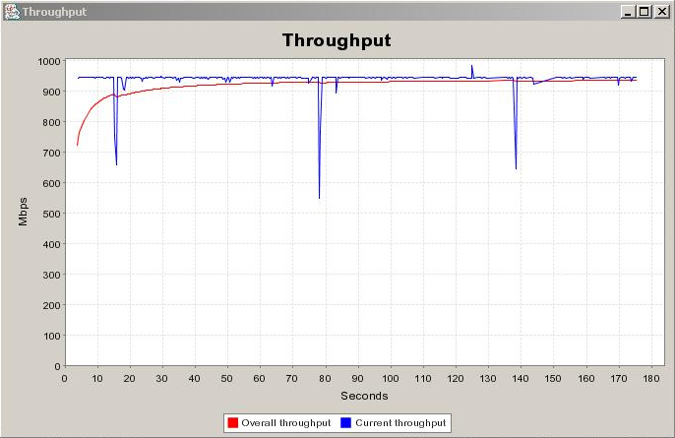
20GB File Transfer

Slide 40
Current Status
Allocation of one-segment lightpath
  On demand allocation has been tested at the OMNInet
  Advance reservation has been implemented but not tested at the OMNInet

Slide 41
Future Work
Nortel Networks / SURFnet
Lightpath allocation
  Multiple-segment lightpaths
  Optimized allocation when more than one path is available
Scheduling in large-scale networks
  Involves different administrative and/or geographic domains
  Requires a distributed approach

Slide 42
Conclusion
Dynamic optical network is a key technology for data-intensive grid computing
DWDM-RAM’s network service enables lightpaths to be provided as a primary resource

