Slide 1





DWDM
RAM
DWDM
RAM
Data@LIGHTspeed
DWDM-RAM:
DARPA-Sponsored Research for Data Intensive Service-on-Demand
Advanced Optical Networks
Tal Lavian
BUSINESS WITHOUT BOUNDARIES

Slide 2

Optical Abundant Bandwidth Meets Grid
The Data Intensive App Challenge:
Emerging data intensive applications in the field of HEP,
astro-physics, astronomy, bioinformatics, computational
chemistry, etc., require extremely high performance and
long term data flows, scalability for huge data volume,
global reach, adjustability to unpredictable traffic
behavior, and integration with multiple Grid resources.
Response: DWDM-RAM
An architecture for data intensive Grids enabled by next
generation dynamic optical networks, incorporating
new methods for lightpath provisioning. DWDM-RAM
is designed to meet the networking challenges of
extremely large scale Grid applications. Traditional
network infrastructure cannot meet these demands,
especially, requirements for intensive data flows
PBs Storage
Data-Intensive Applications
DWDM-RAM
Abundant Optical Bandwidth
Tbs on single fiber strand

Slide 3
DWDM-RAM Architecture
The DWDM-RAM architecture identifies two distinct planes over the dynamic
underlying optical network:
the Data Grid Plane that speaks for the diverse requirements of a data-intensive application by providing generic data-intensive interfaces and services and
2) the Network Grid Plane that marshals the raw bandwidth of the underlying optical
network into network services, within the OGSI framework, and that matches the complex requirements specified by the Data Grid Plane.
At the application middleware layer, the Data Transfer Service (DTS) presents an interface between the system and an application. It receives high-level client requests, policy-and-access filtered, to transfer specific named blocks of data with specific advance scheduling constraints.
The network resource middleware layer consists of three services: the Data Handler Service (DHS), the Network Resource Service (NRS) and the Dynamic Lambda Grid Service (DLGS). Services of this layer initiate and control sharing of resources.

Slide 4
DWDM-RAM Architecture
Data-Intensive Applications
DTS API
Application
Middleware
Layer
Data
Transfer Service
Network Resource
Service
NRS Grid Service API
Network Resource
Middleware
Layer
Data
Handler
Service
Basic Network
Resource
Service
Network
Resource
Scheduler
Information Service
λ OGSI-ification API
Dynamic Lambda, Optical Burst, etc., Grid services
Connectivity and
Fabric Layers
Optical path control
Data
Center
λ₁
λ₁
Data
Center
λ_{n}
λ_{n}
Dynamic Optical Network OMNInet

Slide 5
DWDM-RAM vs. Layered Grid Architecture
Layered DWDM-RAM
Layered Grid
Application
Application
“Coordinating multiple resources”: ubiquitous infrastructure services, app-specific distributed services
DTS API
Data Transfer
Service
Collective
Application
Middleware
Layer
“Sharing single resources”: negotiating access, controlling use
NRS Grid Service API
Network
Resource
Service
Resource
Network Resource
Middleware
Layer
“Talking to things”: communication (Internet protocols) & security
Data Path Control
Service
λ OGSI-ification API
Connectivity &
Fabric Layer
Connectivity
Optical Control
Plane
“Controlling things locally”: Access to, & control of, resources
Fabric
λ’s
Notes:
We define Grid architecture in terms of a layered collection of protocols.
Fabric layer includes the protocols and interfaces that provide access to the resources that are being shared, including computers, storage systems, datasets, programs, and networks. This layer is a logical view rather then a physical view. For example, the view of a cluster with a local resource manager is defined by the local resource manger, and not the cluster hardware. Likewise, the fabric provided by a storage system is defined by the file system that is available on that system, not the raw disk or tapes.
The connectivity layer defines core protocols required for Grid-specific network transactions. This layer includes the IP protocol stack (system level application protocols [e.g. DNS, RSVP, Routing], transport and internet layers), as well as core Grid security protocols for authentication and authorization.
Resource layer defines protocols to initiate and control sharing of (local) resources. Services defined at this level are gatekeeper, GRIS, along with some user oriented application protocols from the Internet protocol suite, such as file-transfer.
Collective layer defines protocols that provide system oriented capabilities that are expected to be wide scale in deployment and generic in function. This includes GIIS, bandwidth brokers, resource brokers,….
Application layer defines protocols and services that are parochial in nature, targeted towards a specific application domain or class of applications. These are are are … arrgh

Slide 6

DWDM-RAM Service Control Architecture
DATA GRID SERVICE PLANE
GRID Service Request
Service
Control
Service
Control
NETWORK SERVICE PLANE
Network Service Request
ODIN
OmniNet Control Plane
ODIN
Optical Control Network
UNI-N
UNI-N
Data
Path
Control
Data
Path
Control
Connection
Control
Data Transmission Plane
Data
Center
λ₁
λ₁
Data
storage
switch
λ_{n}
λ_{n}
L3 router
Data
Center
L2 switch
λ₁
λ_{n}
Data
Path

Slide 7

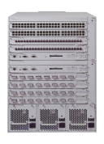
OMNInet Core Nodes
UIC
Northwestern U
8x1GE
4x10GE
4x10GE
8x1GE
Application
Cluster
Optical
Switching
Platform
Optical
Switching
Platform
Passport
8600
Passport
8600
Application
Cluster
OPTera
Metro
5200
StarLight
CA*net3--Chicago
8x1GE
4x10GE
4x10GE
8x1GE
Loop
Application
Cluster
Optical
Switching
Platform
Optical
Switching
Platform
Passport
8600
Passport
8600
Closed loop
A four-node multi-site optical metro testbed network in Chicago -- the first 10GE service trial!
A test bed for all-optical switching and advanced high-speed services
OMNInet testbed Partners: SBC, Nortel, iCAIR at Northwestern, EVL, CANARIE, ANL

Slide 8
DWDM-RAM Components
Data Management Services
OGSA/OGSI compliant, capable of receiving and understanding application requests, have complete knowledge of network resources, transmit signals to intelligent middleware, understand communications from Grid infrastructure, adjust to changing requirements, understands edge resources, on-demand or scheduled processing, support various models for scheduling, priority setting, event synchronization
Intelligent Middleware for Adaptive Optical Networking
OGSA/OGSI compliant, integrated with Globus, receives requests from data services and applications, knowledgeable about Grid resources, has complete understanding of dynamic lightpath provisioning, communicates to optical network services layer, can be integrated with GRAM for co-management, architecture is flexible and extensible
Dynamic Lightpath Provisioning Services
Optical Dynamic Intelligent Networking (ODIN), OGSA/OGSI compliant, receives requests from middleware services, knowledgeable about optical network resources, provides dynamic lightpath provisioning, communicates to optical network protocol layer, precise wavelength control, intradomain as well as interdomain, contains mechanisms for extending lightpaths through E-Paths - electronic paths, incorporates specialized signaling, utilizes IETF – GMPLS for provisioning, new photonic protocols

Slide 9
Design for Scheduling
Network and Data Transfers scheduled
Data Management schedule coordinates network, retrieval, and sourcing services (using their schedulers)
Scheduled data resource reservation service (“Provide 2 TB storage between 14:00 and 18:00 tomorrow”)
Network Management has own schedule
Variety of request models:
  Fixed – at a specific time, for specific duration
  Under-constrained – e.g. ASAP, or within a window
Auto-rescheduling for optimization
Facilitated by under-constrained requests
Data Management reschedules for its own requests or on request of Network Management

Slide 10
Example: Lightpath Scheduling
W
Request for 1/2 hour between 4:00 and 5:30 on Segment D granted to User W at 4:00
New request from User X for same segment for 1 hour between 3:30 and 5:00
Reschedule user W to 4:30; user X to 3:30. Everyone is happy.
3:30
4:00
4:30
5:00
5:30
X
3:30
4:00
4:30
5:00
5:30
W
X
3:30
4:00
4:30
5:00
5:30
Route allocated for a time slot; new request comes in; 1st route can be rescheduled for a later slot within window to accommodate new request

Slide 11
End-to-end Transfer Time
20GB File Transfer
Set up: 29.7s
Transfer: 174s
Tear down: 11.3s
File transfer request arrives
File transfer done, path released
0.5s
3.6s
0.5s
25s
0.14s
174s
0.3s
11s
Path Allocation request
ODIN Server Processing
Path ID returned
Network reconfiguration
Transport setup time
Data Transfer
20 GB
Path Deallocation
request
ODIN Server Processing

Slide 12
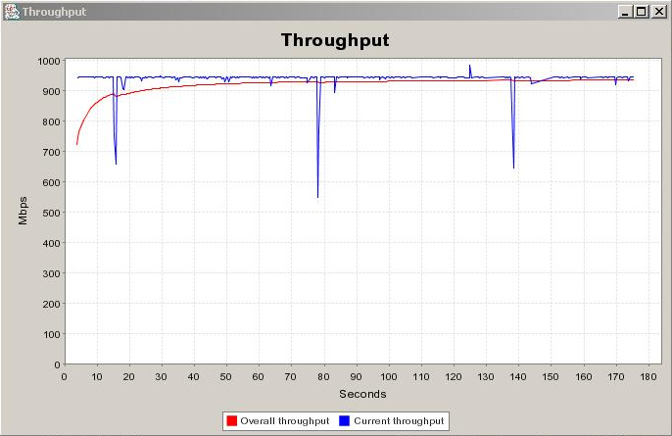
20GB File Transfer

