Slide 1





DWDM
RAM
DWDM
RAM
Data@LIGHTspeed
Application-engaged
Dynamic Orchestration of
Optical Network Resources
Defense Advanced Research Projects Agency
BUSINESS WITHOUT BOUNDARIES

Slide 2
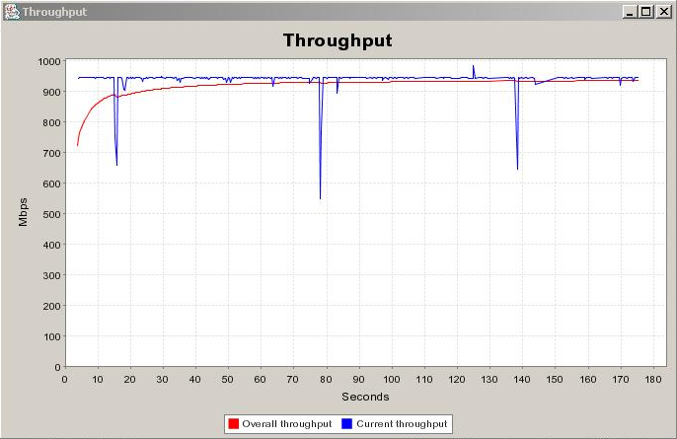
Grids & C. freed us from the cuffs of bit-blasting races
Apps such as Grids call for a complex mix of:
        Bit-blasting
        Finesse (granularity of control)
        Virtualization (access to diverse knobs)
        Resource bundling (network AND …)
        Security (AAA to start)
        Free from GUIs, any human intervention
+
+
+
+
+
= λ’s are worth a whole new look!

Slide 3
Business Drivers for next-gen λ services
Business Continuity/Disaster Recovery
  Remote file storage/back-up
  Recovery after equipment or path failure
  Alternate site operations due to natural or man-made disaster
Storage and data on demand
  Rapid expansion of network attached storage capacity
  Archival storage and retrievals
  Logistical networking – pre-fetch and cache
Grids
  Financial: portfolio risk analysis; Manufacturing: CAD; Entertainment: digital rendering; Lifesciences: drug discovery
  Utility computing for pay-as-you-go business models

Slide 4
We pick role-model dynamics…
Under-constrained window use-case
Request for 1/2 hour between 4:00 and 5:30 on Segment D granted to Bob’s Grid at 4:00
New request from Alice’s Grid for same segment for 1 hour between 3:30 and 5:00. Alice’s credentials support the request
Reschedule Bob’s Grid to 4:30; Alice’s Grid stays at 3:30. Everyone is happy.
Bob’s Grid
3:30
4:00
4:30
5:00
5:30
Alice’s Grid
3:30
4:00
4:30
5:00
5:30
Bob
Alice
3:30
4:00
4:30
5:00
5:30
Route allocated for a time slot; new request comes in; former route can be rescheduled for a later slot within window to accommodate new request

Slide 5
… and map them over dynamic λs
Applications
Application
DWDM-RAM
Data Transfer Scheduling
Collective
Network Resource Scheduling
Resource
Communication Protocols
Connectivity
ODIN
Fabric
OMNInet

Slide 6
DWDM-RAM Architecture
Data-Intensive Applications
DTS API
Application
Middleware
Layer
Data
Transfer Service
Network Resource
Service
NRS Grid Service API
Network Resource
Middleware
Layer
Data
Handler
Service
Basic Network
Resource
Service
Network
Resource
Scheduler
Information Service
λ OGSI-ification API
Dynamic Lambda, Optical Burst, etc., Grid services
Connectivity and
Fabric Layers
Optical path control
Data
Center
λ₁
λ₁
Data
Center
λ_{n}
λ_{n}

Slide 7
Finesse Task 2: Characterize
overall utilization
#1 Transfer
#2 Transfer
#1 Transfer
#2 Transfer
-30 0 30 60 90 120 150 180 210 240 270 300 330 360 390 420 450 480 510 540 570 600 630 660
time (sec) →
allocate path
de-allocate path

Slide 8
Demonstrator, a Notional View
Remote storage / processing location
100s of transactions per second
100s of transactions per second
Dynamically provisioned carrier or large enterprise network – switched lambdas and sub-lambdas
Remote storage / processing location
Remote storage / processing location
100s of transactions per second

Slide 9
Current Demonstrator (Supercomm, 0604)
BIGBANK
Stocks-R-Us
Records/second: 16K records/second
Record size: 4 KB
Queue Load: 1,245,726 records
4,982,904,000 bytes
Queue Fill rate: 64 Mbytes/sec
Next Sched. Queue Delivery: 2:35 pm
Delivery countdown: 33 sec
Burst duration: 150 sec
Last burst throughput: 610 Mbps
Accumulation period: constant
Records/second: 14K records/second
Record size: 2 KB
Queue Load: 70 records
140,000 bytes
Queue Fill rate: 28 Mbytes/sec
Next Sched. Queue Delivery: IN PROCESS
Delivery countdown: IN PROCESS
Burst duration: 90 sec
Last burst throughput: 580 Mbps
Accumulation period: constant
Carrier
POP
POP
Dynamically Provisioned Lambda Mesh
POP
POP

Slide 10
Conclusions
A journey past “bit-blasting” has begun
For rich λ semantics, it’s key to define proper layers
  Web Service mechanisms dominate the upper layers
  The ASTN-based OMNInet control plane proves solid foundation and handy separation of concerns
  The combination gives preliminary confirmation of scaling
New work items
  Simulation + empirical validation with large(r) populations
  Integration with workflow languages
  AAA and data path security
  Integration with a Grid Community Scheduler

