Slide 1
A Grid Proxy Architecture for Network Resources
Phil Wang, Inder Monga, Tal Lavian,
Ramesh Durairaj, Franco Travostino
Nortel Networks Labs
{pywang, imonga, tlavian, radurai, travos}@nortelnetworks.com

Slide 2
Agenda
Challenges
Grid Proxy Architecture for Networks (GPAN)
Demo
Summary

Slide 3
Grids and Networks
Network is an integral part to Grids
  Network resources guarantee Grid resource sharing
  Networks resource allocation needed to effectively enable distributed virtual organizations (VOs)
Networks are heterogeneous in nature
  Different kinds of devices and vendors
  Domain-specific clouds in separate administrative domains
  Unknown number of network layers and elements in a p2p connection
Networks have their own standards and evolution curve, not necessarily grid savvy
  Standards and architectures defined in IEEE, IETF, ITU and others
  Data plane, control plane, and management plane protocols
  Network services provided for management and control
For Grids to be successfully deployed across LAN/MAN/WAN,
we need a rich 2-way interaction between Grid and Nets
Networks are unaware of Grid concepts and services

Slide 4
Challenge:
Grid Management of Network Resources
Current network services do not match Grid Resource requirements
  E.g., reporting resource status into MDS/Index
  E.g., allocating resources based on GRAM/RSL request
Network elements individually may not be able to offer Grid compatible resource services
  Limited CPU, memory, embedded system environment
  Ineffective allocations of element resources when shared by multiple VO’s
Grid deployment over legacy and varied networks
  Optical, Ethernet, IP, FR, ATM networks do not all offer same resources
  Legacy network elements cannot be grid enabled

Slide 5
Agenda
Challenges
Grid Proxy Architecture for Networks (GPAN)
Demo
Summary

Slide 6
Grid Proxy Architecture for Network Resources (GPAN)
Enables Grid Resource Services to take advantage of existing network services
The GPAN Grid middleware functionality includes:
  Proxy for accepting Grid resource requirements
  Provider of information regarding network resource availability/status
  Co-existence and integration with GRAM2, MDS
  Support for RSL2 extensions featuring network resource allocation capabilities
  OGSI-services providing network resource info & dynamic allocation capabilities
  Abstract view and access to base network services
Grid Applications
Grid Services
GPAN
Network Services
Network Elements

Slide 7





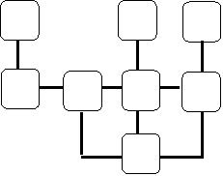



Grid Resources: general setup
A Grid Domain:
Virtual Organization
Computing
MFJS
RIPS
Storage
MFJS
RIPS
MJS
RIPS
application
MFJS
RIPS
MFJS
RIPS
A
RM
Info
GRAM2
MMJFS
C
Hosting
Environment
D
GRAM2
RM
Core Network
xSP
xSP
Access
Access
B
Computing
MFJS
RIPS
MFJS
RIPS
MJS
RIPS
GPAN
Proxy
NIP
E
Broker/Metascheduler
Network Service Overlay
GRAM2
MMJFS
MDS Index
Grid Overlay
A Grid VO utilizes grid resources in Campus A-E
Service Providers (xSP) on MAN/WAN access networks peer together to provide required network services to the Grid VO.
Index services collects resource information from computing, storage resources in Campus A-E and xSP
Broker/metascheduler performs resource lookups and allocations of all grid resources for applications

Slide 8
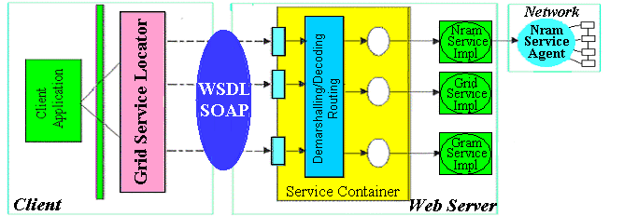
Proxy architecture implements scalable resource services for networks
GPAN
Grid
Service
Network
Services
Network device
Computer
GPAN Grid Service
  Provides a GRAM-2 instance in a network
  Extends RSL2 for network resources
  Supports resource discovery and info updates on the Grid
  Supports resource dynamic provisioning, optimization
  Resource Services such as GRAM talks to GPAN for network resource requests
  Grid clients and services use GPAN WSDL interface

Slide 9
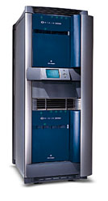
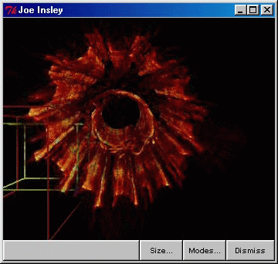
Resource Management Flow
MDS
Broker/Metascheduler
Application
Feeds not
shown
GRAM2
GRAM2
GRAM2
GRAM2
Storage RM
Computing RM
GPAN
Visual. RM
Network Service overlay
Network RM
Derived from © ANL Material

Slide 10
Network Resource Information using GPAN
A Grid Domain:
Virtual Organization
Computing
MFJS
RIPS
Storage
MFJS
RIPS
MJS
RIPS
application
MFJS
RIPS
MFJS
RIPS
A
RM
Info
GRAM2
MMJFS
C
Hosting
Environment
D
GRAM2
RM
Core Network
xSP
xSP
Access
Access
B
Computing
MFJS
RIPS
GPAN
Proxy
NIP
MFJS
RIPS
MJS
RIPS
E
Network Service Overlay
GRAM2
MMJFS
Broker/Metascheduler
MDS Index
Grid Overlay
GPAN provides network info to MDS/Index
  Proxy for network resource allocation status and updates
Network Info Provider (NIP) aggregates resource discovery and status updates
  Based on virtual network topology related to the VO

Slide 11
Network Resource Allocation using GPAN
A Grid Domain:
Virtual Organization
Computing
MFJS
RIPS
Storage
MFJS
RIPS
MJS
RIPS
application
MFJS
RIPS
MFJS
RIPS
RM
Info
GRAM2
MMJFS
C
Hosting
Environment
A
D
GRAM2
RM
Core Network
xSP
1
xSP
Access
Access
B
3
Computing
MFJS
RIPS
GPAN
Proxy
NIP
MFJS
RIPS
RSL2
MJS
RIPS
2
E
2
RSL2
Network Service Overlay
GRAM2
MMJFS
Broker/Metascheduler
MDS Index
Grid Overlay
Application requests broker/metascheduler for job services and resources
Broker/metascheduler generates RSL2 for resource allocation requests after consulting MDS/Index
xSPs co-ordinate to allocate requested resources

Slide 12
GPAN Programming Model
Legends
Common OGSI block
Common NS block
Two service infrastructures involved
  OGSI: Grid services
  NS: network services
New GPAN block
Grid Security
End Client
GPAN Service Components
  GPS: GPAN proxy
  NIP: GPAN network info provider
  GDS: GPAN delegation
  Smart: NS intelligence
  NPS: NS network provisioning
  RIS: NS network discovery and info update
Other Service Components
  BM: Broker/Metascheduler
  MJS: Managed Job Service
BM
OGSI 1.0
RSL-2
Index
GRAM-2 Interface
MJS
GPAN
NIP
GPS
GDS
Network
RIS
Smart
NPS
Network Service Infrastructure

Slide 13
GPAN RSL2 extension
ID
CLIENT
TYPE
TITLE
ACTION
STARTTIME
ENDTIME
BANDWIDTH profile
TRAFFICROUTE profile
[Extensions]
Resource
RSL
Allocation request
Discovery
all resources
GPAN
RSL2
info request
Index
Info
Refresh
update all resources
feedback
specify
ID
CLIENT
TYPE
[Extensions]
Query
Resource
Response
Resource
ID
CLIENT
TYPE
ACTION
STATUS
[Extensions]
GPAN RSL2 is defined in terms of XML and schemas
GPAN RSL2 is used for resource allocation, info and feedback
GPAN RSL2 is fully extensible

Slide 14
Agenda
Challenges
Grid Proxy Architecture for Networks (GPAN)
Demo
Summary

Slide 15
Bandwidth Boost Notional Picture
1. I’m in San Francisco. I need this application of mine to munch on a 200 GB data set. Elapsed time is a known function of Ω/N, with Ω a manifest constant and N the number of processors <= 100. I need the result (estimated ~100 GB) to be shipped to Chicago, Eindhoven, and back here within the next 12 hrs.
2. That is, I anycast everything but the final destination(s)
<=100 cpus,
300 GB RAID
[X]
A
B
β
C
δ
Chicago
San Francisco
Eindhoven
3. Infrastructure decides [A,B,C] vs. [A,B,δ] vs. [A,β,δ] vs.[others] according to which Location [X]s complies and which optical by-passes [A,B,C,β,δ] can be set at times t₀ and t₀+f(Ω /N). Proceed to reserve Location [X] with the chosen optical by-passes (all or none).

Slide 16
“A Globus-based Grid Infrastructure Negotiates Ephemeral Optical Bandwidth Boost”
Internet
Ethernet
Switch
App. A
Resources
Optical bypass
App. A
Resources
Ethernet
Switch
Photonic
switch
App. B
Resources
Ethernet
Switch
Optical Control Plane
RSL2
App. B
Resources
GPAN
Proxy
Two applications use Grid FTP for communicating large sets of data
Grid FTP provides data movement requirements and constraints to GPAN
GPAN Proxy module translates Grid requirements to appropriate network resource allocation
GPAN Proxy module works with Network provisioning services to allocate optical by-pass as shown.
Network
Provisioning
Services

Slide 17
Agenda
Challenges
Grid Proxy Architecture for Networks (GPAN)
Demo
Summary

Slide 18
Related Work
GARA, DUROC
  Concept of Resource co-allocation, scheduler, advanced reservations leveraged in our work
  GPAN extends the reach of GARA/DUROC concepts
  Job Manager in GPAN refers to GRAM2 and its instances
WS-Agreement
  Services and resource lifetime-management and policy-based negotiations between network domains
GRAM/RSL/JSDL
  Extend RSL2 to work with GPAN for network resources
  JSDL is new standard being discussed @GGF for job submissions

Slide 19
Relevant Standards Activities
Global Grid Forum
DMTF
  CIM schemas for network devices and end-to-end services
OIF
  New UNIs
IETF/IRTF
  Policy, AAAs
ITU
  VPNs, (E)NNIs, GMPLS
OASIS, W3C
  Evolution of WS technologies

Slide 20
Summary
GPAN leverages existing network service facilities for Grid resource provisioning
  Grid applications needs not to use or know about network services
  Current network services need not to be modified for Grids
  GPAN exploits network smart services for Grid applications
  No Grid service is deployed on any particular network element
GPAN Achievement
  Support of OGSI 1.0, GT3 implementation
  Extensions to RSL2 for network resource info and allocation
  GT3 integration with MDS/Index
  Built on Nortel’s extensible network service platform
  Can run over hybrid optical + IP networks
  Live demo at GW04!

