Slide 1





DWDM
RAM
DWDM
RAM
Data@LIGHTspeed
A Platform for Data Intensive Services Enabled by Next Generation Dynamic Optical Networks
D. B. Hoang, T. Lavian, S. Figueira, J. Mambretti, I. Monga, S. Naiksatam, H. Cohen, D. Cutrell, F. Travostino
Gesticulation by Franco Travostino
Defense Advanced Research Projects Agency
BUSINESS WITHOUT BOUNDARIES

Slide 2
Topics
Limitations of Packet Switched IP Networks
Why DWDM-RAM?
DWDM-RAM Architecture
An Application Scenario
Current DWDM-RAM Implementation

Slide 3
Limitations of Packet Switched Networks
What happens when a TeraByte file is sent over the Internet?
If the network bandwidth is shared with millions of other users, the file transfer task will never be done (World Wide Wait syndrome)
Inter-ISP SLAs are “as scarce as dragons”
DoS, route flaps phenomena strike without notice
Fundamental Problems
Limited control and isolation of Network Bandwidth
Packet switching is not appropriate for data intensive applications => substantial overhead, delays, CapEx, OpEx

Slide 4
Why DWDM-RAM ?
The new architecture is proposed for data intensive enabled by next generation dynamic optical networks
  Offers a Lambda scheduling service over Lambda Grids
  Supports both on-demand and scheduled data retrieval
  Supports bulk data-transfer facilities using lambda-switched networks
  Provides a generalized framework for high performance applications over next generation networks, not necessary optical end-to-end
  Supports out-of-band tools for adaptive placement of data replicas

Slide 5
DWDM-RAM
Architecture
An OGSA compliant Grid architecture
The middleware architecture modularizes components into services with well-defined interfaces
The middleware architecture separates services into 3 principal service layers
  Data Transfer Service Layer
  Network Resource Service Layer
  Data Path Control Service Layer over a Dynamic Optical Network

Slide 6

DWDM-RAM ARCHITECTURE
Applications
Data Transfer Service
Basic Data
Transfer Service
Data Transfer
Scheduler
External Services
Network Resource Service
Data
Handler
Service
Processing
Resource
Service
Storage
Resource
Service
Basic Network
Resource
Service
Network
Resource
Scheduler
Data Path Control Service
Data Path Control
Optical Control
Plane
Connection
Control
Data
Center
λ₁
λ₁
Data
storage
switch
λ_{n}
λ_{n}
Dynamic Optical Network
L3 router
Data
Center
Data
Path
Data Transmission Plane

Slide 7
DWDM-RAM Service Architecture
The Data Transfer Service (DTS):
  Presents an interface between an application and a system – receives high-level requests, to transfer named blocks of data
  Provides Data Transfer Scheduler Service: various models for scheduling, priorities, and event synchronization
The Network Resource Service (NRS)
  Provides an abstraction of “communication channels” as a network service
  Provides an explicit representation of network resources scheduling model
  Enables capabilities for dynamic on-demand provisioning and advance scheduling
  Maintains schedules and provisions resources in accordance with the schedule
Data Path Control Service Layer
  Presents an interface between the network resource service and the network resources of the underlying network
  Establishes, controls, and deallocates complete paths across both optical and electronic domains

Slide 8
DWDM-RAM Service Control Architecture
DATA GRID SERVICE PLANE
GRID Service Request
Service
Control
Service
Control
NETWORK SERVICE PLANE
Network Service Request
ODIN
OmniNet Control Plane
ODIN
Optical Control Network
UNI-N
UNI-N
Data
Path
Control
Data
Path
Control
Connection
Control
Data Transmission Plane
Data
Center
λ₁
λ₁
Data
storage
switch
λ_{n}
λ_{n}
L3 router
Data
Center
L2 switch
λ₁
λ_{n}
Data
Path

Slide 9
An Application Scenario: Fixed Bandwidth List Scheduling
A scheduling request is sent from the application to the NRS with the following five variables: Source host, Destination host, Duration of connection, Start time of request window, Finish time of request window
The start and finish times of the request window are the upper and lower limits of when the connection can happen.
The scheduler must then reserve a continuous hour slot somewhere within that time range. No bandwidth, or capacity, is referred to and the circuit designated to the connection is static.
The message returned by the NRS is a “ticket” which informs of the success or failure of the request

Slide 10
Fixed Bandwidth List Scheduling
Job | Job Run-time | Window
A | 1.5 hours | 8am – 1pm
B | 2 hours | 8:30am – 12pm
C | 1 hour | 10am – 12pm
This scenario shows three jobs being scheduled sequentially, A, B and C. Job A is initially scheduled to start at the beginning of its under-constrained window. Job B can start after A and still satisfy its limits. Job C is more constrained with its runtime window but is a smaller job. The scheduler adapts to this conflict by intelligently rescheduling each job so all constraints are met.

Slide 11
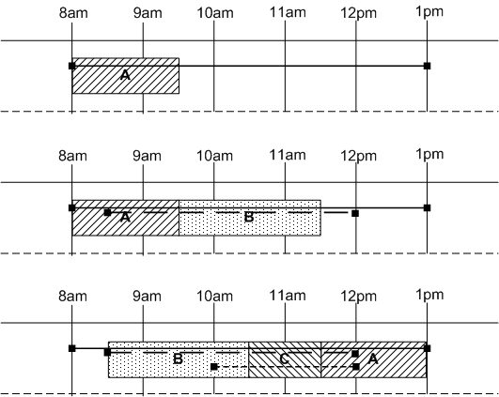
Fixed Bandwidth List Scheduling

Slide 12
DWDM-RAM Implementation
Applications
Replication,
Disk,
Accounting
Authentication,
Etc.
DHS
DTS
NRS
ftp,
GridFTP,
Sabul
Fast, Etc.
ODIN
OMNInet
Other
DWDM
…
λ’s
λ’s

Slide 13
Dynamic Optical Network
Gives adequate and uncontested bandwidth to an application’s burst
Employs circuit-switching of large flows of data to avoid overheads in breaking flows into small packets and delays routing
Is capable of automatic wavelength switching
Is capable of automatic end-to-end path provisioning
Provides a set of protocols for managing dynamically provisioned wavelengths

Slide 14
OMNInet Testbed
Four-node multi-site optical metro testbed network in Chicago -- the first 10GigE service trial when installed in 2001
Nodes are interconnected as a partial mesh with lightpaths provisioned with DWDM on dedicated fiber.
Each node includes a MEMs-based WDM photonic switch, Optical Fiber Amplifier (OFA), optical transponders, and high-performance Ethernet switch.
The switches are configured with four ports capable of supporting 10GigE.
Application cluster and compute node access is provided by Passport 8600 L2/L3 switches, which are provisioned with 10/100/1000 Ethernet user ports, and a 10GigE LAN port.
Partners: SBC, Nortel Networks, iCAIR/Northwestern University

Slide 15
Optical Dynamic Intelligent Network Services (ODIN)
Software suite that controls the OMNInet through lower-level API calls
Designed for high-performance, long-term flow with flexible and fine grained control
Stateless server, which includes an API to provide path provisioning and monitoring to the higher layers

Slide 16
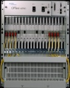

OMNInet
W Taylor
Sheridan
10 GE
λ
1
Photonic
Photonic
λ
10 GE
Optera
5200
10Gb/s
TSPR
λ
2
Node
Node
λ
1
10/100/
GE
10/100/
GE
PP
λ
2
Optera
5200
10Gb/s
TSPR
PP
8600
3
λ
3
λ
4
λ
4
8600
…
Optera 5200 OFA
#5 – 24 km
Optera Metro 5200 OFA
#6 – 24 km
10 λ
#2 – 10.3 km
EVL/UIC
OM5200
5200 OFA
Lake Shore
TECH/NU
OM5200
λ
1
10 GE
Photonic
10/100/
GE
Node
λ
2
Optera
5200
10Gb/s
TSPR
PP
10 λ
λ
3
8600
2 x gigE
λ
4
5200 OFA
StarLight
Interconnect
with other
research
networks
Grid
Clusters
LAC/UIC
OM5200
#8 – 6.7 km
#9 – 5.3 km
Grid Storage
#4 – 7.2 km
8x8x8λ Scalable photonic switch
Trunk side – 10G DWDM
OFA on all trunks
ASTN control plane
5200 OFA
S. Federal
10 GE
10GE LAN PHY (Aug 04)
Photonic
λ
1
Node
λ
2
Optera
5200
10Gb/s
TSPR
PP
λ
3
8600
10/100/
GE
WAN PHY interfaces
λ
4
1310 nm 10 GbE

Slide 17
Initial Performance measure:
End-to-End Transfer Time
File transfer request arrives
File transfer done, path released
0.5s
3.6s
0.5s
25s
0.14s
174s
0.3s
11s
Path Allocation request
ODIN Server Processing
Path ID returned
Network reconfiguration
FTP setup time
Data Transfer
20 GB
Path Deallocation
request
ODIN Server Processing

Slide 18
Transaction Demonstration Time Line
6 minute cycle time
Customer #2 Transaction Accumulation
#1 Transfer
#2 Transfer
#1 Transfer
#2 Transfer
Customer #1 Transaction Accumulation
-30 0 30 60 90 120 150 180 210 240 270 300 330 360 390 420 450 480 510 540 570 600 630 660
allocate path
de-allocate path
time (sec) →

Slide 19
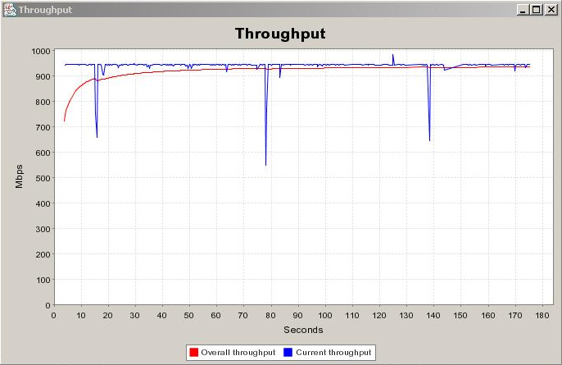
20GB File Transfer

Slide 20
Conclusion
The DWDM-RAM architecture yields Data Intensive Services that best exploit Dynamic Optical Networks
Network resources become actively managed, scheduled services
This approach maximizes the satisfaction of high-capacity users while yielding good overall utilization of resources
The service-centric approach is a foundation for new types of services

Slide 21
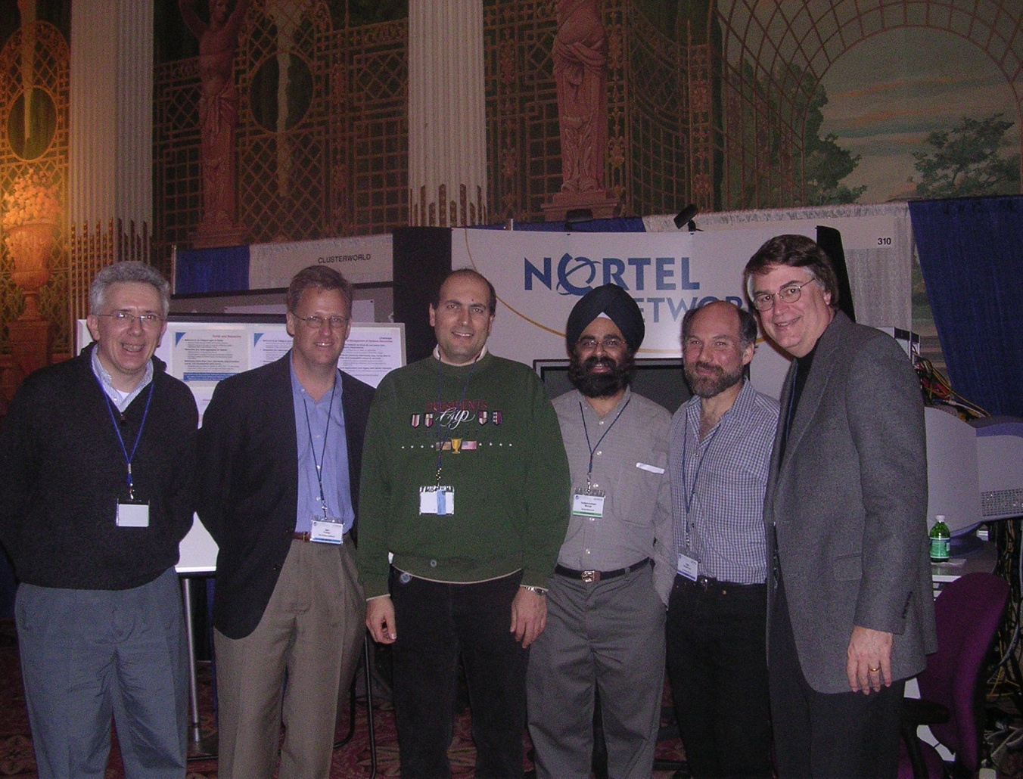
Some key folks checking us out at our CO2+Grid booth, GlobusWORLD ‘04, Jan ‘04
Ian Foster and Carl Kesselman, co-inventors of the Grid (2nd,5th from the left)
Larry Smarr of OptIPuter fame (6th and last from the left)
Franco, Tal, and Inder (1th, 3rd, and 4th from the left)

Slide 22
DWDM
RAM
DWDM
RAM
Data@LIGHTspeed
Defense Advanced Research Projects Agency
BUSINESS WITHOUT BOUNDARIES

Slide 23
Back up slides

Slide 24

Optical Abundant Bandwidth Meets Grid
The Data Intensive App Challenge:
Emerging data intensive applications in the field of HEP,
astro-physics, astronomy, bioinformatics, computational
chemistry, etc., require extremely high performance and
long term data flows, scalability for huge data volume,
global reach, adjustability to unpredictable traffic
behavior, and integration with multiple Grid resources.
Response: DWDM-RAM
An architecture for data intensive Grids enabled by next
generation dynamic optical networks, incorporating
new methods for lightpath provisioning. DWDM-RAM
is designed to meet the networking challenges of
extremely large scale Grid applications. Traditional
network infrastructure cannot meet these demands,
especially, requirements for intensive data flows
PBs Storage
Data-Intensive Applications
DWDM-RAM
Abundant Optical Bandwidth
Tbs on single fiber strand

Slide 25
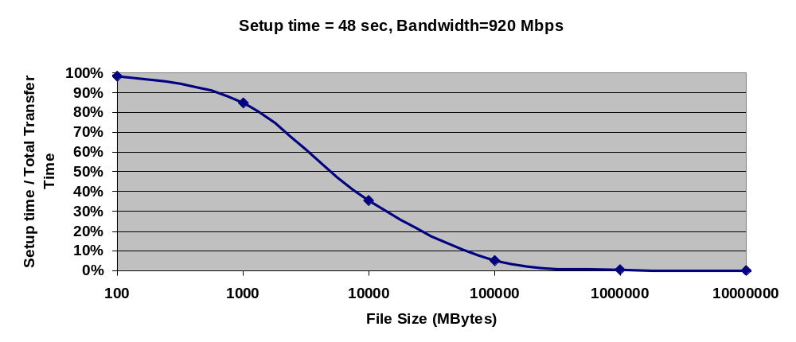
Overheads - Amortization
When dealing with data-intensive applications, overhead is insignificant!
500GB

Slide 26
Grids urged us to think End-to-End Solutions
Look past boxes, feeds, and speeds
Apps such as Grids call for a complex mix of:
        Bit-blasting
        Finesse (granularity of control)
        Virtualization (access to diverse knobs)
        Resource bundling (network AND …)
        Multi-Domain Security (AAA to start)
        Freedom from GUIs, human intervention
+
SOFTWARE!
+
+
+
+
Our recipe is a software-rich symbiosis of Packet and Optical products

Slide 27
NRS Interface and Functionality
// Bind to an NRS service:
NRS = lookupNRS(address);
//Request cost function evaluation
request = {pathEndpointOneAddress,
pathEndpointTwoAddress,
duration,
startAfterDate,
endBeforeDate};
ticket = NRS.requestReservation(request);
// Inspect the ticket to determine success, and to find
the currently scheduled time:
ticket.display();
// The ticket may now be persisted and used
from another location
NRS.updateTicket(ticket);
// Inspect the ticket to see if the reservation’s scheduled time has changed, or verify that the job completed, with any relevant status information:
ticket.display();

Slide 28
Application Level Measurements
File size: | 20 GB
Path allocation: | 29.7 secs
Data transfer setup time: | 0.141 secs
FTP transfer time: | 174 secs
Maximum transfer rate: | 935 Mbits/sec
Path tear down time: | 11.3 secs
Effective transfer rate: | 762 Mbits/sec

Slide 29
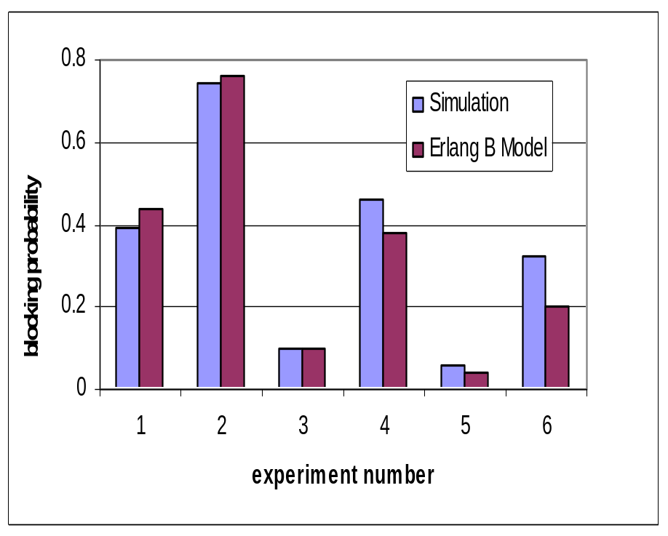
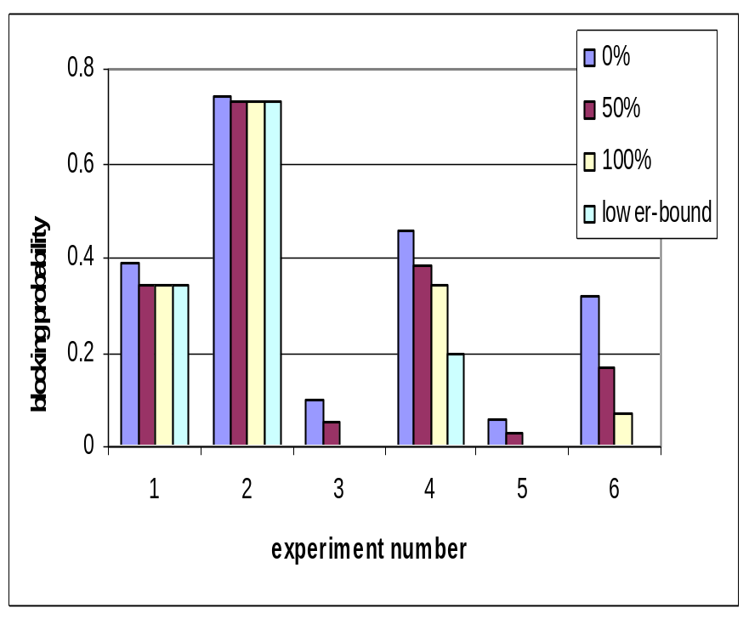
Network Scheduling – Simulation Study
Blocking probability
Under-constrained requests
Blocking Probability

Slide 30
The Network Resource Service (NRS)
Provides an OGSI-based interface to network resources
Request parameters
  Network addresses of the hosts to be connected
  Window of time for the allocation
  Duration of the allocation
  Minimum and maximum acceptable bandwidth (future)

Slide 31
The Network Resource Service
Provides the network resource
  On demand
  By advance reservation
Network is requested within a window
  Constrained
  Under-constrained

