Slide 1





DWDM
RAM
DWDM
RAM
Data@LIGHTspeed
A Platform for Large-Scale Grid Data Service on Dynamic High-Performance Networks
T. Lavian, D. B. Hoang, J. Mambretti, S. Figueira, S. Naiksatam, N. Kaushik,
I. Monga, R. Durairaj, D. Cutrell, S. Merrill, H. Cohen, P. Daspit, F. Travostino
Presented by Tal Lavian
Defense Advanced Research Projects Agency
BUSINESS WITHOUT BOUNDARIES

Slide 2
Topics
Limitations of Current IP Networks
Why Dynamic High-Performance Networks and DWDM-RAM?
DWDM-RAM Architecture
An Application Scenario
Testbed and DWDM-RAM Implementation
Experimental Results
Simulation Results
Conclusion

Slide 3
Limitations of Current Network Infrastructures
Packet-Switched Limitation
Packet switching is NOT appropriate for data intensive applications => substantial overhead, delays, CapEx, OpEx
Limited control and isolation of Network Bandwidth
Grid Infrastructure Limitation
Difficulty in encapsulating network resources
Notion of Network resources as scheduled Grid services.

Slide 4
Why Dynamic High-Performance Networks?
Support data-intensive Grid applications
Gives adequate and uncontested bandwidth to an application’s burst
Employs circuit-switching of large flows of data to avoid overheads in breaking flows into small packets and delays routing
Is capable of automatic end-to-end path provisioning
Is capable of automatic wavelength switching
Provides a set of protocols for managing dynamically provisioned wavelengths

Slide 5
Why DWDM-RAM ?
New platform for data intensive (Grid) applications
  Encapsulates “optical network resources” into a service framework to support dynamically provisioned and advanced data-intensive transport services
  Offers network resources as Grid services for Grid computing
  Allows cooperation of distributed resources
  Provides a generalized framework for high performance applications over next generation networks, not necessary optical end-to-end
  Yields good overall utilization of network resources

Slide 6
DWDM-RAM
The generic middleware architecture consists of two planes over an underlying dynamic optical network
  Data Grid Plane
  Network Grid Plane
The middleware architecture modularizes components into services with well-defined interfaces
DWDM-RAM separates services into 2 principal service layers
  Application Middleware Layer: Data Transfer Service, Workflow Service, etc.
  Network Resource Middleware Layer: Network Resource Service, Data Handler Service, etc.
And a Dynamic Lambda Grid Service over a Dynamic Optical Network

Slide 7
DWDM-RAM Architecture
Data-Intensive Applications
DTS API
Application
Middleware
Layer
Data
Transfer Service
NRS Grid Service API
Network Resource Service
Network Resource
Middleware
Layer
Data
Handler
Service
Basic Network
Resource
Service
Network
Resource
Scheduler
Information Service
λ OGSI-ification API
Dynamic Lambda, Optical Burst, etc., Grid services
Connectivity and
Fabric Layers
Optical path control
Data
Center
λ₁
λ₁
Data
Center
λ_{n}
λ_{n}

Slide 8
DWDM-RAM vs. Layered Grid Architecture
Layered DWDM-RAM
Layered Grid
Application
Application
“Coordinating multiple resources”: ubiquitous infrastructure services, app-specific distributed services
DTS API
Data Transfer
Service
Collective
Application
Middleware
Layer
“Sharing single resources”: negotiating access, controlling use
NRS Grid Service API
Network
Resource
Service
Resource
Network Resource
Middleware
Layer
“Talking to things”: communication (Internet protocols) & security
Data Lambda Grid
Service
λ OGSI-ification API
Connectivity &
Fabric Layer
Connectivity
Optical Control
Plane
“Controlling things locally”: Access to, & control of, resources
Fabric
λ’s
Notes:
We define Grid architecture in terms of a layered collection of protocols.
Fabric layer includes the protocols and interfaces that provide access to the resources that are being shared, including computers, storage systems, datasets, programs, and networks. This layer is a logical view rather then a physical view. For example, the view of a cluster with a local resource manager is defined by the local resource manger, and not the cluster hardware. Likewise, the fabric provided by a storage system is defined by the file system that is available on that system, not the raw disk or tapes.
The connectivity layer defines core protocols required for Grid-specific network transactions. This layer includes the IP protocol stack (system level application protocols [e.g. DNS, RSVP, Routing], transport and internet layers), as well as core Grid security protocols for authentication and authorization.
Resource layer defines protocols to initiate and control sharing of (local) resources. Services defined at this level are gatekeeper, GRIS, along with some user oriented application protocols from the Internet protocol suite, such as file-transfer.
Collective layer defines protocols that provide system oriented capabilities that are expected to be wide scale in deployment and generic in function. This includes GIIS, bandwidth brokers, resource brokers,….
Application layer defines protocols and services that are parochial in nature, targeted towards a specific application domain or class of applications. These are are are … arrgh

Slide 9
Data Transfer Service Layer
Presents an OGSI interface between an application and a system – receives high-level requests, policy-and-access filtered, to transfer named blocks of data
Reserves and coordinates necessary resources: network, processing, and storage
Provides Data Transfer Scheduler Service (DTS)
Uses OGSI calls to request network resources
Data Receiver
λ
Data Source
FTP client
FTP server
DTS
NRS
Client App

Slide 10
Network Resource Service Layer
Provides an OGSI-based interface to network resources
Provides an abstraction of “communication channels” as a network service
Provides an explicit representation of network resources scheduling model
Enables capabilities for dynamic on-demand provisioning and advance scheduling
Maintains schedules and provisions resources in accordance with the schedule

Slide 11
The Network Resource Service
On Demand
  Constrained window
  Under-constrained window
Advance Reservation
  Constrained window
    Tight window, fits the transference time closely
  Under-constrained window
    Large window, fits the transference time loosely
    Allows flexibility in the scheduling

Slide 12
Dynamic Lambda Grid Service
Presents an OGSI interface between the network resource service and the network resources of the underlying network
Establishes, controls, and deallocates complete paths across both optical and electronic domains
Operates over a dynamic optical network

Slide 13
An Application Scenario
A High Energy Physics group may wish to move 100 Terabytes data block from a particular run or set of events at an accelerator facility to its local or remote computational machine farm for extensive analysis
Client requests: “Copy data X to the local store on machine Y after 1:00 and before 3:00.”
Client receives a “ticket” which describes the resultant scheduling and provides a method for modifying and monitoring the scheduled job

Slide 14
An Application Scenario (cont’d)
At application level: Data Transfer Scheduler Service creates a tentative plan for data transfers that satisfies multiple requests over multiple network resources distributed at various sites
At middleware level: A network resource schedule is formed based on the understanding of the dynamical lightpath provisioning capability of the underlying network and its topology and connectivity
At resource provisioning level: Actual physical optical network resources are provisioned and allocated at the appropriate time for a transfer operation
Data Handler Service on the receiving node is contacted to initiate the transfer
At the end of the data transfer process, the network resources are de-allocated and returned to the pool

Slide 15
NRS Interface and Functionality
// Bind to an NRS service:
NRS = lookupNRS(address);
//Request cost function evaluation
request = {pathEndpointOneAddress,
pathEndpointTwoAddress,
duration,
startAfterDate,
endBeforeDate};
ticket = NRS.requestReservation(request);
// Inspect the ticket to determine success, and to find
the currently scheduled time:
ticket.display();
// The ticket may now be persisted and used
from another location
NRS.updateTicket(ticket);
// Inspect the ticket to see if the reservation’s scheduled time has changed, or verify that the job completed, with any relevant status information:
ticket.display();

Slide 16

Testbed and Experiments
Experiments have been performed on the OMNInet
  End-to-end FTP transfer over a 1Gbps link
DATA GRID SERVICE PLANE
GRID Service Request
Service
Control
Service
Control
NETWORK SERVICE PLANE
Network Service Request
ODIN
OmniNet Control Plane
ODIN
Optical Control Network
UNI-N
UNI-N
Data
Path
Control
Data
Path
Control
Connection
Control
Data Transmission Plane
Data
Center
λ₁
λ₁
Data
storage
switch
λ_{n}
λ_{n}
L3 router
Data
Center
L2 switch
λ₁
λ_{n}
Data
Path

Slide 17
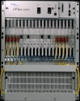

OMNInet Testbed
W Taylor
Sheridan
10 GE
λ
1
Photonic
Photonic
λ
10 GE
Optera
5200
10Gb/s
TSPR
λ
2
Node
Node
λ
1
10/100/
GE
10/100/
GE
PP
λ
2
Optera
5200
10Gb/s
TSPR
PP
8600
3
λ
3
λ
4
λ
4
8600
…
Optera 5200 OFA
#5 – 24 km
Optera Metro 5200 OFA
#6 – 24 km
10 λ
#2 – 10.3 km
EVL/UIC
OM5200
5200 OFA
Lake Shore
TECH/NU
OM5200
λ
1
10 GE
Photonic
10/100/
GE
Node
λ
2
Optera
5200
10Gb/s
TSPR
PP
10 λ
λ
3
8600
2 x gigE
λ
4
5200 OFA
StarLight
Interconnect
with other
research
networks
Grid
Clusters
LAC/UIC
OM5200
#8 – 6.7 km
#9 – 5.3 km
Grid Storage
#4 – 7.2 km
8x8x8λ Scalable photonic switch
Trunk side – 10G DWDM
OFA on all trunks
ASTN control plane
5200 OFA
S. Federal
10 GE
10GE LAN PHY (Oct 04)
Photonic
λ
1
Node
λ
2
Optera
5200
10Gb/s
TSPR
PP
λ
3
8600
10/100/
GE
WAN PHY interfaces
λ
4
1310 nm 10 GbE

Slide 18
The Network Resource Scheduler Service
Under-constrained window
Request for 1/2 hour between 4:00 and 5:30 on Segment D granted to User W at 4:00
New request from User X for same segment for 1 hour between 3:30 and 5:00
Reschedule user W to 4:30; user X to 3:30. Everyone is happy.
W
3:30
4:00
4:30
5:00
5:30
X
3:30
4:00
4:30
5:00
5:30
W
X
3:30
4:00
4:30
5:00
5:30
Route allocated for a time slot; new request comes in; 1st route can be rescheduled for a later slot within window to accommodate new request

Slide 19
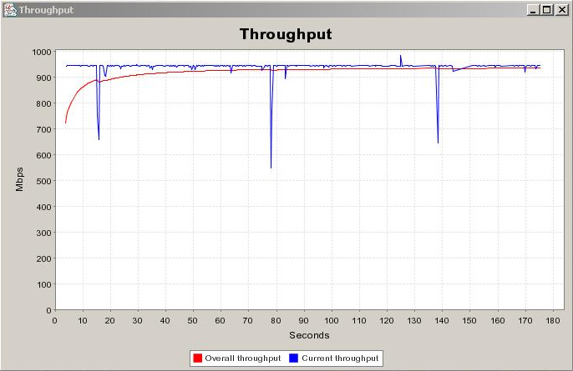
20GB File Transfer

Slide 20
Initial Performance measure:
End-to-End Transfer Time
File transfer request arrives
File transfer done, path released
0.5s
3.6s
0.5s
25s
0.14s
174s
0.3s
11s
Path Allocation request
ODIN Server Processing
Path ID returned
Network reconfiguration
FTP setup time
Data Transfer
20 GB
Path Deallocation
request
ODIN Server Processing

Slide 21
Transaction Demonstration Time Line
6 minute cycle time
Customer #2 Transaction Accumulation
#1 Transfer
#2 Transfer
#1 Transfer
#2 Transfer
Customer #1 Transaction Accumulation
-30 0 30 60 90 120 150 180 210 240 270 300 330 360 390 420 450 480 510 540 570 600 630 660
allocate path
de-allocate path
time (sec) →

Slide 22
Conclusion
The DWDM platform forges close cooperation between data intensive Grid applications and network resources
The DWDM-RAM architecture yields Data Intensive Services that best exploit Dynamic Optical Networks
Network resources become actively managed, scheduled services
This approach maximizes the satisfaction of high-capacity users while yielding good overall utilization of resources
The service-centric approach is a foundation for new types of services

Slide 23
Back up slides

Slide 24
DWDM-RAM Prototype Implementation
Applications
Replication,
Disk,
Accounting
Authentication,
Etc.
DHS
DTS
NRS
ftp,
GridFTP,
Sabul
Fast, Etc.
ODIN
OMNInet
Other
DWDM
…
λ’s
λ’s
DWDM-RAM October 2003

Slide 25
DWDM-RAM Service Control Architecture
DATA GRID SERVICE PLANE
GRID Service Request
Service
Control
Service
Control
NETWORK SERVICE PLANE
Network Service Request
ODIN
OmniNet Control Plane
ODIN
Optical Control Network
UNI-N
UNI-N
Data
Path
Control
Data
Path
Control
Connection
Control
Data Transmission Plane
Data
Center
λ₁
λ₁
Data
storage
switch
λ_{n}
λ_{n}
L3 router
Data
Center
L2 switch
λ₁
λ_{n}
Data
Path

Slide 26
Application Level Measurements
File size: | 20 GB
Path allocation: | 29.7 secs
Data transfer setup time: | 0.141 secs
FTP transfer time: | 174 secs
Maximum transfer rate: | 935 Mbits/sec
Path tear down time: | 11.3 secs
Effective transfer rate: | 762 Mbits/sec

Slide 27
The Network Resource Service (NRS)
Provides an OGSI-based interface to network resources
Request parameters
  Network addresses of the hosts to be connected
  Window of time for the allocation
  Duration of the allocation
  Minimum and maximum acceptable bandwidth (future)

Slide 28
The Network Resource Service
Provides the network resource
  On demand
  By advance reservation
Network is requested within a window
  Constrained
  Under-constrained

Slide 29
OMNInet Testbed
Four-node multi-site optical metro testbed network in Chicago -- the first 10GigE service trial when installed in 2001
Nodes are interconnected as a partial mesh with lightpaths provisioned with DWDM on dedicated fiber.
Each node includes a MEMs-based WDM photonic switch, Optical Fiber Amplifier (OFA), optical transponders, and high-performance Ethernet switch.
The switches are configured with four ports capable of supporting 10GigE.
Application cluster and compute node access is provided by Passport 8600 L2/L3 switches, which are provisioned with 10/100/1000 Ethernet user ports, and a 10GigE LAN port.
Partners: SBC, Nortel Networks, iCAIR/Northwestern University

Slide 30
Optical Dynamic Intelligent Network Services (ODIN)
Software suite that controls the OMNInet through lower-level API calls
Designed for high-performance, long-term flow with flexible and fine grained control
Stateless server, which includes an API to provide path provisioning and monitoring to the higher layers

Slide 31
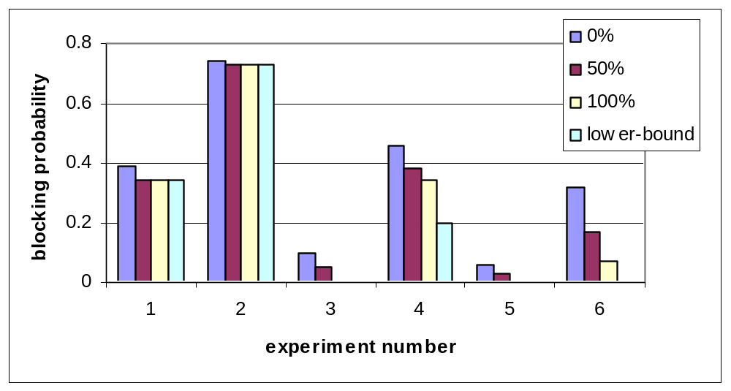
Blocking probability
Under-constrained requests

Slide 32
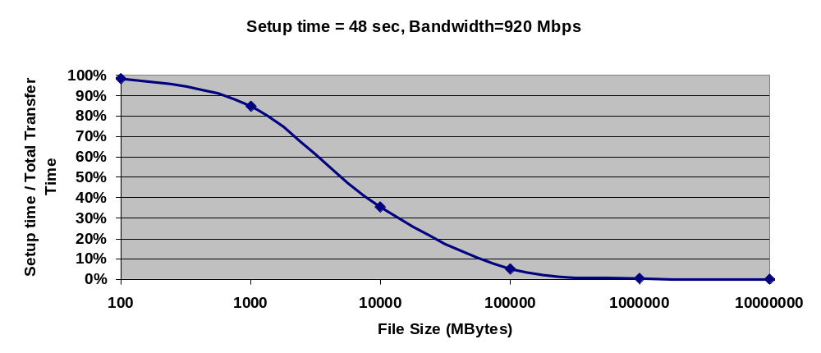
Overheads - Amortization
When dealing with data-intensive applications, overhead is insignificant!
500GB

Slide 33
Grids urged us to think End-to-End Solutions
Look past boxes, feeds, and speeds
Apps such as Grids call for a complex mix of:
        Bit-blasting
        Finesse (granularity of control)
        Virtualization (access to diverse knobs)
        Resource bundling (network AND …)
        Multi-Domain Security (AAA to start)
        Freedom from GUIs, human intervention
+
SOFTWARE!
+
+
+
+
Our recipe is a software-rich symbiosis of Packet and Optical products

Slide 34

Optical Abundant Bandwidth Meets Grid
The Data Intensive App Challenge:
Emerging data intensive applications in the field of HEP,
astro-physics, astronomy, bioinformatics, computational
chemistry, etc., require extremely high performance and
long term data flows, scalability for huge data volume,
global reach, adjustability to unpredictable traffic
behavior, and integration with multiple Grid resources.
Response: DWDM-RAM
An architecture for data intensive Grids enabled by next
generation dynamic optical networks, incorporating
new methods for lightpath provisioning. DWDM-RAM
is designed to meet the networking challenges of
extremely large scale Grid applications. Traditional
network infrastructure cannot meet these demands,
especially, requirements for intensive data flows
PBs Storage
Data-Intensive Applications
DWDM-RAM
Abundant Optical Bandwidth
Tbs on single fiber strand

