Slide 1
Impact of Grid Computing on Network Operators and HW Vendors
Hot Interconnect @ Stanford
Tal Lavian
tlavian@ieee.org
Advanced Technology Research , Nortel Networks
August 18th, 2005
Notes:
Nortel Corporate Presentation
© 2004 Nortel

Slide 2
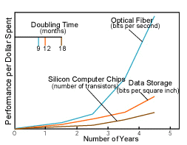
Optical Networks Change the Current Pyramid
x10
George Stix,
Scientific American,
January 2001
DWDM- fundamental miss-balance between computation and communication
5 Years – x10 gap, 10 years- x100 gap
Notes:
Nortel Corporate Presentation
© 2004 Nortel

Slide 3
Waste Bandwidth
“A global economy designed to waste transistors, power, and silicon area -and conserve bandwidth above all- is breaking apart and reorganizing itself to waste bandwidth and conserve power, silicon area, and transistors.“ George Gilder Telecosm
Notes:
Nortel Corporate Presentation
© 2004 Nortel

Slide 4
The “Network” is a Prime Resource for Large- Scale Distributed System
Computation
Visualization
Network
Person
Storage
Instrumentation
Integrated SW System Provide the “Glue”
  Dynamic optical network as a fundamental Grid service in data-intensive Grid application, to be scheduled, to be managed and coordinated to support collaborative operations
Notes:
Nortel Corporate Presentation
© 2004 Nortel

Slide 5
From Super-computer to Super-network
In the past, computer processors were the fastest part
  peripheral bottlenecks
In the future optical networks will be the fastest part
  Computer, processor, storage, visualization, and instrumentation - slower "peripherals”
eScience Cyber-infrastructure focuses on computation, storage, data, analysis, Work Flow.
  The network is vital for better eScience
Notes:
Nortel Corporate Presentation
© 2004 Nortel

Slide 6
Grid Network Limitations in L3
Radical mismatch between the optical transmission world and the electrical forwarding/routing world.
  Currently, a single strand of optical fiber can transmit more bandwidth than the entire Internet core.
Transmit 1.5TB over 1.5KB packet size
  →1 Billion identical lookups
Mismatch between L3 core capabilities and disk cost
  With $2M disks (6PB) can fill the entire core internet for a year
L3 networks can’t handle these amounts effectively, predictably, in a short time window
  L3 network provides full connectivity -- major bottleneck
  Apps optimized to conserve bandwidth and waste storage
  Network does not fit the “e-Science Workflow” architecture
Prevents true Grid Virtual Organization (VO) research collaborations
Notes:
Nortel Corporate Presentation
© 2004 Nortel

Slide 7
Lambda Grid Service
Need for Lambda Grid Service architecture that interacts with Cyber-infrastructure, and overcome data limitations efficiently & effectively by:
  treating the “network” as a primary resource just like “storage” and “computation”
  treat the “network” as a “scheduled resource”
  rely upon a massive, dynamic transport infrastructure: Dynamic Optical Network
Notes:
Nortel Corporate Presentation
© 2004 Nortel

Slide 8
Generalization and Future Direction for Research
Need to develop and build services on top of the base encapsulation
Lambda Grid concept can be generalized to other eScience apps which will enable new way of doing scientific research where bandwidth is “infinite”
The new concept of network as a scheduled grid service presents new and exciting problems for investigation:
  New software systems that is optimized to waste bandwidth
    Network, protocols, algorithms, software, architectures, systems
  Lambda Distributed File System
  The network as a Large Scale Distributed Computing
  Resource co/allocation and optimization with storage and computation
  Grid system architecture
  enables new horizon for network optimization and lambda scheduling
  The network as a white box, Optimal scheduling and algorithms
Notes:
Nortel Corporate Presentation
© 2004 Nortel

Slide 9
Enabling new degrees of App/Net coupling
Optical Packet Hybrid
  Steer the herd of elephants to ephemeral optical circuits (few to few)
  Mice or individual elephants go through packet technologies (many to many)
  Either application-driven or network-sensed; hands-free in either case
  Other impedance mismatches being explored (e.g., wireless)
Application-engaged networks
  The application makes itself known to the network
  The network recognizes its footprints (via tokens, deep packet inspection)
  E.g., storage management applications
Workflow-engaged networks
  Through workflow languages, the network is privy to the overall “flight-plan”
  Failure-handling is cognizant of the same
  Network services can anticipate the next step, or what-if’s
  E.g., healthcare workflows over a distributed hospital enterprise
DRAC - Dynamic Resource Allocation Controller
Notes:
Nortel Corporate Presentation
© 2004 Nortel

Slide 10
Teamwork
from/to peering DRACs
AAA
DRAC, portable SW
Negotiate
Detect
supply
events
Alert, Adapt,
Route, Accelerate
supply
events
demand
dynamic provisioning plane
virtualization plane
connectivity plane
Agile
Network(s)
Application(s)
NE
Application
Admin.
Notes:
Nortel Corporate Presentation
© 2004 Nortel

Slide 11










SC2004 CONTROL CHALLENGE
Chicago
Amsterdam
Application
Application
control
Services
Services
Services
control
AAA
AAA
AAA
AAA
DRAC*
DRAC
DRAC
DRAC
data
data
OMNInet
Starlight
Netherlight
UvA
ODIN
SNMP
ASTN
* Dynamic Resource Allocation Controller
finesse the control of bandwidth across multiple domains
while exploiting scalability and intra- , inter-domain fault recovery
thru layering of a novel SOA upon legacy control planes and NEs
Notes:
Nortel Corporate Presentation
© 2004 Nortel

Slide 12



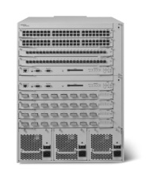

GT4
GT4
A
B
Multi-Resource Orchestration
GW05 Floor
DRAC
DRAC
Internet (Slow)
Grid Network Services
www.nortel.com/drac
Grid Network Services
www.nortel.com/drac
GT4
GT4
Fiber (FA$T)
A
A
GT4
GT4
OM3500
OM3500
B
B
Make the Network part of the GT4 - WSRF - SOA Equation
Notes:
Nortel Corporate Presentation
© 2004 Nortel

Slide 13
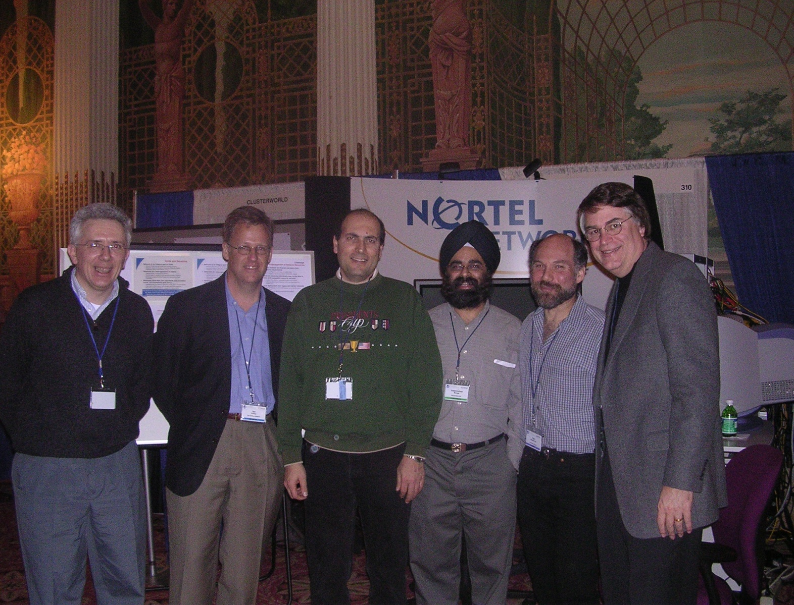
Some key folks checking us out at our booth,
GlobusWORLD ‘04, Jan ‘04
Notes:
Nortel Corporate Presentation
© 2004 Nortel

