Slide 1
Intelligent Network Services through
Active Flow Manipulation
T. Lavian, P. Wang, F. Travostino,
S. Subramanian, D. Hoang, V. Sethaput
Nortel Networks, UC Berkeley, Harvard U
Notes:
Intelligent Network Services through Active Flow Manipulation
T. Lavian, P. Wang, F. Travostino,
S. Subramanian, D. Hoang, V. Sethaput
NORTEL Networks
ABSTRACT
A significant challenge in today's Internet is the
ability to efficiently introduce intelligent network
services into commercial high performance network
devices. This paper tackles the challenge by intro-ducing
the Active Flow Manipulation (AFM) mechanism,
a key enabling technology of the
programmable networking platform Openet. AFM
enhances the control functionality of network devices
through programmability. With AFM, customer
network services can exercise intelligent network
control by identifying specific flows and applying
particular actions thereby altering their behavior in
real-time. These services are dynamically deployed
in the CPU-based control plane and are closely cou-pled
with the silicon-based forwarding plane of the
network node, without negatively impacting forwarding
performance. The effectiveness of our approach
is demonstrated by several experimental
applications on a commercial network node.

Slide 2
Outline
Introduction
Network Element – Control Plane/Forwarding Plane
Active Flow Manipulation (AFM) abstractions
OPENET
Examples
Conclusion

Slide 3
Programmability
A significant challenge in today’s Internet is the ability to efficiently incorporate customizable network intelligence in commercial high performance network devices.
  Framework for introducing services
  API for programming network devices

Slide 4
Network Element
Software: routing protocols,
Network management, etc.
Limited control of the forwarding plane
Routers are not reprogrammable (except by vendors)
Users can only see IP/ICPM packets, but have no direct control over the internal handling of their data.
ASIC: packet forwarding

Slide 5
Programmable Network Element
Routing
Signaling
Controllers
Software: routing protocols,
Network management, etc.
Router Control Interface
Local Resource Manager
ASIC: packet forwarding
Classifier
Scheduler
Routing

Slide 6
Active Flow Manipulation Abstractions
Aggregate data into traffic flows
  Flows whose characteristics can be identified in real-time
  E.g., “all UDP packets to a particular service”, “all TCP packets from a particular machine”.
Actions to be performed in the traffic flows
  Actions that can be performed in real-time
  E.g., “Change the priority of all traffic destined to a particular service on a particular machine”, “Stop all traffic out of a particular link of a router”.

Slide 7
Identifiable Elements of Primitive Flows
Destination Address (DA)
Range of Destination Address (RDA)
Source Address (SA)
Range of Source Address (RSA)
Exact TCP protocol match (TCP)
Exact UDP protocol match (UDP)
Exact ICMP protocol match (ICMP)
Source Port number, for both TCP and UDP (SP)
Destination Port number for both TCP and UDP (DP)
TCP connection request (TCPReg)
ICMP request (ICMPReg)
DS field of a datagram (DS)
IP Frame fragment (FrameFrag)

Slide 8
Primitive Permissible actions
Drop
Forward
Mirror
Stop on Match (SOM)
Detect Out of Profile behaviour (Out)
Change DSCP value (DSCP)
Prevent TCP Connect Request
Modify IEEE 802.1p bit

Slide 9
A subset of flows
Destination Address (DA)
All traffic to a particular destination machine
Range of DA
All traffic to a range of destination machines
Source Address (SA)
All traffic between 2 particular machines
Range of SAs
All traffic from many source machines to a particular destination
TCP
All TCP flows to a particular destination machine
UDP
All data gram packets to a particular destination machine
ICMP
All ICMP messages to a particular destination machine
ICMP Request
All ICMP requests to a particular destination machine
TCP ACK
All TCP acknowledgements to a particular destination machine
TCP RST
All TCP connection with the RST bit set
DP (TCP)
All TCP flows to a particular service in a particular server machine
DP (UDP)
All UDP datagram to a particular service in a particular machine
SA-SP (TCP)
All TCP flows from particular client of a source to a destination
SA-SP (UDP)
All UDP datagram from a client of a source to a destination
IP Fragments
All IP fragments to a particular destination machine
DS Field
All traffic of a particular QoS class to a particular destination
VLAN
All traffic from a particular VLAN to a particular destination
Switch-Port
All traffic on a particular switch port to a particular destination

Slide 10
New Capabilities
Allow introducing services and control on demands dynamically
  Services can be any general network applications
  Control on demands to manipulate flows and flow aggregates
Allowing dynamic and mobile agents
Respond quickly to changes in traffic conditions.
Cope with unforeseen requirements
Extending router functionality (optimization)
Multiple control elements are installed at routers or hosts and they collaborate to achieve some overall objective.

Slide 11
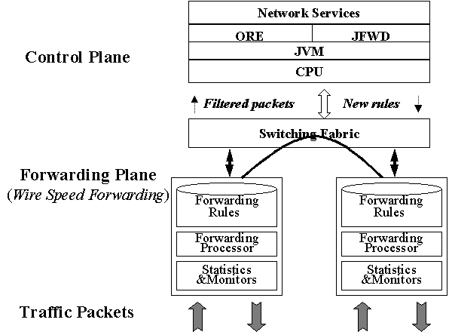
Openet Architecture

Slide 12
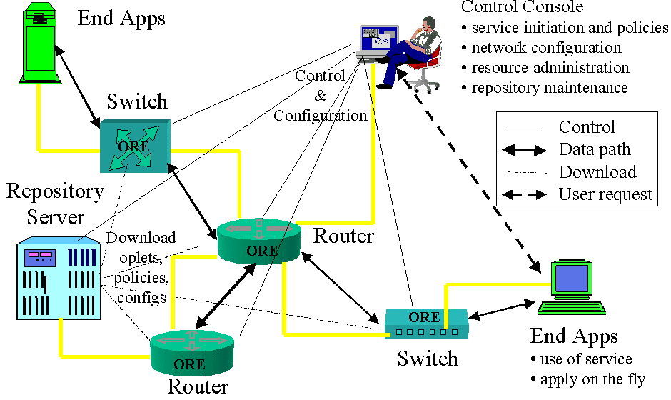
Openet: Passport Implementation

Slide 13
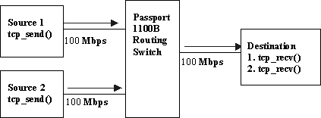
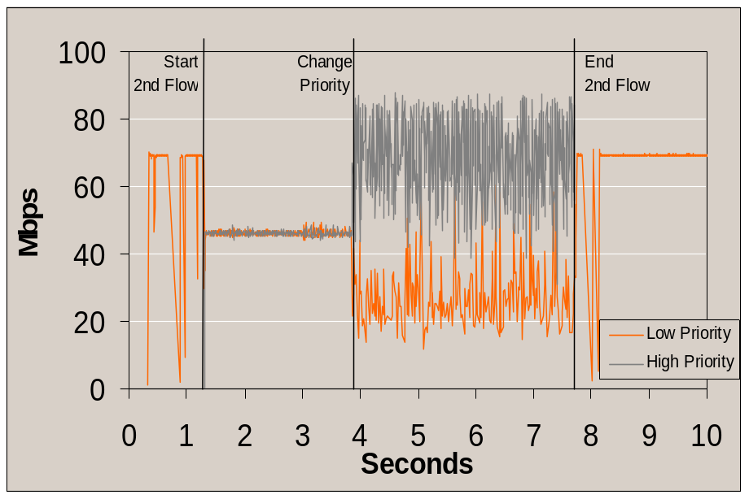
Active Flow Priority Change in Real-time

Slide 14
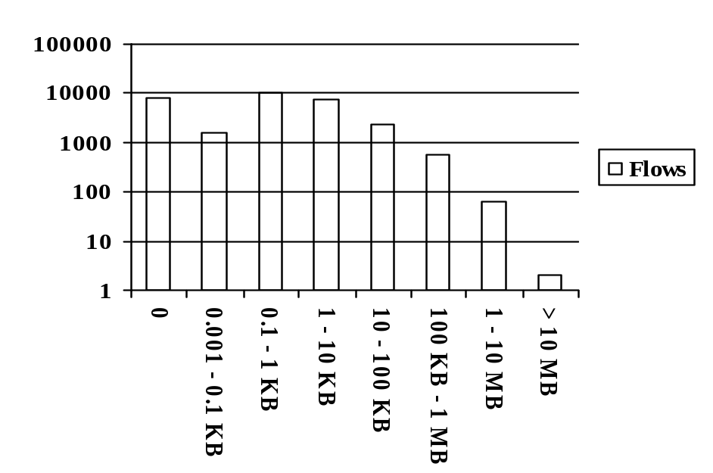
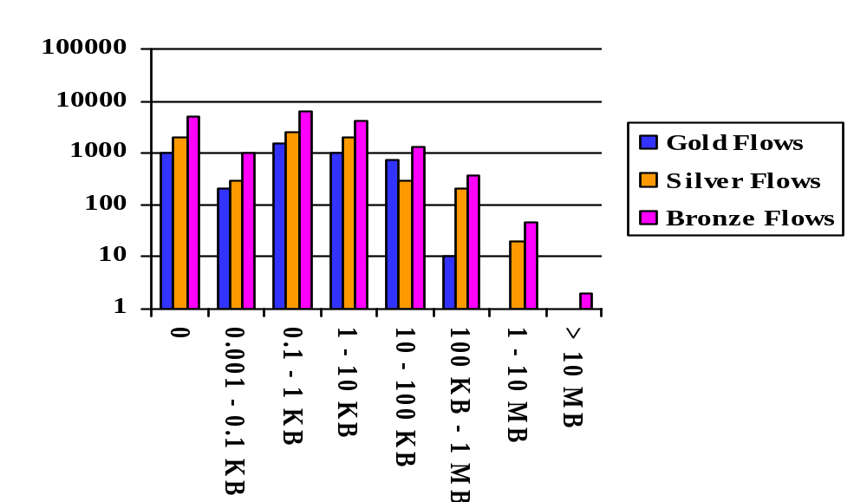
AIACE
Number of flows (log)
Number of flows (log)
7
3
2
1
8
6
5
4
7
4
6
5
3
8
2
1
Bytes carried
in 30 secs.
In this example, a network-node organizes about 2 million PDU traces into 30,000 IP flows. It classifies the resulting flows based on the bytes transferred on each flow. It then ranks flows (from 1 to 8). The higher the rank number, the higher the chance that the flow will not be transferred to the accounting server in case of data overload.
The node now structures the same accounting data into QoS-flavored flows (same X and Y axis as in a). After applying a QoS-specific weighting algorithm to the flows, the node ranks flows with different results than a). The weighting algorithm can be arbitrarily complex and take into account other considerations besides bytes transferred (e.g., hosts, number of packets, duration).

Slide 15
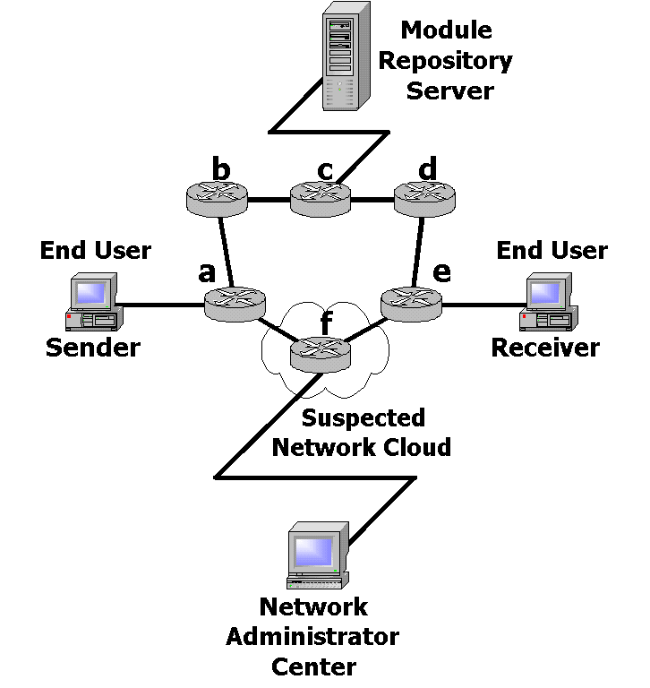
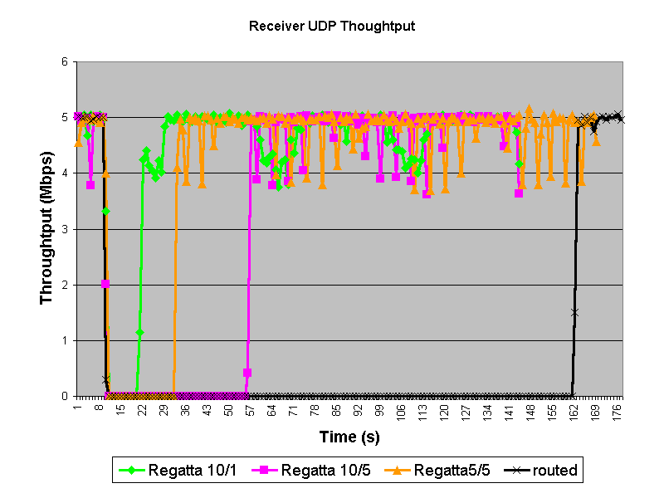
Regatta: Dynamic flow bypass

Slide 16
Regatta: Reactivity times
Flow Path
Reactivity Time (s)
Static route
Infinite
Routed
152
Regatta 10/1
10
Regatta 10/5
47
Regatta 5/5
24
Regatta M/HB
≈M*HB

Slide 17
Conclusions
AFM enables dynamic introduction of services
AFM enables rapid network response to changing conditions
AFM in a powerful control plane can lead to sophisticated control over forward plane
AFM allows practical implementation of programmability in a real world network device

