Slide 1
Unified Device Management via Java-enabled Network Devices
Tal Lavian
Rob Duncan

Slide 2
Agenda
Unified Management for Unified Networks
Openness - Virtual community development, Domain experts
Open Service Interface - values
Architecture and technology concepts
Strong security
Java SNMP MIB API
Summary

Slide 3
Purpose
To introduce the new Open Networking Architecture that is based on Java-enabled Network Devices

Slide 4


Unified Management
O B J E C T I V E
Unified management
Java on all devices
Unique value of Java
S O L U T I O N
Java “Optlets” on all devices
Security and Directory
B E N E F I T S
Unified Management
Java-Enabled Network Devices

Slide 5
Community Openness
Success stories by large community of developers
Net-Based developers’ communities
  Linux, GNU, Apache, BSD, X-Windows, Perl, Tk/Tcl
  Netscape browser, NFS, JDK, JVM
Linux everywhere:
  Compaq, HP, IBM, SUN and SGI.
  Intel, Sparc64, Alpha, PowerPC
The Web Changes everything
  Java, XML, E-Business

Slide 6
Open Service Interface - Value Propositions
An open device software architecture enabler that:
  Reduces development cost by enabling cross-platform development.
  Improves TTM through “feature-on-demand” capabilities.
  Increases product differentiation by allowing incremental customization of products.

Slide 7
Open Service Interface - Value Propositions Cont.
An open device software architecture enabler that:
  Enhances scalability and flexibility for distributed deployment of management and IP services.
  Facilitates innovation by opening devices to third party developers.
  Provides incremental revenue through potential consulting/ customization services.

Slide 8
Open Service Interface - Levels of Adoption
Phase 4
New Type of
Applications
Innovation
Imagination
Value
Phase 3
Distributed
Applications
Framework
Common distributed features.
Distributed NMS applications “Optlets”.
Mobile Agents
Phase 2
Open
Systems
Architecture
Opening up of APIs for:-
- Customers.
- Consulting services.
- 3rd party ISVs.
Phase 1
Device Level
Enabling
Technology
Selected device implementation.
Feature-on-demand capability.
Development efficiency.
Time

Slide 9
Java-enabled Network Devices
What we have accomplished:
  Java-enabled Device Architecture
  JVM for Switch, Router
  JVM for Network device
  Java SNMP MIB API
    include proxy mode for devices with no JVM,

Slide 10




Technology Concept
“Reversed Applets”
Applet
Web Browser
Web Server
The JVM is in the Browser
Technology is based on the concept of Reversed-Applets
Java Beans
Optlets
Reversed Applets
NMS
The JVM is in the Device

Slide 11
Potential Applications
“Feature-on-demand” for devices
New class of system level Optivity applications in the form of distributed “Optlets”
  Characterized by system applications that require intensive interaction between NMS and device and/or across multiple devices.
  Potential applications are topology, design analysis, diagnostics, policy implementations.

Slide 12
Benefits and Value
Enabling component of a new intelligent network architecture
  Distributed applications-on-demand.
  Component of AI (artificial intelligence) enabling infrastructure.
  Roaming diagnostics and self-healing capabilities.
  Built-in support for open industry ISV support.

Slide 13
Example - Local Intelligence
Monitor
Security
Intelligence
Authentication
Download
On-demand
React
JVM
OS
HW
Network Device

Slide 14
Application Example
NMS
Download Intelligent Agent Monitor from NMS to the device.
Wait for threshold.
  Might be complex conditions
Send “condition exceeded” event to NMS.
Automatic download appropriate application
Application takes action.
Monitor
Download
Complex Condition
Exceeded
Appropriate
Application
Download

Slide 15
System Architecture
Optivity
Browser
HTTP
Applets
SNMP
“Optlets”
RMI
App Server
Java Beans
Digital Signature
Authentication
Server
Routing Switches
Applets
HTTP
Web Server
“Optlets” = Distributed Optivity Applications

Slide 16
Open Device Architecture
C/C++
API
Java
API
“Optlet”
Java
Bean
Download
Device
Code
Java
Bean
Java Lib
JNI
DataCom API
Device
Drivers
Native
Code
JVM
Operating System
Device HW

Slide 17
JSCP System diagram
Java Applications
JVM
Java Libraries
Services
Reset
Clean-up
Configuration
Event Mapping
Monitor Thread
JNI
Memory
Manager
Scheduler
Context
Switch
Native Applications
RTOS & Hardware

Slide 18
Strong Security in the new model
The new concept is secure to add 3rd party code to Nortel devices
  Digital Signature
  Nortel “Certified Optlet”
  No access out of the JVM space
  No pointers to harm the work
  Access only to the published API
  Verifier - only correct code can be loaded
  Class loader access list
    Different Optles with different access levels
  JVM has run time bounds, type, and executing checking

Slide 19
Old model Security (C/C++)
Old model - Not secure to add 3rd party code
  Not recommended to add 3rd party code
  Dangerous, C/C++ Pointers
    Can touch sensitive memory location
  Risk: Memory allocations and free
    Allocation without freeing
    Free without allocation (core dump !!!! )
Limited security in SNMP

Slide 20
Java SNMP MIB API
Portable across a range of network devices
Extensible
Simple and convenient for client use
Consistent with SNMP model
Hide unnecessary SNMP details
Permit optimized access
Re-use MIB documentation

Slide 21
MIB API Generation
Most of the Java code is generated automatically
ASN.1 MIB definitions are converted into Java classes
Documentation and commentary in the MIB definitions is placed as Javadoc formal comments
HTML documentation generated from Javadoc

Slide 22
MIB Objects
The MIB data model is structured as a tree
API represents MIB groups with Java classes
MIB variables are represented with accessor methods
Conceptual tables are represented with iterators
API converts SNMP data values into standard Java types

Slide 23
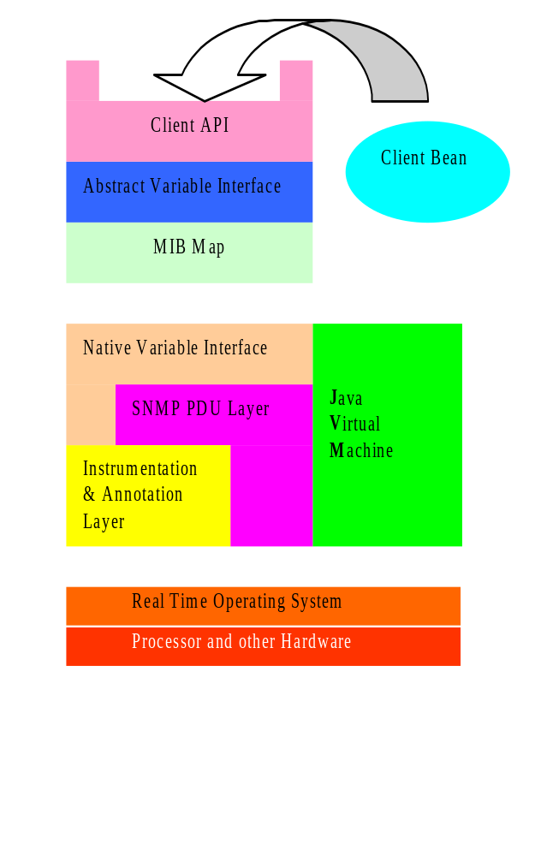
JSNMP MIB API Architecture
API uses a MIB Map to dispatch requests to variable access routines
Different parts of the MIB tree can be serviced by different mechanisms
Two main schemes:
An ad hoc interface to the SNMP instrumentation layer
A generic SNMP loopback

Slide 24
Advantages of MIB map
Allows immediate generic implementation of the entire MIB via the loopback scheme
Enables optimized native implementation of key MIB variables for maximum efficiency
Permits definition of pseudo-MIB variables for extending MIB dynamically
Provides site for centralized access management

Slide 25



Java MIB API - Proxy mode
Uses SNMP loopback mechanism to target a remote network element
API can be used to control devices that don’t have an embedded JVM
JSNMP API
Proxy mode
Java “Optlet”
SNMP
Router
with No JVM
JVM on PC
Java Server

Slide 26
Summary
Openness - successfully proven paradigm
Domain experts - virtual community
Allows innovations and added value
dynamic agents vs. static agents
Dynamic Loading
Strong Security
An enabling-technology
Take it, and make it work for you

