Slide 1
Openet:
Open Networking through Programmability
Tal Lavian
tlavian@ieee.org
Nortel Network, Advanced Technology Lab

Slide 2
Agenda
Two Evolutions: computer vs network
Openet: open networking approach
DARPA-Funded Project: Openet/Alteon & Research Platform
EE CS Collaboration
Openet Features and Applications
Summary

Slide 3
Think of computer evolution …
Applications
OSs
Peripherals
Hardware
IBM
CDC
Digital
Amdel
1980s - Vertical Industry
2000s - Horizontal Industry

Slide 4
The inflection point is quickly approaching …
What’s network evolution?
Network &
Mgmt services
?
Embedded
OS
System
ASICs
Cisco
Nortel
Juniper
Lucent
“2000s Vertical Network Industry
Horizontal Network Industry

Slide 5

Why Open Networking?
Open network boxes to public
  Current network devices are close systems
Intelligence to network nodes because
  Internet infrastructure evolves slow
  Customers can not add new services
Better use of network resources
  Abundant bandwidth
  Diversified clients’ needs
Move Turing Machine onto Device
  Add local intelligence to network devices
while (true) doLocalProcessingOnDevice();

Slide 6
Challenges and Solution
Commercial network devices have
  Ever more use of hardware acceleration
    Static and well-defined protocols and services
  Little flexibility to introduce users’ intelligence
    Allowing configuration rather than value addition
Active Networks requires
  Open boxes to users
  Networking programmability
Our solution
  Openet
    A programmable networking platform across devices
  Active Services through Openet
  Wire-speed data plane, powerful computation in the control plane

Slide 7
The Openet Approach
Open networking through programming
  A Service-enabled networking platform
  Intelligence to commercial network devices
    Network control and management
    Packet forwarding and processing
  Not impeding network performance and reliability
    Forwarding
    Security
Enabling service creation and deployment
  Value-added services across network elements
  Dynamic and downloadable
Standards and Partners
  IEEE, IETF, Active Networks and FAIN
  Columbia U., UC Berkeley
  MITRE, TASC, and CSIRO

Slide 8
Openet Architecture
Applications
ORE
System Services
Control Plane
CPU System
Monitor status
New rules
Switching Fabric
Data Plane
(Wire Speed Forwarding)
Forwarding
Rules
Forwarding
Rules
Forwarding
Rules
. . .
Forwarding
Processor
Forwarding
Processor
Forwarding
Processor
Statistics
&Monitors
Statistics
&Monitors
Statistics
&Monitors
Traffic Packets

Slide 9
DARPA-Funded Project
Active Nets Technology Transfer through High-Performance Network Devices
Exploring new commercial network hardware as a research platform
  L2-L7 filtering
  Fast content filtering and redirection
  Strong and extensible CPU capability
  Secure partitioning hardware and software
Server and network collapse
  Getting computation inside the network
  Explore new ideas

Slide 10
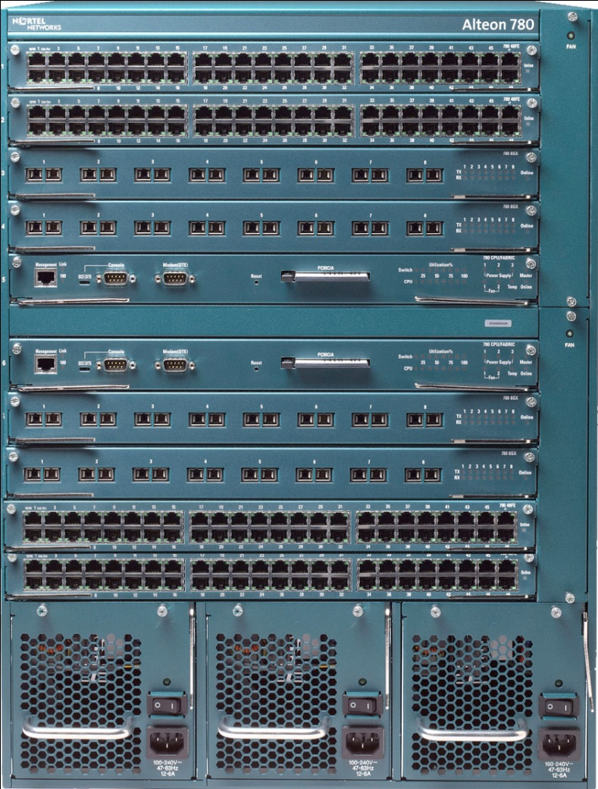
Introducing the Alteon 780 Series
Large-Scale Data Center Content Switch/Router
Alteon Webworking integrated with
Nortel switching technology
  Distributed Alteon WebICs
  Alteon WebOS services
  Layers 2-7 switching
  128G switch capacity
  300+ FE; 60 GbE
  Data center class redundancy
  Future:
    iSD and PCD integration
    ATM and PoS connectivity
    NEBS-3 compliance platform

Slide 11
L2-L7 Filtering Capability
Dynamic L2-L7 Filtering
JFWD 5-tuple Filtering
Source Address
Source Port
Destination Address
Destination Port
Protocol
Diffserve Code Points
Content Filtering
Cookies Filtering
Divert the packet to the control plane
Don't forward the packet
Change DSCP field
Set VLAN priority
Adjust priority queue
Modify session table
Parsing request header
Parsing application contents

Slide 12
The value of Alteon:
Alteon = Control + Processing + Storage + Programmable Services
Alteon intercepts selected
flows and do some intelligent processing based on L2-L7 filtering
  An API is needed for filtering
Users
Servers
The emphasis is on interception and processing transparently.
Entities at both ends may not be aware of the existence of the Alteon in the path

Slide 13
What does Alteon do that cannot be done by another processor? (X=Processor+1Gbyte+SWs)
Before X can do any processing X has to do filtering and/or redirecting the intended flows (flows in general sense, i.e L2 – L7). Alteon does this within its architecture.
Some intended flows require Ln processing. X processor has to process L2 – L(n-1) before Ln level processing can be done. Alteon prepares up to and including L(n-1) level processing within its architecture.
X processor can be an iSD or any general processor as long as there is an Alteon API.

Slide 14
Alteon API – differentiates itself from other boxes
Alteon API
Generic
Has interface functions from L2, L3, L4, and L5+
Object Oriented designed
Can be extended to include future sophisticated functionalities
iSD or
other intelligent
processing devices
API
High-speed Link Layer
between Alteon Switch
and iSDs
Others
Layer 5+ processing and filtering
Alteon
Layer 4 processing and filtering
Layer 3 processing and filtering
Layer 2 processing and filtering

Slide 15
T1: Programmable content switch
Openet on Alteon
  L2-L7 filtering
  Fast content filtering and redirection to active services
  Enhanced closely with Alteon features
Alteon: new generation of content switch
  Multiple processors and ASICs
  Programmable microcode
  L2-L4 and application filtering and processing

Slide 16

T2: Research Platform
iSD: powerful and extensible computational plane
  Partitioning hardware and software resources
  Close interfaces to Alteon
  Cluster computations
Network Research Platform
  Openet: active service enabling
  Alteon: content filtering in real-time
  iSD: integral computation inside the network
Openet
L2-L7
filtering
Content
processing
Power
computing
iSD
Local
Core
Passport
Alteon
Optical

Slide 17

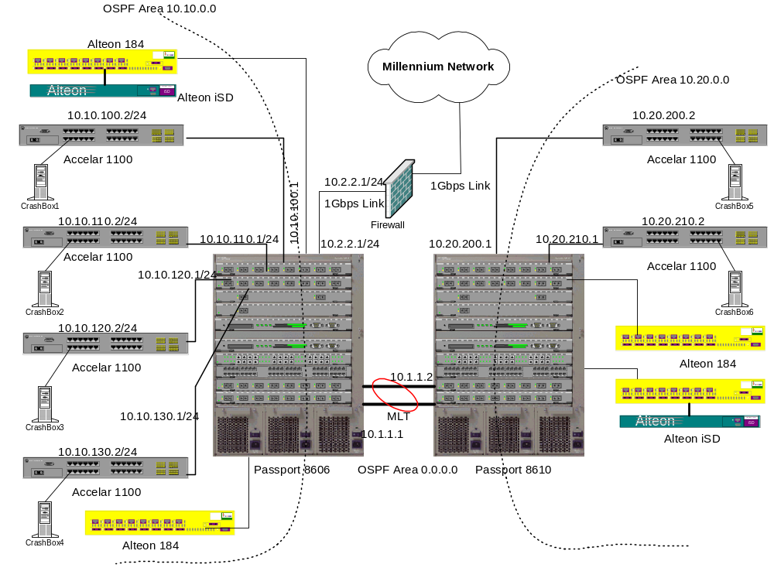

Slide 18
Any interest?
Looking for a grant?
Interested in summer internship?
  Talk with me later

Slide 19
How Can We Collaborate?
Corry is not far from Soda
  Are we EE+CS or EECS?
  How can we bridge CS and EE projects?
  Can we create a virtual lab? How?
Openet and SmartNet are supported by DARPA

Slide 20
Summary
Openet on Alteon is a powerful programmable networking platform
  Great Research platform to explore new ideas
  Commutation embedded within the network
  Linux development environment
Gigabit speed data-plane with programmability on the control-plane
Openet-Alteon is a sophisticated platform for developing real applications and for introducing services on-demand
Openet-Alteon SmartNets requires your collaboration!

Slide 21
Q & A
Visit us at
HTTP://www.openetlab.org
Thank You !

Slide 22
Backup

Slide 23
Openet Features and Applications

Slide 24




Openet Architecture
End Apps
Control Console (Net Mgr)
service initiation and policies
network configuration
resource administration
repository maintenance
Control
&
Configuration
Switch
Control
Data path
Download
User request
ORE
Repository
Server
Download
codes,
policies,
configs
Router
ORE
ORE
End Apps
use of service
request on the fly
ORE
Router
Switch

Slide 25
Openet Compositions
ORE
  Service creation and deployment
  Service lifecycle management
Services
  Every network function is a service
  Every service provides object APIs
ODK
  Service development and encapsulation
Management
  Service mgmt: initiation, policy and configuration
  Manager on console and Agents on nodes

Slide 26
Openet: a node’s view
Oplet
Oplet
Oplet
Service
Service
Service
Oplet
Service
Service
ORE
Java Virtual Machine
API Extensions
Hardware
Oplet is a program unit wrapping services

Slide 27
ORE: the Openet Core
ORE
  Object-oriented Runtime Environment
  Run customized software on network nodes
  Neutral to heterogeneous hardware
  Secure downloading, installation, and safe execution inside JVM
  Fully implemented using Java

Slide 28
System Services: JFWD
Java Forwarding
  IP forwarding and routing
    Diffserv marking
    Filtering and diverting
    Forwarding priority
    Routing
Platform-independent APIs
  Implemented on Passport/Accelar and Linux

Slide 29
Function Services
Common use utility
Public neutral APIs
Examples
  HTTP: HTTP service
  Shell: ORE interactive shell
  Packet: packet handling (IP, TCP, UDP)
  Logger: service runtime printout
  OreServlet: Java servlet

Slide 30
Typical Applications
JDiffserv
  Diffserv forwarding and DSCP marking on Passport 8600
OpeCfg
  Dynamic configuration of optical port interfaces
IP filtering
  Dynamic priority changes on Passport 1100
JSNMP and JMIB
  SNMP/MIB access
  Passport 1100 and 8600
Regatta: Fault recovery

Slide 31
JDiffserv
Goals
  DSCP marking and re-marking
  Priority forwarding or dropping
  Filtering
Passport
  Model: 8600
  Java 2
ORE
  version 0.4.1
  JFWD/JDiffserv service
  URL: “http://www.openetlab.org/downloads/”

Slide 32



JDiffserv on Passport
Device Console
Differv-enabled Network
UDP receiver
UDP sender
Passport 8600
Passport 1100B
Passport 1100B
UDP
UDP
JDiffserv
UDP
Linux PC
Linux PC
HTTP server
Diffserv Monitor
Linux PC

Slide 33
JDiffserv Features
Marking Types
  Admission marking
  condition marking (a.k.a., remarking)
Filters
  IP headers: 5-tuple
    Source address and port, destination address and port
    Protocol type
  DSField: DSCP
  Interface ports
Traffic profile
  Average rate and bucket size
  Peak rate and bucket size
Action
  Marking then forwarding
    3-color marker: R/Y/G,RFC 2697
    new DSCP
  Dropping

Slide 34
On-the-fly configuration
Policy
Dynamic Apps
Filters
Filter
Packet
Packet
Forwarding
Processor
Forwarding
Processor
Packet

Slide 35
What’s an Oplet?
Oplet: a self-contained downloadable unit
  Encapsulates one or more service objects
  Contains service attributes, e.g., names
  Eases secure downloading and service installation
  Use other service oplets
  Examples
    Active Networks services: EE
    Java Forwarding services: JFWD
    Base services: ODK

Slide 36
How a service is deployed?
Service design and coding
  Regular Java programming
Service package
  Oplets by ODK
  JAR files
  Uploading to downloading servers
ORE start at Passport
Service activation by ORE
  Downloading, start and stop
    Startup service
    Shell service
Service execution

Slide 37
Dynamic Classification
Objectives
  Implement flow performance enhancement mechanisms
  without introducing software into data forwarding path
  Service defined packet processing in a silicon-based forwarding engine
  packet classifier

Slide 38
Experimental Setup
Acclear
1100B
Routing
Switch
Source 1
tcp_send()
100 Mbps
Destination
1. tcp_recv()
2. tcp_recv()
100 Mbps
Source 2
tcp_send()
100 Mbps

Slide 39
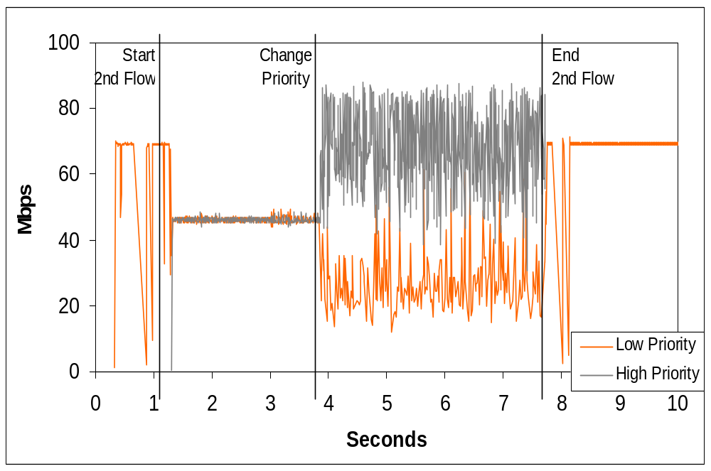
Throughput Results

