Slide 1
Grid Optical Network Service Architecture for Data Intensive Applications
Control of Optical Systems and Networks OFC/NFOEC 2006
Tal Lavian tlavian@cs.berkeley.edu
UC Berkeley, and Advanced Technology Research , Nortel Networks
Randy Katz – UC Berkeley
John Strand – AT&T Research
March 8, 2006
Notes:
Nortel Corporate Presentation
© 2004 Nortel

Slide 2
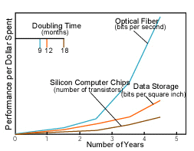
Impedance mismatch:
Optical Transmission vs. Computation
x10
Original chart from Scientific American, 2001
Support – Andrew Odlyzko 2003, and NSF Cyber-Infrastructure Jan 2006
DWDM- fundamental miss-balance between computation and communication
5 Years – x10 gap, 10 years- x100 gap
Notes:
Nortel Corporate Presentation
© 2004 Nortel

Slide 3
Waste Bandwidth
“A global economy designed to waste transistors, power, and silicon area -and conserve bandwidth above all- is breaking apart and reorganizing itself to waste bandwidth and conserve power, silicon area, and transistors.“ George Gilder Telecosm
Despite the bubble burst – this is still a driver
  It will just take longer
Notes:
Nortel Corporate Presentation
© 2004 Nortel

Slide 4
The “Network” is a Prime Resource for Large- Scale Distributed System
Computation
Visualization
Network
Person
Storage
Instrumentation
Integrated SW System Provide the “Glue”
  Dynamic optical network as a fundamental Grid service in data-intensive Grid application, to be scheduled, to be managed and coordinated to support collaborative operations
Notes:
Nortel Corporate Presentation
© 2004 Nortel

Slide 5
From Super-computer to Super-network
In the past, computer processors were the fastest part
  peripheral bottlenecks
In the future optical networks will be the fastest part
  Computer, processor, storage, visualization, and instrumentation - slower "peripherals”
eScience Cyber-infrastructure focuses on computation, storage, data, analysis, Work Flow.
  The network is vital for better eScience
Notes:
Nortel Corporate Presentation
© 2004 Nortel

Slide 6
Cyber-Infrastructure for e-Science:
Vast amounts of Data– Changing the Rules of the Game
PetaByte storage – Only $1M
CERN - HEP – LHC:
  Analog: aggregated Terabits/second
  Capture: PetaBytes Annually, 100PB by 2008
  ExaByte 2012
  The biggest research effort on Earth
SLAC BaBar: PetaBytes
Astrophysics: Virtual Observatories - 0.5PB
Environment Science: Eros Data Center (EDC) – 1.5PB, NASA 15PB
Life Science:
  Bioinformatics - PetaFlops/s
  One gene sequencing - 800 PC for a year
Notes:
Nortel Corporate Presentation
© 2004 Nortel

Slide 7
Crossing the Peta (10¹⁵) Line
Storage size, comm bandwidth, and computation rate
  Several National Labs have built Petabyte storage systems
  Scientific databases have exceeded 1 PetaByte
  High-end super-computer centers - 0.1 Petaflops
    will cross the Petaflop line in five years
  Early optical lab transmission experiments - 0.01 Petabits/s
    When will cross the Petabits/s line?
Notes:
Nortel Corporate Presentation
© 2004 Nortel

Slide 8
e-Science example
Application Scenario | Current | Network Issues
Pt – Pt Data Transfer of Multi-TB Data Sets | Copy from remote DB: Takes ~10 days (unpredictable) Store then copy/analyze | Want << 1 day << 1 hour, innovation for new bio-science Architecture forced to optimize BW utilization at cost of storage
Access multiple remote DB | N* Previous Scenario | Simultaneous connectivity to multiple sites Multi-domain Dynamic connectivity hard to manage Don’t know next connection needs
Remote instrument access (Radio-telescope) | Cant be done from home research institute | Need fat unidirectional pipes Tight QoS requirements (jitter, delay, data loss)
Other Observations:
Not Feasible To Port Computation to Data
Delays Preclude Interactive Research: Copy, Then Analyze
Uncertain Transport Times Force A Sequential Process – Schedule Processing
After Data Has Arrived
No cooperation/interaction among Storage, Computation & Network Middlewares
Dynamic network allocation as part of Grid Workflow, allows for new scientific experiments that are not possible with today’s static allocation
Notes:
Nortel Corporate Presentation
© 2004 Nortel

Slide 9
Grid Network Limitations in L3
Radical mismatch between the optical transmission world and the electrical forwarding/routing world
Transmit 1.5TB over 1.5KB packet size
  →1 Billion identical lookups
Mismatch between L3 core capabilities and disk cost
  With $2M disks (6PB) can fill the entire core internet for a year
L3 networks can’t handle these amounts effectively, predictably, in a short time window
  L3 network provides full connectivity -- major bottleneck
  Apps optimized to conserve bandwidth and waste storage
  Network does not fit the “e-Science Workflow” architecture
Prevents true Grid Virtual Organization (VO) research collaborations
Notes:
Nortel Corporate Presentation
© 2004 Nortel

Slide 10
Lambda Grid Service
Need for Lambda Grid Service architecture that interacts with Cyber-infrastructure, and overcome data limitations efficiently & effectively by:
  treating the “network” as a primary resource just like “storage” and “computation”
  treat the “network” as a “scheduled resource”
  rely upon a massive, dynamic transport infrastructure: Dynamic Optical Network
Notes:
Nortel Corporate Presentation
© 2004 Nortel

Slide 11









Super Computing CONTROL CHALLENGE
Chicago
Amsterdam
Application
Application
control
Services
Services
Services
control
AAA
AAA
AAA
AAA
DRAC*
DRAC
DRAC
DRAC
data
data
OMNInet
Starlight
Netherlight
UvA
ODIN
SNMP
ASTN
* Dynamic Resource Allocation Controller
finesse the control of bandwidth across multiple domains
while exploiting scalability and intra- , inter-domain fault recovery
thru layering of a novel SOA upon legacy control planes and NEs
Notes:
Nortel Corporate Presentation
© 2004 Nortel

Slide 12



Bird’s eye View of the Service Stack
3rd Party
Services
Grid
Community
Scheduler
Workflow
Language
Value-Add
Services
<DRAC>
DRAC Built-in
Services
(sampler)
smart bandwidth management
Layer x <-> L1 interworking
SLA Monitoring and Verification
Service Discovery
Alternate Site Failover
Workflow Language Interpreter
Session
Convergence &
Nexus
Establishment
End-to-end
AAA
Proxy
Proxy
Proxy
Proxy
Proxy
Topology
PCSCF
P-CSCF
Phys.
P-CSCF
Phys.
P-CSCF
Policy
</DRAC>
Proxy
Legacy
Sessions
(Management & Control Planes)
OAM
OAM
OAM
Control
Plane A
OAM
OAMP
OAMP
OAM
OAM
Control
Plane B
OAM
OAMP
Core
Metro
Access
Sources/Sinks
Notes:
Nortel Corporate Presentation
© 2004 Nortel

Slide 13
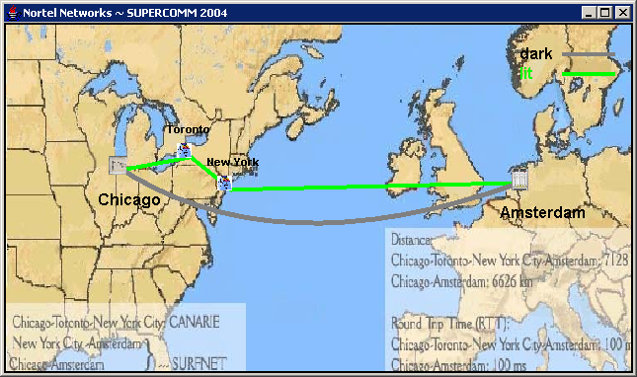
Fail over From Rout-D to Rout-A
(SURFnet Amsterdam, Internet-2 NY, CANARIE Toronto, Starlight Chicago)
Notes:
Nortel Corporate Presentation
© 2004 Nortel

Slide 14
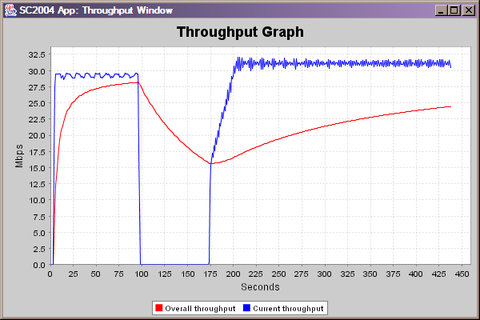
Transatlantic Lambda reservation
Notes:
Nortel Corporate Presentation
© 2004 Nortel

Slide 15
Layered Architecture
CONNECTION
BIRN Mouse
Application
BIRN Toolkit
Apps Middleware
BIRN Workflow
Lambda
Data
Grid
Collaborative
Grid FTP
NMI
Grid Layered Architecture
Resource
Resource managers
OGSA
WSRF
NRS
Optical Control
UDP
TCP/HTTP
Connectivity
IP
Optical protocols
DB
ODIN
Optical hw
Fabric
Storage
Computation
Resources
OMNInet
Lambda
Notes:
Nortel Corporate Presentation
© 2004 Nortel

Slide 16

Control Interactions
Apps Middleware
DTS
Scientific workflow
Data Grid Service Plane
NMI
NRS
Network Service Plane
Resource managers
Optical Control Network
optical Control Plane
λ₁
λ₁
Storage
Compute
λ_{n}
λ_{n}
DB
λ₁
λ_{n}
Data Transmission Plane
Notes:
Nortel Corporate Presentation
© 2004 Nortel

Slide 17

BIRN Mouse Example
Mouse Applications
Net Grid
Apps
Middleware
Comp Grid
Lambda-
Data-Grid
DTS
GT4
Data Grid
NRS
WSRF/IF
Meta-
Scheduler
SRB
Control Plane
NMI
Network(s)
Resource Managers
C
S
D
V
I
S
D
S
S
Notes:
Nortel Corporate Presentation
© 2004 Nortel
Application Engaged Networks
Allowing applications to place demands on the network (bandwidth, QoS, duration….)
Allowing applications to get visibility into network status
Full integration to ensure maximum value, performance

Slide 18
Summary
Cyber-infrastructure – for emerging e-Science
Realizing Grid Virtual Organizations (VO)
Lambda Data Grid
Communications Architecture in Support of Grid Computing
Middleware for automated network orchestration of resources and services
Scheduling and co-scheduling or network resources
Notes:
Nortel Corporate Presentation
© 2004 Nortel

Slide 19
Back-up
Notes:
Nortel Corporate Presentation
© 2004 Nortel

Slide 20
Generalization and Future Direction for Research
Need to develop and build services on top of the base encapsulation
Lambda Grid concept can be generalized to other eScience apps which will enable new way of doing scientific research where bandwidth is “infinite”
The new concept of network as a scheduled grid service presents new and exciting problems for investigation:
  New software systems that is optimized to waste bandwidth
    Network, protocols, algorithms, software, architectures, systems
  Lambda Distributed File System
  The network as a Large Scale Distributed Computing
  Resource co/allocation and optimization with storage and computation
  Grid system architecture
  enables new horizon for network optimization and lambda scheduling
  The network as a white box, Optimal scheduling and algorithms
Notes:
Nortel Corporate Presentation
© 2004 Nortel

Slide 21
Enabling new degrees of App/Net coupling
Optical Packet Hybrid
  Steer the herd of elephants to ephemeral optical circuits (few to few)
  Mice or individual elephants go through packet technologies (many to many)
  Either application-driven or network-sensed; hands-free in either case
  Other impedance mismatches being explored (e.g., wireless)
Application-engaged networks
  The application makes itself known to the network
  The network recognizes its footprints (via tokens, deep packet inspection)
  E.g., storage management applications
Workflow-engaged networks
  Through workflow languages, the network is privy to the overall “flight-plan”
  Failure-handling is cognizant of the same
  Network services can anticipate the next step, or what-if’s
  E.g., healthcare workflows over a distributed hospital enterprise
DRAC - Dynamic Resource Allocation Controller
Notes:
Nortel Corporate Presentation
© 2004 Nortel

Slide 22
Teamwork
from/to peering DRACs
AAA
DRAC, portable SW
Negotiate
Detect
supply
events
Alert, Adapt,
Route, Accelerate
supply
events
demand
dynamic provisioning plane
virtualization plane
connectivity plane
Agile
Network(s)
Application(s)
NE
Application
Admin.
Notes:
Nortel Corporate Presentation
© 2004 Nortel

Slide 23



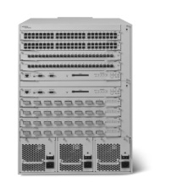

GT4
GT4
A
B
Multi-Resource Orchestration
GW05 Floor
DRAC
DRAC
Internet (Slow)
Grid Network Services
www.nortel.com/drac
Grid Network Services
www.nortel.com/drac
GT4
GT4
Fiber (FA$T)
A
A
GT4
GT4
OM3500
OM3500
B
B
Make the Network part of the GT4 - WSRF - SOA Equation
Notes:
Nortel Corporate Presentation
© 2004 Nortel

Slide 24
Example: Lightpath Scheduling
☺
W
Request for 1/2 hour between 4:00 and 5:30 on Segment D granted to User W at 4:00
New request from User X for same segment for 1 hour between 3:30 and 5:00
Reschedule user W to 4:30; user X to 3:30. Everyone is happy.
3:30
4:00
4:30
5:00
5:30
X
3:30
4:00
4:30
5:00
5:30
W
X
3:30
4:00
4:30
5:00
5:30
Route allocated for a time slot; new request comes in; 1st route can be rescheduled for a later slot within window to accommodate new request
Notes:
Nortel Corporate Presentation
© 2004 Nortel

Slide 25
Scheduling Example - Reroute
☺
A
B
Request for 1 hour between nodes A and B between 7:00 and 8:30 is granted using Segment X (and other segments) is granted for 7:00
New request for 2 hours between nodes C and D between 7:00 and 9:30 This route needs to use Segment E to be satisfied
Reroute the first request to take another path thru the topology to free up Segment E for the 2nd request. Everyone is happy
X
C
7:00-8:00
D
Y
A
B
X
C
7:00-8:00
D
Route allocated; new request comes in for a segment in use; 1st route can be altered to use different path to allow 2nd to also be serviced in its time window
Notes:
Nortel Corporate Presentation
© 2004 Nortel

Slide 26
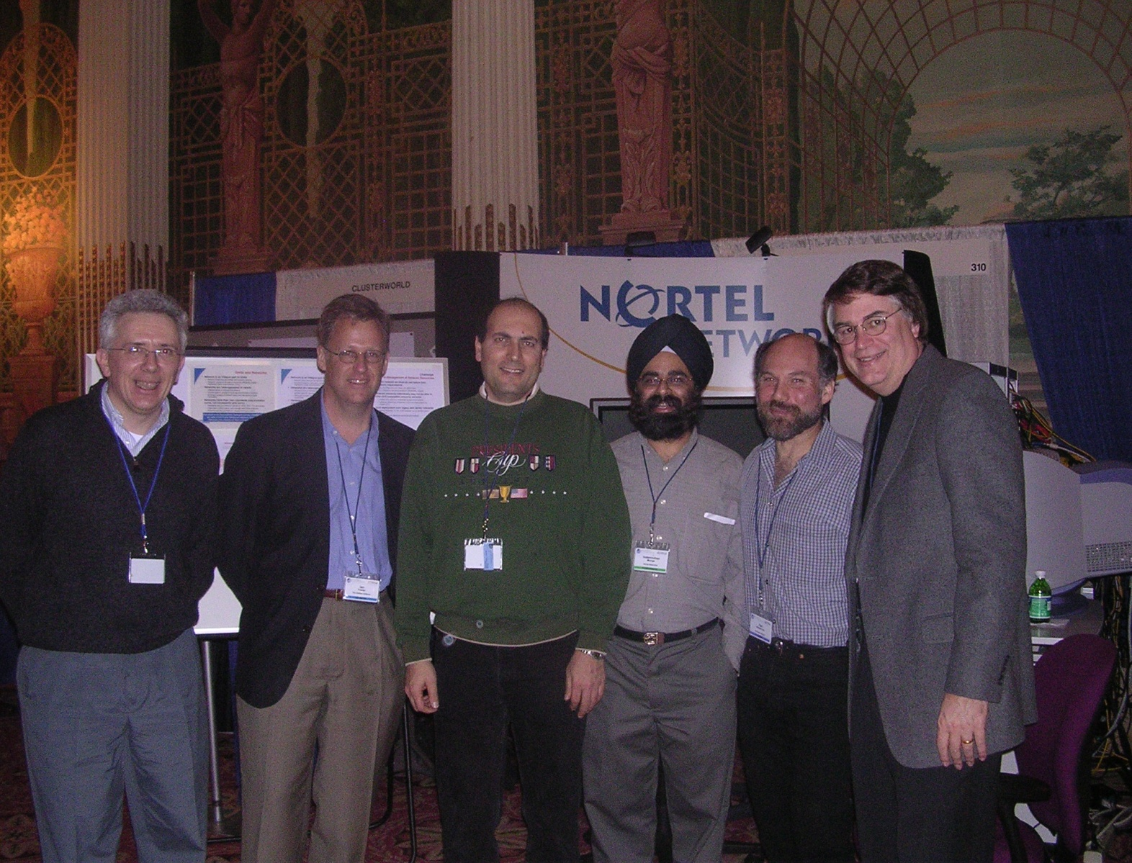
Some key folks checking us out at our booth,
GlobusWORLD ‘04, Jan ‘04
Ian Foster, Carl Kesselman, Larry Smarr
Notes:
Nortel Corporate Presentation
© 2004 Nortel

