Slide 1
Open Programmable Architecture for Java-enabled Network Devices
A Revolution!
Tal Lavian
Technology Center tlavian@NortelNetworks.com http://openet.lab.baynetworks.com

Slide 2
Programmable Network Devices
Openly Programmable devices enable
new types of intelligence on the network

Slide 3
Agenda
The market is changing
Local Computation
Architecture
New types of applications
ORE - Oplet Run-time Environment
API’s
Summary

Slide 4
Our Market is Changing
Customers demand for Openness & programmability
IEEE P1520
Lucent’s Programmable Networks
Intel as driving force

Slide 5
Lucent in Open Programmable Networks
Lucent’s Programmable Network Conference 9/15-16
  Cosponsored: Sun, HP, Oracle, Novell, Compaq …….
  Over 500 participants, enthusiastic response
SoftSwitch as programmable network
  70 developers
  Jun 99 - PR, Sept 99 - Prog Conference, October 99 - SDK, Jan 00 - APIs, Feb 00 - Dev Conference, May 00 - 3rd party Test Lab
7 R/E program
$1.7B- Excel Switching acquisition (Programmable switch)
Other products and directions in Openness and Programmability
Marketing and PR on Lucent’s Openness

Slide 6
ES - Openet Center
Create an open development community to deliver customer-valued solutions based on Nortel Networks’ and partners’ products and technologies
Openet Center creates a focus to open Nortel Networks platforms
Promotes Open Network Computing
This potentially changes landscape and rules of the networking industry

Slide 7
Vision: JOOSE - the OS of Choice for Programmable Network Devices
JOOSE - Java Oplet Operation System Environment
JOOSE is OS of choice for routers and network devices.
Be the Microsoft for Routers
(or better way the Linux for Programmable Network Devices)

Slide 8
Agenda
The market is changing
Local Computation
Architecture
Applications
ORE - Oplet Run-time Environment
API’s
Summary

Slide 9
Evolution vs. Revolution
Bandwidth x200
Last Mile
56kb ==>10Mb
Performance /
Enhancement
Logarithmic
Net
10G
Web
Net SW
Intelligence
Dynamic
HW
1G
100M
Static Net SW
10M
Now
Time
Notes:
The Internet has had a profound, and not-yet-complete impact on the ways corporations do business with other corporations, governments, and consumers.
The “Net Economy” is based on the fact that companies can be connected to each other without regard to the barriers of distance, time zones, and differing legacy computing systems. Thus, companies are free to seek business relationships with customers and suppliers based on the greatest economic return.
In addition to reducing the costs of doing business with its existing business partners, a company can now establish new business relationships based on its business assets. (word choice here).
Marketmakers - Deliver services to large communities of partners, suppliers and customers e.g. Citibank
Commerce Leaders- Set up commerce shops to transact business outside corporate boundaries e.g. GMBuyPower
Service Providers - Supply hosted communications & commerce services to consumers & small-medium businesses e.g. Netcom

Slide 10

Changing the Rules of the Game
Move Turing Machine onto device
  Add local intelligence to network devices
while (true) { doLocalProcessingOnDevice()
}

Slide 11
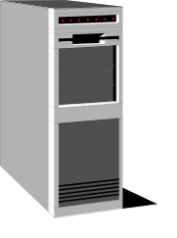



Technology Concept
Applet
Web Server
Web Browser
The JVM is in the Browser
Download applications for local processing
Reversed Applet
Server

Slide 12
The Web Changed Everything
Browsers
  Introducing JVM to browsers allowed dynamic loading of Java Applets to end stations
Routers
  Introducing JVM to routers allows dynamic loading of Java Oplets to routers
This Capability WILL Change Everything

Slide 13
Example: Downloading Intelligence
Monitor
Security
Intelligence
Authentication
Dynamic
loading
application
React
JVM
OS
HW
Network Device

Slide 14
Security and Stability
secure download of Java Applications
safe execution environment
  insulate core router applications from dynamically loaded applications

Slide 15
Device-based Intelligence
Static-vs-Dynamic Agents
  Static
    SNMP set/get mechanisms
    Telnet, User Interfaces (cli, web, etc…)
  Dynamic closed-loop interaction on nodes
    capable of dealing with new and difficult situations
    autonomous and rational properties.
    dynamically system monitoring & modification
    report status and trends

Slide 16
Agenda
The market is changing
Local Computation
Architecture
Applications
ORE - Oplet Run-time Environment
API’s
Summary

Slide 17
ORE - Oplet Run-time Environment
Oplet 1
Oplet 2
Service A
Service B
Service C
Why ORE?
ORE
JVM

Slide 18
Java-enabled Device Architecture
C/C++
API
Java
API
Download
Oplet
Device
Code
ORE Service
JNI
Oplet Runtime Env
Device
Drivers
JVM
JFWD API
Operating System
Device HW

Slide 19
Architecture Issues
Green Threads -vs- Native Threads
  Native threads:
    provides non-interference between Java applications
    difficult thread-to-thread communication and sharing of data between threads
    creates a dependency on underlying RTOS
    multiple JVM instances consume resources
  Green Threads
    single JVM must manage CPU & memory resources between concurrently running threads

Slide 20
Evolution of Router Architecture
Distributed,
line-card based Model
Centralized,
CPU-based Model
Routing software
w/ router OS
Routing software
w/ COTS OS
Line card
(forwarding
buffering)
Routing
CPU
Buffer
memory
CPU
Buffer
memory
Line card
(forwarding
buffering)
Line card
(forwarding
buffering)
NI as
line card
NI as
line card
...
NI as
line card
Line card
(forwarding
buffering)
Added scalability,
Flexibility,
extensibility
Control + Forwarding
Functions combined
Control separated
From forwarding

Slide 21
Explicit Separation of Control Plane from Data Forwarding
Control
Element
Routing
Traditional device
Forwarding
Shared
Memory
Forwarding/
Flow/filter
Table
Download
Forwarding
Element
CPU
Forwarding
Packet
Flow
Line Card
Forwarding
Element
Line Card
Forwarding
Forwarding
Element
Forwarding

Slide 22
Separation of Control and
Forwarding Planes
Centralized,
CPU-based Router
Forwarding-Processors
based Router
Routing
SW
Control
Plane
CPU
CPU
Forwarding
Processor
Forwarding
Processor
Forwarding
Processor
Slow
Wire Speed
Control + Forwarding
Functions combined
Control separated
From forwarding

Slide 23
Open Networking Architecture
IP Telephony
Policy Server
VPN
Firewall
Unified policy-based management
Application
server
Vertical Proprietary
Server Operating System
Networking Box Level Hardware
Network Services Protocol
Control
element
Proprietary Apps
Network Services Objects
Network OS
Proprietary NOS
Custom Switch ASIC’s
Connect Transport Interface
Forwarding
element
Today
Real-time OS
Network Si
Copyright - Intel
Open

Slide 24
Dynamic Configuration of Forwarding Rules
AN Apps
CPU
Forwarding
Rules
Forwarding
Rules
Forwarding
Rules
Forwarding
Rules
Forwarding
Processor
Forwarding
Processor
Forwarding
Processor
Forwarding
Processor
SW
HW

Slide 25
Real-time forwarding Stats and Monitors
AN Apps
CPU
Forwarding
Rules
Forwarding
Rules
Forwarding
Rules
Forwarding
Processor
Forwarding
Processor
Forwarding
Processor
Statistics
&Monitors
Statistics
&Monitors
Statistics
&Monitors
SW
HW

Slide 26
Dynamic - On the Fly Configuration
Policy
Dynamic Apps
Filters
Filter
Packet
Packet
Forwarding
Processor
Forwarding
Processor
Packet

Slide 27
Packet Capture
Oplet
CPU
JFWD to
Divert or Copy
Wire Speed
Forwarding
Processor
Forwarding
Processor
Forwarding
Processor
Forwarding
Processor
Packet

Slide 28
Java Environment
Green Threads -- Present RTOS with single unified task that includes:
  Java VM (JVM)
  Java Resource Manager (JRM)
    thread scheduling
    manages CPU utilization
      JVM time-slice is managed by the JRM preemptive thread scheduler
    internal memory manager (intercepts “new”)
    garbage collection with priority based on available memory

Slide 29
Non-Interference w/ Single JVM
Multiple threads compete for resources
  memory
  CPU
  persistent storage
Denial-of-service attacks possible
  memory or CPU consumption attacks
  trusted/untrusted service interactions

Slide 30
Agenda
The market is changing
Local Computation
Architecture
Applications
ORE - Oplet Run-time Environment
API’s
Summary

Slide 31
Applications
Active Network Management
  Proactive Network Management
  Diagnostic Agents
Dynamic DiffServ Classifier
Active Intrusion Detection
Multicast Caching
IP Accounting
Application-Layer Router-Server Collaboration
Pseudo Default Drop Capability

Slide 32
Active Network Management
Download Oplet Service to the device.
Monitor MIB variables
  Might be complex conditions
  Trend analysis
  DiffServ, RMON-II, etc… MIBs
Report “events” to NMS
  drop rate, packets/second
Allow Service to take action
Download application
Adjust parameters based on direction from NMS
Extensive access
to internal resources
No more
polling
NMS
Monitor
Download
Complex Condition
Exceeded
Appropriate
Application
Download
router

Slide 33
An Open Service API Example
  SNMP API for Network Management
    generated automatically
    allows device-based applications to query MIB
    device-based application -- query local MIB
    report trends or significant events
    initiate downloading of problem specific diagnostic code
    take corrective action

Slide 34
Proactive Network Management
Device-based Intelligence is Dynamic
  Static Management
    SNMP set/get mechanisms
    Telnet, User Interfaces (cli, web, etc…)
  Dynamic Closed-loop Management at Network Node
    capable of dealing with new and difficult situations
    autonomous and rational properties.
    dynamically system monitoring & modification
    report status and trends
  Monitor MIB to identify poor performance and notify NMS prior to failures
  Downloaded service can instantiated new services

Slide 35
Diagnostic Mobile Agents
Automatic trace-route from edge router where problem exists.
  Each node reached generates a report to NMS
  Trace-route code “moves” to next node in path
  Mobile agents identify router health
  Create logs for NMS

Slide 36
Dynamic DiffServ Classifier
Set router filters to sample packets from edge device host ports
Identify real-time traffic (RTP flows)
Set filter on port to adjust DS-byte value based on policy
Keep track of filters set
Remove filters no longer in use

Slide 37
Dynamic DiffServ Classification
Policy
Control
Plane
ORE Service
Filters
Filter
Packet
Packet
Forwarding
Processor
Forwarding
Processor
Packet
Sample packets, set filters to modify DS-byte for Per-Hop-Behavior modification

Slide 38

Active Intrusion Detection
Intruder is identified by Intrusion Detection software
Intruder signature is identified
Mobile agent is dispatched in direction of intruder (based on physical port of entry)
Mobile agent “chases” intruder and terminates him (shuts down link, reboot host, notify NMS)

Slide 39
Multicast Caching
Reliable Multicasting
Distribute error control throughout multicast tree
Retransmission a local node keeps control close to lossy links
Balances processor load away from multicast source

Slide 40
IP Accounting
Project ABCD (Active Bean Counter in Device)
Perform usage accounting at edge node
PreCorrelate/aggregate/reduce accounting record on-site
$1 rule for billing
Real-time billing can be realized
Customize billable resources

Slide 41

Server Collaboration
Supports distributed computing applications in which network devices participate
  router to router
  server to router
Supports Intelligent Agents
Supports Mobile Agents
Java-based
Application
Java-based
Application
Java-based
Application

Slide 42
Application Layer Collaboration Among Routers and Servers
Server farm load balancing
  server state monitored; rerouting based on congestion/load
Auctioning Applications
Bandwidth Broker

Slide 43

Collaboration with Business Applications
New paradigm of distributed applications
Network devices collaborating with business applications
Application aware routing
Apps Server
Oplet
Oplet
Apps
Apps
RMI, XML, CORBA
JVM
JVM
Accelar
Passport
Shasta
BayRS
BS450
Oracle DB
E-Commerce
Business apps
SAP , ERP,
Optivity

Slide 44
Bandwidth Broker Collaboration
Routers Monitor RMON and DIFFSERV MIB
Report Per-IPAddress, Per Protocol statistic to resource broker
Adjust DS-byte and Per Hop Behavior based on Bandwidth Broker directions

Slide 45
Dynamic - On the Fly Configuration
From downloadable Java application, we can modify the behavior of the ASICs

Slide 46
Agenda
Our market is changing
Local Computation
Architecture
Applications
ORE - Oplet Run-time Environment
API’s
Summary

Slide 47
Oplet Runtime Environment
An Overview
A platform to dynamically deploy services on network elements
Desirable properties
  Portable to many different devices
  Secure, reliable
  Low impact on device performance
  Open
  Provide a framework to structure code
    Reusable, maintainable, robust
Implemented in Java

Slide 48
ORE - Basic Concepts
Oplet Runtime Environment (ORE)
  A kernel that manages the life cycle of oplets and services
  Provides a registry of services
Service
  The value being added. Minimal constraints, could be anything…
  Represented as a Java interface
Oplet
  The unit of deployment: a JAR file
  Contains meta-data (eg signatures, dependency declarations)
  Contains services and other resources (data files, images, properties, JAR files)

Slide 49
Dependencies
A service S can use facilities provided by another service T
This means that the oplet containing S has a dependency on service T
Before an oplet can be started, all of its dependent services must have be started
ORE manages dependencies and lifecycle of oplets and services

Slide 50
ORE Architecture
Oplet
Service
Oplet
Oplet
Service
Service
Oplet
Service
Service
Oplet Runtime Environment
Java Virtual Machine
API Extensions

Slide 51
Oplet Lifecycle
Install
  Loaded from URL
Start
  Services that are depended on must already be started
Stop
  Any oplets that depend on this oplet’s services will be stopped
  Code and data can be unloaded from ORE
Uninstall

Slide 52
Some services
Bootstrap
  Basic configuration
Log
  Centralized logging for oplets
HTTP server
  Simple servlet support
Command line shell
Administration commands
  Manage oplets and services

Slide 53
An Example
Traffic Monitor
RSVP MIB Group
Servlet Engine
HTTP Server
MIB Engine
JFWD
Loopback SNMP
Access
Native MIB
Variables
Log

Slide 54
Security Issues
Sandbox
  Each oplet provides a Java name space and applet-like sandbox
Signed oplets
  Oplets can be signed for assigning trust
Denial of service
  Vulnerable to DoS (memory, cycle, bandwidth, peristent storage, monitors) like all Java applications

Slide 55
ORE Status
Done now
  Runs on Accelar and workstations
  First release of ORE SDK available internally
To be done
  More APIs and services (MIB, JFWD, Wrapper)
  Security (authentication)
  Oplet updates
  Persistent storage

Slide 56
ORE Future work
Capabilities
  Revocable services
Security
  Java 2 style permissions
Resource limits, DoS protection
  Probably requires support from JVM
Jini, Oplet Directory
Mobile Agents
Open source

Slide 57
Agenda
Our market is changing
Local Computation
Architecture
Applications
ORE - Oplet Run-time Environment
API’s
Summary

Slide 58
Initial APIs
Console Logging API
Generic MIB Access API
Optimized MIB Access APIs
Trap Interception API
Management Authentication API
Web-Based Management Extensions API
CLI Extensions API
MIB Extensions API
Pluggable Authentication API
Network Forwarding API

Slide 59
Tools
MIB API
  Monitor device Management Information Base variables
    MIB
    RMON and RMON-II
    DiffServ
Network API (JFWD)
  Interface to Filters
    set packet drop filters
    intercept packets
    carbon copy packets while forwarding at line-speed

Slide 60
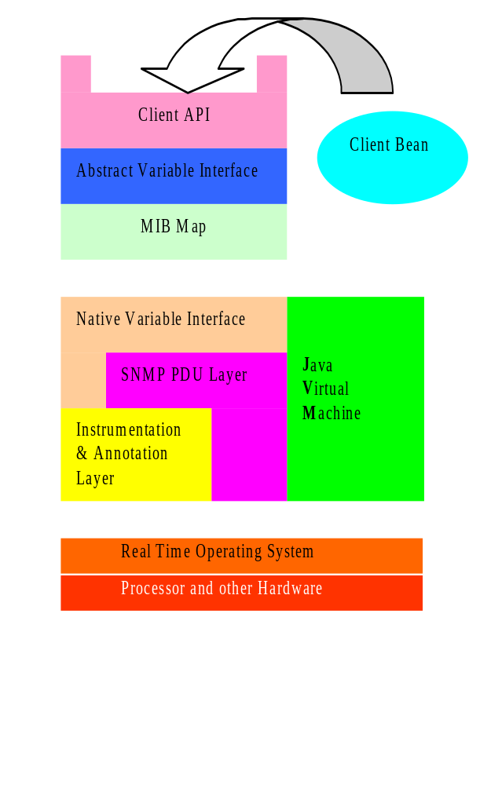
MIB API Example
API uses a MIB Map to dispatch requests to variable access routines
Different parts of the MIB tree can be serviced by different mechanisms
Two main schemes:
An ad hoc interface to the SNMP instrumentation layer
A generic SNMP loopback

Slide 61
An Open Service API Example
  SNMP API for Network Management
    generated automatically
    allows device-based applications to query MIB
    device-based application -- query local MIB
    report trends or significant events
    initiate downloading of problem specific diagnostic code
    take corrective action

Slide 62

Java MIB API - Proxy Mode
Uses SNMP loopback mechanism to target a remote network element
API can be used to control devices that don’t have an embedded JVM
JSNMP API
Proxy mode
Java Oplet
Application
Servers
JVM on PC
Router with No JVM

Slide 63
Agenda
Our market is changing
Local Computation
Architecture
New types of applications
ORE - Oplet Run-time Environment
API’s
Summary

Slide 64
Summary
JOOSE - OS of Choice for Open Routers
Programmable
  Turing Machine on network devices
  dynamic agents vs. static agents
  dynamic loading
Our market is changing
Openness - successfully proven paradigm
  Facilitates innovation
  Domain experts - virtual development community
  With 3rd parties we can change the networking landscape
Application aware routing

Slide 65

This is only the first step
1903 the Wright brothers
Compare to this first flight and look where aviation is today

Slide 66
Appendix

Slide 67
Why Java
Dynamic Loading
Reuse security mechanisms
  byte-code verifier
  security manager
  classloader
System stability
  constrains applications to the JVM
  Prohibits native code applications
Extensible, portable, & distributable services

Slide 68
Bandwidth x200 - start of new demand
Intel web hosting - BIG pipes
Last mile bandwidth x 200
Multimedia and new applications will drive the demand.
Bandwidth
Content
Applications

Slide 69
The P1520 Reference Model
End User Applications
V interface
Algorithms for value-added communication services created by network operators, users, and third parties
Value Added Services Level
U interface
Algorithms for routing and connection management, directory services etc.
Network Generic Services Level
L interface
Virtual Network Devices Level
Virtual Network Device (software representation)
CCM interface
Physical Elements (hardware, namespace)
PE Level
Notes:
U interface -- provides a means for creating a representation of specific services (DIFF SERV or INT SERV).

Slide 70
CSIX Consortium
Common switch interface for switch fabric independence
  www.csix.org
  Detailed interface specification between port/packet processor logic and interconnect fabric logic
  Similar to common media interface such as Utopia, but for switch fabric interface
  Targeted at scalable switches at higher end
  Permits mix-and-match of silicon and software components

Slide 71

Multi-Services Switching Forum (MSF) www.msforum.org
Open Multi-service Switching
  Common transmission and switching infrastructure
  Modular, layered architecture
  Integration at a module level through open interfaces
  Multi-vendor model with 3rd party software options
Voice Service
ATM Services
Switch
Switch
Adaption
Adaption
IP Services
Source: MSS

