Slide 1
OptiCal Inc.
Kwest Proposal
Lukas Chrostowski
Carlos Mateus
Tal Lavian
The Light at the end of the Tunnel

Slide 2
OptiCal Outline
Design
Link Analysis
Financing
OptiCal Proposal

Slide 3
Goal
Design OADM network.
Compare purchasing this network all at once, vs. purchasing the regeneration-based network all at once.
OptiCal Proposal

Slide 4
Network Diagram 1st year
B
OA Huts
10 Gb/s
320
2.5 Gb/s
T
80
A
S
X
U
C
80
240
160
400
OptiCal Proposal

Slide 5
Network Diagram 2nd year
B
OA Huts
10 Gb/s
320
2.5 Gb/s
T
80
A
S
X
U
C
80
240
160
400
OptiCal Proposal

Slide 6
Network Diagram 3rd year
B
OA Huts
10 Gb/s
320
2.5 Gb/s
T
80
A
S
X
U
C
80
240
160
400
OptiCal Proposal

Slide 7
Network Diagram 3rd year /w OADMs (a)
B
OA Huts
10 Gb/s
320
2.5 Gb/s
OADMs
T
80
A
S
X
U
C
80
240
160
400
OptiCal Proposal

Slide 8
Network Diagram 3rd year /w OADMs (b)
B
OA Huts
10 Gb/s
320
2.5 Gb/s
OADMs
T
80
A
S
X
U
C
80
240
160
400
OptiCal Proposal

Slide 9
Link SX comparison
 | (a) | (b)
EDFAs | 3 extra
OC48-192 | 0 extra (12) | 12 extra (24)
2.5 lasers | Same | same
10 laser/det |  | 12 extra
 | CHEAPER!
OptiCal Proposal

Slide 10
Electrical Regeneration
Don’t need to use transponders. Use cheaper line cards (Line-O-192)
  2.5 – 10 conversion (both 2.5 and 10 line cards)
  From A,S through X: 5+5
  2.5-10 at nodes T,U: 2+2
  Data from B-C: 3
OptiCal Proposal

Slide 11
OADM Restrictions
Choose wavelength based on minimum dispersion (1530, 1550 nm)
Eye closure < 0.3
Dispersion restrictions:
  BC: too much dispersion.
  BU: 1548.5 < λ < 1550.5
  CX: λ < 1539
  BX: 1538 < λ < 1561
  TC: λ < 1536
  TU: λ < 1552
OptiCal Proposal

Slide 12
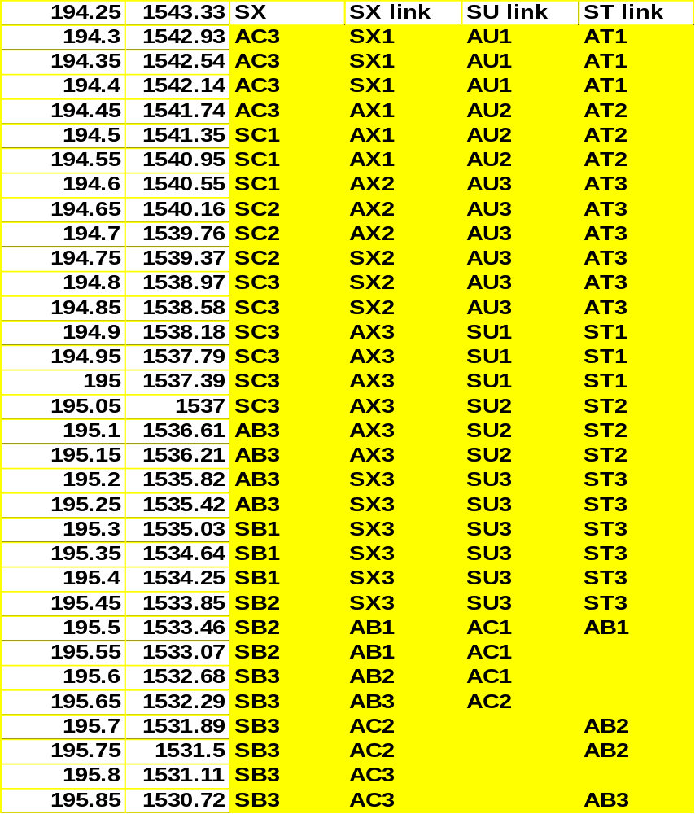
From Node S
OptiCal Proposal

Slide 13
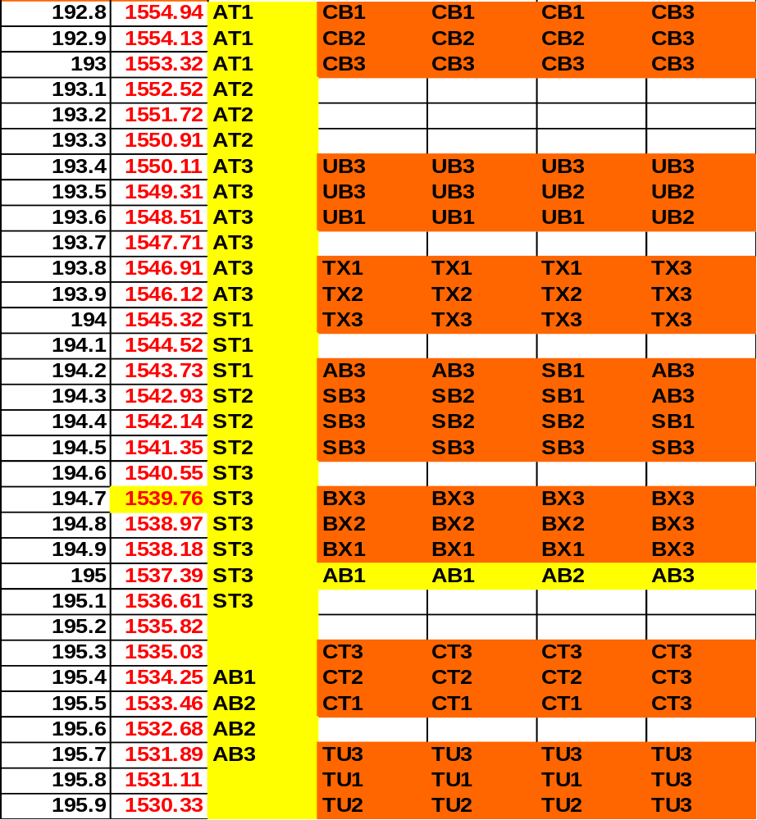
Link TX
OptiCal Proposal

Slide 14
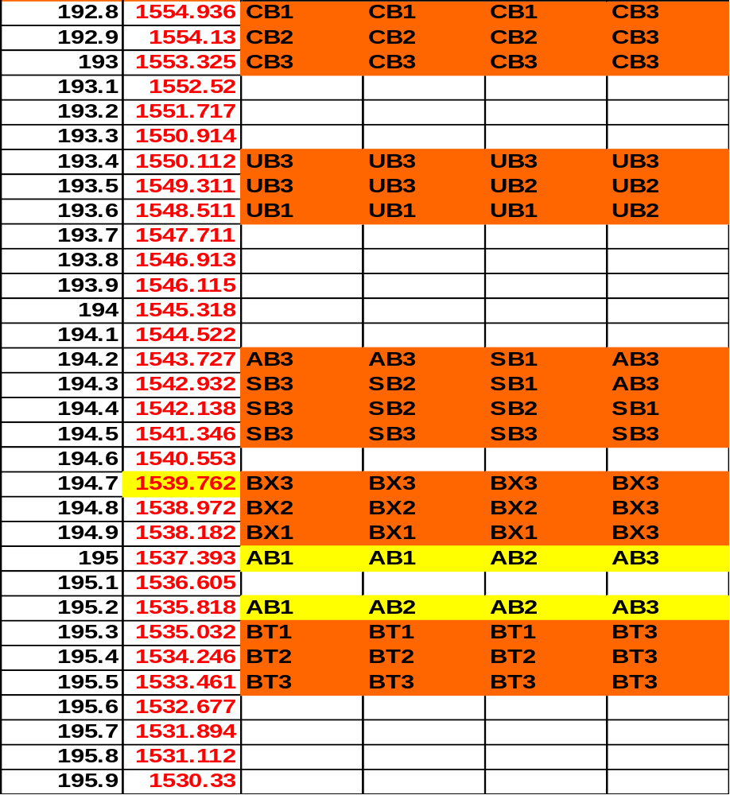
Link BT
OptiCal Proposal

Slide 15
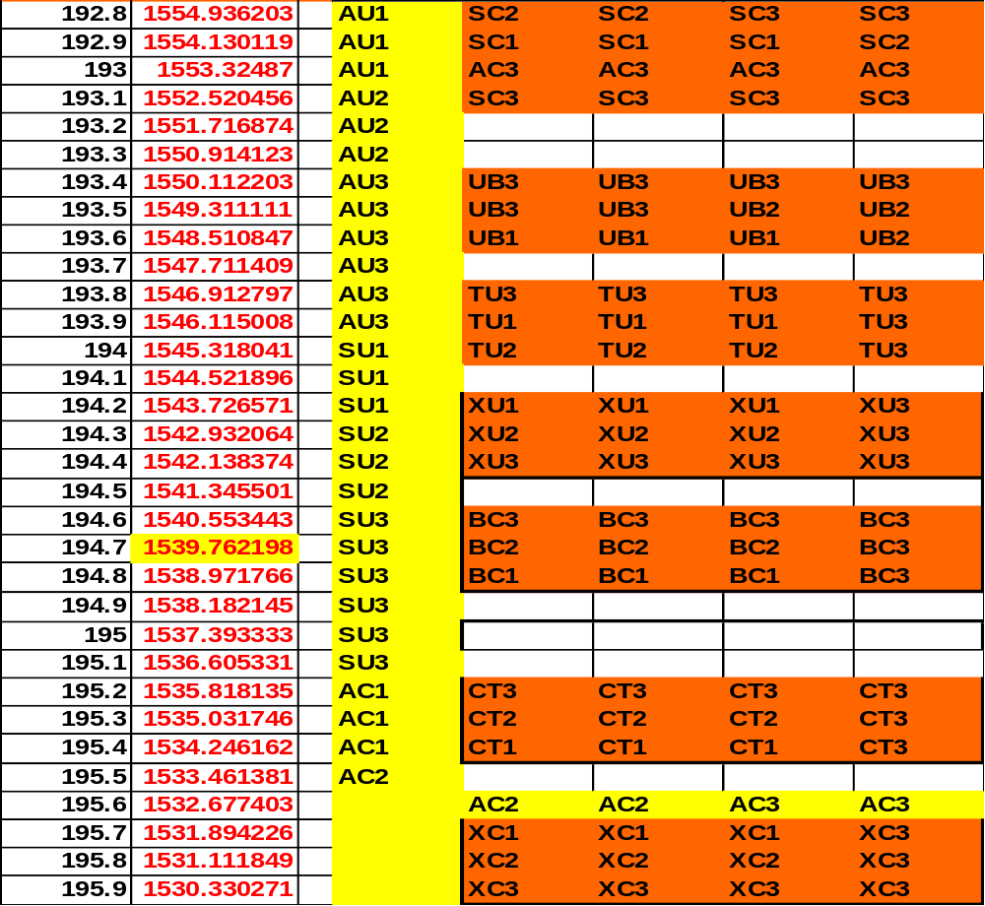
Link XU
OptiCal Proposal

Slide 16
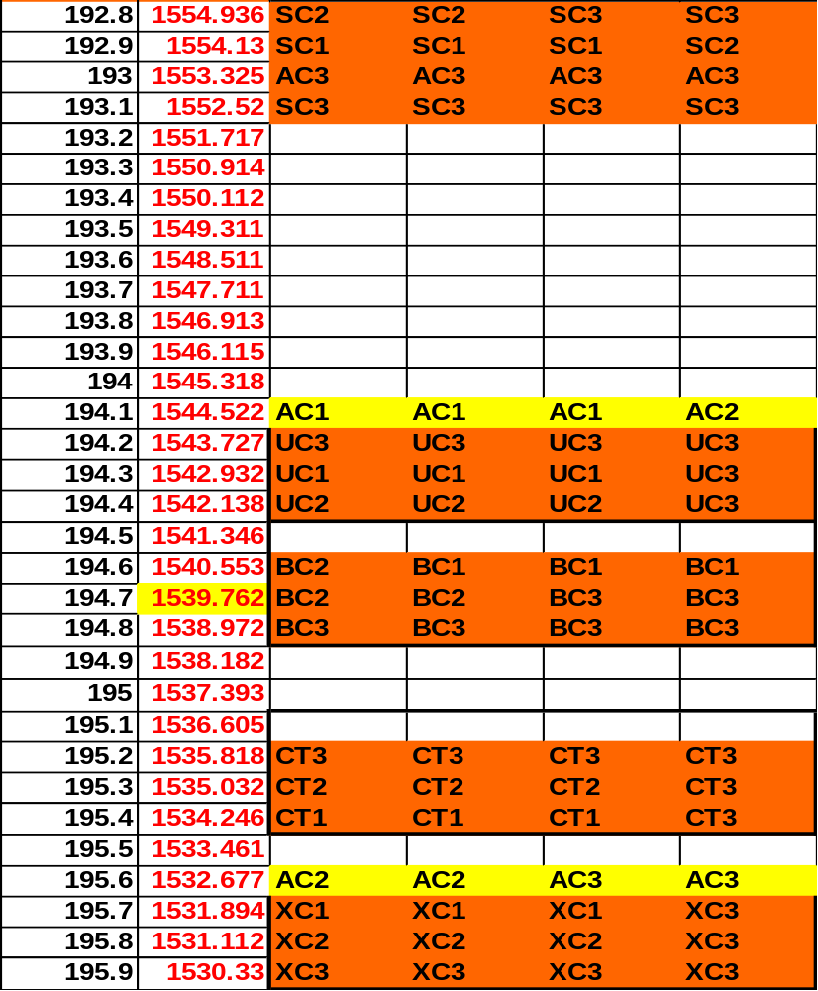
Link UC
OptiCal Proposal

Slide 17
Link B-T-X-U-C Power Budget
OA Huts
10 Gb/s
2.5 Gb/s
OADMs
B
T
X
U
C
(-14 fiber+
EDFA)
(-16 fiber)
(-7 fiber+
EDFA)
(-5 fiber+
EDFA)
+3 (modulated),
-4 (muxed)
-18 (input),
-22 (after OADM)
+3 (amplified)
-13 (input),
-21 (after OADM)
-28 (input),
-3 (amplified),
-7 (after OADM)
-12 (input),
-19 (after mux)
-19 (input),
-23 (after OADM)
+2 (amplified)
+5 (input),
-3 (after OADM)
-9 (input),
-13 (after OADM),
+12 (amplified)
-12 (input),
-19 (after mux)
+3 (modulated),
-4 (muxed)
OptiCal Proposal

Slide 18
EDFAs, Channel Spacing
System uses only EDFA-32 C-Band
Channel spacing 100 Ghz.
  Chosen to allow 10 Gb/s transmission.
System is symmetric for easier bi-directionality.
OptiCal Proposal

Slide 19
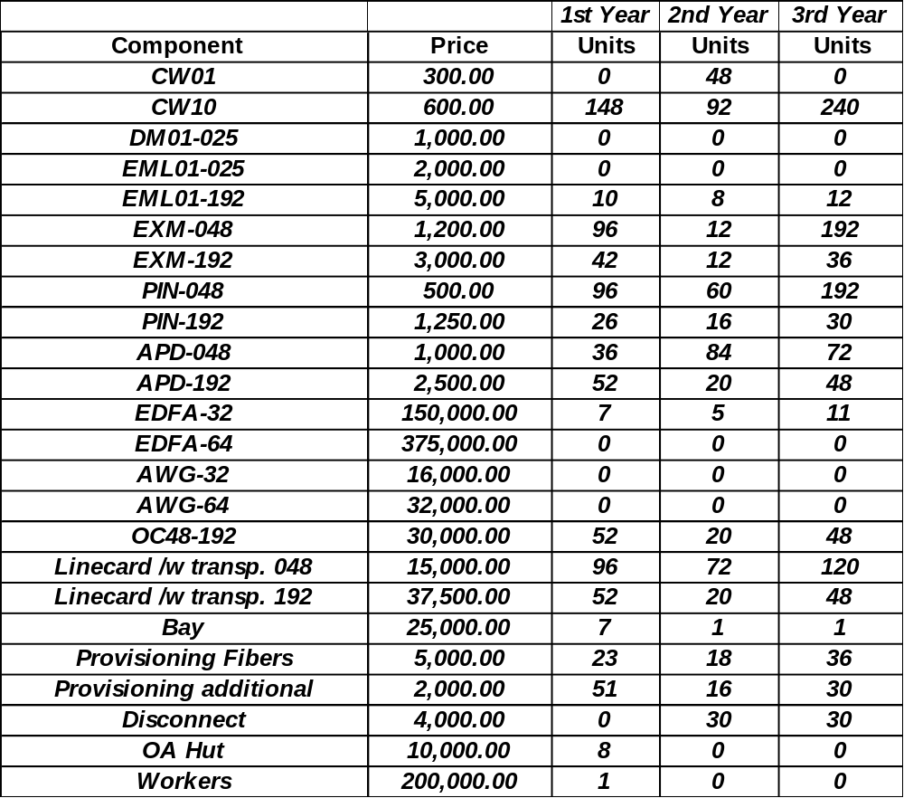
Equipment Needed
OptiCal Proposal

Slide 20
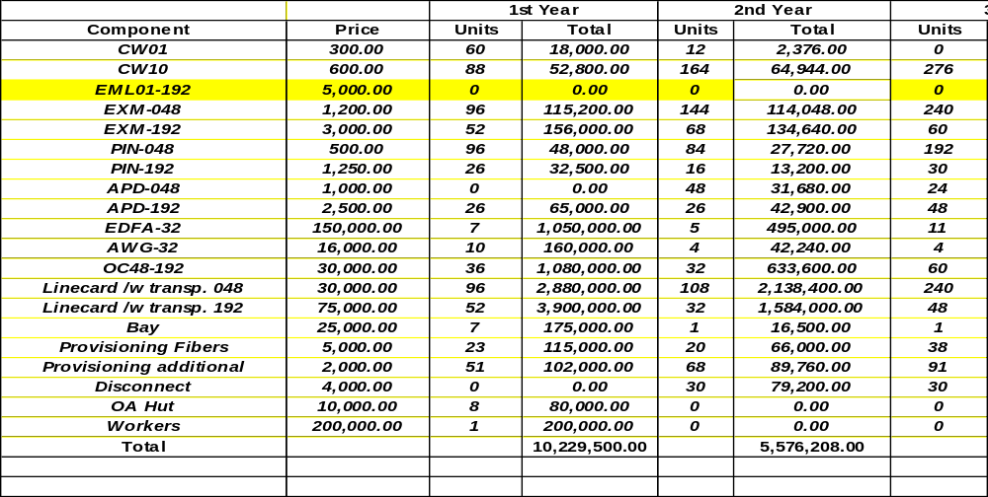
Finance (updated 3 year Solution)
*** note: O-E-O conversion doesn't require transponders. Actual total line card cost should be lower.
OptiCal Proposal

Slide 21
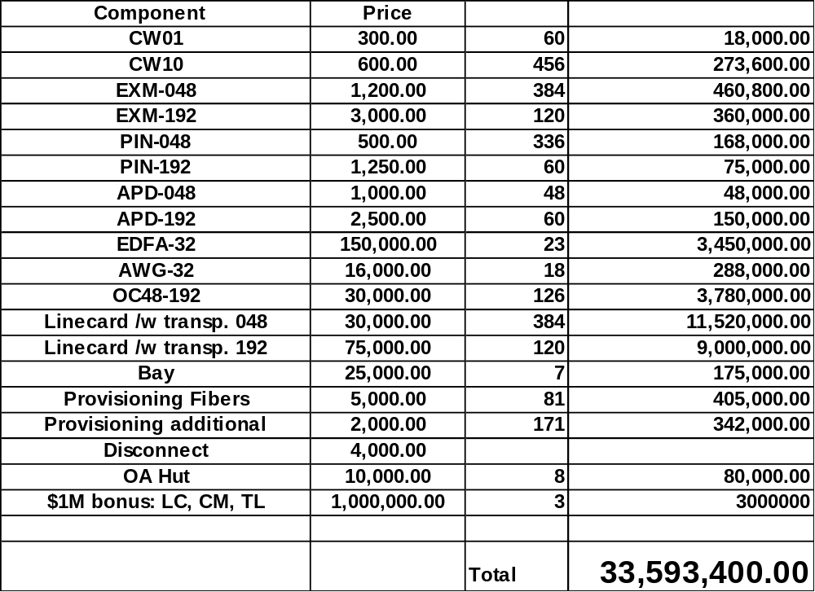
Finances for one-time purchase
*** note: O-E-O conversion doesn't require transponders. Actual total line card cost should be lower.
OptiCal Proposal

Slide 22
Cost Distribution?
Over 60% is for line cards - ☹
Line card w/ transp048 $11.5M
Line card w/ transp192 $9M
OC-48-192 $3.7
EDFA-32 $3.5M
Bonus - ☺ $3M
OptiCal Proposal

Slide 23
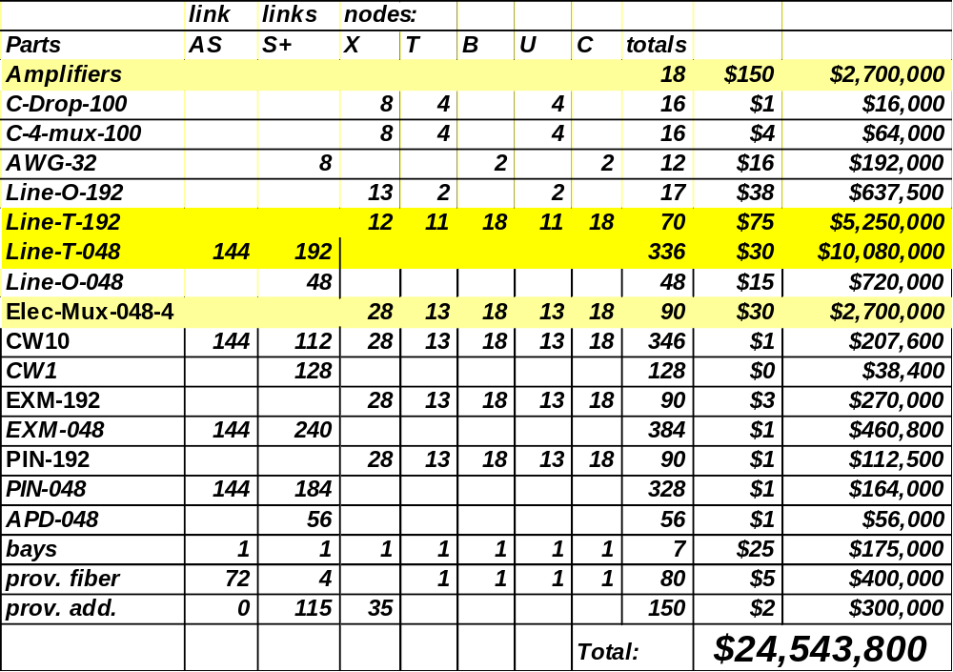
OADM Solution
*** note: $1.4M more if we used only Line-T-xxx
OptiCal Proposal

Slide 24
Cost Distribution?
Over 80% is for:
Line-T-048 $10M
Line-T-192 $5.2M
Elec-Mux-048-4 $2.7M
Amplifiers $2.7M
OptiCal Proposal

Slide 25
Questions
Provision costs for OADM?
OptiCal Proposal

Slide 26
Price Summary
Solution | Price
3 Year Plan (incl. depreciation) | $23,038,264
One time purchase (with regeneration) | $33,593,400
One time purchase (OADM Solution) | $24,543,800
OptiCal Proposal

