Slide 1

Optical Networks
CS294-3: Distributed Service Architectures in Converged Networks
George Porter
Tal Lavian
Feb. 5, 2002
EECS - UC Berkeley

Slide 2
Overview
Physical technology, devices
How are optical networks currently deployed?
Customer-empowered networks
  New applications, ways of doing business
  How does this change the “big picture”?
  How do we do it?
  What are the challenges? Payoffs?
Feb. 5, 2002
EECS - UC Berkeley

Slide 3
Overview
Physical technology, devices
How are optical networks currently deployed?
Customer-empowered networks
  New applications, ways of doing business
  How does this change the “big picture”?
  How do we do it?
  What are the challenges? Payoffs?
Feb. 5, 2002
EECS - UC Berkeley

Slide 4
Why optical?
Handle increase in IP traffic
  Moore’s law doesn’t apply here
  1984: 50Mbps, 2001: 6.4Tbps
Reduce cost of transmitting a bit
  Cost/bit down by 99% in last 5 years
Enable new applications and services by pushing optics towards the edges
Feb. 5, 2002
EECS - UC Berkeley

Slide 5
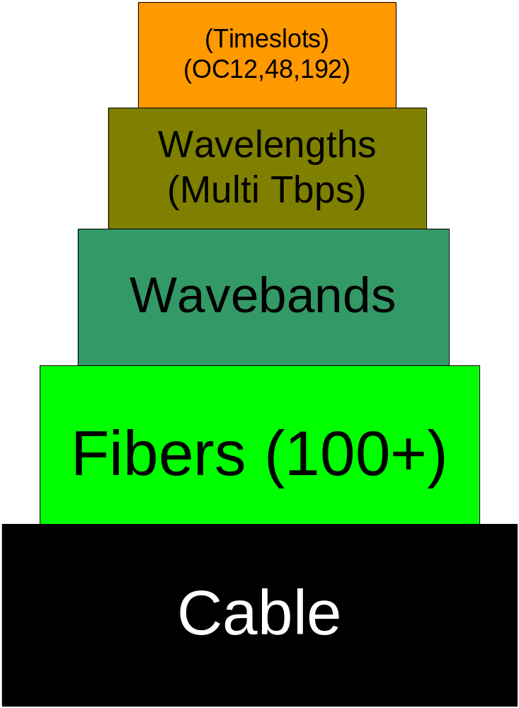
Fiber capabilities/WDM
Wavelengths can be time-division multiplexed into a series of aggregated connections
Sets of wavelengths can be spaced into wavebands
Switching can be done by wavebands or wavelengths
1 Cable can do multi terabits/sec
Feb. 5, 2002
EECS - UC Berkeley

Slide 6

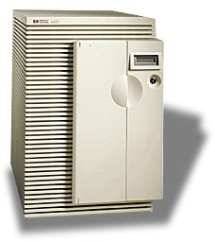








Internet Reality
Data
Center
SONET
SONET
DWDM
DWDM
SONET
SONET
Access
Metro
Long Haul
Metro
Access
Feb. 5, 2002
EECS - UC Berkeley

Slide 7
Devices
Add/Drop multiplexer
Optical Cross Connect (OXC)
  Tunable: no need to keep the same wavelength end-to-end
  Switches lambdas from input to output port
For “transparent optical network”, wavelengths treated as opaque objects, with routing control brought out-of-band
Feb. 5, 2002
EECS - UC Berkeley

Slide 8
Overview
Physical technology, devices
How are optical networks currently deployed?
Customer-empowered networks
  New applications, ways of doing business
  How does this change the “big picture”?
  How do we do it?
  What are the challenges? Payoffs?
Feb. 5, 2002
EECS - UC Berkeley

Slide 9
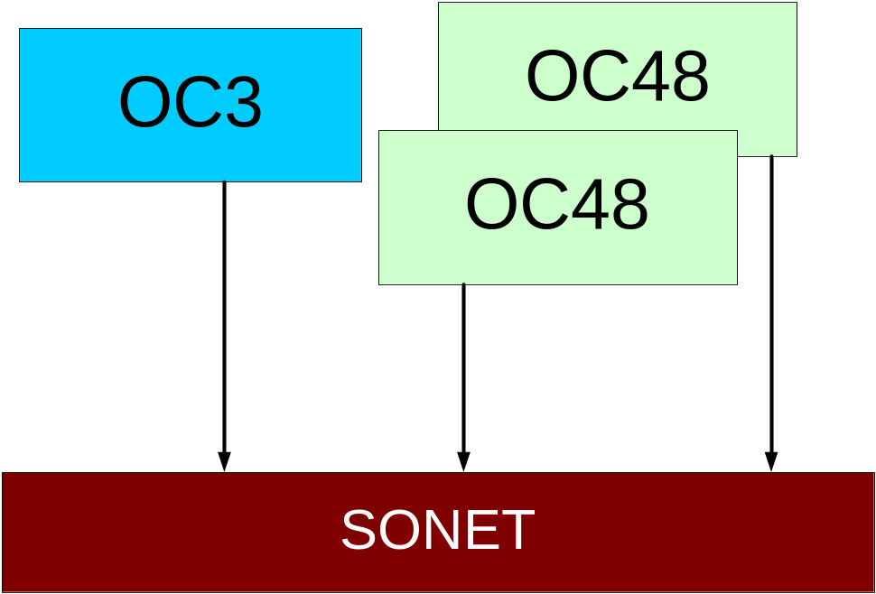
Overview of SONET
Synchronous Optical Network
Good for aggregating small flows into a fat pipe
Electric endpoints, strong protection, troubleshooting functionality
Feb. 5, 2002
EECS - UC Berkeley

Slide 10
Today’s provisioning
Anywhere between months to minutes
  Semi-automatic schemes
  Much like old-style telephone operator
The fact is there are tons of fibers underground, but they are not organized in a way where you can utilize their full potential
Feb. 5, 2002
EECS - UC Berkeley

Slide 11
Drive to autoswitched network
Make the network intelligent
On-demand bandwidth to the edge of the network
New applications
  Disaster Recovery
  Distributed SAN
  Data warehousing
    Backup Bunkers (no more tapes)
  Big Pipes on Demand
    Download movies to movie theaters
    Site replication
  Optical VPN
  Grid Computing
Feb. 5, 2002
EECS - UC Berkeley

Slide 12
Overview
Physical technology, devices
How are optical networks currently deployed?
Customer-empowered networks
  New applications, ways of doing business
  How does this change the “big picture”?
  How do we do it?
  What are the challenges? Payoffs?
Feb. 5, 2002
EECS - UC Berkeley

Slide 13
Customer empowered nets
Huge bandwidth to the enterprise
  The curb
  The house
  The desktop
End hosts can submit requirements to the network, which can then configure itself to provide that service
Issues of APIs, costs, QoS
Feb. 5, 2002
EECS - UC Berkeley

Slide 14
Changing the big picture
Now the converged network looks different
Dial-up bandwidth has huge implications
Pushing bandwidth to the edges of the network
  Affects service placement, for example
Feb. 5, 2002
EECS - UC Berkeley

Slide 15
Bandwidth at the edges
Services placed there (ServicePoP)
Need to connect services to customers and other services
Metro networks
  Use of Ethernet as low cost/flexible mechanism
Eventually fibers to pcmcia?!
Feb. 5, 2002
EECS - UC Berkeley

Slide 16



Protocol and Services on Edge Devices
Handle Protocol
New Services
Internet
Access
Access
Feb. 5, 2002
EECS - UC Berkeley

Slide 17
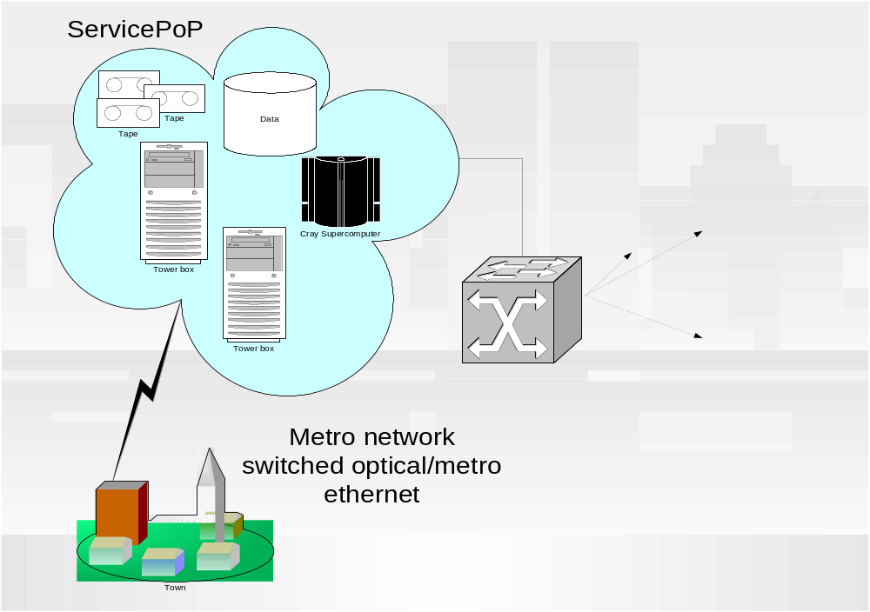
ServicePoPs
ServicePoPs act as intermediary between service provider and customer
Connectivity between ServicePoP and customer more important than provider to customer
Feature is very fast infrastructure
Feb. 5, 2002
EECS - UC Berkeley

Slide 18
Metro networks
Interim step: services in servicePoPs
Tap into fast connections here for enterprises
Use of Ethernet as protocol to connect the enterprise to the MAN
Avoid need for last mile for certain applications/services
Feb. 5, 2002
EECS - UC Berkeley

Slide 19
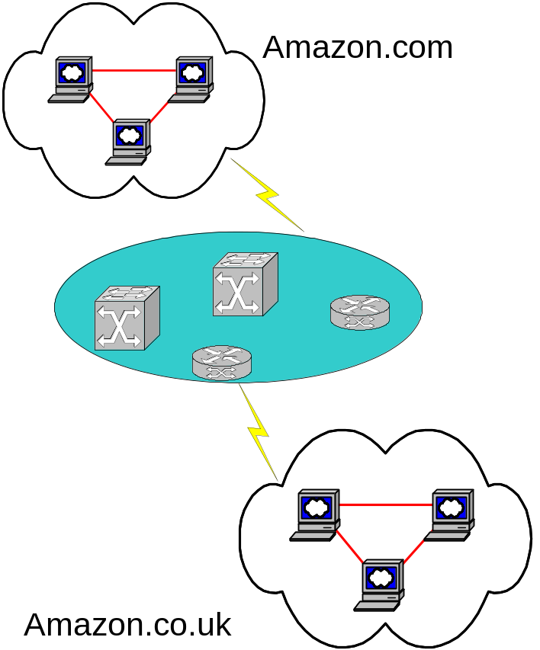
Amazon.com–vs-Amazon.co.uk
One site wants to do a software upgrade
Reserve 100Gbps for outage time
Send entire database over at outage time, reroute all customer requests to other site
When outage is over, transfer all data back to original site
Feb. 5, 2002
EECS - UC Berkeley

Slide 20
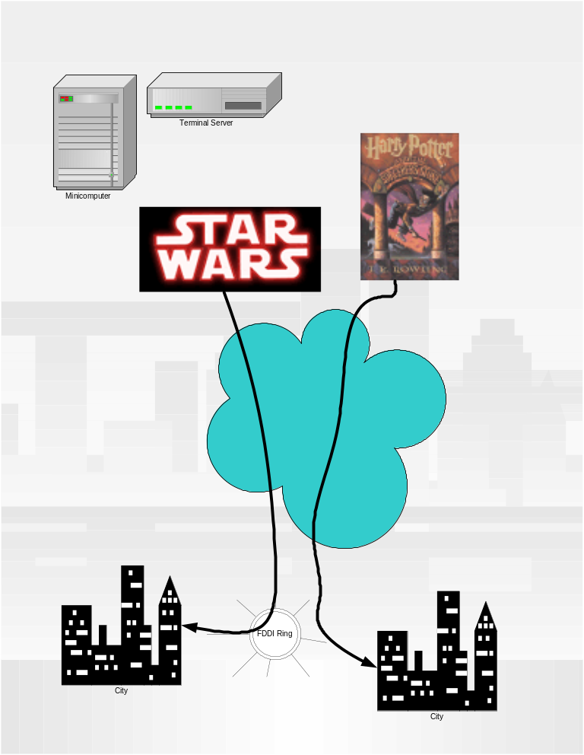
Movie Distribution
Each movie theater in a large area (SF, New York, Houston) requests 1 hour of bandwidth a week (OC192)
All movies transferred during this time
Efficient use of expensive but necessary fat pipe
Feb. 5, 2002
EECS - UC Berkeley

Slide 21
New type of businesses
Data warehousing: no more mailing tapes
Have tape vaults with gigabit connectivity
Data is sent optically to destination, where it is written to magnetic tape
Feb. 5, 2002
EECS - UC Berkeley

Slide 22
How to do it
Generalized Multiprotocol Label Switching (GMPLS)
UNI: user-to-network interface as API to specify requirements, service requests
NNI: network-to-network interface acts as API between entities for service composition/path formation
Feb. 5, 2002
EECS - UC Berkeley

Slide 23
How to do it
Interdomain?
Wavelength selection/routing
Exchange info
  Connectivity
  Wavelengths
  Qos, bandwidth requirements
  Switching instructions
Feb. 5, 2002
EECS - UC Berkeley

Slide 24
Canarie’s approach
OBGP (Optical BGP)
Routers spawn “virtual BGP” processes that peers can connect to
By modifying BGP messages, lightpath information can be traded between ASes
Feb. 5, 2002
EECS - UC Berkeley

Slide 25
1)
BGP OPEN message sent to router with information about optical capabilities
A virtual BGP process is spawned
A BGP session is initiated independently with new BGP process
The virtual process (running on the router) configures the OXC to switch the proper optical wavelengths
BGP OPEN
AS 123
OXC
AS 456
2)
Virtual Router
BGP OPEN
OXC
AS 123
AS 456

Slide 26
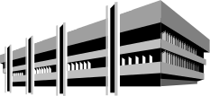


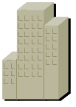

Optical BGP Networks
Dark fiber Network
City X
Dark fiber Network
City Y
ISP A
ISP B
EGP
ISP C
EGP
AS100
AS200
To other Wavelength
Clouds
Wavelength Routing Arbiter
& ARP Server
AS300
AS400
Customer Owned
Dim Wavelength
EGP
Dark fiber Network
City Z
ISP A
ISP B
Figure 12.0
Feb. 5, 2002
EECS - UC Berkeley

Slide 27
What is ASON?
The Automatic Switched Optical Network (ASON) is both a framework and a technology capability.
As a framework that describes a control and management architecture for an automatic switched optical transport network.
As a technology, it refers to routing and signalling protocols applied to an optical network which enable dynamic path setup.
Recently changed names to Automatic Switched Transport Network (G.ASTN)
Feb. 5, 2002
EECS - UC Berkeley

Slide 28
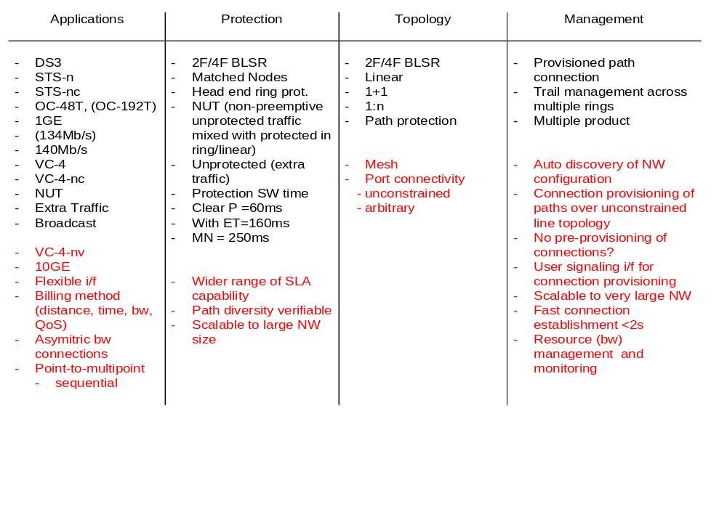
Optical Network: Today vs. Tomorrow
Today
Tomorrow
Optimized IP application - current driver for transparent NW
Additional SLA capability
Mesh network
Auto connection & resource mgnt
ASON value added
Feb. 5, 2002
EECS - UC Berkeley

Slide 29

ASON Network Architecture
Integrated
Management
ASON control plane
OCC
OCC
NNI
OCC
OCC
IrDI_NNI
User
signaling
UNI
CCI
Clients
e.g. IP, ATM, TDM
Clients
e.g. IP, ATM, TDM
GHCT
NE
GHCT
NE
GHCT
NE
IrDI
Transport Network
Legacy
Network
Interfaces:
UNI: User Network Interface
CCI: Connection Control Interface
NNI: ASON control Node Node Interface
GHAT NE: Global High Capacity transport NE
ASON: Automatic Switched Optical Network
OCC: Optical Connection Controller
IrDI: Inter Domain Interface
Feb. 5, 2002
EECS - UC Berkeley
Notes:
ASON connection management system consists of signaling plane, switch controller and SLC machine.
Signaling plane is the brain of ASON connection management system. It discovers the transport network topology including the available network resources (such as b/w) automatically or by pre-configuration. Upon a connection request, the signal plane will decide the connection path and inform switch controller to set-up the connection.
Switch controller is associated with each network element (OXC, ADM, …) or a group of NEs. It performs actual connection function (set-up, or tear-down connections) under the control of the signal plane.
SLA machine is part of the switch controller function. It performs “call” administration control and billing function which off loads function from the signal plane
Four connection control interfaces are identified:
UNI: The user network interface (UNI) is the interface between ASON control plane and a user such as a router, or an ATM switch, etc. A signal channel is required at this interface as a dialog channel between the user and ASON control plane for connection set up/tear down request.
SCI: The signal control interface (SCI) is the interface between the connection control plane and the switch controller in a network element. The ASON signal control plane calculates the connection routes, and set up connection via switch controllers. Switch controller just execute the command from the ASON control plane.
IaDI: The intra-domain interface is the interface between network elements in ASON control plane.
NNI: The network network interface is the interface between ASON control planes in different administration domains. It allows the network to be partitioned into sub-networks; each sub-network is managed independently while still be able to set up end-to-end connections across multiple administration domains (sub-networks).

Slide 30
ASON Layer Hierarchy
Domain B
Network Layer
Domain
A
Domain
C
Domain
E
Domain
D
Domain
Domain/Region Layer
Fibers
Conduit 1
Conduit Layer
Fiber Layer
Conduit 2
λ1
λn
λ Layer
Feb. 5, 2002
EECS - UC Berkeley

Slide 31
Resilient packet ring (802.17)
Put lan on top of man
50ms protection
Feb. 5, 2002
EECS - UC Berkeley

Slide 32
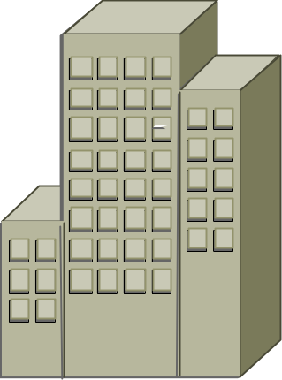

The Metro Bottleneck
Other Sites
Access
Metro
Core Network
End User Access Metro Core
T1
DS1
DS3
Ethernet LAN
OC-12
OC-48
OC-192
DWDM n x λ
IP/DATA
1GigE
LL/FR/ATM
1-40Meg
1Gig+
10GigE+
Feb. 5, 2002
EECS - UC Berkeley

Slide 33







RPR - Expanding the LAN to the MAN/WAN
MAN/WAN
LAN
LAN in the MAN Paradigm
Distributed
Switch
Low Cost
Simplicity
Universality
Low Cost
Simplicity
Universality
Scalability
Reach
Robustness
+
Feb. 5, 2002
EECS - UC Berkeley
Notes:
The Optical Ethernet takes the application protocol (Native-rate Ethernet) and keeps it intact across the entire network. The limitations of TDM SONET are eliminated by dedicating SONET STS-n bandwidth to Ethernet Data applications. This allows bandwidth sharing as well as highly flexible service offerings.

Slide 34
What is RPR?
Ethernet networking on Optics (STS-Nc)
Ethernet
Frame
Ethernet
Frame
Ethernet
Frame
Ethernet
Frame
STS-N Envelope
Ethernet
Frame
Ethernet
Frame
Ethernet
Frame
Feb. 5, 2002
EECS - UC Berkeley

Slide 35
Scalable Bandwidth and Services
VT’s
STS-N
TDM
VT’s
VT’s
VT’s
1000M
OC-3 / 12 / 48 / 192
10M
STS-Nc
Ethernet
300M
500M
1M
80M
Feb. 5, 2002
EECS - UC Berkeley

Slide 36



Network & Customer Management
Customer
Ethernet
Ports
Customer Privacy through managed Virtual LANs (802.1Q tags)
Customer Agreements through flow attributes (802.1p prioritized queues and traffic policing)
Feb. 5, 2002
EECS - UC Berkeley

Slide 37
Move to optical
The key is to find a way to use the infrastructure that we have available in an efficient manner
What services are available? What can we do?
Challenges?
Feb. 5, 2002
EECS - UC Berkeley

Slide 38
The Future is Bright
There is a light in the end of the tunnel
Feb. 5, 2002
EECS - UC Berkeley

