Slide 1
Integrating Active Networking and Commercial-Grade Routing Platforms
The University of Maryland
Rob Jaeger
(rfj@cs.umd.edu)
J.K. Hollingsworth
Bobby Bhattacharjee

Slide 2
The Network Paradigm Spectrum
Traditional Networks
- end-to-end connectivity
- well defined protocols
- increasingly perform
forwarding in hardware
Active Networks
- on-the-fly service
introduction
- per-flow granularity
possible
- inject software in
data path
?

Slide 3
Objectives
Implement flow performance enhancement mechanisms without introducing software into data forwarding path
  Service defined packet processing in a silicon-based forwarding engine
  Policy-based Dynamic packet classifier
Create OPEN platform for introduction of new services
  Specify OPEN interfaces for Java applications to control a generic, platform-neutral forwarding plane
  Enable downloading of services to network node
  Allow object sharing and inter-service communication
Notes:
To introduce the new Open Networking Architecture that is based on Java-enabled Network Devices
To enable easy 3rd party integration and leverage Nortel Networks’ competitive advantage

Slide 4
Accomplishments
  JVM on a Silicon-Based Routing Switch
  ORE - Oplet Run-time Environment
    Java-enabled platform for secure downloading and safe execution of services
    Ensures required services are installed for a downloaded Oplet
  Java SNMP API (proxy mode for non Java devices)
  Implementation of Network Forwarding API (JFWD)
  RESULT: Dynamic Classification in Silicon-Based forwarding engine on a Gigabit Routing Switch

Slide 5
Oplet Runtime Environment Overview
A platform to dynamically deploy services on network elements
Desirable properties
  Portable to many different devices
  Secure, reliable
  Low impact on device performance
  Open
  Provide a framework to structure code
    Reusable, maintainable, robust
Implemented in Java

Slide 6
Basic Concepts
Oplet Runtime Environment (ORE)
  A kernel that manages the life cycle of oplets and services
  Provides a registry of services
Services
  The value being added. Minimal constraints
  Represented as a Java interface
Oplets
  The unit of deployment: a JAR file
  Contains meta-data (eg signatures, dependency declarations)
  Contains services and other resources (data files, images, properties, JAR files)

Slide 7
Architecture
Oplet
Service
Oplet
Oplet
Service
Service
Oplet
Service
Service
Oplet Runtime Environment
Java Virtual Machine
API Extensions

Slide 8
Oplet Lifecycle
Install
  Loaded from URL
Start
  Services that are depended on must already be started
Stop
  Any oplets that depend on this oplet’s services will be stopped
  Code and data can be unloaded from ORE
Uninstall

Slide 9
Dependencies
A service S can use facilities provided by another service T
This means that the oplet containing S has a dependency on service T
Before an oplet can be started, all of its dependent services must have been started
ORE manages dependencies and lifecycle of oplets and services

Slide 10
Some services
Bootstrap (ORE start time) - basic configuration
Log - Centralized logging for oplets
HTTP server
  Simple servlet support
Command line shell -
  service depends on shell to register commands
Administration commands -
  Manage oplets and services
Access to router resource including hardware instrumentation via JMIB

Slide 11
Security Issues
Sandbox
  Each oplet provides a Java name space and applet-like sandbox
Signed oplets
  Oplets can be signed for assigning trust
Denial of service
  Vulnerable to DoS (memory, cycle, bandwidth, peristent storage, monitors) like all Java applications
  resource management is a problem

Slide 12
ORE Status
Done now
  Runs on several Nortel routing products
  Run on workstations
  First release of ORE SDK complete
  JMIB monitor/control system through MIBs
  JFWD

Slide 13
Future ORE work
Capabilities
  Revocable services
Security
  Java 2 style permissions to perform operations
Resource limits, DoS protection
  Probably requires support from JVM
Jini, Oplet Directory - locate and load services
Agents/Services
Open source

Slide 14
Open Device Architecture
C/C++
API
Java
API
ORE
Service
Device
Code
JNI
Download Oplet
ORE
Device
Drivers
JVM
JFWD API
Operating System
Device HW

Slide 15
Silicon-based Forwarding Engines
Control
Plane
CPU
Switching Fabric
Wire Speed
Forwarding
Forwarding
Rules
Forwarding
Rules
Forwarding
Rules
. . .
Forwarding
Processor
Forwarding
Processor
Forwarding
Processor
Statistics
&Monitors
Statistics
&Monitors
Statistics
&Monitors

Slide 16
Dynamic Configuration of Forwarding Rules
Dynamic
Policy
CPU
Forwarding
Rules
Forwarding
Processor
Forwarding
Processor
Forwarding
Processor
Forwarding
Processor
SW
HW

Slide 17
CarbonCopy Capability
CPU
Forwarding
Processor
Forwarding
Processor
Forwarding
Processor
Forwarding
Processor

Slide 18
Dynamic Packet Configuration
Policy
DSC
Service
Filters
Filter
Packet
Packet
Forwarding
Processor
Forwarding
Processor
Packet

Slide 19
Dynamic Classification
Identify real-time flows (e.g. packet signature/flowId )
  Use CarbonCopy filters to deliver multimedia control protocols to control plane
    e.g. SIP, H.323. RTSP
    Determine dynamically assigned ports from control msgs
  Use CarbonCopy filters to sample a number of packets from the physical port and identify RTP packets/signature
Set a packet processing filter for packet signature to:
  adjust DS-byte OR
  adjust priority queue
Notes:
To introduce the new Open Networking Architecture that is based on Java-enabled Network Devices
To enable easy 3rd party integration and leverage Nortel Networks’ competitive advantage

Slide 20
JFWD 5-tuple Filtering
copy the packet to the control plane
don't forward the packet
set TOS field
set VLAN priority
adjust priority queue
Notes:
To introduce the new Open Networking Architecture that is based on Java-enabled Network Devices
To enable easy 3rd party integration and leverage Nortel Networks’ competitive advantage

Slide 21
ANTS on Gigabit Router
Demo - 1

Slide 22

ANTS Demo Configuration
RoutingSwitch loads boot image from TFTP server
RoutingSwitch dynamically loads Oplets from the Class Server
Laptop 1 originates the ping
Router gets Ping code from Laptop 1.
Router “evaluates” ping
Ping forwarded to Laptop2
Laptop 2 requests code
Laptop 2 perform ping reply
Laptop 1
ORE
Services
Java-enabled Routing Switch
Laptop 2
1. Class Server 2. TFTP Server

Slide 23
ANTS Demo
Demo 1
AN Ping
AN Ping
AN Ping
ORE
Services
Laptop 1
Laptop 2
Java-enabled Routing Switch

Slide 24
ANTS Demo
AN_Ping
Application
AN_Ping
Application
ANTS EE
ANTS EE
Service
Ping
Capsule
ORE
JVM
JVM
WIN-95
Routing Switch
DLResponse
Capsule
DLBootstrap
Capsule
DLRequest
Capsule

Slide 25
ANTS Demo
Java application running on the router
ORE facilitate downloading services
Interoperable with ANTS Distribution
Minimum changes to make it conform to ORE service specification

Slide 26
Dynamic Filtering & Configuring
Demo - 2

Slide 27
Demo 2
Dynamic - On the Fly Configuration
Policy
AN Apps
Filters
Filter
Packet
Packet
Forwarding
Processor
Forwarding
Processor
Packet

Slide 28
Dynamic - On the Fly Configuration
From downloadable Java application, we can modify the behavior of the ASICs

Slide 29
Active Networks Packets Interception
Demo 3 -

Slide 30
Active Networks Packet Capture
Demo 3
AN Apps
CPU
JFWD to
Divert or Copy
Wire Speed
Forwarding
Processor
Forwarding
Processor
Forwarding
Processor
Forwarding
Processor
Packet

Slide 31
Packet Divert
Application
Application
Active Network topology is unknown
ANEP packets NOT addressed to this node are delivered to the control plane for processing
ANEP daemon receives packets and delivers them to the appropriate EE based on TypeID
Execution
Environment
Execution
Environment
ANEP
ANEP packet
ASIC
Filter

Slide 32
Active Networks Packet Capture
Be able to get the packets from the forwarding plane to the control plane
Process Active Networks packets in the control plane

Slide 33
Experimental Setup
Source 1
tcp_send()
Acclear
1100B
Routing
Switch
100 Mbps
Destination
1. tcp_recv()
2. tcp_recv()
100 Mbps
Source 2
tcp_send()
100 Mbps

Slide 34
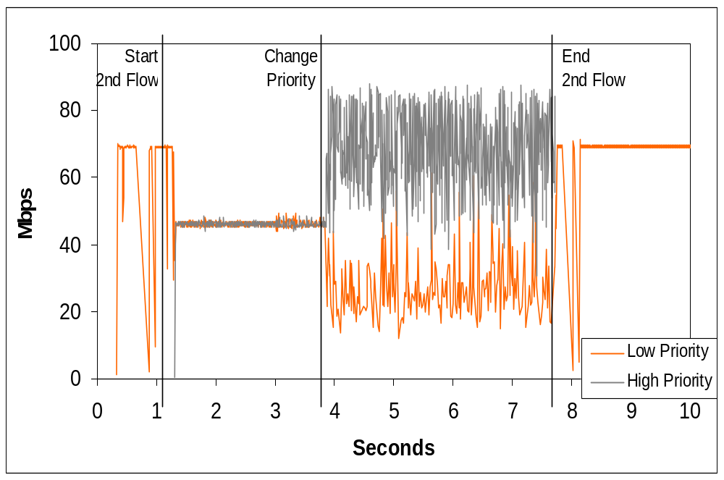

Slide 35
Summary
Developed the ORE for downloading and safely running services onto network devices
Without introducing software into data path we performed Dynamic Classification of flows in a Silicon-Based Gigabit Routing Switch
  Introduced a new service to a Gigabit Routing Switch
  Identified real-time flows
  Performed policy-based flow behavior classification
  Adjusted DS-byte value
  Showed that flow performance can be improved
For more info email: rfj@cs.umd.edu
Notes:
To introduce the new Open Networking Architecture that is based on Java-enabled Network Devices
To enable easy 3rd party integration and leverage Nortel Networks’ competitive advantage

