Slide 1
DWDM-RAM:
DARPA-Sponsored Research for Data Intensive Service-on-Demand
Advanced Optical Networks
DWDM-RAM demonstration sponsored by
Nortel Networks and iCAIR/Northwestern University
Dates Monday Oct 6 at 4pm & 6pm
& Tuesday Oct 7 at 12Noon, 2pm & 4pm
Times: Wednesday Oct 8 at 10am & 12Noon

Slide 2
SLAC Agenda
DWDM-RAM Overview
  The Problem
  Our Architecture & Approach
Discussion with HEP Community

Slide 3
Problem: More Data Than Network
Application-level network scheduling
  Application must see dedicated bandwidth as a managed resource
  Advance scheduling of network from application
  Optimization is important
    Rescheduling with under-constrained requests
Data transfers require service model
  Scheduled network and host data services combined
  Co-reservation of storage, data, and network
  Requires scheduling

Slide 4
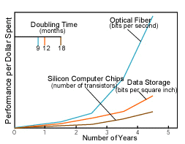
Optical Networks Change the Current Pyramid
x10
George Stix,
Scientific American,
January 2001
DWDM- fundamental misbalance between computation and communication

Slide 5



Radical mismatch: L1 – L3
Radical mismatch between the optical transmission world and the electrical forwarding/routing world.
Currently, a single strand of optical fiber can transmit more bandwidth than the entire Internet core
Current L3 architecture can’t effectively transmit PetaBytes or 100s of TeraBytes
Current L1-L0 limitations: Manual allocation, takes 6-12 months - Static.
  Static means: not dynamic, no end-point connection, no service architecture, no glue layers, no applications underlay routing

Slide 6


Growth of Data-Intensive Applications
IP data transfer: 1.5TB (10¹²) , 1.5KB packets
  Routing decisions: 1 Billion times (10⁹)
  Over every hop
Web, Telnet, email – small files
Fundamental limitations with data-intensive applications
  multi TeraBytes or PetaBytes of data
  Moving 10KB and 10GB (or 10TB) are
  different (x10⁶, x10⁹)
  1Mbs & 10Gbs are different (x10⁶⁾

Slide 7
Challenge: Emerging data intensive applications require:
Extremely high performance, long term data flows
Scalability for data volume and global reach
Adjustability to unpredictable traffic behavior
Integration with multiple Grid resources
Response: DWDM-RAM - An architecture for data intensive
Grids enabled by next generation dynamic optical networks,
incorporating new methods for lightpath provisioning

Slide 8
Architecture
Applications
Other
Svcs
DTS
DMS
NRM
ftp, GridFTP,
Sabul, fast,
etc
ODIN
omninet
Other
dwdm
…
Replication,
Disk, Accounting,
Authentication, Etc.
OGSI provided for
all application layer
interfaces
λ’s
λ’s
Architecture, Page 2

Slide 9
Data Management Services
OGSA/OGSI compliant
Capable of receiving and understanding application requests
Has complete knowledge of network resources
Transmits signals to intelligent middleware
Understands communications from Grid infrastructure
Adjusts to changing requirements
Understands edge resources
On-demand or scheduled processing
Supports various models for scheduling, priority setting,
event synchronization

Slide 10
Intelligent Middleware for Adaptive Optical Networking
OGSA/OGSI compliant
Integrated with Globus
Receives requests from data services
Knowledgeable about Grid resources
Has complete understanding of dynamic lightpath provisioning
Communicates to optical network services layer
Can be integrated with GRAM for co-management
Architecture is flexible and extensible

Slide 11
Dynamic Lightpath Provisioning Services
Optical Dynamic Intelligent Networking (ODIN)
OGSA/OGSI compliant
Receives requests from middleware services
Knowledgeable about optical network resources
Provides dynamic lightpath provisioning
Communicates to optical network protocol layer
Precise wavelength control
Intradomain as well as interdomain
Contains mechanisms for extending lightpaths through
E-Paths - electronic paths

Slide 12


DWDM-RAM Service Control Architecture
DATA GRID SERVICE PLANE
GRID Service Request
Service
Control
Service
Control
NETWORK SERVICE PLANE
Network Service Request
ODIN
OmniNet Control Plane
ODIN
Optical Control Network
UNI-N
UNI-N
Data
Path
Control
Data
Path
Control
Connection
Control
Data Transmission Plane
Data
Center
λ₁
λ₁
Data
storage
switch
λ_{n}
λ_{n}
L3 router
Data
Center
L2 switch
λ₁
λ_{n}
Data
Path

Slide 13
Design for Scheduling
Network and Data Transfers scheduled
  Data Management schedule coordinates network, retrieval, and sourcing services (using their schedulers)
  Network Management has own schedule
Variety of request models
  Fixed – at a specific time, for specific duration
  Under-constrained – e.g. ASAP, or within a window
Auto-rescheduling for optimization
  Facilitated by under-constrained requests
  Data Management reschedules
    for its own requests
    request of Network Management
DWDM-RAM October 2003
Architecture Page 4

Slide 14
New Concepts
Many-to-Many vs. Few-to-Few
Apps optimized to waste bandwidth
Network as a Grid service
Network as a scheduled service
New transport concept
New control plane
Cloud bypass

Slide 15
Summary
Next generation optical networking provides significant
new capabilities for Grid applications and services,
especially for high performance data intensive processes
DWDM-RAM architecture provides a framework for
exploiting these new capabilities
These conclusions are not only conceptual – they are being
proven and demonstrated on OMNInet –
a wide-area metro advanced photonic testbed

Slide 16
End of SLAC mini-overview
3 March 2004

Slide 17
Key Terms
DTS – Data Transfer Service
Effects transfers
NRM – Network Resource Management
Interface to multiple physical/logical network types
Consolidation, topology discovery, path allocation, scheduler, etc.
DMS – Data Management Service
Topology discovery, route creation, path allocation
Scheduler/optimizer
Other Services
Replication, Disk, Accounting, Authentication, Security, etc.

Slide 18
Possible Extensions
Authentication/Security
  Multi-domain environments
Replication for optimization
  May help refine current Grid file system models
  May Use existing replica location services
Priority models
Rule-based referees
  Allow local and policy-based management
  Add domain specific constraints
DWDM-RAM October 2003
Architecture Page 5

Slide 19
Extending Grid Services
OGSI interfaces
  Web Service implemented using SOAP and JAX-RPC
  Non-OGSI clients also supported
GARA and GRAM extensions
  Network scheduling is new dimension
  Under-constrained (conditional) requests
  Elective rescheduling/renegotiation
Scheduled data resource reservation service (“Provide 2 TB storage between 14:00 and 18:00 tomorrow”)
DWDM-RAM October 2003
Architecture Page 6

Slide 20
DWDM-RAM: An architecture designed to meet the
networking challenges of extremely large scale Grid applications.
Traditional network infrastructure cannot meet these demands,
especially, requirements for intensive data flows
DWDM-RAM Components Include:
Data management services
Intelligent middleware
Dynamic lightpath provisioning
State-of-the-art photonic technologies
Wide-area photonic testbed implementation

Slide 21
Current Implementation
Client Application
DTS
DMS
NRM
OGSI provided for
network allocation
interfaces
ODIN
OMNInet
ftp
λ’s

Slide 22
NRM OGSA Compliance
OGSI interface
GridService PortType with two application-oriented methods:
  allocatePath(fromHost, toHost,...)
  deallocatePath(allocationID)
Usable by a variety of Grid applications
Java-oriented SOAP implementation using the Globus Toolkit 3.0

Slide 23
NRM Web Services Compliance
Accessible as Web Service for non-OGSI callers
Fits Web Service model:
  - Single-location always-on service
  - Atomic message-oriented transactions
  - State preserved where necessary at the application level
No OGSI extensions, such as service data and service factories

Slide 24
Data Management Service
Uses standard ftp (jakarta commons ftp client)
Implemented in Java
Uses OGSI calls to request network resources
Currently uses Java RMI for other remote interfaces
Uses NRM to allocate lambdas
Designed for future scheduling
Data Receiver
λ
Data Source
FTP client
FTP server
DMS
NRM
Client App

Slide 25
Network Resource Manager
Presents application-oriented OGSI / Web Services interfaces for network resource (lightpath) allocation
Hides network details from applications
Implemented in Java
Items in blue are planned

Slide 26
Network Resource Manager
Using Application
(DMS)
Scheduling / Optimizing Application
Network
Resource Manager
End-to-End-Oriented Allocation Interface
Segment-Oriented Topology and Allocation Interface
Items in blue are planned
Omninet Data Interpreter
Network-Specific Data Interpreter
Network-Specific Data Interpreter
Omninet Network Manager (Odin)
Network-Specific Network Manager
Network-Specific Network Manager

Slide 27
Lightpath Services
Enabling High Performance Support for
Data-Intensive Services With On-Demand Lightpaths Created By
Dynamic Lambda Provisioning, Supported by Advanced Photonic
Technologies
OGSA/OGSI Compliant Service
Optical Service Layer: Optical Dynamic Intelligent Network
(ODIN) Services
Incorporates Specialized Signaling
Utilizes Provisioning Tool: IETF GMPLS
New Photonic Protocols

Slide 28
ODIN
Optical Dynamic Intelligent Networking Services:
An Architecture Specifically Designed to Support Large Scale,
Data Intensive, Extremely High Performance, Long-Term Flows
OGSA/OGSI Compliant Service
Dynamic Lambda Provisioning Based on DWDM
Beyond Traditional Static DWDM Provisioning
Scales to Gbps, Terabits Data Flows with
Flexible, With Fine-Grained Control
Lightpaths: Multiple Integrated Linked Lambdas, Including
One to Many and Many to One, Intradomain/Interdomain

Slide 29
Terms
ODIN Server – A server software that accepts and fulfills requests (eg, allocates and manages routes, paths)
Resource – A host or other hardware that provides a service over the optical network, OGSA/OGSI compliant
Resource Server – Server software running on a Resource that provides the service
Resource Config. Server – Server software that receives route configuration data from the ODIN Server
Client – A host connecting to a Resource through the optical network, in this demonstration, Grid clusters
Network Resource – Dynamically allocated network resource, in this demonstration, Lightpaths

Slide 30
Lightpath Provisioning Processes
Specialized Signaling
Request Characterization, Resource Characterization, Optimization, Performance, and Survival/Protection, Restoration, Characterization
Basic Processes Are Directed at Lightpath/λ Management:
  Create, Delete, Change, Swap, Reserve
And Related Processes:
  Discover, Reserve, Bundle, Reallocate, etc.
IETF GMPLS As Wavelength Implementation Tools
Utilizes New Photonic Network Protocols

Slide 31
Core Processes
O-UNI, Specialized Interfaces, eg, APIs, CLIs
Wavelength Distribution Protocol
Auto-Discovery of Optical Resources
Self-Inventorying
Constraint Based Routing
Options for Path Protection, Restoration
Options for Optical Service Definitions

Slide 32
Addressing and Identification
Options for Interface Addressing
Options for VPN IDs
Port, Channel, Sub-channel IDs
Routing Algorithm Based on Differentiated Services
Options for Bi-directional Optical Lightpaths, and
Optical Lightpath Groups
Optical VPNs

Slide 33

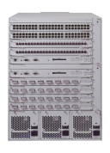
OMNInet Core Nodes
UIC
Northwestern U
8x1GE
4x10GE
4x10GE
8x1GE
Application
Cluster
Optical
Switching
Platform
Optical
Switching
Platform
Passport
8600
Passport
8600
Application
Cluster
OPTera
Metro
5200
StarLight
CA*net3--Chicago
8x1GE
4x10GE
4x10GE
8x1GE
Loop
Application
Cluster
Optical
Switching
Platform
Optical
Switching
Platform
Passport
8600
Passport
8600
Closed loop
A four-node multi-site optical metro testbed network in Chicago -- the first 10GE service trial!
A test bed for all-optical switching and advanced high-speed services
OMNInet testbed Partners: SBC, Nortel, iCAIR at Northwestern, EVL, CANARIE, ANL

Slide 34
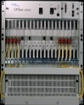
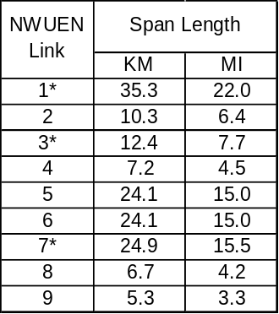
OMNInet
W Taylor
Sheridan
10 GE
λ
1
Photonic
Photonic
λ
10 GE
Grid
Clusters
PP
10 GE
λ
Node
Node
1
10 GE
PP
10/100/
GIGE
8600
Optera
5200
10Gb/s
TSPR
2
NWUEN-1
λ
2
8600
10/100/
GIGE
λ
3
λ
3
Optera
5200
10Gb/s
TSPR
λ
4
λ
4
…
Optera 5200 OFA
NWUEN-5
Optera Metro 5200 OFA
INITIAL
CONFIG:
10 LAMBDAS
(ALL GIGE)
NWUEN-2
NWUEN-6
CAMPUS
FIBER (4)
CAMPUS
FIBER (16)
EVL/UIC
OM5200
NWUEN-3
5200 OFA
Lake Shore
TECH/NU-E
OM5200
λ
1
10 GE
PP
Photonic
10 GE
10/100/
GIGE
INITIAL
CONFIG:
10 LAMBDA
(all GIGE)
Node
λ
2
Optera
5200
10Gb/s
TSPR
8600
λ
3
λ
4
Fiber
CAMPUS
FIBER (4)
5200 OFA
StarLight
Interconnect
with other
research
networks
LAC/UIC
OM5200
NWUEN-8
NWUEN-9
NWUEN-7
NWUEN-4
5200 OFA
S. Federal
8x8x8λ Scalable photonic switch
Trunk side – 10 G WDM
OFA on all trunks
10 GE
10GE LAN PHY (Dec 03)
Photonic
λ
1
PP
Node
λ
2
10 GE
8600
To Ca*Net 4
λ
3
Optera
5200
10Gb/s
TSPR
10/100/
GIGE
Fiber in use
λ
4
1310 nm 10 GbE
WAN PHY interfaces
Fiber not in use

Slide 35
Overlay Management Network (Current)
OMNInet Control Plane Overlay Network
10/100 BT
To Management Network ATM switch port
BayStack 350
Photonic Switch
Evanstan
SBC
OPTera 5200 OLA
10/100 BT
OC-12 Ring
Local Management Station
NAP
OC-3
MREN
Passport 8600
Part of StarTap
710 Lakeshore Dr.
MREN= Metropolitan Research
And Education Network
Univ. IL
600/700 S. Federal
Uses ATM PVC with 2 Mb/s CIR from existing network (MREN + OC12)
Hub and spoke network from 710 Lakeshore Dr.

Slide 36
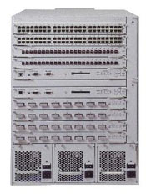
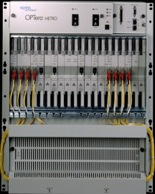
OMNInet Optical Grid Clusters
iCAIR Clusters at Northwestern
Technological Institute
Northwestern
Leverone Hall Data Com Center
DWDM on
Dedicated
Fiber
Clusters
For Telecom2003 Demo
~20m
4-fibers
~1km
~20m
10GE WAN/LAN PHY to OMNInet
PP8600
OM5200
OM5200
Up to 16xGE
(SMF LX)
DWDM Between Cluster Site and OMNInet Core Node at iCAIR sites at Northwestern in Evanston
The implementation is lambdas (unprotected).
Installed shelf capacity and common equipment permits expansion of up to 16 lambdas through deployment of additional OCLD, and OCI modules.
A fully expanded OM5200 system is capable of supporting 64 lambdas (unprotected) over the same 4-fiber span.

Slide 37
Physical Layer Optical Monitoring and Adjustment
Management & OSC
Routing
PPS Control Middleware
Fault isolation
Connection
verification
Photonics
Database
LOS
Switch
Control
Path ID Corr.
Drivers/data translation
Power measurement
Gain
Controller
Tone
code
FLIP
Rapid
Detect
Power
Corr.
Transient
compensator
Relative
λ power
λ Leveling
Relative
Fiber power
OSC cct
+
+
DSP Algorithms & Measurement
+
Set
point
-
AWG Temp.
Control alg.
-
100FX
PHY/MAC
-
D/A
D/A
A/D
D/A
A/D
PhotoDetector
Heater
Photonic H/W
PhotoDetector
switch
OFA
Splitter
tap
VOA
AWG
tap

Slide 38
Application level measurements
Path allocation: | 48.7 secs
Data transfer setup time: | 0.141 secs
FTP transfer time: | 464.624 secs
Effective transfer rate: | 156 Mbits/sec
Path tear down time: | 11.3 secs
File size: | 10 GB

Slide 39
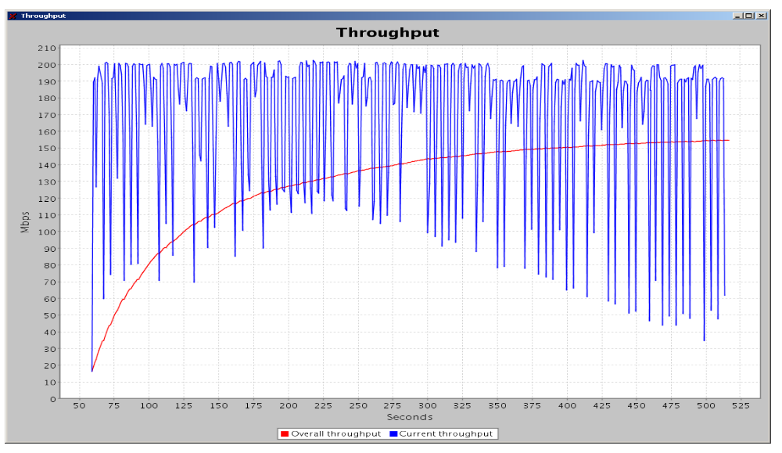
10GB file Transfer

Slide 40
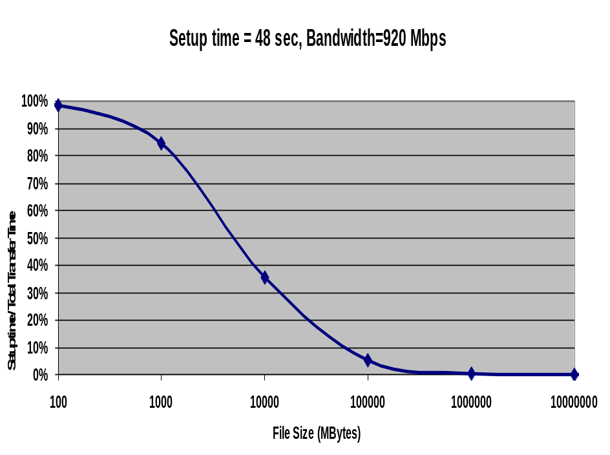
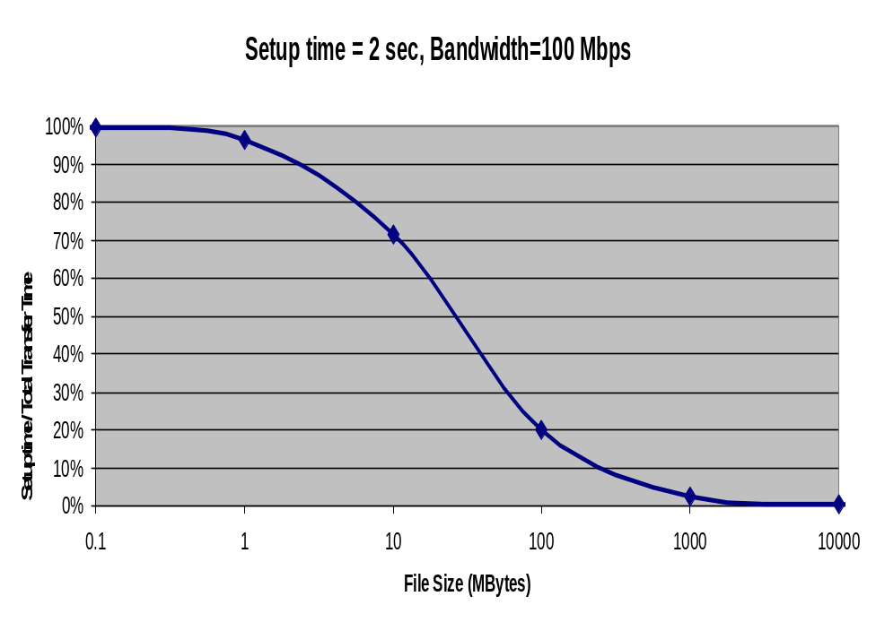
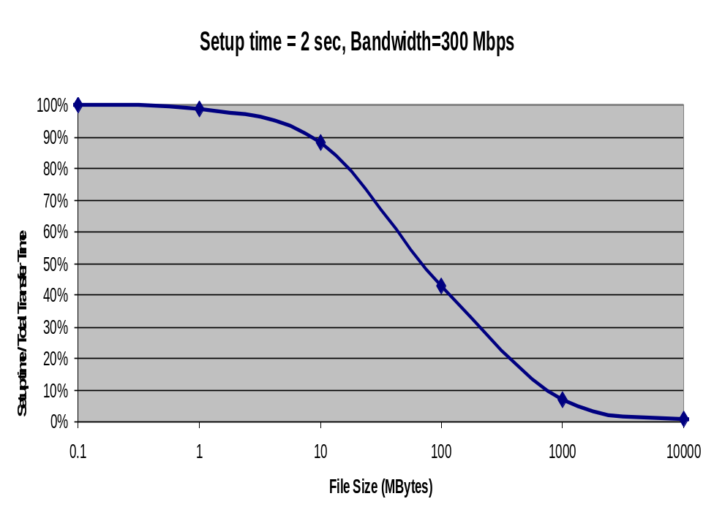
Path Allocation Overhead as a % of the Total Transfer Time
Knee point shows the file size for which overhead is insignificant
500GB
1GB
5GB

Slide 41
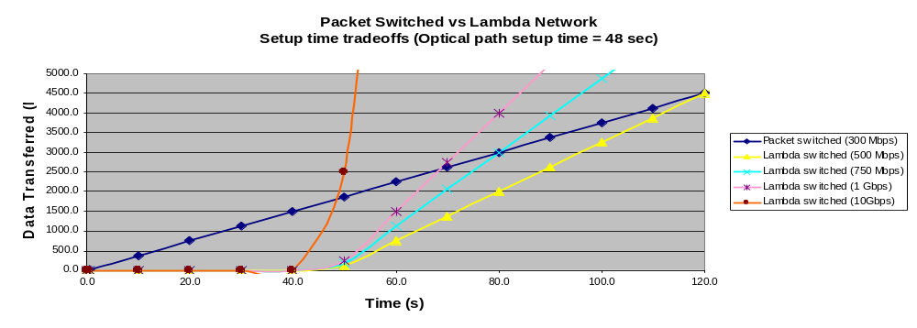
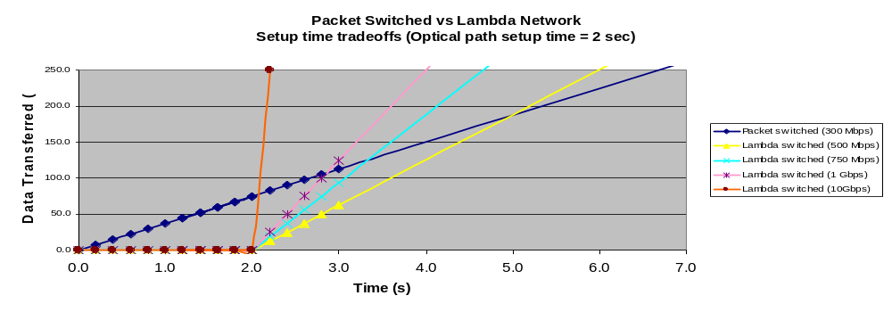

Slide 42
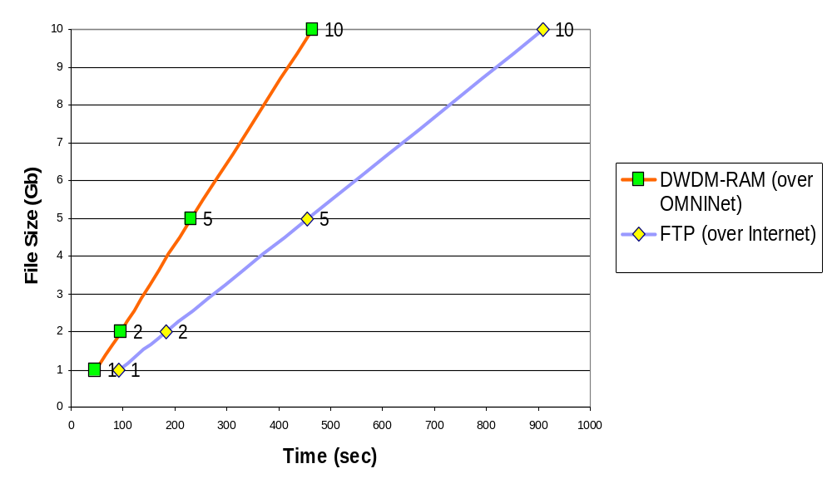
File transfer times

Slide 43
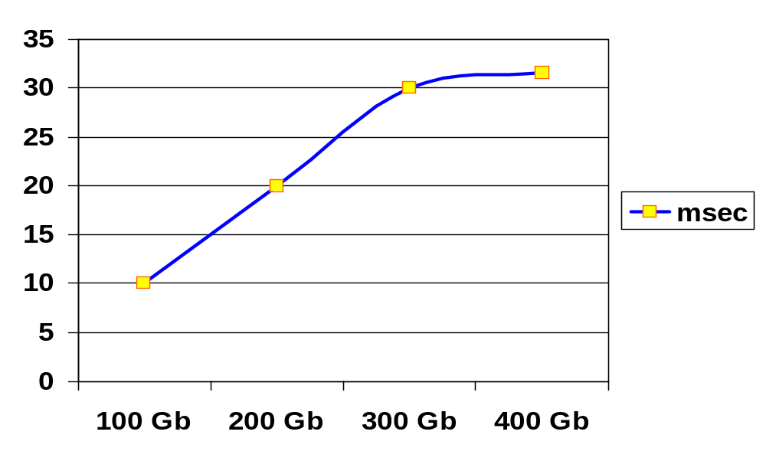
File Transfer Times
Max bandwidth
900+ Mb/s

Slide 44
Optical level measurements
Time to set up an individual X-connect: | secs
UNI-N processing time for request: | secs
Time taken by the routing card to send command to control card: | secs
Time taken by the routing card to forwarding request to next hop in control plane: | secs
Time taken by the control card to drive the switch card : | secs
End-to-end light path setup : | secs

Slide 45
Enhanced Optical Dynamic Intelligent Network Services
Additional OGSA/OGSI development
Enhanced signaling
Enhanced integration with optical component addressing methods
Extension of capabilities for receiving information from
L1 process monitors
Enhanced capabilities for establishing optical VPNs
New adaptive response processes for dynamic conditions
Explicit segment specification

Slide 46
Enhanced Middleware Services
Enhanced integration with data services layer
Enhanced understanding of L3-L7 requirements
Awareness of high performance L3/L4 protocols
Enhanced integration with edge resources
Middleware process performance monitoring and analysis
New capabilities for scheduling
Security

Slide 47
Expanded Data Management Service
New methods for scheduling
New methods of priority setting
Enhance awareness of network resources
Technique for forecasting demand and preparing responses
Replication services
Integration with metadata processes
Integration with adaptive storage services
Enhanced policy mechanisms

Slide 48
Photonic Testbed - OMNInet
Implementation of RSVP methods
Experiments with parallel wavelengths
Experiments with new types of flow aggregation
Experiments with multiple 10 Gbps parallel flows
Enhancement of control plane mechanisms
Additional experiments with interdomain integration
Enhanced integration with clusters and storage devices

Slide 49
Additional Topics
Enhanced security methods
Optimization heuristics
Integration with data derivation methods
Extended path protection
Restoration algorithms
Failure prediction and fault protection
Performance metrics, analysis and reporting
Enhanced integration of optical network information flows
with L1 process monitoring

