Slide 1





DWDM
RAM
DWDM
RAM
Data@LIGHTspeed
Business Model Concepts
for
Dynamically Provisioned Optical Networks
Tal Lavian
Defense Advanced Research Projects Agency
BUSINESS WITHOUT BOUNDARIES

Slide 2
User/Bandwidth Profile
Application Profile
A – Lightweight users, browsing, mailing, home use
B – Current business applications, multicast, streaming, VPNs, mostly LAN
C – Emerging business, government, industry & scientific applications, data grids, virtual-presence
A
# of users
SC
SA
SB
Network Profile
A – Internet routing, one to many
B – VPN services on/and full Internet routing, several to several
C – Very fat pipes (both full and non-full period services), limited multiple Virtual Organizations, few to few
A
C
B
ADSL
ADSL
GE
BW requirements
chart courtesy of Cees de Laat, University of Amsterdam

Slide 3
Dynamic Wave Provisioning Service
Business Models
Business Continuity/Disaster Recovery
  Remote file storage/back-up
  Recovery after equipment or path failure
  Alternate site operations after disaster
Storage and Data on Demand
  Rapid expansion of NAS capacity
  Archival storage and retrievals
  Logistical networking – pre-fetch and cache
Financial Community and Transaction GRIDs
  Distributed computation and storage
  Shared very high bandwidth network
  Pay-for-use utility computing

Slide 4
Core network is a shared resource
SLAs for graduated performance
Fixed time slots
  Lambdas & sub-lambdas
Dynamically allocated
Remote storage / processing location
100s of transactions per second
100s of transactions per second
Dynamically provisioned carrier or large enterprise network – switched lambdas and sub-lambdas
Remote storage / processing location
Remote storage / processing location
100s of transactions per second

Slide 5
Transaction GRID Demonstration
Real-time transactions
  Collected, initially processed, buffered at primary collection site
Periodic transfer to secondary/remote site
  Secondary/batch processing
  Computationally intensive
Fixed timeslot dynamic lambda provisioning
High bandwidth/low holding time connection provides periodically scheduled, shared use path between collection and remote sites.

Slide 6
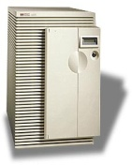
McCormick Place
DemoControl
nrm
odinserver
DemoGUI
DemoReceiver1
Demo Display Station
ControlHost (129.105.25.103/24)
ODIN (129.105.220.46/24)
NRM (129.105.220.101/24)
LakeShoreHost (192.26.85.147/26)
DemoSender1
PP8600
Lakeshore
24.1 km
SheridanHost1 (192.26.85.169/26)
24.9 km
DemoSender2
PP8600
6.7 km
10.3 km
Sheridan
SheridanHost2 (192.26.85.170/26)
Federal
7.2 km
100 Mbps
Taylor
Media Converter/ Local Sw/hub
PP8600
OMNInet
1 x GE
DemoReceiver2
10GE (λ1)
10GE (λ2)
Logical Demo Layout
10GE (λ3)
FederalHost (192.26.85.130/26) GRIDBRICK
Photonic
Switch

Slide 7
Start
Stop
BIGBANK
Stocks-R-Us
Records/second: 16K records/second
Record size: 4 KB
Queue Load: 1,245,726 records
4,982,904,000 bytes
Queue Fill rate: 64 Mbytes/sec
Next Sched. Queue Delivery: 2:35 pm
Delivery countdown: 33 sec
Burst duration: 150 sec
Last burst throughput: 610 Mbps
Accumulation period: constant
Records/second: 14K records/second
Record size: 2 KB
Queue Load: 70 records
140,000 bytes
Queue Fill rate: 28 Mbytes/sec
Next Sched. Queue Delivery: IN PROCESS
Delivery countdown: IN PROCESS
Burst duration: 90 sec
Last burst throughput: 580 Mbps
Accumulation period: constant
Carrier
POP
POP
Dynamically Provisioned Lambda Mesh
POP
POP

Slide 8
Transaction Demonstration Time Line
Time (min:sec) | Event
 | Customer #1 | Customer #2
- 0:35 | Allocate path
0:00 | Start burst transfer (150 sec)
2:30 | Stop burst & de-allocate path
2:55 |  | Allocate path
3:30 |  | Start burst transfer (90 sec)
5:00 |  | Stop burst & de-allocate path
5:25 | Allocate path
6:00 | Start burst transfer (150 sec)
8:30 | Stop burst & de-allocate path
8:55 |  | Allocate path
9:30 |  | Start burst transfer (90 sec)
11:00 |  | Stop burst & de-allocate path
11:25 | Allocate path

Slide 9
Transaction Demonstration Time Line
6 minute cycle time
Customer #2 Transaction Accumulation
#1 Transfer
#2 Transfer
#1 Transfer
#2 Transfer
Customer #1 Transaction Accumulation
-30 0 30 60 90 120 150 180 210 240 270 300 330 360 390 420 450 480 510 540 570 600 630 660
time (sec) →
allocate path
de-allocate path

Slide 10
Foundation
Technology

Slide 11
DWDM-RAM Architecture
Data-Intensive Applications
DTS API
Application
Middleware
Layer
Data
Transfer Service
NRS Grid Service API
Network Resource Service
Network Resource
Middleware
Layer
Data
Handler
Service
Basic Network
Resource
Service
Network
Resource
Scheduler
Information Service
λ OGSI-ification API
Dynamic Lambda, Optical Burst, etc., Grid services
Connectivity and
Fabric Layers
Optical path control
Data
Center
λ₁
λ₁
Data
Center
λ_{n}
λ_{n}

Slide 12
End-to-end Transfer Time (Un-optimized)
GigE - L2 Switch - 10GE - switched lambdas
20GB File Transfer
Set up: 29.7s
Transfer: 174s
Tear down: 11.3s
Transfer rate: 920Mb/s Effective rate:744Mb/s
1. File transfer request
10. File transfer complete, path released
0.5s
3.6s
0.5s
25s
0.14s
174s
0.3s
11s
7. Data Transfer (20 GB)
5. Network reconfiguration
6. Transport setup
8. Path Deallocation
request
3. ODIN Server Processing
4. Path ID returned
2. Path Allocation request
9. ODIN Server Processing
For a 200GB file: Transfer rate:920Mb/s Effective rate: 898Mb/s

Slide 13
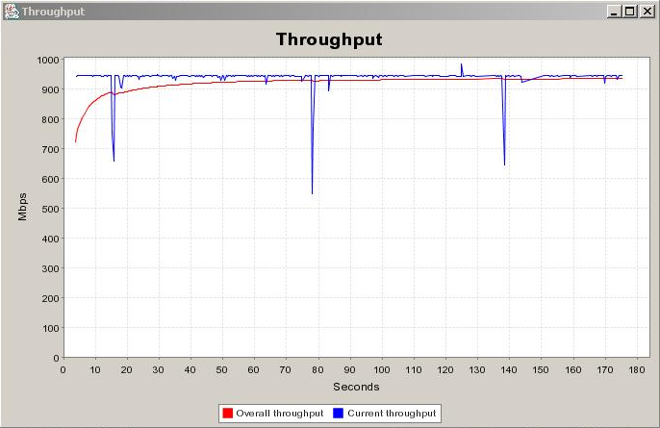
20GB File Transfer

Slide 14
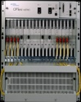
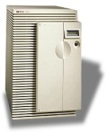
OMNInet
W Taylor
Sheridan
PP
10 GE
λ
1
Photonic
Photonic
λ
10 GE
10 GE
λ
2
Node
Node
λ
1
10 GE
PP
10/100/
GIGE
10/100/
GIGE
8600
Optera
5200
10Gb/s
TSPR
λ
λ
2
Optera
5200
10Gb/s
TSPR
8600
3
3
λ
4
λ
4
…
Optera 5200 OFA
#5 – 24 km
Optera Metro 5200 OFA
#6 – 24 km
10 λ
#2 – 10.3 km
EVL/UIC
OM5200
5200 OFA
Lake Shore
TECH/NU
OM5200
λ
1
10 GE
PP
Photonic
10 GE
10/100/
GIGE
Node
λ
2
Optera
5200
10Gb/s
TSPR
8600
10 λ
λ
3
λ
4
5200 OFA
StarLight
Interconnect
with other
research
networks
Grid
Clusters
LAC/UIC
OM5200
#8 – 6.7 km
#9 – 5.3 km
#4 – 7.2 km
5200 OFA
S. Federal
8x8x8λ Scalable photonic switch
Trunk side – 10G DWDM
OFA on all trunks
10 GE
10GE LAN PHY (July 04)
Photonic
λ
1
PP
Node
λ
2
10 GE
8600
To Ca*Net 4
λ
3
Optera
5200
10Gb/s
TSPR
10/100/
GIGE
λ
4
1310 nm 10 GbE
WAN PHY interfaces
Grid
Storage

