Slide 1
TeraGrid Communication and Computation
Tal Lavian
tlavian@cs.berkeley.edu
Brainstorm and concepts
Many slides and most of the graphics are taken from other slides
TeraGrid Comm & Comp
Slide: <number>

Slide 2
Agenda
Introduction
Some applications
TeraGrid Architecture
Globus toolkit
Future comm direction
Summary
TeraGrid Comm & Comp
Slide: <number>

Slide 3
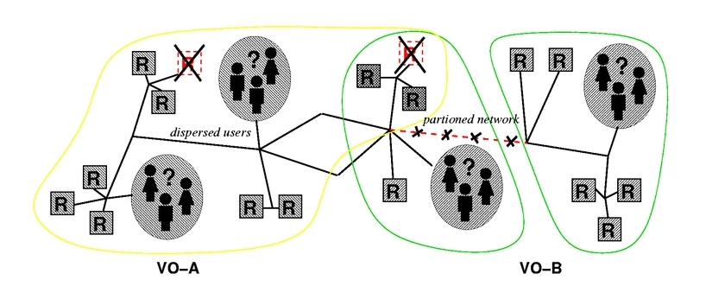
The Grid Problem
Resource sharing & coordinated problem solving in dynamic, multi-institutional virtual organizations
Some relation to Sahara
  Service composition: computation, servers, storage, disk, network…
  Sharing, cooperating, peering, brokering…
TeraGrid Comm & Comp
Slide: <number>

Slide 4

TeraGrid Wide Area Network -
NCSA, ANL, SDSC, Caltech
StarLight
International Optical Peering Point
(see www.startap.net)
Abilene
Chicago
DTF Backplane (4xλ: 40 Gbps)
Indianapolis
Urbana
Los Angeles
UIC
Starlight / NW Univ
San Diego
I-WIRE
Multiple Carrier Hubs
OC-48 (2.5 Gb/s, Abilene)
ANL
Ill Inst of Tech
Multiple 10 GbE (Qwest)
Univ of Chicago
Indianapolis (Abilene NOC)
Multiple 10 GbE (I-WIRE Dark Fiber)
NCSA/UIUC
Solid lines in place and/or available by October 2001
Dashed I-WIRE lines planned for summer 2002
Source: Charlie Catlett, Argonne
TeraGrid Comm & Comp
Slide: <number>
Notes:
Explanation of dashed lines:
St. Louis: State of Illinois fiber between St. Louis and Chicago will be connected to I-WIRE by November 2001. This fiber will terminate at 900 Walnut Street-- the Switch Data Services carrier collocation facility in St. Louis (location of St. Louis Gigapop). In Chicago the State of Illinois fiber will connect both directly to Argonne (which will serve as one of the State’s repeater/opto-electronic equipment hubs) and to the James R. Thompson Center downtown. I-WIRE fiber connects the James R. Thompson Center to the Starlight hub via the Qwest POP.
Indianapolis: We are working with Indiana University to obtain fiber either to Urbana or Chicago. We have preliminary pricing and expect at least a pair of fiber to be available by Summer 2002 if not before.

Slide 5
The 13.6 TF TeraGrid:
Computing at 40 Gb/s
Site Resources
Site Resources
26
4
HPSS
HPSS
24
External Networks
External Networks
8
5
Caltech
Argonne
External Networks
External Networks
SDSC
4.1 TF
225 TB
NCSA/PACI
8 TF
240 TB
Site Resources
Site Resources
HPSS
UniTree
TeraGrid Comm & Comp
Slide: <number>
TeraGrid/DTF: NCSA, SDSC, Caltech, Argonne www.teragrid.org

Slide 6
4 TeraGrid Sites Have Focal Points
SDSC – The Data Place
  Large-scale and high-performance data analysis/handling
  Every Cluster Node is Directly Attached to SAN
NCSA – The Compute Place
  Large-scale, Large Flops computation
Argonne – The Viz place
  Scalable Viz walls
Caltech – The Applications place
  Data and flops for applications – Especially some of the GriPhyN Apps
Specific machine configurations reflect this
TeraGrid Comm & Comp
Slide: <number>

Slide 7
TeraGrid building blocks
Distributed, multisite facility
  single site and “Grid enabled” capabilities
    uniform compute node selection and interconnect networks at 4 sites
    central “Grid Operations Center”
  at least one 5+ teraflop site and newer generation processors
    SDSC at 4+ TF, NCSA at 6.1-8 TF with McKinley processors
  at least one additional site coupled with the first
    four core sites: SDSC, NCSA, ANL, and Caltech
Ultra high-speed networks (Static configured)
  multiple gigabits/second
    modular 40 Gb/s backbone (4 x 10 GbE)
Remote visualization
  data from one site visualized at another
    high-performance commodity rendering and visualization system
    Argonne hardware visualization support
    data serving facilities and visualization displays
NSF - $53M award in August 2001
TeraGrid Comm & Comp
Slide: <number>

Slide 8
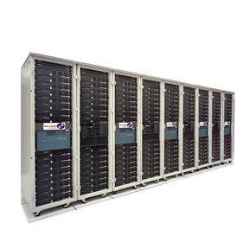
Traditional Cluster Network Access
GbE
OC-48 Cloud
OC-12
High performance cluster system interconnect using Myrinet with very high bisection bandwidth (hundreds of GB/s) with external connection of n x GbE, n is small integer.
(Time to move entire contents of memory)
2000 s (33 min)
13k s (3.6h)
1 TB
0.5 GB/s
78 MB/s
64 GB
Traditionally, high-performance computers have been islands of capability separated by wide area networks that provide a fraction of a percent of the internal cluster network bandwidth.
1024 MB
TeraGrid Comm & Comp
Slide: <number>

Slide 9
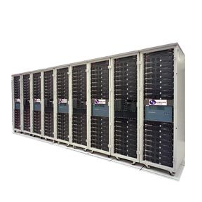
To Build a Distributed Terascale Cluster…
Each node with external GbE
Big Fast Interconnect
Interconnect
(Time to move entire contents of memory and application state on rotating disk)
200 s (3.3 min)
10 TB
5 GB/s
10 TB
5 GB/s = 200 nodes x 25 MB/s (=20% of GbE per node)
4096 GB
TeraGrid is building a “machine room” network across the country while increasing external cluster bandwidth to many GbE. Requires edge systems that handle n x 10 GbE and hubs that handle minimum 10 x 10 GbE.
64 GB
TeraGrid Comm & Comp
Slide: <number>

Slide 10
Agenda
Introduction
Some applications
TeraGrid Architecture
Globus toolkit
Future comm direction
Summary
TeraGrid Comm & Comp
Slide: <number>

Slide 11
What applications are being targeted for Grid-enabled computing? Traditional
Quantum Chromodynamics
Biomolecular Dynamics
Weather Forecasting
Cosmological Dark Matter
Biomolecular Electrostatics
Electric and Magnetic Molecular Properties
TeraGrid Comm & Comp
Slide: <number>

Slide 12
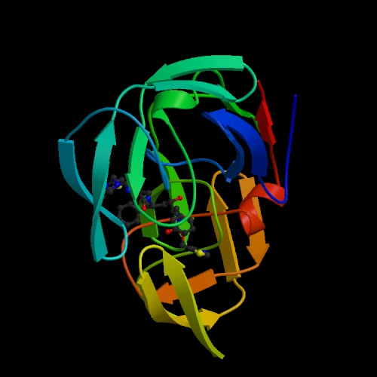
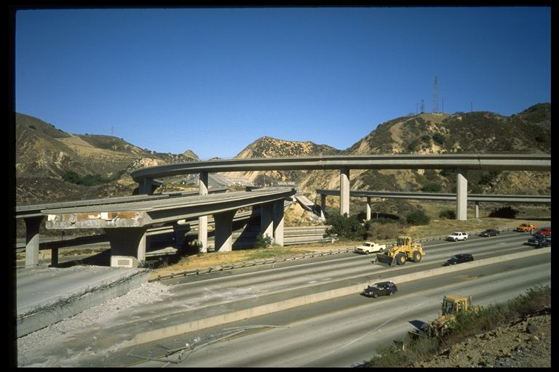
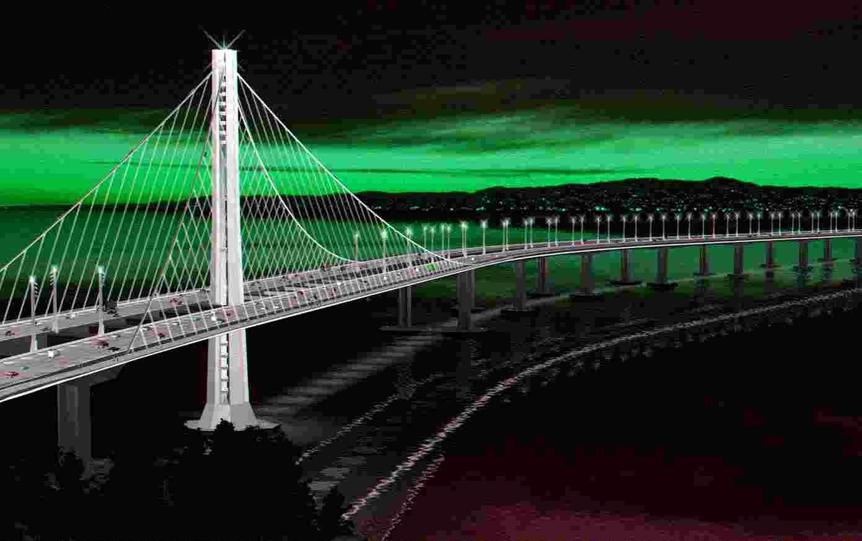



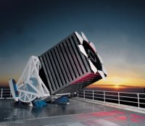
Beginning of the Digital Millennium:
The Data Decade!
Sensors
Picture of
earthquake
and bridge
Picture of
genomic
data
Disaster
response
Genomics
GriPhyn
type picture
Picture of
digital
library
Picture of
digital sky
Physics
Digital
Libraries
Astronomy
TeraGrid Comm & Comp
Slide: <number>

Slide 13

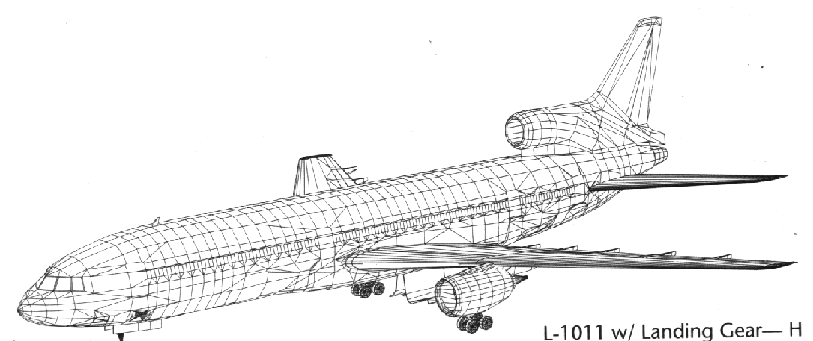
Multi-disciplinary Simulations: Aviation Safety
Wing Models
Lift Capabilities
Drag Capabilities
Responsiveness
Stabilizer Models
Airframe Models
Deflection capabilities
Responsiveness
Crew Capabilities
- accuracy
- perception
- stamina
- re-action times
- SOP’s
Engine Models
Human Models
Braking performance
Steering capabilities
Traction
Dampening capabilities
Thrust performance
Reverse Thrust performance
Responsiveness
Fuel Consumption
Source NASA
Landing Gear Models
Whole system simulations are produced by coupling all of the sub-system simulations
TeraGrid Comm & Comp
Slide: <number>

Slide 14
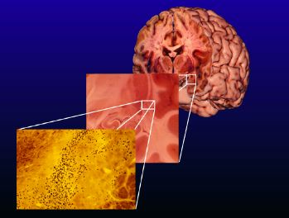
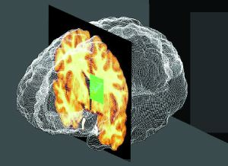
New Results Possible on TeraGrid
Biomedical Informatics Research Network (National Inst. Of Health):
  Evolving reference set of brains provides essential data for developing therapies for neurological disorders (Multiple Sclerosis, Alzheimer’s, etc.).
Pre-TeraGrid:
  One lab
  Small patient base
  4 TB collection
Post-TeraGrid:
  Tens of collaborating labs
  Larger population sample
  400 TB data collection: more brains, higher resolution
  Multiple scale data integration and analysis
TeraGrid Comm & Comp
Slide: <number>

Slide 15

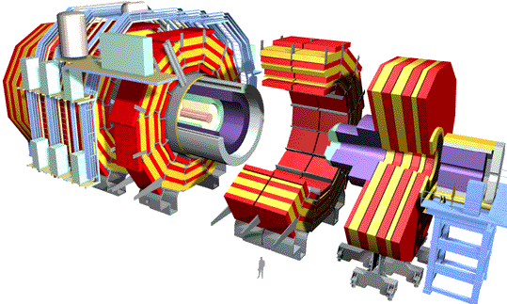
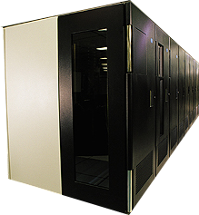
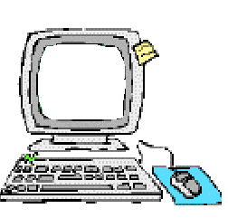
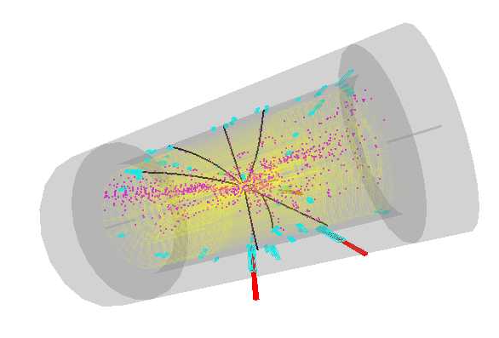
Grid Communities & Applications:
Data Grids for High Energy Physics
~PBytes/sec
Online System
~100 MBytes/sec
1 TIPS is approximately 25,000
SpecInt95 equivalents
There is a “bunch crossing” every 25 nsecs.
There are 100 “triggers” per second
Each triggered event is ~1 MByte in size
Offline Processor Farm
~20 TIPS
~100 MBytes/sec
Tier 0
CERN Computer Centre
HPSS
~622 Mbits/sec or Air Freight (deprecated)
Tier 1
France Regional Centre
HPSS
Germany Regional Centre
HPSS
Italy Regional Centre
HPSS
FermiLab ~4 TIPS
HPSS
~622 Mbits/sec
Tier 2
Caltech ~1 TIPS
Tier2 Centre ~1 TIPS
Tier2 Centre ~1 TIPS
Tier2 Centre ~1 TIPS
Tier2 Centre ~1 TIPS
~622 Mbits/sec
Institute ~0.25TIPS
Institute
Institute
Institute
Physicists work on analysis “channels”.
Each institute will have ~10 physicists working on one or more channels; data for these channels should be cached by the institute server
Physics data cache
~1 MBytes/sec
Tier 4
Pentium II 300 MHz
Pentium II 300 MHz
Physicist workstations
Pentium II 300 MHz
Pentium II 300 MHz
TeraGrid Comm & Comp
Slide: <number>
Source Harvey Newman, Caltech

Slide 16
Agenda
Introduction
Some applications
TeraGrid Architecture
Globus toolkit
Future comm direction
Summary
TeraGrid Comm & Comp
Slide: <number>

Slide 17
Grid Computing Concept
New applications enabled by the coordinated use of geographically distributed resources
  E.g., distributed collaboration, data access and analysis, distributed computing
Persistent infrastructure for Grid computing
  E.g., certificate authorities and policies, protocols for resource discovery/access
Original motivation, and support, from high-end science and engineering; but has wide-ranging applicability
TeraGrid Comm & Comp
Slide: <number>

Slide 18
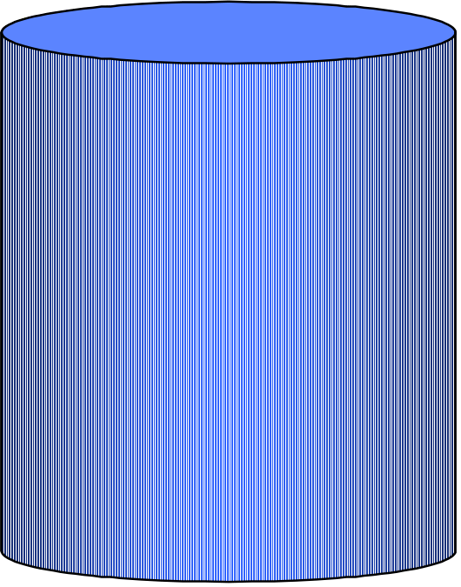
Globus Hourglass
Focus on architecture issues
  Propose set of core services as basic infrastructure
  Use to construct high-level, domain-specific solutions
Design principles
  Keep participation cost low
  Enable local control
  Support for adaptation
  “IP hourglass” model
A p p l i c a t i o n s
Diverse global services
Core Globus
services
Local OS

Slide 19
Elements of the Problem
Resource sharing
  Computers, storage, sensors, networks, …
  Sharing always conditional: issues of trust, policy, negotiation, payment, …
Coordinated problem solving
  Beyond client-server: distributed data analysis, computation, collaboration, …
Dynamic, multi-institutional virtual orgs
  Community overlays on classic org structures
  Large or small, static or dynamic
TeraGrid Comm & Comp
Slide: <number>

Slide 20
Gilder vs. Moore – Impact on the Future of Computing
10x every 5 years
2x/9 mo
Log Growth
1M
10x
10,000
WAN/MAN Bandwidth
Processor
Performance
100
2x/18 mo
1995
1997
1999
2001
2003
2005
2007
TeraGrid Comm & Comp
Slide: <number>

Slide 21
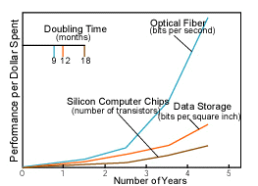
Improvements in Large-Area Networks
Network vs. computer performance
  Computer speed doubles every 18 months
  Network speed doubles every 9 months
  Difference = order of magnitude per 5 years
1986 to 2000
  Computers: x 500
  Networks: x 340,000
2001 to 2010
  Computers: x 60
  Networks: x 4000
Moore’s Law vs. storage improvements vs. optical improvements. Graph from Scientific American (Jan-2001) by Cleo Vilett, source Vined Khoslan, Kleiner, Caufield and Perkins.
TeraGrid Comm & Comp
Slide: <number>

Slide 22
Evolving Role of Optical Layer
Service interface rates
equal
transport line rates
160λ
10
6
Capacity
(Mb/s)
5
WDM
OC-192
32λ
10
8λ
4λ
10 Gb/s transport line rate
2λ
OC-192c
4
10
10 Gb
Ethernet
1.7 Gb/s
OC-48
Gb
Ethernet
OC-48c
10
3
565 Mb/s
TDM
Fast
Ethernet
OC-12c
2
135 Mb/s
10
OC-3c
Transport system capacity
1
Ethernet
T3
10
Data: LAN standards
T1
Data: Internet backbone
85
90
95
2000
Year
Source: IBM WDM research
TeraGrid Comm & Comp
Slide: <number>

Slide 23
Scientific Software Infrastructure
One of the Major Software Challenges
Peak Performance is skyrocketing (more than Moore’s Law)
but ...
  Efficiency has declined from 40-50% on the vector supercomputers of 1990s to as little as 5-10% on parallel supercomputers of today and may decrease further on future machines
Research challenge is software
  Scientific codes to model and simulate physical processes and systems
  Computing and mathematics software to enable use of advanced computers for scientific applications
  Continuing challenge as computer architectures undergo fundamental changes: Algorithms that scale to thousands-millions processors
TeraGrid Comm & Comp
Slide: <number>

Slide 24
Agenda
Introduction
Some applications
TeraGrid Architecture
Globus toolkit
Future comm direction
Summary
TeraGrid Comm & Comp
Slide: <number>

Slide 25
Globus Approach
A toolkit and collection of services addressing key technical problems
  Modular “bag of services” model
  Not a vertically integrated solution
  General infrastructure tools (aka middleware) that can be applied to many application domains
Inter-domain issues, rather than clustering
  Integration of intra-domain solutions
Distinguish between local and global services
TeraGrid Comm & Comp
Slide: <number>

Slide 26
Globus Technical Focus & Approach
Enable incremental development of grid-enabled tools and applications
  Model neutral: Support many programming models, languages, tools, and applications
  Evolve in response to user requirements
Deploy toolkit on international-scale production grids and testbeds
  Large-scale application development & testing
Information-rich environment
  Basis for configuration and adaptation
TeraGrid Comm & Comp
Slide: <number>

Slide 27
Layered Grid Architecture
(By Analogy to Internet Architecture)
Application
Application
Internet Protocol Architecture
“Coordinating multiple resources”: ubiquitous infrastructure services, app-specific distributed services
Collective
“Sharing single resources”: negotiating access, controlling use
Resource
“Talking to things”: communication (Internet protocols) & security
Connectivity
Transport
Internet
“Controlling things locally”: Access to, & control of, resources
Fabric
Link
TeraGrid Comm & Comp
Slide: <number>
For more info: www.globus.org/research/papers/anatomy.pdf
Notes:
We define Grid architecture in terms of a layered collection of protocols.
Fabric layer includes the protocols and interfaces that provide access to the resources that are being shared, including computers, storage systems, datasets, programs, and networks. This layer is a logical view rather then a physical view. For example, the view of a cluster with a local resource manager is defined by the local resource manger, and not the cluster hardware. Likewise, the fabric provided by a storage system is defined by the file system that is available on that system, not the raw disk or tapes.
The connectivity layer defines core protocols required for Grid-specific network transactions. This layer includes the IP protocol stack (system level application protocols [e.g. DNS, RSVP, Routing], transport and internet layers), as well as core Grid security protocols for authentication and authorization.
Resource layer defines protocols to initiate and control sharing of (local) resources. Services defined at this level are gatekeeper, GRIS, along with some user oriented application protocols from the Internet protocol suite, such as file-transfer.
Collective layer defines protocols that provide system oriented capabilities that are expected to be wide scale in deployment and generic in function. This includes GIIS, bandwidth brokers, resource brokers,….
Application layer defines protocols and services that are parochial in nature, targeted towards a specific application domain or class of applications. These are are are … arrgh

Slide 28
Globus Architecture?
No “official” standards exist
But:
  Globus Toolkit has emerged as the de facto standard for several important Connectivity, Resource, and Collective protocols
  Technical specifications are being developed for architecture elements: e.g., security, data, resource management, information
TeraGrid Comm & Comp
Slide: <number>

Slide 29
Agenda
Introduction
Some applications
TeraGrid Architecture
Globus toolkit
Future comm direction
Summary
TeraGrid Comm & Comp
Slide: <number>

Slide 30
Static lightpath setting
NCSA, ANL, SDSC, Caltech
Abilene
Chicago
DTF Backplane (4xλ: 40 Gbps)
Indianapolis
Urbana
Los Angeles
San Diego
OC-48 (2.5 Gb/s, Abilene)
Multiple 10 GbE (Qwest)
Multiple 10 GbE (I-WIRE Dark Fiber)
Solid lines in place and/or available by October 2001
Dashed I-WIRE lines planned for summer 2002
Source: Charlie Catlett, Argonne
TeraGrid Comm & Comp
Slide: <number>

Slide 31
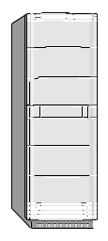


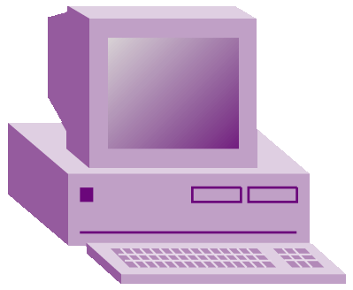
Lightpath for OVPN
Lightpath setup
  One or two-way
  Rates: OC48, OC192 and OC768
  QoS constraints
  On demand
Aggregation of BW
  OVPN
  Video
  HDTV
ASON
Mirror Server
ASON
Optical Ring
ASON
OVPN
video
HDTV
Optical fiber and channels
TeraGrid Comm & Comp
Slide: <number>

Slide 32
Dynamic Lightpath setting
Resource optimization (route 2)
  Alternative lightpath
Route to mirror sites (route 3)
  Lightpath setup failed
  Load balancing
  Long response time
    Congestion
    Fault
ASON
Route 3
Mirror Server
Route 2
ASON
Optical Ring
ASON
Route 1
main Server
TeraGrid Comm & Comp
Slide: <number>

Slide 33
Multiple Architectural
Considerations
Apps
Clusters
C
O
N
T
R
O
L
P
L
A
N
E
Dynamically
Allocated
Lightpaths
Switch Fabrics
Physical
Monitoring
TeraGrid Comm & Comp
Slide: <number>

Slide 34
Agenda
Introduction
Some applications
TeraGrid Architecture
Globus toolkit
Future comm direction
Summary
TeraGrid Comm & Comp
Slide: <number>

Slide 35
Summary
The Grid problem: Resource sharing & coordinated problem solving in dynamic, multi-institutional virtual organizations
Grid architecture: Emphasize protocol and service definition to enable interoperability and resource sharing
Globus Toolkit a source of protocol and API definitions, reference implementations
Current static communication. Next wave dynamic optical VPN
Some relation to Sahara
  Service composition: computation, servers, storage, disk, network…
  Sharing, cooperating, peering, brokering…
TeraGrid Comm & Comp
Slide: <number>

Slide 36
References
globus.org
griphyn.org
gridforum.org
grids-center.org
nsf-middleware.org
TeraGrid Comm & Comp
Slide: <number>

Slide 37
Backup
TeraGrid Comm & Comp
Slide: <number>

Slide 38
Wavelengths and the Future
Wavelength services are causing a network revolution:
  Core long distance SONET Rings will be replaced by meshed networks using wavelength cross-connects
  Re-invention of pre-SONET network architecture
Improved transport infrastructure will exist for IP/packet services
Electrical/Optical grooming switches will emerge at edges
Automated Restoration (algorithm/GMPLS driven) becomes technically feasible.
Operational implementation will take some time
TeraGrid Comm & Comp
Slide: <number>

Slide 39
Optical components
Router/Switch
SONET/SDH
GbE
OXC
DWDM
Fiber
TeraGrid Comm & Comp
Slide: <number>

Slide 40

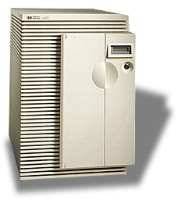








Internet Reality
Data
Center
SONET
SONET
DWDM
DWDM
SONET
SONET
Access
Metro
Long Haul
Metro
Access
TeraGrid Comm & Comp
Slide: <number>

Slide 41
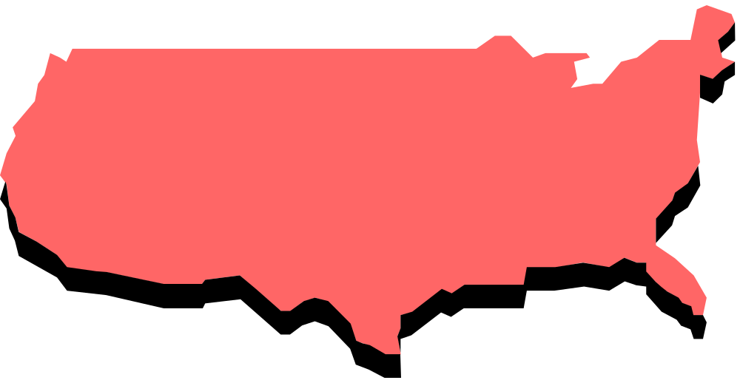

OVPN on Optical Network
Light
Path
TeraGrid Comm & Comp
Slide: <number>

Slide 42





Three networks in The Internet
OPE
ASON
OPE
Access
ASON
ASON
Backbone
ASON
PX
Metro
Core
Local
Network
(LAN)
Long-Haul Core
(WAN)
Metro Network
(MAN)
TeraGrid Comm & Comp
Slide: <number>

Slide 43
Data Transport Connectivity
Packet Switch
data-optimized
  Ethernet
  TCP/IP
Network use
  LAN
Advantages
  Efficient
  Simple
  Low cost
Disadvantages
  Unreliable
Circuit Switch
Voice-oriented
  SONET
  ATM
Network uses
  Metro and Core
Advantages
  Reliable
Disadvantages
  Complicate
  High cost
Efficiency ? Reliability
TeraGrid Comm & Comp
Slide: <number>

Slide 44
Global Lambda Grid -
Photonic Switched Network
λ1
λ2
TeraGrid Comm & Comp
Slide: <number>

Slide 45

The Metro Bottleneck
Other Sites
Access
Metro
Core Network
End User Access Metro Core
Ethernet LAN
DS1
DS3
OC-12
OC-48
OC-192
OC-192
DWDM n x λ
IP/DATA
1GigE
LL/FR/ATM
1-40Meg
10G
40G+
TeraGrid Comm & Comp
Slide: <number>

