Slide 1
Workflow Integrated Network Resource Orchestration
Notes:
Nortel Corporate Presentation
© 2004 Nortel

Slide 2
Agenda
WS Workflows and Challenges
WINNER
Featured Solutions
Related Work
Summary
Notes:
Nortel Corporate Presentation
© 2004 Nortel

Slide 3
WS Workflows
WS boosts up new opportunity of business development
  Web Services (WS): service providers to customers
  WS is interoperable and trustable among business partners
  WS increases productivity by component service development and reduces cost by sharing services and avoiding function duplications
  New opportunity for WS providers, publishers, applications and …
  Globus is offering WSRF, as GT4 comes
Workflow defines the automation of a business process
  Streamlines the application job: WS and Grids
  Evolves from object-oriented programming (OOP) to service-oriented architecture (SOA)
  New support for WS: BPEL4WS, for Grid: GSFL
Workflow has a bandwagon of applications
  E-commercial: B2B, financial brokerage, travel planning
  Enterprise: concurrent design, data center, human resources
  E-Science: Grid computing, hi-energy computation
Notes:
Nortel Corporate Presentation
© 2004 Nortel

Slide 4
Challenges
WS Workflows brings many new challenges
  Business workflows streamline to network-wide collaboration
  Grids/WS services and resources become workflow-aware
Challenges on Network resources → our target
  Pervasive resources share with service collaborations
  Supply of services and resources may vary
  Workflows may demand different levels of resources
  Resource requirements move up or down as the workflow goes
App
Grid/WS
Workflow
Workflow Engine
Process
Activity
Start
Data Distribution
Computing
Data Collection
Visualization
End
WS/GS
Service
Service
Service
Service
Resource
Storage+Network
Cluster+Network
Storage+Network
Display+Network
Notes:
Nortel Corporate Presentation
© 2004 Nortel

Slide 5
WINNER
Workflow INtegrated NEtwork Resource orchestration
Orchestrates network resources to serve workflows
  Introduces new workflow process to applications
  Provides workflow process services
  Employs resource services to obtain network resources
  Resource allocations and updates in time
Extend the workflow arm of DRAC
  DRAC is the Nortel product “Dynamic Resource Allocation Controller” in networks
  WINNER is the workflow gateway between apps and DRAC
Applications
End users
Grid
WINNER
Storage
API gateways
DRAC
Network services
GMPLS
UNI
TL1
SNMP
Network protocols
Networks
Resources
Notes:
Nortel Corporate Presentation
© 2004 Nortel

Slide 6
WINNER Components
WINNER Process
  Defines the business activities specific on network resources
  Is used by app, with associated business processes
WINNER Process services
  Realize the resource operations of the WINNER process
  Support the workflow processing of network resources
WINNER Resource services
  Perform the allocation of network resources
  Update the status of network resources
  Work closely with DRAC
Application
WINNER Process
WINNER PS
Workflow Engine
WINNER RS
Resources
Notes:
Nortel Corporate Presentation
© 2004 Nortel

Slide 7
WINNER Process: activity samples
Interface to the Workflow Applications
Application registration
  Unique identification of each application
  Classification of resource workflows
Resource Job
  Resource specification
  Resource allocation
  Resource re-allocation
  Resource release
Query
  Network resources: available, status
  Resource workflows
  Resource negotiation, when applicable
Misc
  Account billing
  authorization, and security enhancement
Notes:
Nortel Corporate Presentation
© 2004 Nortel

Slide 8
DRAC: Dynamic Resource Allocation Controller
WINNER is the Workflow Arm of DRAC
Resource discovery
  Available physical resources in network domains
  Available network services in network domains
  Resource property, status and updates
Resource Utilization
  Resource reservation and scheduling
  Resource allocation and release
  Job status and feedback
Resource management
  Resource collection and abstraction
  Network configuration and control
  Security and AAA
Application-aware smarts on resources
  Multiple API gateways: Grid, workflow, storage
  Resource policy, SLA
  Resource optimization
  Resource monitor and performance
WINNER
Workflow
GPAN
Grid
DRAC
Storage
EvaQ8
Health
WEN
Notes:
Nortel Corporate Presentation
© 2004 Nortel

Slide 9
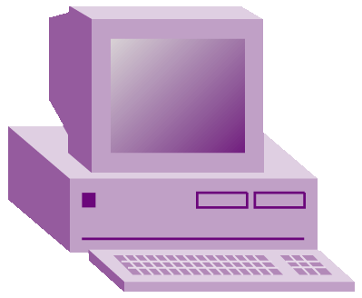



WINNER and Grids Workflows
WINNER supports Grid apps with Grid workflow engine
  WINNER Process provides the workflow interface to Grids apps
  WINNER service (PS) provides workflow processing of network resources
  WINNER service (RS) works with the DRAC Grid (GPAN) to perform network resource allocations in the Grid domains
Grid app
WINNER Process
Globus engine
WINNER Services
WSRF
WSRF
WSRF
WSRF
DRAC
DRAC
DRAC
DRAC
Grids
1
Grids
2
Grids
…
Grids
N
Notes:
Nortel Corporate Presentation
© 2004 Nortel

Slide 10
WINNER, Grids and WS Workflows
WS Workflow applications take advantages of Grids
  WS engine provides the WINNER process to WS apps
  Grids engine provides Grids services to WS app through WINNER services
WS app
WINNER Process
WS engine
WINNER Services
UI
Globus engine
WINNER Services
WSRF
WSRF
WSRF
WSRF
DRAC
DRAC
DRAC
DRAC
Grids
1
Grids
2
Grids
…
Grids
N
Notes:
Nortel Corporate Presentation
© 2004 Nortel

Slide 11
WINNER and Multiple Workflows
Web Services are re-utilized across multiple types of workflows
  GT4: WSRF
  BPEL4WS
  Apache WS
WINNER support respective workflow service engines
  WINNER services widely shared
WS App
Grid App
Business PS
Compute RS
WINNER
BPEL engine
WINNER
WINNER
WINNER PS
App WS
Globus engine
WINNER
WINNER
Storage RS
Apache engine
WINNER
Utility PS
WINNER
Network RS
DRAC
Notes:
Nortel Corporate Presentation
© 2004 Nortel

Slide 12
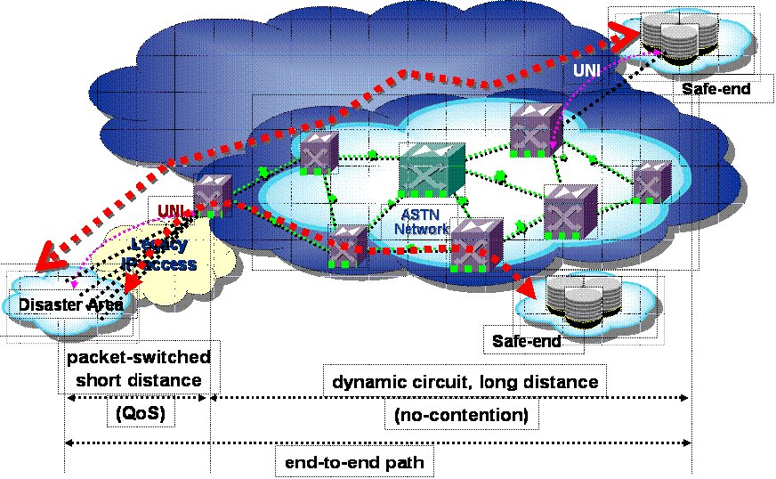
WINNER and Late-Binding
Late binding resources with workflows happen when
  Workflow services and/or resources supply change
  Workflows compete or optimize for resources
  Workflows have special or uncertain requirements of resources
WINNER performs workflow-aware late-binding, through DRC
  Network resources selections or alternations according to applications
  Resource optimization such as switching among workflows
  Service site selections or alternations, together with service providers
Typical usecases
  Workflow Engaged Networks for Radiology in Metro Regions
  Disaster Data Evacution workflow (see below)
Notes:
Nortel Corporate Presentation
© 2004 Nortel

Slide 13
Related Work
BPEL4WS
GridFlow: the SDRC Matrix
  http://www.npaci.edu/dice/srb/matrix/
GSFL and GridAnt
  http://www-unix.globus.org/cog/projects/workflow/
Pegasus and vGRADS
  http://www.globus.org/about/events/sc2004/demos.html
GWFE
  http://www.gridbus.org/workflow/
Notes:
Nortel Corporate Presentation
© 2004 Nortel

Slide 14
Summary
WINNER integrates network resources with WS workflows
  Provides WINNER processes, process services and resource services
  Workflow-aware network resource allocations
DRAC network services are leveraged for allocation and information on network resource orchestration
Late-binding gives the capability to supply network resources in favor of application workflows
WINNER fits with Grids, Web Services, and other workflow applications
  WS workflows can take advantages of Grids
Notes:
Nortel Corporate Presentation
© 2004 Nortel

Slide 15
Workflow Integrated Network Resource Orchestration
Questions and Comments ?
Notes:
Nortel Corporate Presentation
© 2004 Nortel

