Slide 1
Openet:
Open Networking through Programmability
Tal Lavian tlavian@nortelnetworks.com
Nortel Network, Advanced Technology Lab

Slide 2
Agenda
Two Evolutions: computer vs network
Openet: open networking
ORE and Openet Compositions
Typical Applications
Related Projects
Summary

Slide 3
Think of computer evolution …
Applications
OSs
Peripherals
Hardware
IBM
CDC
Digital
Amdel
1980s - Vertical Industry
2000s - Horizontal Industry

Slide 4
The inflection point is quickly approaching …
What’s network evolution?
Network &
Mgmt services
?
Embedded
OS
System
ASICs
Cisco
Nortel
Juniper
3Com
“00 Vertical Network Industry
Horizontal Network Industry

Slide 5

Why Open Networking?
Open network boxes to public
  Current network devices are close systems
Intelligence to network nodes because
  Internet infrastructure evolves slow
  Customers can not add new services
Better use of network resources
  Abundant bandwidth
  Diversified clients’ needs
Move Turing Machine onto Device
  Add local intelligence to network devices
while (true)
doLocalProcessingOnDevice();

Slide 6
The Openet Approach
Open networking through programming
  A Service-enabled networking platform
  Intelligence to commercial network devices
    Network control and management
    Packet forwarding and processing
  Not impeding network performance and reliability
    Forwarding
    Security
Enabling service creation and deployment
  Value-added services across network elements
  Dynamic and downloadable
Standards and Partners
  IEEE, IETF, Active Networks and FAIN
  Columbia U., UC Berkeley and UPenn
  MITRE, TASC, NetFuel and CSIRO

Slide 7




Openet Architecture
End Apps
Control Console (Net Mgr)
service initiation and policies
network configuration
resource administration
repository maintenance
Control
&
Configuration
Switch
Control
Data path
Download
User request
ORE
Repository
Server
Download
codes,
policies,
configs
Router
ORE
ORE
End Apps
use of service
request on the fly
ORE
Router
Switch

Slide 8
Openet Compositions
ORE
  Service creation and deployment
  Service lifecycle management
Services
  Every network function is a service
  Every service provides object APIs
ODK
  Service development and encapsulation
Management
  Service mgmt: initiation, policy and configuration
  Manager on console and Agents on nodes

Slide 9
Openet: a node’s view
Oplet
Oplet
Oplet
Service
Service
Service
Oplet
Service
Service
ORE
Java Virtual Machine
API Extensions
Hardware
Oplet is a program unit wrapping services

Slide 10
ORE: the Openet Core
ORE
  Object-oriented Runtime Environment
  Run customized software on network nodes
  Neutral to heterogeneous hardware
  Secure downloading, installation, and safe execution inside JVM
  Fully implemented using Java

Slide 11
System Services: JFWD
Java Forwarding
  IP forwarding and routing
    Diffserv marking
    Filtering and diverting
    Forwarding priority
    Routing
Platform-independent APIs
  Implemented on Passport/Accelar and Linux

Slide 12
Function Services
Common use utility
Public neutral APIs
Examples
  HTTP: HTTP service
  Shell: ORE interactive shell
  Packet: packet handling (IP, TCP, UDP)
  Logger: service runtime printout
  OreServlet: Java servlet

Slide 13
Typical Applications
JDiffserv
  Diffserv forwarding and DSCP marking on Passport 8600
OpeCfg
  Dynamic configuration of optical port interfaces
IP filtering
  Dynamic priority changes on Passport 1100
JSNMP and JMIB
  SNMP/MIB access
  Passport 1100 and 8600
Regatta: Fault recovery

Slide 14
Challenges and Solution
Active Networks requires
  Open boxes to users
  Networking programmability
Commercial network devices have
  Ever more use of hardware acceleration
    Static and well-defined protocols and services
  Little flexibility to introduce users’ intelligence
    Allowing configuration rather than value addition
Our solution
  Openet
    A programmable networking platform across devices
  Active Services through Openet

Slide 15
Openet Architecture
Applications
ORE
System Services
Control Plane
CPU System
Monitor status
New rules
Switching Fabric
Data Plane
(Wire Speed Forwarding)
Forwarding
Rules
Forwarding
Rules
Forwarding
Rules
. . .
Forwarding
Processor
Forwarding
Processor
Forwarding
Processor
Statistics
&Monitors
Statistics
&Monitors
Statistics
&Monitors
Traffic Packets

Slide 16
JDiffserv
Goals
  DSCP marking and re-marking
  Priority forwarding or dropping
  Filtering
Passport
  Model: 8600
  Java 2
ORE
  version 0.4.1
  JFWD/JDiffserv service
  URL: “http://www.openetlab.org/downloads/”

Slide 17

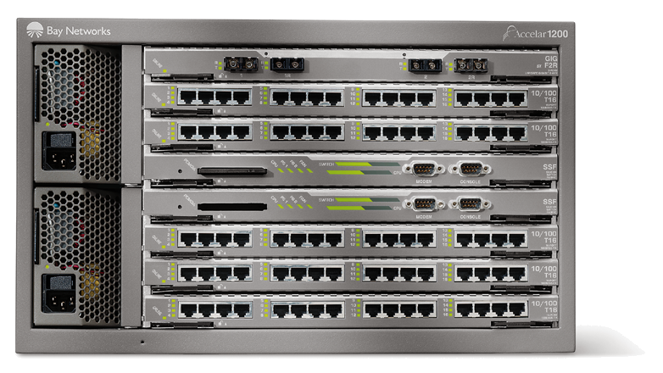
JDiffserv on Passport
Device Console
Differv-enabled Network
UDP receiver
UDP sender
Passport 8600
Passport 1100B
Passport 1100B
UDP
UDP
JDiffserv
UDP
Linux PC
Linux PC
HTTP server
Diffserv Monitor
Linux PC

Slide 18
JDiffserv Features
Marking Types
  Admission marking
  condition marking (a.k.a., remarking)
Filters
  IP headers: 5-tuple
    Source address and port, destination address and port
    Protocol type
  DSField: DSCP
  Interface ports
Traffic profile
  Average rate and bucket size
  Peak rate and bucket size
Action
  Marking then forwarding
    3-color marker: R/Y/G,RFC 2697
    new DSCP
  Dropping

Slide 19
Dynamic Classification
Objectives
  Implement flow performance enhancement mechanisms
  without introducing software into data forwarding path
  Service defined packet processing in a silicon-based forwarding engine
  packet classifier

Slide 20
On-the-fly configuration
Policy
Dynamic Apps
Filters
Filter
Packet
Packet
Forwarding
Processor
Forwarding
Processor
Packet

Slide 21
Experimental Setup
Acclear
1100B
Routing
Switch
Source 1
tcp_send()
100 Mbps
Destination
1. tcp_recv()
2. tcp_recv()
100 Mbps
Source 2
tcp_send()
100 Mbps

Slide 22
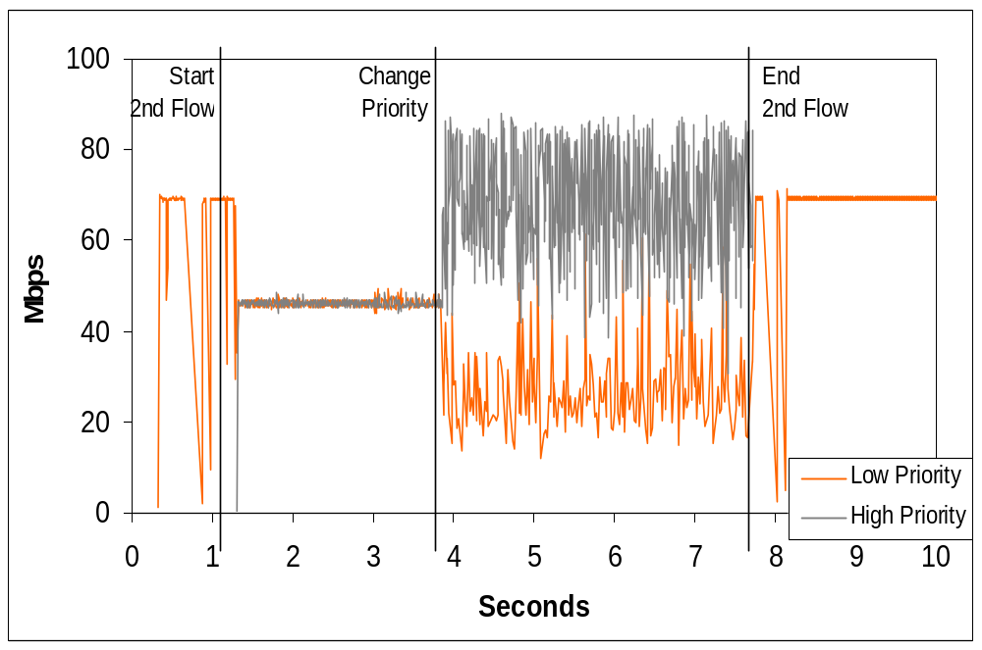
Throughput Results

Slide 23
OpeCfg: Optical Control
Goals
  Content-aware bandwidth allocation
Features
  Content flow interception
  Dynamic optical control
2 Alteon switches, 3 iSD boxes and 2 OM3400
CO2 App
iSD-1
Pckt
Intercept
For
ward
Optical
BW
iSD-2
NA/SA
Opecfg-C
OpeCfg
Openet
Packets
Filters
SNMP
Redir
CLI
MIB
App Server
Switch
OPE
Fiber
Linux-1
Alteon184-1
OM3400-1
Notes:
Software components involved:
1. Application
- client
- server
2. iSD Control service
- UNI-C / FSM
- NASA alternative
3. iSD Data service
- Packet processing
4. ASON simulator
- UNI-N
- CCI client
5. DX simulator
- CCI server
- DX simulation

Slide 24
DARPA-Funded Project
Active Nets Technology Transfer through High-Performance Network Devices
Exploring new commercial network hardware
  L2-L7 filtering
  Fast content filtering and redirection
  Strong and extensible CPU capability
  Secure partitioning hardware and software
  Supporting heterogeneous EEs
Research platform
Server and network collapse

Slide 25
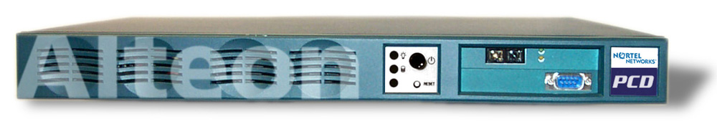

iSD Architecture
iSD
Web Switch
application code
Switch
Interface:
SSI
Clustering
Management
Registry, CLI, …
NAAP
Operating System (Alteon Embedded Linux
Or
RTIK – Real time Internet Kernel)
iSD Hardware

Slide 26
Alteon API – differentiates itself from other boxes
Alteon API
Generic
Has interface functions from L2, L3, L4, and L5+
Object Oriented designed
Can be extended to include future sophisticated functionalities
iSD or
other intelligent
processing devices
API
Serial Link Layer
between Alteon
and external devices
Others
Layer 5+ processing and filtering
Alteon
Layer 4 processing and filtering
Layer 3 processing and filtering
Layer 2 processing and filtering
This slide and other previous slides sent to you illustrate my point.
You can also see it more clearly if you ask the question “Why don’t I just use a powerful iSD without the Alteon?”

Slide 27
How Does Application Acceleration Work ?
NAAP
Communication
Interface
Data Enters
Application Program
Data Tunnel 1
Alteon
Linux
Appliance
(iSD)
Alteon
Web
Switch
Control Tunnels
Data Tunnel 2
Return Path
Use of NAAP interface eliminates TCP overhead between switch & server and allows large data blocks (complete HTTP request)
Server is removed from return data path
Switching functions are removed from Linux application code and transferred to switch hardware
See notes section below for further detail
Data Exits
Notes:
In a minimal TCP session (with a one packet query and a one packet response) there are 9 packets. All packets with TCP flags (SYN/FIN/RST) must be sent to the firewall in either direction, meaning 4 packets of the 9 are sent through the firewall. In addition, the final ACK also goes through the firewall.
This slide only shows the data flow for two packets that go through the firewall and the direct packet forwarding.
All packets with TCP flags (SYN, RST or FIN) are sent to FW-1.
On first SYN, connection entry is created. FW-1 monitors for SYN/ACK.
Data packets are accelerated.
Timeout information allows FW-1 to detect connections no longer in use, and delete them.
On receipt of 1st FIN, FW-1 makes the connection unidirectional.
On receipt of 2nd FIN, FW-1 has the switch redirect all packets to FW-1.
On receipt of final ACK, or on 50 second timeout, FW-1 removes the connection entry

Slide 28
T1: Programmable content switch
Openet on Alteon
  L2-L7 filtering
  Fast content filtering and redirection to active services
  Enhanced closely with Alteon features
Alteon: new generation of content switch
  Multiple processors and ASICs
  Programmable microcode
  L2-L4 and application filtering and processing

Slide 29

T2: Research Platform
iSD: powerful and extensible computational plane
  Partitioning hardware and software resources
  Close interfaces to Alteon
  Cluster computations
Network Research Platform
  Openet: active service enabling
  Alteon: content filtering in real-time
  iSD: integral computation inside the network
Openet
L2-L7
filtering
Content
processing
Power
computing
iSD
Local
Core
OPE
Optical
Passport
Alteon

Slide 30

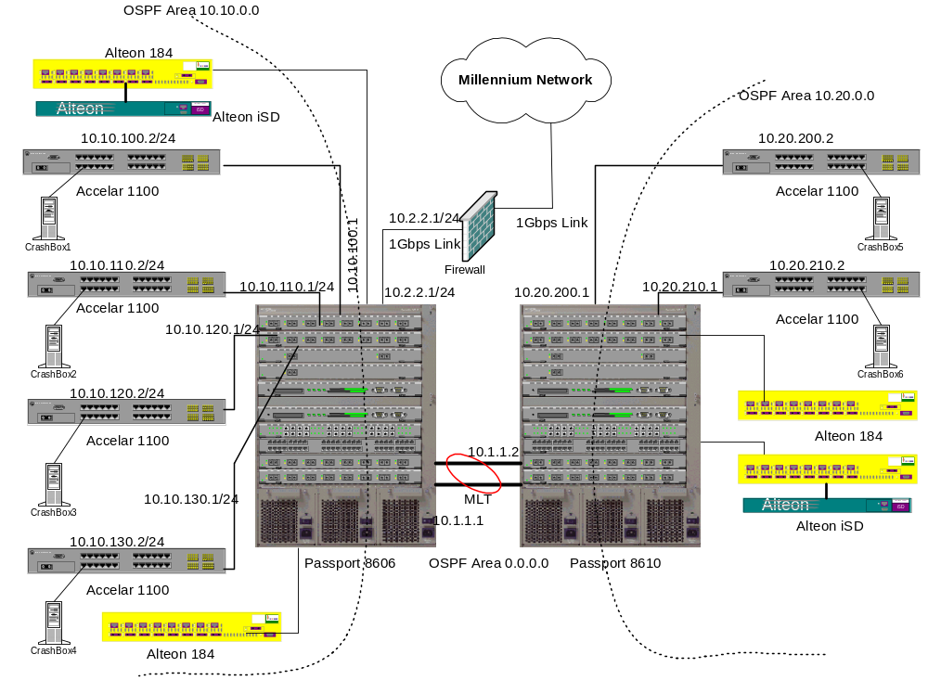

Slide 31
Any interest?
Looking for grant?
Interested in summer internship?
  Talk with me latter

Slide 32
How Can we Collaborate?
Corry is not far from Soda
  Are we EE+CS or EECS?
  How can we bridge CS and EE projects?
  Can we create a virtual lab? How?
Openet and SmartNet are supported by DARPA

Slide 33
Summary
Industry supports open networking
  Network evolutions
  Programmable network devices
Openet is a programmable networking platform
  Java 1.1 and Java 2
  Devices: Alteon/iSD, Passport 1100 and 8600
  OS: VxWorks, Linux, Unix and Windows

Slide 34
Q & A
Visit us at
HTTP://www.openetlab.org
Thank You !

Slide 35
Backup

Slide 36
What’s an Oplet?
Oplet: a self-contained downloadable unit
  Encapsulates one or more service objects
  Contains service attributes, e.g., names
  Eases secure downloading and service installation
  Use other service oplets
  Examples
    Active Networks services: EE
    Java Forwarding services: JFWD
    Base services: ODK

Slide 37
How a service is deployed?
Service design and coding
  Regular Java programming
Service package
  Oplets by ODK
  JAR files
  Uploading to downloading servers
ORE start at Passport
Service activation by ORE
  Downloading, start and stop
    Startup service
    Shell service
Service execution

