Slide 1
Enabling Active Flow Manipulation (AFM) in Silicon-based Network Forwarding Engines
D. Hoang
with T. Lavian, P. Wang, F. Travostino, S. Subramanian, V. Sethaput, and D. Culler

Slide 2
Outline
Introduction
Network Element – Control Plane/Forwarding Plane
Control Functions
AFM abstractions: aggregated flows/actions
Possible Realizations
Examples
Conclusion: Issues to be resolved

Slide 3
Programmable Internet
Enhance internetworking functions.
Move computations into the network for value added services.
Manage the network more capably than possible with SNMP.
More quickly introduce Diffserv or Inserv to support new multimedia applications
Implement traffic control algorithms to support QoS.

Slide 4
Programmability
A significant challenge in today’s Internet is the ability to efficiently incorporate customizable network intelligence in commercial high performance network devices.
  Framework for introducing services
  API for programming network devices

Slide 5
Network Element
Software: routing protocols,
Network management, etc.
Limited control of the forwarding plane
Routers are not reprogrammable (except by vendors)
Users can only see IP/ICPM packets, but have no direct control over the internal handling of their data.
ASIC: packet forwarding

Slide 6
Programmable Network Element
Routing
Signaling
Controllers
Software: routing protocols,
Network management, etc.
Router Control Interface
Local Resource Manager
ASIC: packet forwarding
Classifier
Scheduler
Routing

Slide 7
Control Functions
CE: Control Element
FE: Forwarding Element
(1)
Control
Intensive
computation
CE
(2)
(3)
FE
Control functions that reside wholly in the control plane
Control functions that insert software in the critical data path
Control functions that allow control entities to act both in the
control plane and in the data forwarding plane without adding
software in the data path

Slide 8
Control categories
Category 1: Purely on the control plane like off-line or out-of-band services.
Category 2: Intensive Computation is needed before data is forwarded.
Category 3: No software delay is introduced in the data forwarding plane. Control is for setting target. Category 3 is applicable to real-time applications.

Slide 9
Application Timescales
Network Components
Service creation and introduction
Sessions (connections)
Packets

Slide 10
Active Flow Manipulation Abstractions
Aggregate data into traffic flows
  Flows whose characteristics can be identified in real-time
  E.g., “all UDP packets to a particular service”, “all TCP packets from a particular machine”.
Actions to be performed in the traffic flows
  Actions that can be performed in real-time
  E.g., “Change the priority of all traffic destined to a particular service on a particular machine”, “Stop all traffic out of a particular link of a router”.

Slide 11
Identifiable Elements of Primitive Flows
Table 1: The primitive flow set of identifiable elements
Destination Address (DA)
Range of Destination Address (RDA)
Source Address (SA)
Range of Source Address (RSA)
Exact TCP protocol match (TCP)
Exact UDP protocol match (UDP)
Exact ICMP protocol match (ICMP)
Source Port number, for both TCP and UDP (SP)
Destination Port number for both TCP and UDP (DP)
TCP connection request (TCPReg)
ICMP request (ICMPReg)
DS field of a datagram (DS)
IP Frame fragment (FrameFrag)

Slide 12
Primitive Permissible actions
Drop
Forward
Mirror
Stop on Match (SOM)
Detect Out of Profile behaviour (Out)
Change DSCP value (DSCP)
Prevent TCP Connect Request
Modify IEEE 802.1p bit

Slide 13
More Specific Goals
Allow introducing services and control on demands dynamically
  Services can be any general network applications
  Control on demands to manipulate flows and flow aggregates
Allowing dynamic and mobile agents
Respond quickly to changes in traffic conditions.
Cope with unforeseen requirements
Extending router functionality (optimization)
Multiple control elements are installed at routers or hosts and they collaborate to achieve some overall objective.

Slide 14
Realistic Framework
Control Plane
Wire-speed | Non Wire-speed
Interface
MIB Routing Table
Meters
Forwarding Plane

Slide 15
Realization
Control Plane
Forwarding Plane
Set filter
Flow
Flow aggregate
Routing table
Utilization parameters
Queue length parameters
RED parameters
Scheduling parameters
QoS parameters

Slide 16
Realization
Control Plane
Forwarding Plane
Real-time Action
Mirror
Drop
Stop
Change DS
Tunnelling
Rerouting
Change BW allocation

Slide 17
Possible Realization
Control Plane
Forwarding Plane
Non-Real-time Action
Alter routing table
Alter RED parameters
Alter QoS parameters
New congestion control algorithms
New QoS control algorithms
New Bandwidth Allocation algorithms

Slide 18
Examples
Active manipulation of flows and flow aggregates to
  Provide adequate QoS to users: reliability, availability, securely, and acceptable quality.
  Manage resources efficiently: utilization, simple control and maintenance.
  Control congestion: monitoring, admission control, shaping and policing
Control Plane
Wire-speed | Non Wire-speed
Interface
MIB Routing Table
Meters
Forwarding Plane

Slide 19
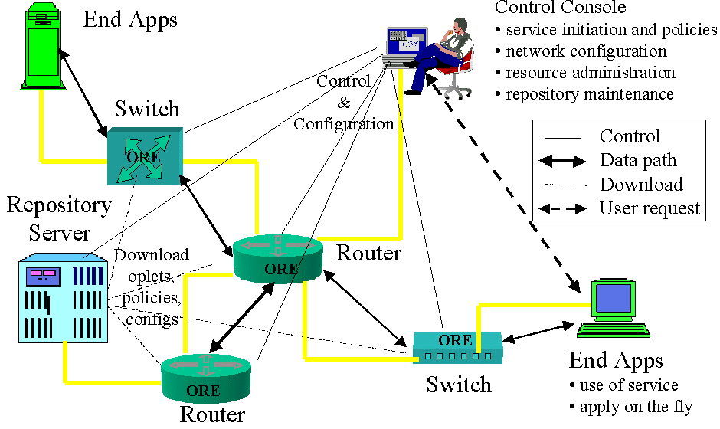
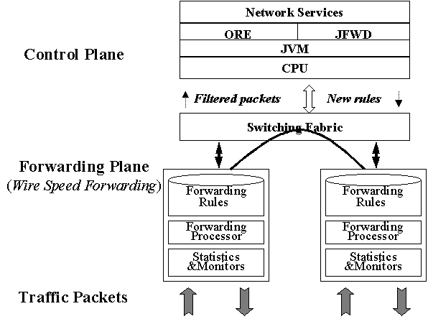
Openet Framework
Openet Architecture with Passport Switches

Slide 20
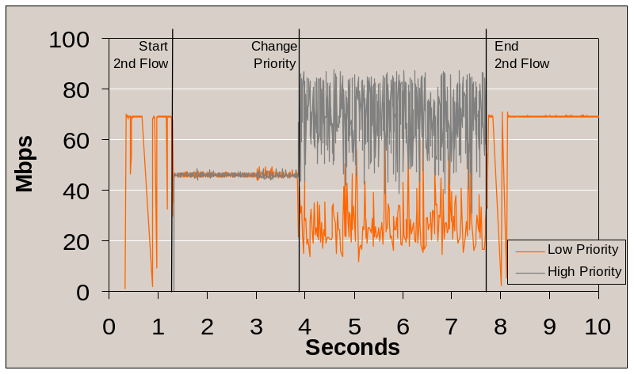
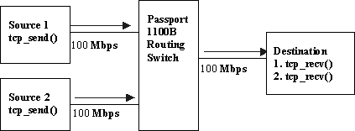
Active Flow Priority Change in Real-time

Slide 21
Path Capacity Discovery (Plan to do)
Boundary Routers
Edge Router
Edge Router
Hosts
L-R
E-R
B-R
C-R
B-R
E-R
L-R
Hosts
Leaf Router
DiffServ Region
InServ/RSVP
Region
InServ/RSVP
Region
RD(Q^{S}₁, …Q^{S}_{n})
RD(Q¹₁, …Q¹_{n})
RD(Q^{k}₁, …Q^{k}_{n})
RD(Q^{D}₁, …Q^{D}_{n})
Link Utilization (U_{n})
For each link:
Average rate (R_{n})
Queue size queue (Q_{n})
Q7/w₇: Network
Control Element (CE)
C₁, C₂,.. C₁, w₁, w₂,.. w₇
Q6/w₆: Premium
Q5/w₅: Platinum(AF4)
Q4/w₄: Gold (AF3)
FE
Q3/w₃: Silver (AF2)
Q2/w₂: Bronze (AF1)
Q1/w₁: Best Effort(DE)
C_{n}

Slide 22
Possible Applications
VPN
Video on Demand
Multicast
Explicit QoS Control loop
Traffic Engineering
  Admission control
  Path capacity discovery
  Explicit Congestion control
  Load or bandwidth balancing
  Bandwidth shaping

Slide 23
Possible applications
Mobile agent for Ecommerce-Stock
Agents for network management
Allow the service to adapt to demands and locations of customers
Automatic protocol deployment-IPv6
Reliable multicast
Congestion control for real-time audio/video
Media gateway
Sensor data mixing

Slide 24
Issues
API
Short term – Long term
Filters
Meters
Light signaling
Fault tolerant mechanisms
Security

