Slide 1
Abundant Bandwidth
and how it affects us?
More Questions Than Answers
Tal Lavian tlavian@eecs.Berkeley.edu
The Light at the end of the Tunnel

Slide 2
Our Networking Beliefs
Let’s challenge some of our networking beliefs
Let’s be a networking agnostic or skeptic for a moment
Sorry…. I know it’s provocative
I could be wrong, but it’s fun to challenge!
Abundant Bandwidth

Slide 3
Agenda
Optical Internet & abundant bandwidth
The economic factors (cheap bandwidth)
Do we need protocol change?
Do we need architectural change?
Where are the bottlenecks?
Summary
Abundant Bandwidth

Slide 4
Abundant Bandwidth
Why does this change the playground?
Optical core bandwidth is growing in an order of magnitude every 2 years, 4 orders of magnitude in 9 years
  1992 – 100Mbs (100FX, OC-3)
  2001 – 1.6Tbs (160 DWDM of OC-192)
  OC-768 (40Gbs) on single λ is commercial (80Gbs in lab)
2-3 orders of magnitude bandwidth growth in many dimensions
    Core – Optical bandwidth - (155mb/s → 1Tb/s)
    Core Metro – DWDM optical aggregation – (2.4Gb/s → N*10Gb/s)
    Metro – Access for businesses (T1 → OC3, 100FX, 1-Gb/s)
    Access – Cable, DSL, 3G – (28kb/s→10mb/s, 1.5mb/s, 384kb/s)
    LAN – (10mbp/s → 10Gbp/s)
Abundant Bandwidth

Slide 5
Why Does This Matter?
How do these photonic breakthroughs affect us as researchers?
This is a radical change to the current internet architecture
The WAN is no longer the bottleneck
  How congestion control/avoidance affected?
  Why DiffServ if you can get all the bandwidth that you need?
  Why do we need QoS?
  Why do we need cache? (if we can have big pipes)
  Where to put the data? (centralized, distributed)
  What changes in network architecture needed?
  What changes in system architecture needed?
  Distributed computing, central computing, cluster computing
  Any changes to the current routing?
Abundant Bandwidth

Slide 6



Our Concept of the Internet
Abundant Bandwidth

Slide 7




Internet Reality
Access
Metro
Long Haul
Metro
Access
Abundant Bandwidth

Slide 8

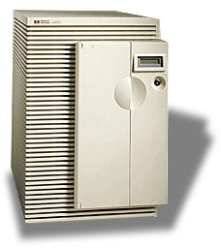






Internet Reality
Data
Center
SONET
SONET
DWDM
DWDM
SONET
SONET
Access
Metro
Long Haul
Metro
Access
Abundant Bandwidth

Slide 9
How Does this Affects our Lives?
What are the new applications to use this abundant bandwidth?
Distance learning?
Telecommuting? (for the average person, not us)
Broadcasting?(I want to see TV channel 48 from Japan)
Video conference?
What else? (this is a BIG question)
  What are the new applications and services?
Abundant Bandwidth

Slide 10
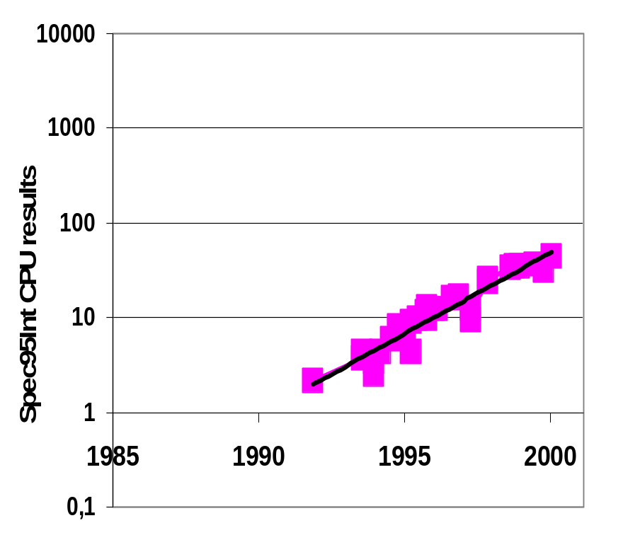
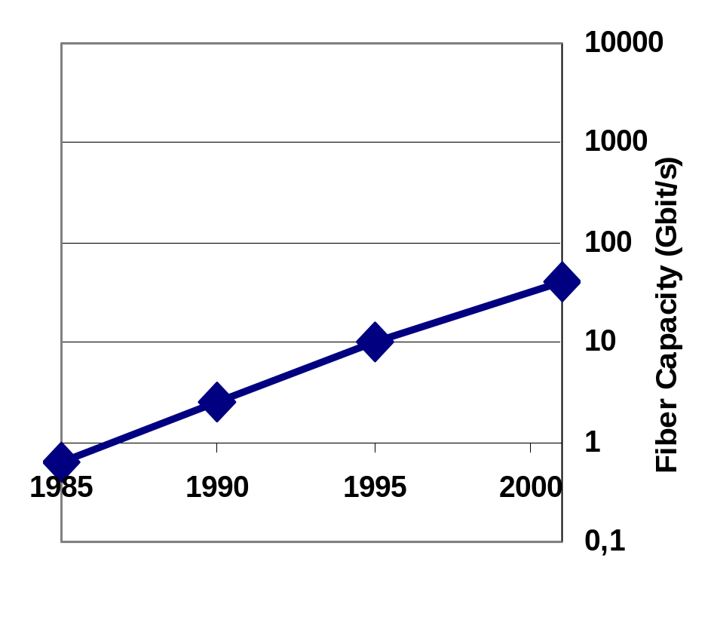
Fast Links, Slow Routers
Processing Power
Link Speed (Fiber)
Source: Nike McKeown, Stanford
SouSSrce: SPEC95Int & David Miller, Stanford.
Abundant Bandwidth
Notes:
SPEC95Int: doubles every 2 ¼ years
FO: doubles every 2 years
DWDM: triples every year, i.e. Doubles every 7 months
Need to optimize router processing not bandwidth efficiency
Optical technology requires:
No buffering
Slow switching
Little logic

Slide 11
Fast Links, Slow Routers
Processing Power
Link Speed (Fiber)
10000
2x / 2 years
2x / 7 months
1000
100
Fiber Capacity (Gbit/s)
10
1
1985
1990
1995
2000
0,1
Source: Nike McKeown, Stanford
TDM
DWDM
Source: SPEC95Int & David Miller, Stanford.
Abundant Bandwidth
Notes:
SPEC95Int: doubles every 2 ¼ years
FO: doubles every 2 years
DWDM: triples every year, i.e. Doubles every 7 months
Need to optimize router processing not bandwidth efficiency
Optical technology requires:
No buffering
Slow switching
Little logic

Slide 12
Agenda
Optical Internet & abundant bandwidth
The economic factors (cheap bandwidth)
Do we need protocol change?
Do we need architectural change?
Where are the bottlenecks?
Summary
Abundant Bandwidth

Slide 13
Breakthrough...Bandwidth
6.4 Tbps
Optical Capacity Revolution
Cost per
Gigabit Mile
1.6 Tbps
320 Gbps
2.5 Gbps
Moore’s
Law
50 Mbps
1984
1994
1998
2001
1993
1998
2002
Wavelengths will become the communications circuits of the future...
Abundant Bandwidth

Slide 14
Monthly Charges
Current Connectivity
  UUNET – OC12, $75- $140K
  Sprint – OC12 - $78k
  AOL – OC3 – $20k
  XO – T1- $1500
Current dedicated connection
  OC3 SF-NY – $340k ($4M a year)
  Only limited organizations could afford it
  Optical bandwidth is changing dramatically
Abundant Bandwidth

Slide 15
Bandwidth is Becoming Commodity
Price per bit went down by 99% in the last 5 years on the optical side
  This is one of the problems of the current telecom market
Optical Metro – cheap high bandwidth access
  $1000 a month for 100FX (in major cities)
  This is less than the cost of T1 several years ago
Optical Long-Haul and Metro access - change of the price point
  Reasonable price drive more users (non residential)
Abundant Bandwidth

Slide 16
Optical Ethernet
New technologies are much cheaper
Ethernet as the WAN access for businesses
Will be at home if it is cheap enough
  Charlottesville Virginia has become one of the first cities in the country to build its own Optical Ethernet network with 40,000 residents and 18,000 university students
Abundant Bandwidth

Slide 17
If we had the bandwidth…
What if we all had 100Mb/s at home?
  Killer apps, other apps, services
  Peer-to-peer video swapping
  Is it TV, HDTV, something else?
What if we had larger pipes at businesses?
  1Gbs home office, 10GE/DWDM large organizations
How would the network architecture look, if we solve the last mile problem?
Abundant Bandwidth

Slide 18
Agenda
Optical Internet & abundant bandwidth
The economic factors (cheap bandwidth)
Do we need protocol change?
Do we need architectural change?
Where are the bottlenecks?
Summary
Abundant Bandwidth

Slide 19
Possible changes
Network architecture changes
  Network computation on Edge devices
  New services on Edge devices
  Servers and servers farm location
  Applications that interact with the network
  Load balance switches, content switches, and server farms
  Optical SAN connect directly to the networks with no servers
Service model changes
  New economic factors
  Bandwidth and access is cheap
Transport protocol changes
  New protocol between hosts and edge devices
  New protocol between the two sides of edge devices
  End-to-End argument between edge devices and not end hosts
Abundant Bandwidth

Slide 20
Assumption Changes
Is TCP the right protocol?
  BIG MAN & WAN pipes
  No optical queues, no optical buffers
    Like circuit switching (and not packet switching)
  Extremely low bit lost (10^{–15})
  Extremely low delays
  100Mb/s on every desk
  Ratio change (file size/pipe size). No time to fill up the pipe
Are we sure that in a new technology, losing packets means congestion? What if this is not true?
TCP was designed for packet switching while optical is close in its characteristics to circuited switching
Abundant Bandwidth

Slide 21
Do We Need Protocol Changes?
If there are no queues, how TCP “slow start” helps us?
How this fits to the sliding windows?
  Why don’t we start dumping packets at our link speed?
    Most HTTP files are relatively small ( few K’s)
    For 100KB file, no time to fills up the pipe
    The max Wind size is 16 bit=64kb
    For 1Mbs wind we need about 20 RTT
      If RTT is 10ms --> 200ms.
      What if RTT 100ms ? That’s 2000ms!!
      What if RTT 500ms? (Australia on a bad day)? That’s 10,000ms!!!
      But just burst at 100Mb/s link speed - is 10ms
  Assuming that we need daily backup of 100GB over a 10GE line – Do we need the same TCP assumptions?
    Just dump - about 100 seconds (and correct at once in the end)
    TCP with very high bit lose (say 10⁻⁹) - might be much longer
      10¹²Gb/ 10⁹ = 1 thousand restarts
Abundant Bandwidth

Slide 22
Agenda
Optical Internet & abundant bandwidth
The economic factors (cheap bandwidth)
Do we need protocol change?
Do we need architectural change?
Where are the bottlenecks?
Summary
Abundant Bandwidth

Slide 23

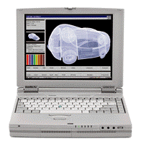
The Access Bottleneck
N x GigE
T1 up to OC3
Glut of 10Gb
Enterprise
PC – 100Mb/s
Dial-up, DSL, Cable
Home
Access
Core Internet
Abundant Bandwidth

Slide 24



The Access
Dial up
xDSL
Cable
Wireless
Internet
Ethernet
ATM
POS
STSx
DS-x/OC-x
Abundant Bandwidth

Slide 25
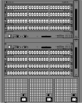

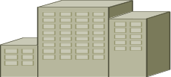
Access and Metro Networks?
CO/PoP
CO/PoP
OC-3/OC-12 Access rings
OC-48/OC-192/Metro
Backbone Rings
OC-3/OC-12 Access rings
Abundant Bandwidth

Slide 26
Architecture Change
End-to-end argument by the Edge instead of end hosts.
Get some server functionality
Services platform on the edge
Overlay Networks
Peer-to-Peer gateways
Content Distribution Networks
Load balance switch
Bandwidth Auction – Weidong work
Abundant Bandwidth

Slide 27
Services Platform on the Edge
Can’t do computation on the optical core
Need to add the intelligence and the computation on the edge
This might be a better place to add network services
Services platform on the edge
Abundant Bandwidth

Slide 28


Protocol and Services on Edge Devices
Handle Protocol
New Services
Internet
Access
Access
Abundant Bandwidth

Slide 29

Bandwidth Trading
To Canada
To Europe
BW Mgr
To Asia
To So. America
Abundant Bandwidth

Slide 30
Agenda
Optical Internet & abundant bandwidth
The economic factors (cheap bandwidth)
Do we need protocol change?
Do we need architectural change?
Where are the bottlenecks?
Summary
Abundant Bandwidth

Slide 31
Where are the New Bottlenecks?
Last mile? (for me it is the first)
Aggregation routers?
Between service providers?
Between Metro and Long-Haul?
Data centers? Clusters?
Servers and CPU power?
Abundant Bandwidth

Slide 32
Example of a new Bottleneck
Long Haul
DWDM
Long Haul
CO
LAN
NNI 1
NNI 2
10/100
LAN
10/100
SONET Access Ring
Access Ring
10/100
LAN
LAN
10/100
LAN
LAN
10/100
Abundant Bandwidth

Slide 33


Example of a Bottleneck
Service Provider A
Public Peering
Relationship
Service Provider B
Service Provider C
Abundant Bandwidth

Slide 34



Open a Bottleneck
Service Provider A
Public Peering
Relationship
Service Provider B
Service Provider C
Abundant Bandwidth
Notes:
Network peering Requirements
Administrative policies
Monitor and control of peering relationships
Seamless re-configuration based on flexible peering policies, fast convergence
Large number of peers per node (200), large routing tables
Security, authentication

Slide 35
Open the Bottlenecks
New products coming offer dramatic performance and capacity improvements that open some of the bottlenecks
  Terabit Routers
  Aggregation routers with optical output
  Multipurpose boxes
    Optical switch + IP router
    SONET node + DWDM switch
    SONET DCS + IP router
    Long-Haul + Metro switch
  Session switching vs. packet switching
Abundant Bandwidth

Slide 36
Agenda
Optical Internet & abundant bandwidth
The economic factors (cheap bandwidth)
Do we need protocol change?
Do we need architectural change?
Where are the bottlenecks?
Summary
Abundant Bandwidth

Slide 37
Summary
Disruptive technologies
Optical Internet creates abundant bandwidth
Dramatic changes in the cost per bit (99% in 5 years)
Access is becoming cheap
Opens several bottlenecks
Need to rethink on architecture and protocol
Our mission is to identify and build the services on top
For most of the questions I simply don’t know the answers
Abundant Bandwidth

Slide 38
“Blindsided by Technology”
When a base technology leaps ahead in a dramatic fashion relative to other technologies, it always reshapes what is possible
It drives the basic fabric of how distributed systems will be built
It blindsides
us all...
Source – unidentified marketing
Abundant Bandwidth
Notes:
This happened with microprocessors getting cheap and small…ended the era of mainframes

Slide 39
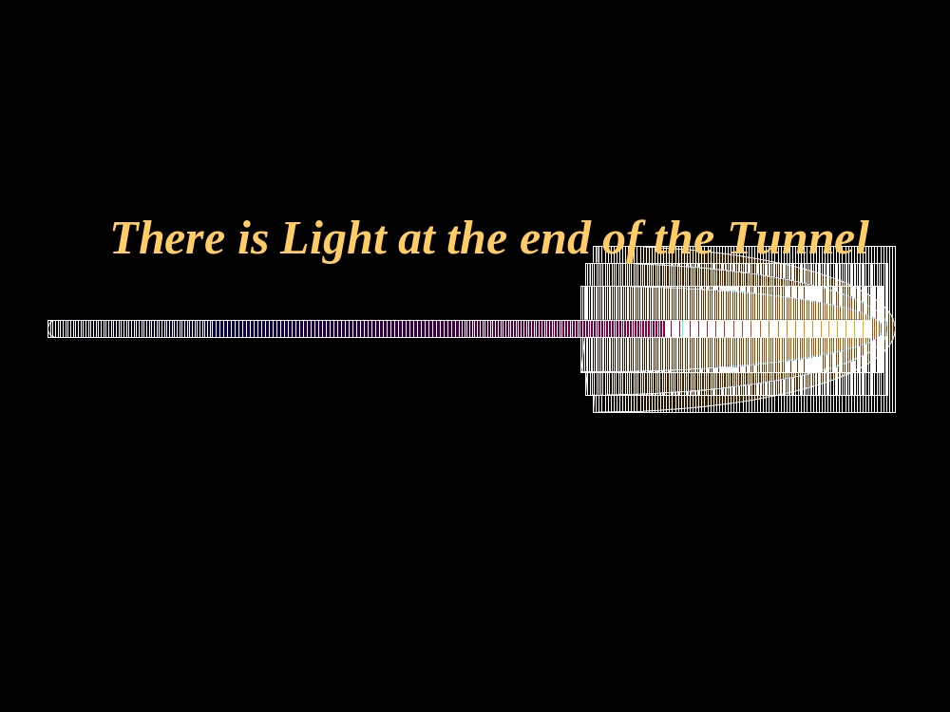
There is Light at the end of the Tunnel
Imagine it 5 years from now?
There are more questions than answers.
Abundant Bandwidth

Slide 40
The Future is Bright
Imagine the next 5 years.
There are more questions than answers.
Abundant Bandwidth

