Slide 1
Programmable Network Node: Applications
Tal Lavian¹ tlavian@IEEE.org
Rob Jaeger^{1,2} rojaeger@NortelNetworks.com
rfj@cs.umd.edu
¹ Technology Center, Enterprise Solutions, Nortel Networks
² Department of Computer Science, University of Maryland

Slide 2
Accomplishments
JVM on a silicon-based L3 Routing Switch
ORE - Oplet Run-time Environment
Java-enabled Device Architecture
SNMP MIB API
Network Forwarding API
Active Networks applications:
  dynamic control and modification of ASIC forwarding

Slide 3
Nortel Java-Enabled Device Architecture
C/C++
API
Java
API
Oplet
AN Packet Interception
Device
Code
ORE Service
JNI
Oplet Runtime Env
Device
Drivers
JVM
JFWD API
Operating System
Device HW

Slide 4
Tools
MIB API
  Monitor device Management Information Base variables
    MIB
    RMON and RMON-II
    DiffServ
Network API (JFWD)
  Interface to Filters
    set packet drop filters
    intercept packets
    carbon copy packets while forwarding at line-speed
Notes:
To introduce the new Open Networking Architecture that is based on Java-enabled Network Devices
To enable easy 3rd party integration and leverage Nortel Networks’ competitive advantage

Slide 5
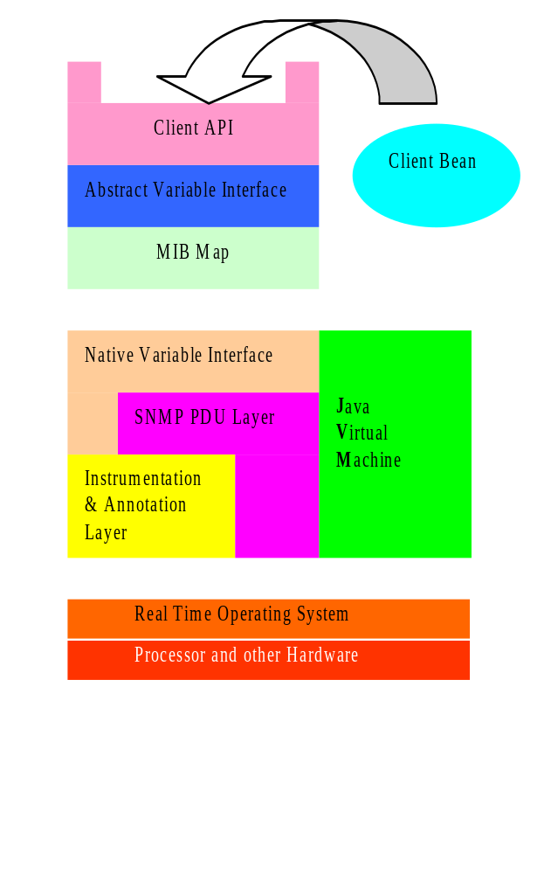
MIB API
API uses a MIB Map to dispatch requests to variable access routines
Different parts of the MIB tree can be serviced by different mechanisms
Two main schemes:
An ad hoc interface to the SNMP instrumentation layer
A generic SNMP loopback

Slide 6
Network API: Dynamic Configuration of Forwarding Rules
Java
Services
CPU
Forwarding
Rules
Forwarding
Rules
Forwarding
Rules
Forwarding
Rules
Forwarding
Processor
Forwarding
Processor
Forwarding
Processor
Forwarding
Processor
SW
HW

Slide 7
Network API: Control-vs-Forwarding Plane
Centralized,
CPU-based Router
Forwarding-Processors
based Router
Routing
SW
Control
Plane
CPU
CPU
Forwarding
Processor
Forwarding
Processor
Forwarding
Processor
Slow
Wire Speed
Control + Forwarding
Functions combined
Control separated
From forwarding

Slide 8
Network API: Packet Capture
AN Apps
CPU
JFWD to
Divert or Copy
Wire Speed
Forwarding
Processor
Forwarding
Processor
Forwarding
Processor
Forwarding
Processor
Packet

Slide 9
Applications
Active Network Management
  Proactive Network Management
  Diagnostic Agents
Dynamic DiffServ Classifier
Active Intrusion Detection
Multicast Caching
IP Accounting
Application-Layer Router-Server Collaboration
Pseudo Default Drop Capability
Notes:
To introduce the new Open Networking Architecture that is based on Java-enabled Network Devices
To enable easy 3rd party integration and leverage Nortel Networks’ competitive advantage

Slide 10
Active Network Management
Download Oplet Service to the device.
Monitor MIB variables
  Might be complex conditions
  Trend analysis
  DiffServ, RMON-II, etc… MIBs
Report “events” to NMS
  drop rate, packets/second
Allow Service to take action
Download application
Adjust parameters based on direction from NMS
Extensive access
to internal resources
No more
polling
NMS
Monitor
Download
Complex Condition
Exceeded
Appropriate
Application
Download
router

Slide 11
Proactive Network Management
Device-based Intelligence is Dynamic
  Static Management
    SNMP set/get mechanisms
    Telnet, User Interfaces (cli, web, etc…)
  Dynamic Closed-loop Management at Network Node
    capable of dealing with new and difficult situations
    autonomous and rational properties.
    dynamically system monitoring & modification
    report status and trends
  Monitor MIB to identify poor performance and notify NMS prior to failures
  Downloaded service can instantiate new services

Slide 12
Diagnostic Agents
Automatic traceroute from edge router where problem exists.
  Each node reached generates a report to NMS
  Traceroute code “moves” to next node in path
  Mobile agents identify router health
  Create logs for NMS

Slide 13
Dynamic DiffServ Classifier
Set router filters to sample packets from edge device host ports
Identify real-time traffic (RTP flows)
Set filter on port to adjust DS-byte value based on policy
Keep track of filters set
Remove filters no longer in use
Notes:
To introduce the new Open Networking Architecture that is based on Java-enabled Network Devices
To enable easy 3rd party integration and leverage Nortel Networks’ competitive advantage

Slide 14
Dynamic DiffServ Classification
Policy
Control
Plane
ORE Service
Filters
Filter
Packet
Packet
Forwarding
Processor
Forwarding
Processor
Packet
Sample packets, set filters to modify DS-byte for Per-Hop-Behavior modification

Slide 15
Active Intrusion Detection
Intruder is identified by Intrusion Detection software
Intruder signature is identified
Mobile agent is dispatched in direction of intruder (based on physical port of entry)
Mobile agent “chases” intruder and terminates him (shuts down link, reboot host, notify NMS)
Notes:
To introduce the new Open Networking Architecture that is based on Java-enabled Network Devices
To enable easy 3rd party integration and leverage Nortel Networks’ competitive advantage

Slide 16
Multicast Caching
Reliable Multicasting
Distribute error control throughout multicast tree
Retransmission a local node keeps control close to lossy links
Balances processor load away from multicast source
Notes:
To introduce the new Open Networking Architecture that is based on Java-enabled Network Devices
To enable easy 3rd party integration and leverage Nortel Networks’ competitive advantage

Slide 17
IP Accounting
Project ABCD (Active Bean Counter in Device)
Perform usage accounting at edge node
PreCorrelate/aggregate/reduce accounting record on-site
$1 rule for billing
Real-time billing can be realized
Customize billable resources

Slide 18
Application Layer Collaboration Among Routers and Servers
Server farm load balancing
  server state monitored; rerouting based on congestion/load
Auctioning Applications
Bandwidth Broker

Slide 19

Server Collaboration
Supports distributed computing applications in which network devices participate
  router to router
  server to router
Supports Intelligent Agents
Supports Mobile Agents
Java-based
Application
Java-based
Application
Java-based
Application

Slide 20
Bandwidth Broker Collaboration
Routers Monitor RMON and DIFFSERV MIB
Report Per-IPAddress, Per Protocol statistic to resource broker
Adjust DS-byte and Per Hop Behavior based on Bandwidth Broker directions
Notes:
To introduce the new Open Networking Architecture that is based on Java-enabled Network Devices
To enable easy 3rd party integration and leverage Nortel Networks’ competitive advantage

Slide 21
Real-time forwarding Stats and Monitors
AN Apps
CPU
Forwarding
Rules
Forwarding
Rules
Forwarding
Rules
Forwarding
Processor
Forwarding
Processor
Forwarding
Processor
Statistics
&Monitors
Statistics
&Monitors
Statistics
&Monitors
SW
HW

Slide 22
Dynamic - On the Fly Configuration
From downloadable Java application, we can modify the behavior of the ASICs

Slide 23
Mixed Topology of AN system
NO need to know the AN topology ahead of time
- AN Node
- None AN Node

Slide 24
Active Node Topology Discovery
NO need to know the AN topology ahead of time
- AN Node
- Non AN Node

