Slide 1




DWDM
RAM
DWDM
RAM
Data@LIGHTspeed
An Architecture for Data Intensive Service Enabled by Next Generation Optical Networks
Tal Lavian : Nortel Networks Labs
Nortel Networks
International Center for Advanced Internet Research (iCAIR), NWU, Chicago
Santa Clara University, California
University of Technology, Sydney
NTONC
NTONC

Slide 2
Agenda
Challenges
  Growth of Data-Intensive Applications
Architecture
  Lambda Data Grid
Lambda Scheduling
Result
  Demos and Experiment
Summary

Slide 3



Radical mismatch: L1 – L3
Radical mismatch between the optical transmission world and the electrical forwarding/routing world.
Currently, a single strand of optical fiber can transmit more bandwidth than the entire Internet core
Current L3 architecture can’t effectively transmit PetaBytes or 100s of TeraBytes
Current L1-L0 limitations: Manual allocation, takes 6-12 months - Static.
  Static means: not dynamic, no end-point connection, no service architecture, no glue layers, no applications underlay routing

Slide 4


Growth of Data-Intensive Applications
IP data transfer: 1.5TB (10¹²) , 1.5KB packets
  Routing decisions: 1 Billion times (10⁹)
  Over every hop
Web, Telnet, email – small files
Fundamental limitations with data-intensive applications
  multi TeraBytes or PetaBytes of data
  Moving 10KB and 10GB (or 10TB) are
  different (x10⁶, x10⁹)
  1Mbs & 10Gbs are different (x10⁶⁾

Slide 5

Lambda Hourglass
Data Intensive app requirements
  HEP
  Astrophysics/Astronomy
  Bioinformatics
  Computational Chemistry
Inexpensive disk
  1TB < $1,000
DWDM
  Abundant optical bandwidth
One fiber strand
  280 λs, OC-192
CERN 1-PB
Data-Intensive Applications
Lambda
Data Grid
Abundant Optical Bandwidth
2.8 Tbs on single fiber strand

Slide 6
DWDM
RAM
DWDM
RAM
Data@LIGHTspeed
Challenge: Emerging data intensive applications require:
Extremely high performance, long term data flows
Scalability for data volume and global reach
Adjustability to unpredictable traffic behavior
Integration with multiple Grid resources
Response: DWDM-RAM - An architecture for data intensive Grids enabled by next generation dynamic optical networks, incorporating new methods for lightpath provisioning

Slide 7
DWDM
RAM
DWDM
RAM
Data@LIGHTspeed
DWDM-RAM: An architecture designed to meet the
networking challenges of extremely large scale Grid applications.
Traditional network infrastructure cannot meet these demands,
especially, requirements for intensive data flows
DWDM-RAM Components Include:
Data management services
Intelligent middleware
Dynamic lightpath provisioning
State-of-the-art photonic technologies
Wide-area photonic testbed implementation

Slide 8
Agenda
Challenges
  Growth of Data-Intensive Applications
Architecture
  Lambda Data Grid
Lambda Scheduling
Result
  Demos and Experiment
Summary

Slide 9
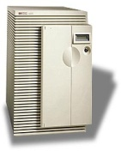
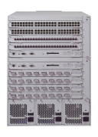
OMNInet Core Nodes
UIC
Northwestern U
8x1GE
4x10GE
4x10GE
8x1GE
Application
Cluster
Optical
Switching
Platform
Optical
Switching
Platform
Passport
8600
Passport
8600
Application
Cluster
OPTera
Metro
5200
StarLight
CA*net3--Chicago
8x1GE
4x10GE
4x10GE
8x1GE
Loop
Application
Cluster
Optical
Switching
Platform
Optical
Switching
Platform
Passport
8600
Passport
8600
Closed loop
A four-node multi-site optical metro testbed network in Chicago -- the first 10GE service trial!
A test bed for all-optical switching and advanced high-speed services
OMNInet testbed Partners: SBC, Nortel, iCAIR at Northwestern, EVL, CANARIE, ANL

Slide 10
What is Lambda Data Grid?
Grid Computing Applications
Grid Middleware
A service architecture
  comply with OGSA
  Lambda as an OGSI service
  on-demand and scheduled Lambda
GT3 implementation
Demos in booth 1722
Data Grid Service Plane
Network Service Plane
Centralize Optical
Network Control
Lambda Service

Slide 11

DWDM-RAM Service Control Architecture
DATA GRID SERVICE PLANE
GRID Service Request
Service
Control
Service
Control
NETWORK SERVICE PLANE
Network Service Request
ODIN
OmniNet Control Plane
ODIN
Optical Control Network
UNI-N
UNI-N
Data
Path
Control
Data
Path
Control
Connection
Control
Data Transmission Plane
Data
Center
λ₁
λ₁
Data
storage
switch
λ_{n}
λ_{n}
L3 router
Data
Center
L2 switch
λ₁
λ_{n}
Data
Path

Slide 12
Applications
Data Transfer Service
Basic Data
Transfer Service
Data Transfer
Scheduler
External Services
Network Transfer Service
Other
Services
Processing
Resource
Service
Storage
Resource
Service
Basic Network
Resource
Service
Network
Resource
Scheduler
Data Path Control
Optical Control
Plane
Connection
Control
Data
Center
λ₁
λ₁
Data
storage
switch
λ_{n}
λ_{n}
Dynamic Optical Network
L3 router
Data
Center
Data
Path
Data Transmission Plane

Slide 13
Data Management Services
OGSA/OGSI compliant
Capable of receiving and understanding application requests
Has complete knowledge of network resources
Transmits signals to intelligent middleware
Understands communications from Grid infrastructure
Adjusts to changing requirements
Understands edge resources
On-demand or scheduled processing
Supports various models for scheduling, priority setting,
event synchronization

Slide 14
Intelligent Middleware for Adaptive Optical Networking
OGSA/OGSI compliant
Integrated with Globus
Receives requests from data services
Knowledgeable about Grid resources
Has complete understanding of dynamic lightpath provisioning
Communicates to optical network services layer
Can be integrated with GRAM for co-management
Architecture is flexible and extensible

Slide 15
Dynamic Lightpath Provisioning Services
Optical Dynamic Intelligent Networking (ODIN)
OGSA/OGSI compliant
Receives requests from middleware services
Knowledgeable about optical network resources
Provides dynamic lightpath provisioning
Communicates to optical network protocol layer
Precise wavelength control
Intradomain as well as interdomain
Contains mechanisms for extending lightpaths through
E-Paths - electronic paths

Slide 16
Agenda
Challenges
  Growth of Data-Intensive Applications
Architecture
  Lambda Data Grid
Lambda Scheduling
Result
  Demos and Experiment
Summary

Slide 17
Design for Scheduling
Network and Data Transfers scheduled
  Data Management schedule coordinates network, retrieval, and sourcing services (using their schedulers)
  Network Management has own schedule
Variety of request models
  Fixed – at a specific time, for specific duration
  Under-constrained – e.g. ASAP, or within a window
Auto-rescheduling for optimization
  Facilitated by under-constrained requests
  Data Management reschedules
    for its own requests
    request of Network Management

Slide 18
Example 1: Time Shift
Request for 1/2 hour between 4:00 and 5:30 on Segment D granted to User W at 4:00
New request from User X for same segment for 1 hour between 3:30 and 5:00
Reschedule user W to 4:30; user X to 3:30. Everyone is happy.
D
4:00
4:30
5:00
5:30
W
4:00
4:30
5:00
5:30
D
W
4:00
4:30
5:00
5:30
Route allocated for a time slot; new request comes in; 1st route can be rescheduled for a later slot within window to accommodate new request

Slide 19
Example 2: Reroute
A
B
Request for 1 hour between nodes A and B between 7:00 and 8:30 is granted using Segment X (and other segments) for 7:00
New request for 2 hours between nodes C and D between 7:00 and 9:30 This route needs to use Segment E to be satisfied
Reroute the first request to take another path thru the topology to free up Segment E for the 2nd request. Everyone is happy
X
C
7:00-8:00
D
Y
A
B
X
C
7:00-8:00
D
Route allocated; new request comes in for a segment in use; 1st route can be altered to use different path to allow 2nd to also be serviced in its time window

Slide 20
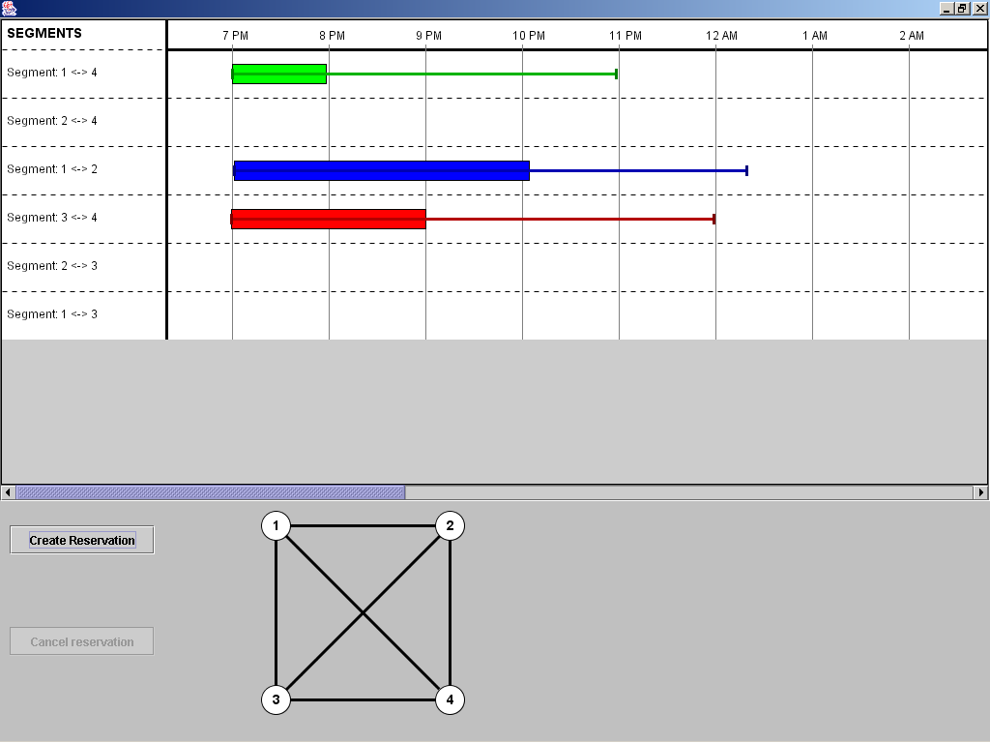

Slide 21
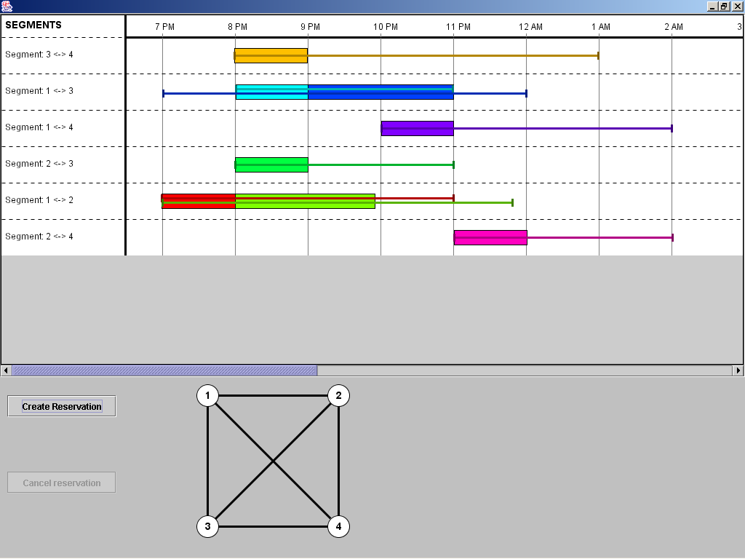

Slide 22
Agenda
Challenges
  Growth of Data-Intensive Applications
Architecture
  Lambda Data Grid
Lambda Scheduling
Result
  Demos and Experiment
Summary

Slide 23
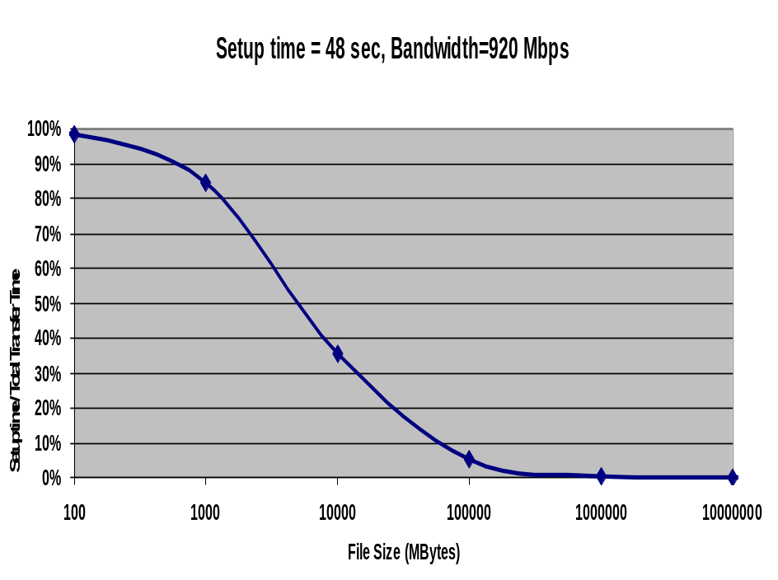
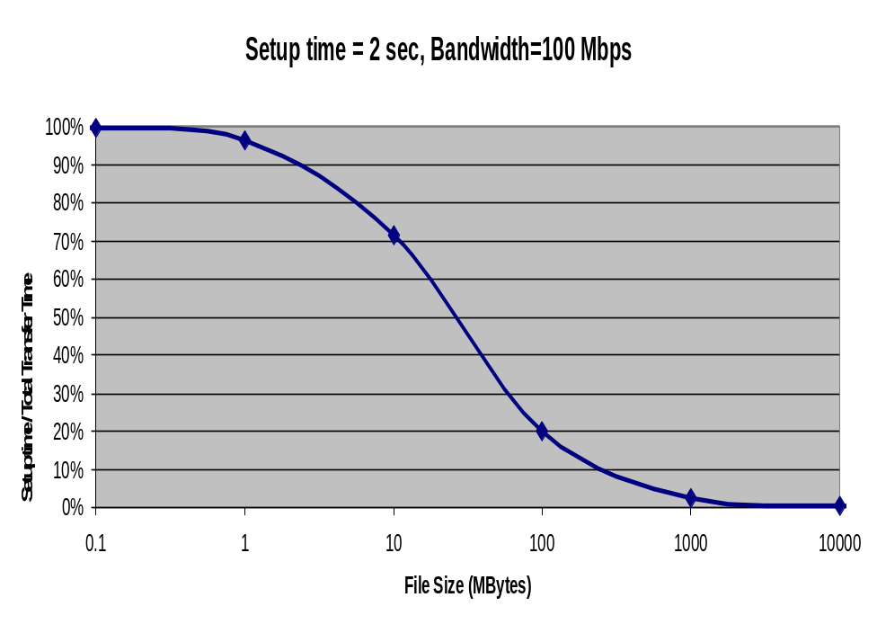
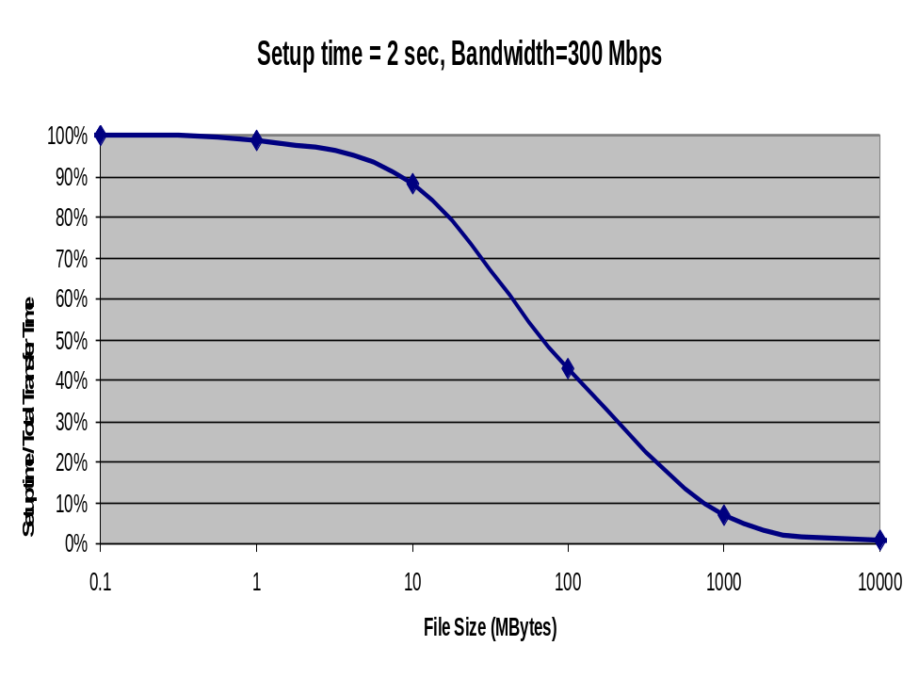
Path Allocation Overhead as a % of the Total Transfer Time
Knee point shows the file size for which overhead is insignificant
500GB
1GB
5GB

Slide 24
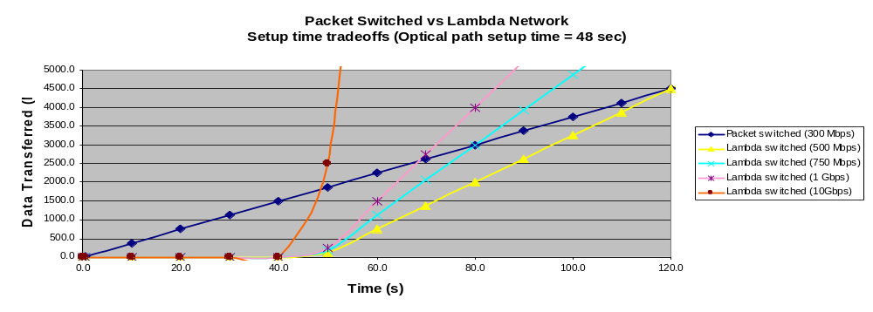
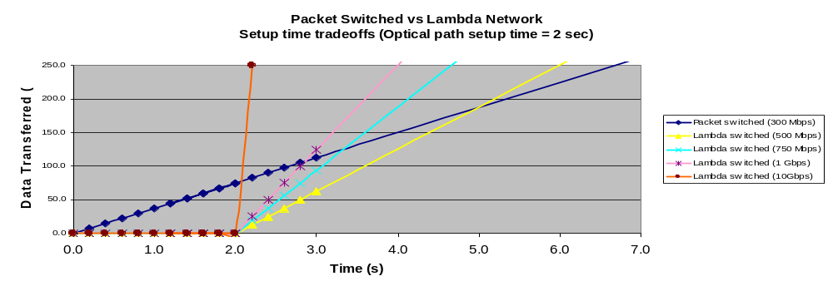

Slide 25
Agenda
Challenges
  Growth of Data-Intensive Applications
Architecture
  Lambda Data Grid
Lambda Scheduling
Result
  Demos and Experiment
Summary

Slide 26
Summary
Next generation optical networking provides significant new capabilities for Grid applications and services, especially for high performance data intensive processes
DWDM-RAM architecture provides a framework for exploiting these new capabilities
These conclusions are not only conceptual – they are being proven and demonstrated on OMNInet –
a wide-area metro advanced photonic testbed

Slide 27
Thank you !

Slide 28
NRM OGSA Compliance
OGSI interface
GridService PortType with two application-oriented methods:
  allocatePath(fromHost, toHost,...)
  deallocatePath(allocationID)
Usable by a variety of Grid applications
Java-oriented SOAP implementation using the Globus Toolkit 3.0

Slide 29
Network Resource Manager
Presents application-oriented OGSI / Web Services interfaces for network resource (lightpath) allocation
Hides network details from applications
Implemented in Java
Items in blue are planned

Slide 30
Scheduling : Extending Grid Services
OGSI interfaces
  Web Service implemented using SOAP and JAX-RPC
  Non-OGSI clients also supported
GARA and GRAM extensions
  Network scheduling is new dimension
  Under-constrained (conditional) requests
  Elective rescheduling/renegotiation
Scheduled data resource reservation service (“Provide 2 TB storage between 14:00 and 18:00 tomorrow”)
DWDM-RAM October 2003
Architecture Page 6

Slide 31
Lightpath Services
Enabling High Performance Support for
Data-Intensive Services With On-Demand Lightpaths Created By
Dynamic Lambda Provisioning, Supported by Advanced Photonic
Technologies
OGSA/OGSI Compliant Service
Optical Service Layer: Optical Dynamic Intelligent Network
(ODIN) Services
Incorporates Specialized Signaling
Utilizes Provisioning Tool: IETF GMPLS
New Photonic Protocols

Slide 32
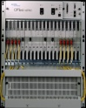
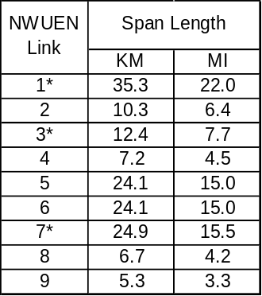
OMNInet
W Taylor
Sheridan
10 GE
λ
1
Photonic
Photonic
λ
10 GE
Grid
Clusters
PP
10 GE
λ
Node
Node
1
10 GE
PP
10/100/
GIGE
8600
Optera
5200
10Gb/s
TSPR
2
NWUEN-1
λ
2
8600
10/100/
GIGE
λ
3
λ
3
Optera
5200
10Gb/s
TSPR
λ
4
λ
4
…
Optera 5200 OFA
NWUEN-5
Optera Metro 5200 OFA
INITIAL
CONFIG:
10 LAMBDAS
(ALL GIGE)
NWUEN-2
NWUEN-6
CAMPUS
FIBER (4)
CAMPUS
FIBER (16)
EVL/UIC
OM5200
NWUEN-3
5200 OFA
Lake Shore
TECH/NU-E
OM5200
λ
1
10 GE
PP
Photonic
10 GE
10/100/
GIGE
INITIAL
CONFIG:
10 LAMBDA
(all GIGE)
Node
λ
2
Optera
5200
10Gb/s
TSPR
8600
λ
3
λ
4
Fiber
CAMPUS
FIBER (4)
5200 OFA
StarLight
Interconnect
with other
research
networks
LAC/UIC
OM5200
NWUEN-8
NWUEN-9
NWUEN-7
NWUEN-4
5200 OFA
S. Federal
8x8x8λ Scalable photonic switch
Trunk side – 10 G WDM
OFA on all trunks
10 GE
10GE LAN PHY (Dec 03)
Photonic
λ
1
PP
Node
λ
2
10 GE
8600
To Ca*Net 4
λ
3
Optera
5200
10Gb/s
TSPR
10/100/
GIGE
Fiber in use
λ
4
1310 nm 10 GbE
WAN PHY interfaces
Fiber not in use

Slide 33
Physical Layer Optical Monitoring and Adjustment
Management & OSC
Routing
PPS Control Middleware
Fault isolation
Connection
verification
Photonics
Database
LOS
Switch
Control
Path ID Corr.
Drivers/data translation
Power measurement
Gain
Controller
Tone
code
FLIP
Rapid
Detect
Power
Corr.
Transient
compensator
Relative
λ power
λ Leveling
Relative
Fiber power
OSC cct
+
+
DSP Algorithms & Measurement
+
Set
point
-
AWG Temp.
Control alg.
-
100FX
PHY/MAC
-
D/A
D/A
A/D
D/A
A/D
PhotoDetector
Heater
Photonic H/W
PhotoDetector
switch
OFA
Splitter
tap
VOA
AWG
tap

Slide 34
Summary (I)
Allow applications/services
  to be deployed over the Lambda Data Grid
Expand OGSA
  for integration with optical network
Extend OGSI
  interface with optical control
  infrastructure and mechanisms
Extend GRAM and GARA
  to provide framework for network resources optimization
Provide generalized framework for multi-party data scheduling

Slide 35
Summary (II)
Treating the network as a Grid resource
Circuit switching paradigm moving large amounts of data over the optical network, quickly and efficiently
Demonstration of on-demand and advance scheduling use of the optical network
Demonstration of under-constrained scheduling requests
The optical network as a shared resource
  may be temporarily dedicated to serving individual tasks
  high overall throughput, utilization, and service ratio.
Potential applications include
  support of E-Science, massive off-site backups, disaster recovery, commercial data replication (security, data mining, etc.)

Slide 36
Extension of Under-Constrained Concepts
Initially, we use simple time windows
More complex extensions
  any time after 7:30
  within 3 hours after Event B happens
  cost function (time)
  numerical priorities for job requests
Extend (eventually) concept of under- constrained to user-specified utility functions for costing, priorities, callbacks to request scheduled jobs to be rerouted/rescheduled (client can say yea or nay)

