Slide 1
Enabling Active Flow Manipulation In Silicon-based Network Forwarding Engines
Tal Lavian - tlavian@ieee.org
Nortel Networks
Advanced Technology Labs
Open Source - http://www.openetlab.org

Slide 2
Outline of the talk
AN technologies => Real Network Devices
Main thrust of the paper
Commercial Active Nets Platform
Application Example 1 – SSL
Application Example 2 – ASF
Next Generation AN Platform
Conclusion
Notes:
Here is the outline of the talk.
First I will identify several driving forces that led us in this direction of programmable networking
Next, I review some basic functionality of a routing network element.
Then I introduce our idea when we develop the AFM concept
I will describe a framework for which AFM can be applied
I will also describe several relevant examples using AFM and the platform
Finally I conclude with a hint of what we go from here.

Slide 3


AN Technology Transfer
Active Nets Community
Active Nets
Ideas
Realistic
Mechanisms
Real AN Network Products
Internet
Great Ideas
Usable/Realizable
Mechanisms/Products
Notes:
To us as researchers: to be able to implement several of our new ideas on a real router.
For Nortel Networks (if I am not wrong): potential revenue generating direction by inventing and developing advanced technology/
By looking at the Internet from users’ perspective, service providers’ perspective and network providers’ perspective, we have identified several driving forces that steered us in this direction of research:
Users want intelligent services
Service providers want to differentiate their service by offering new services, time to market, flexibility in managing their services
Network Providers want to manage their services efficiently and economically. They want to sell, lease their resources at premium price.
They want to sell bandwidth on-demand, etc.

Slide 4
Great Active Nets Community Solutions
Active networks (AN) approach opens an exciting opportunity for individual applications to define the service provided by the network through programmability.
Active Networks technologies expose a novel approach that allows customer value-added services to be introduced to the network “on-the-fly”.
Active Nets program has produced a new network platform flexible and extensible at runtime to accommodate the rapid evolution and deployment of network technologies.
The exciting opportunity exists for network service providers and third parties, not just the network device providers, to program the network infrastructure and services.

Slide 5
AN issues
Lack of industrial-strength Active Network devices that dispel major concerns:
AN requires substantial supports from a NOS
AN introduces substantial software component, hence delay on the data path
AN lacks adequate measures to addressing integrity and security of network devices.

Slide 6
Main contributions of the paper
Active Flow Manipulation Concept
  Flow abstraction
  Actions on Flows
  Control/Data separation
Openet Platform
  Commercial Network Devices
  Runtime Environment
  Active Services
Applications
Notes:
Above all we need programmability in network devices for introducing, enabling all kinds of intelligent services.
What we need : a framework, a platform independent API.

Slide 7
Openet: An active service platform
User Oplets
ANTS
Firewall, DiffServ
Application services
OpletService,
Shell, Logger
Standard Services
Function Services
Jcapture, HTTP,
IpPacket
ORE
JFWD
JVM
JNI/Native Code
MEM
CPU
…
Control Plane
Filtered packets
Monitor status
New forwarding rules
Data Plane
Forwarding Engine

Slide 8
Active Flow Manipulation
A key enabling technology of Openet
Two abstractions
  Primitive flows
  Primitive actions
Customer network services exercise active network control
  Identifying specific flows
  Apply actions to alter network behavior in real-time
Policy
AFM
Filters
Filter
Action
Packet
Packet
Forwarding
Processor
Forwarding
Processor
Packet
Notes:
Database of what to be done based on SLA
Database of possible filters of interests
AFM defines a set of primitive flows and operation to obtain composite flows
AFM defines a set of primitive actions
Flow and Action can form an algebra in the most general sense. One can actually design machine with this algebra.
The main interest is in identifying specific flows and applying actions to alter the behaviour in real-time.

Slide 9

Openet Alteon Active Nets Platform
= A Powerful Platform for AN Technologies Transfer
A powerful and extensible control and computational plane
  Partitioning hardware/software resources
  Active service enabling
  Content filtering in real-time
  Active services accommodation
Content
Aware
Computation
Power
Active
Services
Dynamic
Service Enabling
Optical
Wireless
router
Content
gateway
Edge Device

Slide 10
Nortel Networks’ contributions to Active Networks
Practical Active Networks Architecture on real network device.
First Commercial Active Networks platform.

Slide 11
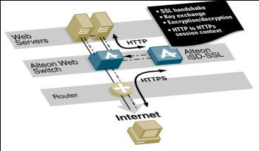

Any AN products?
Experimental/Laboratory
Platforms
Active Nets Community
Active Nets
Ideas
Commercial AN Platform?
?
Realistic
Mechanisms
Nortel Networks AN Products
SSL
ASF
IDS
VPN

Slide 12
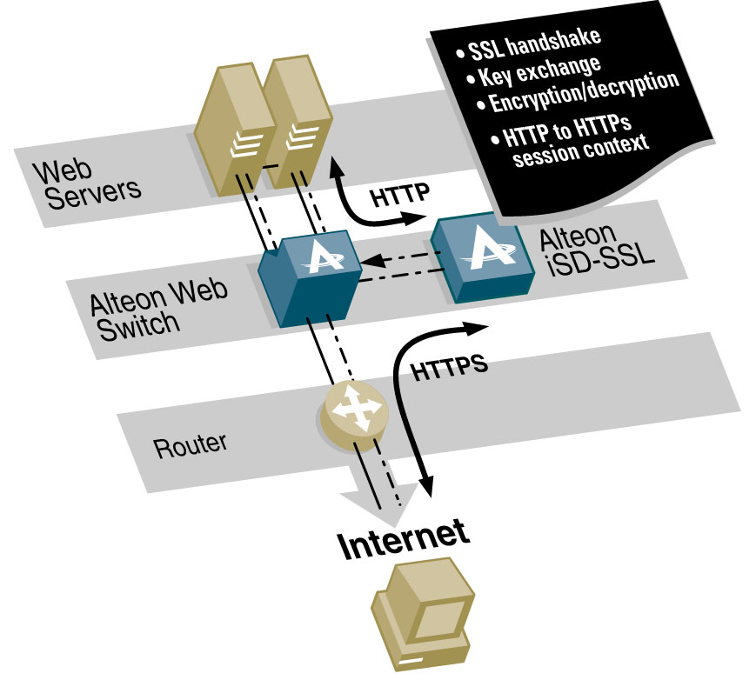
SSL Acceleration
How Does the iSD-SSL Accelerator work?
Client sends an HTTPS request
Switch redirects request on port 443 to iSD-SSL
iSD-SSL completes SSL handshake
iSD-SSL initiates HTTP connection to server on port 80
Switch selects real server based on configured LB policy
Server responds to HTTP request and replies to the iSD-SSL
iSD-SSL encrypts session and sends HTTPS response to client
HTTPS, SMTP-S, POP3-S and IMAP-S services

Slide 13
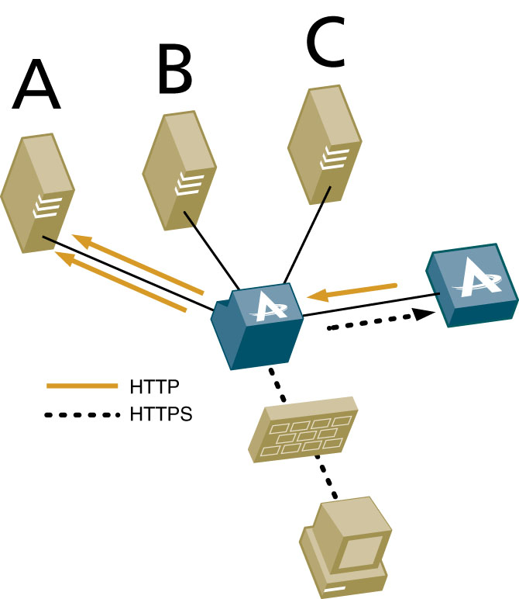

Client And Server Authentication
6
Send encrypted data to back end
Serves request/response
7
2
Sends server certificate
3
Requests client certificate
Private key
Confidential
Validates the client certificate info.
5
1
User opens session
4
Client sends the certificate with public key
Public key
Published

Slide 14
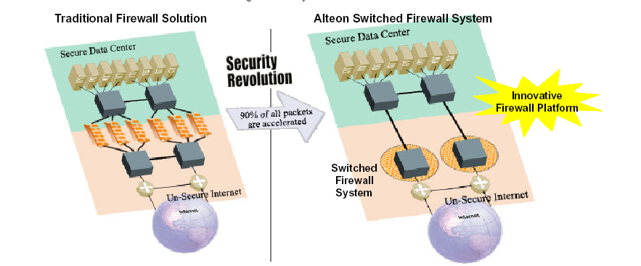
ASF – Alteon Switched Firewall

Slide 15
Relate AFS to AN Technology
The Alteon selectively redirects new connection requests to the Alteon Switched Firewall Director to perform policy checking.
The Director runs the Check Point FireWall-1 engine as an Active Service.
The Active Service manages the connection table, specifies rules for handling packets in the session, passes the connection table to the Alteon Switched Accelerator.
90% of traffic is accelerated, supporting a throughput of 3.2 Gbps.

Slide 16

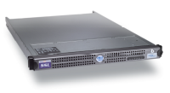
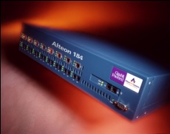
Alteon Security Cluster
Acceleration and intelligent integration of security applications
Management Plane
Single point of secure central management BBI, CLI, SSI, Plug and Play
SSL
Fir
IDS
Fir
Virus
Scan
URL
Filtering
SSL
Fi
IDS
SSL
IDS
SSL
Firewall
IDS
Fi
SSL
IDS
VPNs
Application Plane
Security Appliance
Controller of accelerated sessions
Control Plane
NAAP
Nortel Appliance Acceleration Protocol (Enables application control of switch sessions)
Security Accelerator
Switch based acceleration of session data
Data Plane

Slide 17
What next?

Slide 18


Disaster Recovery concept
EvaQ8 OG -2
iSD
Control Mesg
Alteon
EvaQ8 OG - 1
Control Mesg
OmniNet Control Plane
[Linux]
iSD
8600
1G
TL1
10G
10G
OmniNet
Y
Alteon
8600
B2
B1
B3
C
10G
B
8600
1G
A
X
Normal App flow : Client X -> Server Z
Disaster Strikes at Location Z
EvaQ8 OG 3 sends a signal[RSVP] to OG1
OG1 instructs Omnit net to connect B2 & B3 ; Server Z and Server Y data syncd
On successful sync, OG2 instructs OmniNet to connect B1->B2.
Service Restored for Client X ->server Y
1G
D
Z
iSD
Disaster Event/
Environ. Sensor
Alteon
EvaQ8 OG - 3

Slide 19
What next? Quotes from VIPs

Slide 20
What after next?
Service-centric Active Nets Platform
Service Enabling API
Control API
Impedance Matching API
Security API
Management API
Intra-service Communications API
Manage
Service
Enabling
SERVICES
Security
Impedance Matching
Intra-Service Comm
Control

Slide 21
Summary
AN Technologies Transfer => Nortel AN Platform
New AN platform: Openet + Alteon + iSD
  Alteon: AN platform advanced content filtering
  iSD: powerful & extensible computation plane
Important Applications
Impact of AN on next generation networks

Slide 22
OpenetLab – Nortel Networks: http://www.openetlab.org/
Q&A

Slide 23
Backup Slides

Slide 24
Policy Engine Enhancement
WebOS Policy Engine
Actions
MAC source/dest address
IP /not
IP source/dest address /range
Protocol
IP TOS
IP Options /not
ICMP message types
TCP/UDP source/dest port
TCP flags
URL and Cookie
VLAN ID (New)
Drop
NAT
Frame Ingress
IP TOS rewrite
Redirect (to IP or server group)
Allow / express forward
Iterate per unmatched frame / session

Slide 25
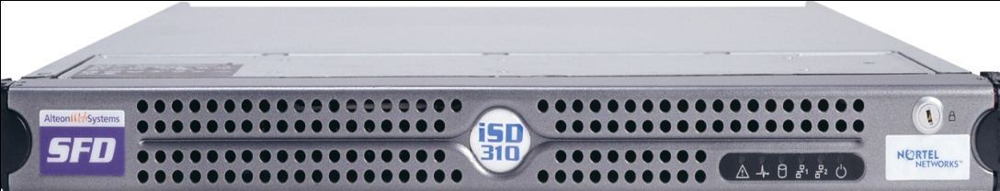

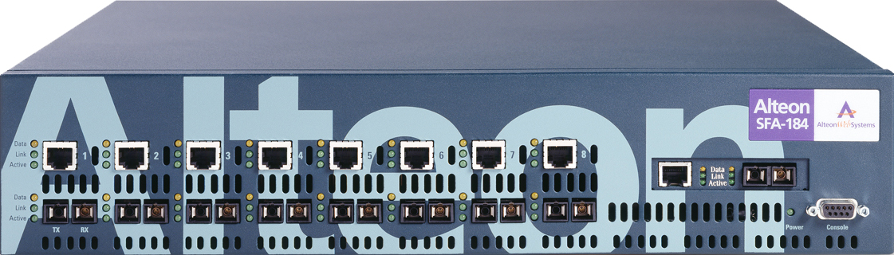
Secure XL & NAAP in Action TCP session
Policy Check
Alteon Switched Firewall (ASF)
1
Clients
1
1
3
5
6
7
Add Conn. (F2F)
Update Conn.
Update Conn.
Update Conn.
Delete Conn.
Servers
1
SYN
2
SYN/ACK
3
ACK
(TCP 3-way handshake complete)
4
TCP 3-way handshake complete, data for the session accelerated
5
FIN-1
6
FIN-2
7
ACK

Slide 26
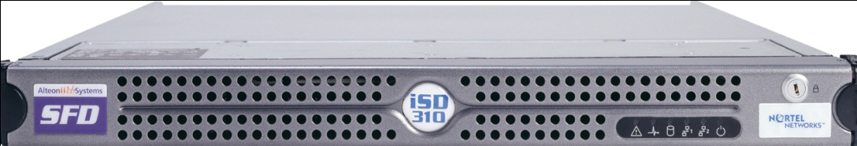
Secure XL & NAAP in Action UDP session
Policy Check
Alteon Switched Firewall (ASF)
1
Clients
1
1
3
Add Conn.
Delete Conn. after UDP timeout if session is inactive
Servers
1
1st pkt
2
Data for the session accelerated

Slide 27
New Focus on Integrated Management and Flow
Application Clusters
SSL
FW
VPN
IDS
Virus
Scanning
URL
Filtering
SSL
FW
VPN
IDS
Virus
Scanning
URL
Filtering
SSL
FW
VPN
IDS
Virus
Scanning
URL
Filtering
SSL
FW
VPN
IDS
Virus
Scanning
URL
Filtering
SSL
FW
VPN
IDS
Virus
Scanning
URL
Filtering
SSL
FW
VPN
IDS
Virus
Scanning
URL
Filtering
Intelligent Flow Management
Security Dashboard
Shift from physical management to logical management
Central management of multiple services
Plug and play simplicity and scalability
Notes:
Shift from physical management to logical management
o Manage the data based on flows and apply the services depending on the user and flow
o Simplify the configuration significantly
o Essentially separate data plane from control plane to enable effective management
Central management of multiple services
o Eliminate multiple points of management
o Scale management to control devices and applications
Plug and play simplicity and scalability

