Slide 1
Enabling Active Flow Manipulation In Silicon-based Network Forwarding Engines
Tal Lavian - tlavian@ieee.org
Nortel Networks
Advanced Technology Labs
Open Source - http://www.openetlab.org

Slide 2
Outline of the talk
Driving Forces
Openet
AFM Enabling Mechanism
Realization with Openet Passport
Application Examples
Openet Alteon: AN platform
Next step
Conclusion
Notes:
Here is the outline of the talk.
First I will identify several driving forces that led us in this direction of programmable networking
Next, I review some basic functionality of a routing network element.
Then I introduce our idea when we develop the AFM concept
I will describe a framework for which AFM can be applied
I will also describe several relevant examples using AFM and the platform
Finally I conclude with a hint of what we go from here.

Slide 3
Driving Forces
Users – Service Providers – Network Providers
Introducing services on-demand
Assuring Quality of Service
Addressing Impedance Mismatch
Demanding Programmability
Notes:
To me as a researcher (before sabbatical) : to be able to implement several of our new congestion control algorithms on a real router.
For Nortel Networks (if I am not wrong): potential revenue generating direction by inventing and developing advanced technology/
By looking at the Internet from users’ perspective, service providers’ perspective and network providers’ perspective, we have identified several driving forces that steered us in this direction of research:
Users want intelligent services
Service providers want to differentiate their service by QoS, time to market, flexibility in managing their services
Network Providers want to manage their services efficiently and economically. They want to sell, lease their resources at premium price.
They want to sell bandwidth on-demand, etc.

Slide 4
Introducing Services on-demand
Monitor
Security
Services &
Control Intelligence
Authentication
Dynamic
loading
application
React
VIRTUAL ENVIRONMENT
OS
HW
Network Device
Notes:
Here is an example of introducing services on-demand.
The environment allows users/service providers to dynamically, securely download new service to a network device. The service may be a new QoS mechanism, a congestion control algorithms, a new service differentiation scheme, a new monitoring scheme, etc

Slide 5
Programmability
A significant challenge in today’s Internet is the ability to efficiently incorporate customizable network intelligence in commercial high performance network devices.
  Framework for introducing services
  API for programming network devices
Notes:
Above all we need programmability in network devices for introducing, enabling all kinds of intelligent services.
What we need : a framework, a platform independent API.

Slide 6



Impedance Mismatch
User Connections
HTTP, RTP,
TCP, UDP, etc
Optical World
Fiber 1
Residential
LAN
Access
(Edge)
Core Networks (WAN)
Access
(Edge)
Enterprise
Intranet
User
Network
ISP Network
ISP Network
Carrier Network
Notes:
Today’s Internet really consists of three types of networks: Residential/Enterprise Networks, Access Networks and Core Wide Area Networks. The characteristics of these are very different from each other in terms of bandwidth, scale, and quality of service.
We need a flexible edge device that is intelligent enough to address this type of impedance mismatches.
IP/Optical networks
IP/Wireless networks

Slide 7
AN Solution
Active networks (AN) approach opens an exciting opportunity for individual applications to define the service provided by the network through programmability.
Active Networks technologies expose a novel approach that allows customer value-added services to be introduced to the network “on-the-fly”.
Active Nets program has produced a new network platform flexible and extensible at runtime to accommodate the rapid evolution and deployment of network technologies.
The exciting opportunity exists for network service providers and third parties, not just the network device providers, to program the network infrastructure and services.

Slide 8
AN issues
Lack of industrial-strength Active Network devices that dispel major concerns:
AN requires substantial supports from a NOS
AN introduces substantial software component, hence delay on the data path
AN lacks adequate measures to addressing integrity and security of network devices.

Slide 9
Openet Platform
= Active Nets Enabling Platform = Programmable Networking Solution
Passport Router
Openet
Active Flow Manipulation (AFM)
Programmable Openet Passport Platform

Slide 10
Passport Router - Separation of Control and Forwarding Planes
Centralized,
CPU-based Router
Forwarding-Processors
Based Router
Routing
SW
Control
Plane
CPU
CPU
Forwarding
Processor
Forwarding
Processor
Forwarding
Processor
Slow
Wire Speed
Control + Forwarding
Functions combined
Control separated
from forwarding
Notes:
Software router. Everything is integrated and have to be processed by the CPU. Slow
Separate control from forwarding
Control for determining optimal routing paths and for management
Forwarding is dedicated and hence is fast.

Slide 11
Openet: a view from a node
User Oplets
ANTS
Firewall, DiffServ
Application services
OpletService,
Shell, Logger
Standard Services
Function Services
Jcapture, HTTP,
IpPacket
ORE
JFWD
JVM
JNI/Native Code
MEM
CPU
…
Control Plane
Filtered packets
Monitor status
New forwarding rules
Data Plane
Forwarding Engine

Slide 12
Control Functions
CE: Control Element
FE: Forwarding Element
(1)
Control
Intensive
computation
CE
(2)
(3)
FE
Control functions that reside wholly in the control plane
Control functions that insert software in the critical data path
Control functions that allow control entities to act both in the
control plane and in the data forwarding plane without adding
software in the data path
Notes:
Configuring the system at start-up time. Occasionally
Control and/or computation on every packet. Active packets or Capsule
Control On Demand. This is what we are interested.

Slide 13
Active Flow Manipulation Abstractions
Aggregate data into traffic flows
  Flows whose characteristics can be identified in real-time
  E.g., “all UDP packets to a particular service”, “all TCP packets from a particular machine”.
Actions to be performed in the traffic flows
  Actions that can be performed in real-time
  E.g., “Change the priority of all traffic destined to a particular service on a particular machine”, “Stop all traffic out of a particular link of a router”.
Notes:
The interest is in flows and aggregated flows (classes of traffic)
The interest is in the types of action that can be operated on the flow.
Both Identification and Action must be performed in real-time

Slide 14
Active Flow Manipulation
A key enabling technology of Openet
Two abstractions
  Primitive flows
  Primitive actions
Customer network services exercise active network control
  Identifying specific flows
  Apply actions to alter network behavior in real-time
Policy
AFM
Filters
Filter
Action
Packet
Packet
Forwarding
Processor
Forwarding
Processor
Packet
Notes:
Database of what to be done based on SLA
Database of possible filters of interests
AFM defines a set of primitive flows and operation to obtain composite flows
AFM defines a set of primitive actions
Flow and Action can form an algebra in the most general sense. One can actually design machine with this algebra.
The main interest is in identifying specific flows and applying actions to alter the behaviour in real-time.

Slide 15
Identifiable Elements of Primitive Flows
Table 1: The primitive flow set of identifiable elements
Destination Address (DA)
Range of Destination Address (RDA)
Source Address (SA)
Range of Source Address (RSA)
Exact TCP protocol match (TCP)
Exact UDP protocol match (UDP)
Exact ICMP protocol match (ICMP)
Source Port number, for both TCP and UDP (SP)
Destination Port number for both TCP and UDP (DP)
TCP connection request (TCPReg)
ICMP request (ICMPReg)
DS field of a datagram (DS)
IP Frame fragment (FrameFrag)

Slide 16
Primitive Permissible actions
Drop
Forward
Mirror
Stop on Match (SOM)
Detect Out of Profile behaviour (Out)
Change DSCP value (DSCP)
Prevent TCP Connect Request
Modify IEEE 802.1p bit

Slide 17
Openet on Passport Router
Active Services
Active Networks
Services
ORE
System Services
Control Plane
CPU System
Monitor status
New rules
Switching Fabric
Data Plane
(Wire Speed Forwarding)
Forwarding
Rules
Forwarding
Rules
Forwarding
Rules
. . .
Forwarding
Processor
Forwarding
Processor
Forwarding
Processor
Statistics
&Monitors
Statistics
&Monitors
Statistics
&Monitors
Traffic Packets

Slide 18
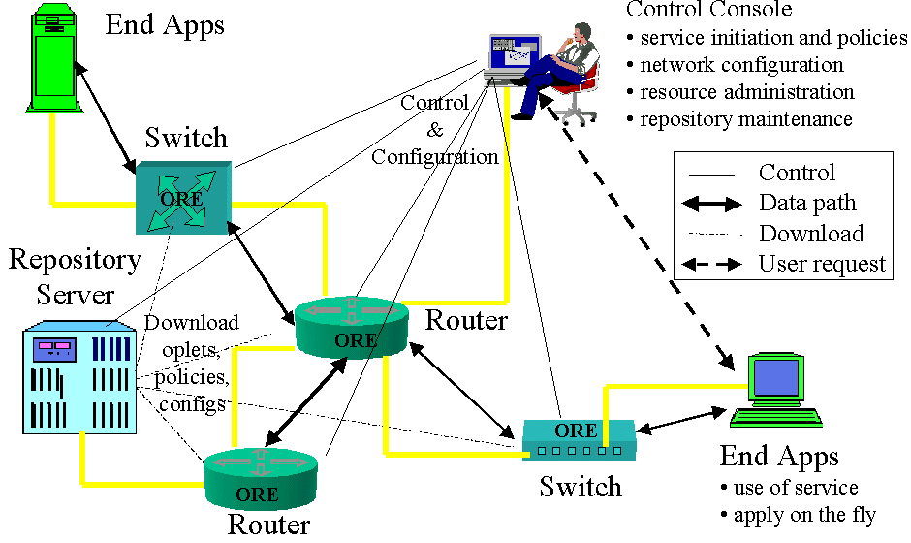
Openet Framework
Openet Architecture with Passport Switches

Slide 19
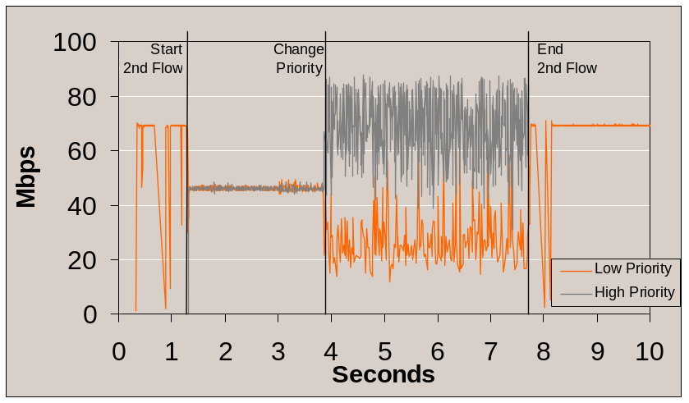
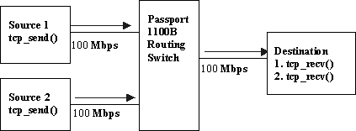
Example 1: Active Flow Priority Change in Real-time
Notes:
The active flow priority change is a control-plane network service that applies AFM to alter the packet forwarding priorities of particular flows in real-time.
The experiment procedure is as follows (see Figure 3b). At the beginning, the first TCP flow at a constant rate of 100Mbps is set up from Source 1 to the Destination through the Passport. The link bandwidth between the Passport and the Destination is 100Mbps at maximum. At time 1.3 seconds, the second TCP flow at the same rate from Source 2 is set up through the same link to the Destination. When they become stable, each claims nearly half of the link bandwidth (47Mbps). Then, the ORE on the Passport is instructed to activate the “active priority” service, which employs AFM to detect particular flows and increases the packet priority of the second flow at time 3.8 seconds. As expected, the receiving rate of the second flow (now with a high priority) increases and stabilizes at the desired bandwidth (70Mpbs) and the low-priority first one at a lower rate (24Mbps)

Slide 20







Example 2 : JDiffserv on Passport
Device Console
Differv-enabled Network
UDP receiver
UDP sender
Passport 8600
Passport 1100B
Passport 1100B
UDP
UDP
JDiffserv
UDP
Linux PC
Linux PC
HTTP server
Diffserv Monitor
Linux PC

Slide 21
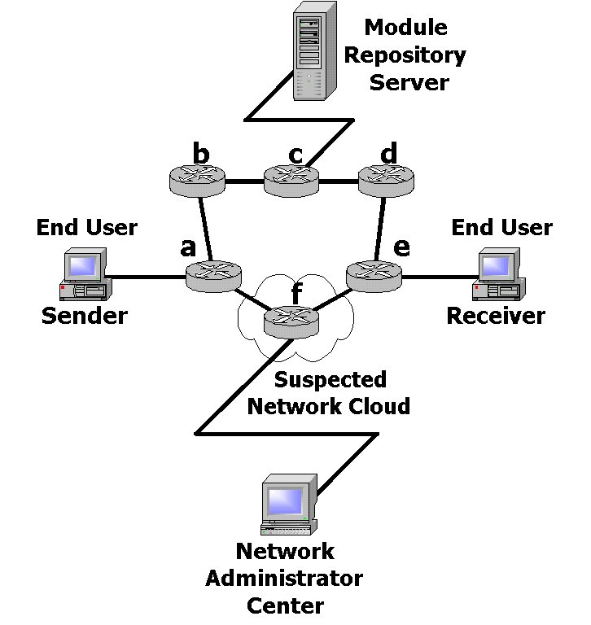
Example 3 : Regatta - Fault Recovery
Automated supervision
Minimal service interruption
Heartbeats
Notes:
Regatta is another control-plane service that employs the Openet infrastructure and AFM for automated supervision [23]. Regatta stops, in a dynamic fashion, flows through routers when a node operation fails and leaves them to the Regatta (routing) supervision procedure. The Regatta supervision procedure handles the bypass with minimal service interruption to the user
Traffic flows between the two end users go through nodes a, f, and e which is the shortest path. After the network operator installed Regatta at node f, Regatta begins to unfold itself outside of node f. In particular, it installs itself in the two adjacent nodes: a and e. Node f does not play any active role of control except in this bootstrap operation. It becomes the subject of the attentions by other reliable neighboring nodes. The Regatta-activated nodes a and e exchange periodic heartbeats between them to supervise the well being of suspected node f. The type and rate of the heartbeats are defined by the operator.

Slide 22
Current Development: Programmable Services Solution
Alteon-iSD
Openet
Extended Active Flow Manipulation (AFM)
Openet Alteon-based Active Nets Platform

Slide 23

Openet Alteon Active Nets Platform
= A Powerful Platform for AN Technologies Transfer
A powerful and extensible control and computational plane
  Partitioning hardware/software resources
  Active service enabling
  content filtering in real-time
  active services accommodation
Openet
L2-L7
filtering
Content
processing
Power
computing
Optical
Wireless
router
Edge Device
Content
gateway

Slide 24
Solutions’ Features
Real-time Filtering
  Ability to poke at the device’s data flows
Processing Power
  Ability to perform intensive processing
Enabling Services
  Introducing services on-demand
Programmable Services
  Enabling active and adaptive services
Impedance Matching
  Addressing mismatches between disparate domains, disparate technologies

Slide 25
Streaming Media Distribution Service
Openet Alteon AN Platform for SMDS
  1 Real server on Linux or NT, 2~8 Real Players on Solaris
  SMDS on iSD
    Real Player RTSP request filter and interception
    Real Server reply real-time stream filter and replication
    RTSP session setup by replicating first 16 packets cached
iSD
SMDS service
rtsp://pcary1gc:5454/real8video
RTSP
intercept
Client
Register
Packet
Replicate
Real Player 2
Packet
Redirection
Packet
Writeback
Alteon
rtsp://pcary1gc/real8video
Real Server 8
Real Player 1
1st Client RTSP Request
Server reply
Linux/X86
Sun/Solaris

Slide 26


A Simple EvaQ8 concept
EvaQ8 OG -2
iSD
Control Mesg
Alteon
EvaQ8 OG - 1
Control Mesg
OmniNet Control Plane
[Linux]
iSD
8600
1G
TL1
10G
10G
OmniNet
Y
Alteon
8600
B2
B1
B3
C
10G
B
8600
1G
A
X
Normal App flow : Client X -> Server Z
Disaster Strikes at Location Z
EvaQ8 OG 3 sends a signal[RSVP] to OG1
OG1 instructs Omnit net to connect B2 & B3 ; Server Z and Server Y data syncd
On successful sync, OG2 instructs OmniNet to connect B1->B2.
Service Restored for Client X ->server Y
1G
D
Z
iSD
Disaster Event/
Environ. Sensor
Alteon
EvaQ8 OG - 3

Slide 27
What next?
Service-centric Active Nets Platform
Service Enabling API
Control API
Impedance Matching API
Security API
Management API
Intra-service Communications API
Manage
Service
Enabling
SERVICES
Security
Impedance Matching
Intra-Service Comm
Control

Slide 28
Summary
Openet – our Networking Programmability
Commercial network programmable hardware
New AN platform: Openet + Alteon + iSD
  Alteon: AN platform on an advanced content switch
  iSD: powerful & extensible computation plane
Enables AN technologies transfer ☺
Promoting an edge device service-centric platform ☹

Slide 29
OpenetLab – Nortel Networks: http://www.openetlab.org/
Q&A

