Slide 1
Open Programmable Architecture for Java-enabled Network Devices
A Revolution!
Tal Lavian
Technology Center
Nortel Networks tlavian@NortelNetworks.com

Slide 2
Programmable Network Devices
Openly Programmable devices enable
new types of intelligence on the network

Slide 3
Agenda
Local Computation
New types of applications
Architecture
API’s
Summary

Slide 4

Changing the Rules of the Game
Move Turing Machine onto device
  Run non-vendor/non-bundled applications on network device
while (true) { doLocalProcessingOnDevice()
}

Slide 5




Non-vendor/Non-bundled Applications
Applet
Web Server
Web Browser
The JVM is in the Browser
Download applications for local processing
non-bundled application
Reversed Applets
Server
The JVM is in the Device: supports non-bundled apps

Slide 6
The Web Changed Everything
Browsers
  Introducing JVM to browsers allowed dynamic loading of Java Applets to end stations
Routers
  Introducing JVM to routers allows dynamic loading of Java Oplets to routers
This Capability WILL Change Everything

Slide 7
Architecture to Augment Vendor-Provided Software
Supports non-vendor applications
End-user custom application development
  Tight interaction between business applications and network devices
    Domain experts who understand business goals
    Innovative approaches
  “Features on Demand”
    download software services
    dynamically add new capabilities

Slide 8

Paradigm Shift
Supports distributed computing applications in which network devices participate
  router to router
  server to router
Supports Intelligent Agents
Supports Mobile Agents
Java-based
Application
Java-based
Application
Java-based
Application

Slide 9
Example: Downloading Intelligence
Monitor
Security
Intelligence
Authentication
Dynamic
loading
application
React
JVM
OS
HW
Network Device

Slide 10
Security and Stability
secure download of Java Applications
safe execution environment
  insulate core router applications from dynamically loaded applications

Slide 11
Device-based Intelligence
Static-vs-Dynamic Agents
  Static
    SNMP set/get mechanisms
    Telnet, User Interfaces (cli, web, etc…)
  Dynamic closed-loop interaction on nodes
    capable of dealing with new and difficult situations
    autonomous and rational properties.
    dynamically system monitoring & modification
    report status and trends

Slide 12

Why not an external JVM?
Isn’t it easier to use an inexpensive PC with an external JVM?
New type of apps utilizing the local computation and access to router resources.
Apps
JVM
Apps
JVM

Slide 13
Agenda
Local Computation
New types of applications
Architecture
API’s
Summary

Slide 14
New Types of Applications
Mobile Agents
Local Intelligence for NMS
Collaboration among routers
Router & Server Collaboration
E-commerce

Slide 15
Mobile Agents
Intrusion Detection - Hacker Chaser
Trace-route for Layer 2
Mobile Connectivity Mapper

Slide 16
Local Intelligence for NMS:
Diagnostic Agents
Extensive access
to internal resources
No more
polling
Download Intelligent Agent monitor from NMS to the device.
Wait for threshold.
  Might be complex conditions
  Trend analysis
Send “condition exceeded” event to NMS.
Automatic download appropriate application
Application takes action.
NMS
Monitor
Download
Complex Condition
Exceeded
Appropriate
Application
Download
router

Slide 17
Application Layer Collaboration Among Routers and Servers
Server farm load balancing
  server state monitored
  rerouting based on congestion/load
Auctioning Applications

Slide 18
E-Commerce Example
Business logic based operation changes
Resize forwarding queues
Modify congestion control algorithm
Adjust Packet Scheduling
Change routing table

Slide 19
Agenda
Local Computation
New type of applications
Architecture
API’s
Summary

Slide 20
Java Network Services Environment
Service 1
Service 4
dependencies
Service 2
Service 3
JNSE
JVM/JRM

Slide 21
Open Device Architecture
C/C++
API
Java
API
Service
Java
Service
Download
Device
Code
Java
Service
Java Lib
JNI
DataCom API
Device
Drivers
Native
Code
JVM
Operating System
Device HW

Slide 22
Architecture Issues
Green Threads -vs- Native Threads
  Native threads:
    provides non-interference between Java applications
    difficult thread-to-thread communication and sharing of data between threads
    creates a dependency on underlying RTOS
    multiple JVM instances consume resources
  Green Threads
    single JVM must manage CPU & memory resources between concurrently running threads

Slide 23
Java Environment
Green Threads -- Present RTOS with single unified task that includes:
  Java VM (JVM)
  Java Resource Manager (JRM)
    thread scheduling
    manages CPU utilization
      JVM time-slice is managed by the JRM preemptive thread scheduler
    internal memory manager (intercepts “new”)
    garbage collection with priority based on available memory

Slide 24
Non-Interference w/ Single JVM
Multiple threads compete for resources
  memory
  CPU
  persistent storage
Denial-of-service attacks possible
  memory or CPU consumption attacks
  trusted/untrusted service interactions

Slide 25
Why Java
Reuse security mechanisms
  byte-code verifier
  security manager
  classloader
System stability
  constrains applications to the JVM
  Prohibits native code applications
Extensible, portable, & distributable services

Slide 26

But Java is slooowwwww
Not appropriate in the fast-path data forwarding plane
  forwarding is done by ASICs
  packet processing not affected
Java applications run on the CPU
  Packets destined for Java application are pushed into the control plane

Slide 27

Strong Security in the new model
The new concept is secure to add 3rd party code to network devices
  Digital Signature
  Administrative “Certified Optlet”
  No access out of the JVM space
  No pointers that can do harm
  Access only to the published API
  Verifier - only correct code can be loaded
  Class loader access list
  JVM has run time bounds, type, and execution checking

Slide 28

Old model Security (C/C++)
Old model: Not safe to add 3rd party code
  Dangerous, C/C++ Pointers
    Can touch sensitive memory location
  Risk: Memory allocations and Free
    Allocation without freeing (leaks)
    Free without allocation (core dump !!!! )
Limited security in SNMP

Slide 29
Agenda
Openness
Local Computation
New types of applications
Architecture
API’s
Summary

Slide 30
An Open Service API Example
  SNMP API for Network Management
    generated automatically
    allows device-based applications to query MIB
    device-based application -- query local MIB
    report trends or significant events
    initiate downloading of problem specific diagnostic code
    take corrective action

Slide 31
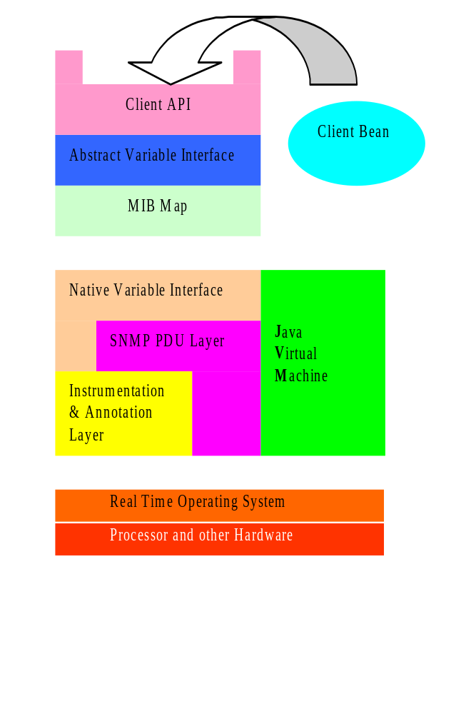
MIB API Example
API uses a MIB Map to dispatch requests to variable access routines
Different parts of the MIB tree can be serviced by different mechanisms
Two main schemes:
An ad hoc interface to the SNMP instrumentation layer
A generic SNMP loopback

Slide 32
Agenda
Openness
Local Computation
New type of applications
Architecture
API’s
Summary

Slide 33
Summary
Programmable
  Turing Machine on network devices
  dynamic agents vs. static agents
  dynamic loading
  strong security
Openness - successfully proven paradigm
  Facilitates innovation
  Domain experts - virtual development community
Enabling Technology for the Revolution

Slide 34

This is only the first step
1903 the Wright brothers
Compare to this first flight and look where aviation is today

