Slide 1
Edge Device Multi-unicasting for Video Streaming
T. Lavian, P. Wang, R. Durairaj, F. Travostino
Advanced Technology Lab, Nortel Networks
D. B. Hoang
University of Technology, Sydney
Presented By
Ramesh Durairaj
radurai@nortelnetworks.com

Slide 2
Outline
Introduction
Application Layer Multicast and related work
Application Layer Multi-Unicast
ALMuti-Unicast Testbed
Performance Measurement
Conclusion

Slide 3
Problems with IP multicast
After a decade of research and development IP Multicast still has not been deployed widely in the global Internet due to:
  Lack of feasible admission control
  Small multicast address space
  Difficulty in estimating group size for billing
  best-effort multi-point delivery service

Slide 4
IP multicast for Video Streaming
Business model does not adequately cover the cost of replication of data at each intermediate routers.
Multicast adds software complexity and requires support inside the networks in terms of elaborate control support from IP routes, membership managements and multicast routing protocols.
Enterprises do not want to run multicast for fear of degrading the performance of other critical applications.
Enterprises are not willing to pay the additional charges incurred from content streaming.

Slide 5
Application Level Multicast
Multicast data stream from a server to multiple clients at the application level.
Overlay network structure must be constructed at the application layer to connect participating end systems
Mechanisms for adapting the overlay structure are necessary to provide and maintain adequate level of QoS of the application
  Yoid – generic structure for overaly networks for content distribution
  Overcast – single-source multicast
  End System Multicast – small-scale multicast for teleconference
  ALMI – an ALM infrastructure for multi-sender multicast that scales to a large number of groups with small number of members

Slide 6
Application Level Multicast
Offer multipoint delivery as an application level service
All multicast state in end systems
Quick deployment, Remove many of IP multicast deployment barriers
Maintain the simplicity of the underlying IP layer
Delay and bandwidth penalty are low.

Slide 7
Problems with ALM
The application has to integrate itself with a particular ALM scheme
ALM applications encounter a bottleneck at network access links
Considerable processing power is required to support ALM mechanisms.

Slide 8




Stream Duplication
☹
Bottleneck
!!!
Access

Slide 9

General Application Layer Multi-Unicast from Edge Device Architecture
Edge devices
(ISP side)
Application
server
Access Link
bottleneck
Application clients
Edge devices
(Enterprise side)
Edge devices form overlay structure
Edge devices can replicate and multi-unicast to multiple clients
Overcome bottleneck problem over access link

Slide 10
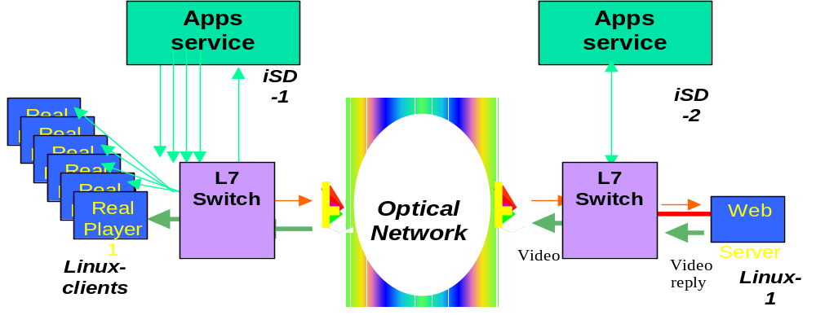
Example - Video Streaming across an Optical Domain

Slide 11


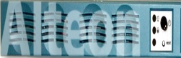
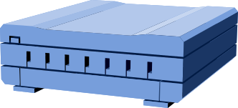
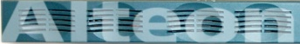
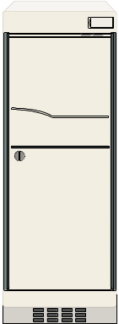

ALMunicast Test Setup
Alteon iSD
PCC
100 Base-T
Alteon 184
100Mbps
10Mbps
Real Server [Win NT 4.0]
10 Real Media Players[Linux,WIn95]

Slide 12
Alteon/iSD Platform
Active Services Platform
Active Services Platform
Active Services Platform
Active Services Platform
Computation
Active Services Platform
Active Services Platform
Up to 256 Linux based engines
SMDS
Intercepts selected flows and performs intelligent processing based on L2-L7 filtering
Forwarding
Users
Servers
The emphasis is on interception and
processing transparently. Entities at both
ends may not be aware of the existence of
the Alteon in the path

Slide 13
Setup/Operation
The setup with Alteon/iSD
  1 Real server on Linux or NT, 2~8 Real Players on Solaris
  Streaming Media Distribution Service (SMDS) on iSD
    Real Player RTSP request filter and interception
    Real Server reply real-time stream filter and replication
    RTSP session setup by replicating first 16 packets cached
SMDS service
rtsp://pcary1gc:5454/real8video
RTSP
intercept
Client
Register
Packet
Replicate
Real Player 2
iSD
Packet
Redirection
Alteon
Packet
Writeback
rtsp://pcary1gc/real8video
1st Client RTSP Request
Real Server 8
Real Player 1
Server reply
Sun/Solaris
Linux/X86

Slide 14
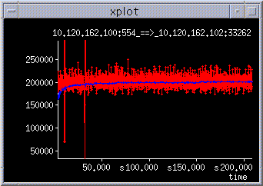
Streaming with one client
One stream, one client – 200KBps = 1.6Mbps

Slide 15
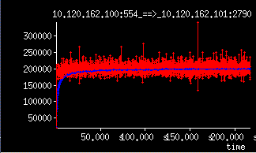
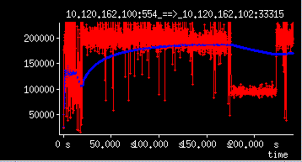
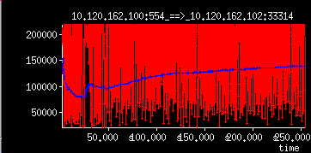
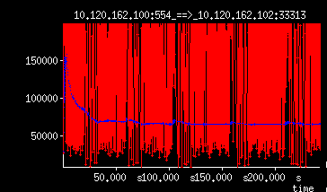
Streaming with 4 clients-without Multi-Unicast
(2)
(1)
(3)
(4)
Simultaneous 4 streams.
Degradation of throughput for each additional client

Slide 16
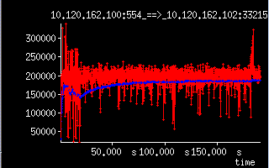
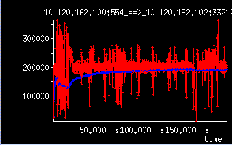
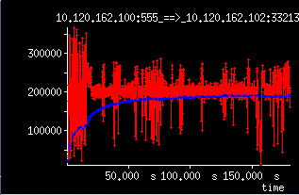
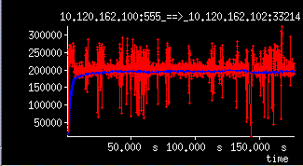
Streaming with 4 clients-with Multi-Unicast
(1)
(2)
(4)
(3)
Sustained throughput with Multi-Unicast
Provides QoS [BW] for each client

Slide 17
Conclusion and Future Work
Streaming Media is just one service on this architecture.
Programmable Intelligent Edge devices in this architecture can support
  Self Organizing Overlays
  Data Replication for any ALM scheme.
  Content-Aware services into the Network
Future Work
  Software API toolkit
  Scalability and performance enhancement via FPGA based hardware Acceleration
  For more Information - www.openetlab.org

Slide 18
Thank you!
Q&A

Slide 19
Backup Slides

Slide 20




Tunnel Multicast
☹
Bottleneck
!!!
R
1
S
1
☹
Bottleneck
!!!
-Content Apps at Access/Edge point
Auto-duplicate multiple content copies
No IP multicast protocol required
S
R
R
1
First mile
Access
Last mile
1
Access
Access
R
1
Access
1
2
3
1
1
R
R
1
Metro Core
Metro Core
R
Access
Access
Home
1
1
1
Hand
Optical core (Long-haul)
R
1
R
R
R
1
Access
1
Metro Core
☺
Enough BW
elsewhere !
Metro Core
Access
Access
Access
Access
R
R

Slide 21
Content-aware Service Gateway Hardware Architecture
Configurable
Resource
Module
FPGA
FPGA
Compute Element
MEM
CPU
Control
CE
CE
CE
CE
Link
Ctrl
Storage
Link Ctrl
Switch
Fabric
NI
NI
NI
NI
MEM
NPU
ASIC
ASIC
PHY
MEM
CPU
Network Interface
(PHY)
Link Ctrl

Slide 22
Performance Concerns
Delay from CMU to
Berk1 increases
Stan1
Gatech
Stan2
CMU
Berk2
Berk1
Duplicate Packets:
Bandwidth Wastage
Gatech
Stan1
CMU
Stan2
Berk1
Source: NARADA
Berk2

