Slide 1
    Open Java-Based
    Intelligent Agent Architecture
    for Adaptive Networking Devices
Tal Lavian,
Bay Architecture Lab
tlavian@IEEE.org
IEEE LAN/ MAN Banf 1998

Slide 2


Intelligent Agents
Intelligence
NMS
Device
Intelligent Agents -
Distribute the intelligence from NMS to the devices
IEEE LAN/ MAN Banf 1998

Slide 3
Secured Download of
Intelligent Agent-on-Demand
Security
Intelligent
Java Agent
On Demand
JVM
OS
HW
Network Device
IEEE LAN/ MAN Banf 1998

Slide 4
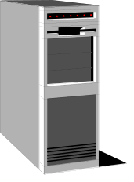


Technology Concept Proposal
“Reversed Applets”
Applet
Web Browser
Web Server
The JVM is in the Browser
Proposed technology is based on the concept of Reversed-Applets
Java Beans
Reversed Applets
The JVM is in the Device
NMS
IEEE LAN/ MAN Banf 1998

Slide 5
Secure new model
The new concept is to add new capabilities to devices securely
  No access out of the JVM space
  No pointers to harm the work
  Access only to the published API
  Verifier - only correct code can be loaded
  Class loader access list
    Different Applets with different access levels
  JVM has run time bounds, type, and executing checking
IEEE LAN/ MAN Banf 1998

Slide 6
Secure Download
Bean
Bean
Secure Download
JVM
Operating System
Device HW
IEEE LAN/ MAN Banf 1998

Slide 7
Sandbox Security
No access out of the Boundary
Sandbox Security
Other Device
Software
Bean
Bean
JVM
Operating System
Device HW
IEEE LAN/ MAN Banf 1998

Slide 8
Java Developer Kits
Compiler
Debugger
{
Applications
Applets
JAE
awt
io
Java Virtual Machine
net
util
lang
JavaOS
NT
Solaris
RT - OS
Others
IEEE LAN/ MAN Banf 1998

Slide 9
Open Device to New Features
New Features
App
Device App
Vendor API
Java Lib
{
awt
io
JRE
Java Virtual Machine
net
util
lang
JavaOS
NT
Solaris
RT-OS
Others
IEEE LAN/ MAN Banf 1998

Slide 10
Distributed Bean Implementation
Upload/Download
Beans
for
Policy
Mgmt
Digital signature
verifier
M-Beans
RMI
HTTP
SNMP
Certificate
Authority
Core Management Framework
Switch hardware and RTOS

Slide 11
New Protocol Adapter
New bean for New
implementation
Upload/Download
RMI
Java
Beans
M-Beans
HTTP
SNMP
SNMP
NEW
Core Management Framework
Java Server
JVM
New Protocol Adapter for
implementing NEW protocol
Switch hardware and RTOS

Slide 12

JMAPI Architecture
http
Http
server
JMAPI code
-applets
- Managed Objects
- Agent Objects
- Native Methods
Applets
Device Mngr
Notification Dispatcher
Managed Object Interface
RMI
Managed Object Factory
Java-enabled Browser
Managed Object Instance
Notification Interfaces
Browser User Interface
Managed Data Interfaces
Agent Object Interfaces
JDBC Interface
http
RMI
Admin Runtime Module
Agent Object Factory
Java Code
SNMP Agent)
Class Loader
Database
Library Loader
Network Device Switch / Router
IEEE LAN/ MAN Banf 1998

Slide 13
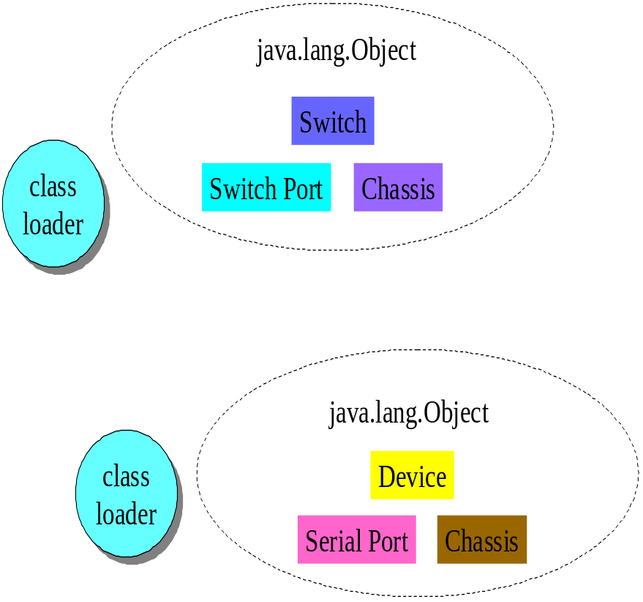
Each class loader in a JVM has its own name space.
Set of type names already loaded
Each name unique within name space
But not unique across name spaces
IEEE LAN/ MAN Banf 1998

Slide 14
2 Kinds of Class Loader
Class Loader
Primordial class loader -- part of VM implementation
Class loader objects -- part of Java application
Class Loader
Class Loader
Class Loader
Class Loader
Class Loader
objects on the heap
part of the JVM implementation
The primordial class loader
IEEE LAN/ MAN Banf 1998

Slide 15
Java Performance
Java is Slow!!
The memory requirements are high!
Java doesn’t fit to the data plane
Examples of using Java in the control plane
The performance is ok for Intelligent Agents
IEEE LAN/ MAN Banf 1998

Slide 16
Potential Applications
“Feature Plug-in” for devices.
Reusable software across devices.
New class of system level NMS applications in the form of distributed “Optlets”.
  Characterized by system applications that requires intensive interaction between NMS and device and/or across multiple devices.
  Potential applications are topology, design analysis, diagnostics, policy implementations.
IEEE LAN/ MAN Banf 1998

Slide 17
Benefits and Value
Enabling component of a new intelligent network architecture
  Distributed applications-on-demand.
  Component of AI (Artificial Intelligence) enabling infrastructure.
  Roaming diagnostics and self-healing capabilities.
IEEE LAN/ MAN Banf 1998

