Slide 1
Java SNMP Oplet
Tal Lavian

Slide 2
Goals
Portable across a range of devices
Extensible
Simple and convenient for client use
Consistent with SNMP model
Hide unnecessary SNMP details
Permit optimized access
Re-use MIB documentation

Slide 3
API Generation
Most of the Java code is generated automatically
ASN.1 MIB definitions are converted into Java classes
Documentation and commentary in the MIB definitions is placed as Javadoc formal comments
HTML documentation generated from Javadoc

Slide 4
MIB Objects
The MIB data model is structured as a tree
API represents MIB groups with Java classes
MIB variables are represented with accessor methods
Conceptual tables are represented with iterators
API converts SNMP data values into standard Java types

Slide 5
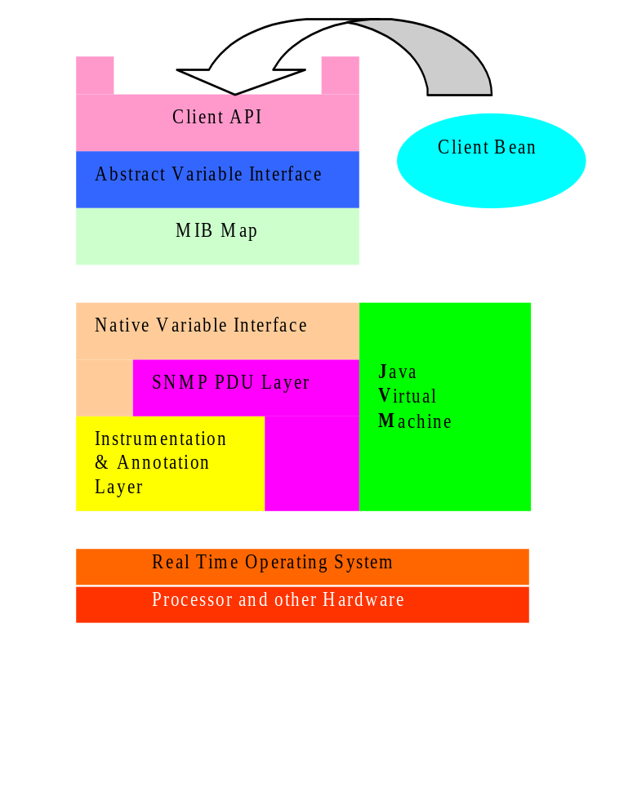
API Architecture

Slide 6
Variable access
API uses a MIB Map to dispatch requests to variable access routines
Different parts of the MIB tree can be serviced by different mechanisms
Two main schemes:
An ad hoc interface to the SNMP instrumentation layer
A generic SNMP loopback

Slide 7
Advantages of MIB map
Allows immediate generic implementation of the entire MIB via the loopback scheme
Enables optimized native implementation of key MIB variables for maximum efficiency
Permits definition of pseudo-MIB variables for extending MIB dynamically
Provides site for centralized access management

Slide 8



Proxy mode
Uses SNMP loopback mechanism to target a remote network element
API can be used to control devices that don’t have an embedded JVM
JSNMP API
Proxy mode
Java “Optlet”
SNMP
Cisco Router
with No JVM
JVM on PC
Java Server

