Slide 1
Lambda Data Grid
A Grid Computing Platform where Communication Function is in Balance with Computation and Storage
Tal Lavian

Slide 2
Outline of the presentation
Introduction to the problems
Aim and scope
Main contributions
  Lambda Grid architecture
  Network resource encapsulation
  Network schedule service
  Data-intensive applications
Testbed, implementation, performance evaluation
Issue for further research
Conclusion

Slide 3
Introduction
Growth of large, geographically dispersed research
  Use of simulations and computational science
  Vast increases in data generation by e-Science
Challenge: Scalability - “Peta” network capacity
Building a new grid-computing paradigm, which fully harnesses communication
  Like computation and storage
Knowledge plane: True viability of global VO

Slide 4
Lambda Data Grid Service
Lambda Data Grid Service architecture interacts with Cyber-infrastructure, and overcomes data limitations efficiently & effectively by:
  treating the “network” as a primary resource just like “storage” and “computation”
  treating the “network” as a “scheduled resource”
  relying upon a massive, dynamic transport infrastructure: Dynamic Optical Network

Slide 5
Motivation
New e-Science and its distributed architecture limitations
The Peta Line – PetaByte, PetaFlop, PetaBits/s
Growth of optical capacity
Transmission mismatch
Limitations of L3 and public networks for data-intensive e-Science

Slide 6
Three Fundamental Challenges
Challenge #1: Packet Switching – an inefficient solution for data- intensive applications
  Elephants and Mice
  Lightpath cut-through
  Statistical multiplexing
  Why not lightpath (circuit) switching?
Challenge #2: Grid Computing Managed Network Resources
  Abstract and encapsulate
  Grid networking
  Grid middleware for Dynamic Optical Provisioning
  Virtual Organization (VO) as reality
Challenge #3: Manage BIG Data Transfer for e-Science
  Visualization example

Slide 7
Aim and Scope
Build an architecture that can orchestrate network resources in conjunction with computation, data, storage, visualization, and unique sensors
  The creation of an effective network orchestration for e-Science applications, with vastly more capability than the public Internet
  Fundamental problems faced by e-Science research today requires a solution
Scope
  Concerns mainly with middleware and application interface
  Concerns with Grid Services
  Assumes an agile underlying Optical Network
  Pays little attention to packet switched networks

Slide 8
Major Contributions
Promote the network to a “First Class” resource citizen
Abstract and encapsulate the network resources into a set of Grid Services
Orchestrate end-to-end resources
Schedule network resources
Design and implement an Optical Grid prototype

Slide 9
Architecture for Grid Network services
This new architecture is necessary for
  Deploying Lambda switching in the underlying networks
  Encapsulating network resources into a set of Grid Network services
  Supporting data-intensive applications
Features of the architecture
  App layer for isolating network service users from complexity of the underlying network
  Middleware network resource layer for network service encapsulation
  Connectivity layer for communications

Slide 10
Architecture
Data-Intensive Applications
DTS API
Application
Middleware
Layer
Data
Transfer Service
Network Resource
Service
NRS Grid Service API
Network Resource
Middleware
Layer
Data
Handler
Service
Basic Network
Resource
Service
Network
Resource
Scheduler
Information Service
λ OGSI-ification API
Dynamic Lambda, Optical Burst, etc., Grid services
Connectivity and
Fabric Layers
Optical path control
Data
Center
λ₁
λ₁
Data
Center
λ_{n}
λ_{n}

Slide 11
Lambda Data Grid Architecture
Optical networks as a “first class” resource, similar to computation and storage resources
Orchestrate resources for data-intensive services, through dynamic optical networking
Date Transfer Service (DTS)
  presents an interface between the system and an application
  Client requests – balance resources - scheduling constrains
Network Resource Service (NRS)
  Resource management service
Grid Layered Architecture

Slide 12

BIRN Mouse Example
Mouse Applications
Net Grid
Apps
Middleware
Comp Grid
Lambda-
Data-Grid
DTS
GT4
Data Grid
NRS
WSRF/IF
Meta-
Scheduler
SRB
Control Plane
NMI
Network(s)
Resource Managers
C
S
D
V
I
S
D
S
S
Notes:
Application Engaged Networks
Allowing applications to place demands on the network (bandwidth, QoS, duration….)
Allowing applications to get visibility into network status
Full integration to ensure maximum value, performance

Slide 13
Network Resource Encapsulation
To make network resource a “first class resource” like CPU and storage resources that can be scheduled
Encapsulation is done by modularizing network functionality and providing proper interfaces

Slide 14
Data Management Service
Data Receiver
λ
Data Source
FTP client
FTP server
DMS
NRM
Client App

Slide 15
DTS - NRS
Apps mware I/F
Data calc
Data service
GT4 /IF
Replica service
NMI /IF
Proposal
evaluation
Scheduling logic
NRS I/F
DTS
DTS IF
Proposal constructor
Proposal evaluator
GT4 /IF
Net calc
Scheduling algorithm
NMI /IF
Scheduling service
Topology map
Optical control I/F
Network allocation
NRS

Slide 16
NRS Interface and Functionality
// Bind to an NRS service:
NRS = lookupNRS(address);
//Request cost function evaluation
request = {pathEndpointOneAddress,
pathEndpointTwoAddress,
duration,
startAfterDate,
endBeforeDate};
ticket = NRS.requestReservation(request);
// Inspect the ticket to determine success, and to find
the currently scheduled time:
ticket.display();
// The ticket may now be persisted and used
from another location
NRS.updateTicket(ticket);
// Inspect the ticket to see if the reservation’s scheduled time has changed, or verify that the job completed, with any relevant status information:
ticket.display();

Slide 17
Network schedule service – an example of use
Encapsulate it as another service at a level above the basic NRS

Slide 18
Example: Lightpath Scheduling
W
Request for 1/2 hour between 4:00 and 5:30 on Segment D granted to User W at 4:00
New request from User X for same segment for 1 hour between 3:30 and 5:00
Reschedule user W to 4:30; user X to 3:30. Everyone is happy.
3:30
4:00
4:30
5:00
5:30
X
3:30
4:00
4:30
5:00
5:30
W
X
3:30
4:00
4:30
5:00
5:30
Route allocated for a time slot; new request comes in; 1st route can be rescheduled for a later slot within window to accommodate new request

Slide 19
Scheduling Example - Reroute
A
B
Request for 1 hour between nodes A and B between 7:00 and 8:30 is granted using Segment X (and other segments) is granted for 7:00
New request for 2 hours between nodes C and D between 7:00 and 9:30 This route needs to use Segment X to be satisfied
Reroute the first request to take another path through the topology to free up Segment X for the 2nd request. Everyone is happy
X
C
7:00-8:30
D
Y
A
B
X
C
7:00-9:30
D
Route allocated; new request comes in for a segment in use; 1st route can be altered to use different path to allow 2nd to also be serviced in its time window

Slide 20
Scheduling - Time Value
Step
value
Level
value
time
time
value
Peak
value
Window
time
time
value
Increasing
value
Decreasing
time
time
Asymptotic
Increasing
Asymptotic
Increasing
value
value
time
time

Slide 21

Service Control Architecture
DATA GRID SERVICE PLANE
GRID Service Request
Service
Control
Service
Control
NETWORK SERVICE PLANE
Network Service Request
ODIN
OmniNet Control Plane
ODIN
Optical Control Network
UNI-N
UNI-N
Data
Path
Control
Data
Path
Control
Connection
Control
Data Transmission Plane
Data
Center
λ₁
λ₁
Data
storage
switch
λ_{n}
λ_{n}
L3 router
Data
Center
L2 switch
λ₁
λ_{n}
Data
Path

Slide 22
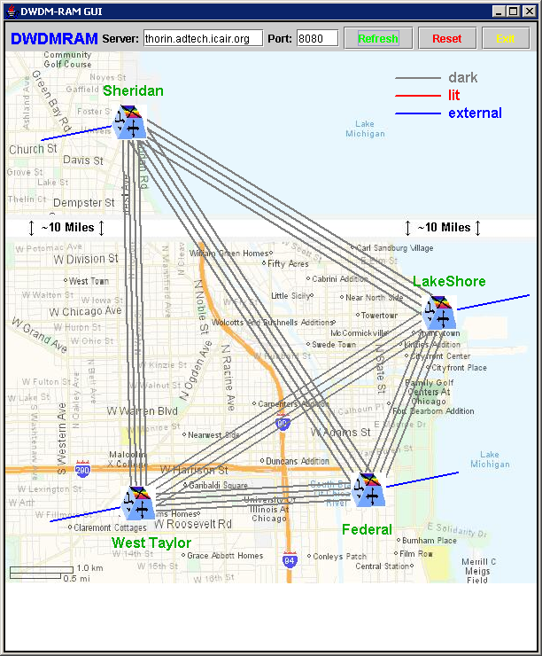
OMNI-View Lightpath Map

Slide 23
Experiments
Proof of concept between four nodes, two separate racks, about 10 meters
Grid Services - dynamically allocated 10Gbs Lambdas over four sites in the Chicago metro area, about 10km
Grid middleware - allocation and recovery of Lambdas between Amsterdam and Chicago, via NY and Canada, about 10,000km

Slide 24
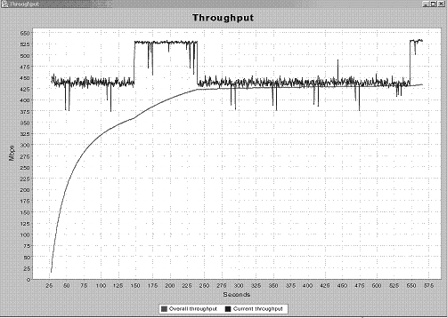
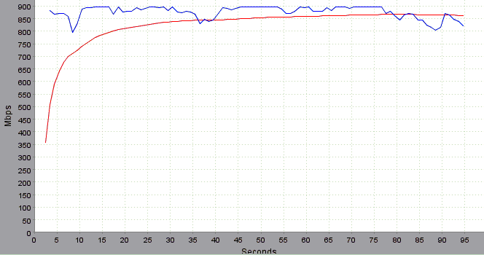
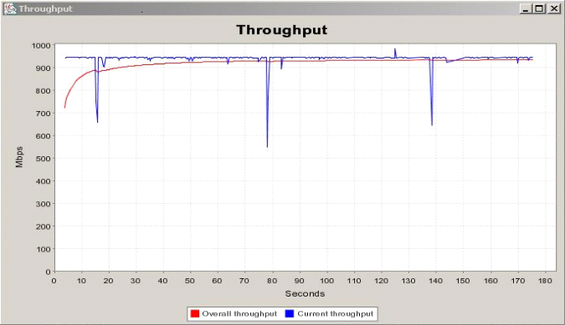
Results and Performance Evaluation
30 GB – Over OMNInet mem-to-mem
10 GB – Mem-to-mem –one rack
20 GB - Effective 920 Mbps

Slide 25
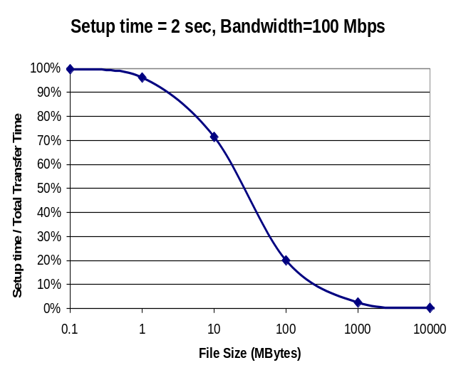
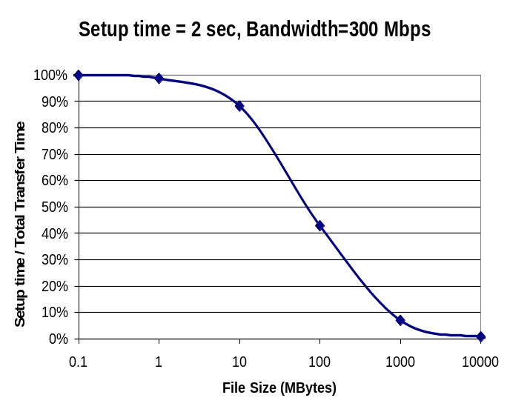
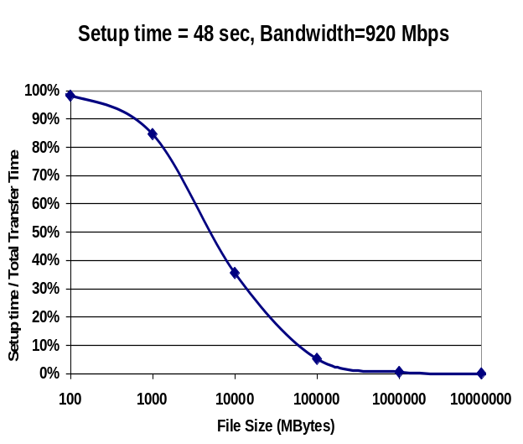
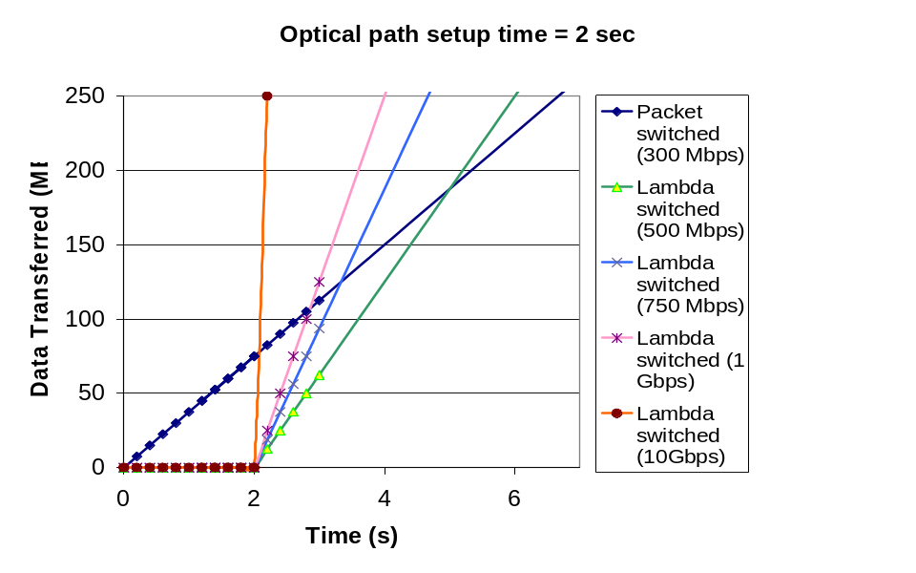
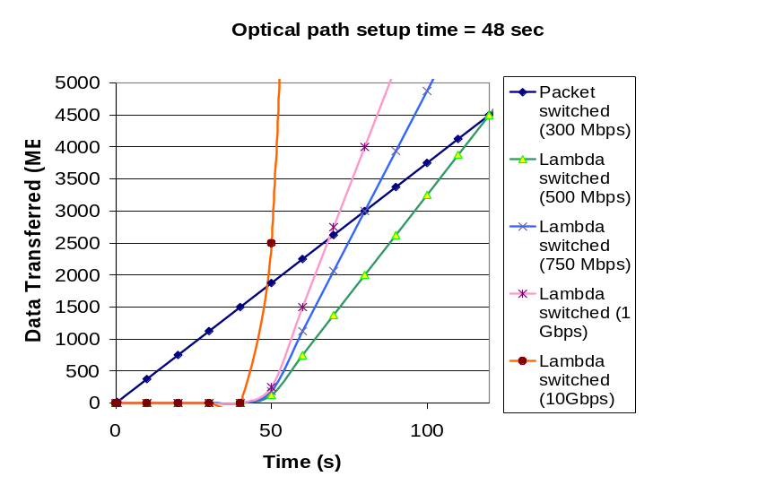
Results and Performance Evaluation
Overhead is Insignificant
1 GB
5 GB
500 GB

Slide 26
Super Computing CONTROL CHALLENGE
Chicago
Amsterdam
Application
Application
control
Services
Services
Services
control
AAA
AAA
AAA
AAA
LDG
LDG
LDG
LDG
data
data
OMNInet
Starlight
Netherlight
UvA
ODIN
SNMP
ASTN
finesse the control of bandwidth across multiple domains
while exploiting scalability and intra- , inter-domain fault recovery
through layering of a novel SOA upon legacy control planes and NEs

Slide 27
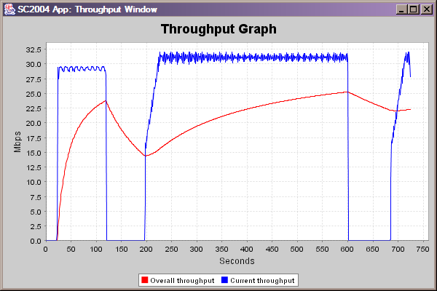
From 100 Days to 100 Seconds

Slide 28
Discussion: What I Have Done
Deploying optical infrastructure for each scientific institute or large experiment would be cost prohibitive, depleting any research budget
Unlike the Internet topology of “many-to-many”
  “few-to-few” architecture
LDG acquires knowledge of the communication requirements from applications, and builds the underlying cut-through connections to the right sites of an e-Science experiment
New optimization to waste bandwidth
  Last 30 years – bandwidth conservation
  Conserve bandwidth – waste computation (silicon)
  New idea – waste bandwidth

Slide 29
Discussion
Lambda Data Grid architecture yields data-intensive services that best exploits Dynamic Optical Networks
Network resources become actively managed, scheduled services
This approach maximizes the satisfaction of high-capacity users while yielding good overall utilization of resources
The service-centric approach is a foundation for new types of services

Slide 30
Conclusion - Promote the network to a first class resource citizen
The network is no longer a pipe; it is a part of the Grid computing instrumentation
it is not only an essential component of the Grid computing infrastructure but also an integral part of Grid applications
Design of VO in a Grid computing environment is accomplished and lightpath is the vehicle
  allowing dynamic lightpath connectivity while matching multiple and potentially conflicting application requirements, and addressing diverse distributed resources within a dynamic environment

Slide 31
Conclusion - Abstract and encapsulate the network resources into a set of Grid services
Encapsulation of lightpath and connection-oriented, end-to-end network resources into a stateful Grid service, while enabling on-demand, advanced reservation, and scheduled network services
Schema where abstractions are progressively and rigorously redefined at each layer
  avoids propagation of non-portable implementation-specific details between layers
  resulting schema of abstractions has general applicability

Slide 32
Conclusion- Orchestrate end-to-end resource
A key innovation is the ability to orchestrate heterogeneous communications resources among applications, computation, and storage
  across network technologies and administration domains

Slide 33
Conclusion- Schedule network resources
(wrong) Assumption that the network is available at all times, to any destination
  no longer accurate when dealing with big pipes
Statistical multiplexing will not work in cases of few-to-few immense data transfers
Built and demonstrated a system that allocates the network resources based on availability and scheduling of full pipes

Slide 34
Generalization and Future Direction for Research
Need to develop and build services on top of the base encapsulation
Lambda Grid concept can be generalized to other eScience apps which will enable new ways of doing scientific research where bandwidth is “infinite”
The new concept of network as a scheduled grid service presents new and exciting problems for investigation:
  New software systems that is optimized to waste bandwidth
    Network, protocols, algorithms, software, architectures, systems
  Lambda Distributed File System
  The network as Large Scale Distributed Computing
  Resource co/allocation and optimization with storage and computation
  Grid system architecture
  Enables new horizons for network optimization and Lambda scheduling
  The network a white box – optimal scheduling and algorithms

Slide 35
Thank You
The Future is Bright
Imagine the next 10 years
There are more questions than answers

Slide 36
Vision
  Lambda Data Grid provides the knowledge plane that allows e-Science applications to orchestrate enormous amounts of data over a dedicated Lightpath
    Resulting in the true viability of global VO
  This enhances science research by allowing large distributed teams to work efficiently, utilizing simulations and computational science as a third branch of research
    Understanding of the genome, DNA, proteins, and enzymes is prerequisite to modifying their properties and the advancement of synthetic biology

Slide 37
BIRN e-Science example
Application Scenario | Current | Network Issues
Pt – Pt Data Transfer of Multi-TB Data Sets | Copy from remote DB: Takes ~10 days (unpredictable) Store then copy/analyze | Want << 1 day << 1 hour, innovation for new bio-science Architecture forced to optimize BW utilization at cost of storage
Access multiple remote DB | N* Previous Scenario | Simultaneous connectivity to multiple sites Multi-domain Dynamic connectivity hard to manage Don’t know next connection needs
Remote instrument access (Radio-telescope) | Can’t be done from home research institute | Need fat unidirectional pipes Tight QoS requirements (jitter, delay, data loss)
Other Observations:
Not Feasible To Port Computation to Data
Delays Preclude Interactive Research: Copy, Then Analyze
Uncertain Transport Times Force A Sequential Process – Schedule Processing
After Data Has Arrived
No cooperation/interaction among Storage, Computation & Network Middlewares
Dynamic network allocation as part of Grid Workflow, allows for new scientific experiments that are not possible with today’s static allocation

Slide 38
Backup Slides

Slide 39
Control Interactions
Apps Middleware
DTS
Scientific workflow
Data Grid Service Plane
NMI
NRS
Network Service Plane
Resource managers
Optical Control Network
optical Control Plane
λ₁
λ₁
Storage
Compute
λ_{n}
λ_{n}
DB
λ₁
λ_{n}
Data Transmission Plane

Slide 40
New Idea - The “Network” is a Prime Resource for Large- Scale Distributed System
Computation
Visualization
Network
Person
Storage
Instrumentation
Integrated SW System Provide the “Glue”
Dynamic optical network as a fundamental Grid service in data-intensive Grid application, to be scheduled, to be managed and coordinated to support collaborative operations

Slide 41
New Idea-
From Super-computer to Super-network
In the past, computer processors were the fastest part
  peripheral bottlenecks
In the future optical networks will be the fastest part
  Computer, processor, storage, visualization, and instrumentation - slower "peripherals”
eScience Cyber-infrastructure focuses on computation, storage, data, analysis, Work Flow.
  The network is vital for better eScience

Slide 42
Conclusion
New middleware to manage dedicated optical network
  Integral to Grid middleware
Orchestration of dedicated networks for e-Science use only
Pioneer efforts in encapsulating the network resources into a Grid service
  accessible and schedulable through the enabling architecture
  opens up several exciting areas of research

