Slide 1
Enabling Active Flow Manipulation In Silicon-based Network Forwarding Engines
Tal Lavian - tlavian@Nortelnetworks.com
Phil Wang, Ramesh Durairaj, Jennifer Rasimas, Doan Hoang, Franco Travostino.
Nortel Networks, Advanced Technology Labs
Open Source - http://www.openetlab.org

Slide 2
Outline of the talk
AN technology Transfer
Issues in the realization of AN technologies
Main contributions of the paper.
Commercial Active Services Platform
Application Example 1 – SSL
Application Example 2 – ASF
A Demo Application
Next Generation Active Services Platform
Conclusion
Notes:
Here is the outline of the talk.
First I will identify several driving forces that led us in this direction of programmable networking
Next, I review some basic functionality of a routing network element.
Then I introduce our idea when we develop the AFM concept
I will describe a framework for which AFM can be applied
I will also describe several relevant examples using AFM and the platform
Finally I conclude with a hint of what we go from here.

Slide 3



AN Technology Transfer
Great Ideas
Active Nets Community
Active Nets Ideas
Usable/Realizable
Mechanisms/Products
Real
Active Services Products
Internet
Current
Technology
Scan the technology horizon
Notes:
To me as a researcher : to be able to implement several of our new congestion control algorithms on a real router.
For Nortel Networks: potential revenue generating direction by inventing and developing advanced technology/
By looking at the Internet from users’ perspective, service providers’ perspective and network providers’ perspective, we have identified several driving forces that steered us in this direction of research:
Users want intelligent services
Service providers want to differentiate their service and offer new services in: time to market, flexibility and by managing their services
Network Providers want to manage their services efficiently and economically. They want to sell, lease their resources at premium price.
They want to sell bandwidth on-demand, etc.

Slide 4
AN issues
Lack of industrial-strength Active Network devices that dispel major concerns:
AN requires substantial supports from a NOS
AN introduces substantial software component, hence delay on the data path
AN lacks adequate measures to addressing integrity and security of network devices.

Slide 5
Main contributions of the paper
Dynamically control ASICs and MEMs
Active Flow Manipulation Concept
  Flow abstraction
  Actions on Flows
  Control/Data separation
Openet Platform
  Commercial Network Devices
  Runtime Environment
  Active Services
Applications
Notes:
Above all we need programmability in network devices for introducing, enabling all kinds of intelligent services.
What we need : a framework, a platform independent API.

Slide 6
Active Flow Manipulation
A key enabling technology of Openet
Two abstractions
  Primitive flows
  Primitive actions
Customer network services exercise active network control
  Identifying specific flows
  Apply actions to alter network behavior in real-time
Policy
AFM
Filters
Filter
Action
Packet
Packet
Forwarding
Processor
Forwarding
Processor
AFM is well suited to work with underlying high-throughput ASICs
Packet
Notes:
Database of what to be done based on SLA
Database of possible filters of interests
AFM defines a set of primitive flows and operation to obtain composite flows
AFM defines a set of primitive actions
Flow and Action can form an algebra in the most general sense. One can actually design machine with this algebra.
The main interest is in identifying specific flows and applying actions to alter the behaviour in real-time.

Slide 7
L2-L7 Filtering Capability
Dynamic L2-L7 Filtering
Active Flow Manipulation
Source Address
Source Port
Destination Address
Destination Port
Protocol
VLAN
Diffserv Code Points
Content Filtering
Cookies Filtering
Flow redirection
Stop/Forward flow
Change DSCP field
Set VLAN priority
Adjust priority queue
Modify session table
Parsing request header
Parsing application contents

Slide 8
Openet: An active service platform
User Oplets
ANTS
Firewall, DiffServ
Application services
OpletService,
Shell, Logger
Standard Services
Function Services
Jcapture, HTTP,
IpPacket
ORE
JFWD
JVM
JNI/Native Code
MEM
CPU
…
Control Plane
Filtered packets
Monitor status
New forwarding rules
Data Plane
Forwarding Engine

Slide 9
Nortel Networks’ contributions to Active Services
Practical Active Services Architecture on real network device.
Commercial Active Services platform.
  ASF - Product
  SSL – Product
  Open Active Architecture for more product
  Alteon+iSD as a research platform
  L3 programmable routing switch PP8600 – used by research community
  Photonic Switch – Early prototype
Identify Active applications (more than Ping☺ )
  Active VPN – Carrier A
  Active fault diagnostic – Carrier A
  Active SLA reliability
  Active Extranet on Demand – CeNTIE- Media post production industry
  Early stages in disaster recovery and fault tolerant networks

Slide 10
Strong computation power inside network device.
Active Services Platform
Active Services Platform
Active Services Platform
Active Services Platform
Computation
Active Services Platform
Active Services Platform
Up to 256 Linux based engines
Active Services Platform
Intercepts selected flows and performs intelligent processing based on L2-L7 filtering
Forwarding
Users
Servers
The emphasis is on interception and
processing transparently. Entities at both
ends may not be aware of the existence of
the Alteon in the path

Slide 11
Alteon Switched Firewall (ASF)
A Real Product
Active Services
Runtime Environment
For Active Services
Active Service:
Policy Checking
AFM Flow (Req.)
Selection
AFM Action
on the data Flow
1
1st pkt
Servers
2
Data
data for the session

Slide 12
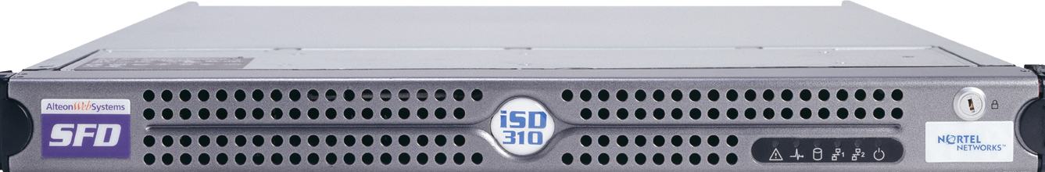
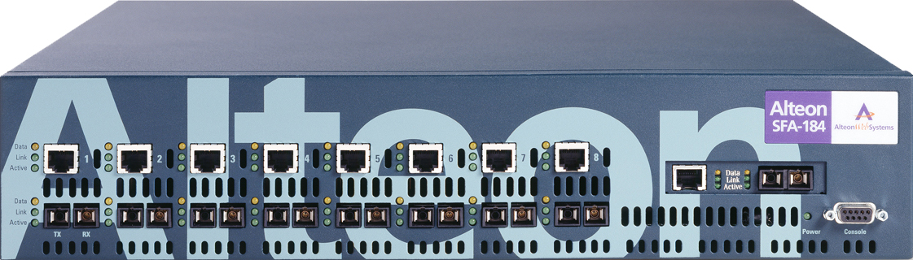
Alteon Switched Firewall (ASF)
A Real Product
Active Services
Active Service:
Policy Checking
Runtime Environment
For Active Services
AFM Flow
Selection
AFM Action
on the Flow
1
3
1
Add Conn.
Delete Conn. after UDP timeout if session is inactive
Servers
1
1st pkt
2
Data for the session

Slide 13

Secure XL & NAAP in Action TCP session
Policy Check
Alteon Switched Firewall (ASF)
1
Clients
1
1
3
5
6
7
Add Conn. (F2F)
Update Conn.
Update Conn.
Update Conn.
Delete Conn.
Servers
1
SYN
2
SYN/ACK
3
ACK
(TCP 3-way handshake complete)
4
TCP 3-way handshake complete, data for the session accelerated
5
FIN-1
6
FIN-2
7
ACK

Slide 14
ASF as an Active Service Technology
The Alteon selectively redirects new connection requests to the Alteon Switched Firewall Director to perform policy checking.
The Director runs the Check Point FireWall-1 engine as an Active Service.
The Active Service manages the connection table, specifies rules for handling packets in the session, passes the connection table to the Alteon Switched Accelerator.
90% of traffic is accelerated, supporting a throughput of 3.2 Gbps.

Slide 15
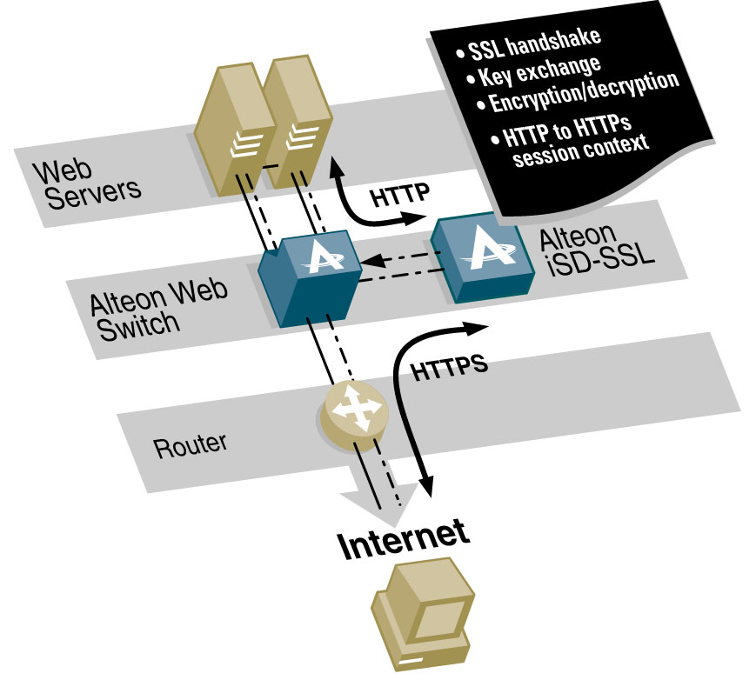
SSL Acceleration
How Does the iSD-SSL Accelerator work?
Client sends an HTTPS request
Switch redirects request on port 443 to iSD-SSL
iSD-SSL completes SSL handshake
iSD-SSL initiates HTTP connection to server on port 80
Switch selects real server based on configured LB policy
Server responds to HTTP request and replies to the iSD-SSL
iSD-SSL encrypts session and sends HTTPS response to client
HTTPS, SMTP-S, POP3-S and IMAP-S services
Notes:
iSD acts as a transparent proxy; source IP addresses are preserved.
Not only does it work with HTTP type of traffic but it can now also handle other protocols: Additional (besides HTTPS) virtual servers for SMTP-S and POP3-S and IMAP-S services are created. Each virtual SSL server listens to a specific TCP port and is mapped to a virtual (VIP) on the Web switch. Each server must be assigned a unique number.

Slide 16
SSL Acceleration Cont
Active Services
Runtime Environment
For Active Services
Encrypt
Decrypt
Policy
Check
Server
Selection
Conn.
Splice
AFM Flow (Req.)
Selection
AFM Action
on the data Flow
Servers
Data
Accelar
data for the session accelerated

Slide 17
Active Services: Surviving Disasters
Active Service Creation: With the right service platform and APIs, we were able to set the prototype in just few weeks
When a disaster strikes, there are a few seconds left to evacuate any and all data out of the disaster area. A huge bolus of data drops unannounced at the network edge
Data Evacuation
  Data collection (e.g., data since last backup, sensor data, top-secret data)
  Automated network setup and data transport
    Disaster sensor acts as service trigger
    Policy elements (e.g., what, where to)
    Secure data carriage
  Active control of both legacy and optical networks
    Cannot have all circuits to all potential disaster areas pinned all the time!
    Fast route setup, end-to-end. Bandwidth on demand
    Secure access to exclusive high-priority service (akin to GETS in telephony)
Data Recovery
  Service restoration from the safe site
  Active control of both optical and legacy networks
    Fast re-route setup
    Bandwidth and priority

Slide 18


Disaster Recovery concept
Active Services on 10GE All-Optical Switch
EvaQ8 OG -2
NAS
Control Mesg
Alteon
EvaQ8 OG - 1
Control Mesg
NAS
Nortel’s Active Services
NAS
NAS
8600
1G
1G
1G
B2
C
Y
Alteon
8600
MEMs
Switch
Prototype
B1
10G
B
B3
10G
NAS
1G
A
X
Normal App flow : Client X -> Server Z
Disaster Strikes at Location Z
EvaQ8 OG 3 sends a signal to OG1
OG1 instructs Photonic Switch to connect B2 & B3 ; Server Z and Server Y data syncd
On successful sync, OG2 instructs Photonic switch to connect B1->B2.
Service Restored for Client X ->server Y
8600
1G
1G
D
Z
NAS
Disaster Event/
Environ. Sensor
Alteon
EvaQ8 OG - 3

Slide 19

AN Collaboration:
CeNTIE – CSRIO- Nortel
Center for Networking Technologies for Information Economy (CeNTIE) - a CSIRO-led consortium including Nortel Networks, Amcom Telecommunications, the UNSW, UTS and the WA Interactive Virtual Environments Centre (IVEC).
www.centie.net
Tele-Health Focus Group
  Royal Australian College of Surgeons
  Medic Vision
  University of Sydney
  NSW Health
  Royal Prince Alfred
  Interactive Virtual Environment Centre (IVEC).
  Centre for Medical and Surgical Skills (CTEC).
Media Systems Focus Group
  Fox Studios
  Animal Logic
  GMD
  Film Industry Broadband Resource
  Ambience
  Enterprise (FIBRE)
  WAM!NET
  Australian Broadcasting Corporation (ABC)
  ScreenWest
Notes:
Tele-Health user information:
Medic Vision – an Australian organisation that commercializes Tele-Health applications (e.g. robotics)
University of Sydney: Chris Liddle (Doctorate of Pharmecology). Interest lies in Information Technology as it applies to health initiatives.
NSW Health: Representation from the group involved with Tele-health initiatives.
Royal Prince Alfred:
IVEC: organisations including CSIRO, University of Western Australia, Curtin University of Technology, Central TAFE.
Media Systems Information about user groups
Animal Logic: film Industry adds special effects.
GMD
Ambience:
FIBRE:
WAM!NET:
ABC
ScreenWest: constorium of companies based in Western Australia that work on film industry related activities.

Slide 20
Summary of Our Work
We have inspired ourselves to active networks concepts
Capable of dynamic monitoring, controlling and modification of ASICs and MEMs
Demonstrate Active Networks technology transfer through Nortel Active Services platform.
We have implemented programmable Gigabit Routing Switch (backplane 256 Gbs)
  New Active Services platform: Openet + Alteon + iSD
Active Services in the control plane (slows down in the data plane)
  AFM abstraction
The granularity is streams and not packets
  Short time granularity (part of apps and not human intervention, keyboard, telnet, cli, snmp)

Slide 21
Summary of Our Our Work (cont.)
Enabling New Types of intelligence on programmable network device to handle Infinite Bandwidth resources, Wire speed routing capability, and nontrivial Streaming media application.

Slide 22
OpenetLab – Nortel Networks: http://www.openetlab.org/
Q&A

Slide 23
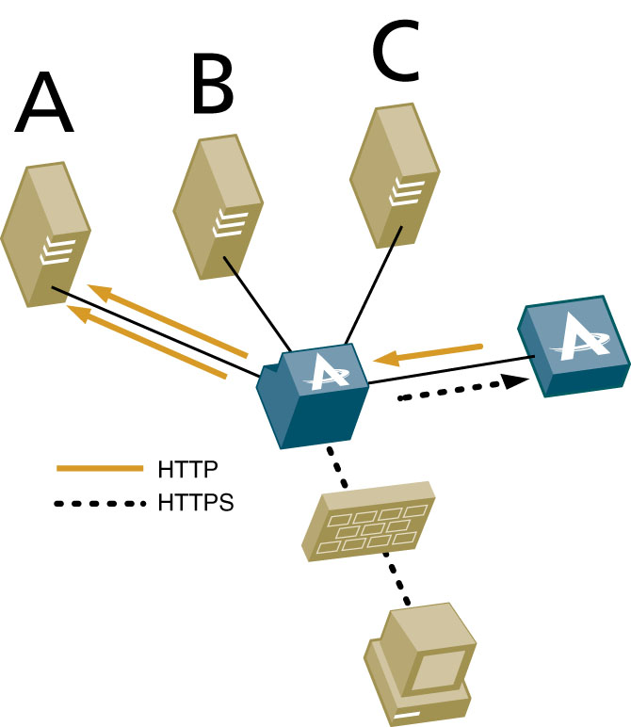

Client And Server Authentication
6
Send encrypted data to back end
Serves request/response
7
2
Sends server certificate
3
Requests client certificate
Private key
Confidential
Validates the client certificate info.
5
1
User opens session
4
Client sends the certificate with public key
Public key
Published
Notes:
This slide describes how the authentication is performed with an Alteon SSL Acceleration solution
This whole process enables authentication of both server and client through certificate and key verifications
Authenticating both clients and servers is a critical need for applications like B2B, extranets and financial. Not only the server has to identify itself to the client but also the user has to be identified for the transaction to be valid.
Authenticating servers only is sufficient in most B2C e-Commerce transactions because the customer has to be reassured about buying on a real and known site while the site does not care about who is buying as long as the credit card information are valid.

Slide 24
Strong computation power inside network device.
Load balance of iSDs (and servers)
iSD
iSD
iSD
iSD
Balancing iSDs
Intelligent Processing such
As Load Balancing, Optimizing
Bandwidth, Specialized services
Server
Server
Server
User connections
Server
Server
Server
Balancing servers
Connections terminate at the Alteon
Balancing can be based on
  load, or
  Functionality
Powerful generic processors do not have the filtering capability of the Alteon. That is
if they have to do the same thing as the Alteons, they have to do filtering in software, hence slow.
  An API is needed for exploring this filtering capacity

Slide 25
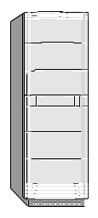



Content Re-route
Resource optimization (route 2)
  Alternative lightpath
Route to mirror sites (route 3)
  Lightpath setup failed
  Load balancing
  Long response time
    Congestion
    Fault
Route 3
Mirror Server
Route 2
Optical Ring
Route 1
Data Server

