Slide 1
Open Networking
Better Networking Through Programmability
Extensible Router Workshop
Princeton University
Tal Lavian
Nortel Networks Labs
tlavian@ieee.org
More info: http://www.openetlab.org

Slide 2
Usual Disclaimer
We are part of research organization
This talk describes exploratory research
No commitment by Nortel to turn technology into product.
No commitment by Nortel to do anything with ideas described in this talk.

Slide 3
Programmable Network Devices
Openly Programmable Devices Enable
New Types of Intelligence on the Network

Slide 4
Industry movement from vertical toward horizontal markets
Applications
OSs
Peripherals
Hardware
IBM
CDC
Digital
Amdel
1980s - Vertical Industry
2000s - Horizontal Industry

Slide 5
Incomplete transformation; the inflection point is quickly approaching …
Inflection Points Ahead of Us
Network &
Mgmt services
Embedded
OS
?
System
ASICs
Cisco
Nortel
Juniper
3Com
“00 Vertical Network Industry
Horizontal Network Industry

Slide 6
Location, location, location
Service-enablement will prove most effective where “impedance mismatches” occur in the network
  Optical vs. Wireline
  Wireline vs. wire-less
  Secure vs. non-secure
  Customer-premises vs. Content-provider-land
  SLA (x) vs. SLA (y)
  Resource-constrained vs. unwashed unlimited computing
A service-enabled box can wear multiple hats

Slide 7
Emancipation of a Router
Proprietary
Apps
Proprietary
NOS
ASICs/Processors
It all started from old-world, vertically-integrated code.

Slide 8
1st Degree of Emancipation
1
N
Routing
N
k
Protocol
r
M
o
1
w
e
O
m
Management
N
a
r
System
F
Interface
s
C
Manager
Agents
O
e
1
c
i
N
v
r
e
1
N
S
Routing
m
Table
e
t
Manager
s
y
M
S
C
M
Forwarding Engine
Forwarding Engine
Interface
FC
FM
ASICs/Processors
Introverted APIs Emerge.
Modular code is native, local, and trusted. port required.

Slide 9
2nd Degree of Emancipation
ISV’s Software
Extroverted APIs
APIs
1
N
k
Routing
N
r
Protocol
o
M
1
w
e
O
m
N
a
Management
r
F
System
Interface
Introverted APIs
s
Agents
e
C
Manager
O
c
1
i
v
N
r
e
1
S
Routing
N
m
Table
e
t
s
Manager
y
M
S
C
M
Forwarding Engine
Forwarding Engine
Interface
FC
FM
ASICs/Processors
Extroverted APIs expose object capabilities to ISV code.
Notes:
ISV code is a local, native, and trusted DLL; seems like there was an extra period before DLL. I took it out.

Slide 10
3th Degree of Emancipation
ISV’s Software
JAPIs
Extroverted APIs
JVM
APIs
1
N
k
Routing
N
r
Protocol
o
M
1
w
e
m
O
N
a
Management
r
Introverted APIs
F
System
Interface
s
e
C
Manager
Agents
O
c
1
i
v
N
r
e
S
Routing
1
N
m
e
Table
t
s
Manager
y
S
C
M
M
Forwarding Engine
Forwarding Engine
Interface
FC
FM
ASICs/Processors
Extroverted APIs extend a commodity Java runtime.

Slide 11
4th Degree of Emancipation
ISV’s Software
ISV’s Software
ISV’s Software
JAPIs
Extroverted APIs
JVM
APIs
1
N
k
Routing
N
r
Protocol
o
M
1
w
e
m
O
N
a
Management
r
Introverted APIs
F
System
Interface
s
e
C
Manager
Agents
O
c
1
i
v
N
r
e
S
Routing
1
N
m
e
Table
t
s
Manager
y
S
C
M
M
Forwarding Engine
Forwarding Engine
Interface
FC
FM
ASICs/Processors
ISV code is local/non-local, non-native, non-trusted, loaded on demand, and can teleport itself.

Slide 12
Java-enabled Device Architecture
Download
Oplet
Oplet
Oplet
Oplet
Native APIs
Oplet Runtime Env
Routing Code
JVM
Operation System
Hardware

Slide 13
Example: Downloading Intelligence
Monitor
Security
Intelligence
Authentication
Dynamic
loading
application
React
JVM
OS
HW
Network Device

Slide 14
Separation of Control and
Forwarding Planes
Centralized,
CPU-based Router
Forwarding-Processors
Based Router
Routing
SW
Control
Plane
CPU
CPU
Forwarding
Processor
Forwarding
Processor
Forwarding
Processor
Slow
Wire Speed
Control + Forwarding
Functions combined
Control separated
from forwarding

Slide 15
Programmable Networking
Network Services
ORE
JFWD
Control Plane
CPU System
Filtered packets
New rules
Switching Fabric
Forwarding Plane
(Wire Speed Forwarding)
Forwarding
Rules
Forwarding
Rules
Forwarding
Rules
. . .
Forwarding
Processor
Forwarding
Processor
Forwarding
Processor
Statistics
&Monitors
Statistics
&Monitors
Statistics
&Monitors
Traffic Packets

Slide 16

But Java is Slooowwwww
Not appropriate in the fast-path data forwarding plane
  forwarding is done by ASICs
  packet processing not affected
Java applications run on the CPU
  Packets designated for Java application are pushed into the control plane

Slide 17
Simple Example: Fine grain monitoring
Imagine a SNMP-based network with:
  100 nodes
  each node with 100 ports
  each port with 100 conditions
  all being checked 100 times a second
That’s 10 billion SNMP variable accesses every second.
And that’s a significant load on the NMS and the network as a whole. It’s not going to work.

Slide 18
Silicon-based Forwarding Engines
Control
Plane
CPU
Switching Fabric
Wire Speed
Forwarding
Forwarding
Rules
Forwarding
Rules
Forwarding
Rules
. . .
Forwarding
Processor
Forwarding
Processor
Forwarding
Processor
Statistics
&Monitors
Statistics
&Monitors
Statistics
&Monitors

Slide 19
Real-time Forwarding Stats and Monitors
Apps
CPU
Forwarding
Rules
Forwarding
Rules
Forwarding
Rules
Forwarding
Processor
Forwarding
Processor
Forwarding
Processor
Statistics
&Monitors
Statistics
&Monitors
Statistics
&Monitors
SW
HW

Slide 20
ORE Architecture
Oplets
Firewall, DiffServ
User-defined services
OpletService,
Shell, Logger
Standard Services
Function Services
Jcapture, HTTP,
IpPacket
ORE
JFWD
JVM
JNI/Native Code
MEM
CPU
…
Filtered packets
Monitor status
New forwarding rules
Forwarding Engine

Slide 21
ORE - Oplet Run-time Environment
Oplet 1
Oplet 2
Service A
Service B
Service C
Why ORE?
ORE
JVM

Slide 22
Basic ORE Concepts
Oplet Runtime Environment (ORE)
  A kernel that manages the life cycle of oplets and services
  Provides a registry of services
Services
  The value being added. Minimal constraint, could be anything
  Represented as a Java interface
Oplets
  The unit of deployment: a JAR file
  Contains meta-data (e.g. signatures, dependency declarations)
  Contains services and other resources (data files, images, properties, JAR files)

Slide 23
Oplet Lifecycle
Install
  Loaded from URL
Start
  Services that are depended on must already be started
Stop
  Any oplets that depend on this oplet’s services will be stopped
  Code and data can be unloaded from ORE
Update
  Updates the oplet with a new oplet
Uninstall

Slide 24
Dynamic Classification Objectives
Implement flow performance enhancement mechanisms without introducing software into data forwarding path
  Service defined packet processing in a silicon-based forwarding engine
  Dynamic packet classifier
Rob Jaeger, Jeff Hollingsworth, Bobby Bhattacharjee - University of Maryland

Slide 25
Dynamic - On the Fly Configuration
Policy
Dynamic Apps
Filters
Filter
Packet
Packet
Forwarding
Processor
Forwarding
Processor
Packet

Slide 26
Experimental Setup
Source 1
tcp_send()
Acclear
1100B
Routing
Switch
100 Mbps
Destination
1. tcp_recv()
2. tcp_recv()
100 Mbps
Source 2
tcp_send()
100 Mbps

Slide 27
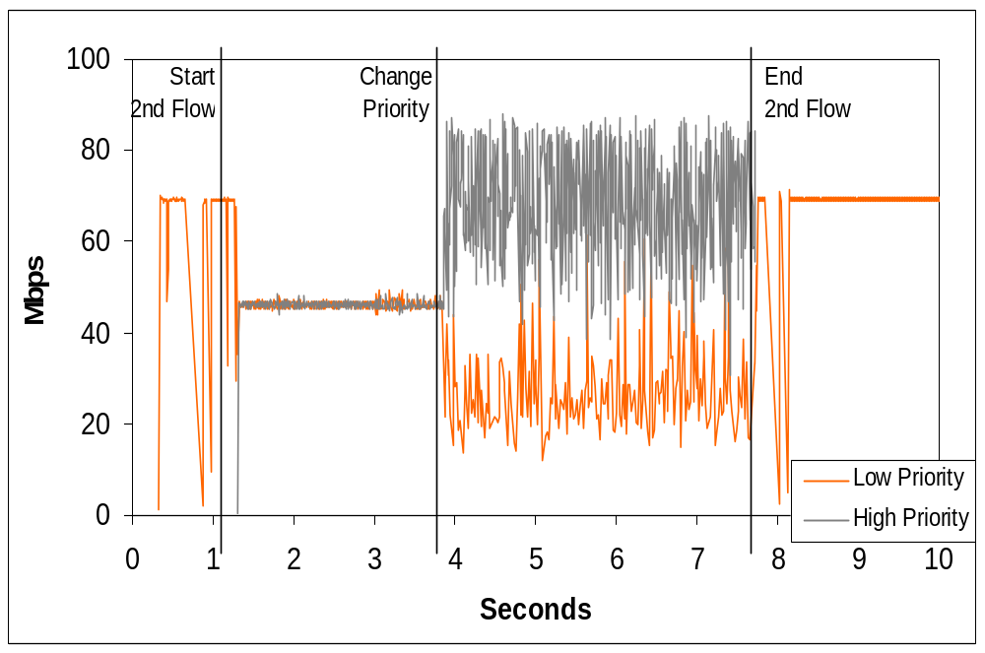

Slide 28
Dynamic Classification
Identify real-time flows (e.g. packet signature/flowId )
  Use CarbonCopy filters to deliver multimedia control protocols to control plane
    e.g. SIP, H.323. RTCP
    Determine dynamically assigned ports from control msgs
  Use CarbonCopy filters to sample a number of packets from the physical port and identify RTP packets/signature
Set a packet processing filter for packet signature to:
  adjust DS-byte OR
  adjust priority queue

Slide 29
5-tuple Filtering List
Source Address
Source Port
Destination Address
Destination Port
Protocol

Slide 30
JFWD 5-tuple Filtering
Copy the packet to the control plane
Don't forward the packet
Set TOS field
Set VLAN priority
Adjust priority queue

Slide 31
Dynamic Classification
Without introducing software into data path we performed Dynamic Classification of flows in a Silicon-Based Gigabit Routing Switch
  Introduced a new service to a Gigabit Routing Switch
  Identified real-time flows
  Performed policy-based flow behavior classification
  Adjusted DS-byte value
  Showed that flow performance can be improved

Slide 32
Nortel’s Openet.lab
It’s an incubator for service-enabled network nodes and sample services
It provides:
  JVM-emancipated prototypes of Nortel routers
  Java APIs to MIBs
  Java APIs to Forwarding Planes, packet capturing
  A runtime environment for downloaded code
Free downloads from http://www.openetlab.org
Notes:
Forwarding Planes: capitalized?

Slide 33

Closing remark
Wright brothers 1904
Back then, thrust wasn’t a problem; control was.
Likewise, network bandwidth isn’t the problem, control is. It demands our collective efforts
Notes:
Back then, thrust wasn’t a problem; control was
Likewise, network bandwidth growth is just fine; control does demand our collective efforts
This is a great idea for a close. You might try rewording it to something like this:
Back then, thrust wasn’t a problem, control was.
Likewise, network bandwidth isn’t the problem, control is;
it demands our collective efforts.

Slide 34
Q&A
Notes:
Projects to fund

Slide 35
Appendix

Slide 36
Multiple points of view
It is possible for node A to lose network “visibility” to node B, even though the NMS has visibility to both
The NMS is the traditional PoV for observing the network
Being able to move the management PoV out of the NMS and into the managed nodes would help
A
B
NMS

Slide 37
Mobile diagnostics
Similar to multiple points of view
Blocking DoS at ingress into the network is best
Inject mobile agent into the network at the node where the DoS is first detected
The agent moves from node to node towards the DoS traffic source
A bit like an immune system ☺

Slide 38

Active Intrusion Detection
Intruder is identified by Intrusion Detection software
Intruder signature is identified
Mobile agent is dispatched in direction of intruder (based on physical port of entry)
Mobile agent “chases” and terminates intruder (shuts down link, reboot host, notify NMS)

Slide 39
Diagnostic Mobile Agents
Automatic trace-route from edge router where problem exists
  Each node reached generates a report to NMS
  Trace-route code “moves” to next node in path
  Mobile agents identify router health
  Create logs for NMS

Slide 40
Apps - Routing Relationship
Extensive access
to internal resources
Download Oplet Service to the router.
Monitor router locally
Report “events” to App server
Allow Service to take action
Download application
Adjust parameters based on direction from app server
App
Server
Monitor
Download
Complex Condition
Exceeded
Appropriate
Application
Download
router

Slide 41

Collaboration with Applications
New paradigm of distributed applications
Network devices collaborating with applications
Application aware routing
Apps Server
Oplet
Oplet
Apps
Apps
RMI, XML, CORBA
JVM
JVM
Routers
Switches
Servers

Slide 42

Router Server Collaboration
Supports distributed computing applications in which network devices participate
  router to router
  server to router
Supports Intelligent Agents
Supports Mobile Agents
Java-based
Application
Java-based
Application
Java-based
Application

Slide 43
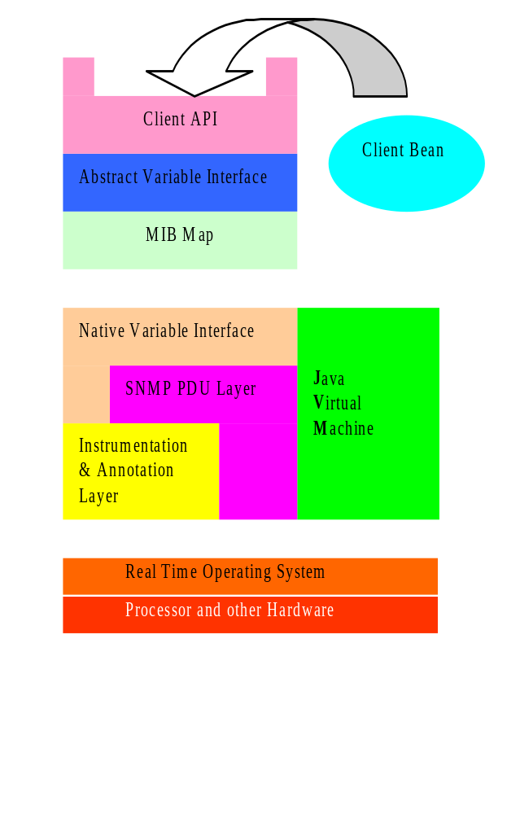
MIB API Example
API uses a MIB Map to dispatch requests to variable access routines
Different parts of the MIB tree can be serviced by different mechanisms
Two main schemes:
  An ad hoc interface to the SNMP instrumentation layer
  A generic SNMP loopback
Notes:
I indented your two main schemes.

Slide 44

Strong Security in the New Model
The new concept is secure to add 3rd party code to network devices
  Digital Signature
  Administrative “Certified Optlet”
  No access out of the JVM space
  No pointers that can do harm
  Access only to the published API
  Verifier - only correct code can be loaded
  Class loader access list
  JVM has run time bounds, type, and execution checking

