Slide 1
Open Distributed Networking Intelligence: A New Java Paradigm
Tal Lavian

Slide 2
Agenda
Openness - Virtual community development, Domain experts
Architecture and technology concepts
Intelligent distributed applications
Demos:
  JEND’s JVM’s, ORE
  Java Oplet
  XML on router
Summary

Slide 3
Vision
Transfer Intelligence to network devices
Programmable network devices
Virtual community of developers
Domain experts bundle Intelligent network devices as part of their solutions
New era of innovation for startups

Slide 4
Change the Name of the Game
Openness
In the current routing market we have to change the name of the game
It will enable technology leapfrog
Programmable devices creates a Paradigm shift
Open Architecture is an excellent technology and direction
Request: Open Architecture
Java appeals to the market & customers

Slide 5
Openness

Slide 6
Why an Open Architecture?
Unparalleled customization capabilities
Dynamic delivery of new services
The network adapts itself to users needs, not the other way around
3rd party developers - create innovative services and applications
HW & OS independent. can migrate to new HW and SW => Investment protection

Slide 7
Benefits
Network PC-ification
Intelligent vs Dumb Devices
Open vs Proprietary
1,000,000 Java programmers
Revolutionize the network
IEEE 1520 - programmable networks: Service Providers, Enterprises, request programmability

Slide 8
Evolution vs. Revolution
Performance /
Enhancement
E-Commences
XML
Last Mile
56k-->10Mb
Logarithmic
Net
10G
Web
Net SW
Intelligence
Dynamic
HW
1G
100M
Static Net SW
10M
Now
Time

Slide 9
The Web changes everything
Large demand bandwidth from web and multimedia applications
Huge LAN bandwidth compared to limited WAN bandwidth
New direction of networked applications
Global village - distributed business and computation environment
More business processes become network-centric and web-centric
Need for programmable
Intelligent network
Notes:
The Internet is changing the world in ways we never imagined, yet it’s full potential is far from being realized. Today if you do not have a presence on the Web you become virtually invisible. Imagine not having a web site!
The web is changing the way people entertain themselves, the way we learn and the way we do business.
It’s affecting everything!

Slide 10














The new networked world
email
Push
Technologies
smtp
pop3
Telephony
Applications
More Users
Network
Computers
Web TV
voice messaging
IP Network
Internet
Telephony
Firewalls
Supply chain
management
E-commerce
Extranets
Search
Engines
Protocols
&
Standards
Richer Content
Multicast
MPEG
Streaming Video
Need for Intelligent Network utilizing the network capabilities Today, the network is used as transparent media
Notes:
A: NO WAY!
Service providers care about apps users consider valuable
IS cares about ensuring bandwidth for apps that impact profits
pace of change. Today, there are literally ‘000s of companies developing products and services that are converging on a single protocol, IP.
Waterfall (Tsunami) of new applications rich with content containing data, voice and video.
This whole mix will only be exacerbated by adding telephony and video applications…..
It should be obvious that new thinking is needed - QUICK!

Slide 11
Users need a new kind of ‘net
Need for device programmability:
Distributed apps
E-commerce
Web centric
Business apps
Personal networking
Accelerating business velocity
Mass customization
Enabled by a new infrastructure
New net
Value
Email
File transfer
Web
1985 1990 1995 2000 2005
time
And a new kind of thinking...
Notes:
Users - enterprise and consumers need something more!
New categories of applications centered around:
Interpersonal communications
accelerating business velocity
Tailoring content to suit individuals
These types of applications require a new infrastructure and a new kind of thinking….

Slide 12
Benefits
Breakaway business strategy for creation of value over network elements
Positioning of open standards versus proprietary designs - market acceptance
Faster TTM for software development
Unparalleled support and maintenance capabilities
PC-ification - broad adoption

Slide 13
Community Openness
Success stories by large community of developers
Net-Based developers’ communities
  Linux, GNU, Apache, BSD, X-Windows, Perl, Tk/Tcl
  Netscape browser, NFS, JDK, JVM
Linux success:
  Compaq, HP, IBM, SUN and SGI
  Intel, Sparc64, Alpha, PowerPC
The Web Changes everything
  Java, XML, E-Business

Slide 14
Technology

Slide 15
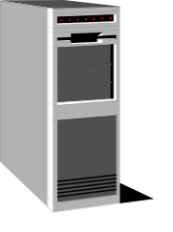



Technology Concept
“Reversed Applets”
Applet
Web Browser
Web Server
The JVM is in the Browser
Technology is based on the concept of Reversed-Applets
Java Beans
Oplets
Reversed Applets
Server
The JVM is in the Device

Slide 16
Why Aren’t The Current Interfaces Sufficient?
There are two main management interfaces to most devices:
  SNMP
  CLI
Web/HTTP is typically just a MIB viewer/manipulator
  “Collapsed SNMP”

Slide 17
SNMP Is Data Driven
SNMP = MIB + side effects + get/set protocol
SNMP is not executable
  As defined, you can’t really script it
  You can script things like Perl and have them do SNMP for you
You can only manipulate MIB objects that are supported
SNMP apps can’t run on the device itself
  Requires separate server
SNMP requires polling
  Eats up net bandwidth
Example: You can’t write a custom CLI login authentication module easily using SNMP
  Perhaps you could with a bunch of traps and such but it would be really ugly

Slide 18
SNMP and CLI Summary
SNMP is not a Turing Machine
CLI could be made into a Turing Machine, but the implementation is ugly and you still couldn’t implement all that you wanted very easily

Slide 19
Desired Solution
Customer-specific functionality
VAR provided functionality
extension functionality
3rd party functionality
Router Run-time

Slide 20
Possible Customer/VAR Applications
Advanced SNMP monitoring and trap generation
  Eliminate polling, generate custom traps or system log messages
“Pluggable” remote authentication systems
  People want different things: LDAP (who’s schema), Security Dynamics, TACACS, etc.
Custom CLI commands or web management screens
Custom accounting interface
Custom asset management
Generated MIB extensions for SNMP
Runtime image file distribution for upgrades
VARs can add a lot of system value tying things together

Slide 21
Possible Applications
INM can download advanced network management functions dynamically
  Might download a diagnosis module after determining a fault
In-field upgrades
  New algorithms
  Dynamic downloads via the Internet
Custom “glue” written by different divisions to create a more cohesive solution

Slide 22
Dynamic ORE Adapters and Oplets
NEW
XML
SNMP
RMI
HTTP
IIOP
XML Bean
Oplet Bean
Oplet Bean
Java Bean
Java Bean
Java Bean
Java Bean
ORE Manageable Service Beans

Slide 23
Enabling New Concepts

Slide 24


Java MIB API - Proxy Mode
Uses SNMP loopback mechanism to target a remote network element
API can be used to control devices that don’t have an embedded JVM
JSNMP API
Proxy mode
Java Oplet
Application
Servers
JVM on PC
Router with No JVM

Slide 25
Collaboration with Business Applications
New paradigm of distributed applications
Network devices collaborating with business applications
Apps Server
Oplet
Oplet
Apps
Apps
RMI, XML, CORBA
JVM
JVM
Oracle DB
E-Commerce
Business apps
SAP , ERP,
Optivity
Accelar
Passport
BayRS

Slide 26

Mobile Agents
Jumping Java Beans across the network
Oplet
Oplet
Oplet
Oplet
Oplet

Slide 27
Network Devices Collaboration
Distribution application across network devices
JVM +ORE
JVM +ORE
RMI, CORBA,XML
JVM +ORE
Accelar
PBX
JVM +ORE
JVM +ORE
ARN, BLN,
BFR, BAC
Passport
Accelar

Slide 28
Summary
Openness - successfully proven paradigm
Domain experts - virtual developers community
Allows innovations and added value
Dynamic Loading
Dynamic agents vs static agents
Strong Security
New capabilities - XML example
An enabling-technology

Slide 29
Appendix A:
Strong Security in the New Model
The new concept is secure to add 3rd party code to network devices
  Digital Signature
  “Certified Oplet”
  No access out of the JVM space
  No pointers to damage the work
  Access only to the published API
  Verifier - only correct code can be loaded
  Class loader access list
    Different Oplets with different access levels
  JVM has run time bounds, type, and executing checking

Slide 30
Old model Security (C/C++)
Old model - Not secure to add 3rd party code
  Not recommended to add 3rd party code to network devices
  Dangerous, C/C++ Pointers
    Can touch sensitive memory location
  Risk: Memory allocations and free
    Allocation without freeing
    Free without allocation (core dump !!!! )
Limited security in SNMP

Slide 31
Appendix B:
Java SNMP MIB API
Portable across a range of network devices
Extendible
Simple and convenient for client use
Consistent with SNMP model
Hides unnecessary SNMP details
Permits optimized access
Re-use MIB documentation

Slide 32
MIB API Generation
Most of the Java code is generated automatically
ASN.1 MIB definitions are converted into Java classes
Documentation and commentary in the MIB definitions is placed as Javadoc formal comments
HTML documentation generated from Javadoc

Slide 33
MIB Objects
The MIB data model is structured as a tree
API represents MIB groups with Java classes
MIB variables are represented with accessor methods
Conceptual tables are represented with iterators
API converts SNMP data values into standard Java types

Slide 34
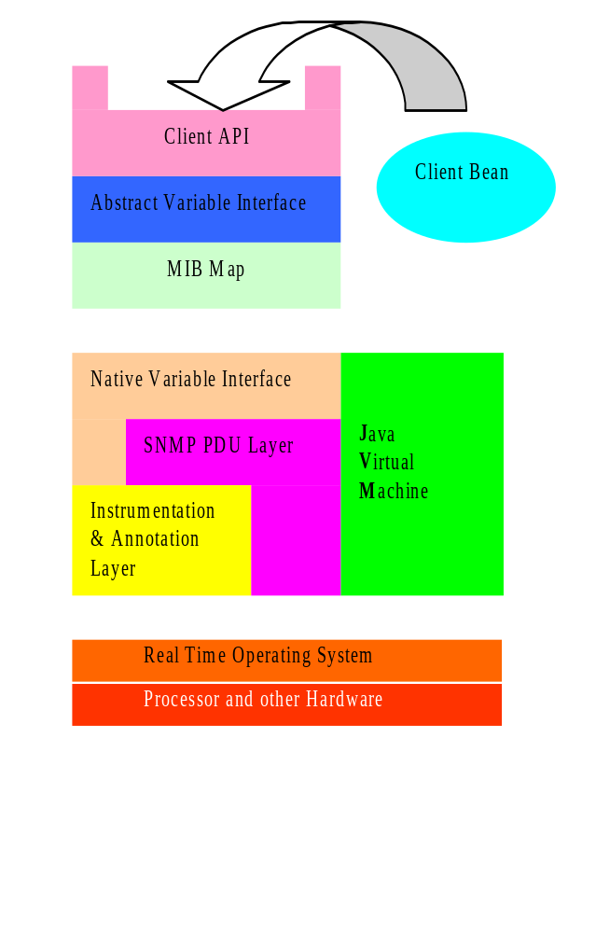
JSNMP MIB API Architecture
API uses a MIB Map to dispatch requests to variable access routines
Different parts of the MIB tree can be serviced by different mechanisms
Two main schemes:
An ad hoc interface to the SNMP instrumentation layer
A generic SNMP loopback

Slide 35
Advantages of MIB map
Allows immediate generic implementation of the entire MIB via the loopback scheme
Enables optimized native implementation of key MIB variables for maximum efficiency
Permits definition of pseudo-MIB variables for extending MIB dynamically
Provides site for centralized access management

