Slide 1
A Combined Effort of
OptiCal & LUMOS NETWORKS
EE 290Q
Lukas Chrostowski, Carlos Mateus, Fan Mo, Lixia Zhou

Slide 2
Metro Ring
Demand Set in OC48:
3 km
A B C D E F
A
A x 8 25 0 0 0
15 km
B
B x x 5 15 1 1
C x x x 5 10 10
D x x x x 5 5
30 km
F
E x x x x x 15
Fiber is standard Corning SMF-28 fiber (dispersion and loss info given in class and HW before)
Total length = 118km
Longest link = 115km
Amplifier can be for 4 or limited number of channels at lower price (use linear scale)
Free to use LumiPhase price list or ask for more
10 km
C
E
20 km
40 km
D

Slide 3
Advantage of STS-48
Group velocity dispersion can be ignored:
  Maximum eye closure = 0.09*238*115*0.02*2.5*0.01 = 0.123
  (for longest link of 115km)
Increased minimum sensitivity of receiver made EDFA unnecessary.

Slide 4
General Design Rule
BLSR/4 is deployed.
Traffic is routed on the shortest path between two nodes in the ring.
Wavelength assignment is done according to maximum load principle.
Power budget is carefully managed in order to maintain the SNR at the receiver.
Span failure protection is realized by 1:1 line protection.

Slide 5
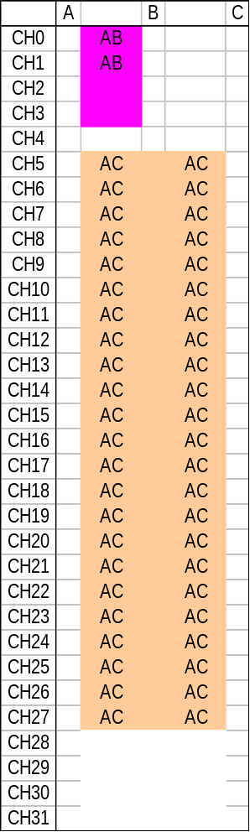
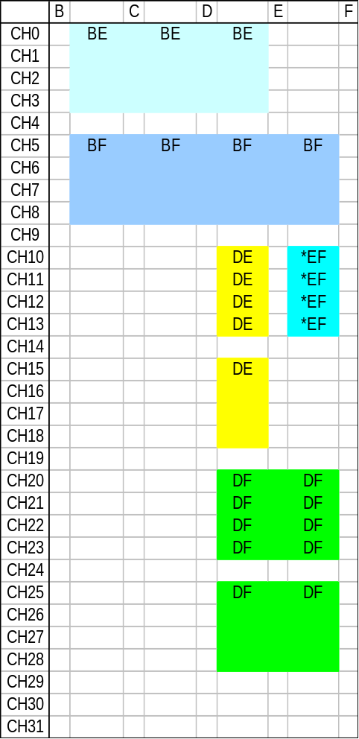
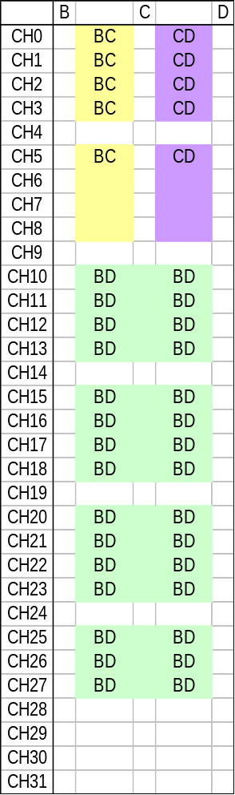
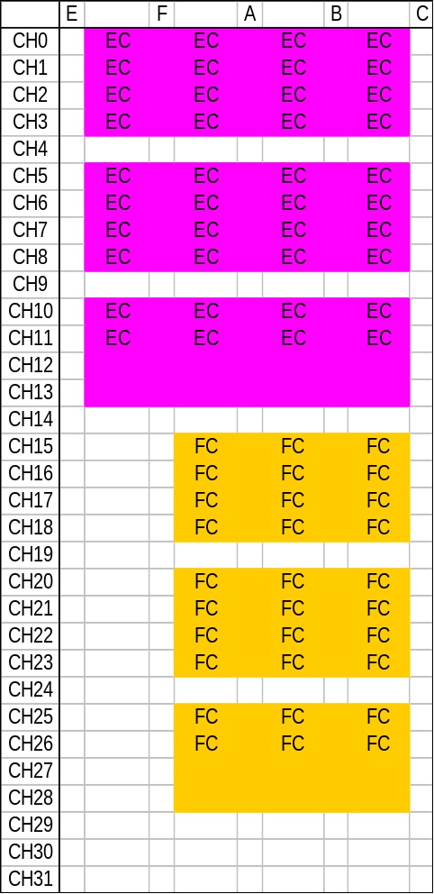
Wavelength Assignment for Service Fibers

Slide 6
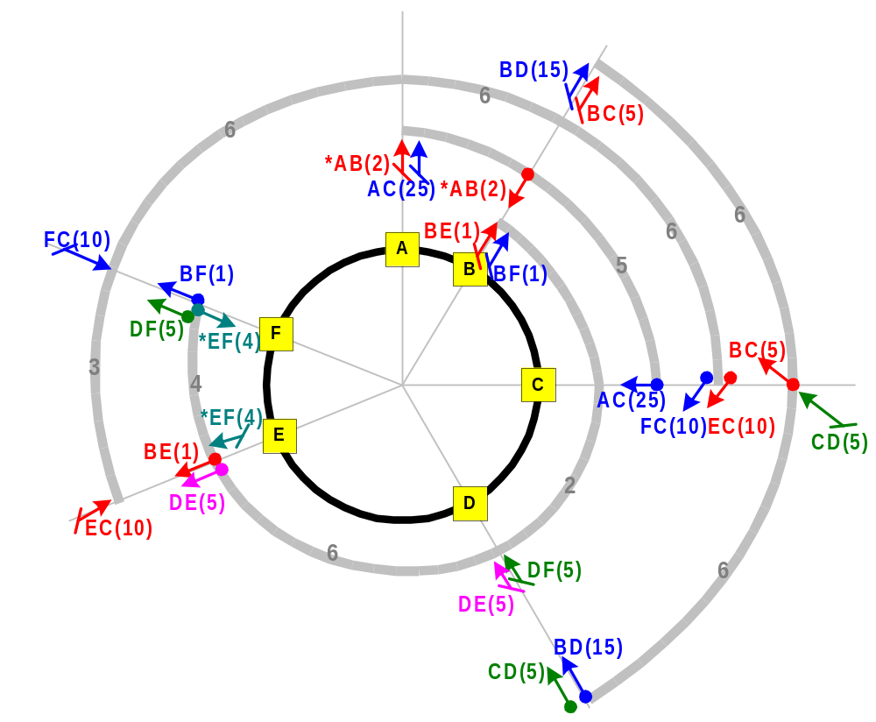
Graphic Illustration

Slide 7
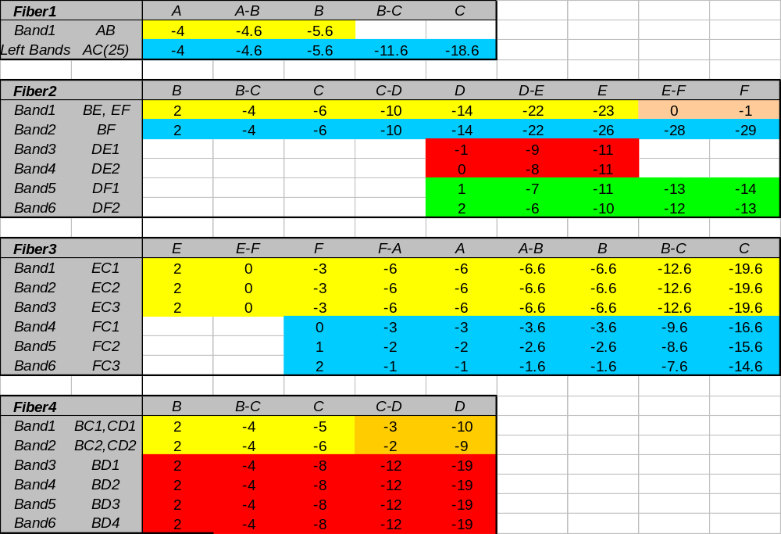
Power Budget for Service Fibers

Slide 8
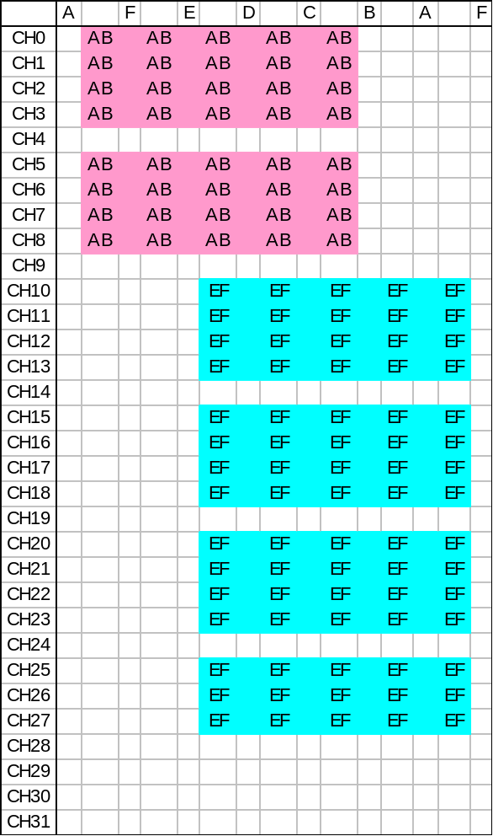
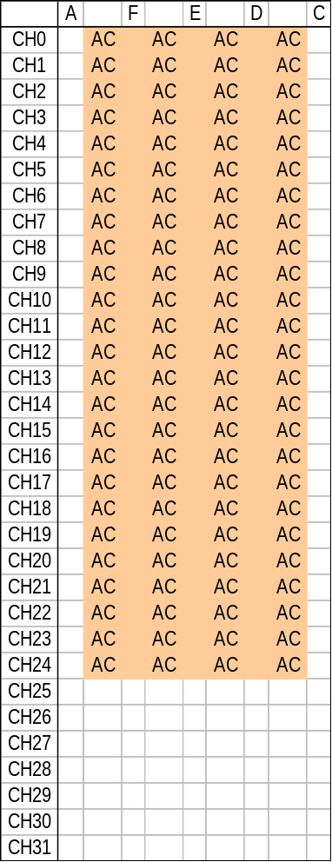
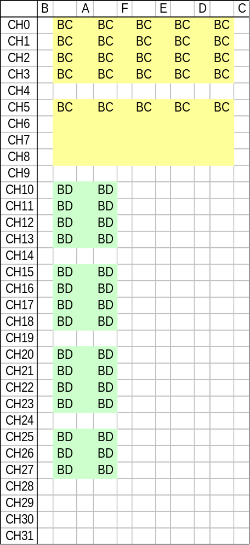
Wavelength Assignment of the Protection (I)

Slide 9
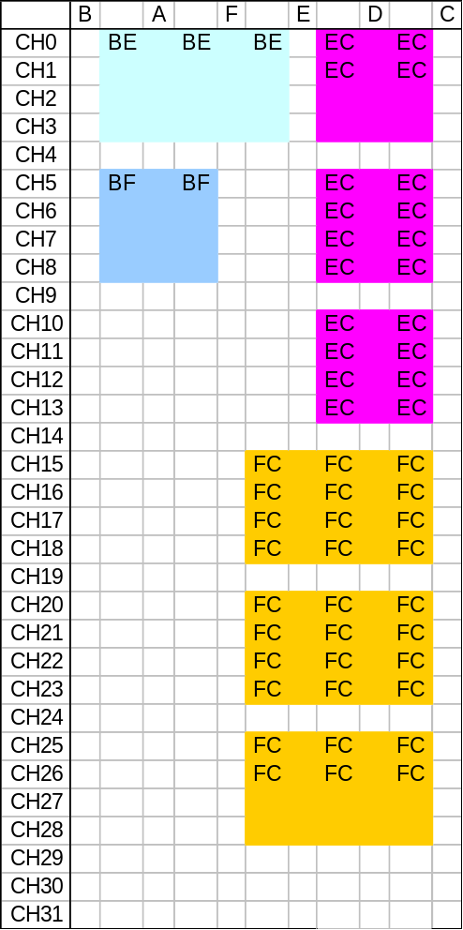
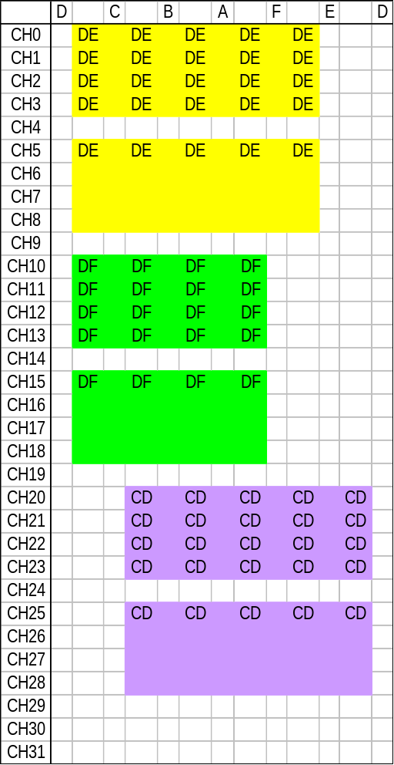
Wavelength Assignment of the Protection (II)

Slide 10
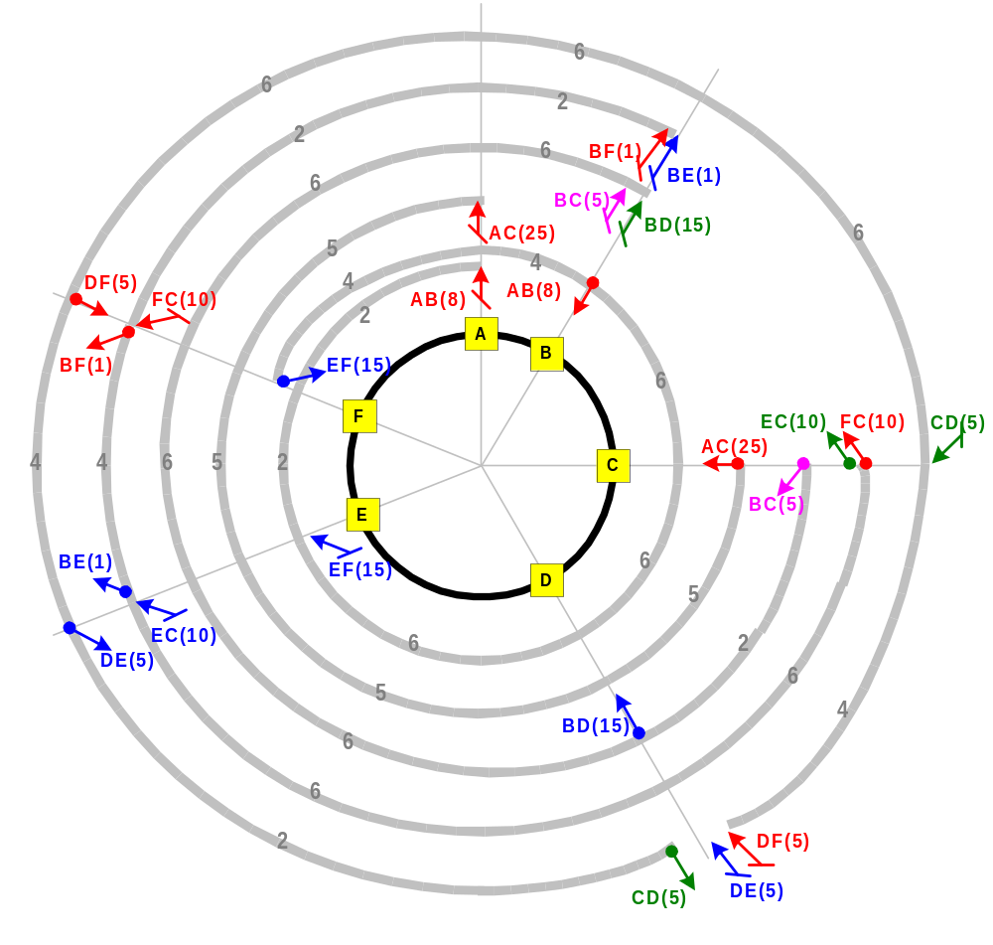
Protection Mechanism

Slide 11
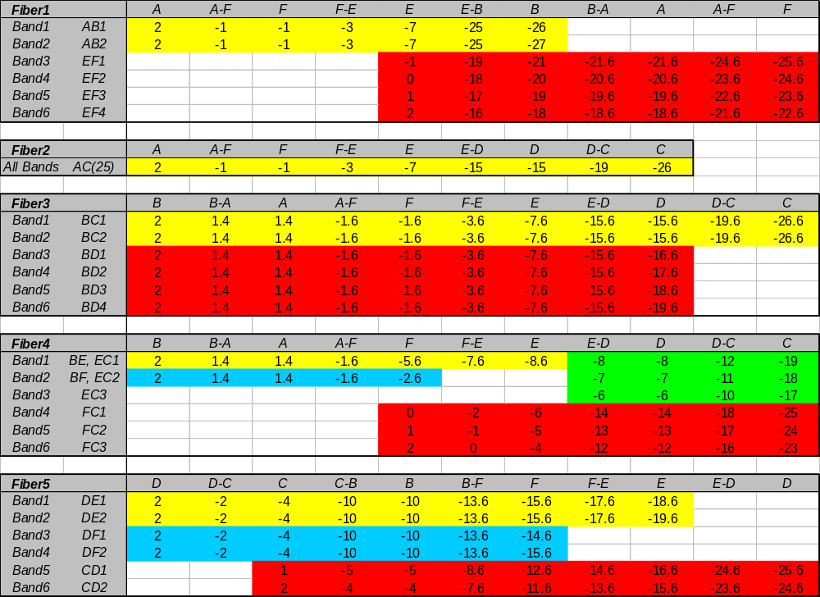

Slide 12
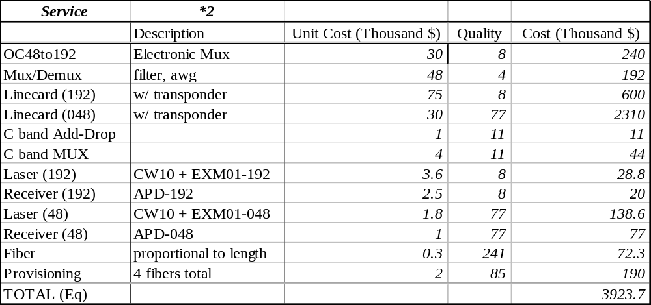
Cost Estimation for Service
8.0 Million$

Slide 13
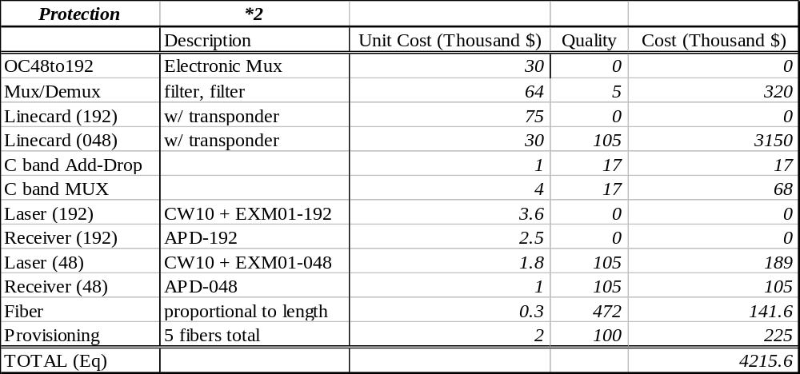
Cost Estimation for Protection
8.4 Million$

Slide 14
Total Cost
Fiber baseline installation fee:
  $20 k/km * 118 km = $2.36 Millions
Service Cost:
  $8.0 Millions
Protection Cost:
  $8.4 Millions
Total Cost:
  $2.36 + $8.0 + $8.4 = $18.8 Millions

Slide 15
OC-192
2 Service Fibers
2 Service Fibers
A
2 Protection Fibers
4 Protection Fibers
B
A
B
F
F
C
C
E
E
D
D
2 Fiber Unidirectional
Path Switched Ring
4 Fiber Unidirectional
Path Switched Ring (6 physical)

Slide 16
Pros and Cons
UPSR
  4 fibers
  More fiber bandwidth efficient
  Slightly cheaper (less components)
  Typical for low speed networks (150Mb/s)
BPSR
  6 fibers
  Reciprocal paths (same delay)
  Less components for service (more reliable)
  Easier network management
  Typical for high speed networks

Slide 17
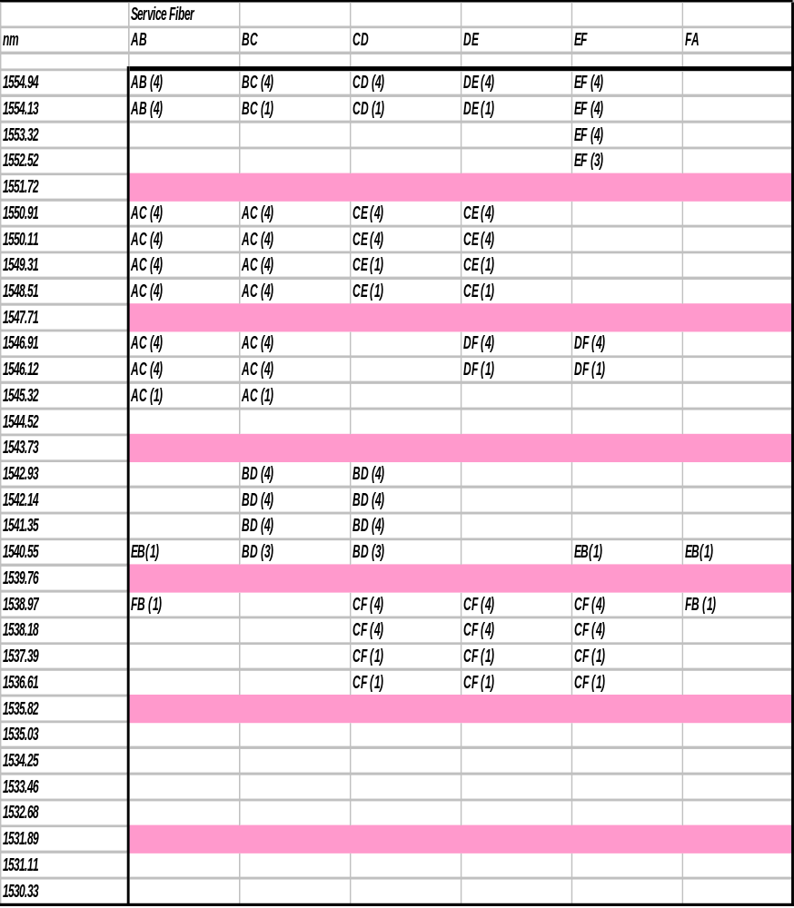
Channel and
Fiber Allocation for Service

Slide 18
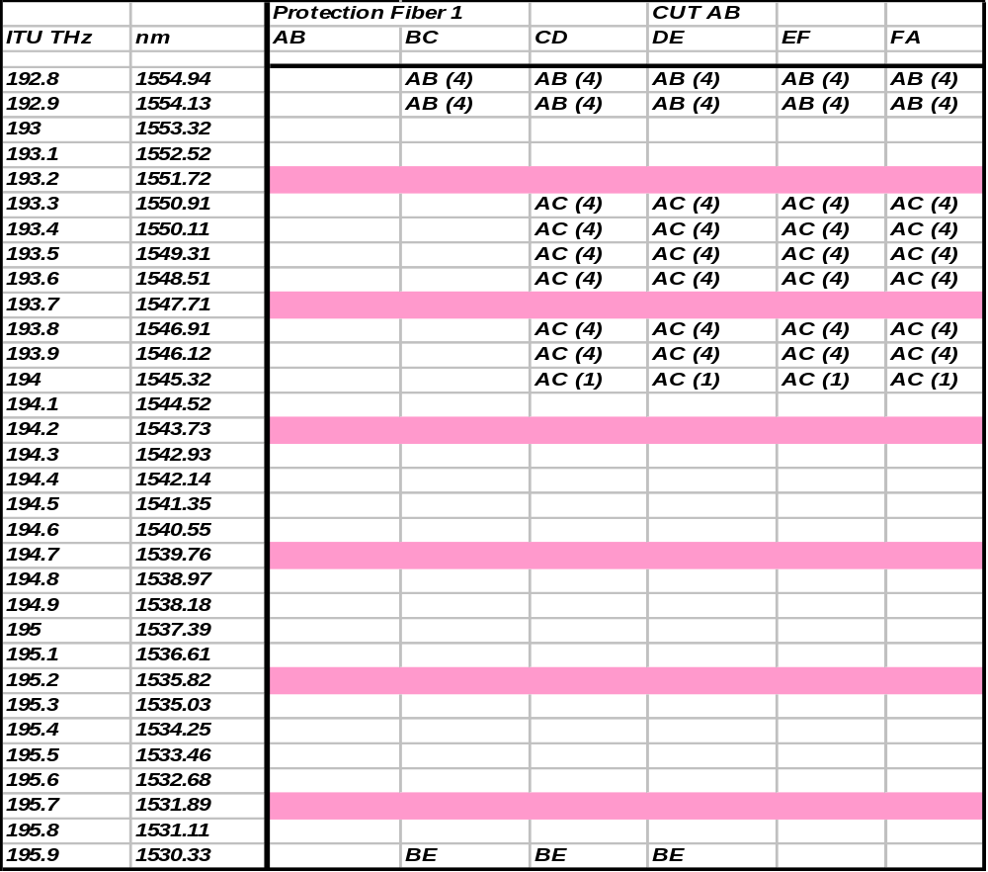
Channel and
Fiber Allocation for Protection:
AB cut

Slide 19
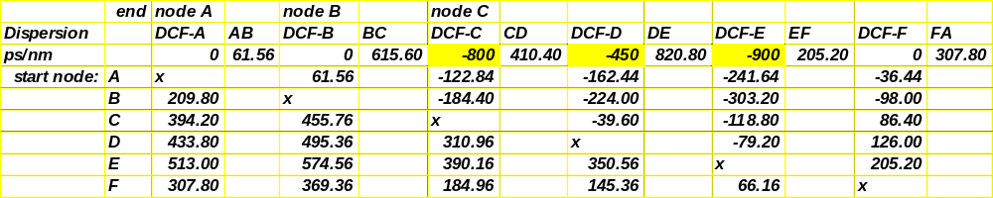
Dispersion Analysis
Service fiber
Spreadsheet calculates dispersion per fiber span, including DCFs
Next adds up dispersion for each link.
Allows us to tailor the location and amount of dispersion.

Slide 20
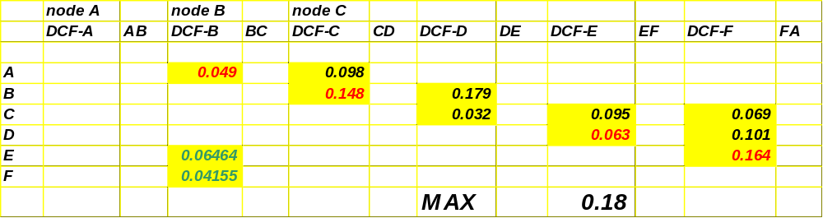
Dispersion Analysis
Service fiber, eye-closure:
Eye closure is calculated based on 10 Gb/s external modulator, or 2.5 Gb/s (for links BE, BF)
Varying the DCFs’ locations and amount changes the eye closures.

Slide 21
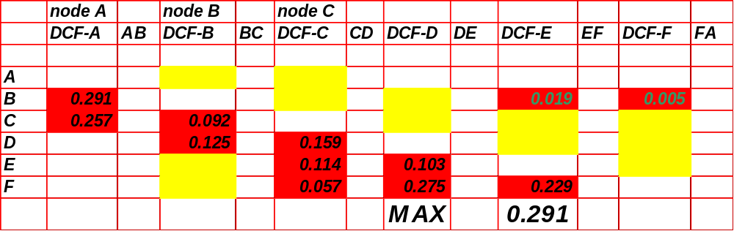
Dispersion Analysis
Protection fiber, eye-closure:
Designed such that eye closure is < 0.3
Gives 1 dB power penalty.

Slide 22
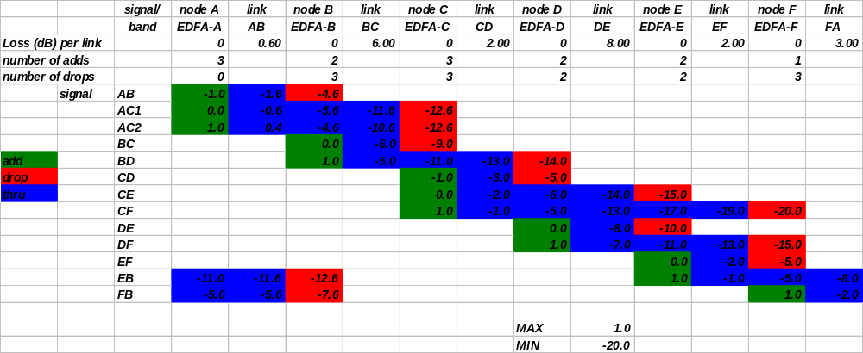
Power Budget- Service CW

Slide 23
Device arrangement
Node C: Protection
Drop
Add
DCF
AC1, AC2, BC
CD, CE, CF

Slide 24
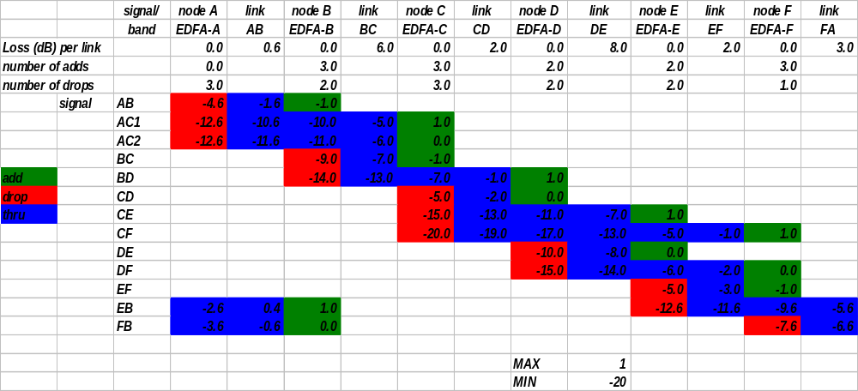
Power Budget- Service CCW

Slide 25
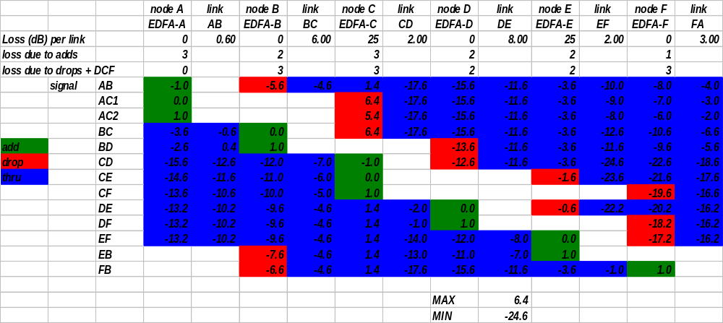
Power Budget- Protection CW (Protects Service CCW)

Slide 26
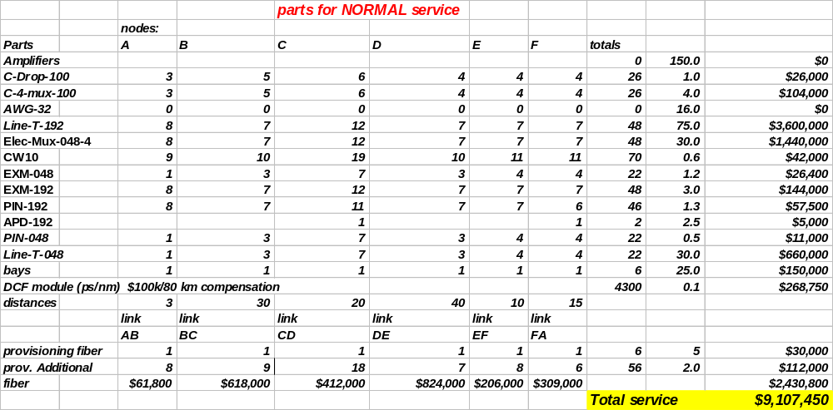
10 Gb/s Cost for Service

Slide 27
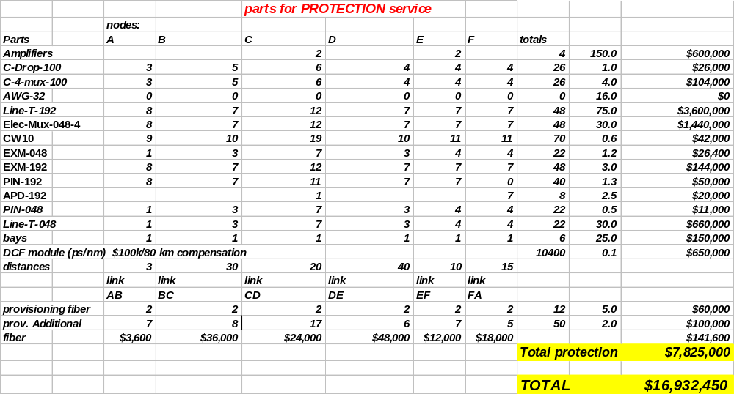
10 Gb/s Cost for Protection

Slide 28
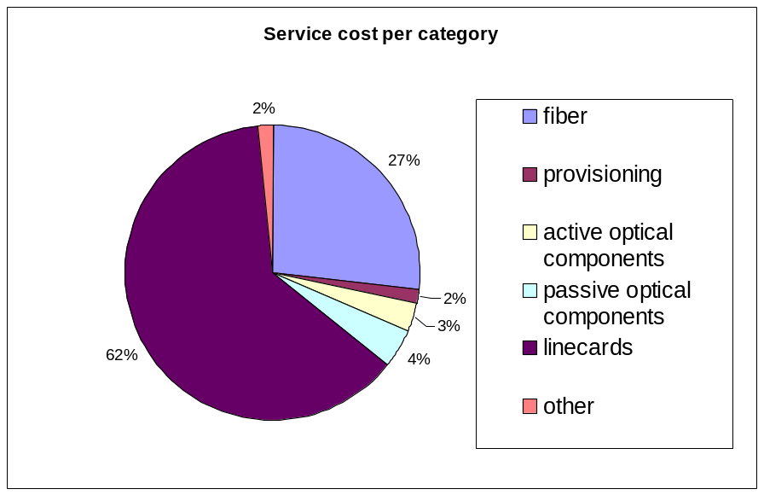
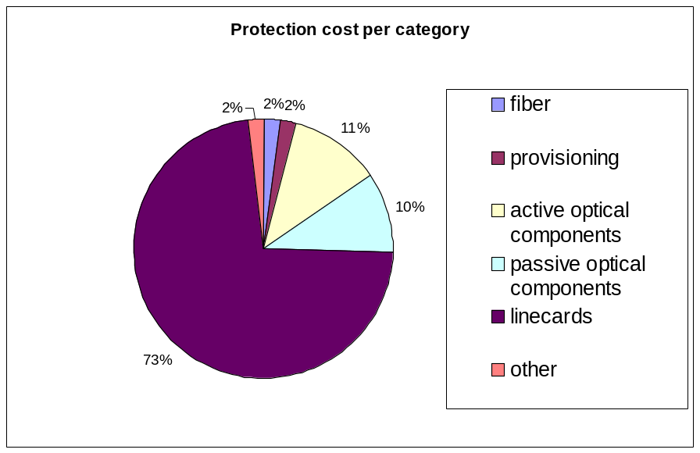
Cost per category

Slide 29
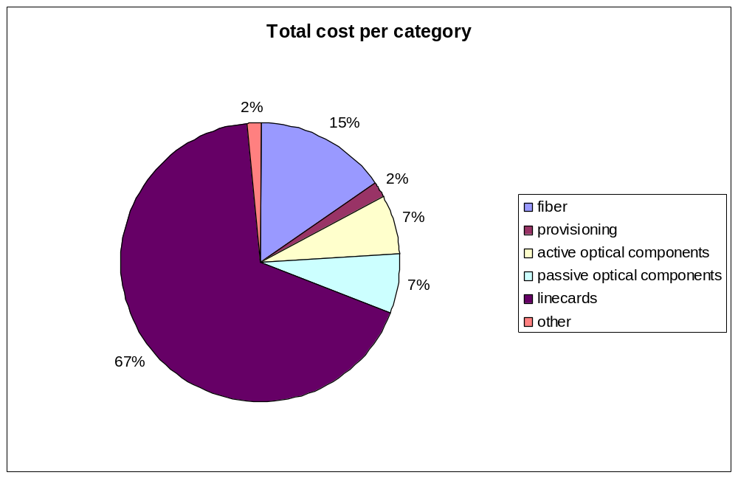
Total Cost per category

Slide 30
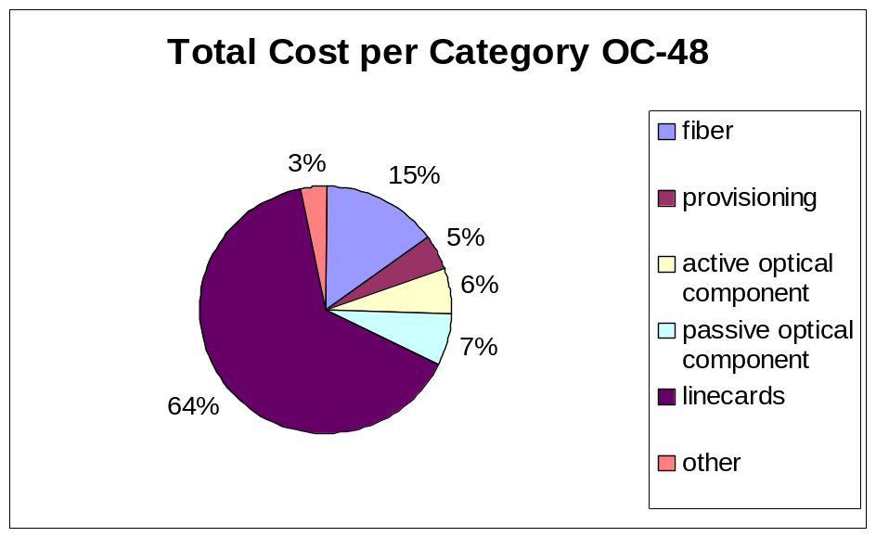
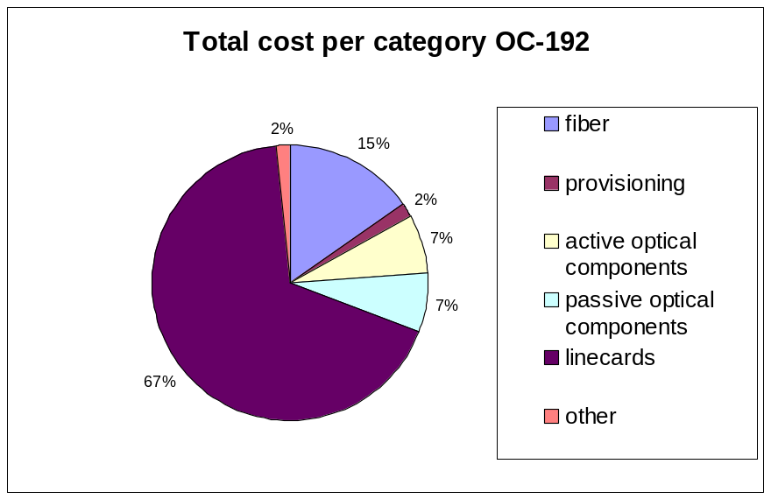
Cost comparison

Slide 31
Conclusion
STS-48 solution costs more on provisioning while less on active optical component.
There are more spare capacity in STS-192 solution than that of STS-48.
STS-48 solution is not so scalable.
STS-192 is easier to manage for both service and protection.

