Slide 1
Optical Networking & DWDM
Tal Lavian
tlavian@eecs.berkeley.edu
The Light at the end of the Tunnel

Slide 2
Agenda
Technology and market drivers
Abundant bandwidth
Underline the Internet is optical networking
What is WDM?
Where are the bottlenecks?
Architecture and protection
Summary
Backup slides
  Underline technologies
  Protection Rings
Optical Networks & DWDM

Slide 3
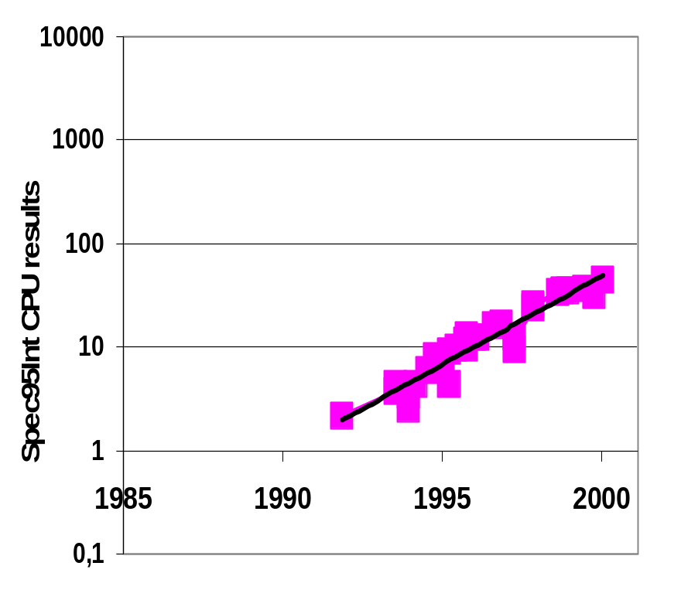
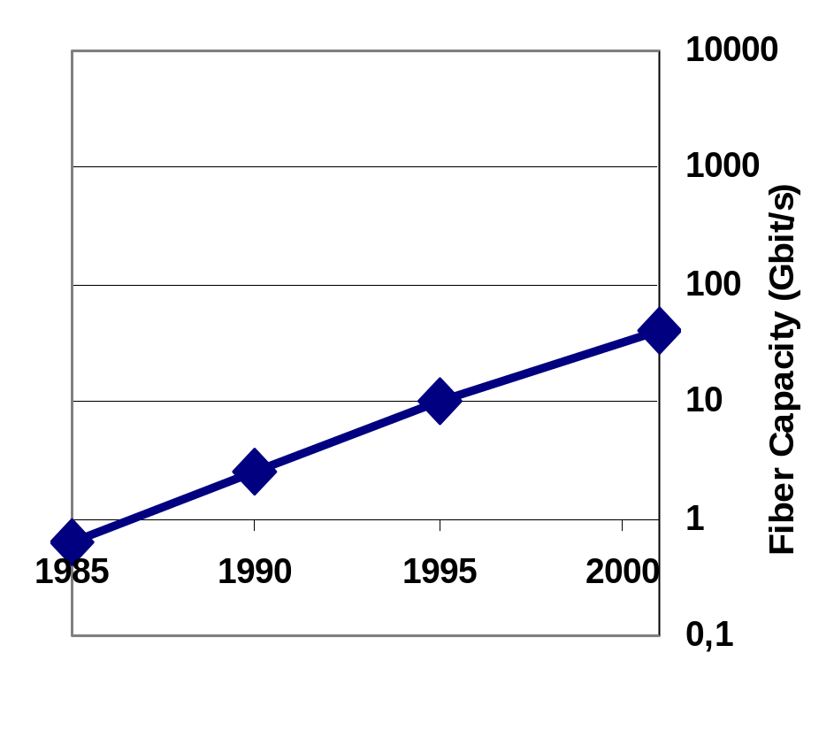
Fast Links, Slow Routers
Processing Power
Link Speed (Fiber)
Source: Prof. Nike McKeown, Stanford
SouSSrce: SPEC95Int & David Miller, Stanford.
Optical Networks & DWDM
Notes:
SPEC95Int: doubles every 2 ¼ years
FO: doubles every 2 years
DWDM: triples every year, i.e. Doubles every 7 months
Need to optimize router processing not bandwidth efficiency
Optical technology requires:
No buffering
Slow switching
Little logic

Slide 4
Fast Links, Slow Routers
Processing Power
Link Speed (Fiber)
10000
2x / 2 years
2x / 7 months
1000
100
Fiber Capacity (Gbit/s)
10
1
1985
1990
1995
2000
0,1
Source: Nike McKeown, Stanford
TDM
DWDM
Source: SPEC95Int & David Miller, Stanford.
Optical Networks & DWDM
Notes:
SPEC95Int: doubles every 2 ¼ years
FO: doubles every 2 years
DWDM: triples every year, i.e. Doubles every 7 months
Need to optimize router processing not bandwidth efficiency
Optical technology requires:
No buffering
Slow switching
Little logic

Slide 5
Evolving Role of Optical Layer
Service interface rates
equal
transport line rates
160λ
10
6
Capacity
(Mb/s)
5
WDM
OC-192
32λ
10
8λ
4λ
10 Gb/s transport line rate
2λ
OC-192c
4
10
10 Gb
Ethernet
1.7 Gb/s
OC-48
Gb
Ethernet
OC-48c
10
3
565 Mb/s
TDM
Fast
Ethernet
OC-12c
2
135 Mb/s
10
OC-3c
Transport system capacity
1
Ethernet
T3
10
Data: LAN standards
T1
Data: Internet backbone
85
90
95
2000
Year
Source: IBM WDM research
Optical Networks & DWDM

Slide 6
Breakthrough...Bandwidth
6.4 Tbps
Optical Capacity Revolution
Cost per
Gigabit Mile
1.6 Tbps
320 Gbps
2.5 Gbps
Moore’s
Law
50 Mbps
1984
1994
1998
2001
1993
1998
2002
Wavelengths will become the communications circuits of the future...
Source: Nortel marketing
Optical Networks & DWDM

Slide 7
Agenda
Technology and market drivers
Abundant bandwidth
Underline the Internet is optical
What is WDM?
Where are the bottlenecks?
Architecture and protection
Summary
Backup slides
  Underline technologies
  Protection Rings
Optical Networks & DWDM

Slide 8
Abundant Bandwidth
Why does this change the playground?
Optical core bandwidth is growing in an order of magnitude every 2 years, 4 orders of magnitude in 9 years
  1992 – 100Mbs (100FX, OC-3)
  2001 – 1.6Tbs (160 DWDM of OC-192)
  OC-768 (40Gbs) on single λ is commercial (80Gbs in lab)
2-3 orders of magnitude bandwidth growth in many dimensions
    Core – Optical bandwidth - (155mb/s → 1Tb/s)
    Core Metro – DWDM optical aggregation – (2.4Gb/s → N*10Gb/s)
    Metro – Access for businesses (T1 → OC3, 100FX, 1-Gb/s)
    Access – Cable, DSL, 3G – (28kb/s→10mb/s, 1.5mb/s, 384kb/s)
    LAN – (10mbp/s → 10Gbp/s)
Optical Networks & DWDM

Slide 9
Why Does This Matter?
How do these photonic breakthroughs affect us?
This is a radical change to the current internet architecture
WAN starts to be no longer the bottleneck
  How congestion control/avoidance affected?
  Why DiffServ if you can get all the bandwidth that you need?
  Why do we need QoS?
  Why do we need cache? (if we can have big pipes)
  Where to put the data? (centralized, distributed)
  What changes in network architecture needed?
  What changes in system architecture needed?
  Distributed computing, central computing, cluster computing
  Any changes to the current routing?
Optical Networks & DWDM

Slide 10
Bandwidth is Becoming Commodity
Price per bit went down by 99% in the last 5 years on the optical side
  This is one of the problems of the current telecom market
Optical Metro – cheap high bandwidth access
  $1000 a month for 100FX (in major cities)
  This is less than the cost of T1 several years ago
Optical Long-Haul and Metro access - change of the price point
  Reasonable price drive more users (non residential)
Optical Networks & DWDM

Slide 11
Agenda
Technology and market drivers
Abundant bandwidth
Underline the Internet is optical
What is WDM?
Where are the bottlenecks?
Architecture and protection
Summary
Backup slides
  Underline technologies
  Protection Rings
Optical Networks & DWDM

Slide 12



Our Concept of the Internet
Optical Networks & DWDM

Slide 13




Internet Reality
Access
Metro
Long Haul
Metro
Access
Optical Networks & DWDM

Slide 14

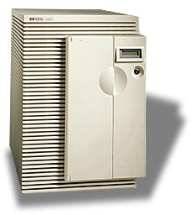






Internet Reality
Data
Center
SONET
SONET
DWDM
DWDM
SONET
SONET
Access
Metro
Long Haul
Metro
Access
Optical Networks & DWDM

Slide 15
What is WDM?
Data Channel 1
Optical
Fibre
Data Channel 2
Data Channel 3
Data Channel n
Wavelength Division Multiplexing (WDM) acts as “optical funnel” using different colors of light (wavelengths) for each signal
Source: Prof. Raj Jain Ohio U
Optical Networks & DWDM
Notes:
Wave Division Multiplexing consists in taking optical signals (each carrying information at a certain bit rate), giving this optical signal a colour (wavelength) and then combining and sending them down the same fibre.
Each piece of equipment sending an optical signal has the illusion of having it own fibre.
If we go back to our road analogy and getting more cars to go from A to B, WDM gets more cars to travel, not by increasing their speed but by getting them to travel in parallel in their own dedicated lane.
Traffic in each ‘lane’ can travel at a different speed - each lane is independent (so this not like a motorway).
The wavelengths used for WDM are chosen in a certain range of frequencies (around 1550nm) or window. This will be clarified later.

Slide 16
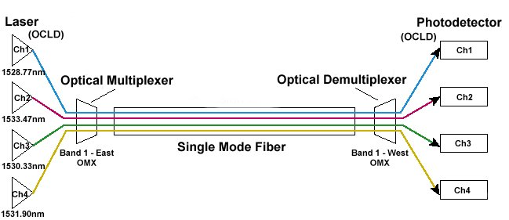

Wavelength Division Multiplexing
Source: ??
Optical Networks & DWDM

Slide 17
Agenda
Technology and market drivers
Abundant bandwidth
Underline the Internet is optical
What is WDM?
Bottlenecks Architecture and protection
Summary
Backup slides
  Underline technologies
  Protection Rings
Optical Networks & DWDM

Slide 18



The Access
Dial up
xDSL
Cable
Wireless
Internet
Ethernet
ATM
POS
STSx
DS-x/OC-x
Optical Networks & DWDM

Slide 19

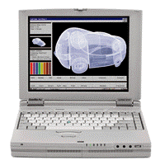
The Access Bottleneck
N x GigE
T1 up to OC3
Glut of 10Gb
Enterprise
PC – 100Mb/s
Dial-up, DSL, Cable
Home
Access
Core Internet
Optical Networks & DWDM

Slide 20
Characteristics of Metro Network Centers
Access
POP
Access
Rings
Collector
Rings
Express
Rings
Secondary
CO
Primary CO/
IXC POP
Local Loop
Distance between nodes 0-10Km 5-10Km 5-120Km
# of fibers/conduit 12-36 12-144 12-144
# of sites passed 1-10
# of nodes /ring 2-4 4-8 4-8
SONET Rates OC-1/3/12 OC-12/48 OC-48/192
Topologies Pt-pt, Pt-pt, Pt-pt,
2f UPSR 2f UPSR, 2f BLSR,
BLSR DWDM
Traditional Interfaces DS1, DS3 DS1, DS3 DS3, OC-n
Interconnect: DS1/EC-1
BWM level: DS1/VT1.5
Matched Nodes: 5-10%
Interconnect: DS3/OC-n
BWM level: DS3/STS1
Matched Nodes: 0-5%
Source: Nortel’s Education
Optical Networks & DWDM

Slide 21
Unidirectional path switched rings
Working
Protection
Ring Node
April, 1998
Optical Networks & DWDM
Notes:
Ring-based APS provides an increased level of survivability for SONET networks by allowing as much traffic as possible to be restored, even in the event of a cable cut or a node failure.
In a ring, a number of network elements are connected in a closed loop. In the event of a disruption at any point on the ring, the affected traffic can be restored by rerouting it the other way around the ring.
The two main types of ring are the unidirectional path switched ring (UPSR) and the bidrectional line switched ring (BLSR).
In the UPSR, the ring consists of two fibers on each span, transmitting in opposite directions, between adjacent nodes. Traffic entering the ring at any node is transmitted in both directions around the ring until it reaches its exit point. Each node on the ring is line terminating, such that the connection across the ring is a path layer connection. At the exit point, the path layer integrity information is examined for each of the two paths and a selection made.
All the selectors will default to a particular direction, such that under non-failure conditions, all traffic is rotating around the ring in the same direction. Hence the name unidirectional. Since the selection is made on a per path basis, using path layer integrity information, the ring is called path switched.

Slide 22
Protection example
A
A
B
D
B
D
C
C
Idle Ring
Protected Ring
Optical Networks & DWDM

Slide 23
If we had the bandwidth…
What if we all had 100Mb/s at home?
  Killer apps, other apps, services
  Peer-to-peer video swapping
  Is it TV, HDTV, something else?
What if we had larger pipes at businesses?
  1Gbs home office, 10GE/DWDM large organizations
How would the network architecture look, if we solve the last mile problem?
Optical Networks & DWDM

Slide 24
Summary
DWDM – phenomenal growth
Abundant bandwidth
Underline optical technologies
The access is still bottleneck
Reliability and protection
Optical Networks & DWDM
Notes:
This happened with microprocessors getting cheap and small…ended the era of mainframes

Slide 25
“Blindsided by Technology”
When a base technology leaps ahead in a dramatic fashion relative to other technologies, it always reshapes what is possible
It drives the basic fabric of how distributed systems will be built
It blindsides
us all...
Source – Nortel’s marketing
Optical Networks & DWDM
Notes:
This happened with microprocessors getting cheap and small…ended the era of mainframes

Slide 26
References
Cisco optical site
www.nortelnetworks.com
www.lucent.com
IBM optical research
IETF
OIF
Stanford – Prof. Nick McKeown
Ohio U – Prof. Raj Jain
Optical Networks & DWDM
Notes:
This happened with microprocessors getting cheap and small…ended the era of mainframes

Slide 27
The Future is Bright
Imagine the next 5 years.
Optical Networks & DWDM

Slide 28
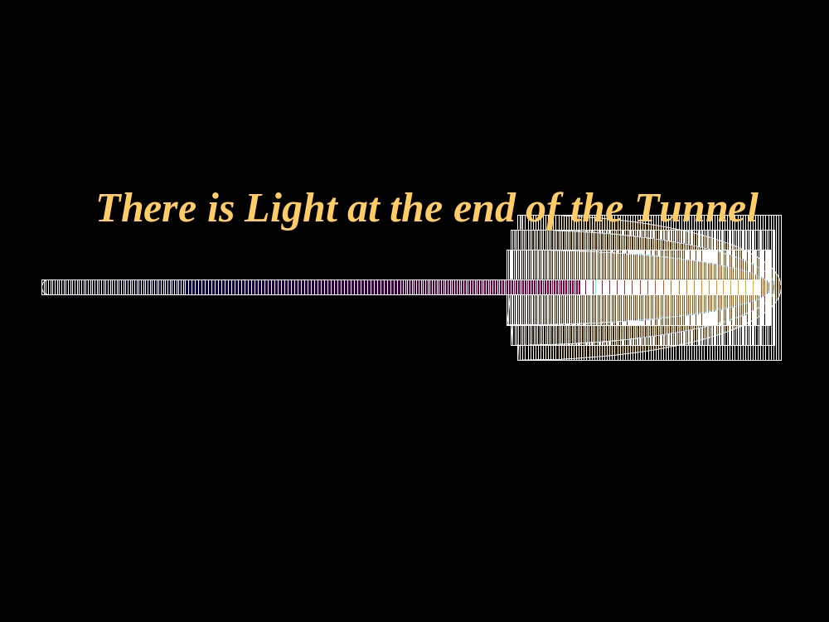
There is Light at the end of the Tunnel
Imagine it 5 years from now?
There are more questions than answers.
Optical Networks & DWDM

Slide 29
Backup Slides
Optical Networks & DWDM
Notes:
This happened with microprocessors getting cheap and small…ended the era of mainframes

Slide 30
DWDM underline technologies
Wavelength – a new dimension growth
Optical multiplexing
Regenerators and Amplifiers
WDM system benefits
Filters
Ad Drop Multiplexes
Optical Networks & DWDM
Notes:
This happened with microprocessors getting cheap and small…ended the era of mainframes

Slide 31
Multiplexing Options
λ ₁
50Msb
155 Mb/s
2.5G
10G
40G
. . . .
λ ₁ … λ _{N}
622Mb/s
2.5 Gb/s
λ _{N}
TDM
  Electrical multiplexing
    50Mb/s to 10Gb/s data services
  Electrical bandwidth management
    flexible trib to aggregate time slot allocation
    flexible aggr. to aggr. time slot allocation
    flexible trib to trib connection
WDM (or DWDM)
  Optical Multiplexing
    Up to 160 wavelengths today
    2.5G, 10G, & 40G per λ
  Optical bandwidth management
    Wavelength add & drop
Total Capacity = TDM x WDM
Optical Networks & DWDM
Notes:
How to send the maximum amount of information (get the biggest capacity) per fibre?
By using the biggest rate on the line and then WDM at this rate.
Nortel is the leading high capacity supplier with the largest deployment of 10Gbit/s systems (over 1000 systems already in 1997 alone!). Nortel now offers 32 wavelengths at 10Gbit/s.

Slide 32
Regens and Optical Amps
Regenerator
Output Signal
Input Signal
Rx
Tx
SONET
Overhead
Optical Amplifier
Output Signal + Noise
Input Signal
(Gain)
Problems
  Noise injected with each amplifier
  No access to SONET overhead (transparent)
Optical Networks & DWDM
Notes:
A regenerator is needed when, due to the long distance between multiplexers, the signal level in the fiber becomes too low. The regenerator clocks itself off of the received signal and replaces the Section Overhead bytes before re-transmitting the signal. The Line Overhead, payload, and Path Overhead are not altered.
The Regenerator requires O/E and E?O conversion. This makes the Regenerators expensive.
On the other hand, an optical Amplifier (MOR) processes the signal entirely in the optical domain without processing the Sonet Overhead. One of the main problems with the MOR is it also amplifiers the noise. This makes it necessary that repeaters be used in appropriate distances. In fact, the MOR/Repeater combination has extended the reach of the optical signal to unprecedented distances now.

Slide 33
WDM System Benefits
Lower equipment cost
Lower operating cost
Increased fiber capacity
Shorter turn-up time
72 regenerators, 8 fiber pairs
4 amplifiers, 1 fiber pair
1
1
1
1
2
2
2
2
3
3
3
3
4
4
4
4
5
5
5
5
6
120Km
6
6
6
7
7
7
7
8
8
8
8
60Km
7
N
N
600 Km
600 Km
Optical Networks & DWDM

Slide 34
Fiber-Bragg Gratings
PORT A
PORT B
PORT D
PORT C
From port A to port D
From port A to port C
dB
dB
Wavelength
Wavelength
Optical Networks & DWDM

Slide 35
Add Drop Multiplexer
Protected Drop
Add
Add/Drop Side
Drop&continue
Pass Thru
Protected Add/Drop
Ring Side
Ring Side
Optical Networks & DWDM

Slide 36
Common Protection Rings
UPSR (Unidirectional Path Switched Ring)
BLSR (Bidirectional Line Switched Ring)
BLSR/4 (4-Fiber, Bidirectional Line Switched Ring)
Optical Networks & DWDM
Source: “SONET – Second Edition”

Slide 37
UPSR –
Unidirectional Path Switched Ring
Signal sent on both working and protected path
Best quality signal selected
Sending Traffic
Receiving Traffic
NE1
NE2
OC-3
Outside Ring = Working
Inside Ring = Protection
NE4
NE3
NE1 send data to NE2
Optical Networks & DWDM

Slide 38
UPSR –
Unidirectional Path Switched Ring
Best quality signal selected
Signal sent on both working and protected path
Receiving Traffic
Reply Traffic
NE1
NE2
OC-3
Outside Ring = Working
Inside Ring = Protection
NE4
NE3
NE2 replies back to NE1
Optical Networks & DWDM

Slide 39
BLSR –
Bidirectional Line Switched Ring
OC-1 through OC-6
Sending/Receiving
Traffic
Sending/Receiving
Traffic
NE1
OC-7 through OC-12
NE2
OC-12
Both Rings = Working & Protection
NE4
NE3
NE1 send data to NE2 & NE2 replies to NE1
Optical Networks & DWDM

Slide 40
BLSR/4 – Bidirectional Line Switched Ring w/4-Fiber
Sending/Receiving
Traffic
Sending/Receiving
Traffic
NE1
NE2
OC-48
2 Outside Rings = Working
2 Inside Rings = Protection
NE4
NE3
NE1 send data to NE2 & NE2 replies to NE1
Optical Networks & DWDM

Slide 41
Example of a new Bottleneck
Long Haul
DWDM
Long Haul
CO
LAN
NNI 1
NNI 2
10/100
LAN
10/100
SONET Access Ring
Access Ring
10/100
LAN
LAN
10/100
LAN
LAN
10/100
Optical Networks & DWDM

Slide 42
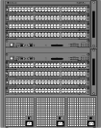


Access and Metro Networks?
CO/PoP
CO/PoP
OC-3/OC-12 Access rings
OC-48/OC-192/Metro
Backbone Rings
OC-3/OC-12 Access rings
Optical Networks & DWDM

Slide 43
Recent DWDM Records
32l x 5 Gbps to 9300 km (1998)
64l x 5 Gbps to 7200 km (Lucent’97)
100l x 10 Gbps to 400 km (Lucent’97)
16l x 10 Gbps to 6000 km (1998)
132l x 20 Gbps to 120 km (NEC’96)
70l x 20 Gbps to 600 km (NTT’97)
128l x 40 Gbps to 300 km (Alcatel’00)
1022 wavelengths on one fiber (Lucent’99)
Ref: Optical Fiber Conference 1996-2000 (Raj Jain)
Optical Networks & DWDM

