Slide 1
Open Programmable Architecture for Java-enabled Network Devices
Tal Lavian
Technology Center
Nortel Networks tlavian@NortelNetworks.com

Slide 2
Programmable Network Devices
Openly Programmable devices enable
new types of intelligence on the network

Slide 3
Agenda
Local Computation
New types of applications
Architecture
API’s
Summary

Slide 4

Changing the Rules of the Game
Move Turing Machine onto device
  Add local intelligence to network devices
while (true) { doLocalProcessingOnDevice()
}

Slide 5
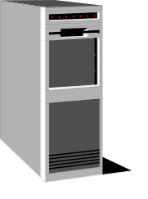



Technology Concept
Applet
Web Server
Web Browser
The JVM is in the Browser
Download applications for local processing
non-bundled application
Reversed Applet
Server

Slide 6
The Web Changed Everything
Browsers
  Introducing JVM to browsers allowed dynamic loading of Java Applets to end stations
Routers
  Introducing JVM to routers allows dynamic loading of Java Oplets to routers
This Capability WILL Change Everything

Slide 7
Accomplishments
  JVM on a silicon-based Routing Switch
  ORE - Oplet Run-time Environment
  Java-enabled Device Architecture
  Java SNMP MIB API
  Implementation of Network Forwarding API
  All of this enables implementation of Dynamic Classification in Silicon-Based Forwarding

Slide 8

Paradigm Shift
Supports distributed computing applications in which network devices participate
  router to router
  server to router
Supports Intelligent Agents
Supports Mobile Agents
Java-based
Application
Java-based
Application
Java-based
Application

Slide 9
Example: Downloading Intelligence
Monitor
Security
Intelligence
Authentication
Dynamic
loading
application
React
JVM
OS
HW
Network Device

Slide 10
Security and Stability
secure download of Java Applications
safe execution environment
  insulate core router applications from dynamically loaded applications

Slide 11
Device-based Intelligence
Static-vs-Dynamic Agents
  Static
    SNMP set/get mechanisms
    Telnet, User Interfaces (cli, web, etc…)
  Dynamic closed-loop interaction on nodes
    capable of dealing with new and difficult situations
    autonomous and rational properties.
    dynamically system monitoring & modification
    report status and trends

Slide 12
Agenda
Local Computation
New types of applications
Architecture
API’s
Summary

Slide 13
New Types of Applications
Mobile Agents
Local Intelligence for NMS
Collaboration among routers
Router & Server Collaboration
E-commerce

Slide 14
Mobile Agents
Intrusion Detection - Hacker Chaser
Trace-route for Layer 2
Mobile Connectivity Mapper

Slide 15
Local Intelligence for NMS:
Diagnostic Agents
Extensive access
to internal resources
No more
polling
Download Intelligent Agent monitor from NMS to the device.
Wait for threshold.
  Might be complex conditions
  Trend analysis
Send “condition exceeded” event to NMS.
Automatic download appropriate application
Application takes action.
NMS
Monitor
Download
Complex Condition
Exceeded
Appropriate
Application
Download
router

Slide 16
Application Layer Collaboration Among Routers and Servers
Application aware routing
Server farm load balancing
  server state monitored
  rerouting based on congestion/load
Auctioning Applications

Slide 17
Applications Aware Forwarding
Business logic based operation changes
Resize forwarding queues
Modify congestion control algorithm
Adjust Packet Scheduling
Change routing table

Slide 18
Agenda
Local Computation
New type of applications
Architecture
API’s
Summary

Slide 19
ORE - Oplet Run-time Environment
Oplet 1
Oplet 2
Service A
Service B
Service C
Why ORE?
ORE
JVM

Slide 20
Node Architecture
C/C++
API
Java
API
Download
Oplet
Device
Code
ORE Service
JNI
Oplet Runtime Env
Device
Drivers
JVM
JFWD API
Operating System
Device HW

Slide 21
Architecture Issues
Green Threads -vs- Native Threads
  Native threads:
    provides non-interference between Java applications
    difficult thread-to-thread communication and sharing of data between threads
    creates a dependency on underlying RTOS
    multiple JVM instances consume resources
  Green Threads
    single JVM must manage CPU & memory resources between concurrently running threads

Slide 22
Evolution of Router Architecture
Distributed,
line-card based Model
Centralized,
CPU-based Model
Routing software
w/ router OS
Routing software
w/ COTS OS
Line card
(forwarding
buffering)
Routing
CPU
Buffer
memory
CPU
Buffer
memory
Line card
(forwarding
buffering)
Line card
(forwarding
buffering)
NI as
line card
NI as
line card
...
NI as
line card
Line card
(forwarding
buffering)
Added scalability,
Flexibility,
extensibility
Control + Forwarding
Functions combined
Control separated
From forwarding

Slide 23
Explicit Separation of Control Plane from Data Forwarding
Control
Element
Routing
Traditional device
Forwarding
Shared
Memory
Forwarding/
Flow/filter
Table
Download
Forwarding
Element
CPU
Forwarding
Packet
Flow
Line Card
Forwarding
Element
Line Card
Forwarding
Forwarding
Element
Forwarding

Slide 24
Separation of Control and
Forwarding Planes
Centralized,
CPU-based Router
Forwarding-Processors
based Router
Routing
SW
Control
Plane
CPU
CPU
Forwarding
Processor
Forwarding
Processor
Forwarding
Processor
Slow
Wire Speed
Control + Forwarding
Functions combined
Control separated
From forwarding

Slide 25
Open Networking Architecture
IP Telephony
Policy Server
VPN
Firewall
Unified policy-based management
Application
server
Vertical Proprietary
Server Operating System
Networking Box Level Hardware
Network Services Protocol
Control
element
Proprietary Apps
Network Services Objects
Network OS
Proprietary NOS
Custom Switch ASIC’s
Connect Transport Interface
Forwarding
element
Today
Real-time OS
Network Si
Open

Slide 26
Dynamic Configuration of Forwarding Rules
AN Apps
CPU
Forwarding
Rules
Forwarding
Rules
Forwarding
Rules
Forwarding
Rules
Forwarding
Processor
Forwarding
Processor
Forwarding
Processor
Forwarding
Processor
SW
HW

Slide 27
Real-time forwarding Stats and Monitors
AN Apps
CPU
Forwarding
Rules
Forwarding
Rules
Forwarding
Rules
Forwarding
Processor
Forwarding
Processor
Forwarding
Processor
Statistics
&Monitors
Statistics
&Monitors
Statistics
&Monitors
SW
HW

Slide 28
Dynamic - On the Fly Configuration
Policy
AN Apps
Filters
Filter
Packet
Packet
Forwarding
Processor
Forwarding
Processor
Packet

Slide 29
Active Networks Packet Capture
AN Apps
CPU
JFWD to
Divert or Copy
Wire Speed
Forwarding
Processor
Forwarding
Processor
Forwarding
Processor
Forwarding
Processor
Packet

Slide 30
Scaling up Active Networks Routing Protocol to commercial networks
Overcome the need to predefine the next hop
No need to know AN topology a head of time
Divert/CarbonCopy specific packets to control plane (e.g. packets on ANEP port )
Wire speed of all other packets
End to end forwarding
Future: Active Networks Routing Protocols

Slide 31
Mixed Topology of AN system
NO need to know the AN topology ahead of time
- AN Node
- Non AN Node

Slide 32
Virtual Topology of AN system
NO need to know the AN topology ahead of time
- AN Node
- Non AN Node

Slide 33
Java Environment
Green Threads -- Present RTOS with single unified task that includes:
  Java VM (JVM)
  Java Resource Manager (JRM)
    thread scheduling
    manages CPU utilization
      JVM time-slice is managed by the JRM preemptive thread scheduler
    internal memory manager (intercepts “new”)
    garbage collection with priority based on available memory

Slide 34
Non-Interference w/ Single JVM
Multiple threads compete for resources
  memory
  CPU
  persistent storage
Denial-of-service attacks possible
  memory or CPU consumption attacks
  trusted/untrusted service interactions

Slide 35
Why Java
Reuse security mechanisms
  byte-code verifier
  security manager
  classloader
System stability
  constrains applications to the JVM
  Prohibits native code applications
Extensible, portable, & distributable services

Slide 36

But Java is slooowwwww
Not appropriate in the fast-path data forwarding plane
  forwarding is done by ASICs
  packet processing not affected
Java applications run on the CPU
  Packets destined for Java application are pushed into the control plane

Slide 37

Strong Security in the new model
The new concept is secure to add 3rd party code to network devices
  Digital Signature
  Administrative “Certified Optlet”
  No access out of the JVM space
  No pointers that can do harm
  Access only to the published API
  Verifier - only correct code can be loaded
  Class loader access list
  JVM has run time bounds, type, and execution checking

Slide 38

Old model Security (C/C++)
Old model: Not safe to add 3rd party code
  Dangerous, C/C++ Pointers
    Can touch sensitive memory location
  Risk: Memory allocations and Free
    Allocation without freeing (leaks)
    Free without allocation (core dump !!!! )
Limited security in SNMP

Slide 39
Agenda
Openness
Local Computation
New types of applications
Architecture
API’s
Summary

Slide 40
An Open Service API Example
  SNMP API for Network Management
    generated automatically
    allows device-based applications to query MIB
    device-based application -- query local MIB
    report trends or significant events
    initiate downloading of problem specific diagnostic code
    take corrective action

Slide 41
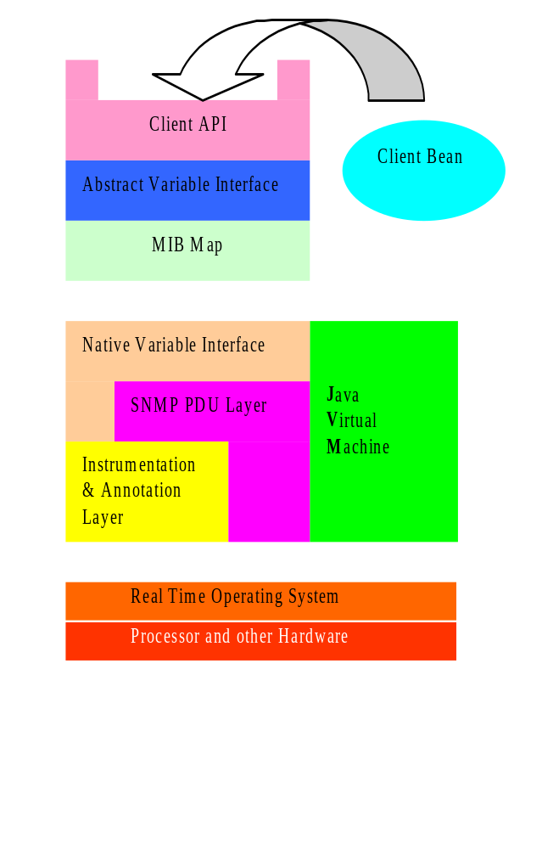
MIB API Example
API uses a MIB Map to dispatch requests to variable access routines
Different parts of the MIB tree can be serviced by different mechanisms
Two main schemes:
An ad hoc interface to the SNMP instrumentation layer
A generic SNMP loopback

Slide 42
Agenda
Openness
Local Computation
New type of applications
Architecture
API’s
Summary

Slide 43
Summary
Programmable
  Turing Machine on network devices
  dynamic agents vs. static agents
  dynamic loading
  strong security
Openness - successfully proven paradigm
  Facilitates innovation
  Domain experts - virtual development community
Enabling Technology for the Revolution

Slide 44

This is only the first step
1903 the Wright brothers
Compare to this first flight and look where aviation is today

