Slide 1
Services and Applications’ infrastructure for agile optical networks
More questions than answers
Tal Lavian

Slide 2
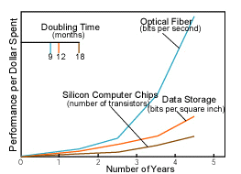
Services and Applications’ infrastructure for agile optical networks ?
  Huge advancements in optical devices, components and networking.
    The underline of the Internet is optical – How can we take advantage of this?
    How can the applications take advantage of this?
  Agile Optical Network is starting to appear. What services and interfaces we’ll need between the optical control and the applications?
    What are the applications?
    The Internet architecture was built on some 15-20 years old assumptions. Are some modifications needed?
  Is packet switching good for all? In some cases, is circuit switching better? (move TeraBytes of SAN date, P2P, Streaming)
  End-to-End Argument – Is is valid for all cases?
    What cases not? What instead?
  The current Internet architecture is based on L3. What is needed in order to offer services in L1-L2?
  Computation vs. Bandwidth 10X in 5 years

Slide 3
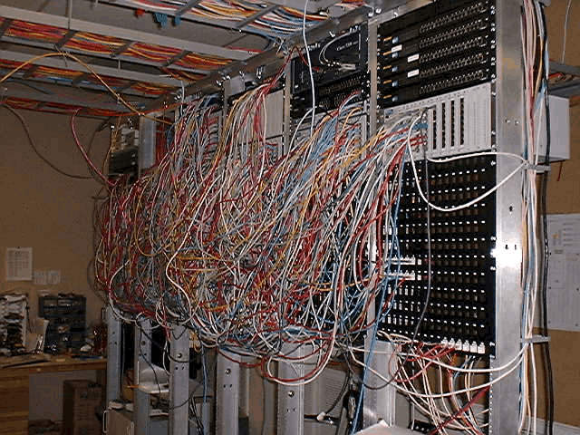
How Optical Agility differ? (vs. L3 Routing)
  Current internet architecture is based on L3 routers with static connection of routers ports (point to point)
  Until recently it took 4-8 month to set an optical link coast to coast.
    Need to cross and contract with 4-6 organization with lawyers
    Need patch panel with manual cable setting
    Need static configurations
    Extremely expensive (10G Monthly - $1M)
  current peering is mainly in L3, BGP and policy
  New fast provisioning in ASON (seconds)
    A head of time static rout computation
    MPLS, MPλS, CR-LDP, RSVP-TE
  New Service Architecture and mechanisms
  for composing services
Manual connectivity

Slide 4
Service Composition
  Current peering is mainly in L3. What can be done in L1-L2?
  The appearance of optical Access, Metro, and Regional networks
  L1-L2: Connectivity Service Composition
    Across administrative domains
    Across functionality domain (access, metro, regional, long-haul, under-see)
    Across boundaries (management, trust, security, control, technologies)
    Peering, Brokering, measurement, scalability
  Appearance of standards UNI – NNI
Trust C
Control E
Security S
Resiliency R
Provider B
Provider F
Trust T
Bandwidth Q
Server
Provider A
Technology G
Admin L
latency P
Access
Metro
Regional
Long Haul
Client

Slide 5




Compose new type of Applications?
  Dynamic L2VPN: enable new type of applications
  Agile connectivity for:
    SAN across metro, regional and long haul.
    Plain disk remote storage
    Backup (start remote backup when the tape in Nebraska is ready and when all the optical connection are ready to be set)
  Set dynamic bandwidth connectivity to the Internet
    What architecture changes are needed?
ASON
Route 3
Mirror Server
Route 2
ASON
Optical Ring
ASON
Route 1
main Server

Slide 6
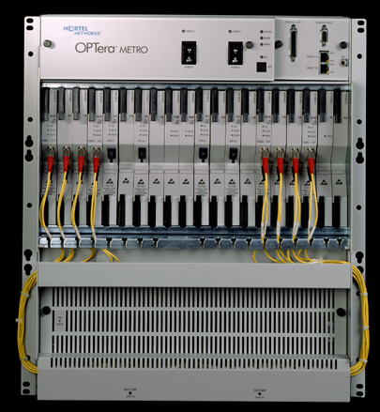

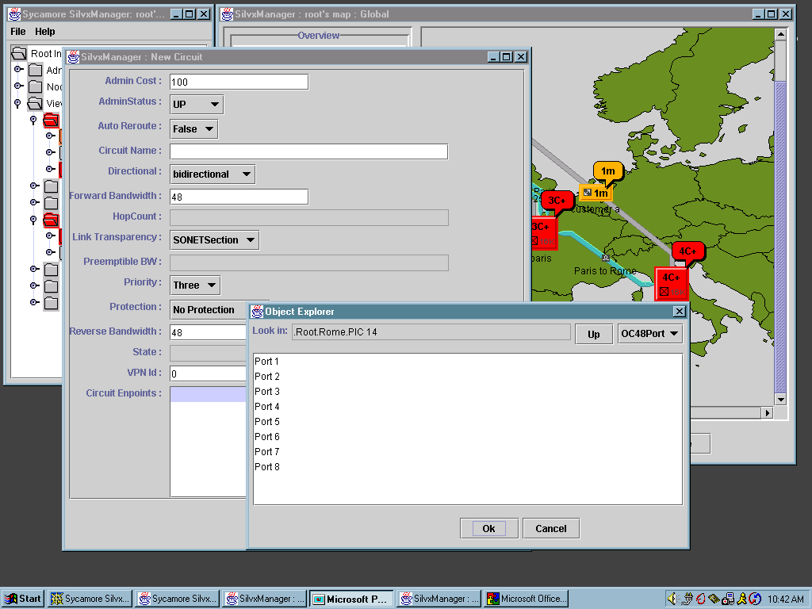
Technology Composition
Overlay
Networks
  L3 routing – drop packets as a mechanism
    (10⁻³ lose look good)
    Circuit switching – set the link a head of time
  Optical networking – bit transmission reliability
    (error 10⁻⁹ -10⁻¹²)
  L3 delay – almost no delay in the optical layers
  Routing protocols are slow – Optics in 50ms
    Failure mechanism redundancy
  DWDM λs tradeoff- higher λ bandwidth vs. more λs
    For agile L1-L2 routing may need to compromise on bandwidth
  RPR – break L3 geographical subnetting
  Dumb Network - Smart Edge? Or opposite?
Data
Networking
Optical
Switching
Optical
Transport
VT’s
VT’s
STS-N
TDM
VT’s
VT’s
Fiber
Fiber
Bundle
SONET
OC-3 / 12 / 48 / 192
10M
1000M
Single
Fiber
STS-Nc
Ethernet
300M
500M
1M
80M

Slide 7

New Architecture Challenges
  We are facing enormous growth of traffic. How the current L3 centric architecture handle this growth?
  Supply - New technologies for the Last Mile
    Servers and storage are moved to Data Centers with big data pipes
    Optical Ethernet, MEF, L2VPNs, Passive Optical Networks (PON)
    Competition in the last mile, mainly business access
  Demand – The need for more bandwidth
    Distribution of data, storage and computation.
    Streaming, virtual gaming, video conferencing,
    P2P, KaZaA, Morpheus - the next big thing that consume traffic?
      Social differences, downloads of Gigabits a day
    Dialup move to broadband
    PCs on the edge become servers
Access
Metro
Core
T1
DS1
DS3
Ethernet LAN
OC-12
OC-48
OC-192
DWDM n x l
IP/DATA
1GigE
LL/FR/ATM
1-40Meg
1Gig+
10GigE+

Slide 8


DARPA demo – Disaster Recovery concept
Agile setting of light-path on 10GE All Optical MEMs switch
Optical
Gateway
Comp
Control Mesg
L7 Switch
Optical
Gateway
Comp
Comp
Comp
Comp
Router
B2
MEMs
Switch
Prototype
NY
L7 Switch
Router
SF
B
B3
Comp
Router
Comp
- Control and computation - Linux
Control Mesg
FL
1Gbs
Comp
10Gbs
L7 Switch

Slide 9
Backup Slides

Slide 10
Networking Issues
  Electrical versus Light
  Copper versus Fiber
  Wired versus Wireless
  Packet versus Circuit
  Flow versus Aggregate
  Stateless versus stateful
  Fixed versus Programmable
  End-to-End versus Hop-by-Hop
  Unicast versus Multicast
  Centralized versus Distributed
  Peer-to-Peer versus Client-Server
  Connectivity versus Service.
  Vertical versus Horizontal
  Users versus Provides
It is impossible to eliminate one completely in favor of the other!
So, how are we composing the next generation Internet?
    Service Architecture instead of Connectivity Architecture
    Composing end-to-end services by negotiation
    Deploying Optical Agility with Programmability and Scalability properties

Slide 11
Packet vs. Circuit
Packet Switch
data-optimized
  Ethernet
  TCP/IP
Network use
  LAN
Advantages
  Simple
  Low cost
Disadvantages
  unreliable
Circuit Switch
Voice-oriented
  SONET
  ATM
Network uses
  Metro and Core
Advantages
  Reliable
Disadvantages
  Complicate
  High cost

Slide 12
Networking – Composing the Next Step ?
  How are we composing the next Internet?
    Elimination
    Addition
    Combination
    Survival of the fittest
  Composing the Internet = Choosing and combining components to construct services, at the same time optimizing some utility function (resources, monetary, etc)
    Service Architecture
    Optical Core
    Programmability
    Scalability
    Composing by negotiation

Slide 13



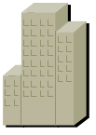

Canarie Optical BGP Networks
Dark fiber Network
City X
Dark fiber Network
City Y
ISP A
ISP B
EGP
ISP C
EGP
AS100
AS200
To other Wavelength
Clouds
Wavelength Routing Arbiter
& ARP Server
AS300
AS400
Customer Owned
Dim Wavelength
EGP
Dark fiber Network
City Z
ISP A
ISP B
Figure 12.0

Slide 14
Impedance Mismatch
Cross boundaries (Control, Management, security)
Cross Technologies (Sonet, DWDM, ATM)
Cross topologies (P2P, Rings all types, mesh, )
Circlet , packets
Speeds (1.5, 10, 51, 100, 155, 622, 1G, 2.4G, 10G…)
Fiber, copper, wireless
Level of media security

Slide 15
Openet Architecture
Applications
ORE
System Services
Control Plane
CPU System
Monitor status
New rules
Switching Fabric
Data Plane
(Wire Speed Forwarding)
Forwarding
Rules
Forwarding
Rules
Forwarding
Rules
. . .
Forwarding
Processor
Forwarding
Processor
Forwarding
Processor
Statistics
&Monitors
Statistics
&Monitors
Statistics
&Monitors
Traffic Packets

Slide 16
Scalable Bandwidth and Services
VT’s
STS-N
TDM
VT’s
VT’s
VT’s
1000M
OC-3 / 12 / 48 / 192
10M
STS-Nc
Ethernet
300M
500M
1M
80M
Notes:
SONET OC-x pipes are composed of multiple STS-n pipes which are in turn composed of virtual tributaries (VTs) which are in turn composed of voice based DS-0s. These STS-n’s, VT’s and DS-0’s are maintained in logical point-to-point connections which allocate the full-bandwidth provisioned even if traffic is not present.

