Slide 1
Optical Networks Infrastructure
Tal Lavian

Slide 2
Area of interest
  Need for building new services utilizing agile optical
  What are the new services?
  Impendence mismatch
  Static Provisioning
  Carrier Hotels
  Optical Ethernet - 802.17 RPR – Resilient Packet Ring
  ASON – Automatically Switched Optical Networks
  EFM - Ethernet First Mile
  Where are the bottlenecks - it is changing
  OXC – Optical Cross Connects – long hope – move intelligence to the edge
Optical Service and Applications

Slide 3
Need for new services
Optical Service and Applications

Slide 4

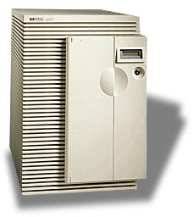








Internet Reality
Data
Center
SONET
SONET
DWDM
DWDM
SONET
SONET
Access
Metro
Long Haul
Metro
Access
Optical Service and Applications

Slide 5
Patch Panel- Manually provisioning
Optical Service and Applications

Slide 6
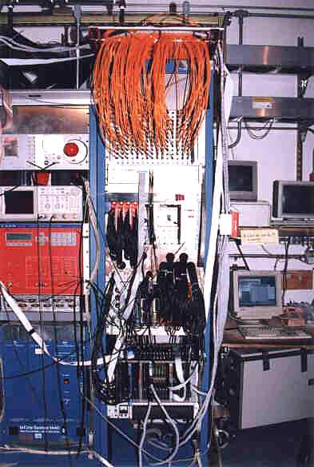
New services takes too long
Manually cable connections
It takes 4-6 months to provision a new optical connection
Cross bounders
Tier 1, Tier 2, Tier 3
  Why not Tier 3 talk directly with another Tier 3?
  Small Metro providers in LA and NY want to connect via small LH provider.
  Why we need the big players?
Optical Service and Applications

Slide 7
Service Composition
Service composition of light path across service provider
Many AS each of them does not have access to the rest
Build a light path among service providers
Many different networks, no one can have full coverage,
Network infrastructure is extremely expansive (Billions of Dollars), service composition save resources (I’ll use your infrastructure, you’ll use mine)
Service composition to set light path between technologies (Access, Metro and Long Haul)
Grid computing, SAN
Optical Service and Applications

Slide 8
Cooperation and Brokering
Service composition
Optical Service and Applications

Slide 9
Impedance Mismatch
Cross boundaries (Control, Management, security)
Cross Technologies (Sonet, DWDM, ATM)
Dross topologies (P2P, Rings all types, mesh, )
Circlet , packets
Speeds (1.5, 10, 51, 100, 155, 622, 1G, 2.4G, 10G…)
Fiber, copper, wireless
Level of media security
Optical Service and Applications

Slide 10
Business Case for Direct Peering
Typical Internet transit costs - $1000/Mbps per month
  For 100 Mbps Internet transit then $100,000/mo
But coast to coast 100 Mbps channel is $1000/mo (e.g. www.Cogent.com)
  New optical technology will reduce that cost further
Compelling business case to do as much no-cost direct peering as possible
  See http://www.nanog.org/mtg-0010/tree.doc
OBGP is a proposed protocol that will allow massive direct peerings
  Each optical switch is in effect a mini-IX to allow direct no cost peering
  OBGP will also automate peering relationships
Significant business opportunity for carriers who want to partner with CANARIE in building next generation optical Internet
For example Telia claims that they save 75% in Internet transit fees with massive direct peering
Speeds up convergence time on BGP routing
Source – cook report
Optical Service and Applications

Slide 11
ASON – Automatically Switched Optical Networks
Dynamically switch the light path
Enabler for many applications
Controlled by UNI and NNI – Allow applications to set the light path
Allow to add the intelligence into the optical core
Optical Service and Applications

Slide 12
What is ASON?
The Automatic Switched Optical Network (ASON) is both a framework and a technology capability.
As a framework that describes a control and management architecture for an automatic switched optical transport network.
As a technology, it refers to routing and signalling protocols applied to an optical network which enable dynamic path setup.
Recently changed names to Automatic Switched Transport Network (G.ASTN)
Optical Service and Applications

Slide 13
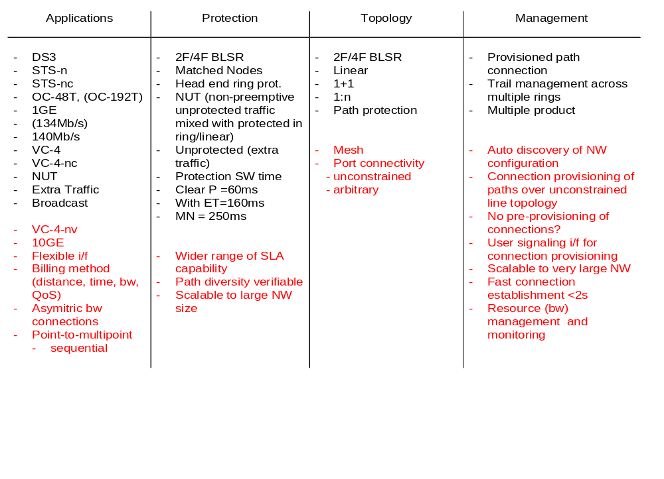
Optical Network: Today vs. Tomorrow
Today
Tomorrow
Optimized IP application - current driver for transparent NW
Additional SLA capability
Mesh network
Auto connection & resource mgnt
ASON value added
Source Nortel
Optical Service and Applications

Slide 14

ASON Network Architecture
Integrated
Management
ASON control plane
OCC
OCC
NNI
OCC
OCC
IrDI_NNI
User
signaling
UNI
CCI
Clients
e.g. IP, ATM, TDM
Clients
e.g. IP, ATM, TDM
GHCT
NE
GHCT
NE
GHCT
NE
IrDI
Transport Network
Legacy
Network
Interfaces:
UNI: User Network Interface
CCI: Connection Control Interface
NNI: ASON control Node Node Interface
GHAT NE: Global High Capacity transport NE
ASON: Automatic Switched Optical Network
OCC: Optical Connection Controller
IrDI: Inter Domain Interface
Optical Service and Applications
Notes:
ASON connection management system consists of signaling plane, switch controller and SLC machine.
Signaling plane is the brain of ASON connection management system. It discovers the transport network topology including the available network resources (such as b/w) automatically or by pre-configuration. Upon a connection request, the signal plane will decide the connection path and inform switch controller to set-up the connection.
Switch controller is associated with each network element (OXC, ADM, …) or a group of NEs. It performs actual connection function (set-up, or tear-down connections) under the control of the signal plane.
SLA machine is part of the switch controller function. It performs “call” administration control and billing function which off loads function from the signal plane
Four connection control interfaces are identified:
UNI: The user network interface (UNI) is the interface between ASON control plane and a user such as a router, or an ATM switch, etc. A signal channel is required at this interface as a dialog channel between the user and ASON control plane for connection set up/tear down request.
SCI: The signal control interface (SCI) is the interface between the connection control plane and the switch controller in a network element. The ASON signal control plane calculates the connection routes, and set up connection via switch controllers. Switch controller just execute the command from the ASON control plane.
IaDI: The intra-domain interface is the interface between network elements in ASON control plane.
NNI: The network network interface is the interface between ASON control planes in different administration domains. It allows the network to be partitioned into sub-networks; each sub-network is managed independently while still be able to set up end-to-end connections across multiple administration domains (sub-networks).

Slide 15
ASON Service Composition
Domain B
Network Layer
Domain
A
Domain
C
Domain
E
Domain
D
Domain
Domain/Region Layer
Fibers
Conduit 1
Conduit Layer
Fiber Layer
Conduit 2
λ1
λn
λ Layer
Optical Service and Applications

Slide 16
Optical Ethernet – RPR
RPR – Resilient Packet Ring – IEEE 802.17
Ethernet over MAN (Ethernet is winning all time)
Distributed L2 switch over MAN
  Can have one part of the same subnet at SF, another part in SJ and SC
  Virtual organization over MAN with NO routing.
  Started to be deployed in the field
Cost – much cheaper than WAN
Optical Service and Applications

Slide 17
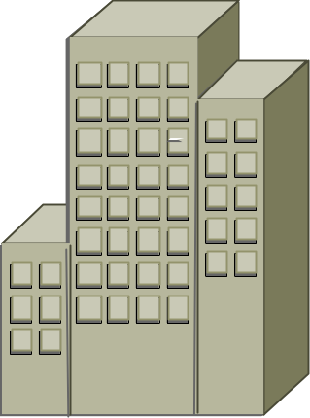

The Metro Bottleneck
Other Sites
Access
Metro
Core Network
End User Access Metro Core
T1
DS1
DS3
Ethernet LAN
OC-12
OC-48
OC-192
DWDM n x λ
IP/DATA
1GigE
LL/FR/ATM
1-40Meg
1Gig+
10GigE+
Optical Service and Applications
Notes:
Enterprise employees have been able to communicate across their Local Area Network (LAN) without much concern over format or rate; Ethernet 10Bt and 100Bt are common in almost all enterprises. The enterprise bottleneck to the Wide Area Network (WAN) has always been constrained to the traditional voice telecommunication rates of DS0 (64Kb/s), DS1 and on rare occasions DS3.
Format conversion and adaptation is required for any data communication beyond the LAN.
The service provider is seen simply as a “middleman”, providing network connectivity with no value-added content, leaving them susceptible to customer churn as lowered priced offerings become available.
Bandwidth capacity has been increasing in the service provider WAN as OC-48 and OC-192 optical backbones have been deployed.
Bandwidth has also been increasing in the enterprise LAN as they have deployed Fast Ethernet and 1G Ethernet connections in their corporate networks.
A bandwidth bottleneck still exists, however, at the connection between the LAN and the WAN, the Metropolitan Area Network (MAN).

Slide 18







RPR - Expanding the LAN to the MAN/WAN
MAN/WAN
LAN
LAN in the MAN Paradigm
Distributed
Switch
Low Cost
Simplicity
Universality
Low Cost
Simplicity
Universality
Scalability
Reach
Robustness
+
Optical Service and Applications
Notes:
The Optical Ethernet takes the application protocol (Native-rate Ethernet) and keeps it intact across the entire network. The limitations of TDM SONET are eliminated by dedicating SONET STS-n bandwidth to Ethernet Data applications. This allows bandwidth sharing as well as highly flexible service offerings.

Slide 19
What is RPR?
Ethernet networking on Optics (STS-Nc)
Ethernet
Frame
Ethernet
Frame
Ethernet
Frame
Ethernet
Frame
STS-N Envelope
Ethernet
Frame
Ethernet
Frame
Ethernet
Frame
Optical Service and Applications

Slide 20
Scalable Bandwidth and Services
VT’s
STS-N
TDM
VT’s
VT’s
VT’s
1000M
OC-3 / 12 / 48 / 192
10M
STS-Nc
Ethernet
300M
500M
1M
80M
Optical Service and Applications
Notes:
SONET OC-x pipes are composed of multiple STS-n pipes which are in turn composed of virtual tributaries (VTs) which are in turn composed of voice based DS-0s. These STS-n’s, VT’s and DS-0’s are maintained in logical point-to-point connections which allocate the full-bandwidth provisioned even if traffic is not present.

Slide 21



Network & Customer Management
Customer
Ethernet
Ports
Customer Privacy through managed Virtual LANs (802.1Q tags)
Customer Agreements through flow attributes (802.1p prioritized queues and traffic policing)
Optical Service and Applications

Slide 22
Streaming media as bandwidth driver
Streaming needs big pipes – 2-3 orders or magnitudes more than web surfing.
  Speed of 3Mbs is about 1GB per hour
Constant traffic (can be turn on for hours with no one watching)
Web looks like a big traffic driver on the edge – but it is small traffic on the core.
  One hour web, 10 second a page, 360 pages, 10KB page → 3.6MB
Optical Service and Applications

Slide 23
EFM –Ethernet First Mile
Ethernet at the first mile start to be attractive.
Drive more bandwidth to the end users
Three proposals :
  22Mbs on the current phone line
  PON –Passive Optical Network – split the optical link to 4 and additional 8 total 32 customers (60Mbs per residence)
  Point-to-point optical – more expansive
SBC and alike are interested.
The tight of way is the main issue. Optical fibers work fine in harsh environment
  Sewer net, Power line, Gas line, water line.
Optical Service and Applications

Slide 24
Where are the bottlenecks
Optical networking is evolving
  Much more bandwidth
  Agile reconfiguring of light path
As soon as one problem is solved, the bottleneck is moving to a new place
Currently it looks like the bottleneck is at the first mile
Streaming media - bottleneck push on routers
Much more bandwidth in the MAN move the bottlenecks away from the access and the edge
Peering points between service provides
Optical Service and Applications

Slide 25
OXC – Optical Cross Connect
Optical cross connects – less need for core routing
  Fat pipes replace core routers with NO delay
It looks more like circuit switching instead of packet switching (ouhh)
MPLS, MPλS, LDP – Label Distribution Protocol – room for binding it to services on the edge.
UNI - User Network Interface , - allow the end machines and edge to send service request to the core
NNI – Network Network Interface, - control of the core (if the core agree to provide the service, might say no)
Optical Service and Applications

Slide 26
Backup Slides
Optical Service and Applications

Slide 27
Major Data Transport Solutions
Packet Switch
data-optimized
  Ethernet
  TCP/IP
Network use
  LAN
Advantages
  Simple
  Low cost
Disadvantages
  unreliable
Circuit Switch
Voice-oriented
  SONET
  ATM
Network uses
  Metro and Core
Advantages
  Reliable
Disadvantages
  Complicate
  High cost
Optical Service and Applications

Slide 28





Optical BGP Networks
Dark fiber Network
City X
Dark fiber Network
City Y
ISP A
ISP B
EGP
ISP C
EGP
AS100
AS200
To other Wavelength
Clouds
Wavelength Routing Arbiter
& ARP Server
AS300
AS400
Customer Owned
Dim Wavelength
EGP
Dark fiber Network
City Z
ISP A
ISP B
Figure 12.0
Optical Service and Applications

