Slide 1
Technology & Society
More Questions Than Answers
Tal Lavian
Nortel Networks Labs
tlavian@nortelnetworks.com
The Light at the end of the Tunnel

Slide 2
Some Technology Innovation
Fire
Writing
First book, press, commodity press, copy machine, laser printer
Wheel, wagon, steam engine, train, ship, car, airplane,
Phone, radio, TV
Consumer electronics

Slide 3
Technology and Sociology
Mapping of social communication on top of the technology communication
Focus - social behavior of the technology and technology adoption
Technology aspects give a different point of view
Technologies that change our community

Slide 4
Technology Advancements
Facing many technology revolutions that some of them might have huge impact of our lives and we need to understand it
Need for question mark after every single point

Slide 5
Technologies - Agenda
Big-Bandwidth Pipes
  Video Conferencing
  Virtual Presence (Holograms)
  Last Mile - Optical Network availability
Big Disk availability
  Video Files, Storage capacity
Computation
Silicon
New Applications

Slide 6
Big Bandwidth Pipes
What if Last Mile is solved?
  Optical, FTH, MEF, EFM, RPR, CDM……
  Dedicated connection (circuit)
Video Conferencing
  does not really work (yet)
  TV quality – 2.2Mbs , DVD 4.5Mbs (each direction)
Virtual Presence – (not science fiction)
  8Gbs dedicated

Slide 7
Big Disk Availability
What is the implication of having very large disk?
What type of usage we will do with abounded disks?
Currently disk cost is about $700/TB
What type of applications can we use it?
Video files – movie 1GB, - 70 cents store, in 5 years – 0.3 cents
  How this change the use of personal storage?
  type of new things we will store if the disk is so inexpensive?

Slide 8
Computation
We have massive amount of computation in our hands
In our watch, we have more computation that we needed to send Apollo 11 to the moon and the processor cost less than one cent
We have amount of computation on our desk that is larger than supercomputer 15 years ago
How this affects us?

Slide 9
Silicon
Moor’s Law still working
We can add much more functionalities into silicon
Price point – consumer electronics
The cost of new gadgets - commodity

Slide 10
Application adoption
New innovations and adding new applications is a very simple process in the web time
  Web itself
  P2P apps
  Recording Industry
  Open Source

Slide 11

The Metro Bottleneck
Other Sites
Access
Metro
Core Network
End User Access Metro Core
Ethernet LAN
DS1
DS3
OC-12
OC-48
OC-192
OC-192
DWDM n x λ
IP/DATA
1GigE
LL/FR/ATM
1-40Meg
10G
40G+
Notes:
Enterprise employees have been able to communicate across their Local Area Network (LAN) without much concern over format or rate; Ethernet 10Bt and 100Bt are common in almost all enterprises. The enterprise bottleneck to the Wide Area Network (WAN) has always been constrained to the traditional voice telecommunication rates of DS0 (64Kb/s), DS1 and on rare occasions DS3.
Format conversion and adaptation is required for any data communication beyond the LAN.
The service provider is seen simply as a “middleman”, providing network connectivity with no value-added content, leaving them susceptible to customer churn as lowered priced offerings become available.
Bandwidth capacity has been increasing in the service provider WAN as OC-48 and OC-192 optical backbones have been deployed.
Bandwidth has also been increasing in the enterprise LAN as they have deployed Fast Ethernet and 1G Ethernet connections in their corporate networks.
A bandwidth bottleneck still exists, however, at the connection between the LAN and the WAN, the Metropolitan Area Network (MAN).

Slide 12
Bandwidth is Becoming Commodity
Price per bit went down by 99% in the last 5 years on the optical side
  This is one of the problems of the current telecom market
Optical Metro – cheap high bandwidth access
  $1000 a month for 100FX (in major cities)
  This is less than the cost of T1 several years ago
Optical Long-Haul and Metro access - change of the price point
  Reasonable price drive more users (non residential)

Slide 13
Summary
Optical transport brings abundant bandwidth
Efficient use of bandwidth becomes crucial
Network Services enable
  Use network flexibly and transparently
  Add customized intelligence
Killer Applications night be OVPN or any other dynamic bandwidth provisioning

Slide 14
Breakthrough...Bandwidth
6.4 Tbps
Optical Capacity Revolution
Cost per
Gigabit Mile
1.6 Tbps
320 Gbps
2.5 Gbps
Moore’s
Law
50 Mbps
1984
1994
1998
2001
1993
1998
2002
Wavelengths will become the communications circuits of the future...
Source: Nortel marketing

Slide 15
“Blindsided by Technology”
When a base technology leaps ahead in a dramatic fashion relative to other technologies, it always reshapes what is possible
It drives the basic fabric of how distributed systems will be built
It blindsides
us all...
Source – Nortel’s marketing
Notes:
This happened with microprocessors getting cheap and small…ended the era of mainframes

Slide 16
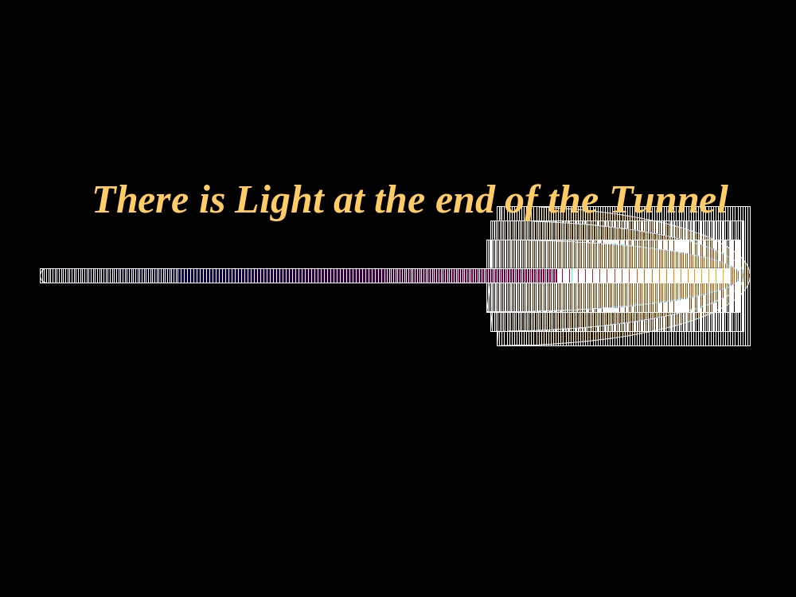
There is Light at the end of the Tunnel
Imagine it 5 years from now?
There are more questions than answers.

Slide 17
Backup Slides

Slide 18
Agenda
Technology and market drivers
Abundant bandwidth
Underline the Internet is optical
What is WDM?
Where are the bottlenecks?
Architecture and protection
Summary
Backup slides
  Underline technologies
  Protection Rings

Slide 19
Changing the big picture
Now the converged network looks different
Dial-up bandwidth has huge implications
Pushing bandwidth to the edges of the network
  Affects service placement, for example

Slide 20
Bandwidth at the edges
Services placed there (ServicePoP)
Need to connect services to customers and other services
Metro networks
  Use of Ethernet as low cost/flexible mechanism
Eventually fibers to pcmcia?!

Slide 21
Metro networks
Interim step: services in servicePoPs
Tap into fast connections here for enterprises
Use of Ethernet as protocol to connect the enterprise to the MAN
Avoid need for last mile for certain applications/services

Slide 22
Abundant Bandwidth
Why does this change the playground?
Optical core bandwidth is growing in an order of magnitude every 2 years, 4 orders of magnitude in 9 years
  1992 – 100Mbs (100FX, OC-3)
  2001 – 1.6Tbs (160 DWDM of OC-192)
  OC-768 (40Gbs) on single λ is commercial (80Gbs in lab)
2-3 orders of magnitude bandwidth growth in many dimensions
    Core – Optical bandwidth - (155mb/s → 1Tb/s)
    Core Metro – DWDM optical aggregation – (2.4Gb/s → N*10Gb/s)
    Metro – Access for businesses (T1 → OC3, 100FX, 1-Gb/s)
    Access – Cable, DSL, 3G – (28kb/s→10mb/s, 1.5mb/s, 384kb/s)
    LAN – (10mbp/s → 10Gbp/s)

Slide 23
Why Does This Matter?
How do these photonic breakthroughs affect us?
This is a radical change to the current internet architecture
WAN starts to be no longer the bottleneck
  How congestion control/avoidance affected?
  Why DiffServ if you can get all the bandwidth that you need?
  Why do we need QoS?
  Why do we need cache? (if we can have big pipes)
  Where to put the data? (centralized, distributed)
  What changes in network architecture needed?
  What changes in system architecture needed?
  Distributed computing, central computing, cluster computing
  Any changes to the current routing?

Slide 24

Movie Distribution
Each movie theater in a large area (SF, New York, Houston) requests 1 hour of bandwidth a week (OC192)
All movies transferred during this time
Efficient use of expensive but necessary fat pipe

Slide 25
Move to optical
The key is to find a way to use the infrastructure that we have available in an efficient manner
What services are available? What can we do?
Challenges?

Slide 26
New type of businesses
Data warehousing: no more mailing tapes
Have tape vaults with gigabit connectivity
Data is sent optically to destination, where it is written to magnetic tape

Slide 27
Abundant Bandwidth
Why does this change the playground?
Optical core bandwidth is growing in an order of magnitude every 2 years, 4 orders of magnitude in 9 years
  1992 – 100Mbs (100FX, OC-3)
  2001 – 1.6Tbs (160 DWDM of OC-192)
  OC-768 (40Gbs) on single λ is commercial. (80Gbs in lab)
2-3 orders of magnitude bandwidth growth in many dimensions
    Core – Optical bandwidth - (155mb/s → 1Tb/s)
    Core Metro – DWDM optical aggregation – (2.4Gb/s → N*10Gb/s)
    Metro – Access for businesses (T1 → OC3, 100FX, 1-Gb/s)
    Access – Cable, DSL, 3G – (28kb/s→10mb/s, 1.5mb/s, 384kb/s)
    LAN – (10mbp/s → 10Gbp/s)

Slide 28
How this Affects our Lives?
What are the new applications to use this abundant bandwidth?
Distance learning?
Telecommuting? (for the average person, not us)
Broadcasting?(I want to see TV channel 48 from Japan)
Video conference?
What else? (this is a BIG question)
  What are the new applications and services?

Slide 29
Need for new services
Optical networking is evolving
  Much more bandwidth
  Agile reconfiguring of light path
Need to take advantage of this and tie it to applications and services
  Need to define the glue and the interface between the applications and lower levels.
Can’t do computation in the optical core
  Need to move the intelligence from the core to the edge.
I’d like to focus and formulate a research program in this area of providing intelligent services at the Optical core.

Slide 30
Where are the bottlenecks
Optical networking is evolving
As soon as one problem is solved, the bottleneck is moving to a new place
Currently it looks like the bottleneck is at the first mile
Streaming media - bottleneck push on routers
Much more bandwidth in the MAN move the bottlenecks away from the access and the edge
Peering points between service provides

Slide 31
Streaming media as bandwidth driver
Streaming needs big pipes – 2-3 orders or magnitudes more than web surfing.
  Speed of 3Mbs is about 1GB per hour
Constant traffic (can be turn on for hours with no one watching)
Web looks like a big traffic driver on the edge – but it is small traffic on the core.
  One hour web, 10 second a page, 360 pages, 10KB page → 3.6MB

Slide 32
EFM –Ethernet First Mile
Ethernet at the first mile start to be attractive.
Drive more bandwidth to the end users
Three proposals :
  22Mbs on the current phone line
  PON –Passive Optical Network – split the optical link to 4 and additional 8 total 32 customers (60Mbs per residence)
  Point-to-point optical – more expansive
SBC and alike are interested.
The tight of way is the main issue. Optical fibers work fine in harsh environment
  Sewer net, Power line, Gas line, water line.

Slide 33
Where are the bottlenecks
Optical networking is evolving
As soon as one problem is solved, the bottleneck is moving to a new place
Currently it looks like the bottleneck is at the first mile
Streaming media - bottleneck push on routers
Much more bandwidth in the MAN move the bottlenecks away from the access and the edge
Peering points between service provides

Slide 34
Need for new services
Optical networking is evolving
  Much more bandwidth
  Agile reconfiguring of light path
Need to take advantage of this and tie it to applications and services
  Need to define the glue and the interface between the applications and lower levels.
Can’t do computation in the optical core
  Need to move the intelligence from the core to the edge.
I’d like to focus and formulate a research program in this area of providing intelligent services at the Optical core.

Slide 35
If we had the bandwidth…
What if we all had 100Mb/s at home?
  Killer apps, other apps, services
  Peer-to-peer video swapping
  Is it TV, HDTV, something else?
What if we had larger pipes at businesses?
  1Gbs home office, 10GE/DWDM large organizations
How would the network architecture look, if we solve the last mile problem?

Slide 36
Summary
DWDM – phenomenal growth
Abundant bandwidth
Underline optical technologies
The access is still bottleneck
Reliability and protection
Notes:
This happened with microprocessors getting cheap and small…ended the era of mainframes

Slide 37
What is WDM?
Data Channel 1
Optical
Fibre
Data Channel 2
Data Channel 3
Data Channel n
Wavelength Division Multiplexing (WDM) acts as “optical funnel” using different colors of light (wavelengths) for each signal
Source: Prof. Raj Jain Ohio U
Notes:
Wave Division Multiplexing consists in taking optical signals (each carrying information at a certain bit rate), giving this optical signal a colour (wavelength) and then combining and sending them down the same fibre.
Each piece of equipment sending an optical signal has the illusion of having it own fibre.
If we go back to our road analogy and getting more cars to go from A to B, WDM gets more cars to travel, not by increasing their speed but by getting them to travel in parallel in their own dedicated lane.
Traffic in each ‘lane’ can travel at a different speed - each lane is independent (so this not like a motorway).
The wavelengths used for WDM are chosen in a certain range of frequencies (around 1550nm) or window. This will be clarified later.

Slide 38
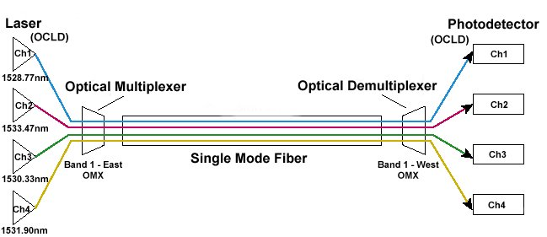

Wavelength Division Multiplexing
Source: ??

