Slide 1
Workflow Integrated Network Resource Orchestration
Phil Wang, Inder Monga, Satish Raghunath, Franco Travostino, Tal Lavian
{pywang, imonga, satishra, travos, tlavian}@nortelnetworks.com
Nortel Networks Labs
Presented by Franco Travostino
Boston, 02/09/2005
Notes:
Nortel Corporate Presentation
© 2004 Nortel

Slide 2
Agenda
WS Workflows and Challenges
WINNER
Featured Solutions
Related Work
Summary
Notes:
Nortel Corporate Presentation
© 2004 Nortel

Slide 3
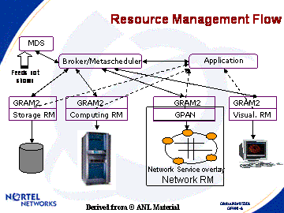
Propel Network Resources into the Grid Universe
1st Generation: Network Resources Mgmt for Grids
  Demo-ed at GW04
Branded as “DRAC”
www.nortel.com/DRAC
2nd Generation: Secure Multi-Domain Brokering
  Demo-ed at Supercomputing 2004
3rd Generation: Intercept the WS Workflow Curve (Today)
Notes:
Nortel Corporate Presentation
© 2004 Nortel

Slide 4
WS Workflows
Web Services (WS) boost opportunities for business development
Workflow defines the automation of a business process
  With new SOA solutions, for WS: BPEL4WS, for Grid: GSFL
  Streamlines application jobs in terms of WS and Grids activities
Workflow has a host of applications
  eCommerce: B2B, financial brokerage, travel planning
  Enterprise: concurrent design, data center, human resources
  eScience: computing, data, visualization, sensor Grids
Notes:
Nortel Corporate Presentation
© 2004 Nortel

Slide 5
Challenges
WS Workflows bring new challenges
  Business workflows streamline to network-wide collaboration
  Grids/WS services and resources become workflow-aware
Challenges on Network resources → our target
  Pervasive resources sharing
  Supply of services and resources may vary on conditions
  Each workflow may demand a different level of resources
  Resource requirements change as the workflow goes
App
Grid/WS
Workflow
Workflow Engine
Process
Activity
Start
Data Distribution
Computing
Data Collection
Visualization
End
WS/GS
Service
Service
Service
Service
Resource
Storage+Network
Cluster+Network
Storage+Network
Display+Network
Notes:
Nortel Corporate Presentation
© 2004 Nortel

Slide 6
WINNER
Workflow INtegrated NEtwork Resource orchestration
Orchestrates network resources in harmonization with workflows
  Enhances business processes with resource extensions
  Employs network services to perform resource operations
Applications
End users
Globus
BPEL
Custom
User environments
Grid
WINNER
Custom
Network services w/
Service gateways
DRAC
GMPLS
UNI
TL1
SNMP
Network protocols
Networks
Resources
Notes:
Nortel Corporate Presentation
© 2004 Nortel

Slide 7
DRAC: Dynamic Resource Allocation Controller
WINNER is the Workflow Arm of DRAC
Resource discovery
  Available physical resources in network domains
  Available network services in network domains
  Resource properties, status and updates
Resource Utilization
  Resource collection and abstraction
  Resource reservation and scheduling
  Job status and feedback
Resource management
  Resource allocation and release
  Network configuration and control
  Security and AAA
Application-aware smarts on resources
  Multiple service gateways: Grid, workflow, storage
  Resource policy, SLA
  Resource optimization
  Resource monitor and performance
WINNER
Workflow
Grid
DRAC
Storage
Health
Notes:
Nortel Corporate Presentation
© 2004 Nortel

Slide 8
WINNER and Workflow Engine
WINNER Process
  Defines the workflow activities specific on network resources
  Acts in either standalone or extension to a legacy process
  Invocated from apps, and related business services
WINNER Process services (PS)
  Web services that provide the activities of the business process
  Realize the resource operations of the WINNER process
  Support the workflow processing of network resources
WINNER Resource services (RS)
  Web services that support PS by provisioning necessary resources to conduct the process and its activities
  Perform the allocation of network resources
  Update the status of network resources
  Work closely with DRAC
Application
WINNER Process
WINNER PS
Workflow Engine
WINNER RS
Resources
Notes:
Nortel Corporate Presentation
© 2004 Nortel

Slide 9
WINNER Process: activity samples
Interface to the Workflow Applications
Application registration
  Unique identification of each application
  Classification of resource workflows
Resource Job
  Resource specification
  Resource allocation
  Resource re-allocation
  Resource release
Query
  Network resources
  Resource workflows
  Resource negotiation, when applicable
Misc
  Account billing
  Authorization, and security enhancement
  Exceptions, status check, and error handling
Notes:
Nortel Corporate Presentation
© 2004 Nortel

Slide 10
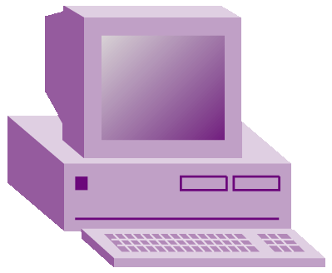



WINNER and Grids Workflows
WINNER supports Grid infrastructures with a Grid workflow engine
  WINNER enhances the Grid workflow processes with resource activities
  WINNER Services interact with DRAC to perform network resource allocations in the Grid domains
WINNER-enhanced Processes
Grid app
Globus engine
WINNER Services
WSRF
WSRF
WSRF
WSRF
DRAC
DRAC
DRAC
DRAC
Net
1
Net
2
Net
…
Net
N
Notes:
Nortel Corporate Presentation
© 2004 Nortel
The diagram does simplify the whole picture with Grid workflows.
+ The WINNER process is one of the Grid workflow processes that the Globus engine provides.
+ The WINNER process can be called by a Grid app, or though other processes and services.
Only those apps directly using WINNER needs the WINNER API, and thus they are WINNER-specialized.
+ Similarly, the WINNER services are some of the Grid services that Globus engine runs.

Slide 11
WINNER, Grids and WS Workflows
WS Workflow applications take advantages of Grids
  WS engine provides the WINNER enhanced business processes to WS apps
  Grids engine provides Grids services to WS apps through WINNER services
WS app
WINNER-enhanced Processes
WS engine
WINNER Services
API
Globus engine
WINNER Services
WSRF
WSRF
WSRF
WSRF
DRAC
DRAC
DRAC
DRAC
Net
1
Net
2
Net
…
Net
N
Notes:
Nortel Corporate Presentation
© 2004 Nortel

Slide 12
WINNER and Multiple Workflows
Web Services are re-utilized across multiple types of workflows
  Grid workflow
  WS workflow: BPEL4WS
  Others
WINNER supports respective workflow engines
  WINNER services widely shared
WS App
Grid App
Business PS
Compute RS
Process
BPEL engine
Process
WINNER
WINNER PS
App WS
Globus engine
WINNER
Process
Storage RS
Workflow engine
Services
Utility PS
WINNER
Network RS
DRAC
PS = Process Service
RS = Resource Service
Notes:
Nortel Corporate Presentation
© 2004 Nortel

Slide 13
WINNER and Late-Binding
Late binding resources with workflows happen when
  Workflow services and/or resources supply change
  Workflows compete or optimize for resources
  Workflows have special or uncertain requirements for resources
WINNER performs workflow-aware late-binding, through DRAC
  Network resource selections or alternations according to applications
  Resource optimization among workflows
  Service site selections or alternations, together with service providers
Notes:
Nortel Corporate Presentation
© 2004 Nortel

Slide 14
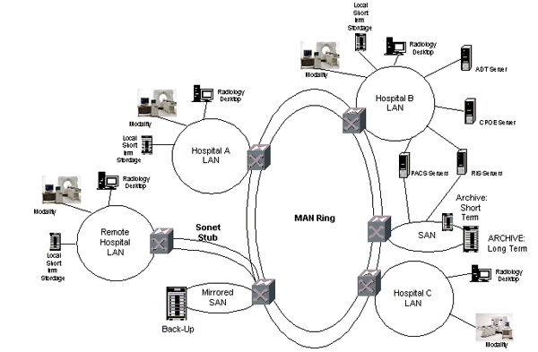
Use Case: Workflow Engaged Networks for Radiology in Metro Regions
Workflows of radiology data transporting and medical processing
  Application-aware network resource allocations
  Dynamic adjustments of network resources and workflow priorities
  Maximal utilization of network resources
  Workflow classifications
App Entry
Notes:
Nortel Corporate Presentation
© 2004 Nortel

Slide 15
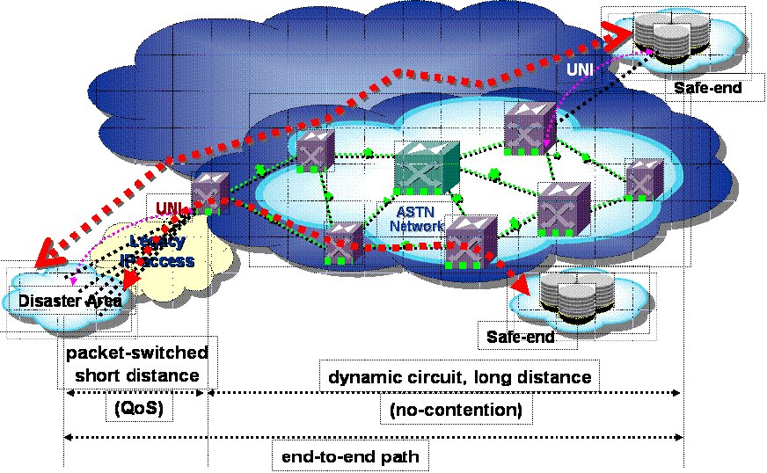
Use Case: Disaster Recovery
Workflows of data evacuation and restoration in a disaster area
  Critical Live Data pointing to survivors and their whereabouts
  Sensor data showing distress in architectural structures and environment
Orchestrates network resources for orderly, max-yield workflows
  Sensor-triggered workflow automation without any operator involvement
  End-to-end, secure, across the agile network infrastructure
  Policy-driving resource allocation and its preemptive usage
Notes:
Nortel Corporate Presentation
© 2004 Nortel

Slide 16
Related Work
WSBPEL or BPEL4WS: the OASIS effort
  http://www.oasis-open.org
GridFlow/SDRC Matrix: a peer-to- peer infrastructure for Grid Workflow Management Systems
  http://www.npaci.edu/dice/srb/matrix/
GSFL and GridAnt: Globus workflow effort
  http://www-unix.globus.org/cog/projects/workflow/
Pegasus: mapping of complex scientific workflows onto the grid
  http://pegasus.isi.edu/pegasus/main.htm
GWFE: execute their workflow applications on Grids
  http://www.gridbus.org/workflow/: Globus 2.4
Taverna: a language and software tools for eScience
  http://taverna.sourceforge.net/
Notes:
Nortel Corporate Presentation
© 2004 Nortel

Slide 17
Summary
WINNER integrates network resources with WS workflows
  WINNER processes, process services and resource services
  Workflow-aware network resource orchestration
DRAC network services are leveraged for allocation and information in network resource orchestration
Late-binding gives the adaptability to orchestrate network resources in favor of workflows’ needs
WINNER fits with Grids, Web Services, and other workflow applications
  Enhances business processes with resource extensions
  WS workflows can take advantages of Grids
Two use-cases show the workflow benefits in medical and disaster applications
Notes:
Nortel Corporate Presentation
© 2004 Nortel

Slide 18

Workflow Integrated Network Resource Orchestration
Questions and Comments ?
Notes:
Nortel Corporate Presentation
© 2004 Nortel

