Slide 1
Dynamic Classification in a Silicon-Based
Forwarding Engine
Technology Center, Nortel Networks
& The University of Maryland
Rob Jaeger
(rfj@cs.umd.edu)
Tal Lavian
Rob Duncan
Franco Travostino
J.K. Hollingsworth

Slide 2
The Network Paradigm Spectrum
Traditional Networks
- end-to-end connectivity
- well defined protocols
- increasingly perform
forwarding in hardware
Active Networks
- on-the-fly service
introduction
- per-flow granularity
possible
- inject software in
data path
?

Slide 3
Objectives
Implement flow performance enhancement mechanisms without introducing software into data forwarding path
  Service defined packet processing in a silicon-based forwarding engine
  Policy-based Dynamic packet classifier
Create OPEN platform for introduction of new services
  Specify OPEN interfaces for Java applications to control a generic, platform-neutral forwarding plane
  Enable downloading of services to network node
  Allow object sharing and inter-service communication

Slide 4
Accomplishments
  JVM on a Silicon-Based Routing Switch
  ORE - Oplet Run-time Environment
    Java-enabled platform for secure downloading and safe execution of services
    Ensures required services are installed for a downloaded Oplet
  Java SNMP MIB API (proxy mode for non Java devices)
  Implementation of Network Forwarding API (JFWD)
  RESULT: Dynamic Classification in Silicon-Based forwarding engine on a Gigabit Routing Switch

Slide 5
Open Device Architecture
C/C++
API
Java
API
ORE
Service
Device
Code
JNI
Download Oplet
ORE
Device
Drivers
JVM
JFWD API
Operating System
Device HW

Slide 6
ORE - Oplet Run-time Environment
Oplet 1
Oplet 2
Service A
Service B
Service C
ORE
JVM

Slide 7
Silicon-based Forwarding Engines
Control
Plane
CPU
Switching Fabric
Wire Speed
Forwarding
Forwarding
Rules
Forwarding
Rules
Forwarding
Rules
. . .
Forwarding
Processor
Forwarding
Processor
Forwarding
Processor
Statistics
&Monitors
Statistics
&Monitors
Statistics
&Monitors

Slide 8
Dynamic Configuration of Forwarding Rules
Dynamic
Policy
CPU
Forwarding
Rules
Forwarding
Processor
Forwarding
Processor
Forwarding
Processor
Forwarding
Processor
SW
HW

Slide 9
CarbonCopy Capability
CPU
Forwarding
Processor
Forwarding
Processor
Forwarding
Processor
Forwarding
Processor

Slide 10
Dynamic Packet Configuration
Policy
DSC
Service
Filters
Filter
Packet
Packet
Forwarding
Processor
Forwarding
Processor
Packet

Slide 11
Dynamic Classification
Identify real-time flows (e.g. packet signature/flowId )
  Use CarbonCopy filters to deliver multimedia control protocols to control plane
    e.g. SIP, H.323. RTSP
    Determine dynamically assigned ports from control msgs
  Use CarbonCopy filters to sample a number of packets from the physical port and identify RTP packets/signature
Set a packet processing filter for packet signature to:
  adjust DS-byte OR
  adjust priority queue

Slide 12
Experimental Setup
Source 1
tcp_send()
Acclear
1100B
Routing
Switch
100 Mbps
Destination
1. tcp_recv()
2. tcp_recv()
100 Mbps
Source 2
tcp_send()
100 Mbps

Slide 13
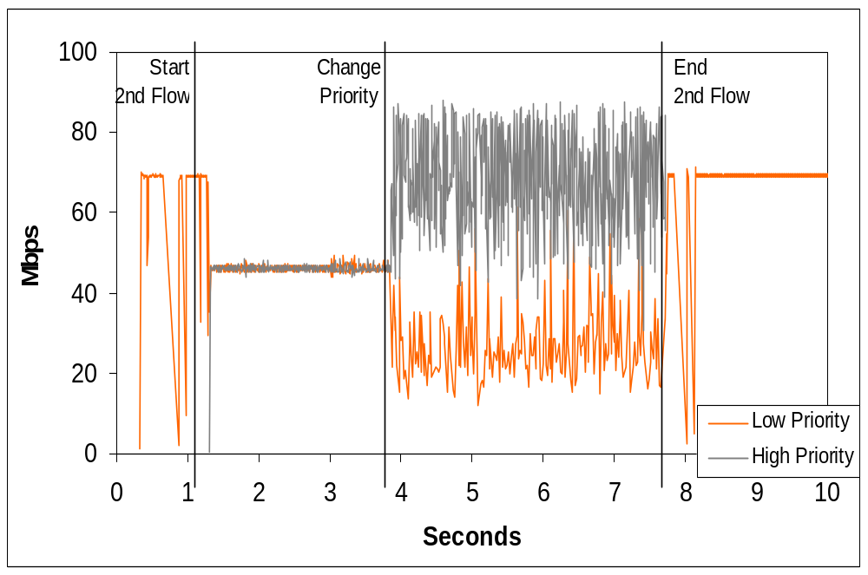

Slide 14
Summary
Developed the ORE for downloading and safely running services onto network devices
Without introducing software into data path we performed Dynamic Classification of flows in a Silicon-Based Gigabit Routing Switch
  Introduced a new service to a Gigabit Routing Switch
  Identified real-time flows
  Performed policy-based flow behavior classification
  Adjusted DS-byte value
  Showed that flow performance can be improved
For more info email: rfj@cs.umd.edu
Notes:
To introduce the new Open Networking Architecture that is based on Java-enabled Network Devices
To enable easy 3rd party integration and leverage Nortel Networks’ competitive advantage

